Slide 1
分布式事务
并发事务带来的问题
CAP
ACID
BASE
PAXOS
2PC
3PC
XA事务
LLT
SAGA
TCC
ZAB
RAFT

Slide 2
并发事务带来的问题
脏读（Dirty read）: 当一个事务正在访问数据并且对数据进行了修改，而这种修改还没有提交到数据库中，这时另外一个事务也访问了这个数据，然后使用了这个数据。因为这个数据是还没有提交的数据，那么另外一个事务读到的这个数据是“脏数据”，依据“脏数据”所做的操作可能是不正确的。
丢失修改（Lost to modify）: 指在一个事务读取一个数据时，另外一个事务也访问了该数据，那么在第一个事务中修改了这个数据后，第二个事务也修改了这个数据。这样第一个事务内的修改结果就被丢失，因此称为丢失修改。
例如：事务1读取某表中的数据A=20，事务2也读取A=20，事务1修改A=A-1，事务2也修改A=A-1，最终结果A=19，事务1的修改被丢失。
不可重复读（Unrepeatableread）: 指在一个事务内多次读同一数据。在这个事务还没有结束时，另一个事务也访问该数据。那么，在第一个事务中的两次读数据之间，由于第二个事务的修改导致第一个事务两次读取的数据可能不太一样。这就发生了在一个事务内两次读到的数据是不一样的情况，因此称为不可重复读。
幻读（Phantom read）: 幻读与不可重复读类似。它发生在一个事务（T1）读取了几行数据，接着另一个并发事务（T2）插入了一些数据时。在随后的查询中，第一个事务（T1）就会发现多了一些原本不存在的记录，就好像发生了幻觉一样，所以称为幻读。
不可重复度和幻读区别：
不可重复读的重点是修改，幻读的重点在于新增或者删除。
https://juejin.im/post/5b00c52ef265da0b95276091

Slide 3
CAP(CAP theorem/布鲁尔定理Brewer's theorem)
一致性(Consistency)
所有节点访问同一份最新的数据副本
A fully Consistent system is one where the system can guarantee that once you store a state (lets say X=Y) in the system, it will report the same state in every subsequent operation until the imagestate is explicitly changed by something outside the system.
All nodes see the same data at the same time
可用性（Availability）
每次请求都能获取到非错的响应——但是不保证获取的数据为最新数据
Availability means just that - the service is available (to operate fully or not as above)
分区容错性（Partition tolerance）
“三选二”
网络中即使出现单个组件无法可用，操作依然可以完成
If your application and database runs on one box then (ignoring scale issues and assuming all your code is perfect) your server acts as a kind of atomic processor in that it either works or doesn’t (i.e. if it has crashed it’s not available, but it won’t cause data inconsistency either).
https://zh.wikipedia.org/wiki/CAP%E5%AE%9A%E7%90%86
https://www.infoq.com/articles/cap-twelve-years-later-how-the-rules-have-changed
翻译： http://www.infoq.com/cn/articles/cap-twelve-years-later-how-the-rules-have-changed

Slide 4
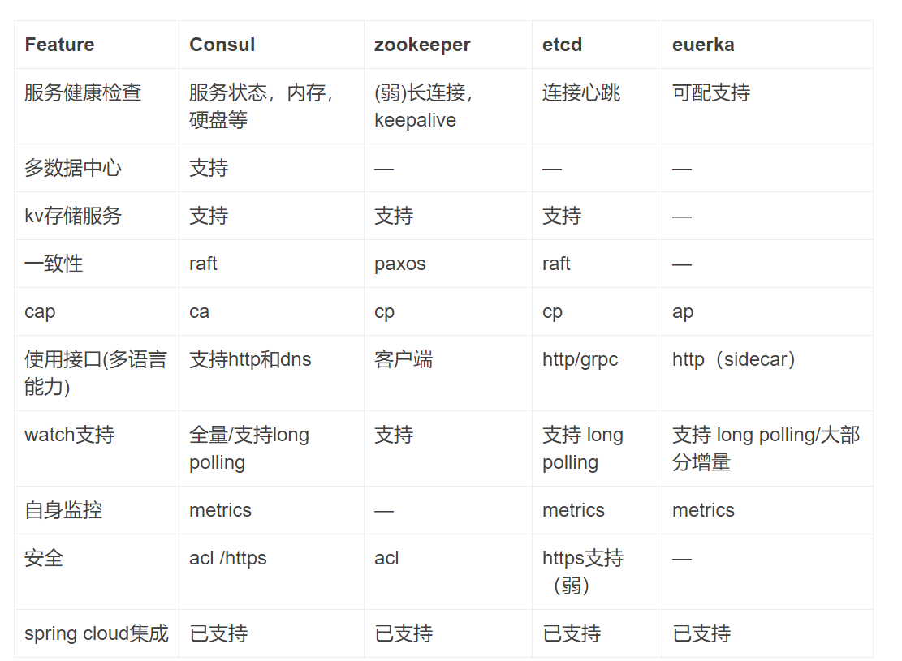
CAP(CAP theorem/布鲁尔定理Brewer's theorem)

Slide 5
ACID 注重一致性，是数据库的传统设计思路
原子性(Atomicity)
事务是最小的执行单位，不允许分割。事务的原子性确保动作要么全部完成，要么完全不起作用；
Transactions are often composed of multiple statements. Atomicity guarantees that each transaction is treated as a single "unit", which either succeeds completely, or fails completely: if any of the statements constituting a transaction fails to complete, the entire transaction fails and the database is left unchanged. An atomic system must guarantee atomicity in each and every situation, including power failures, errors and crashes.
一致性(Consistency)
在事务开始之前和事务结束以后，数据库的完整性没有被破坏。这表示写入的资料必须完全符合所有的预设规则，这包含资料的精确度、串联性以及后续数据库可以自发性地完成预定的工作。
Consistency ensures that a transaction can only bring the database from one valid state to another, maintaining database invariants: any data written to the database must be valid according to all defined rules, including constraints, cascades, triggers, and any combination thereof. This prevents database corruption by an illegal transaction, but does not guarantee that a transaction is correct.
https://zh.wikipedia.org/wiki/ACID

Slide 6
ACID
隔离性(Isolation)
并发访问数据库时，一个用户的事务不被其他事务所干扰，各并发事务之间数据是独立的；
Isolation ensures that concurrent execution of transactions leaves the database in the same state that would have been obtained if the transactions were executed sequentially. Isolation is the main goal of concurrency control; depending on the method used, the effects of an incomplete transaction might not even be visible to other transactions.
持久性(Durability)
一个事务被提交之后。它对数据库中数据的改变是持久的，即使数据库发生故障也不应该对其有任何影响。
Durability guarantees that once a transaction has been committed, it will remain committed even in the case of a system failure (e.g., power outage or crash). This usually means that completed transactions (or their effects) are recorded in non-volatile memory.

Slide 7
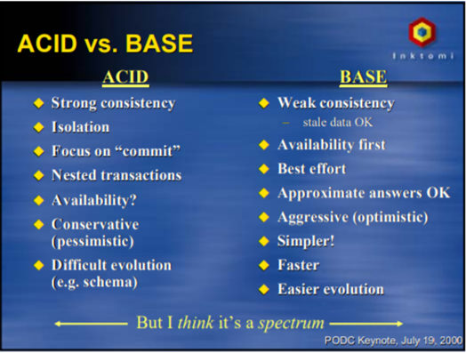
BASE注重可用性
基本可用(Basically Available)
分布式系统在出现故障的时候，允许损失部分可用性，即保证核心可用。注意，这绝不等价于系统不可用
软状态(Soft state)
允许系统存在中间状态，而该中间状态不会影响系统整体可用性
最终一致性(Eventually consistent)
系统中的所有数据副本经过一定时间后，最终能够达到一致的状态
Eventual consistency is a consistency model used in distributed computing to achieve high availability that informally guarantees that, if no new updates are made to a given data item, eventually all accesses to that item will return the last updated value. Eventual consistency, also called optimistic replication, is widely deployed in distributed systems, and has origins in early mobile computing projects. A system that has achieved eventual consistency is often said to have converged, or achieved replica convergence. Eventual consistency is a weak guarantee – most stronger models, like linearizability are trivially eventually consistent, but a system that is merely eventually consistent does not usually fulfill these stronger constraints.
Eventual consistency is purely a liveness guarantee (reads eventually return the same value) and does not make safety guarantees: an eventually consistent system can return any value before it converges.
https://en.wikipedia.org/wiki/Eventual_consistency
https://www.cnblogs.com/xrq730/p/4944768.html
https://my.oschina.net/foodon/blog/372703

