Slide 1
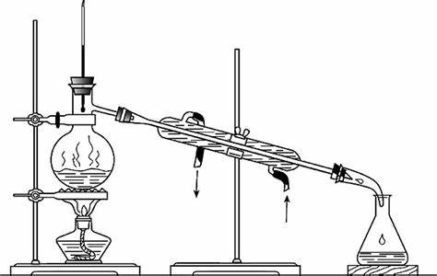
知识蒸馏

Slide 2
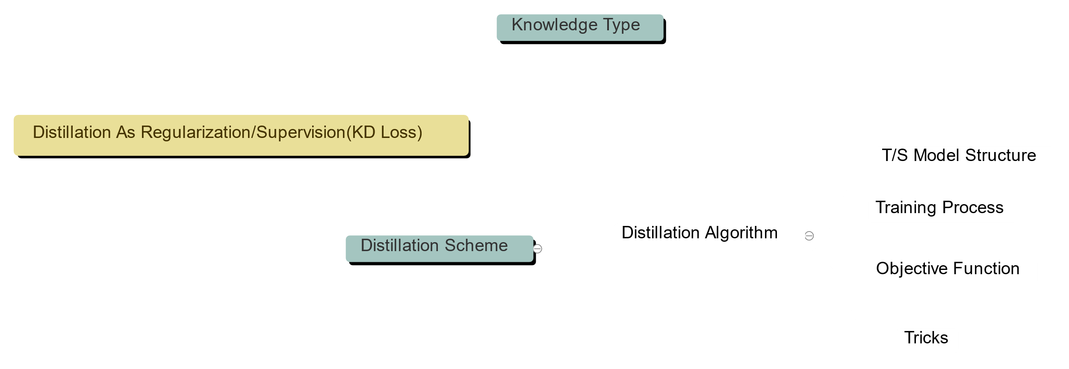
知识种类
1 response-based
2 feature-based
3 relation-based
4 other
知识来源也影响蒸馏算法与流程
不同任务下知识的含义不同，来源不同
complementary information for student
Application
model compression
不同任务下知识的使用方法不同
蒸馏算法
1 Adversarial
2 graph-based
3 cross-modal
4 attention-based
5 other
1 online 2 offline 3 self-distillation 4 other

Slide 3
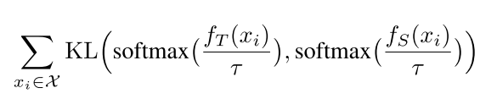

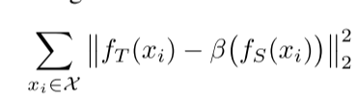

Slide 4
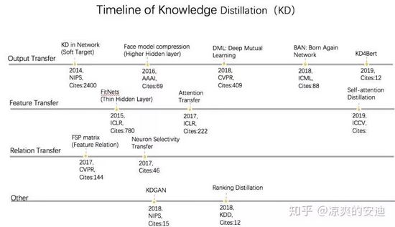

Slide 5
知识来源
output of the last layer | Distilling the knowledge in a Neural Network (NIPS2014)
 | Face model compression by distilling knowledge from neurons (AAAI2016)
 | Deep Mutual Learning(CVPR2018)
 | Born-Again Networks(ICML2018)
 | KD4Bert(2019)
 | Conditional Teacher-Student Learning(ICASSP2019)

Slide 6
知识种类
middle layer outputs | Fitnets: Hints for Thin Deep Nets
 | Paying More Attention to Attention: Improving the Performance of Convolutional Neural Networks via Attention Transfer(ICLR17)
 | Paraphrasing Complex Network: Network Compression via Factor Transfer (NIPS2018)
 | Learning Lightweight Lane Detection CNNs by Self Attention Distillation(ICCV2019)
parameters(sharing/distribution) | Rocket Launching: A Universal and Efficient Framework for Training Well-performing Light Net
 | Knowledge Representing: Efficient, Sparse Representation of Prior Knowledge for Knowledge Distillation(CVPR2019)
neuron activation | Like What You Like: Knowledge Distill via Neuron Selectivity Transfer (2017)
 | A Comprehensive Overhaul of Feature Distillation (ICCV2019)

Slide 7
知识种类
[between-layer relations]The relations of any two feature maps from any two layers of networks. | A gift from knowledge distillation: Fast optimization, network minimization and transfer learning(CVPR2017)
[intra-data relations]graph-based， graph contains the knowledge about instance features, instance relationships and the feature space transformation cross layers of teacher | Relational knowledge distillation（CVPR2019）
[intra-data relations]The intra-data relations between any two feature maps via multi-head attention network. | Graph-based Knowledge Distillation by Multi-head Attention Network (BMVC2019)
[intra-data relations]The locality similarities of feature representations of hint layers of the teacher networks are transferred into the student network | Learning student networks via feature embedding(IEEE TRANSACTIONS ON NEURAL NETWORKS AND LEARNING SYSTEMS2020)

Slide 8
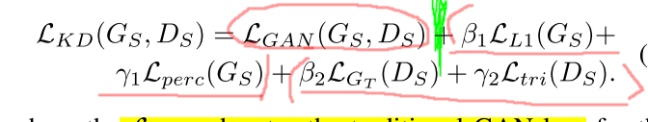
Distilling portable Generative Adversarial Networks for Image Translation
Adversarial Distillation
In such algorithm, both teacher G&D offer supervision for student. Teacher G not only offers high-quality generated picture for studentG to mimic, but let studentG to discriminate better as well. Teacher D judges whether input comes from teacherG or studentG, thus it also forces studentG to mimic teacherG.

Slide 9
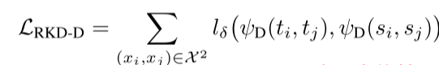

Relational KD
IKD VS RKD
IKD: student sample-mimic-teacher sample identically
RKD: student sample_batch structure-mimic-teacher sample_batch structure: Eucilidean-dist(x1,x2)/cosine(x1,x2,x3)

Slide 10

第二次KD内容分享
1. 思考一个KD方法的角度
2. 基于relation的蒸馏法
3. KD的一些理论性insight
TN
SN

Slide 11
How do we inspect a KD method?
Top-level
0. why use KD (task-oriented)
1. where does knowledge come from
2. how do we transfer knowledge from TN to SN
Application-level
0. Same task(compression/reinforcement) or different task(transfer)
1. Inputs to TN/SN
2. TN/SN network structure(SN: smaller?deeper?same?totally different?)
3. performance(横向比较而非ablation study)
may perform better than TN

Slide 12
基于relation的蒸馏法
relation: 输入-输出之间的关系（学习的过程）
数据集的空间特征
用某种方法学习到的sample之间关系
Graph data 我觉得与relation KD关系最大。研究关系的话也许会在模型压缩以外的领域有更好的泛化性。（GNN蒸馏？）

Slide 13
Improvement to Fitnet（还是侧重于压缩）
Drawback1: SN directly mimic TN hidden layer’s output.
(不可控，也有over regularized的风险；直接学结果不泛化)
soluition1: 学习attention map (上周讲过)
《 PAYING MORE ATTENTION TO ATTENTION: IMPROVING THE PERFORMANCE OF CONVOLUTIONAL NEURAL NETWORKS VIA ATTENTION TRANSFER 》
solution2：学习 学习的过程 instead of 学习 结果
《 A Gift from Knowledge Distillation: Fast Optimization, Network Minimization and Transfer Learning 》
=====================================================================
Drawback2: Use extra network to project TN hidden layter feature to SN space, more params.
solution1: use manifold learning method to preserve low dimension feature for high-dimensional TN hidden layer’s output
《 Learning Student Networks via Feature Embedding 》

Slide 14
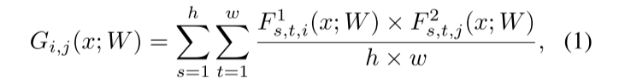
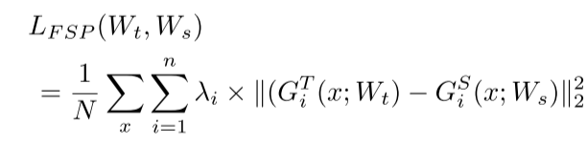
FSP: student learns how teacher learns
Define knowledge as TN learning process
Define learning process in DNN as relation between arbitrary two layers’ features: A →…→ B
layer A: h*w*c1 layer B: h*w*c2 do inner product between 2 feats
Transfer by MSE loss , SN learns FSP matrix G from TN
Two-stage training-process like Fitnet
Notes:
《 A Gift from Knowledge Distillation: Fast Optimization, Network Minimization and Transfer Learning 》

Slide 15
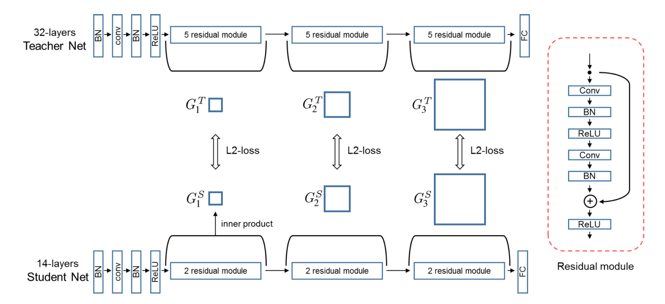
保持每个module 的I/O维度相同；选几个module or 在哪个module 影响不大
2 stage训练： 首先利用FSP训练(pre train, like good param-initiation)，之后用任务训练(finetune)
学习 学习的过程 而不是 结果，可以看做对TN 知识的一种平滑。防止over constrained(边界在哪)

Slide 16
1. SN performs better than TN 1~2% and converges faster
(Fitnet: deeper architech + good param-initiation=better performance).
FSP: FSP as guidance so converges faster. Better than TN: ? Better than Fitnet: 学习输入输出之间的关系，因此在训练后续module时不要求前序网络抽出的特征足够好；但是fitnet只学习输出，所以如果多loss（多层mimic）就要求前序网络抽出足够好的特征，这样做SN到TN的映射才有意义。所以FSP可以泛化到多层mimic。
2. Transfer learning
TN pretrained on ImageNet, SN do classification on other image datasets.
就像普通的大模型pretrain/finetune一样，但是大模型finetune必须还是本模型，这里可以finetune到小模型上。（slightly lower performance than teacher）
3. ensemble learning
1 TN + multiple FSP matrix = multiple SN

Slide 17
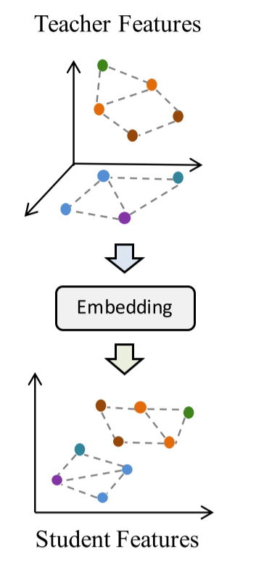

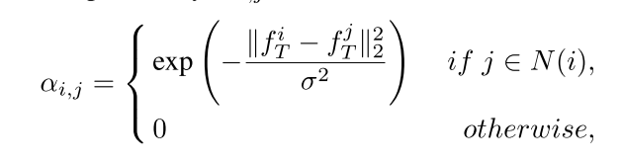
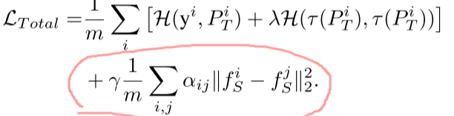
Feature embedding: embed TN feature to SN space
define knowledge as data(feature)-manifold
如果TN观测的数据足够多，模型学得足够好，就能把样本点分得足够开，这种信息传递给学生会不会有作用。
SN抽出的特征应该与TN抽出来的特征在空间结构上保持一致，一致性的衡量指标为locality preserving projection

Slide 18
1. 像RKD一样，挖掘数据集/feature空间特征的loss作为额外的第三项loss，而还可以引入Hinton loss。
2. 你也不知道为什么他做的这个比FSP好。横向比较时很难找到蒸馏法A比B好的理由，只有单方法的ablation study能说明方法好是有理由的。每个蒸馏法都是从不同的侧面思考问题。
3. more loss, more better: hinton loss +RKD loss >hinton loss 因为我们是从数据层面又加入了一些约束
如果我们不停地从不同侧面加约束进去，性能会一直提升么？带来训练速度的牺牲么？

Slide 19
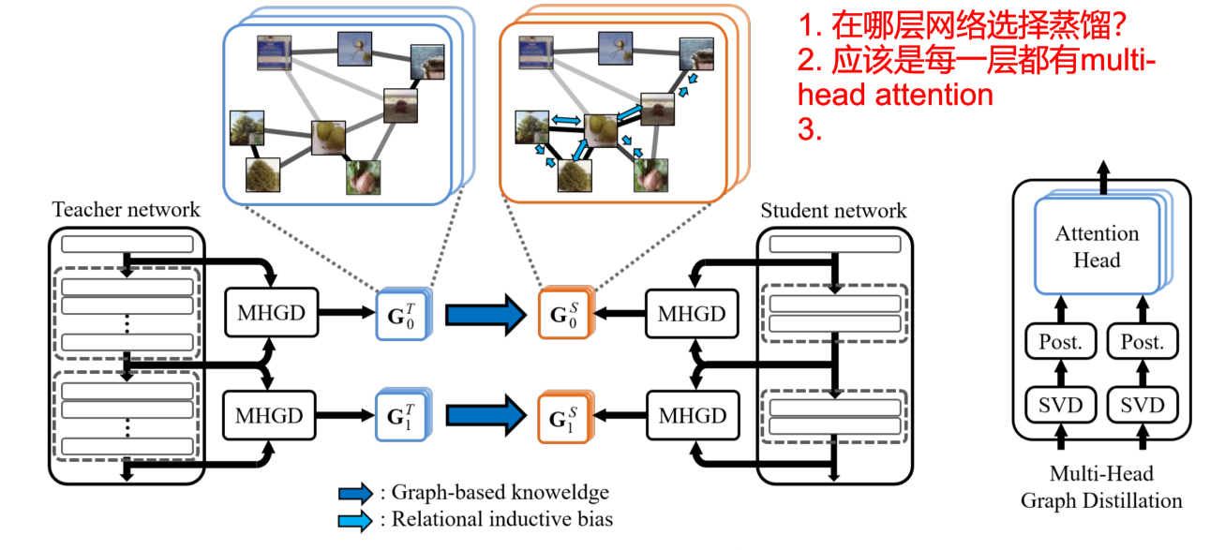
Graph-based Knowledge Distillation by Multi-head Attention Network
蒸馏数据集知识：不是从空间结构挖掘，而是TN、SN分别进行无监督学习dataset每个sample（这里是图片）之间的关系，形成图，边表示sample之间的量化数值关系。transfer knowledge手段就是minimize TN/SN每个batch形成图之间的边value分布（KL散度）
Notes:
同样是韩国人写的paper为什么FSP的可读性比这个强1w倍！

Slide 20
1. 如果TN transfer过多知识，比如在中间许多层作为hint去指导学生，就会出现over constrained的情况。目前已经有一些soften的方法。

Slide 21
Deeper insights
《 The State Of Knowledge Distillation For Classification Tasks 》研究并复现了在图像分类任务上不同的蒸馏法。以下是几条结论：
0. 公认的baseline hinton-loss
1. 蒸馏法对网络结构和训练设置（参数、超参数）很敏感。尤其是feature based方法。这种方法可能泛化能力不强，高度依赖特定的模型结构和训练设置。
2. response based knowledge泛化能力也不强，要求SN/TN干同样的事情，不然很难约束。
3. 综上基于relation的蒸馏应该比较靠谱

Slide 22
priviledge information and KD
KD和priviledge information/knowledge transfer/transfer learning的关联
《 UNIFYING DISTILLATION AND PRIVILEGED INFORMATION 》
priviledge information（PI）: train时可用，test时不可用的特征。
从SVM+中诞生的概念，SVM+也体现了teacher-student的概念。比如teacher如果能给soft-margin SVM提供每个样本的松弛变量，就可以大幅优化问题求解过程。
从hinton soft targets出发，把每个sample产生的soft target看成一种PI
Having a good teacher is one opportunity to learn charateristics about the decision boundary which are not contained in the training samples.
数学太多，真的看不懂

Slide 23
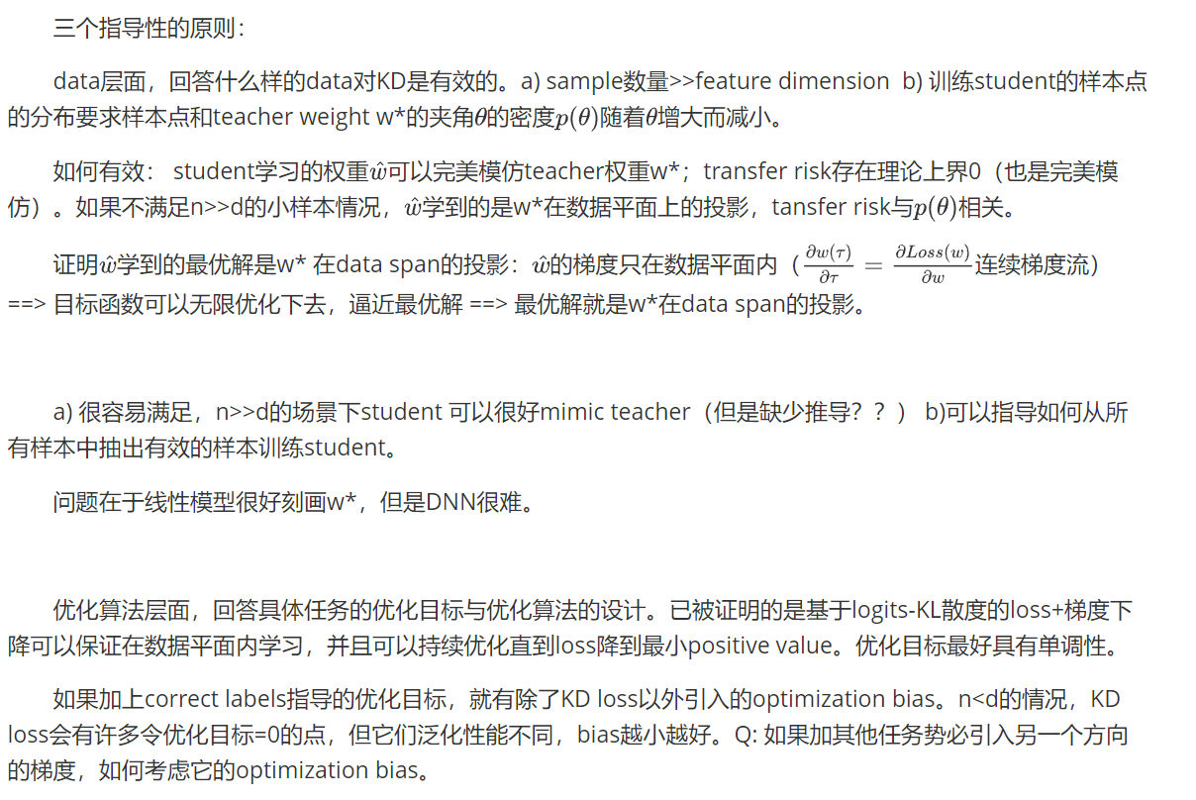
《Towards Understanding KD》 近似去做，优化思路，而不是完全指导

Slide 24
蒸馏这块的to-read list
KD-SVD
大量工业应用的实践
KD in Neural Sequence Generation。
知识应该是specialized。序列和网络数据抽取知识去蒸馏。
和semi-supervised/self-supervised/few shot learning等等结合起来。
核心的思想留下来

