Slide 1


Slide 2

Nornir – Python Framework for Network Automation
Fórum Técnico de LACNIC - FTL
William Prado IX.br Engineering

Slide 3
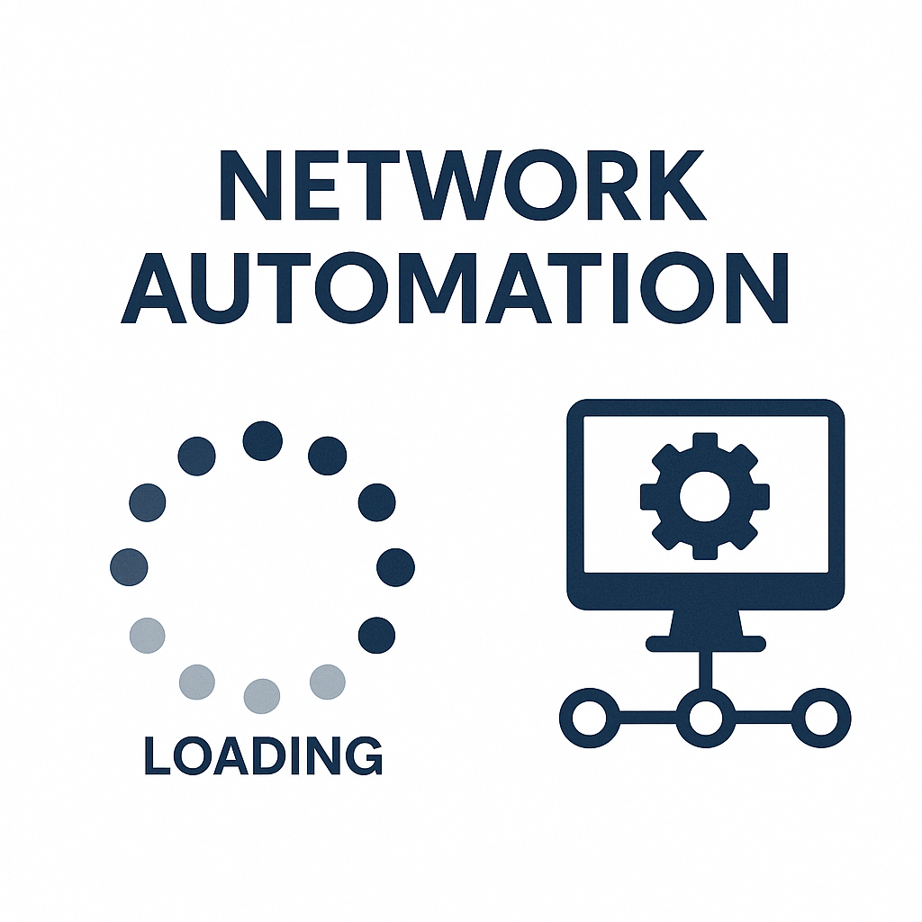

Slide 4
Nornir - What is it?
Automation Framework 100% written in python.
Open-source.
Multi-threaded – multiple tasks can be executed at the same time.
Inventory Management – Static and Dynamic.
Easily extended with custom plugins.
Faster.
To install nornir: pip install nornir
https://nornir.readthedocs.io/en/latest/

Slide 5
Nornir - Installation Guide

Slide 6
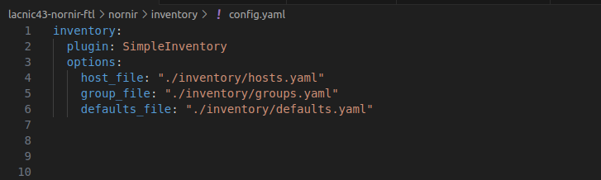
Nornir - Simple Inventory – config.yaml

Slide 7
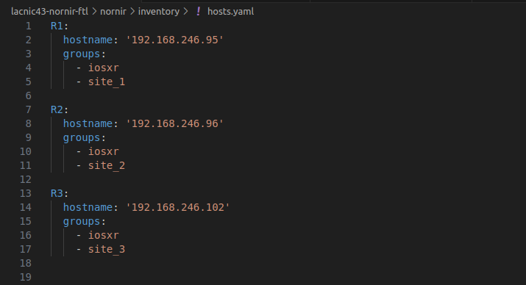
Nornir - Simple Inventory – hosts.yaml

Slide 8
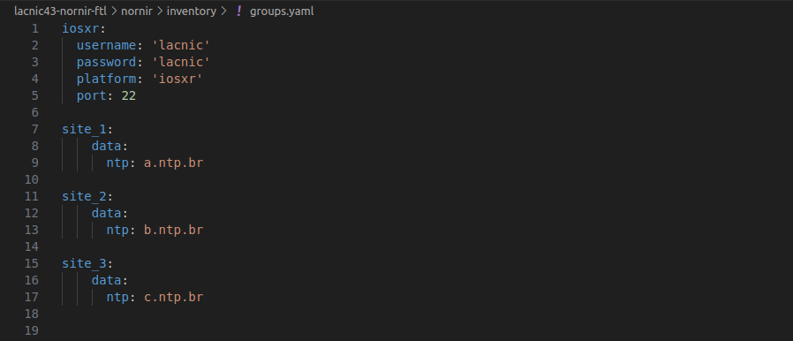
Nornir - Simple Inventory – groups.yaml

Slide 9
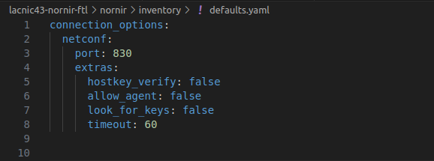
Nornir - Simple Inventory – defaults.yaml

Slide 10
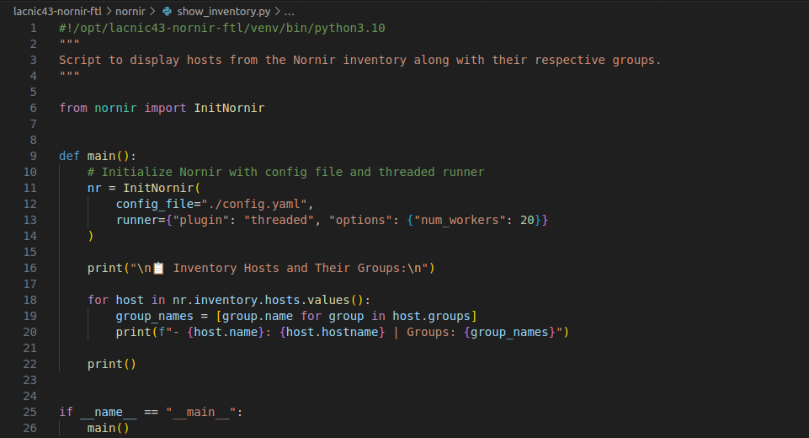
Nornir - show_inventory.py

Slide 11
Nornir - show_inventory.py

Slide 12
Nornir - show_inventory.py

Slide 13
Nornir - Plugins
Plugin is a software component that can be customized to add new features.
Nornir allow add new features using plugins.
Plugins can be installed using PIP – Package installer for Python.
https://nornir.readthedocs.io/en/stable/plugins/

Slide 14
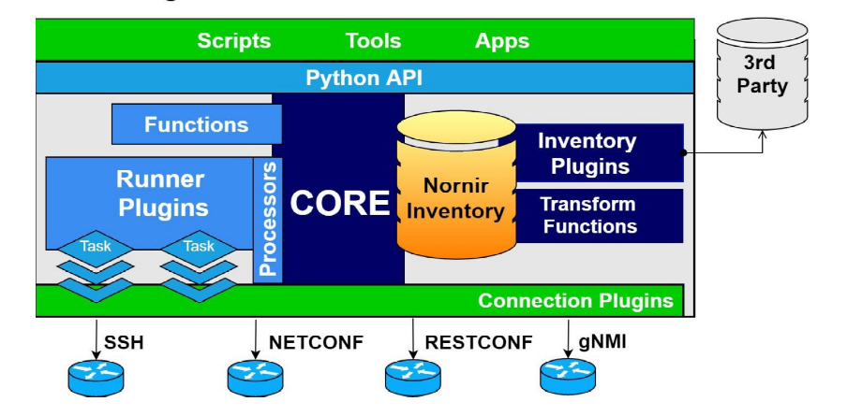
Nornir - Plugins Architecture
https://nornir.readthedocs.io/en/stable/plugins/

Slide 15
Nornir - Plugins List
nornir_napalm
nornir_netmiko
nornir_scrapli
nornir_netconf
nornir_netbox
nornir_infrahub
nornir_rich
nornir_inspect
nornir_ansible
nornir_vault
nornir_utils
nornir_rich
nornir_salt
nornir_pyez
nornir_f5
nornir_routeros
nornir_http
nornir_pygnmi
nornir_nuts
nornir_csv
https://nornir.tech/nornir/plugins/

Slide 16
Nornir - Tasks
Task defines the actions that will be performed on the host.
Task is a python function.
To execute one task use the method RUN.
Tasks are marked with failed in case of exceptions during execution.

Slide 17
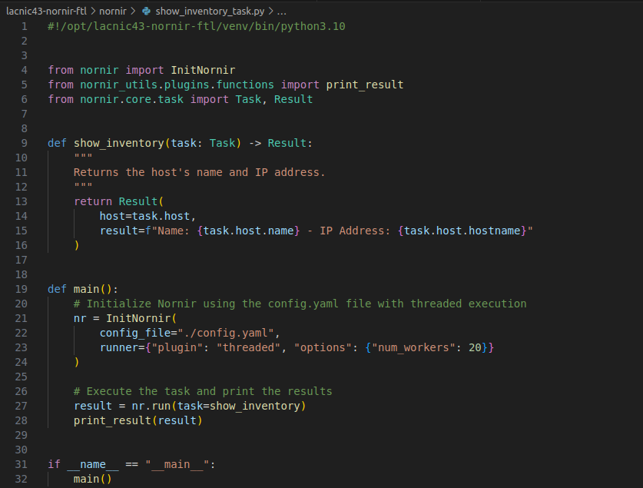
Nornir - Tasks

Slide 18
Nornir - Tasks

Slide 19
Nornir - Tasks

Slide 20

What is Netmiko?
Netmiko is a python library that simplifies the process of interacting with network devices
such as routers, switches, and firewalls with the help of the SSH Protocol.
Offers a consistent and user-friendly interface for executing commands, getting output,
and, most importantly, automating various network management tasks.
To install netmiko as a nornir plugin: pip install nornir_netmiko
https://github.com/ktbyers/nornir_netmiko
https://github.com/ktbyers/netmiko

Slide 21
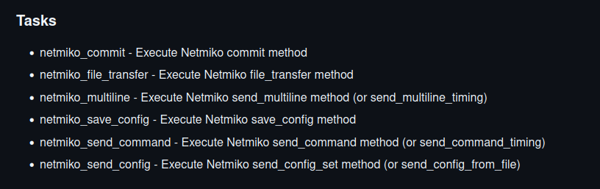
Nornir - Netmiko Tasks
https://github.com/ktbyers/nornir_netmiko
https://github.com/ktbyers/netmiko

Slide 22
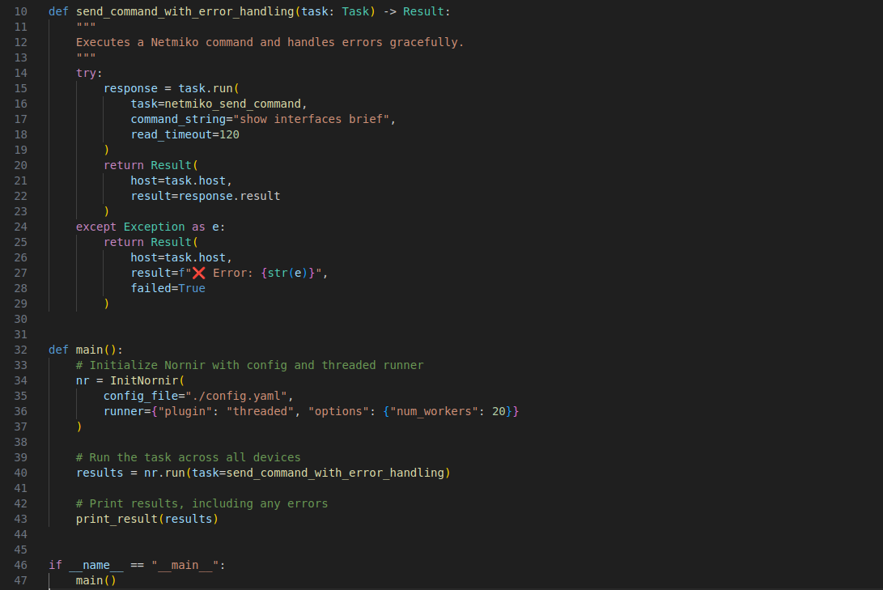
Nornir - Netmiko - A First Glance

Slide 23
Nornir - Netmiko - A First Glance

Slide 24

What is NetBox?
Open-source IPAM/DCIM.
Developed in Python using Django Framework.
NSOT – Network Source of Truth.
API Support: REST and GraphQL.
Webhooks and Plugins.
Custom Fields.
To install netbox as a nornir plugin: pip install nornir_netbox
https://netboxlabs.com/docs/netbox/en/stable/
https://docs.netbox.dev/en/stable/ https://github.com/netbox-community/netbox-docker

Slide 25
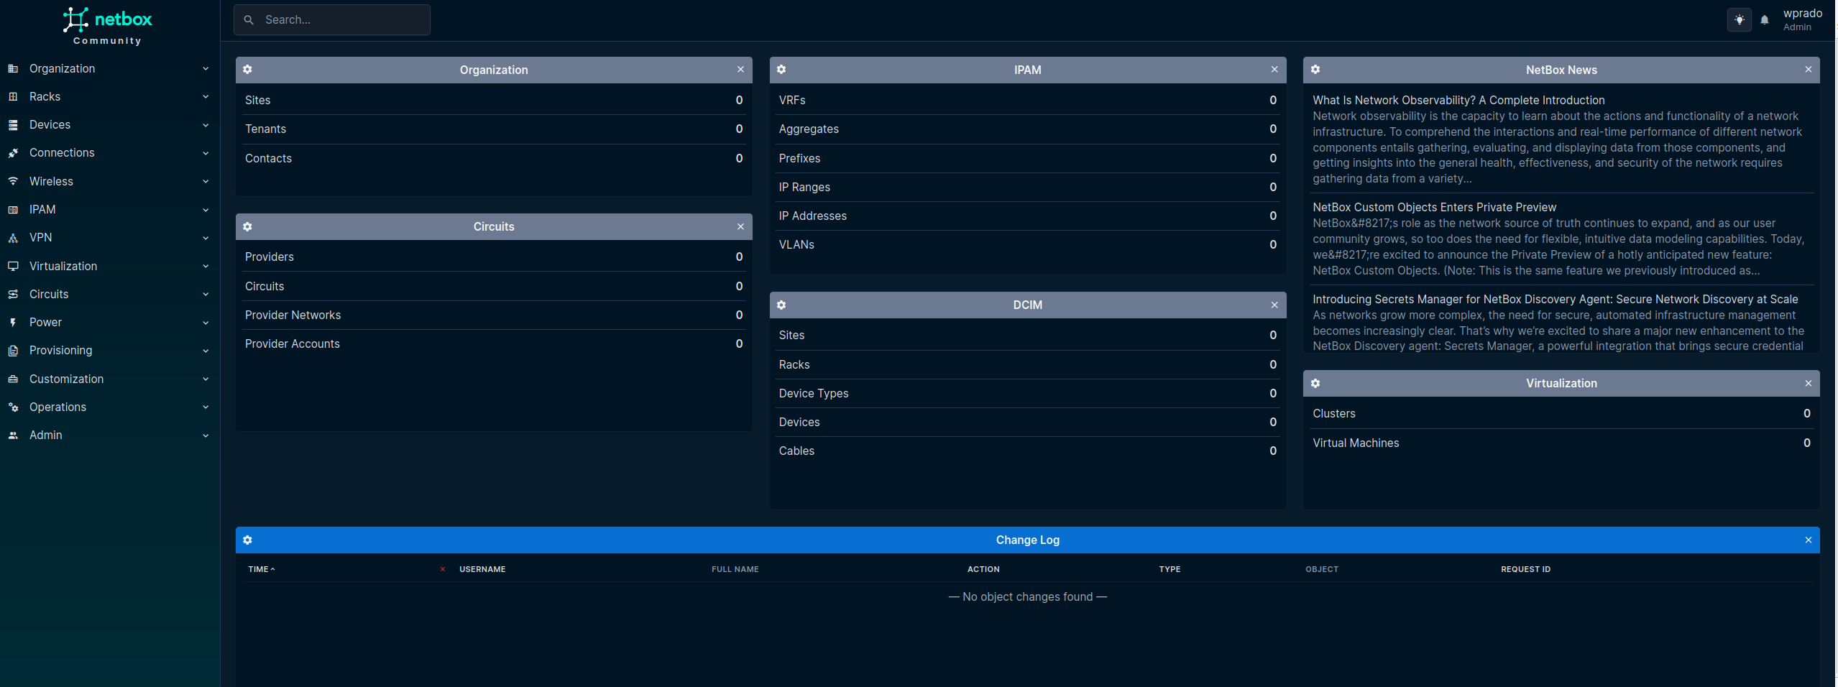
NetBox - WEB

Slide 26
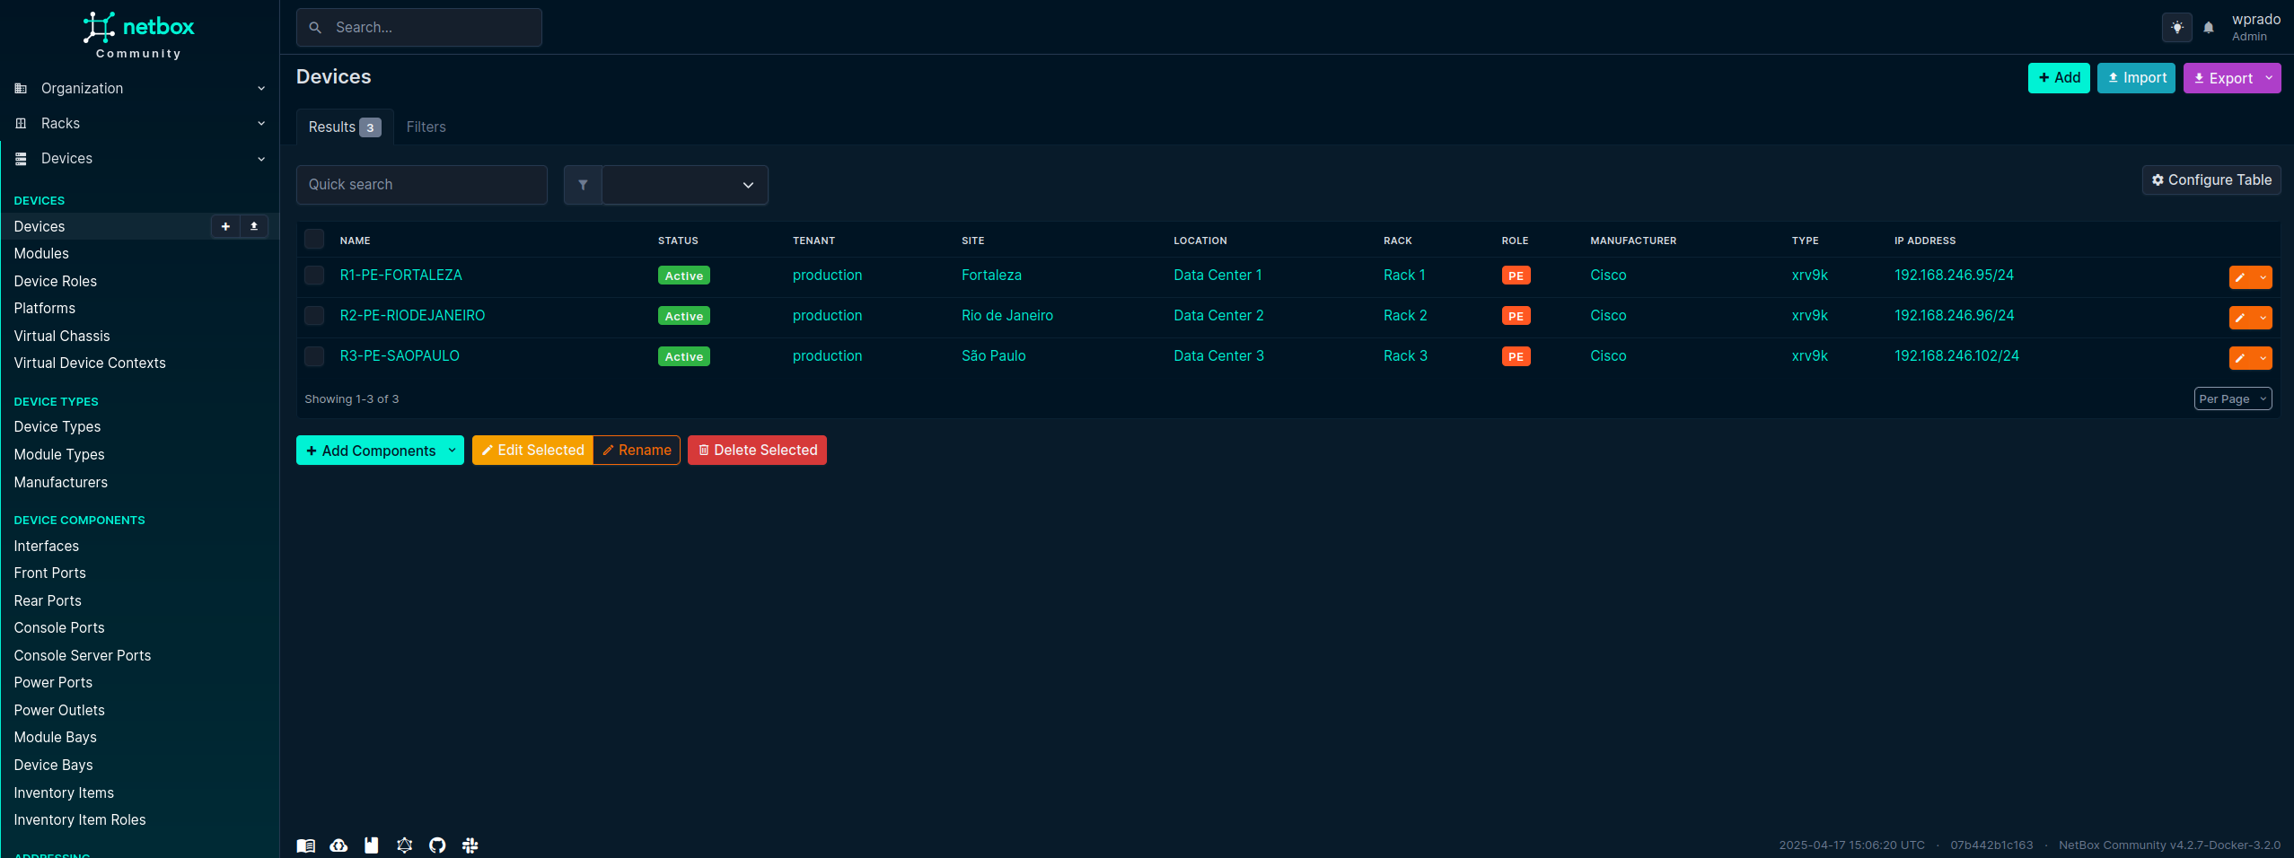
NetBox - Inventory

Slide 27
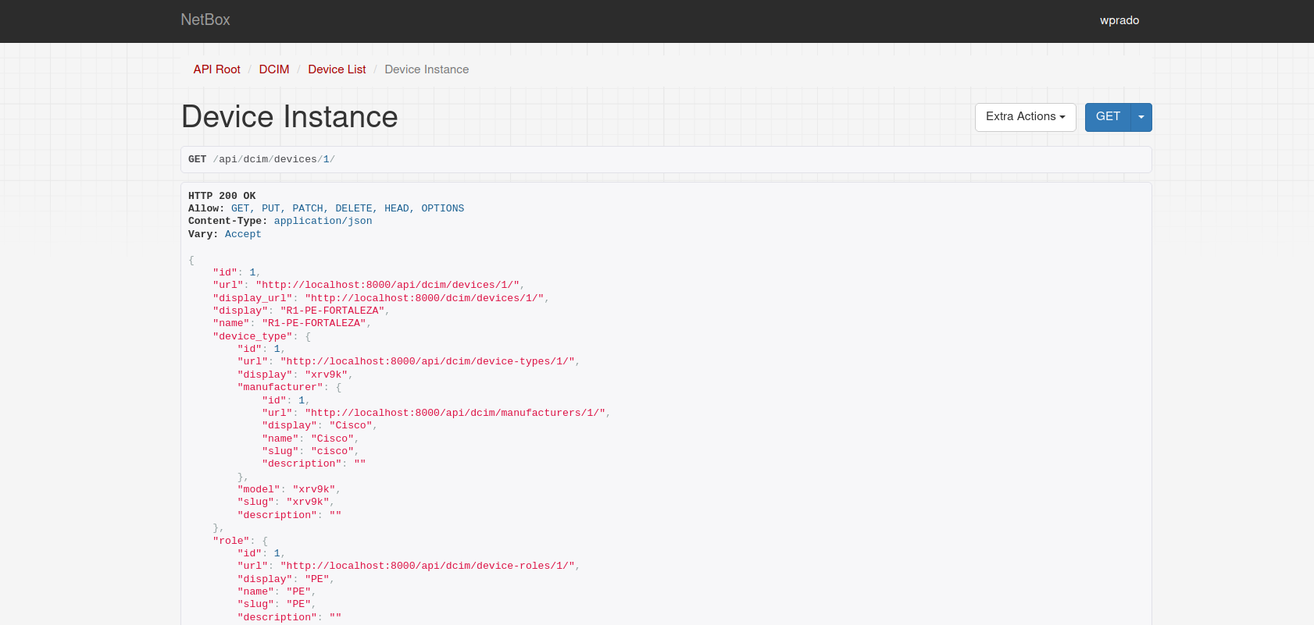
NetBox - REST API

Slide 28
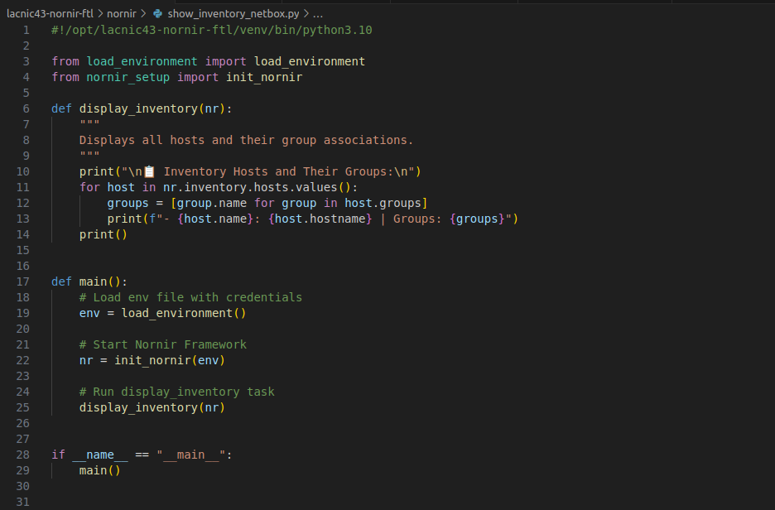
Nornir + Netbox + Filters

Slide 29
Nornir + Netbox + Filters

Slide 30
Nornir + Netbox + Filters

Slide 31
Nornir + Netbox + Filters

Slide 32
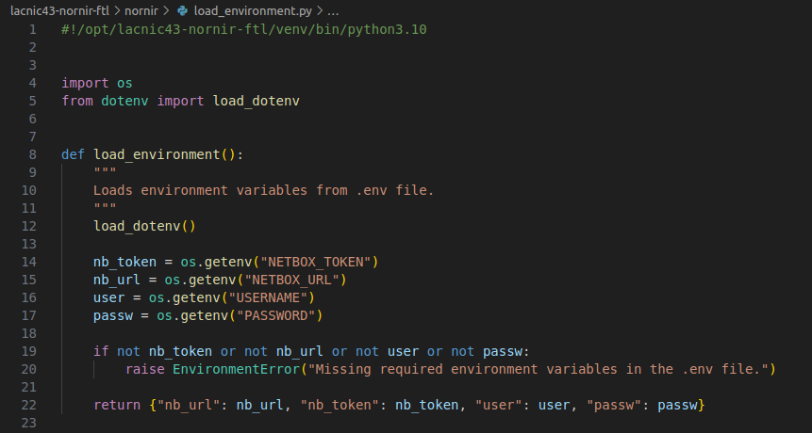
Nornir + Netbox + Filters – load_environment.py

Slide 33
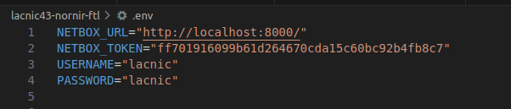
Nornir + Netbox + Filters – .env

Slide 34
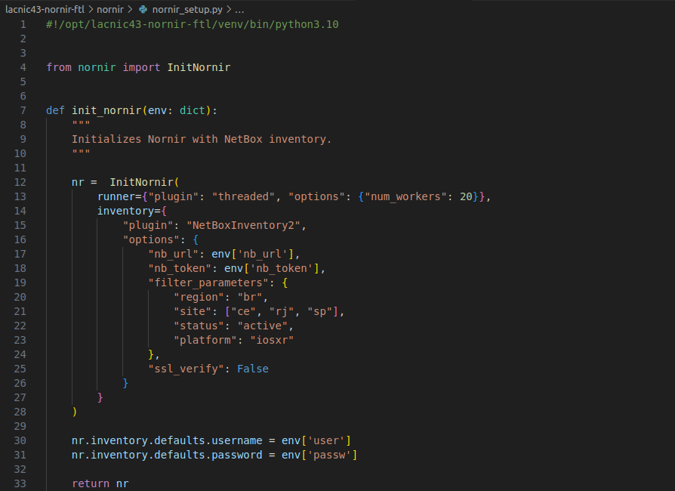
Nornir + Netbox + Filters – nornir_setup.py

Slide 35
Nornir + Netbox + Filters – nornir_setup.py

Slide 36
Nornir + Netbox + Filters

Slide 37

What is Napalm?
Python Library that implements a set of functions to interact with different
network device using a unified API.
Support: Cisco IOS-XR, Cisco IOS, Cisco NX-OS, Junos, Arista EOS and others.
Open Source.
Abstraction layer for network programming and automation.
To install netbox as a nornir plugin: pip install nornir_napalm

Slide 38
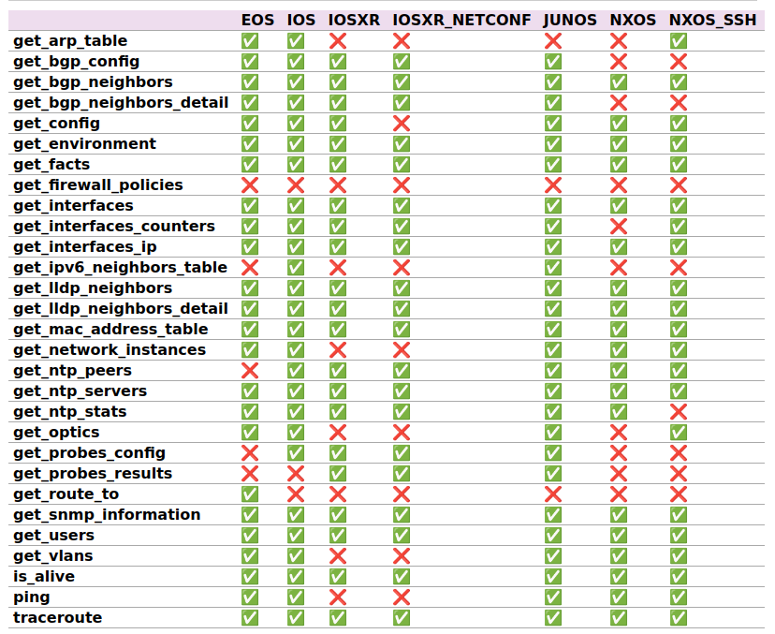
Napalm - Methods

Slide 39
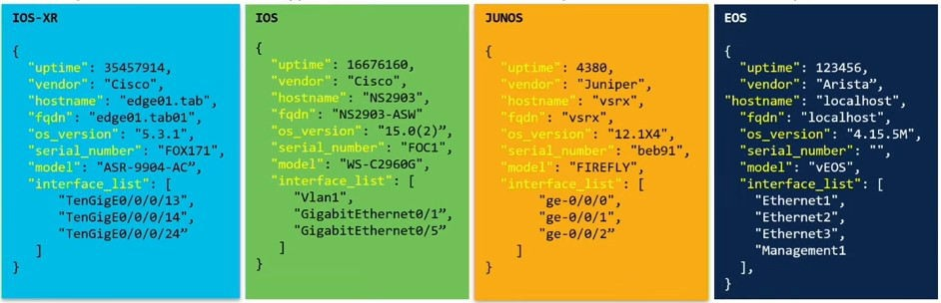
Napalm – Data Structured - JSON

Slide 40
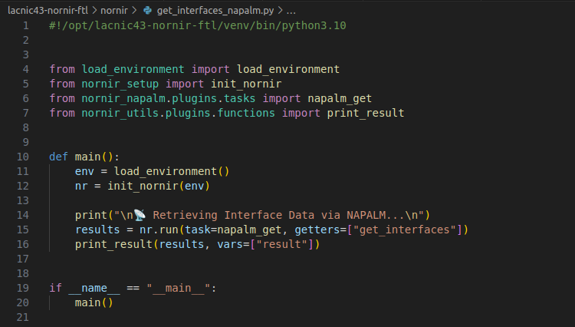
Nornir + Netbox + Napalm

Slide 41
Nornir + Netbox + Napalm

Slide 42
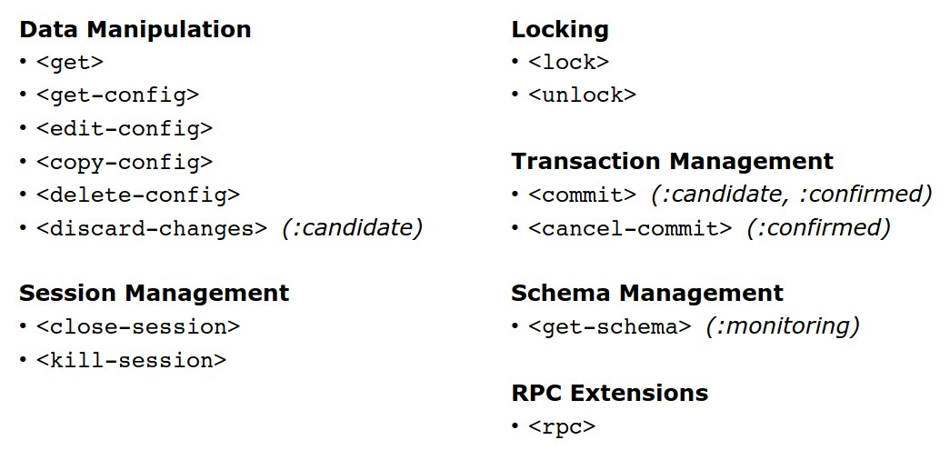
NETCONF – Operations

Slide 43
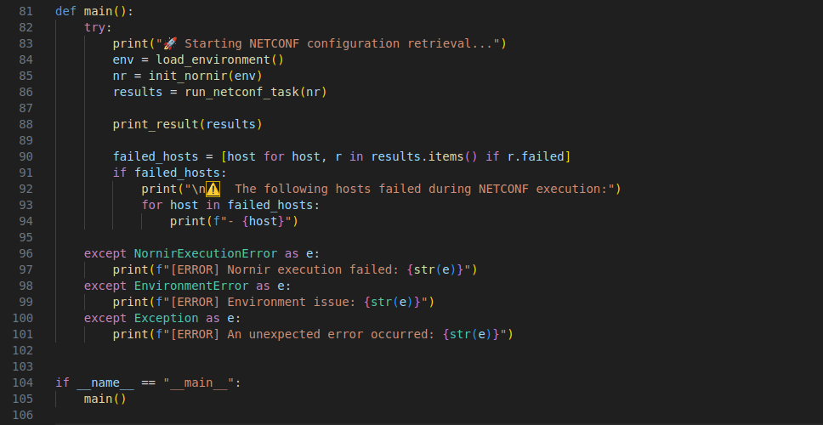
Nornir + Netbox + NETCONF (XML)

Slide 44
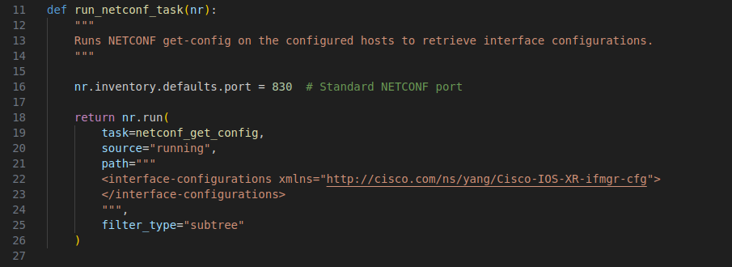
Nornir + Netbox + NETCONF (XML)

Slide 45
Nornir + Netbox + NETCONF (XML)

Slide 46
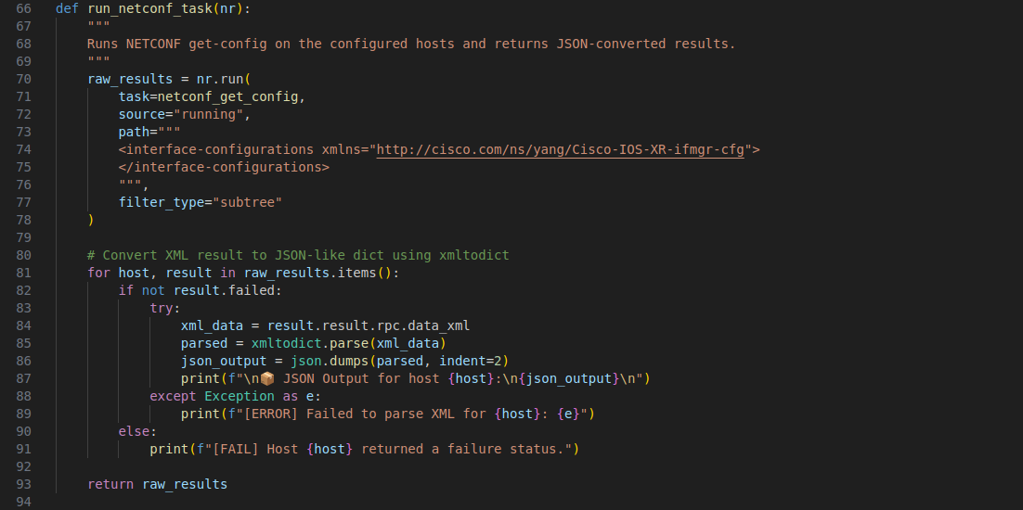
Nornir + Netbox + NETCONF (JSON)

Slide 47
Nornir + Netbox + NETCONF (JSON)

Slide 48
Nornir + Netbox + NETCONF (JSON)

Slide 49
Curious facts: 312 Devices with 100 workers

Slide 50
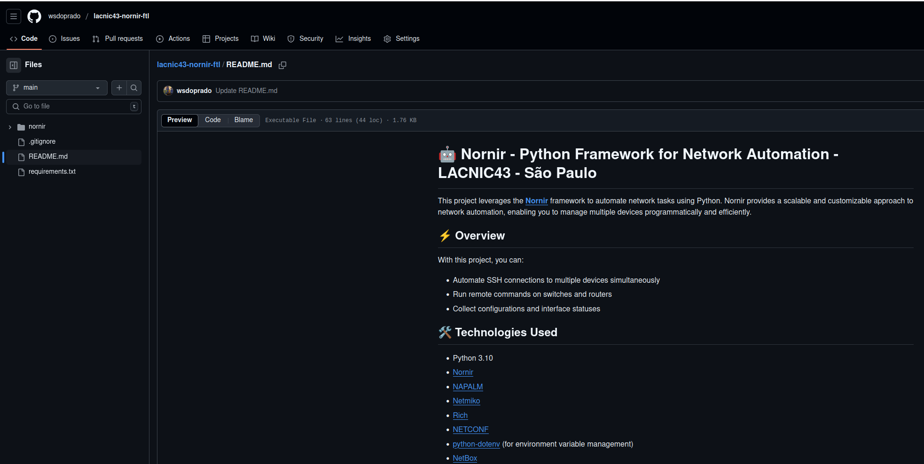
Github - https://github.com/wsdoprado/lacnic43-nornir-ftl/

Slide 51


Thank you
www.ix.br
wprado@nic.br
May 6th, 2025

