Slide 1



Detecting Metadata-Related Logic Bugs in Database Systems via Raw Database Construction
50th International Conference on Very Large Databases
Jiansen Song, Wensheng Dou, Yu Gao, Ziyu Cui, Yingying Zheng, Dong Wang, Wei Wang, Jun Wei, Tao Huang
Institute of Software
Chinese Academy of Sciences
University of Chinese Academy of Sciences

Slide 2

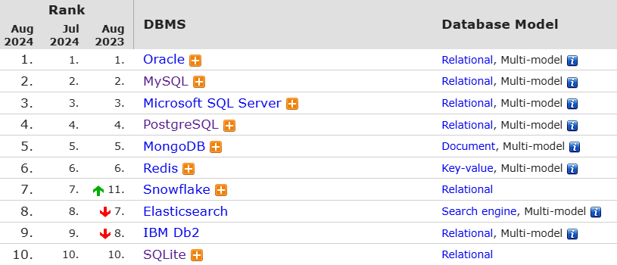




Database Management System (DBMS)
DBMSs are widely used to store and retrieve data
DB-Engines Ranking
https://db-engines.com/en/ranking

Slide 3
Database Metadata
Relational DBMSs use database metadata to describe the organization and structure of data in their managed databases
Table name
Data type
t1
Column name
c1 TEXT
NOT NULL
c2 INT
UNIQUE
Data constraint
Index
Jason
1
Bob
2
Tom
3

Slide 4


Metadata-Related Query Optimization
Metadata can be used to accelerate query evaluation
An index provides an efficient way to access data
t1
c1 TEXT
c2 INT
Sequential scan
1s
Jason
1
Bob
2
SELECT * FROM t1
WHERE c2>1
Index-related optimization
t1
c1 TEXT
c2 INT
UNIQUE
Jason
1
Bob
2
Index scan
0.01s

Slide 5
Metadata-Related Query Optimization
Metadata can be used to accelerate query evaluation
NOT NULL columns avoid unnecessary data access for the IS NULL condition
t1
c1 TEXT
c2 INT
Sequential scan
1s
Jason
1
Bob
2
SELECT * FROM t1
WHERE c1 IS NULL
NOT NULL constraint-related optimization
t1
c1 TEXT
NOT NULL
c2 INT
Jason
1
Bob
2
No table scan
0.01s

Slide 6



Metadata-Related Logic Bug
Incorrect metadata-related query optimization mechanisms and implementations can lead to metadata-related logic bugs
It does not crash
the DBMS server
DBMS
Index-related opt.
Not Null-related opt.
Foreign Key-related opt.
…
Query
Incorrect query result

Slide 7
Bug Example
Incorrect index-related implementations cause the DBMS to fail to return the data
t1
c1 TEXT
NOT NULL
c2 FLAOT UNSIGNED
UNIQUE
{1,2}
✓
SELECT c2 FROM t1
WHERE '1e500' != c2
Jason
1
ERROR: constant
overflows float
Bob
2
https://github.com/pingcap/tidb/issues/44241

Slide 8

Detecting Metadata-Related Logic Bugs
The key challenge is to check whether the metadata-related query optimization causes an incorrect query result
DBMS
Is the query result correct?
Index-related opt.
Not Null-related opt.
Foreign Key-related opt.
…
Query
Query result

Slide 9
Existing Approaches
Existing approaches construct equivalent queries to detect logic bugs
DQE [1] executes SELECT, UPDATE, and DELETE with the same WHERE clauses
NoREC [2] transforms WHERE clauses into SELECT expressions
TLP [3] rectifies WHERE clauses based on the three-valued logic
SELECT c1 FROM t1 WHERE c1=1
Select the first row
t1
c1 INT
NOT NULL
UPDATE t1 SET c1=0 WHERE c1=1
Update the first row
1
2
DELETE FROM t1 WHERE c1=1
Delete the first row
They focus on predicate-related bugs and cannot detect metadata-related logic bugs
[1] Song et al., Testing Database Systems via Differential Query Execution, ICSE 2023
[2] M. Rigger and Z. Su, Detecting optimization bugs in database engines via non-optimizing reference engine construction, ESEC/FSE 2020
[3] M. Rigger and Z. Su, Finding bugs in database systems via query partitioning, OOPSLA 2020

Slide 10
Observation
Some metadata is necessary for query execution
Table names, column names, and data types
t1
c1 TEXT
c2 INT
SELECT c2
FROM t1
WHERE c2>1
Jason
1
{2,3}
Bob
2
Tom
3

Slide 11

Observation
Some metadata is optional and only used for query optimization
Such optional metadata does not change the query result
Data constraints and indexes
t1
c1 TEXT
NOT NULL
c2 FLAOT UNSIGNED
UNIQUE
{1,2}
Jason
1
Bob
2
SELECT c2 FROM t1
WHERE '1e500' != c2
Enable metadata-related optimization
$$=$$
t1
c1 TEXT
c2 FLAOT UNSIGNED
Jason
1
{1,2}
Bob
2
Disable metadata-related optimization

Slide 12



Approach
We propose raw database construction (Radar) to detect metadata-related logic bugs in DBMSs
③ Executing and comparing
query results
t1
c1 TEXT
NOT NULL
c2 FLAOT UNSIGNED
UNIQUE
Error
② Generating
random queries
Jason
1
Optimized execution
Database $db$
SELECT c1 FROM t1
WHERE '1e500' != c1
Y
① Constructing a
raw database
$$≠$$
t1
c1 TEXT
c2 FLAOT UNSIGNED
{1}
Jason
1
Unoptimized execution
Raw database $rawDb$

Slide 13
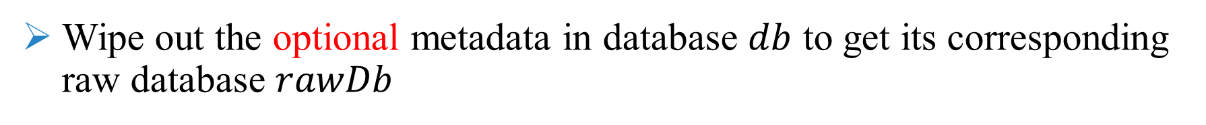


Constructing Raw Database
Wipe out the optional metadata in database $db$ to get its corresponding raw database $rawDb$
Wipe out the NOT NULL constraint
Wipe out the UNIQUE index
t1
c1 TEXT
NOT NULL
c2 INT
UNIQUE
t1
c1 TEXT
c2 INT
Jason
1
Bob
2
Database $db$
Raw database $rawDb$

Slide 14

Constructing Raw Database
Copy table data from database $db$ to database $rawDb$
t1
c1 TEXT
NOT NULL
c2 INT
UNIQUE
Copy table data in $db$ to $rawDb$
t1
c1 TEXT
c2 INT
Jason
1
Jason
1
Bob
2
Bob
2
Database $db$
Raw database $rawDb$

Slide 15





Comparing Query Results
Compare the returned execution results from $db$ and $rawDb$
Query result
Error message
Database $db$
Execution result 1
$$≠$$
Query
Query result
Error message
Database $rawDb$
Execution result 2

Slide 16





Testing Similar Databases Reduces Testing Efficiency
Testing databases with the same or similar database metadata is more likely to examine similar metadata-related implementations
t1
c1 TEXT
NOT NULL
c2 INT
UNIQUE
Test NOT NULL constraint-related and index-related implementations
Jason
1
Bob
2
Database $db1$
5,000 queries
t2
c3 TEXT
NOT NULL
c4 INT
UNIQUE
More likely to detect duplicate bugs
Jason
1
Bob
2
Database $db2$
5,000 queries

Slide 17


Metadata-Oriented Testing Optimization
Test databases with unique abstract database metadata
t1
c1 TEXT
NOT NULL
c2 INT
UNIQUE
t1
c1 TEXT, NOT NULL
c2 INT, UNIQUE(c2)
t1
c1 TEXT, NOT NULL
c2 INT, UNIQUE(INT)
Jason
1
Database $db1$
db1’s metadata
db1’s abstract metadata
Equivalent
t2
c3 TEXT
NOT NULL
c4 INT
UNIQUE
t2
c3 TEXT, NOT NULL
c4 INT, UNIQUE(c4)
t2
c3 TEXT, NOT NULL
c4 INT, UNIQUE(INT)
Jason
1
Database $db2$
db2’s metadata
db2’s abstract metadata

Slide 18
Evaluation
RQ1: Bug detection capability
What 𝑚𝑒𝑡𝑎𝐵𝑢𝑔s can Radar detect in real-world DBMSs?
RQ2: Effectiveness of metadata-oriented testing optimization
How effective is the metadata-oriented testing optimization in Radar?
RQ3: Comparing with existing approaches
How many bugs detected by Radar can be found by existing approaches?

Slide 19
Target DBMSs
We select five widely-used and production-level relational DBMSs
DBMS | DB-Engines Ranking | GitHub Stars | Type
MySQL | 2 | 9.6K | Traditional
SQLite | 9 | 4.7K | Embedded
MariaDB | 13 | 5K | Traditional
CockroachDB | 64 | 28K | NewSQL
TiDB | 88 | 35K | NewSQL

Slide 20
Bug Detection Capability
42 bugs are submitted
38 bugs are confirmed as new bugs
16 bugs have been fixed
DBMS | Submitted | Confirmed | Fixed | 𝑚𝑒𝑡𝑎𝐵𝑢𝑔 | Non-𝑚𝑒𝑡𝑎𝐵𝑢𝑔
MySQL | 4 | 3 | 0 | 3 | 0
MariaDB | 4 | 2 | 2 | 2 | 0
SQLite | 1 | 1 | 0 | 1 | 0
CockroachDB | 2 | 1 | 1 | 0 | 1
TiDB | 31 | 31 | 13 | 24 | 7
Total | 42 | 38 | 16 | 30 | 8

Slide 21
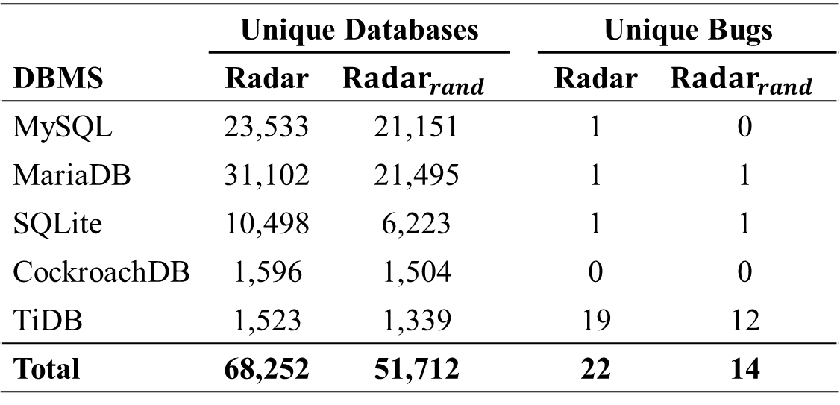
Effectiveness of Testing Optimization
Compare Radar with Radar_{rand}, which tests all generated databases
Run Radar and Radar_{rand} on our target DBMSs for 12 hours, respectively
 | Unique Databases |  |  | Unique Bugs
DBMS | Radar | $${Radar}_{rand}$$ |  | Radar | $${Radar}_{rand}$$
MySQL | 23,533 | 21,151 |  | 1 | 0
MariaDB | 31,102 | 21,495 |  | 1 | 1
SQLite | 10,498 | 6,223 |  | 1 | 1
CockroachDB | 1,596 | 1,504 |  | 0 | 0
TiDB | 1,523 | 1,339 |  | 19 | 12
Total | 68,252 | 51,712 |  | 22 | 14
Radar can test more unique databases and
detect more unique bugs than Radar_{rand}

Slide 22
Comparing with Existing Approaches
Investigate whether the 30 confirmed 𝑚𝑒𝑡𝑎𝐵𝑢𝑔s can be detected by existing approaches
DBMS | Radar | NoREC | TLP | DQE | MutaSQL
MySQL | 3 | 2 | 1 | 1 | 2
MariaDB | 2 | 2 | 2 | 0 | 2
SQLite | 1 | 0 | 0 | 0 | 0
CockroachDB | 0 | 0 | 0 | 0 | 0
TiDB | 24 | 9 | 0 | 7 | 1
Total | 30 | 13 | 3 | 8 | 5
Existing approaches can detect at most 13 out of the 30 confirmed 𝑚𝑒𝑡𝑎𝐵𝑢𝑔s
[1] M. Rigger and Z. Su, Detecting optimization bugs in database engines via non-optimizing reference engine construction, ESEC/FSE 2020
[2] M. Rigger and Z. Su, Finding bugs in database systems via query partitioning, OOPSLA 2020
[3] Song et al., Testing Database Systems via Differential Query Execution, ICSE 2023
[4] Chen et al., Testing query execution engines with mutations, DBTest 2020

Slide 23
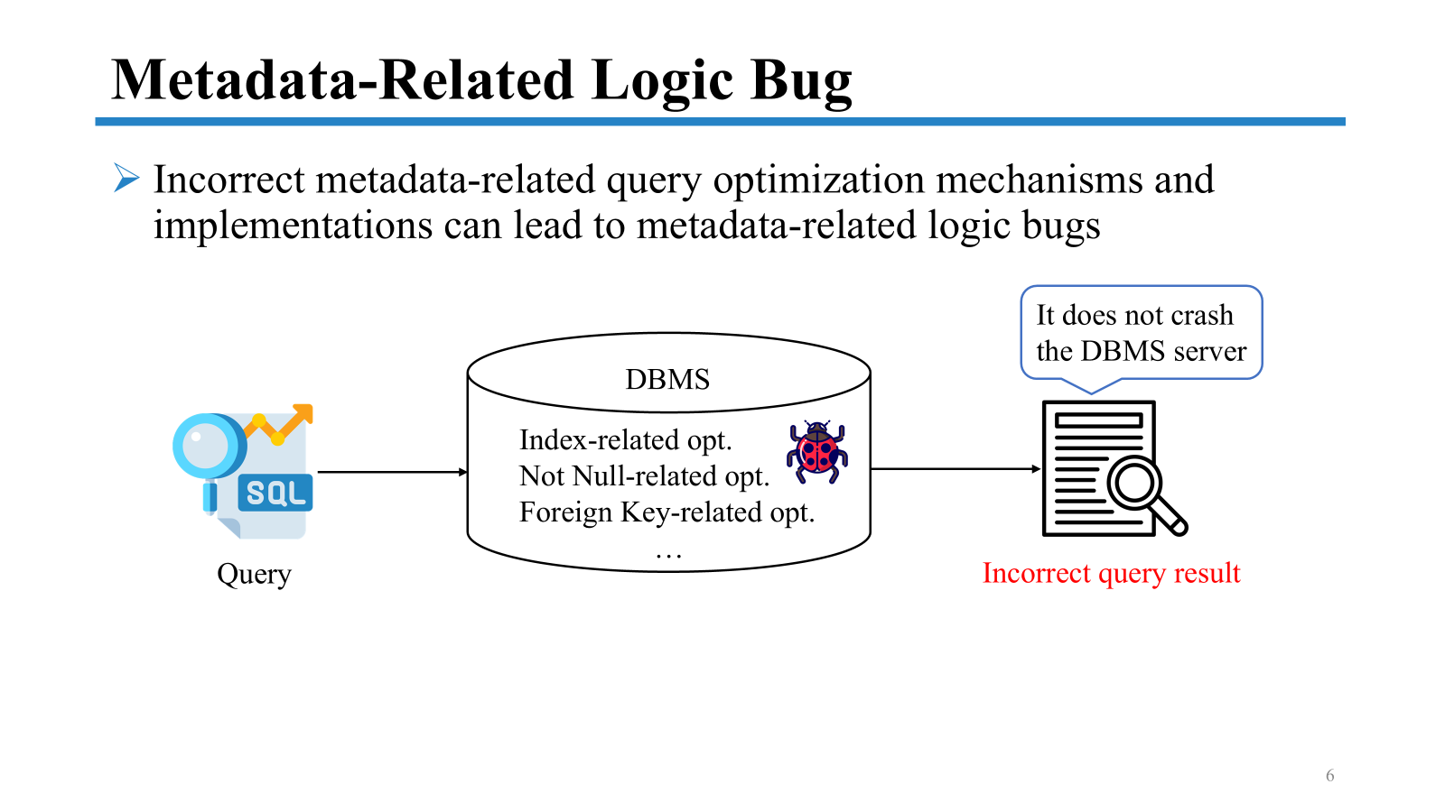
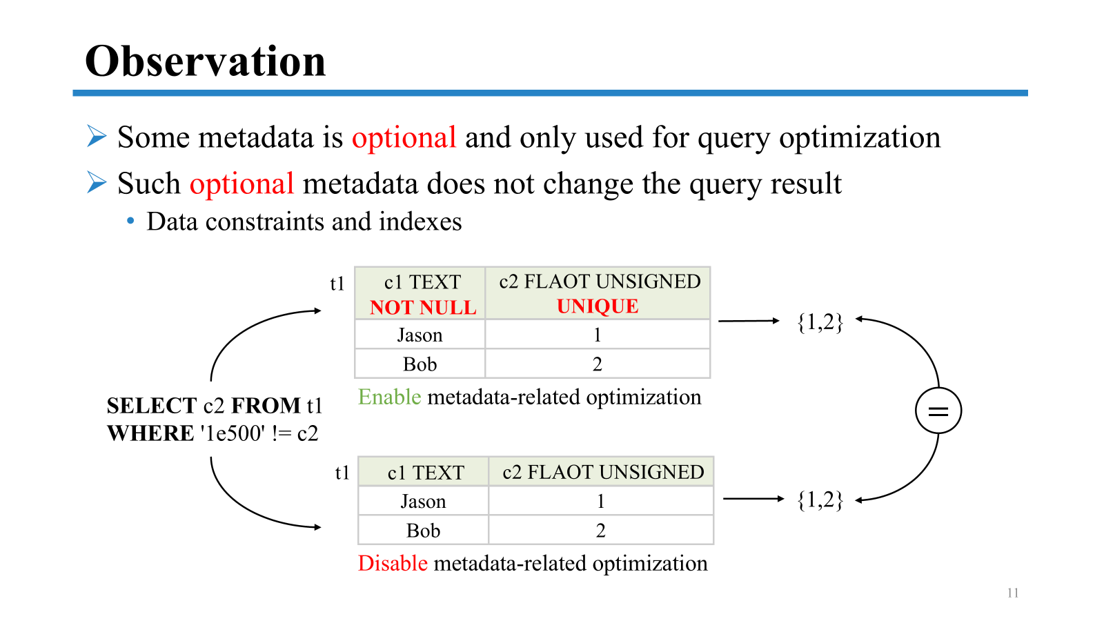
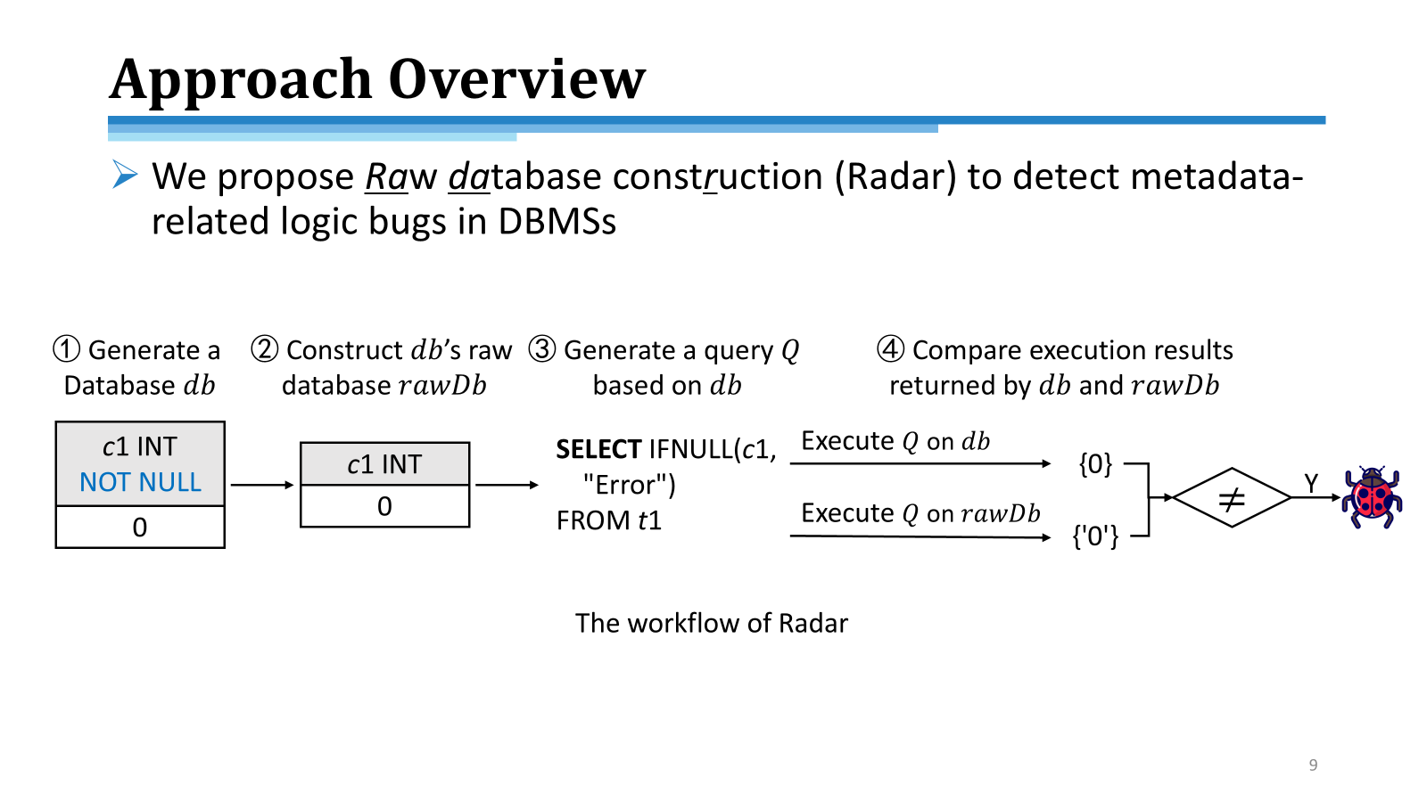
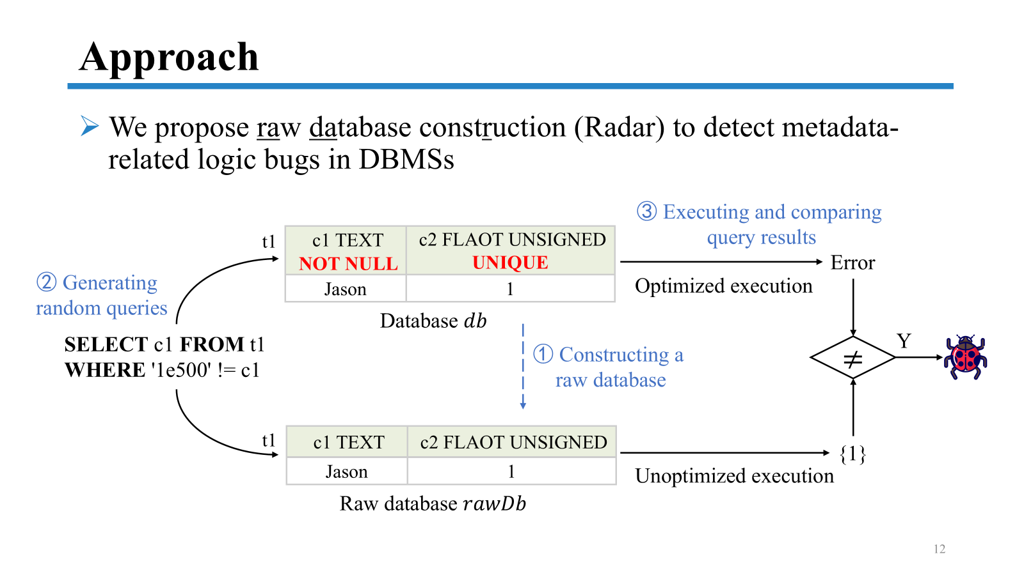
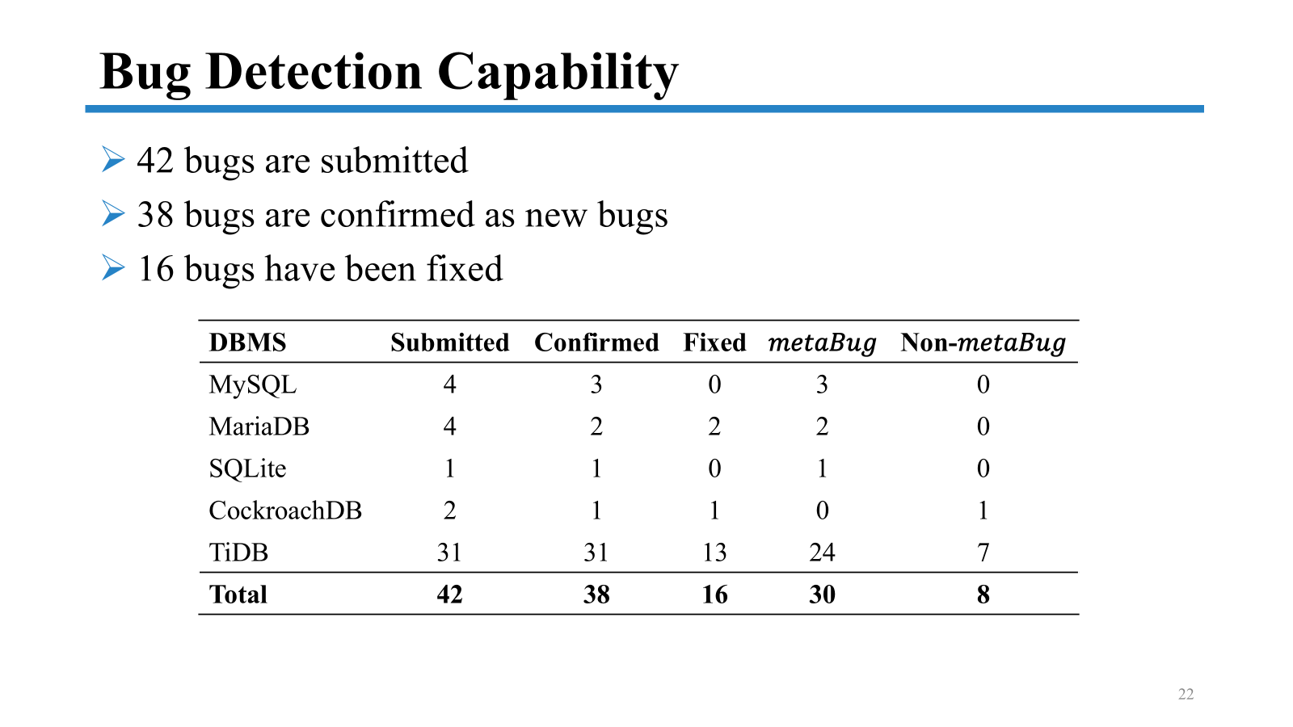

Conclusion
https://github.com/tcse-iscas/radar

