Slide 1


37th IEEE/ACM International Conference on Automated Software Engineering (ASE 2022)
Differentially Testing Database Transactions
for Fun and Profit
Ziyu Cui, Wensheng Dou, Qianwang Dai, Jiansen Song,
Wei Wang, Jun Wei, Dan Ye
Institute of Software, Chinese Academy of Sciences
University of Chinese Academy of Sciences
Notes:
Hello everyone. I am Cui Ziyu from University of Chinese Academy of Sciences. It’s my honor to be here and talk about our work：Differentially Testing Database Transactions for Fun and Profit.

Slide 2








Database Management Systems (DBMS)
DBMSs play an essential role for storing and retrieving data in many applications
Applications
DBMSs
Notes:
Database Management Systems, like MySQL and PostgreSQL and so on, play an essential role for storing and retrieving data in many applications, such as e-commerce applications. For convenience, we call Database Management Systems as DBMSs.

Slide 3


Data Consistency and Integrity
DBMSs need to ensure data consistency and integrity
UPDATE account SET balance=balance – 100 WHERE name = “Alice”;
Alice
$ 100
DBMS
UPDATE account SET balance=balance + 100 WHERE name = “Bob”;
Bob
Notes:
DBMSs need to ensure data consistency and integrity. (Click) For example, a user Alice wants to transfer money to Bob. In general, there are two steps by database standard language “Structured Query Language”. (Click) First, database (/səbˈtrækts/) subtracts one hundred dollars from Alice’ account, (Click) then adds one hundred dollars to Bob’s account. We don't want any of these steps to go wrong.

Slide 4
Transaction
DBMSs utilize transactions to ensure data consistency and integrity
BEGIN;
UPDATE account SET balance=balance – 100 WHERE name = “Alice”;
Alice
$ 100
DBMS
UPDATE account SET balance=balance + 100 WHERE name = “Bob”;
Bob
COMMIT;
Notes:
DBMSs utilize transactions to ensure data consistency and integrity. With Structured Query Language, (Click) transaction is started by a start statement such as BEGIN statement. And finally, transaction is committed by COMMMIT statement (Click) to ensure that the two manipulation statements are executed as a whole.

Slide 5
Isolation Level
DBMSs provide several common isolation levels to balance consistency and performance^{[1-4]}
Read Uncommitted
Read Committed
Repeatable Read
Serializable
[1] The ANSI isolation levels. http://www.adp-gmbh.ch/ora/misc/isolation_level.html.
[2] Hal Berenson, et. al., A Critique of ANSI SQL Isolation Levels. SIGMOD 1995.
[3] Atul Adya. Weak Consistency: A Generalized Theory and Optimistic Implementations for Distributed Transactions. Massachusetts Institute of Technology 1999.
[4] Atul Adya, et. al., Generalized Isolation Level Definitions. ICDE 2000.
Notes:
DBMSs provide several common isolation levels to balance consistency and performance, such as Read Uncommitted, Read Committed, Repeatable Read, and Serializable in MySQL.

Slide 6
Transaction Bug
Buggy transaction implementations can cause transaction bugs
Transaction bugs cause incorrect database states and query results
Init
name | balance
Alice | 0
tx1 | tx2
BEGIN; | BEGIN;
SELECT balance FROM account WHERE name=“Alice”; | SELECT balance FROM account WHERE name=“Alice”;
UPDATE account SET balance=balance + 50 WHERE name=“Alice”; | UPDATE account SET balance=balance + 100 WHERE name=“Alice”;
COMMIT; | COMMIT;
Notes:
However, transaction bugs can occur due to buggy transaction implementations, which cause incorrect database states and query results. For example, a user wants to check the balance before the transfer. Two transactions perform these operations concurrently on Alice’s account. (Click) First, transaction one and transaction two query the balance. They both see that Alice has no balance.

Slide 7
Transaction Bug
Buggy transaction implementations can cause transaction bugs
Transaction bugs cause incorrect database states and query results
Init
name | balance
Alice | 0
tx1 | tx2
BEGIN; | BEGIN;
SELECT balance FROM account WHERE name=“Alice”; | SELECT balance FROM account WHERE name=“Alice”;
UPDATE account SET balance=balance + 50 WHERE name=“Alice”; | UPDATE account SET balance=balance + 100 WHERE name=“Alice”;
COMMIT; | COMMIT;
Expected Database State
Wrong Database State
tx1.update is overwritten
name | balance
Alice | 150
name | balance
Alice | 100
Notes:
So transaction one adds fifty dollars to Alice’s account, (Click) and transaction two concurrently adds one hundred dollars. (Click) So Alice’s balance should be one hundred and fifty dollars. However, after two transactions complete, Alice’s balance is one hundred dollars, that is, update in transaction one is overwritten. In fact, such bugs cannot occur in DBMSs today.

Slide 8


Real-World Transaction Bug —— MDEV 27922
A critical bug at Repeatable Read and Serializable in MariaDB
Init
c(PK)
3
tx1 | tx2
BEGIN; | BEGIN;
UPDATE t SET c = 5; | DELETE FROM t WHERE TRUE;
INSERT INTO t(c) VALUES (2); | INSERT INTO t(c) VALUES (1);
COMMIT; | ROLLBACK;
c(PK)
5
ERROR
deadlock
(tx2 rolls back)
block
c(PK)
5
2
https://jira.mariadb.org/browse/MDEV-27922
Notes:
So we show a simplified real-world transaction bug in MariaDB, which is detected by our tool. The initial table contains one primary key column with a record three. (Click) Transaction one first updates the record to value five. (Click) Transaction two concurrently tries to delete all data, and is blocked. (Click) Then, transaction one inserts a value two. (Click) However, MariaDB encounters a conflict at this INSERT statement, resulting in a deadlock that occurs in transaction two. (Click) In this case, transaction two is rolled back.

Slide 9
Real-World Transaction Bug —— MDEV 27922
A critical bug at Repeatable Read and Serializable in MariaDB
Init
c(PK)
3
tx1 | tx2
BEGIN; | BEGIN;
UPDATE t SET c = 5; | DELETE FROM t WHERE TRUE;
INSERT INTO t(c) VALUES (2); | INSERT INTO t(c) VALUES (1);
COMMIT; | ROLLBACK;
c(PK)
5
ERROR
deadlock
(tx2 rolls back)
c(PK)
5
2
c(PK)
5
2
1
Expected Database State
Actual Database State
c(PK)
5
2
1
c(PK)
5
2
Unexpected rollback
https://jira.mariadb.org/browse/MDEV-27922
Notes:
Transaction one then is committed. Transaction two then inserts a value one (Click) and executes ROLLBACK statement. We finally retrieve the table, and observe that the results in MySQL and MariaDB are different. (Click) As expected, the database state in MySQL contains records one, two, and five, while that in MariaDB contains records two and five due to unexpected rollback.

Slide 10
Existing DBMSs Bug Detection Works
Query Testing: SQLsmith^{[1]}, TLP^{[2]}, NoREC^{[3]}, and PQS^{[4]}
Construct oracle for single SELECT queries to detect logic bugs
Detect crash bugs
Differential Testing: RAGS^{[5]}, APOLLO^{[6]}
Compare query result among DBMSs
They cannot detect transaction bugs.
[1] SQLsmith. https://github.com/anse1/sqlsmith.
[2] Manuel Rigger and Zhendong Su. Finding Bugs in Database Systems via Query Partitioning. OOPSLA 2020.
[3] Manuel Rigger and Zhendong Su. Detecting Optimization Bugs in Database Engines via Non-Optimizing Reference Engine Construction. ESEC/FSE 2020.
[4] Manuel Rigger and Zhendong Su. Testing Database Engines via Pivoted Query Synthesis. OSDI 2020.
[5] Donald R. Slutz. Massive stochastic testing of SQL. VLDB 1998.
[6] Jinho Jung, et. al., APOLLO: Automatic Detection and Diagnosis of Performance Regressions in Database Systems. PVLDB 2019.
Notes:
Many approaches for (/ɔːtəˈmætɪkl/) automatical DBMSs bug detection have been proposed. Some works construct oracle for single select queries to detect DBMS logic bugs, such as SQLsmith and TLP. These works can also detect crash bugs in DBMSs. Some works utilize differential testing, such as RAGS and Apollo. They compare query results among DBMSs to detect bugs. (Click) However, these approaches are designed to find specific DBMS bugs and cannot detect transaction bugs.

Slide 11





Existing Transaction Verification Works
Transaction Verification: Elle ^{[1]}, Cobra ^{[2]}
Elle
$$T_{1}$$
WR
key-value model
generate
detect
RW
RW
RW
$$T_{2}$$
$$T_{3}$$
WW
transactions’ history
isolation anomalies
They cannot detect transaction bugs that use complex data models, e.g., database constraints and cross-table queries.
[1] Kyle Kingsbury and Peter Alvaro. Elle: Inferring isolation anomalies from experimental observations. VLDB 2020.
[2] Cheng Tan, et. al., Cobra: Making Transactional Key-Value Stores Verifiably Serializable. OSDI 2020.
Notes:
To improve the correctness of transaction implementations, existing works mainly focus on verifying whether DBMSs provide the transaction isolation guarantees that they claim. For example, Elle and Cobra utilize simplified database structure key-value model, analyze the transaction history and dependency graph to find transaction bugs. (Click) However, they cannot detect transaction bugs that use complex data models, such as database constraints and cross-table queries.

Slide 12

DT²: Differentially Testing Database Transactions
Transaction execution behaviors should be the same at the same isolation level in compatible DBMSs (e.g., MySQL and MariaDB)
result1
transactions
result2
=
✓
result3
Notes:
Our key observation is that transaction execution behaviors should be the same at the same isolation level in compatible DBMSs. Inspired by the observation, we propose DT square, a general transaction testing approach leveraging differential testing for automatically testing transaction implementations in DBMSs.

Slide 13
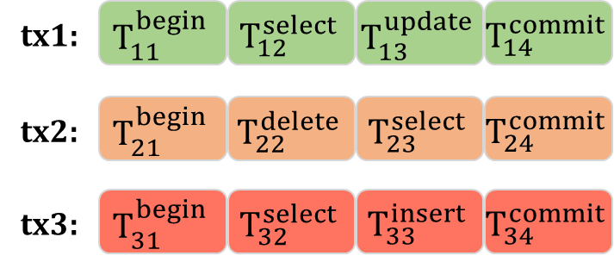


DT² Overview
bug
discrepancy
compatibility issue
Transaction
Generation
Differential Testing
Discrepancy Classification
Step 1
Step 2
Step 3
Notes:
Here is the overview of DT square. First, DT square randomly generates transaction and a submitted order as test case. Then, DT square submits the transaction statements in the submitted order one by one to each DBMS for execution. Finally, DT square compares the execution results of different DBMSs at the same isolation level. If the execution results are different, DT square generates a test report. We manually analyze whether it is a bug. If not, the test case is classified as a compatibility issue.

Slide 14
Database and SQL Generation
Randomly generate data type, data, and constraint for database
Randomly generate SQL statements
+----------------------+-------------------+------------------+
| id (INT PRIMARY KEY) | name (VARCHAR) | balance (DOUBLE) |
+----------------------+-------------------+------------------+
| 1 | Alice | 0 |
| 2 | Bob | 300 |
+----------------------+-------------------+------------------+
SELECT * FROM account;
UPDATE account SET balance=balance–100 WHERE name = “Alice”;
INSERT INTO account VALUES (3, “Mary”, 100);
Notes:
First, DT square randomly generates data type, data, and constraint for initial database, (Click) and randomly generates SQL statements based on SQL syntax supported by tested DBMSs. Since SQL statements usually require some (/pəˈræmɪtəz/) parameters, DT square randomly selects some generated tables and columns to populate the statement (/pəˈræmɪtəz/) parameters.

Slide 15
Transaction Generation
An explicit transaction starts with a BEGIN statement and randomly ends with a COMMIT statement or a ROLLBACK statement
+----------------------+-------------------+------------------+
| id (INT PRIMARY KEY) | name (VARCHAR) | balance (DOUBLE) |
+----------------------+-------------------+------------------+
| 1 | Alice | 0 |
| 2 | Bob | 300 |
+----------------------+-------------------+------------------+
BEGIN;
SELECT * FROM account;
UPDATE account SET balance=balance–100 WHERE name = “Alice”;
INSERT INTO account VALUES (3, “Mary”, 100);
COMMIT;
Notes:
DT square (/ɪkˈsplɪsɪtli/) explicitly starts a transaction (Click) using a BEGIN statement and randomly ends it with a COMMIT statement to apply all changes in the transaction, or a ROLLBACK statement to roll back all changes. SQL statement types in transactions include SELECT, UPDATE, INSERT, and so on.

Slide 16




























Non-determinism Transaction Execution
Execution of concurrent transactions is affected by non-deterministic schedule
tx1:
$$T_{11}^{begin}$$
$$T_{12}^{select}$$
$$T_{13}^{update}$$
$$T_{14}^{commit}$$
tx2:
$$T_{21}^{begin}$$
$$T_{22}^{delete}$$
$$T_{23}^{select}$$
$$T_{24}^{commit}$$
$$T_{11}^{begin}$$
$$T_{12}^{select}$$
$$T_{21}^{begin}$$
$$T_{22}^{delete}$$
$$T_{23}^{select}$$
$$T_{13}^{update}$$
$$T_{14}^{commit}$$
$$T_{24}^{commit}$$
$$T_{11}^{begin}$$
$$T_{12}^{select}$$
$$T_{21}^{begin}$$
$$T_{13}^{update}$$
$$T_{14}^{commit}$$
$$T_{22}^{delete}$$
$$T_{23}^{select}$$
$$T_{24}^{commit}$$
Notes:
A technical issue for transaction differential testing is non-determinism (/dɪˈtɜːmɪnɪzəm/) transaction execution. Given a group of concurrent transactions, (Click) their execution will be affected by non-deterministic (/dɪˌtɜːmɪˈnɪstɪk/) schedule. Therefore, the execution orders of the statements in transactions, which are part of the testing inputs, need to be unified.

Slide 17
































Submitted Order Generation
Randomly generate submitted orders
tx1:
$$T_{11}^{begin}$$
$$T_{12}^{select}$$
$$T_{13}^{update}$$
$$T_{14}^{commit}$$
tx2:
$$T_{21}^{begin}$$
$$T_{22}^{delete}$$
$$T_{23}^{select}$$
$$T_{24}^{commit}$$
Submitted Order Generation
subOrder1:
$$T_{11}^{begin}$$
$$T_{12}^{select}$$
$$T_{21}^{begin}$$
$$T_{13}^{update}$$
$$T_{14}^{commit}$$
$$T_{22}^{delete}$$
$$T_{23}^{select}$$
$$T_{24}^{commit}$$
subOrder2:
$$T_{11}^{begin}$$
$$T_{12}^{select}$$
$$T_{21}^{begin}$$
$$T_{22}^{delete}$$
$$T_{13}^{update}$$
$$T_{14}^{commit}$$
$$T_{23}^{select}$$
$$T_{24}^{commit}$$
subOrder3:
$$T_{11}^{begin}$$
$$T_{12}^{select}$$
$$T_{21}^{begin}$$
$$T_{22}^{delete}$$
$$T_{23}^{select}$$
$$T_{13}^{update}$$
$$T_{14}^{commit}$$
$$T_{24}^{commit}$$
…
Notes:
The submitted order indicates the initial order in which a DBMS accepts statements in concurrent transactions. Concurrent transactions should not violate their isolation level in any execution order, (Click) thus we can enumerate all submitted orders for a group of transactions.

Slide 18









Deterministic Transaction Execution
Execution result
tx1:
$$T_{11}^{begin}$$
tx2:
$$T_{11}^{begin}$$
$$T_{12}^{select}$$
$$T_{21}^{begin}$$
$$T_{22}^{delete}$$
DBMS
$$T_{23}^{select}$$
$$T_{13}^{update}$$
$$T_{14}^{commit}$$
$$T_{24}^{commit}$$
Notes:
To address the issue, we propose a deterministic transaction test protocol. We submit transaction statements in our generated transaction test case to a DBMS one by one in a randomly generated submitted order. For each submitted statement, we set up an individual thread to execute. (Click) If a statement is successfully executed, we record its execution result and add it into the execution order.

Slide 19



Deterministic Transaction Execution
Execution result
tx1:
$$T_{11}^{begin}$$
tx2:
c1
2
3
$$T_{12}^{select}$$
$$T_{11}^{begin}$$
$$T_{21}^{begin}$$
$$T_{12}^{select}$$
$$T_{22}^{delete}$$
block
$$T_{21}^{begin}$$
$$T_{22}^{delete}$$
DBMS
block
$$T_{23}^{select}$$
$$T_{13}^{update}$$
$$T_{14}^{commit}$$
$$T_{24}^{commit}$$
Notes:
If a statement is a SELECT statement, we record its query result. (Click) If a statement does not return its result within two seconds, we determine that the statement is blocked, (Click) and mark it and its transaction as blocked, and place this block point in the execution order.

Slide 20






Deterministic Transaction Execution
Execution result
tx1:
$$T_{11}^{begin}$$
tx2:
c1
2
3
$$T_{12}^{select}$$
$$T_{11}^{begin}$$
$$T_{21}^{begin}$$
$$T_{12}^{select}$$
$$T_{22}^{delete}$$
block
$$T_{21}^{begin}$$
$$T_{13}^{update}$$
$$T_{22}^{delete}$$
DBMS
block
$$T_{14}^{commit}$$
$$T_{23}^{select}$$
$$T_{22}^{delete}$$
$$T_{13}^{update}$$
$$T_{14}^{commit}$$
$$T_{24}^{commit}$$
Notes:
We then skip the blocked statement and its following statements that are in the same transaction, (Click) and execute other unblocked transactions. (Click) A COMMIT statement (/rɪˈzjuːmz/) resumes other blocked transactions. (Click) Then we obtain these (/rɪˈzjuːmd/) resumed transactions, mark them as unblocked, and fetch their corresponding blocked statements’ execution results.

Slide 21


Deterministic Transaction Execution
Execution result
tx1:
$$T_{11}^{begin}$$
tx2:
c1
2
3
$$T_{12}^{select}$$
$$T_{11}^{begin}$$
$$T_{21}^{begin}$$
$$T_{12}^{select}$$
$$T_{22}^{delete}$$
block
$$T_{21}^{begin}$$
$$T_{13}^{update}$$
$$T_{22}^{delete}$$
DBMS
$$T_{14}^{commit}$$
$$T_{23}^{select}$$
$$T_{22}^{delete}$$
$$T_{13}^{update}$$
$$T_{23}^{select}$$
c2
$$T_{14}^{commit}$$
$$T_{24}^{commit}$$
Database state
$$T_{24}^{commit}$$
c1 | c2
2 | 5
Notes:
Then, we scan the submitted order from the beginning and pass the un-submitted statements to the DBMS. (Click) After all transactions complete, (Click) we retrieve the database state, and store it in the execution result.

Slide 22
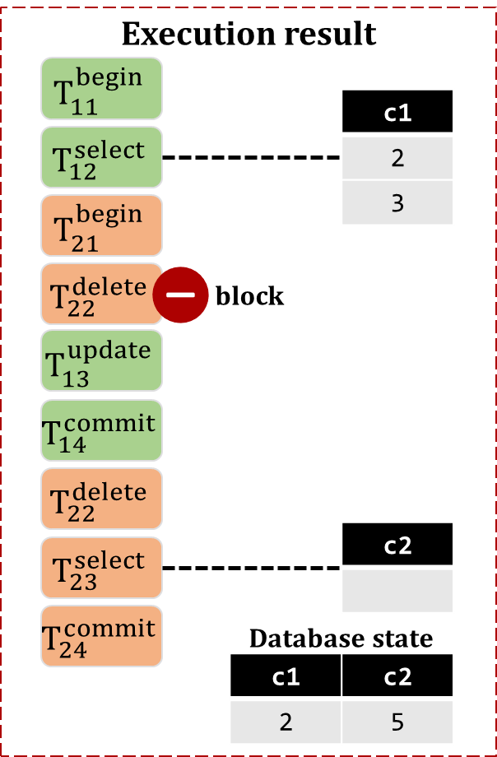

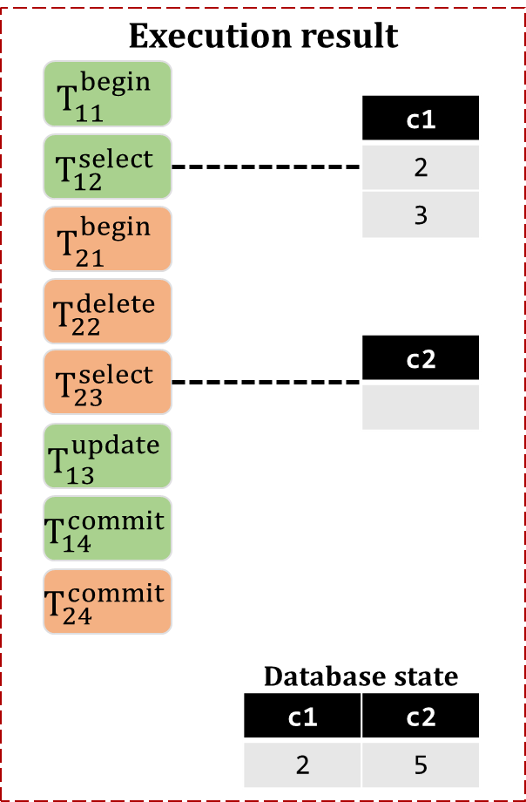








Transaction Differential Testing
$$T_{11}^{begin}$$
$$T_{12}^{select}$$
DBMS1
$$T_{21}^{begin}$$
$$T_{22}^{delete}$$
$$T_{23}^{select}$$
Discrepancy
$$T_{13}^{update}$$
$$T_{14}^{commit}$$
DBMS2
$$T_{24}^{commit}$$
Notes:
DT square executes a group of transactions for each DBMS under a certain submitted order following the test protocol, (Click) and compares their execution results to find discrepancies.

Slide 23
Result Comparison
Inconsistent blocking
Inconsistent Blocking
Notes:
DT square compares the execution results for each statement in the execution order from beginning to end on two DBMSs. Once DT square finds a discrepancy, it will not continue to compare the following statements. For example, for two statements, (Click) if one of them is a blocking point, while the other is not, DT square reports a discrepancy with inconsistent blocking.

Slide 24
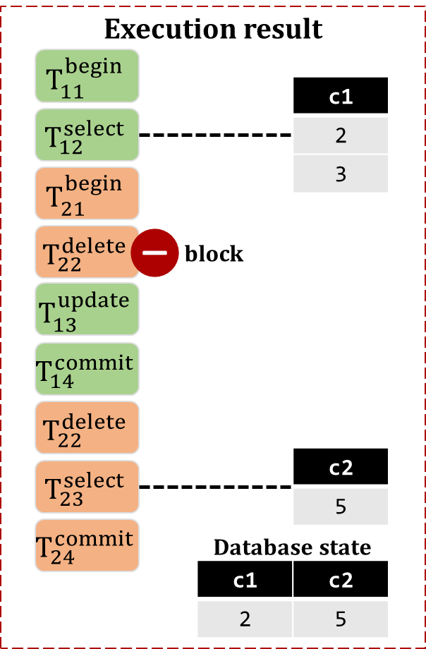
Result Comparison
Inconsistent query result
Inconsistent Query Result
Notes:
For query statements, (Click) if their query results are different, DT square reports inconsistent query result.

Slide 25



Discrepancy Classification
Investigate whether it is a bug or a compatibility issue
SELECT
UPDATE
COMMIT
discrepant test case
specified by document?
yes
development document
compatibility issue
Notes:
If a transaction test case triggers a discrepancy, we investigate whether it is a bug or a compatibility issue. For each detected discrepancy, (Click) we first investigate the transaction implementations from development document provided by related DBMSs to analyze whether a discrepancy is specified by the document. (Click) If the answer is yes, we classify it as a compatibility issue.

Slide 26



Discrepancy Classification
Investigate whether it is a bug or a compatibility issue
SELECT
UPDATE
COMMIT
no
submit
confirm
discrepant test case
specified by document?
potential bug
developer
bug
yes
feature
development document
compatibility issue
Notes:
Once we find that the discrepancy is not specified by the document, (Click) we report it to developers as a potential bug. (Click) If developers confirm that the discrepancy is a compatibility issue, we will re-classify it as a compatibility issue, (Click) otherwise, we re-classify it as a bug.

Slide 27
Evaluation
Evaluate DT² on three widely-used, MySQL-compatible DBMSs
DBMS | Rank | GitHub Star | Isolation Levels
 |  |  | RU | RC | RR | SER
MySQL | 2 | 7.6k | ✓ | ✓ | ✓ | ✓
MariaDB | 3 | 4.2k | ✓ | ✓ | ✓ | ✓
TiDB | 112 | 30.9k |  | ✓ | ✓
RU: Read Uncommitted RR: Repeatable Read
RC: Read Committed SER: Serializable
Notes:
To demonstrate the effectiveness of DT square, we evaluate it on three widely-used MySQL-compatible DBMSs, MySQL, MariaDB and TiDB. MySQL and MariaDB support four isolation levels, that is, Read Uncommitted, Read Committed, Repeatable Read, and Serializable. While TiDB supports Read Committed and Repeatable Read.

Slide 28
Bug Results
DT² has detected 16 unique bugs, including 6 unknown bugs
DBMS | Total | Confirmed |  | Unconfirmed | False Positive
 |  | Unknown | Duplicate
MySQL | 4 | 0 | 2 | 0 | 2
MariaDB | 7 | 4 | 1 | 2 | 0
TiDB | 5 | 2 | 3 | 0 | 0
Total | 16 | 6 | 6 | 2 | 2
Notes:
(Click) DT square has detected 16 unique bugs, (Click) among which 6 bugs have been verified as previously-unknown bugs, (Click) and 6 bugs are duplicate.

Slide 29
MariaDB#27992
MariaDB does not UPDATE primary keys atomically
Init
c(PK)
3
tx1 | tx2
BEGIN; | BEGIN;
UPDATE t SET c = 2; | DELETE FROM t WHERE TRUE;
UPDATE t SET c = 1; | SELECT * FROM t FOR UPDATE;
COMMIT; | COMMIT;
c(PK)
2
block
c(PK)
c(PK)
1
https://jira.mariadb.org/browse/MDEV-27992
Notes:
We show a simplified test case that triggers a new transaction bug in MariaDB at all isolation levels detected by DT square. The initial table has one primary key column with record three. (Click) Transaction one first updates value to two, (Click) while transaction two (/ˌsɪm(ə)lˈteɪniəsli/) simultaneously deletes all rows and is blocked. (Click) Transaction one then updates value (Click) and is committed. After that, transaction two is resumed (Click) and queries the database state.

Slide 30
MariaDB#27992
MariaDB does not UPDATE primary keys atomically
Init
c(PK)
3
tx1 | tx2
BEGIN; | BEGIN;
UPDATE t SET c = 2; | DELETE FROM t WHERE TRUE;
UPDATE t SET c = 1; | SELECT * FROM t FOR UPDATE;
COMMIT; | COMMIT;
c(PK)
2
c(PK)
c(PK)
1
Expected Database State
Actual Database State
c(PK)
c(PK)
1
Incorrect database state
https://jira.mariadb.org/browse/MDEV-27992
Notes:
After transaction two is committed, the database states of MariaDB and TiDB are different. (Click) As expected, TiDB returns the empty table due to the DELETE operation in transaction two. However MariaDB returns value one. So DT square detects this inconsistent database state. The root cause of this bug is that MariaDB does not UPDATE primary keys atomically. This bug will be fixed in the upcoming release version.

Slide 31
Compatibility Issue Results
DT² has detected 92 unique compatibility issues, including 88 transaction-related compatibility issues
DBMS | Total | Transaction Related |  |  |  | Transaction Unrelated
 |  | RU | RC | RR | SER
MySQL - MariaDB | 10 | 0 | 0 | 4 | 4 | 2
MySQL - TiDB | 39 | - | 11 | 28 | - | 0
MariaDB - TiDB | 43 | - | 11 | 30 | - | 2
Total | 92 | 0 | 22 | 62 | 4 | 4
Notes:
(Click) DT square has also detected 92 unique compatibility issues, (Click) including 88 transaction-related, (Click) and 4 transaction unrelated. We mainly study these 88 transaction-related compatibility issues.

Slide 32
Root Cause
Compatibility issues are caused by different lock mechanism, snapshot creation, and aborted transaction
DBMS | Total | Root Cause
 |  | Lock mechanism | Snapshot creation | Aborted transaction
MySQL - MariaDB | 8 | 8 | 0 | 0
MySQL - TiDB | 39 | 34 | 3 | 2
MariaDB - TiDB | 41 | 36 | 3 | 2
Total | 88 | 78 | 6 | 4
Notes:
From these transaction-related compatibility issues, (Click)we identify three root causes, that is, inconsistent lock (/ˈmekənɪzəmz/) mechanisms, inconsistent snapshot creation, and the aborted transaction is different when a deadlock occurs.

Slide 33
Inconsistent Lock Mechanisms (78/88)
Lock rows at Repeatable Read
TiDB: if WHERE condition’s evaluated value is true
MySQL and MariaDB: no matter WHERE condition’s evaluated value
Init
c1 | c2
2 | null
tx1 | tx2
BEGIN; | BEGIN;
UPDATE t SET c1 = 1, c2 = 1; | UPDATE t SET c1 = 3 WHERE c2;
COMMIT; | COMMIT;
tx1 | tx2
BEGIN; | BEGIN;
UPDATE t SET c1 = 1, c2 = 1; | UPDATE t SET c1 = 3 WHERE c2;
COMMIT; | COMMIT;
block
Notes:
Most compatibility issues are due to inconsistent lock mechanisms. Here is an example at Repeatable Read for MySQL and TiDB. The initial table contains only one row with record two and null. (Click) Transaction one firstly updates two columns’ value to one, and transaction two tries to update the row where column c two is not NULL. In TiDB, transaction two first evaluates the WHERE condition on the first row to be FALSE, so it is not blocked. (Click) However, in MySQL, transaction two is blocked. (Click) Then transaction one is committed. (Click) In MySQL, transaction two is resumed and updates the row successfully.

Slide 34
Inconsistent Lock Mechanisms (78/88)
Lock rows at Repeatable Read
TiDB: if WHERE condition’s evaluated value is true
MySQL and MariaDB: no matter WHERE condition’s evaluated value
Init
c1 | c2
2 | null
tx1 | tx2
BEGIN; | BEGIN;
UPDATE t SET c1 = 1, c2 = 1; | UPDATE t SET c1 = 3 WHERE c2;
COMMIT; | COMMIT;
tx1 | tx2
BEGIN; | BEGIN;
UPDATE t SET c1 = 1, c2 = 1; | UPDATE t SET c1 = 3 WHERE c2;
COMMIT; | COMMIT;
block
Notes:
So this compatibility issue is caused by inconsistent lock mechanisms in two DBMSs, which affects their execution order of transactions, as shown in red (/'ærəus/) arrows.

Slide 35


Inconsistent Snapshot Creation (6/88)
Create snapshot at Repeatable Read
TiDB: at the BEGIN statement
MySQL and MariaDB: at the first SELECT statement
tx1: BEGIN;
tx2: BEGIN;
tx2: DELETE FROM t WHERE c1 = 1;
tx2: COMMIT;
tx1: SELECT * FROM t;
tx1: COMMIT;
Init
TiDB
c1 | c2
1 | 1
TiDB: SELECT
c1 | c2
1 | 1
MySQL
MySQL: SELECT
c1 | c2
Notes:
Six compatibility issues are caused by inconsistent snapshot creation location at Repeatable Read. Here is an example for MySQL and TiDB. The initial table contains one row with record one, one. Transaction one first starts. Then, transaction two starts, deletes the row where column c one is one and is committed. Finally, transaction one retrieves the database with SELECT statement. (Click) TiDB returns the result one, one. Whereas, MySQL returns an empty set. (Click) Because TiDB reads the snapshot established in the BEGIN statement in transaction one. MySQL reads the snapshot created by the first SELECT statement.

Slide 36
Inconsistent Snapshot Creation (6/88)
Create snapshot at Repeatable Read
TiDB: at the BEGIN statement
MySQL and MariaDB: at the first SELECT statement
tx1: BEGIN;
tx2: BEGIN;
tx2: DELETE FROM t WHERE c1 = 1;
tx2: COMMIT;
tx1: SELECT * FROM t;
tx1: COMMIT;
Init
TiDB
c1 | c2
1 | 1
TiDB: SELECT
c1 | c2
1 | 1
Transaction specification can alleviate compatibility issues.
MySQL
MySQL: SELECT
c1 | c2
Notes:
After transaction two is committed, the database states are consistent, that is an empty set. So this compatibility issue is caused by inconsistent snapshot in two DBMSs, which affects their query results in transactions. As a result, compatibility issues among compatible DBMSs are common. Although isolation levels have been clearly specified in literatures, transaction execution behaviors can be seriously affected by various design choices in different DBMSs, such as, lock mechanisms and snapshot creation. (Click) Transaction specification can (/əˈliːvieɪt/) alleviate these compatibility issues.

Slide 37
Consequence
Compatibility issues can cause inconsistent database states and query results
DBMS | Total | Consequence
 |  | Database state | Query result | No difference
MySQL - MariaDB | 8 | 4 | 0 | 4
MySQL - TiDB | 39 | 16 | 9 | 14
MariaDB - TiDB | 41 | 17 | 9 | 15
Total | 88 | 37 | 18 | 33
DBMS application developers should be aware of these compatibility issues when migrating their applications among DBMSs.
Notes:
For the 88 transaction-related compatibility issues, (Click) 66 compatibility issues can cause inconveniences among DBMSs, that is, inconsistent database states and query results. The remaining 22 compatibility issues can cause inconsistent blocked statements, but do not affect the final execution results. (Click) Therefore, DBMS application developers should be aware of these compatibility issues when migrating their applications among DBMSs.

Slide 38

Conclusion
Propose a differential testing approach for transaction
Detect 16 unique bugs, including 6 unknown bugs
Find 92 compatibility issues, including 88 transaction-related compatibility issues
Tool and Data in GitHub
https://github.com/tcse-iscas/DT2.
Notes:
In conclusion, we propose a differential testing approach for transaction to detect transaction discrepancies among database management systems. The evaluation on real-world DBMSs shows that our tool DT square is effective. Our tool and data can be found in GitHub. That’s all.

Slide 39

THANK YOU!

