Slide 1


DisTA: Generic Dynamic Taint Tracking for Java-Based Distributed Systems
The 52nd Annual IEEE/IFIP International Conference on Dependable Systems and Networks
Dong Wang, Yu Gao, Wensheng Dou, Jun Wei
Institute of Software, Chinese Academy of Sciences University of Chinese Academy of Sciences

Slide 2
Dynamic taint tracking (DTA)
Any data can be set as the taint source point to be tainted.
Any program point can be set as the taint sink point to check whether a data is tainted.
Program
Program
data1
check(data4)
data2
data5
taint(data3)
data6

Slide 3
DTA in distributed systems
data1
Node 1
data2
taint(data3)
Inter-node taint propagation
Message(data3)
Node 2
data4
check(data6)
data5

Slide 4



DTA use scenarios
Program debugging: taint the single variable and observe its propagation.
Privacy leakage detection: taint every sensitive variable to check if they are leaked to untrusted places.
Thread A
Thread B
Shared variable
password
Untrusted node
account

Slide 5

Existing DTA tools for distributed systems
Kakute^{[1]}
Over-taint the whole value
Imprecise!
Value = sensitive+non-sensitive
Yarn
Node
RDD
Shuffle methods
RDD
Unsound!
HTTP
Password
Cannot used for other systems
Lose taint information of Password
Not generic!
[1] Jiang et al. Kakute: A precise, unified information flow analysis system for big-data security. ACSAC ’17.

Slide 6
Existing DTA tools for distributed systems
Taint-Exchange^{[1]} modifies Linux system calls to mark whether every bit of data is tainted.
Not generic for use scenarios requiring multiple taints.
Not support Java programs.
FlowDist^{[2]} requires users to manually specify message related methods to map data flows between nodes.
Not sound for unspecified methods.
[1] Zavou et al. Taint-Exchange: A generic system for cross-process and cross-host taint tracking. Security Workshop ’11.
[2] Fu et al. FlowDist: Multi-staged refinement-based dynamic information flow analysis for distributed software systems. USENIX Security ’21.

Slide 7
DisTA: DTA for Java-based distributed systems
Generic: can be applied in different use scenarios for different distributed systems
Sound: not drop any taint
Precise: never over-taint

Slide 8
Overview
Distributed system (DS)
Java runtime environment (JRE)
Native library

Slide 9
Overview
Node 1
Node 2
Instrumented DS
Instrumented DS
Instrumented JRE
Instrumented JRE
Native library
Native library

Slide 10
Overview
Node 1
Node 2
Instrumented DS
Taint
Map
Instrumented DS
Instrumented JRE
Instrumented JRE
Message-related JNI methods
Message-related JNI methods
Native library
Native library

Slide 11
Motivating example
Node 1
Vote vote = new Vote(“Vote Node 2”);
SendWorker(Vote data) {
Socket client = new Socket(Node2_ADDRESS);
OutputStream output = client.getOutputStream();
int ret = output.write(data.toBytes());
}
Source
Node 2
RecvWorker(byte[] data) {
Socket server = serverSocket.accept();
InputStream input = client.getInputStream();
input.read(data);
}
Notification n = new Notification(data);
Distributed system
Taint
= tag
Taint
Taint
= tag
Taint
Taint
= tag
Sink
Taint
// java.net.SocketOutputStream.java
write(byte[] b) {
socketWrite0(…, b, …);
}
native socketWrite0(…, byte[] b, …);
// java.net.SocketInputStream.java
read(byte[] b) {
socketRead0(…, b, …);
}
native socketRead0(…, byte[] b, …);
Taint
= tag
Taint
JRE
Taint
= tag
Taint
// solaris\native\java\net\SocketOutputStream.c
Java_java_net_SocketOutputStream
_socketWrite0(jbyteArray data) {
NET_SEND(data);
}
// solaris\native\java\net\SocketInputStream.c
Java_java_net_SocketInputStream
_socketRead0(jbyteArray data) {
NET_READ(data);
}
Native library
We need to instrument methods to propagate taint tags to other nodes!
Operating system

Slide 12
Design choices
What granularity of the taint tags?
Distributed system
String
Vote vote = new Vote(“Vote Node 2”);
SendWorker(Vote data) {
Socket client = new Socket(Node2_ADDRESS);
OutputStream output = client.getOutputStream();
int ret = output.write(data.toBytes());
}
Vote object
Byte array
// java.net.SocketOutputStream.java
write(byte[] b) {
socketWrite0(…, b, …);
}
native socketWrite0(…, byte[] b, …);
JRE
Which layer to propagate inter-node taints?
// solaris\native\java\net\SocketOutputStream.c
Java_java_net_SocketOutputStream
_socketWrite0(jbyteArray data) {
NET_SEND(data);
}
Native library

Slide 13
Design choices for DisTA
DisTA instruments JNI methods in JRE to be sound and generic for different distributed systems.
DisTA tracks inter-node taint in the single byte granularity to be precise and generic for different use scenarios.
Distributed system
Client.write()
RDD.suffle()
Vote
String
RDD
JRE methods
SocketChannel.send()
HTTP.send()
HTTPContent
ByteBuffer
// java.net.SocketOutputStream.java
native socketWrite0(…, byte[] b, …);
byte[]
JNI methods in JRE

Slide 14
Instrumentation details
native socketWrite0(…, byte[] b, …);
Node 1
Only data in stream-oriented methods are in the form of the byte array!
b1
b2
Data
Taints
t1
t2
Serialize
b1
Serialized taint
b2
Serialized taint
Transfer
Node 2
b1
Serialized taint
Deserialize
Data
Taints
t1
b1

Slide 15
Instrument packet-oriented methods
native send(DatagramPacket packet);
Node 1
packet
b1
b2
Data
Taints
t1
t2
b1
b2
Data
Serialize
newPacket
b1
Serialized taint
b2
Serialized taint
Taints
t1
t2
Data
Transfer
Node 2
packet
newPacket
b1
Data
b1
Serialized taint
Data
Deserialize
Taints
t1
Taints
t1
Data
b1

Slide 16
Instrument direct-buffer-oriented methods
DirectBuffer maintains a physical memory region to store data.
// IOUtil.java
int writeFromNativeBuffer(ByteBuffer bb) {
nd.write(fd, ((DirectBuffer)bb.address()), …);
}
// FileDispatcherImpl.java
native int write0(FileDescriptor fd, long address, …);
DisTA cannot get the data variable and its taint!

Slide 17
Instrument direct-buffer-oriented methods
class DirectBuffer{
long address;
+ Taint[] taints;
ByteBuffer put(byte x, Taint x_t) {
unsafe.putByte(ix(nextPutIndex()), ((x)));
+ this.taints.add(x_t);
return this;
}
}

Slide 18
Instrument direct-buffer-oriented methods
Node 1
DirectBuffer
b1
b2
Taints
t1
t2
Addr
get()
b1
Serialized taint
b2
Serialized taint
Taints
t1
t2
Addr
put()
newBuffer
Transfer
Node 2
Addr
DirectBuffer
newBuffer
get()
Addr
b1
Serialized taint
put()
Taints
t1
b1
Taints
t1

Slide 19
Instrumented methods
We inspect JRE source code and finally instrument 23 native methods.
Class | Native method
SocketInputStream | socketRead0
SocketOutputStream | socketWrite0
PlainDatagramSocketImpl | send
 | receive0
 | peek
FileDispatcherImpl | read0
 | readv0
 | write0
 | writev0
DatagramDispatcher | read0
 | readv0
 | write0
 | writev0

Slide 20
Problems in DisTA runtime
Mismatched serialized taint length
Node 1
Packet
256 bytes
526 bytes
b1
Serialized taint
b2
Serialized taint
Data
Transfer
Node 2
Packet
Data
b1
Corrupted taint
Receive ? bytes

Slide 21
Problems in DisTA runtime
Large bandwidth usage when transferring repeated taints
Node 1
256 bytes
256 bytes
256 bytes
256 bytes
b1
Taint 1
b2
Taint 1
b3
Taint 1
b4
Taint 1
Data
Transfer
1028 bytes
Node 2
b1
Taint 1
b2
Taint 1
b3
Taint 1
b4
Taint 1
Data

Slide 22
DisTA runtime: taint map
Node 1
Node 2
Local Taints
Local Taints
b1
b2
② Store GID
b1
b1
1
b2
1
b1
1
t1
t1
③ Transfer
t1
⑤ Store Taint
GID
Global Taints
④ Request Taint
① Request GID
1
t1
Taint Map

Slide 23
DisTA runtime: taint map
Taint map makes the transferred data packets in the fixed length.
Node 1
Packet
4 bytes
4 bytes
b1
1
b2
2
Data
Transfer
Node 2
Packet
Data
b1
1
4 bytes

Slide 24
DisTA runtime: taint map
Taint map reduces the bandwidth usage for repeated taints.
Node 1
Node 2
Local Taints
Local Taints
b1
b2
b3
b4
b1
b2
b1
1
b2
1
b1
1
b2
1
t1
t1
t1
t1
t1
t1
20 bytes
4 bytes
4 bytes
t1
256 bytes
GID
Global Taints
t1
256 bytes
1
t1
Taint Map

Slide 25
Evaluation
RQ1(Soundness and precision): Is DisTA sound and precise in inter-node taint tracking?
RQ2(Generality): Is DisTA easy to use in different distributed systems for different use scenarios?
RQ3(Overhead): How is DisTA’s performance overhead?

Slide 26
Micro benchmark
We implement 29 cases in different network communication ways.
Name | Description | # cases
JRE Socket | JRE standard TCP | 22
JRE Datagram | JRE standard UDP | 1
JRE SocketChannel | JRE NIO TCP | 1
JRE DatagramChannel | JRE NIO UDP | 1
JRE AsyncSocketChannel | JRE AIO | 1
JRE HTTP | JRE HTTP | 1
Netty Socket | 3rd-party TCP | 1
Netty DatagramSocket | 3rd-party UDP | 1
Netty HTTP | 3rd-party HTTP | 1
Total |  | 29

Slide 27
Real-world distributed systems
We select 5 popular real-world distributed systems with common workloads.
System | Workload
ZooKeeper | Leader election
MapReduce/Yarn | Executing Pi
ActiveMQ | Message distribution
RocketMQ | Message distribution
Hbase+ZooKeeper | Query data

Slide 28
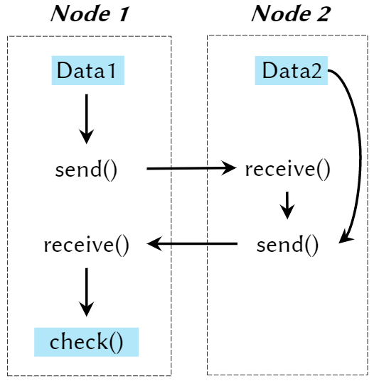
RQ1: Soundness and precision
We design different taint tracking scenarios for different cases, and check if there exist expected and unexpected taints at sink points.
Type | System | # Sources | # Sinks
Specific data trace | ZooKeeper | 3 | 1
 | MapReduce/Yarn | 1 | 1
 | ActiveMQ | 1 | 1
 | RocketMQ | 1 | 1
 | Hbase+ZooKeeper | 1 | 1
System I/O monitor | ZooKeeper | 18 | 347
 | MapReduce/Yarn | 20 | 2,235
 | ActiveMQ | 6 | 371
 | RocketMQ | 9 | 408
 | Hbase+ZooKeeper | 35 | 1,166
DisTA can correctly obtain every taint at pre-determined sink points!

Slide 29
RQ2: Generality
For different systems, we only need to modify 10 LOC on average in their launch script files.
For different scenarios, we only need to specify source and sink points in two configuration files.
1. JAVA="$INST_JAVA_HOME/bin/java"
2. SERVER_JVMFLAGS="-Xbootclasspath/a:DisTA.jar -javaagent:DisTA.jar"
3. CLIENT_JVMFLAGS="-Xbootclasspath/a:DisTA.jar -javaagent:DisTA.jar"
// taint-sources.txt
zookeeper/FileTxnLog.readZxid()
// taint-sinks.txt
Slf4j/Logger.info(String)
DisTA is easy-to-use in different use scenarios for different systems!

Slide 30
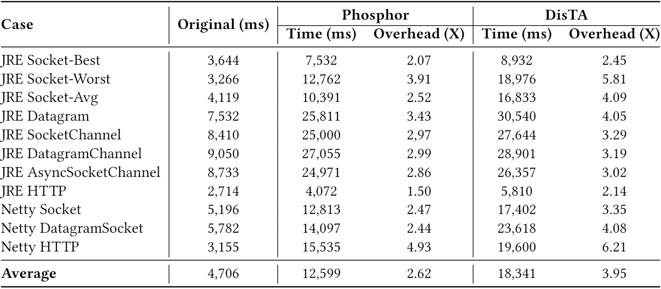

RQ3: Overhead
DisTA causes 3.95X - 2.62X = 1.33X overhead compared with pure intra-node taint tracking!

Slide 31
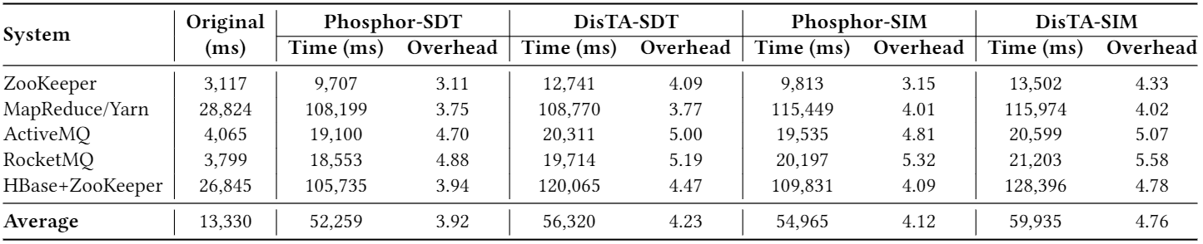
RQ3: Overhead
DisTA causes 4.76X - 4.12X = 0.64X overhead for inter-node taint tracking in real-world distributed systems!

Slide 32
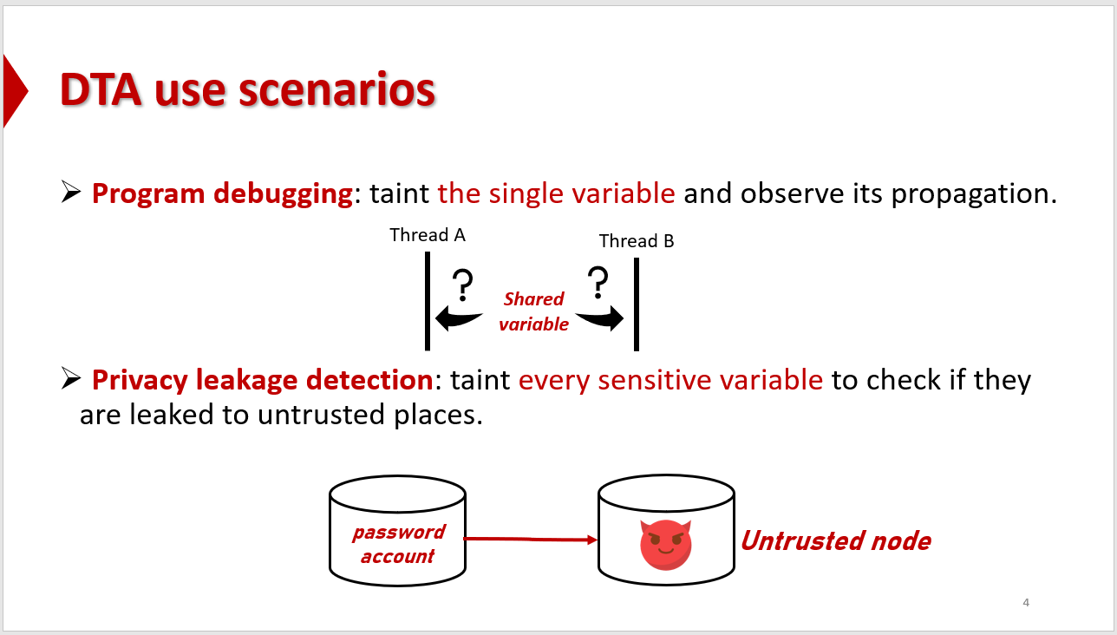
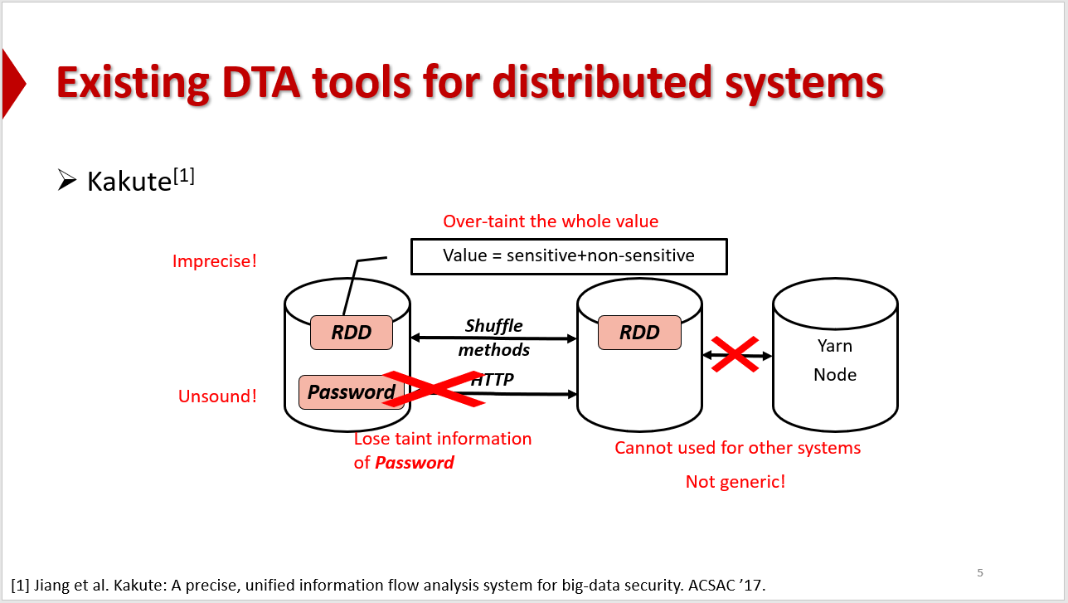
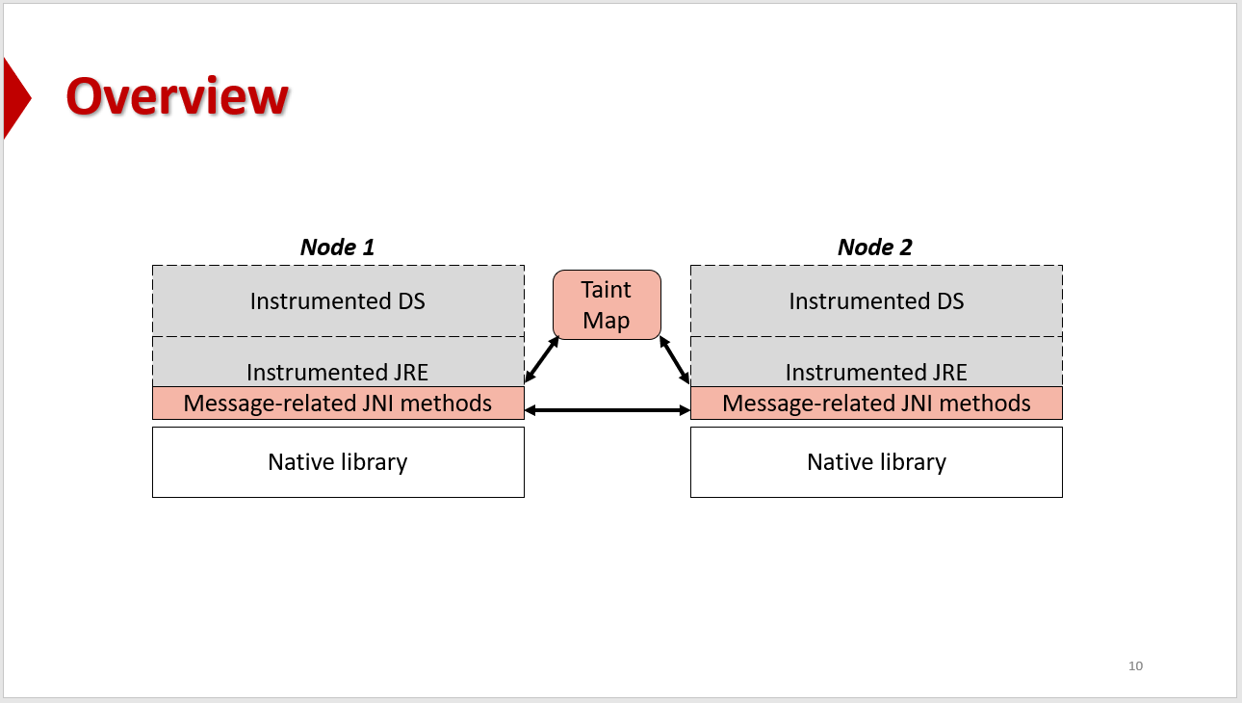
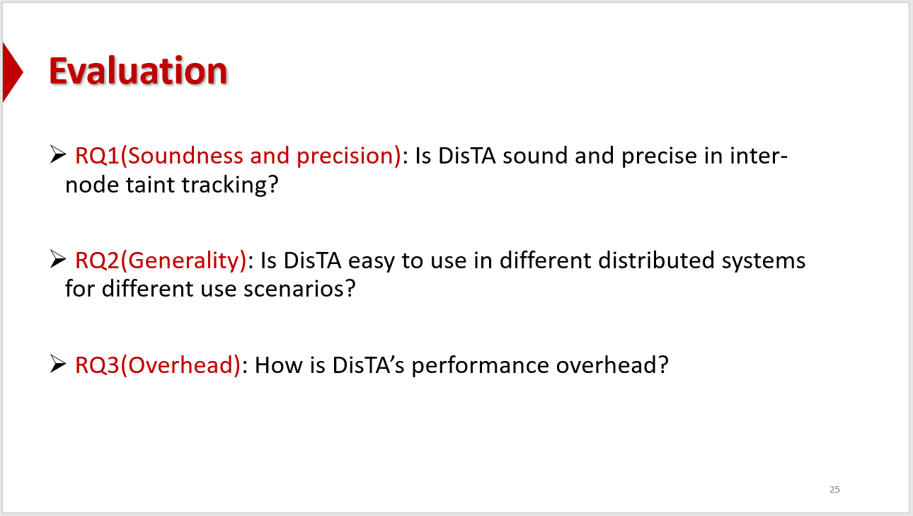
Conclusion

Slide 33


For more information…
DisTA tool
DisTA paper
Contact: wangdong18@otcaix.iscas.ac.cn

Slide 34

THANK YOU!

