Slide 1


Is Spreadsheet Ambiguity Harmful? Detecting and Repairing Spreadsheet Smells due to Ambiguous Computation
Wensheng Dou¹, Shing-Chi Cheung², Jun Wei¹
¹Institute of Software, Chinese Academy of Sciences
²The Hong Kong University of Science and Technology
Notes:
Thanks for nice introduction. Good afternoon, everyone.
I’m wensheng, from Chinese Academy of Sciences. Today I am going to talk about ambiguous computation smell detection and repairing on spreadsheets. This is a joint work with Shing-Chi Cheung and Jun Wei.
/*A major challenge in spreadsheet smell detection is how to decide if a cell’s value or formula is correct or not. In this talk, we’re going to propose a new approach to address this problem. */

Slide 2

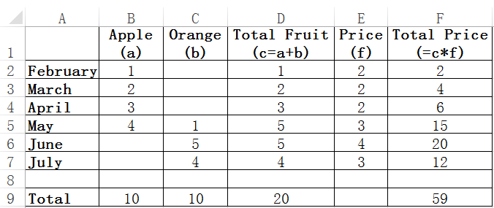
Motivating example
The spreadsheet contains incorrect formulas
Update on the incorrect formulas could cause faulty values in the spreadsheet
Should be 18
4→ 6
4→ 6
… a real example extracted from EUSES spreadsheet corpus
Notes:
First, Let’s look at the spreadsheet, this spreadsheet is extracted from EUSES spreadsheet corpus. This spreadsheet is used to compute the harvest of fruits for each month.
If we look into this spreadsheet carefully, we will find that all the cells in Column D and Column F have correct values now.
But in fact, some cells in these two columns contain incorrect formulas, and they are fault prone.
For example, a user needs to change the harvest of oranges in July from 4 to 6. According to semantics, the total fruit equals the sum of apples and oranges, so the total fruit in July becomes 6.
The total price should be computed by Total Fruit times Price, so the total price in July should be 18 now. But we notices that it is still 12. It’s not easy for end users to notice that this small update will make the spreadsheet incorrect.

Slide 3
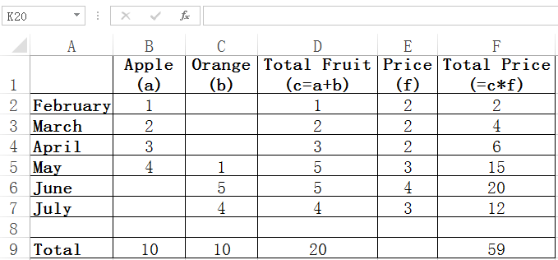
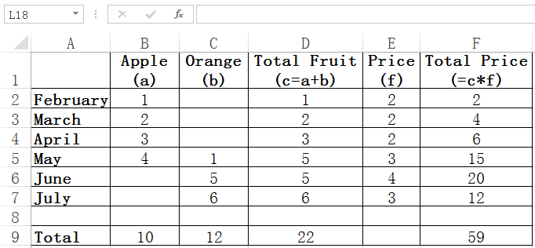
Problems
Screen shot of the spreadsheet before and after the change
No warning is issued by Excel
Q1: Which cells contain incorrect formulas?
Q2: Which cells’ values are incorrect?
Notes:
This is the screen shot of the spreadsheet before and after the last change, and we can see that there is no warning issued by Excel.
This example raises two questions, which are related to the quality of spreadsheets.
The first question is: in a spreadsheet, which cells contain incorrect formulas?
The second question is: in a spreadsheet, which cells’ values are incorrect?

Slide 4



Key challenge - No oracle!
It is hard to identify which cells contain incorrect formulas or values
Require human judgments or specifications
Notes:
But it is difficult to identify which cells contain incorrect formulas or values, because, there is no oracle which can be used to judge whether they are correct or not.
Usually, this process will require human judgments, or some computational specifications of the spreadsheets.

Slide 5
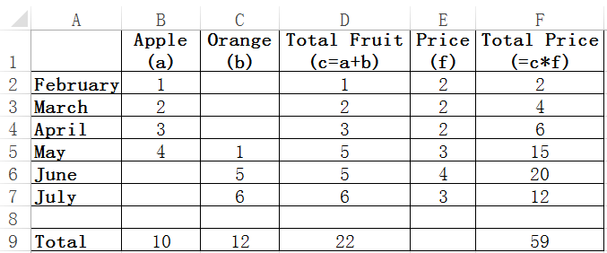
Methodology
Total Fruit = Apple + Orange
Total Price =
Total Fruit * Price
Cell array
Cells are often grouped in a row or column with the same intended computation
We call this kind of group as a cell array
Notes:
We try to address this problem from another perspective.
Our idea is that, cells with the same intended computation are often grouped together in a row or column. Let’s look at our example. The cells in the column F have the same computational semantics, so total price should be total fruit times Price for each month.
In this work, we call this kind of group as a cell array
The Column D is another cell array, it shows that Total fruit should be the sum of apples and oranges in each month.

Slide 6
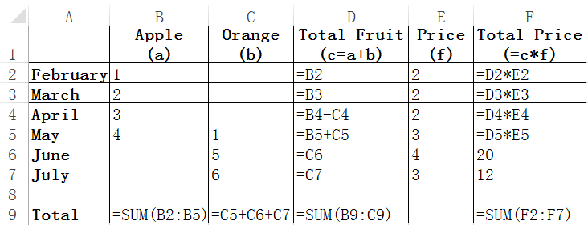
Methodology
The intended computation is ambiguous when not all the cells in a cell array follow the same formula pattern
The cell array suffers from ambiguous computation smells
Notes:
This screen shot shows the cells’ formulas in our example.
For the cell array in the column F, the first four cells have correct formulas, but the last two cells only have plain values, and without computations. We say that this cell array suffers from ambiguous computation smell, because the last two cells don’t have explicit computational semantics.
For the Column D, these cells have the same computational semantics, so all the cells should follow the same formula pattern. But we can find that there are four formula patterns. We say this cell array suffers from ambiguous computation smells, too.

Slide 7
Three smell types
18
Ambiguous computation smells
Missing formula smells
Inconsistent formula smells
Conformance errors
Notes:
In this work, we identify three types of ambiguous computation smells.
If a cell array contains cells with plain values, it suffers from missing formula smells, the cell array in the column F suffers from this kind of smells.
If a cell array contains more than one formula pattern., it suffers from inconsistent formula smells., the cell array in the column D suffers from this kind of smells.
If some cells in a cell array have incorrect values, we say that it suffers from conformance errors. The cell F7 suffers from this kind of smells.
/*A cell array may suffer from more than one type of smells, such as, column F suffers from missing formula smell and conformance error. */

Slide 8

How to get the intended computation?
Notes:
The key question is, how to get the intended computation for a cell array? For the cell array in column F, what should be the intended computation.

Slide 9
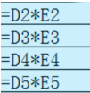
Finding candidates from existing formulas
= D_{i}*E_{i}
Notes:
First, we can start from the existing formulas. For the cell array in the column F, we can find the first four cells use the formula pattern Di times Ei. So it could be a good candidate for the intended computation.

Slide 10

Gaining confidence
= D_{i}*E_{i}
Q: Is it likely the intended computation?
A: Yes if it computes the values of the majority of cells
5
4
20 = D6*E6
Notes:
But is it correct? How do we know the formula pattern is the intended computation?
The answer is that, if the formula pattern can compute the values of the majority of the cells, it should be likely the intended computation.
For this cell array in the column F, we can see that the first four cells can be computed by Di times Ei.
The fifth cell’s value is 20, and it can be computed by D6 times E6. Even though there is no computation in this cell, the value for this cell is correct.
So the formula pattern Di times Ei should be the intended computation.

Slide 11

Conformance error detection
= D_{i}*E_{i}
Assumption:
The values of cells are more likely correct than not
6
3
12 ≠ D7*E7
Likely an error
Notes:
Also, we can see that, the last cell can’t be computed by Di times Ei. In this case, this cell’s value is more likely wrong.
Here, we assume that the values in a cell array are more likely correct. So this exception would be an error.
We use this heuristic to detect conformance errors in the cell arrays.

Slide 12
What if we find multiple formula patterns?
= B_{i} ,when C_{i} = 0
= B_{i} – C_{i}
= B_{i} + C_{i}
= C_{i} ,when B_{i} = 0
Notes:
What if we find multiple formula patterns in a cell array?
For the column D, we can see that, there are four formula patterns. For the first two cells, when there are no oranges, we only compute apples. For the the third cell, the formula pattern is apples minus oranges, and for the fourth cell, we sum apples and oranges up. For the last two cells, we see that, when there are no apples, we only compute oranges.

Slide 13
Synthesizing intended formula pattern
Adapt component-based program synthesis [1][2] to find the intended formula pattern
Constraints: Existing formula patterns, values
Key challenge
Cells with faulty formulas make program synthesis fail
We cannot distinguish faulty formulas from correct ones
Example
= B_{i} , when C_{i} = 0
= B_{i} – C_{i}
= B_{i} + C_{i}
= C_{i} , when B_{i} = 0
Which one should we use?
[1] S. Jha, S. Gulwani, S.A. Seshia, and A. Tiwari. Oracle-guided component-based program synthesis. In ACM/IEEE 32nd International Conference on Software Engineering (ICSE), pages 215–224. 2010.
[2] S. Gulwani, S. Jha, A. Tiwari, and R. Venkatesan, Synthesis of loop-free programs. In ACM SIGPLAN Conference on Programming Language Design and Implementation (PLDI), pages 62–73. 2011.
Notes:
Then we can adapt component-based program synthesis to generate the target formula pattern. We use the existing formula patterns and the values in the cell array as constraints for the target formula pattern.
/*Program synthesis only uses primitive components and could find a formula pattern that satisfies certain constraints.
In our cases, specifications and input-output pairs are the constraints. */
The key problem is that, in a cell array, some cells have faulty formulas, which will make program synthesis fail, and we can’t distinguish these faulty cells from correct ones.
For example, only one of the second and third formula patterns should be correct. We don’t know which one should be used in program synthesis.

Slide 14
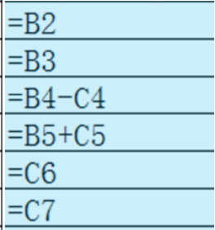
Classify formulas into compatible groups
A compatible group always leads to a possible synthesized formula pattern
Group 1
= B_{i} , when C_{i} = 0
= B_{i} + C_{i}
= C_{i} , when B_{i} = 0
Group 2
= B_{i} , when C_{i} = 0
= B_{i} - C_{i}
= B_{i}+C_{i}
= B_{i}-C_{i}
Notes:
In order to solve this problem, we classify existing formula patterns into compatible groups. In each group, for every possible input, all the formulas yield the same output.
For each compatible group, we can always synthesize a possible formula pattern.
For example, we can generate two groups for our example, and for group one, we can generate Bi + Ci as the target formula pattern. It can subsume all the formula patterns in group 1.
For group 2, we can generate Bi-Ci as the target formula pattern, and it can subsume the two formula patterns in group 2.
Then we can see that the formula pattern Bi+Ci is compatible with all the cells except one. And the formula pattern Bi-Ci is only compatible with half of the cells in the cell array, so we choose the formula pattern Bi+Ci as the final result.

Slide 15
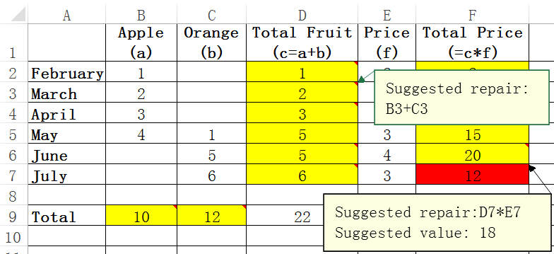
Tool implementation
AmCheck
Apache POI library – Manipulate spreadsheets
Annotate the smells in the resulted spreadsheets
Notes:
We implement our tool in Java, and use Apache poi library to read and write the spreadsheets.
Finally, we annotate the detected smells in the spreadsheets.
This is a screen shot for our motivating example, we annotate the smelly cell arrays with yellow background, we add comments about the suggested repairs, to the cells with incorrect formulas. We annotate the cells with conformance errors with red background, and give the suggested formula repairs and values.

Slide 16
Evaluation
RQ1: How common are ambiguous computation smells in real-life spreadsheets?
RQ2: Can AmCheck detect and repair ambiguous computation smells precisely?
RQ3: Do end users find AmCheck useful for improving the quality of their spreadsheets?
RQ4: Are ambiguous computation smells harmful?
Experiment 1
Subject: EUSES
Method: Manually validate by ourselves
Experiment 2
Subject: 10 real-life spreadsheets
Method: Interview with users
Notes:
For the evaluations, we try to answer four research questions.
First, we want to know how common are these kinds of smells in real-life spreadsheets, and the second question is, can our tool detect and repair these smells precisely. For these two questions, we evaluate them on EUSES corpus, which is the common subject in spreadsheet research. And we manually checked the detected results.
For the third question, we try to find out how useful is our tool for improving the quality of spreadsheets, and are these smells harmful. We pick 10 real-life spreadsheets, and interviewed with their developers to get some answers.

Slide 17
How common? (RQ1)
44.7% of the spreadsheets with cell arrays suffer from ambiguous computation smells
Category | Spreadsheets with cell arrays (CA) | Spreadsheet with smelly cell arrays (SCA) | SCA / CA
cs101 | 7 | 3 | 42.9%
database | 103 | 56 | 54.4%
filby | 0 | 0 | n.a.
financial | 245 | 126 | 51.4%
forms3 | 10 | 4 | 40.0%
grades | 201 | 88 | 43.8%
homework | 163 | 54 | 33.1%
inventory | 173 | 75 | 43.4%
jackson | 0 | 0 | n.a.
modeling | 88 | 38 | 43.2%
personal | 3 | 0 | 0%
Total | 993 | 444 | 44.7%
Notes:
This table shows the result on the EUSES benchmark.
From more than 4000 spreadsheets in the EUSES corpus, we find that 993 spreadsheets contain cell arrays, and out of them, 444 spreadsheets contain smelly cell arrays. In total, for all the spreadsheets with cell arrays, about 45% suffer from ambiguous computation smells.
From this, we conclude, ambiguous computation smells are very common in real-life spreadsheets.

Slide 18
Is AmCheck precise? (RQ2)
Coverage gives the percentage of cells that can be computed by the intended formula pattern
For coverage threshold of 80%, experimental precision is 73.7%
AmCheck fixes 316 out of 319 true smells
Excel only detects 12 out of 319 true smells
Coverage | Sampled smells | True smells | Fixed smells | Detected by Excel
100% | 100 | 95 | 95 | 2
[90%, 100%) | 100 | 73 | 73 | 7
[80%, 90%) | 100 | 53 | 52 | 3
[70%, 80%) | 100 | 46 | 46 | 0
[60%, 70%) | 100 | 38 | 36 | 0
[50%, 60%) | 100 | 9 | 9 | 0
[0%, 50%) | 100 | 5 | 5 | 0
Total | 700 | 319 | 316 | 12
Notes:
This table shows the precision of our tool.
In order to evaluate the precision, we need to manually validate the detected smells.
In the table, the coverage gives the percentage of cells that can be computed by the intended formula pattern in a cell array.
Usually, if the coverage is higher in a cell array, the smell could be more likely true. So we classify the detected smells into 7 classes according to the coverage.
For each class, we randomly pick 100 smells, and manually check them. In total, there are 319 true smells, We can see that, for the coverage threshold of 80%, the experimental precision is about 74 percent. So we prefer to use 80% coverage as a threshold for smell detection.
For the 319 true smells, we confirm that, we can fix 316 of them.
For the 319 true smells, Excel can only detect 12 of them.

Slide 19

Experiment 2 : Set up
Ten real-life spreadsheets prepared by professional finance officers for research project budget
Are the smells common?
Do they contain conformance errors?
Interview three officers who have participated in maintaining these spreadsheets
Are the smells indeed problems?
What are the causes of the smells?
Notes:
For the second experiment, we pick 10 spreadsheets, which are prepared by professional finance officers for research project budget, Most of these spreadsheets are maintained by more than 2 officers, and for more than 3 years.
We try to find out whether the smells are common in these spreadsheets, too. and find out if they contain some conformance errors.
We also interviewed three officers, who have participated in maintaining these spreadsheets, and asked them to confirm these smells, and told us the possible causes of these smells.

Slide 20
Overview result
Ambiguous computation smells are common in financial spreadsheets, too.
50 smelly cell arrays are confirmed
20 conformance errors are confirmed
ID | Cell arrays | Smelly arrays (Confirmed) | Errors (Confirmed)
1 | 12 | 0 (0) | 0 (0)
2 | 24 | 0 (0) | 0 (0)
3 | 16 | 8 (8) | 4 (4)
4 | 32 | 20 (20) | 8 (8)
5 | 32 | 3 (3) | 0 (0)
6 | 32 | 3 (3) | 0 (0)
7 | 10 | 1 (0) | 1 (0)
8 | 32 | 3 (3) | 0 (0)
9 | 50 | 5 (3) | 1 (1)
10 | 29 | 12 (10) | 9 (7)
Total | 270 | 55 (50) | 23 (20)
Findings
Officers happily accepted our fixes even for cells with correct values. (Useful)
Notes:
This table shows the result we have got.
We detect 55 smelly cell arrays, and 50 smells are confirmed, so about 20% of the cell arrays are smelly. So we can say that ambiguous computation smells are common, too.
We also detect 23 conformance errors, and 20 are confirmed.
In our experiment, for the smelly cell arrays, even the values in the cell arrays are correct, officers happily accepted our fixes. They said that the smells are fault-prone, and could cause serious consequences in the future.

Slide 21
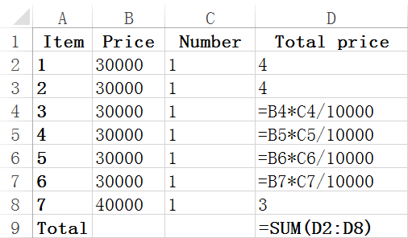
Causes of missing formula smells
Carelessly ignore necessary computation
Copy data from other cells, and miss to check the computations
Fix “division by zero” error by setting a cell’s value to 0
Put down values instead of formulas to make things work quickly
3->4
3->4
=B_{i} * C_{i} / 10000
4->3
22->23
Make the final result correct
Notes:
From the interviews, we also got some interesting results.
we find that missing formula smells are caused by ignoring necessary computations, such as, the users only copy data from other cells, and without computations. and, they try to fix division by zero error, they set the cell’s value as 0.
Sometimes, due to tight deadline, they just set the cell’s value as expected value, which may be incorrect.
Here, we show an example extracted from the 10 spreadsheets, the formula pattern in column D should be Bi times Ci, and divided by 10000. But users have set some cells with plain values, and make the cell D9 get the expected value 23. This will make the final result of the budget look correct. But in fact, the cells are incorrect.

Slide 22
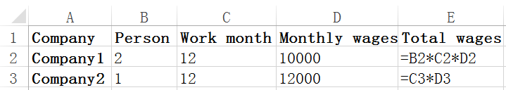
Causes of inconsistent formula smells
Carelessly copy formulas or ignore auto-fill feature
Copy formulas from other cells, without noticing errors
Manually write formulas, rather than auto-fill feature
Where is B3?
Notes:
We also find that the inconsistent formula smells can be caused by carelessly copying formulas, without noticing the formulas are wrong.
Sometimes, users directly write the formulas, and don’t use the auto-fill feature provided by Excel. This may cause inconsistent formulas, too.
Here, we show another example, in this spreadsheet, the cell E3 should be B3 times C3 and then times D3, but users ignore B3, because B3 equals 1.
The value in this cell is correct, but the semantic is not.

Slide 23
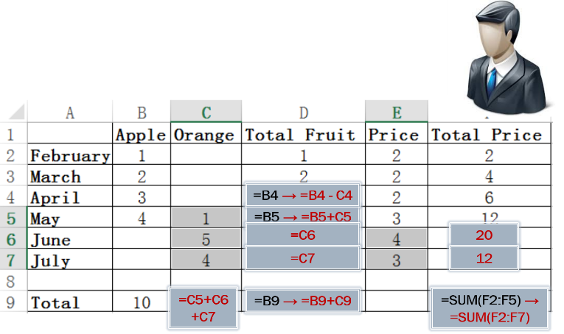
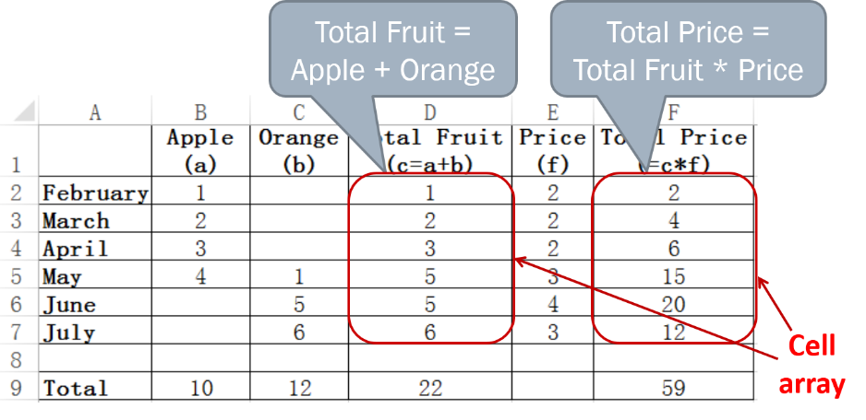
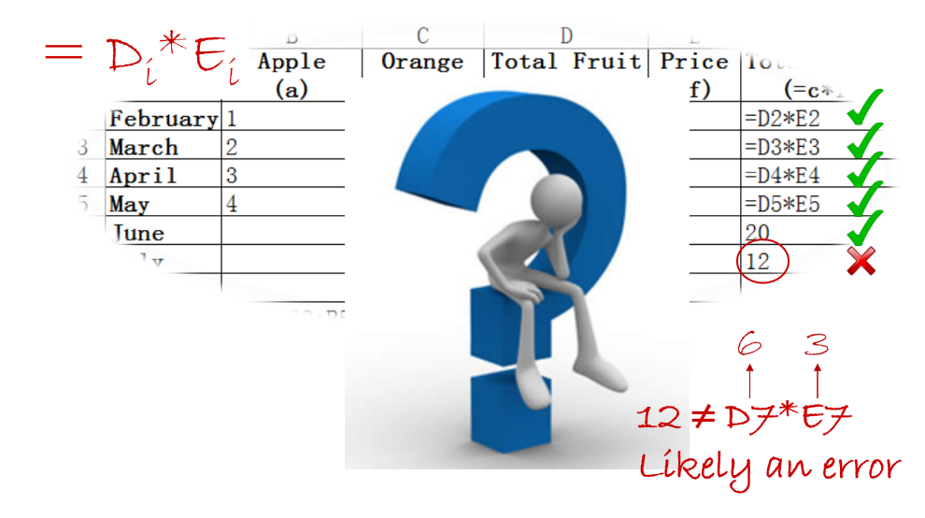
Summary
Ad-hoc modification introduces computation smells
The cells in a cell array have the same computational semantics
Evaluate on EUSES & real-life spreadsheets
Ambiguous computation smells are common and harmful
Ambiguous computation smell detection and repairing
Evaluation
Notes:
Here is the summary of my talk today.
Spreadsheet software allows users to do ad-hoc modifications to any cells, which could introduce some smells.
We observe that the cells in a cell array should have the same computational semantics.
Then we propose a new approach to detect these smells, and recover the formula patterns for a cell array.
At last, we evaluate our approach on EUSES and real-life spreadsheets, the experiments show that ambiguous computation smells are common and harmful.
This is the end of my talk. I am pleased to answer any questions.
I’m ready to take some questions. Thank you very much.

Slide 24
Thank you!

