Slide 1




An Empirical Study on Crash Recovery Bugs in Large-Scale Distributed Systems
Yu Gao, Wensheng Dou, Feng Qin, Chushu Gao, Dong Wang, Jun Wei, Ruirui Huang, Li Zhou, Yongming Wu
Institute of Software,
Chinese Academy of Sciences
University of Chinese Academy of Sciences
The Ohio State University
Alibaba Group

Slide 2

















Large-scale distributed systems

Slide 3





Node crashes are inevitable!
Large-scale distributed systems are commonly built on thousands of commodity machines (nodes)
Power failure
Hardware failure
Software failure

Slide 4
Node crashes are common!
Machine failures in 29-day Google trace log [1]
(12,583 distinct machines)
2.4% machines per day!
# Events
Day
[1] M. Mesbahi et al., Cloud Dependability Analysis: Characterizing Google Cluster Infrastructure Reliability, ICWR 2017.

Slide 5

Basic crash recovery process
Automated crash recovery must be a first-class operation of distributed systems [1]
In-memory state
Node 1
Node 2
Serving
Persistent
state
Crash detection
Crash handling
Local recovery
In-memory state
Reboot detection
Remote synchronization
Reboot handling
[1] B. Cooper et al., Benchmarking Cloud Serving Systems with YCSB, SoCC 2010.

Slide 6





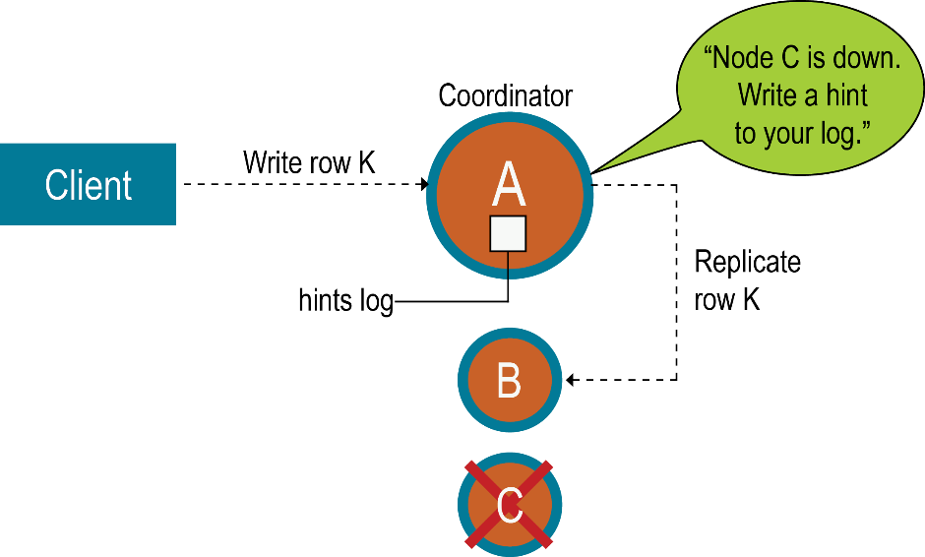


Various crash recovery mechanisms
Backing up
Data synchronization
Failover
Region Server
Region
Put
Memstore
WAL
Ack
HDFS Data Node
Write-ahead logging in HBase
Hinted handoffs in Cassandra

Slide 7

Crash recovery bugs (CR bugs)
Crash recovery processes can have bugs!
Backing up
Data synchronization
Failover
Region Server
Region
Put
Memstore
WAL
Ack
HDFS Data Node
Write-ahead logging in HBase
Hinted handoffs in Cassandra

Slide 8

A real-world crash recovery bug
zookeeper fails to start because of inconsistent epoch
https://issues.apache.org/jira/browse/ZOOKEEPER-1653
Follower
Leader
①
NEWLEADER
②
Take snapshot
Snapshot
case Leader.NEWLEADER:
zk.takeSnapshot();
self.setCurrentEpoch(newEpoch);
…
③
Write current epoch
currentEpoch
if (epochOfZxid > currentEpoch){
// Stop itself
}
Fail to start!

Slide 9
Understanding CR bugs is important!
Empirical bug studies in distributed systems
Cloud bug study [1]
Distributed concurrency bugs [2]
Timeout issues [3]
Existing CR bug detection – Treat a distributed system as a black/grey box
Model checking [4]
Crash injection [5]
Not for CR bugs!
Lack of deep understanding of CR bugs!
[1] H. Gunawi et al., What Bugs Live in the Cloud? A Study of 3000+ Issues in Cloud Systems, SoCC 2014.
[2] T. Leesatapornwongsa et al., TaxDC: A Taxonomy of Non-Deterministic Concurrency Bugs in Datacenter Distributed Systems, ASPLOS 2016.
[3] T. Dai et al., Understanding Real-World Timeout Problems in Cloud Server Systems, IC2E 2018.
[4] T. Leesatapornwongsa et al., 2014. SAMC: Semantic-Aware Model Checking for Fast Discovery of Deep Bugs in Cloud Systems, OSDI 2014.
[5] H. Gunawi et al., FATE and DESTINI: A Framework for Cloud Recovery Testing, NSDI 2011.

Slide 10



CREB: study on Crash REcovery Bugs
103 CR bugs
4 varied distributed systems
Bugs reported during 2011-2014
We carefully study each bug
Inspect comments, patches and source code
Write down all steps to reproduce
Coordination | Computing framework | Storage | Storage
Master/slave based on leader election | Master/slave | Master/slave | Peer-to-peer

Slide 11

Research questions
RQ1: Root cause
What are the root causes for CR bugs?
RQ2: Triggering condition
How is a CR bug triggered?
RQ3: Bug impact
What impacts do CR bugs have?
RQ4: Fixing
How do developers fix CR bugs?

Slide 12
RQ1: Root cause

Slide 13
RQ1: Root cause

Slide 14
RQ1: Root cause
Observer
Leader
Root cause
Incorrect backup
Startup
No backup
Ex:ZOOKEEPER-1552

Slide 15
RQ1: Root cause
Observer
Leader
Root cause
Incorrect backup
“Snapshot of current
in-memory data”
Snapshot
Take snapshot
Snapshot
Startup
No backup
Ex:ZOOKEEPER-1552

Slide 16
RQ1: Root cause
Observer
Leader
Root cause
Incorrect backup
“Snapshot of current
in-memory data”
Snapshot
Take snapshot
Snapshot
No backup
Serving
“Commit TXN_i”
TXN_i
Ex:ZOOKEEPER-1552

Slide 17
RQ1: Root cause
Observer
Leader
Root cause
Incorrect backup
“Snapshot of current
in-memory data”
Snapshot
Take snapshot
Snapshot
No backup
Serving
“Commit TXN_i”
TXN_i
.
.
.
“Commit TXN_n”
TXN_n
Huge in-memory data!
“Snapshot of current
in-memory data”
Take a long time for recovery!
Ex:ZOOKEEPER-1552

Slide 18



RQ1: Root cause
Root cause
Incorrect backup
N
No backup
Data
Data
Backup
Implication:
Important data should be backed up in all cases
Inconsistency about whether data are backed up indicates CR bugs

Slide 19
RQ1: Root cause
Root cause
Incorrect backup
RM
AM1
Finish job X successfully
No backup
Incorrect backup management
Premature removal of backups
RM: ResourceManager
AM: ApplicationMaster
Ex: MAPREDUCE-5476

Slide 20
RQ1: Root cause
Root cause
Incorrect backup
RM
AM1
Finish job X successfully
Delete staging directory
“Unregister to RM”
No backup
Incorrect backup management
Premature removal of backups
RM: ResourceManager
AM: ApplicationMaster
Ex: MAPREDUCE-5476

Slide 21

RQ1: Root cause
Root cause
Incorrect backup
RM
AM1
Finish job X successfully
Delete staging directory
“Unregister to RM”
No backup
Incorrect backup management
Premature removal of backups
Stop itself
RM: ResourceManager
AM: ApplicationMaster
Ex: MAPREDUCE-5476

Slide 22
RQ1: Root cause
Root cause
Incorrect backup
RM
AM1
Finish job X successfully
Delete staging directory
“Unregister to RM”
No backup
Incorrect backup management
Premature removal of backups
Stop itself
AM2
Try to recover job X
Fail the job since staging dir has been already cleaned!
RM: ResourceManager
AM: ApplicationMaster
Ex: MAPREDUCE-5476

Slide 23
RQ1: Root cause
Create backups
Create backups
Root cause
Incorrect backup
Backups
Backups
Period of use
Period of use
No backup
Clean backups
Incorrect backup management
Backups
Premature removal of backups
Clean backups
Backups

Slide 24
RQ1: Root cause
Root cause
Incorrect backup
No backup
Incorrect backup management
Premature removal of backups
Implication:
Backups should be managed properly
Incorrect backup lifecycle indicates CR bugs
Incorrect backup updates
Backups are not updated in an atomic way
Update logic is incorrectly implemented

Slide 25
RQ1: Root cause
Root cause
Incorrect backup
Incorrect crash / reboot detection
No crash detection
Do not perceive a dead node
Unaware crash within timeout
No crash recovery can be applied

Slide 26

RQ1: Root cause
Root cause
Incorrect backup
Incorrect crash / reboot detection
AM
RM
TA
“heartbeat”
No crash detection
Do not perceive a dead node
Unaware crash within timeout
No crash recovery can be applied
RM: ResourceManager
AM: ApplicationMaster
TA: TaskAttempt
Ex: MAPREDUCE-3228

Slide 27

RQ1: Root cause
Root cause
Incorrect backup
Incorrect crash / reboot detection
AM
RM
TA
“heartbeat”
“heartbeat”
“Stop the task container!”
No crash detection
Hang!
Do not perceive a dead node
Unaware crash within timeout
No crash recovery can be applied
RM: ResourceManager
AM: ApplicationMaster
TA: TaskAttempt
Ex: MAPREDUCE-3228

Slide 28
RQ1: Root cause
Root cause
Incorrect backup
Incorrect crash / reboot detection
HM
RS1
RS2
Crash recovery is disabled
“Assign ROOT”
“Succ”
“Assign META”
No crash detection
Untimely crash / reboot detection
“Access ROOT”
No crash recovery can be applied
“Succ”
HM: HBase Master
RS: Region Server
Ex: HBASE-5918

Slide 29
RQ1: Root cause
Root cause
Incorrect backup
Incorrect crash / reboot detection
HM
RS1
RS2
Crash recovery is disabled
Detect RS1’s crash, but no recovery can be applied
“Assign ROOT”
“Succ”
“Assign META”
No crash detection
Untimely crash / reboot detection
Hang!
“Access ROOT”
No crash recovery can be applied
“Succ”
HM: HBase Master
RS: Region Server
Ex: HBASE-5918

Slide 30
RQ1: Root cause
Root cause
Incorrect backup
Incorrect crash / reboot detection
No crash detection
Untimely crash / reboot detection
Implication:
Crashes and reboots can happen at any time
Missing/untimely crash/reboot detection indicates CR bugs

Slide 31
RQ1: Root cause
Root cause
Incorrect backup
Incorrect crash / reboot detection
Incorrect state identification
Consider wrong states as correct
Miss the correct states
Incorrect data parser logic

Slide 32
RQ1: Root cause
Root cause
Incorrect backup
Incorrect crash / reboot detection
Incorrect state identification
N1
N2
“Vote for me?”
“Yes”
Consider wrong states as correct
Miss the correct states
Incorrect data parser logic
Ex: ZOOKEEPER-975

Slide 33
RQ1: Root cause
Root cause
Incorrect backup
Incorrect crash / reboot detection
Incorrect state identification
N1
N2
“Vote for me?”
“Yes”
Take the stale message
Go in LEADING state
Consider wrong states as correct
Performance degradation!
Miss the correct states
Incorrect data parser logic
Ex: ZOOKEEPER-975

Slide 34
RQ1: Root cause
Root cause
Incorrect backup
Incorrect crash / reboot detection
Incorrect state identification
Implication:
Inconsistencies between states before crash and identified states after crash may indicate CR bugs
Consider wrong states as correct
Miss the correct states
Incorrect data parser logic

Slide 35
RQ1: Root cause
Root cause
Incorrect backup
Incorrect crash / reboot detection
Incorrect state identification
Incorrect state recovery
N1
N2
“Message”
Modify in-memory state
v
Leftover of N1!
Incorrect handling of leftovers
No handling of leftovers
• Untimely handling of leftovers

Slide 36
RQ1: Root cause
Root cause
Incorrect backup
Incorrect crash / reboot detection
Incorrect state identification
Incorrect state recovery
TA1
AM
“CommitPending”
if(commitAttempt == null){
commitAttempt = attemptID;
} else { … }
“startCommit”
“doneCommit”
Incorrect handling of leftovers
No handling of leftovers
• Untimely handling of leftovers
AM: ApplicationMaster
TA: TaskAttempt
Ex: MAPREDUCE-3858

Slide 37
RQ1: Root cause
Root cause
Incorrect backup
Incorrect crash / reboot detection
Incorrect state identification
Incorrect state recovery
TA1
AM
Leftover of TA1!
“CommitPending”
If(commitAttempt == null){
commitAttempt = attemptID;
} else { … }
“startCommit”
“doneCommit”
TA2
“CommitPending”
“Kill”
Incorrect handling of leftovers
Task remains unfinished!
No handling of leftovers
• Untimely handling of leftovers
AM: ApplicationMaster
TA: TaskAttempt
Ex: MAPREDUCE-3858

Slide 38
RQ1: Root cause
Root cause
Incorrect backup
Incorrect crash / reboot detection
Incorrect state identification
Incorrect state recovery
Implication:
Unhandled leftovers of a crash node indicates CR bugs
Incorrect handling of leftovers
No handling of leftovers
• Untimely handling of leftovers

Slide 39
RQ2: Triggering condition

Slide 40
RQ2: Triggering condition
Triggering condition
# of nodes
Implication:
We can detect CR bugs in a small cluster, rather than a large cluster
Almost all (97%) CR bugs involve 4 nodes or fewer

Slide 41
RQ2: Triggering condition
Triggering condition
# of nodes
# of crashes
No more than three crashes can trigger almost all (99%) CR bugs

Slide 42
RQ2: Triggering condition
Triggering condition
# of nodes
# of crashes
# of reboots
A combination of no more than 3 crashes and no more than 1 reboot can trigger 87% of the bugs.
Implication:
We can test distributed systems by injecting a small number of crashes and reboots
No more than one reboot can trigger 87% of CR bugs
36% of bugs do not need to inject any reboot

Slide 43
RQ3: Bug impact

Slide 44
RQ3: Bug impact
38% of CR bugs cause downtimes of the cluster or nodes
18% in CBS [1]
17% in TaxDC [2]
Fatal failures
[1] H. Gunawi et al., What Bugs Live in the Cloud? A Study of 3000+ Issues in Cloud Systems, SoCC 2014.
[2] T. Leesatapornwongsa et al., TaxDC: A Taxonomy of Non-Deterministic Concurrency Bugs in Datacenter Distributed Systems, ASPLOS 2016.

Slide 45
RQ4: Fixing

Slide 46
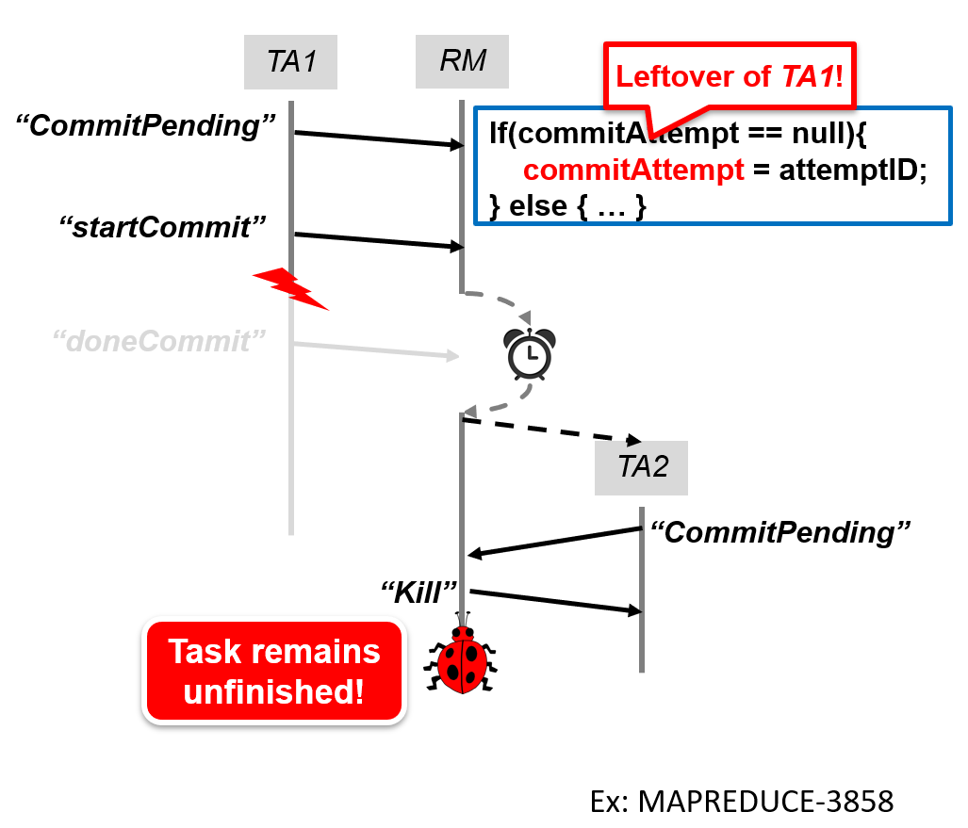

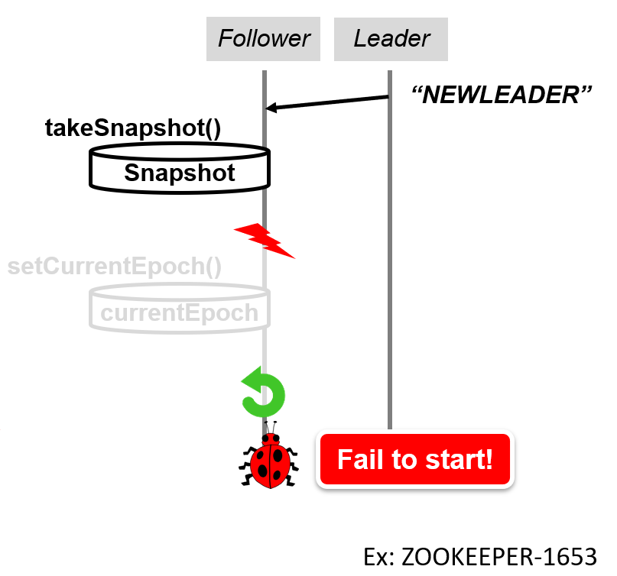
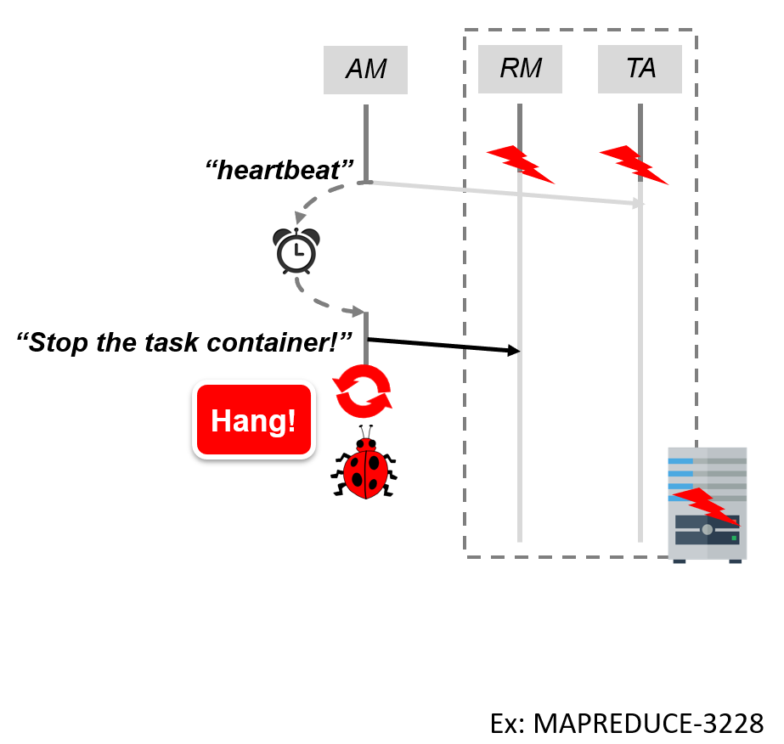
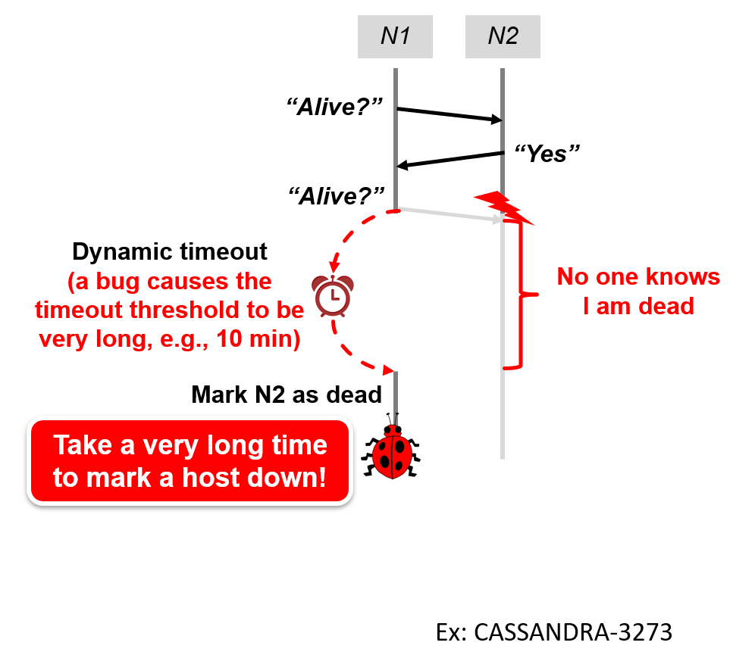
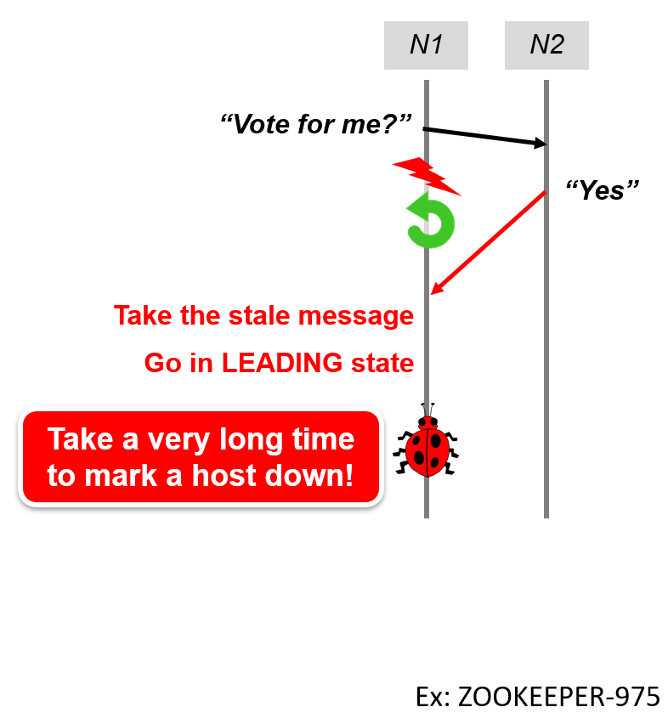
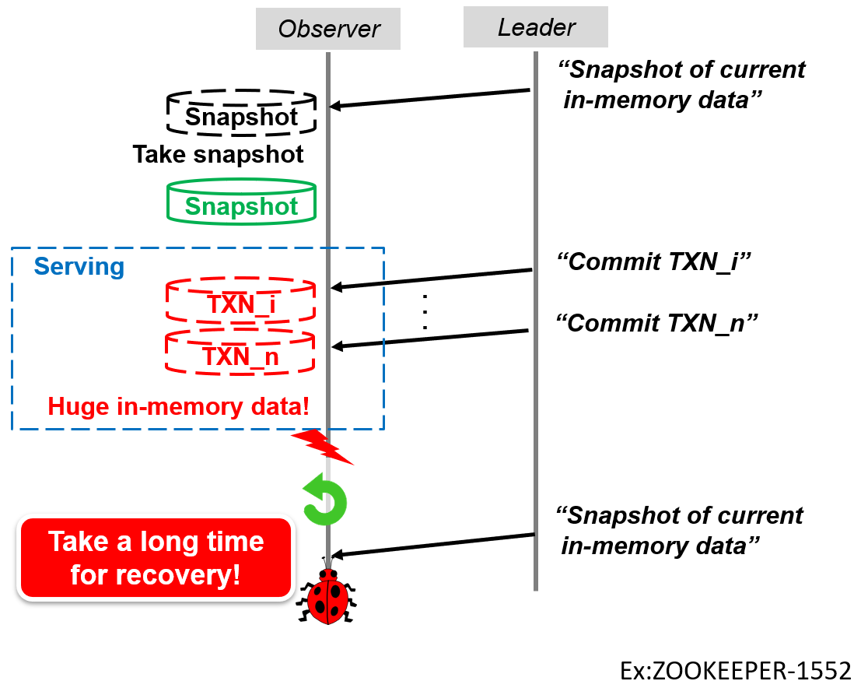
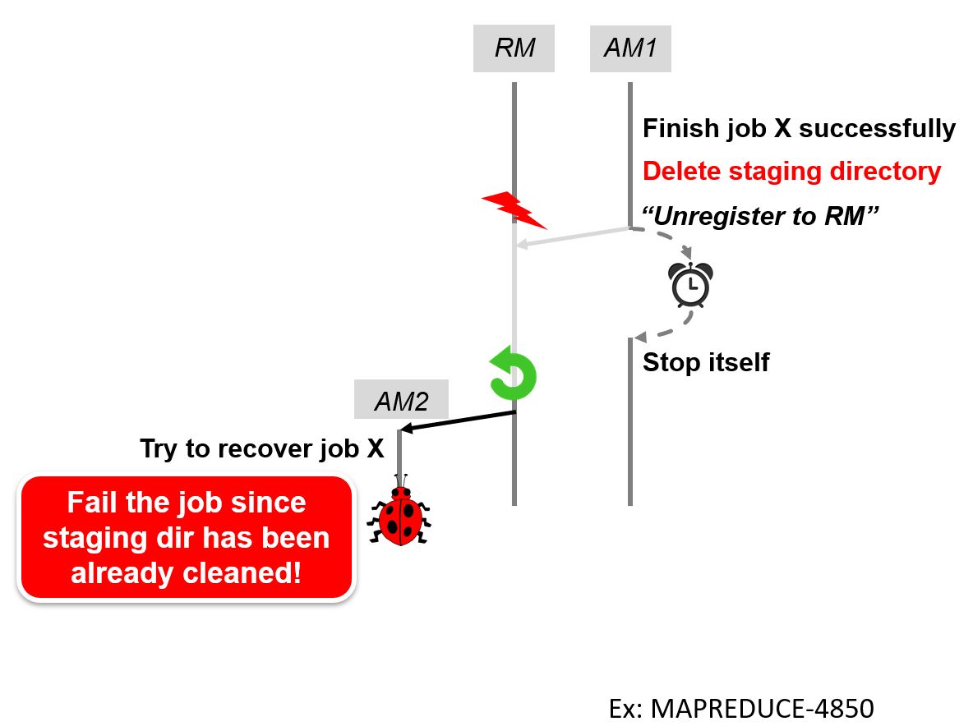
RQ4: Bug fix patterns
No clear fix patterns
Root cause oriented
System-specific
Clean leftover
Detect unexpected crash
Fix dynamic timeout strategy
Add timeout
Delay backup removal
Ignore stale message
Add backing up

Slide 47

RQ4: Incomplete fixes
Reduce the possibility of bug occurrence
JobTracker
“Submit job”
submitJob()
Job info
.
.
.
initJob()
Job token
Ex: MAPREDUCE-5169

Slide 48

RQ4: Incomplete fixes
Reduce the possibility of bug occurrence
JobTracker
JobTracker
“Submit job”
“Submit job”
submitJob()
submitJob()
Job info
Job info
Job token
.
.
.
initJob()
Job token
Fail to recover without jobToken!
Ex: MAPREDUCE-5169

Slide 49
RQ4: Incomplete fixes
Reduce the possibility of bug occurrence
JobTracker
JobTracker
“Submit job”
“Submit job”
submitJob()
submitJob()
Job info
Job info
Job token
.
.
.
initJob()
Job token
Fail to recover without jobToken!
Ex: MAPREDUCE-5169

Slide 50
RQ4: Incomplete fixes
12% of CR bugs have incomplete fixes
Reduce bug occurrence probability
Introduce new bugs
Omit cases
Implication:
CR bug verification is necessary
We can detect new CR bugs in fixes

Slide 51
More lessons
Bug detection
Backup-guided bug detection
Crash/reboot detection analysis
State inconsistency guided detection
Concurrency analysis in crash recovery bugs
Bug fix oriented detection
Testing of distributed systems
Crash/reboot injection strategy
More discussions can be found in our paper!

Slide 52
Conclusion
Inadequate crash recovery mechanisms and their incorrect implementations could introduce CR bugs
We perform a comprehensive study on 103 CR bugs in 4 distributed systems, and obtain many interesting findings
These findings found in our study can help open up new directions to combat crash recovery bugs
http://www.tcse.cn/~wsdou/project/CREB/

Slide 53

THANK YOU!

