Slide 1


How Are Spreadsheet Templates Used in Practice: A Case Study on Enron
ESEC/FSE 2018 New Ideas and Emerging Results
Liang Xu, Wensheng Dou, Jiaxin Zhu, Chushu Gao, Jun Wei, Tao Huang
Institute of Software,
Chinese Academy of Sciences
University of Chinese Academy of Sciences

Slide 2

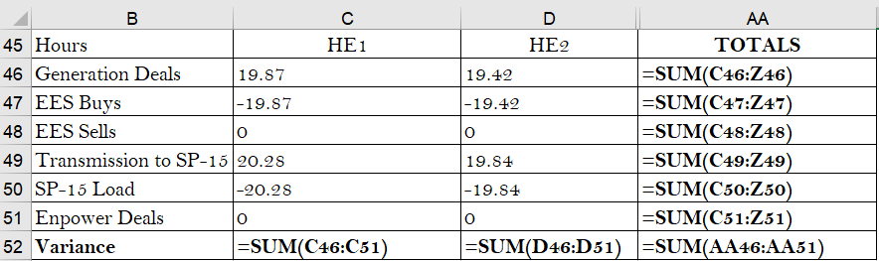
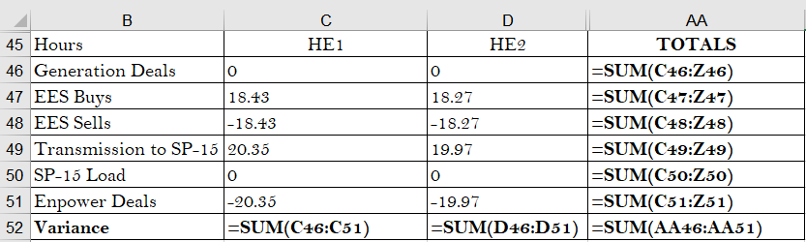
Motivating example
Alice
Store trade data on October 4th
10-4
Store trade data on October 5th
10-5

Slide 3
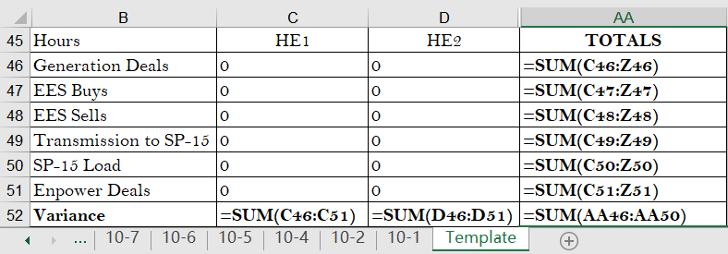
Motivating example
In October, Alice needs to create 31 similar worksheets
I designed a template
Alice

Slide 4
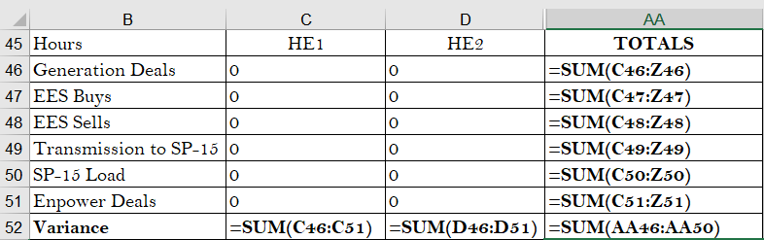
Predesigned template
Contain necessary data layout and formulas
Data placeholders instead of actual data
Placeholder
Data layout
Computational logic
Enter new data

Slide 5
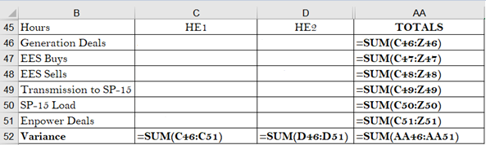
Instance template
Reuse an existing worksheet rather than designing a new template
Actual data
10-4
Clean original data

Slide 6
Benefits of using spreadsheet templates
Reduce users’ efforts
Reuse data layout
Reuse computational logic
Avoid errors in writing formulas
Users can focus on entering necessary data

Slide 7
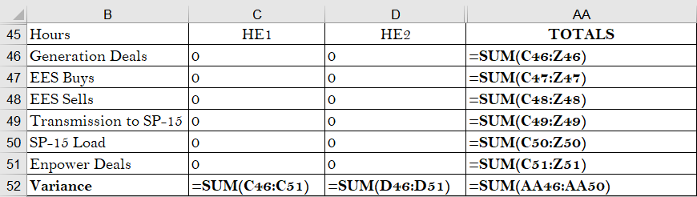
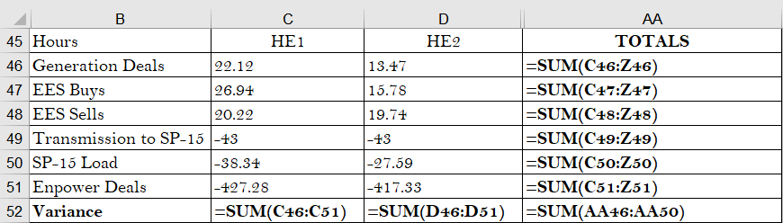
The usage of spreadsheet templates can cause issues
Errors in templates can be propagated to their instances without users’ noticing
Lack of understanding how templates are used in practice
Formula error
Template
propagate
This cell is omitted
Instance

Slide 8
Research questions
RQ1: Are the predesigned templates well-designed?
RQ2: How are errors introduced during template usage?
RQ3: What is the difference between usages of two kinds of templates?

Slide 9

Methodology overview

Predesigned template identification
Instance template identification
●
Template and instance comparison

Study subject: Enron corpus [1]
Real-life spreadsheets used in Enron Corporation
[1] F. Hermans and E. Murphy-Hill, “Enron’s Spreadsheets and Related Emails: A Dataset and Analysis,” in Proceedings of the 37th IEEE International Conference on Software Engineering (ICSE), 2015, pp. 7–16.

Slide 10
Methodology overview

Predesigned template identification
Instance template identification
●
Template and instance comparison

Identify predesigned templates by keywords
“Template”
“Blank”
Identify corresponding instances in the same spreadsheet

Slide 11
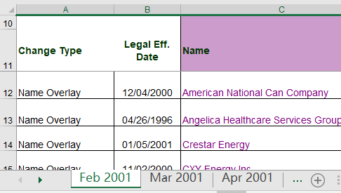
Methodology overview

Predesigned template identification
Instance template identification
●
Template and instance comparison

Randomly sample 100 spreadsheets
Identify similar worksheets
Recover their creation order
Chronological order
e.g., “Jan 2001” and “Feb 2001”
Assumption
Two adjacent worksheets
Template: created earlier
Instance: created later
Template
Instance

Slide 12
Methodology overview

Predesigned template identification
Instance template identification
●
Template and instance comparison

 | Template | Instance
Predesigned template | 47 | 490
Instance template | 168 | 168

Slide 13




Methodology overview

Predesigned template identification
Instance template identification
●
Template and instance comparison

Template
Errors
Template design issues
compare
Analysis
Changes
Root cause
Instance

Slide 14
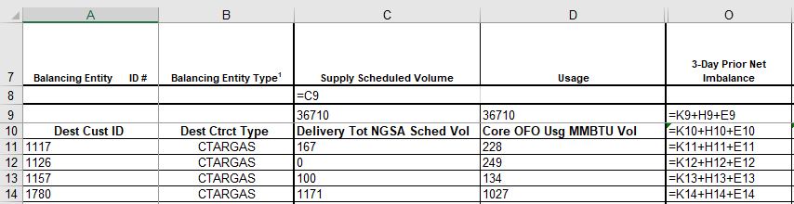
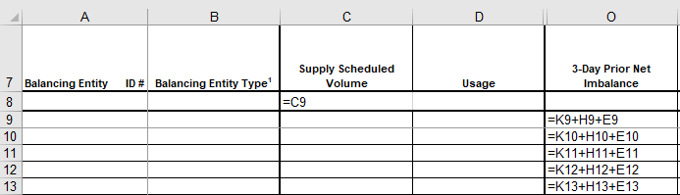
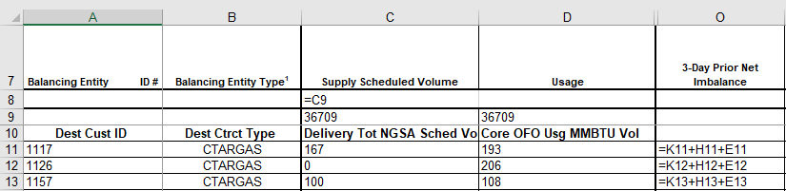
RQ1: Are the predesigned templates well-designed?
Incomplete table layout
E.g., miss some necessary headers
Insert the same headers at the same location
Template
Instances

Slide 15
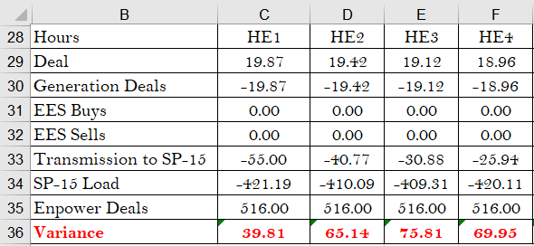
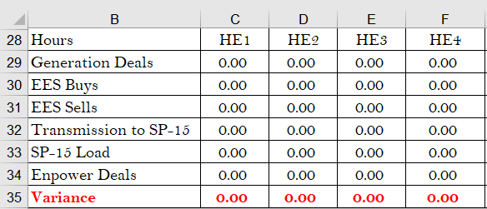
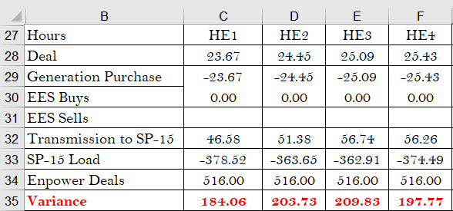
RQ1: Are the predesigned templates well-designed?
Common changes in creation of instances
E.g., miss a data row
Insert a data row at the same location
Template
Instances

Slide 16
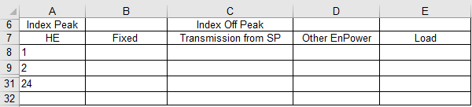
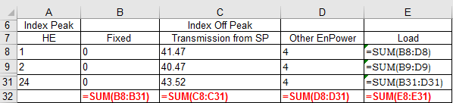
RQ1: Are the predesigned templates well-designed?
Missing formulas or formula errors
Template
Missing formulas
Instance

Slide 17
RQ1: Are the predesigned templates well-designed?
Not well designed
Uncomplete table layout | 8%
Common change | 19%
Missing formulas | 30%
Formula errors | 6%
Total | 40%
Implication:
Template designers should carefully check the completeness and correctness of predesigned templates
Finding:
40% of predesigned templates have design issues

Slide 18
RQ2: How are errors introduced?
Improper use of template
E.g., cell type changes
Unnecessary formula caused by cell type change
Template
Instances
Change data cells to label cells

Slide 19
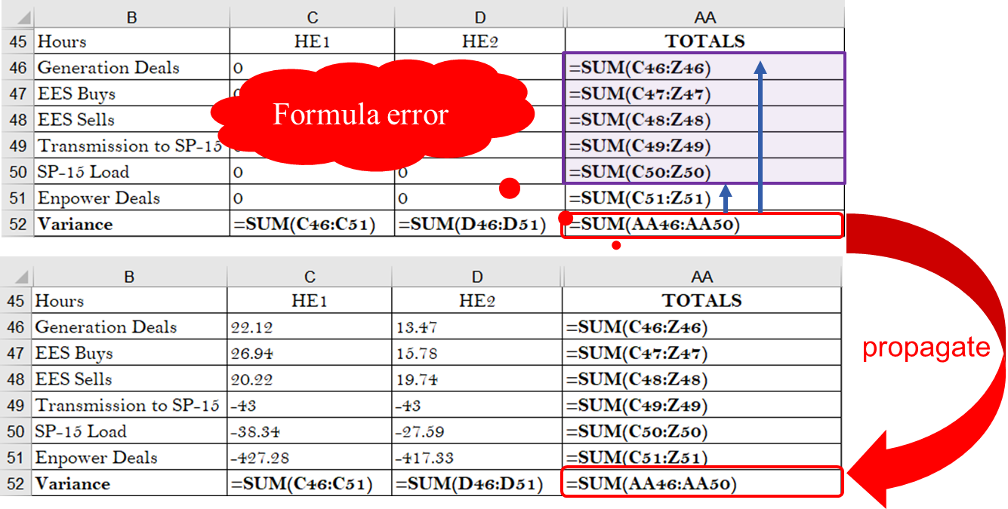
RQ2: How are errors introduced?
Error propagation
560 missing formula errors and 38 formula errors are propagated from templates
Implication:
A template-based error detection approach is promising
Finding:
Errors in templates can be propagated to their instances

Slide 20
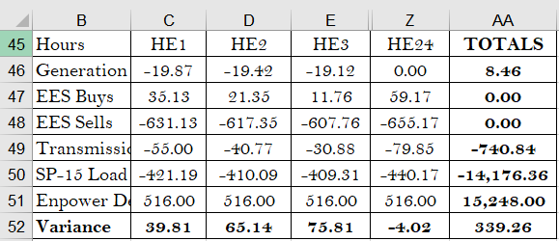
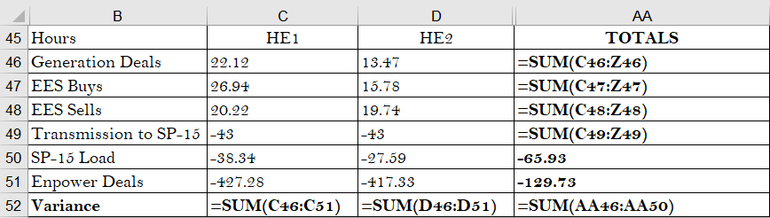
RQ3: What is difference between two kinds of template usage?
Data cleaning is common during usage of instance templates
In 52% of cases, more than 50% of data cells were cleaned
101 missing formulas were caused by data cleaning
Formulas usually look like data
Missing formulas caused by data cleaning
Implication:
An effective data cleaning approach can be helpful
Instance template
Instances
Finding:
Data cleaning can cause errors in the usage of instance templates

Slide 21
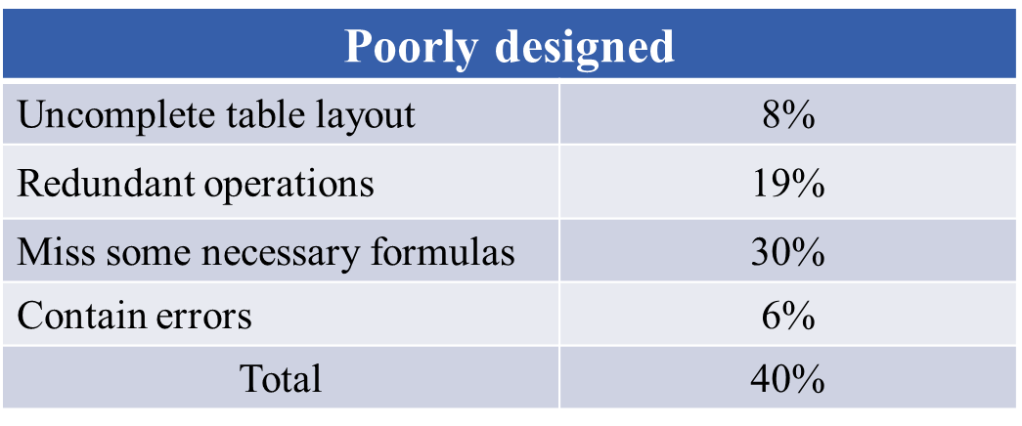
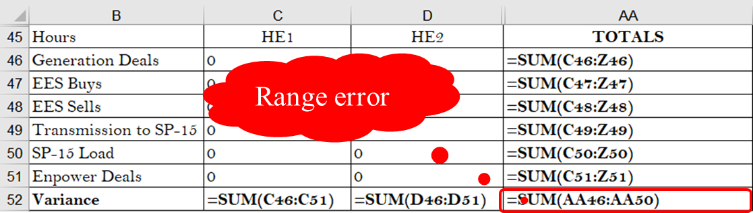
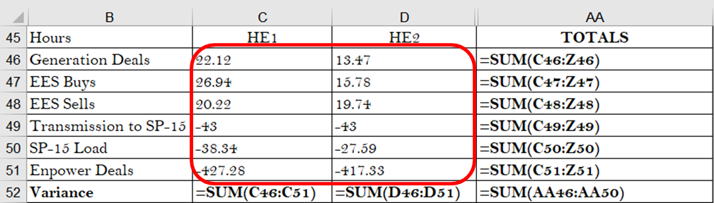
Summary
We perform the first empirical study on the design and usage of spreadsheet templates used in practice
47 predesigned templates (490 instances)
168 template and instance pairs
40% of predesigned templates have design issues
Improper use of templates and error propagation are main reasons for error introduction
Data cleaning can cause errors in the usage of instance templates
TmplEnron
http://www.tcse.cn/~wsdou/project/TmplEnron

Slide 22

Thank you!

