Slide 1


Detecting Atomicity Violations for Event-Driven Node.js Applications
Xiaoning Chang, Wensheng Dou, Yu Gao, Jie Wang, Jun Wei, Tao Huang
Institute of Software,
Chinese Academy of Sciences
University of Chinese Academy of Sciences

Slide 2
JavaScript is the most popular language
[1] https://www.benfrederickson.com/ranking-programming-languages-by-github-users/

Slide 3



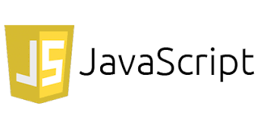

JavaScript is used in various applications
Server-side apps
Mobile apps
Web apps
IoT

Slide 4









Node.js
A server-side JavaScript event-driven framework
Introduced by Ryan Dahl in 2009
800,000+ modules in the npm repository [1]
Node.js is widely used in industry
[1] https://www.npmjs.com/

Slide 5
Event-driven architecture in Node.js
Looper thread
(Single thread)
1. offload read
task queue
readFile(‘bar’, cb);
2. return
Worker pool
(n threads)
3. execute task
event queue
cb();
4. done event

Slide 6
Event-driven architecture in Node.js
Looper thread
(Single thread)
fs.readFile(‘bar’, (data) => {
data = compute(data);
fs.writeFile(‘bar’, data, …);
});
readFile(‘bar’, …);
Worker pool
(n threads)
data
data = compute(data);
writeFile(‘bar’, data);

Slide 7

Event-driven architecture in Node.js
Looper thread
(Single thread)
fs.readFile(‘bar’, (data) => {
data = compute(data);
fs.writeFile(‘bar’, data, …);
});
readFile(‘bar’, …);
Worker pool
(n threads)
x = x + 1;
data
setImmediate(()=>{
x = x + 1;
});
data = compute(data);
writeFile(‘bar’, data);

Slide 8
Atomicity violation -- example
Looper thread
(Single thread)
fs.readFile(‘bar’, (data) => {
data = compute(data);
fs.writeFile(‘bar’, data, …);
});
readFile(‘bar’, …);
Worker pool
(n threads)
deleteFile(‘bar’)
data
setImmediate(()=>{
fs.unlink(‘bar’, …);
});
data = compute(data);
writeFile(‘bar’, …);
File not found!

Slide 9
Atomicity violations are common
65% of concurrency bugs in Node.js
are atomicity violations!
[1] J. Wang, etc. A Comprehensive Study on Real World Concurrency Bugs in Node.js, ASE 2017.
[2] J. Davis, etc. Node.fz: Fuzzing the Server-Side Event-Driven Architecture, EuroSys 2017.

Slide 10






NodeAV overview
e₁
e₂
Application
e₃
e₄
e₅
Test case
Event trace collection
Happens-before
inference
Atomicity violation
detection
Atomic event pair
inference
Bug report

Slide 11
Event trace collection
Event trace collection
Happens-before inference
Atomic event pair inference
Atomicity violation detection
Trigger event
Start event
process.nextTick (() => {
x = compute(x);
fs.readFile(‘bar’, cb);
});
Read x
Event lifecycle
Write x
Resource access
Register cb
Read file bar
End event

Slide 12
Event registration (Rule 1)
Event trace collection
Happens-before inference
Atomic event pair inference
Atomicity violation detection
foo
function foo () {
fs.readFile(‘bar’, cb);
};
register
cb

Slide 13
Event triggering (Rule 2)
Event trace collection
Happens-before inference
Atomic event pair inference
Atomicity violation detection
function foo () {
process.nextTick(cb);
};
foo
trigger
cb

Slide 14
Event types in Node.js
Event trace collection
Happens-before inference
Atomic event pair inference
Atomicity violation detection
Five types of events [1]
API
Event type
Priority
nextTick
process.nextTick()
high
promise
0
promise
immediate
setImmediate()
1
timeout
setTimeout()
2
IO
3
low
asynchronous I/O
[1] M. C. Loring, etc. Semantics of Asynchronous JavaScript, DLS 2017.

Slide 15
Events with the same type (Rule 3)
Event trace collection
Happens-before inference
Atomic event pair inference
Atomicity violation detection
Events with the same type are processed in their triggering order
Looper thread
(Single thread)
function foo () {
process.nextTick (cb1);
process.nextTick (cb2);
};
foo
nextTick
cb1
cb2
cb1
cb2

Slide 16
Events with different types (Rule 4)
Event trace collection
Happens-before inference
Atomic event pair inference
Atomicity violation detection
Looper thread
(Single thread)
foo
function foo () {
fs.readFile(‘bar’, cb1);
process.nextTick(cb2);
};
nextTick
Priority
cb2
high
cb2
IO
cb1
low
cb1

Slide 17


Key observation
Event trace collection
Happens-before inference
Atomic event pair inference
Atomicity violation detection
Callback chain reflects the atomicity among events
setImmediate( function cb1 () {
fs.readFile(‘bar’, function cb2 (data) {
data = compute(data);
fs.writeFile(‘bar’, data, …);
});
};
Atomic event pair
cb1
readFile(‘bar’);
cb2
bar
writeFile(‘bar’);
I want to read a file then write back to it

Slide 18
Key observation
Event trace collection
Happens-before inference
Atomic event pair inference
Atomicity violation detection
Predesigned event order reflects the atomicity among events
var x;
process.nextTick (function cb1 () {
x = 1;
});
process.nextTick (function cb2 () {
if (x == 1) …
});
Atomic event pair
cb1
x = 1;
x
cb2
if (x == 1)
I want to write x, and then read it

Slide 19
Atomic event pair inference
Event trace collection
Happens-before inference
Atomic event pair inference
Atomicity violation detection
Two assumptions for atomic event pair
Event u and v have happens-before relation
Event u and v access the same resource
u
Write x
Atomic event pair
v
Write x

Slide 20
Atomicity violation pattern
Event trace collection
Happens-before inference
Atomic event pair inference
Atomicity violation detection
u
Write x
t
Event t occurs between atomic pair <u, v>
Read x
v
Event u, v, and t access x
Write x
Read dirty data

Slide 21
More atomicity violation patterns
Event trace collection
Happens-before inference
Atomic event pair inference
Atomicity violation detection
u
u
u
Write x
Read x
Read x
t
t
t
Write x
Write x
Write x
v
v
v
Read x
Write x
Read x
Read unexpected data
Rely on overdue data
Read different data
[1] S. Lu, etc. AVIO: Detecting Atomicity Violations via Access-Interleaving Invariants, ASPLOS 2006.

Slide 22

Evaluation
Can NodeAV detect known atomicity violations in Node.js applications?
Can NodeAV detect new atomicity violations in Node.js applications?

Slide 23
Detect known atomicity violations
We select 9 atomicity violations from NodeCB and Node.fz
NodeAV detects 7 known atomicity violations
ID | Application | Issue ID | Detected
1 | michaelwitting/node-logger-file | 1 | Y
2 | substack/node-mkdir-p | 2 | Y
3 | hapijs/nes | 18 | Y
4 | telefonicaid/fiware-pep-steelskin | 269 | Y
5 | telefonicaid/fiware-pep-steelskin | 279 | N
6 | node-modules/agentkeepalive | 23 | N
7 | wikimedia/change-propagation | 84 | Y
8 | brave/browser-laptop | 3,273 | Y
9 | gadicc/meteor-hmr | 71 | Y
Related events are not triggered
in the collected trace.
We do not model the Net API, e.g., destroy().

Slide 24
Detect unknown atomicity violations
10 Node.js applications
Update projects in previous study to their newest versions
Randomly select applications in GitHub
Contain concurrent bug reports
Have test cases
Run test cases to collect event traces

Slide 25
Detect unknown atomicity violations
NodeAV detects 12 unknown atomicity violations
ID | Application | #Star | #Violation | #FP
1 | michaelwitting/node-logger-file | 1 | 2 | 0
2 | substack/node-mkdir-p | 1,218 | 0 | 0
3 | hapijs/nes | 146 | 1 | 0
4 | telefonicaid/fiware-pep-steelskin | 9 | 6 | 1
5 | node-modules/agentkeepalive | 251 | 0 | 0
6 | nickewing/line-reader | 384 | 1 | 0
7 | sitegui/nodejs-websocket | 514 | 1 | 0
8 | JoshuaWise/better-sqlite3 | 1,050 | 0 | 0
9 | derbyjs/racer | 1,098 | 0 | 0
10 | simplecrawler/simplecrawler | 1,847 | 1 | 0

Slide 26
Detect unknown atomicity violations
3 atomicity violations are harmful
u
file = new File ();
t
closeFile(file)
v
logFile(file)
Fail to log
[1] https://github.com/michaelwittig/node-logger-file

Slide 27
Detect unknown atomicity violations
8 atomicity violations are benign
u
x = 1;
t
Read x
v
x = 1;
Event u and v write the same data to x.

Slide 28
Performance of NodeAV?
Runtime overhead of NodeAV ranges from 1.1X to 5.7X
ID | Project | #Event | Time (s)
 |  |  | Orig | Trace | Overhead (X)
1 | michaelwitting/node-logger-file | 1,752 | 19.4 | 31.9 | 1.6
2 | substack/node-mkdir-p | 23 | 4.3 | 5.5 | 1.3
3 | hapijs/nes | 34,211 | 4.7 | 7.5 | 1.6
4 | telefonicaid/fiware-pep-steelskin | 39,757 | 7.3 | 14.4 | 2.0
5 | node-modules/agentkeepalive | 10,873 | 65.7 | 70.1 | 1.1
6 | nickewing/line-reader | 633 | 0.4 | 0.7 | 1.8
7 | sitegui/nodejs-websocket | 676 | 0.2 | 0.9 | 4.5
8 | JoshuaWise/better-sqlite3 | 9,346 | 12.1 | 12.9 | 1.1
9 | derbyjs/racer | 2,065 | 0.2 | 0.5 | 2.5
10 | simplecrawler/simplecrawler | 466 | 4.7 | 26.6 | 5.7

Slide 29
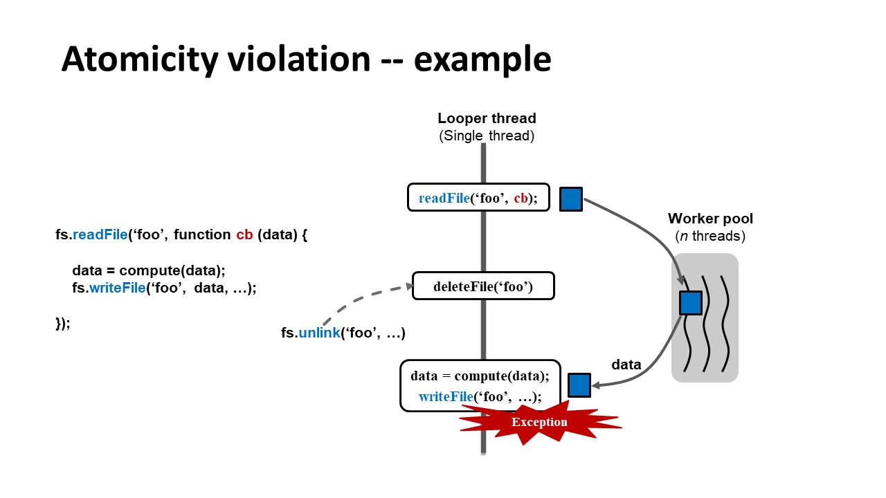
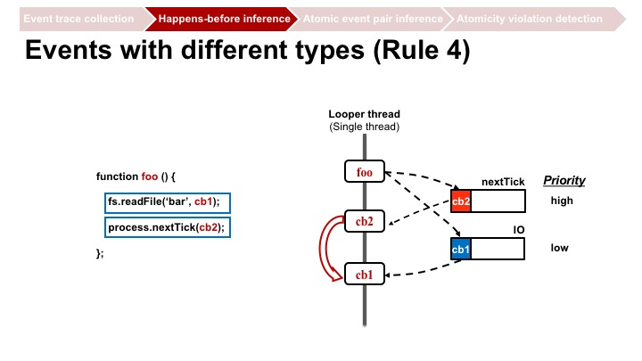
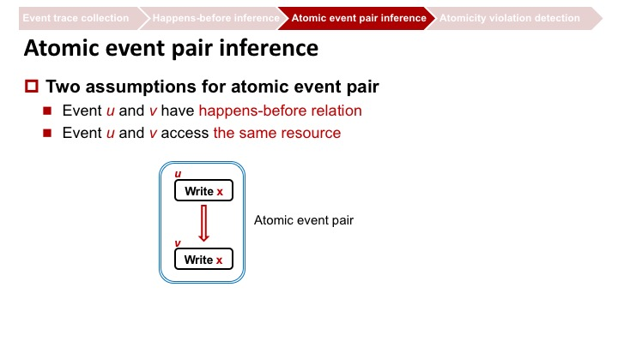
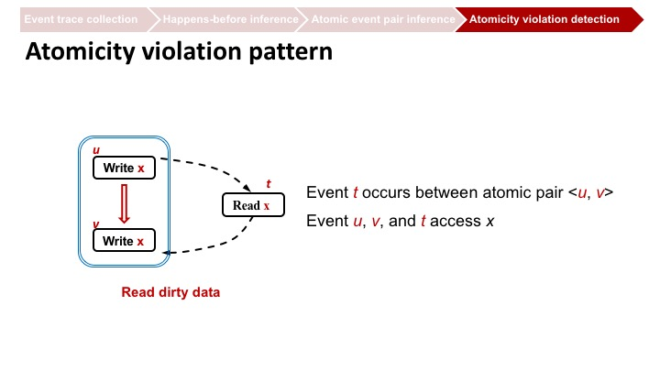
Summary

Slide 30

THANK YOU!

