Slide 1



Detecting Table Clones and Smells in Spreadsheets
Foundations of Software Engineering (FSE 2016), Seattle
Wensheng Dou, Shing-Chi Cheung, Chushu Gao, Chang Xu, Liang Xu, Jun Wei

Slide 2

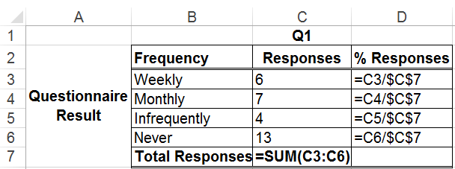

Cloning in Spreadsheet Development
How?
Similar report
Search
Copy & Paste
New data
Fix formulas
New report

Slide 3
Table
Table: a rectangular block of numerical cells
Sheet Q1
Table
Not parts of a table
… real example extracted from EUSES spreadsheet corpus

Slide 4
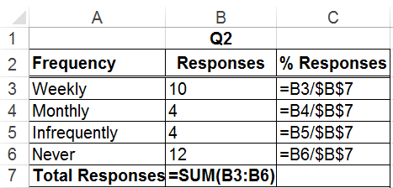
Table Clone
Table Clone: two tables have the same computational semantics
Sheet Q1
Same semantics!
Sheet Q2

Slide 5
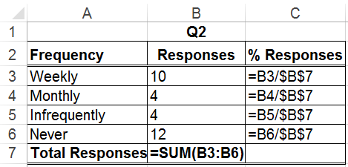
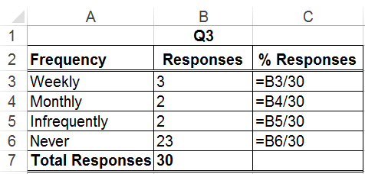
Clone-Related Smell
Inconsistencies among table clones can be indications of potential smells
Total responses are $B$7
Sheet Q2
Inconsistency
Sheet Q3
Total responses must be 30, and never change!

Slide 6
Semantic Smell
Clone-related smells can introduce errors when their input values change
All cells give wrong values!
Sheet Q3
3
31
If total responses change to 31

Slide 7
Existing Smell Detectors (1)
No warnings are issued by Excel
Syntactic smell detectors [1][2] (e.g., multiple operations) cannot detect clone-related smells
Sheet Q3
No syntactic smells!
[1] F. Hermans, et, al., “Detecting and Visualizing Inter-worksheet Smells in Spreadsheets”, ICSE 2012.
[2] F. Hermans, et, al., “Detecting Code Smells in Spreadsheet Formulas”, ICSM 2012.

Slide 8
Existing Smell Detectors (2)
CACheck[1] and CUSTODES[2] aggregate cells into clusters according to formula similarity
Cell cluster with the same formula pattern
Sheet Q2
Two correct clusters, no smells!
Sheet Q3
Cell cluster with the same formula pattern
[1] W. Dou, et, al., “CACheck: Detecting and Repairing Cell Arrays”, TSE 2016.
[2] S.C. Cheung, et, al., “CUSTODES: Automatic Spreadsheet Cell Clustering and Smell Detection Using Strong and Weak Features”, ICSE 2016.

Slide 9

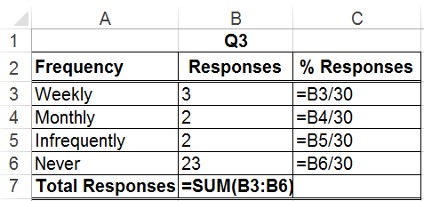
Our Goal
Find tables with the same computational semantics
Detect clone-related smells among table clones
table1
table2
table3

Slide 10
Our Goal - Challenges
Find tables with the same computational semantics
Detect clone-related smells among table clones
table1
No records indicate copy & paste
table2
table3
Not all inconsistencies indicate smells

Slide 11
Our Key Insight
Cell headers represent cells’ computational semantics
Monthly
: % Responses

Slide 12
Our Key Insight
Tables with the same headers would be likely to be clones
Sheet Q1
Same Headers
Sheet Q2

Slide 13
Which Headers can be Used?
Not all levels of headers are created equal
Only First-level headers are used to detect clones
Sheet Q1
First-level
headers
Higher-level
headers
Diff
Same
Higher-level
headers
First-level
headers
Sheet Q2

Slide 14
How to Find Table Clones?
Two tables are likely a table clone if all their corresponding cells have the same headers
Weekly : Responses
Table clone

Slide 15

Inconsistency among Table Clones
Not all inconsistencies indicate smells
Which cells are smelly?
Monthly responses / Total (C4/$C$7)
Monthly responses / 30 (B4/30)

Slide 16


Detect Smells as Outliers
As smelly cells normally occur in minority, they can be detected as outliers
Monthly responses / Total (C4/$C$7 or B4/$B$7)
Monthly responses / 30 (B4/30)

Slide 17
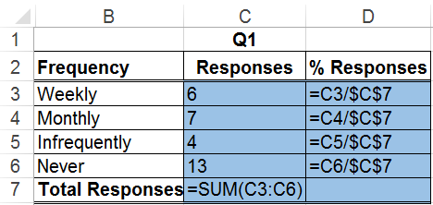
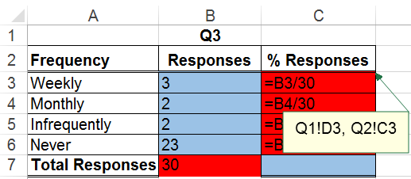
TableCheck Implementation
One color for each clone group
Mark smells with comments of referenced cells
Sheet Q1
Clone
Referenced Cells
Sheet Q3

Slide 18
Evaluation
Subject
All EUSES spreadsheets with formulas [1], 1617 spreadsheets
Manually validate all detected table clones and smells
Do they have the same headers?
Do they have the same computational semantics?
Can smells be fixed by inspecting their referenced cells?
[1] M. Fisher et al., “The EUSES spreadsheet corpus: a shared resource for supporting experimentation with spreadsheet dependability mechanisms,” SIGSOFT Softw Eng Notes, 2005.

Slide 19
How Common are Table Clones? (RQ1)
21.8% spreadsheets contain confirmed table clones
Category | Spreadsheets | Has Clone | Confirmed | Confirmed/Spreadsheets
cs101 | 8 | 2 | 2 | 25.0%
database | 200 | 58 | 54 | 27.0%
filby | 1 | 0 | 0 | 0.0%
financial | 358 | 100 | 96 | 26.8%
forms3 | 18 | 3 | 3 | 16.7%
grades | 282 | 57 | 52 | 18.4%
homework | 277 | 56 | 53 | 19.1%
inventory | 278 | 72 | 68 | 24.5%
jackson | 0 | 0 | 0 | n.a.
modeling | 190 | 25 | 21 | 11.1%
personal | 5 | 4 | 3 | 60.0%
Total | 1,617 | 377 | 352 | 21.8%

Slide 20
How Common are Smells? (RQ2)
5.6% spreadsheets contain clone-related smells
14.6% table clones contain smells
33.6% smelly cells contain wrong values (harmful)
Category | Spreadsheets |  | Table Clones |  | Smells
 | All | Smelly | All | Smelly | All | Error
cs101 | 8 | 2 | 2 | 2 | 2 | 0
database | 200 | 16 | 205 | 46 | 1,441 | 767
filby | 1 | 0 | 0 | 0 | 0 | 0
financial | 358 | 24 | 383 | 59 | 780 | 66
forms3 | 18 | 0 | 5 | 0 | 0 | 0
grades | 282 | 11 | 183 | 17 | 267 | 19
homework | 277 | 10 | 124 | 13 | 45 | 33
inventory | 278 | 21 | 231 | 33 | 305 | 67
jackson | 0 | 0 | 0 | 0 | 0 | 0
modeling | 190 | 5 | 77 | 6 | 45 | 19
personal | 5 | 1 | 4 | 1 | 7 | 0
Total | 1,617 | 90 (5.6%) | 1,214 | 177 (14.6%) | 2,892 | 971 (33.6%)

Slide 21
Is TableCheck Precise? (RQ3)
The precision for table clone detection is 92.2%
The precision for smell detection is 85.5%
Category | Table clones |  |  | Smells
 | Detected | True | Precision | Detected | True | Precision
cs101 | 2 | 2 | 100.0% | 2 | 2 | 100.0%
database | 217 | 205 | 94.5% | 1,524 | 1,441 | 94.6%
filby | 0 | 0 | - | 0 | 0 | -
financial | 396 | 383 | 96.7% | 821 | 780 | 95.0%
forms3 | 5 | 5 | 100.0% | 0 | 0 | -
grades | 202 | 183 | 90.6% | 289 | 267 | 92.4%
homework | 145 | 124 | 85.5% | 56 | 45 | 80.4%
inventory | 253 | 231 | 91.3% | 637 | 305 | 47.9%
jackson | 0 | 0 | - | 0 | 0 | -
modeling | 92 | 77 | 83.7% | 46 | 45 | 97.8%
personal | 5 | 4 | 80.0% | 7 | 7 | 100.0%
Total | 1,317 | 1,214 | 92.2% | 3,382 | 2,892 | 85.5%

Slide 22
Compare with Others (RQ4)
Existing approaches can only detect at most 35.6% smells that TableCheck can detect
(35.6%)

Slide 23
Experimental Results
Table clones in spreadsheets are common
21.8% spreadsheets contain table clones
Clone-related smells are common and harmful
14.6% table clones contain smells
33.6% smelly cells contain wrong values
TableCheck detects table clones and smells precisely
92.2% and 85.5%, respectively
TableCheck can detect smells that existing approaches fail to detect
Only 35.6% smells can be detected by existing approaches

Slide 24
Summary
Table clones are common in spreadsheets. User may not consistently modify table clones
TableCheck: automatically detects table clones and inconsistent smells among table clones
Result
TableCheck is precise
Smells among table clones are harmful
http://www.tcse.cn/~wsdou/project/clone/

Slide 25

Thank you!

