Slide 1


VEnron A Versioned Spreadsheet Corpus and Related Evolution Analysis
ICSE 2016－Software Engineering in Practice
Wensheng Dou, Liang Xu, Shing-Chi Cheung, Chushu Gao, Jun Wei, Tao Huang

Slide 2
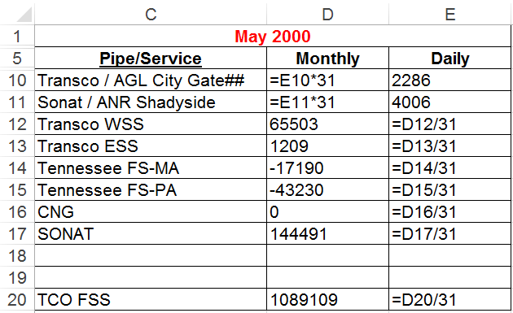


A spreadsheet usage scenario
Service price in May
Enter data
Write formula
Alice
Share
Bob

Slide 3
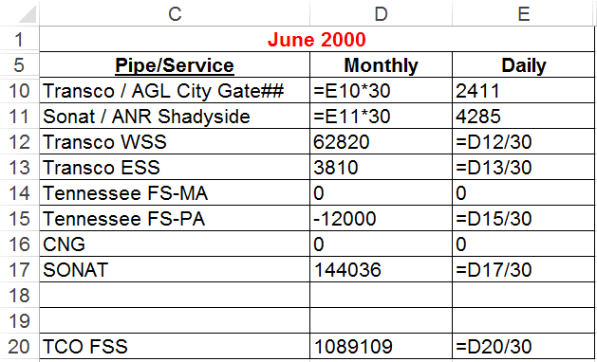
Create a spreadsheet for June
Service price in May
Update data
Modify formulas
Bob
Service price in June
Share
Alice

Slide 4

Similar to software development!
Retrieve
Edit
Share
Developers
Users

Slide 5

Version management is important
Software development
Developer
Developer
Software code is well maintained by version control tools.

Slide 6
Version management is missing
Spreadsheet development
User
User
However, spreadsheets are rarely maintained by version control tools, like SVN and Git.

Slide 7


Do spreadsheet versions matter?
Average lifetime
Average users on a spreadsheet
¹ F. Hermans, M. Pinzger, and A. van Deursen, ICSE’11

Slide 8
Do spreadsheet versions matter?
Find refactoring opportunities
31 days in May
31 & 30 can be changed to a cell A1, which has the number of days
30 days in June
… real spreadsheets from VEnron

Slide 9
Do spreadsheet versions matter?
Find inconsistency
Similar
Inconsistency
The formula is missing
… real spreadsheets from VEnron

Slide 10
Our goal
VEnron
Build an industrial-scale and publicly available spreadsheet evolution corpus
Facilitate future scientific studies on spreadsheet evolution

Slide 11
Why VEnron?
Large spreadsheet corpora so far
EUSES¹
~4,500 spreadsheets
Obtained by searching on Google
FUSE²
~250,000 spreadsheets
Extracted from ~27 billion web pages
Enron³
~15,000 spreadsheets
Extracted from an email archive in the Enron corporation
Independent spreadsheets!
No version information!
¹ M. Fisher and G. Rothermel, WEUSE’05
² T. Barik, K. Lubick, J. Smith, J. Slankas, and E. Murphy-Hill, MSR’15
³ F. Hermans, M. Pinzger, and A. van Deursen, ICSE’15

Slide 12

Why VEnron?
The change history of spreadsheets is rarely documented
90+ million end-user programmers with no comment tracking or version control¹
Few companies may use version management tools (e.g., SharePoint, SpreadGit, Github) for spreadsheets, they are unwilling to share them due to business confidentiality
¹ P. Durusau and S. Hunting, The Markup Conference’15

Slide 13

Version information is not available in spreadsheets! Why can we build VEnron?

Slide 14

How are spreadsheets exchanged?
Spreadsheet development
User
User
Emails are a common way to exchange spreadsheets

Slide 15
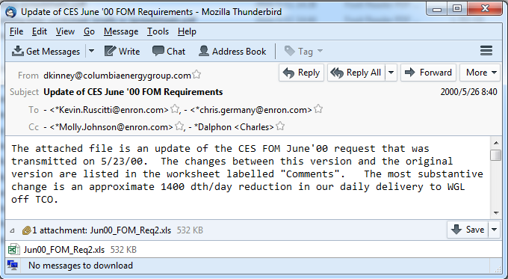
Emails provide version information!
Emails can (partially) provide the history of spreadsheets
Sender
Time
Receivers
Previous version
Spreadsheet

Slide 16
How can we build VEnron?

Slide 17

Why choose the Enron email archive?
We choose the Enron email archive as our subject¹
Publicly available
Real emails and spreadsheets in the Enron corporation
Large
~750,000 emails
~15,000 unique spreadsheets
¹ http://info.nuix.com/Enron.html

Slide 18
Approach overview
Enron emails
Cluster
spreadsheets
evolution group
A group of spreadsheets that are originated from the same spreadsheet
Recover
version
orders
VEnron

Slide 19
How to cluster spreadsheets?
Manually check ~15,000 spreadsheets and their related emails?
Unclear semantics in these spreadsheets
Unknown social network among users
Mission Impossible!

Slide 20
A viable way to cluster spreadsheets
Cluster spreadsheets into different groups according to spreadsheet filename similarity
Spreadsheets in an evolution group often have the same shortened filename by deleting version-related substrings.
Version id | Spreadsheet filename
v1 | May00_FOM_Req2.xls
v2 | Jun00_FOM_Req.xls
v3 | July00_FOM_Req.xls
v4 | July00_FOM_Req02.xls
v5 | Aug00_FOM_Req.xls
Date for versions
ID for versions
Shortened names

Slide 21
A viable way to cluster spreadsheets
The clustering approach may misjudge situations, and wrongly cluster spreadsheets
Manually validated each group, and adjusted each group accordingly
Key idea: check whether all spreadsheets in a group share similar table structures
Similarity on worksheet names?
Similarity on the structure of corresponding worksheets?

Slide 22
Recover version orders (1)
Manually recover version orders by using spreadsheet-related version information
Timestamps indicate version orders
Spreadsheet filenames, worksheet names, spreadsheet tables
Version id | Spreadsheet filename | Worksheet names
v1 | May00_FOM_Req2.xls | FOM May Storage
v2 | Jun00_FOM_Req.xls | FOM Jun Storage
v3 | July00_FOM_Req.xls | FOM Jul Storage
v4 | July00_FOM_Req02.xls | FOM Jul Storage
v5 | Aug00_FOM_Req.xls | FOM Aug Storage

Slide 23
Recover version orders (2)
The email sending history
S
S’
Alice
Bob
Spreadsheets S and S’ belong to the same evolution group

Slide 24
Recover version orders (3)
Email contents may clearly describe where the current spreadsheet come from
“The attached file is an update of CEF FOM June'00 request that was transmitted on 5/23/00”
Previous version

Slide 25

Recover version orders (4)
Timestamps
v1
v2
v3
v4
Email sending history
Total order
Email contents

Slide 26
How about VEnron?

Slide 27
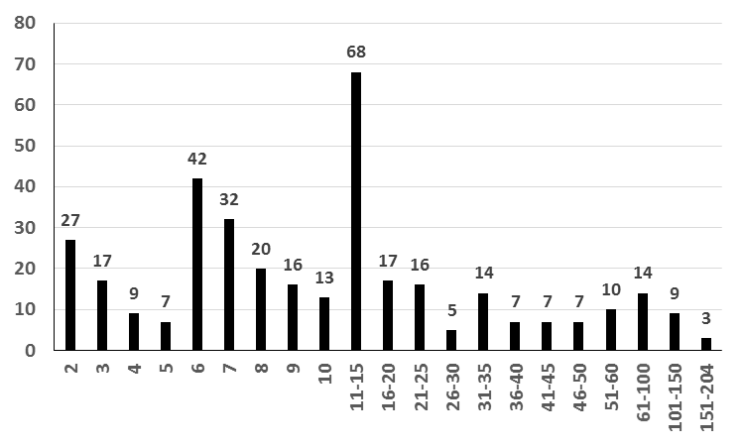
Statistics of evolution groups
360 evolution groups
7,294 spreadsheets and 35,373 worksheets in total
83% groups have more than 5 versions
#group
#spreadsheet

Slide 28
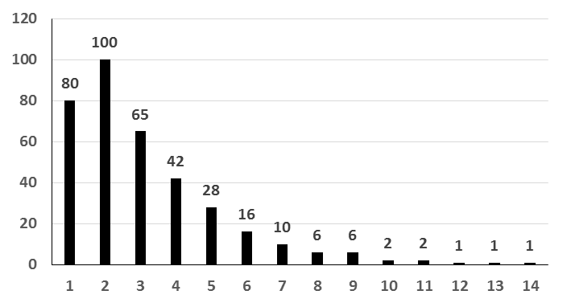
Statistics - More
78% groups are maintained by more than 1 user
#group
#user

Slide 29
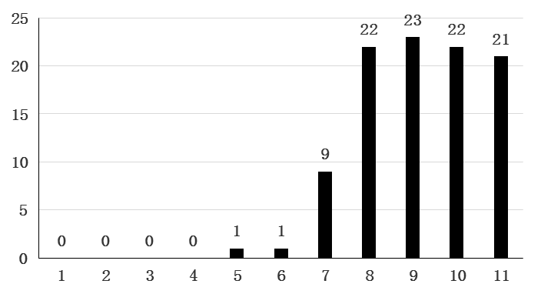
Statistics - More
Count the number of Excel built-in errors
E.g., #Div/0!, #N/A!, etc.
16.9% groups introduce new errors during evolution
#error
#version id
Find more statistics in the paper…

Slide 30
Takeaway
VEnron: The first industrial-scale and publicly available spreadsheet evolution corpus
360 evolution groups, including 7,294 spreadsheets and 35,373 worksheets
Initial statistics (evidence) have shown that VEnron contains interesting evolution, and could be a basis for future studies on spreadsheet evolution
Have a try!
http://sccpu2.cse.ust.hk/venron/

Slide 31

Thank you!

