Slide 1


Model Checking Guided Testing for Distributed Systems
The 18th European Conference on Computer Systems (EuroSys 2023)
Dong Wang, Wensheng Dou, Yu Gao, Chenao Wu and Jun Wei
Institute of Software
Chinese Academy of Sciences
University of Chinese
Academy of Sciences
Notes:
Hello everyone. I’m Dong WANG, from university of Chinese academy of sciences. I’m here to introduce our work: model checking guided testing for distributed systems.

Slide 2








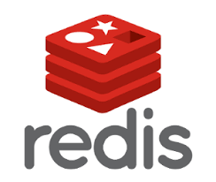
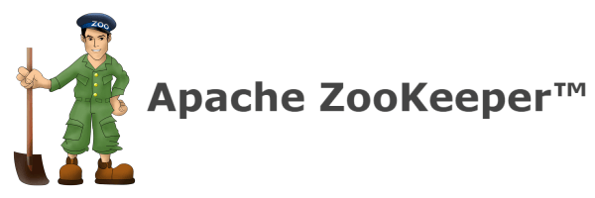







Large-scale distributed systems are widely used
Notes:
Large-scale distributed systems are widely used around the world, and plays an important role in Internet companies.

Slide 3



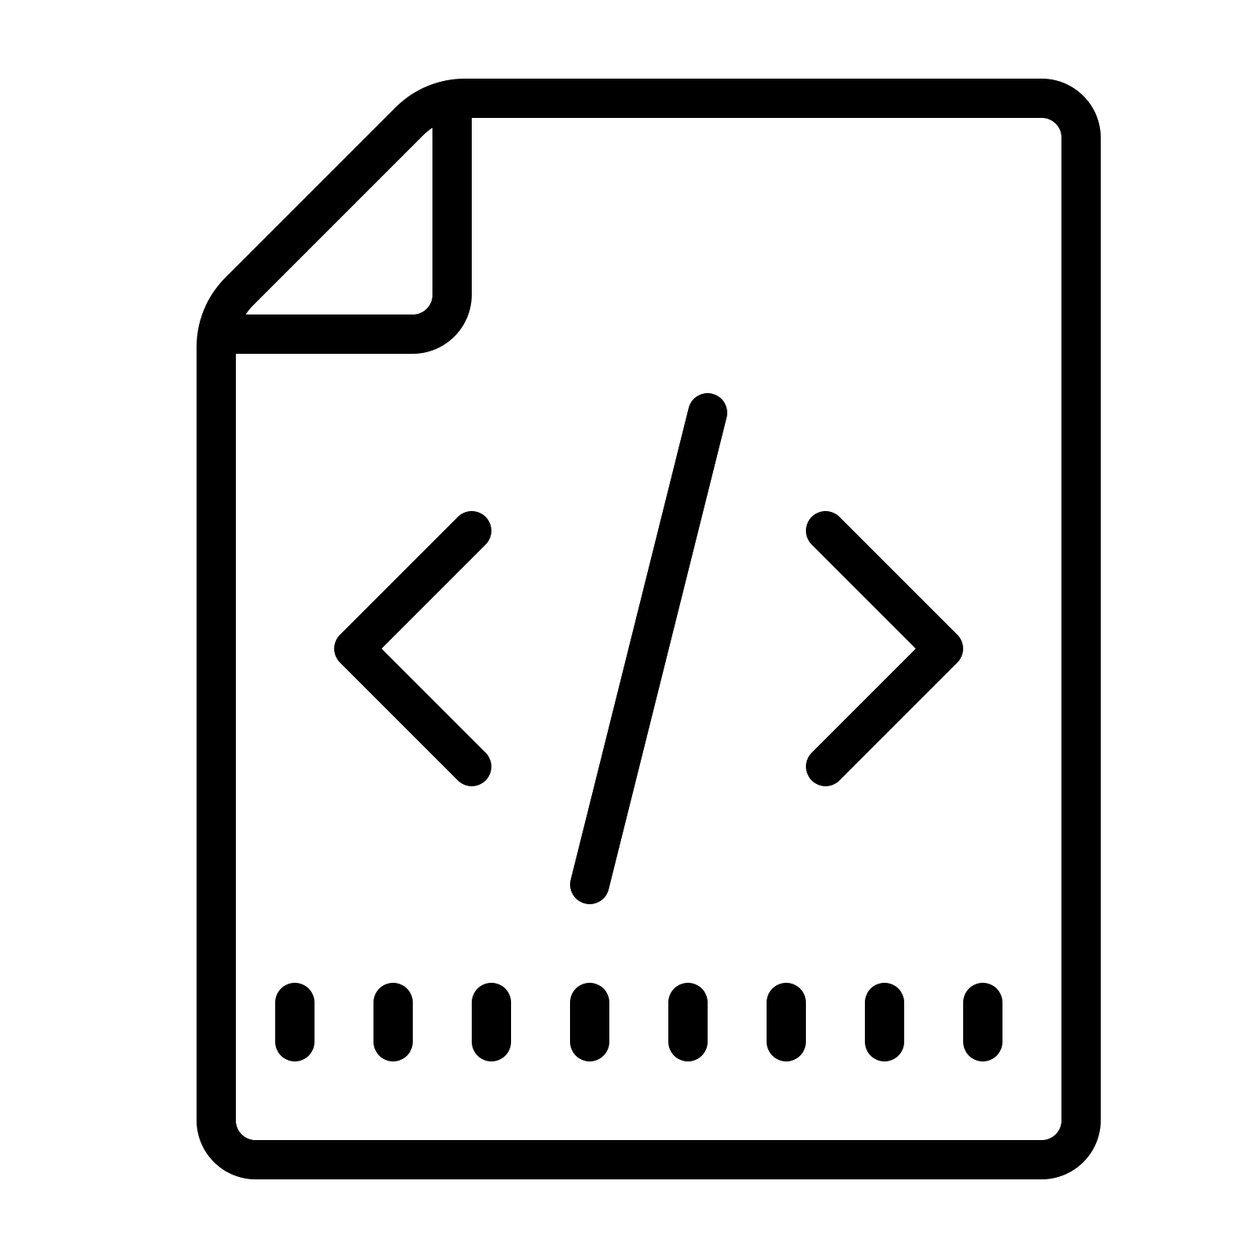
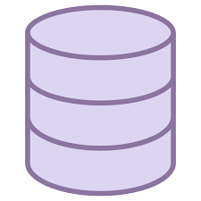

Distributed system bugs cause severe impacts
Implementation incorrectness
Reliability threats
Finance loss
Notes:
Bugs in distributed systems can cause severe impacts. The bug in incorrect implementation can cause reliability threats, and further causes huge finance loss.

Slide 4

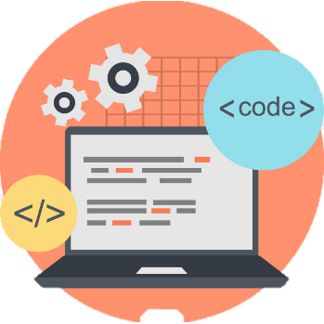









Verify distributed systems’ design^{[1-5]}
TLA+ Formal specification
System code
Build
Cannot guarantee that the system code is correct!
Verify
Check each state
Abstract state space
[1] TLA+ in TiDB. https://github.com/pingcap/tla-plus. 2022
[2] David Langworthy. TLA+ at Microsoft: 16 Years in Production. TLA+ Conference. 2020.
[3] William Schultz. Fixing a MongoDB Replication Protocol Bug with TLA+. TLA+ Conference. 2020.
[4] Yannick Welsch. Using TLA+ for Fun and Profit in the Development of Elasticsearch. TLA+ Conference. 2020
[5] Chris Newcombe et al. How Amazon Web Services Uses Formal Methods. ACM Communication 58, 4 (2015), 66 - 73.
Notes:
In recent years, to combat bugs in distributed systems, verifying distributed systems’ design by formal methods, like TLA+, have become popular. Developers build the formal specification for a distributed system, and further verify whether its design is correct.
However, even if we have verified the specification, we still cannot guarantee that the system code is correct.

Slide 5
Formal verification frameworks
IronFleet [1] and Verdi [2] can help developers build a correct distributed system from scratch.
Using IronFleet to build C# distributed systems
300+ LOC
High-level specification (State machine)
Develop
Prove refinement
900+ LOC
Distributed protocol (TLA)
39000+ LOC
Develop
Prove refinement
5000+ LOC
Practical Implementation (C#)
Cannot verify the correctness of an existing implementation!
[1] Chris Hawblitzel, et al. IronFleet: Proving Practical Distributed Systems Correct. SOSP 2015.
[2] James R Wilcox, et al. Verdi: A Framework for Implementing and Formally Verifying Distribtued Systems. PLDI 2015.
Notes:
Researchers have presented formal verification frameworks to build correct distributed systems from scratch.
To be specific, these frameworks require developers first writing high-level specifications, and then develop the more practical code layer by layer.
Finally, to prove that the implementation is correct, developers must write code to prove that the lower layer code refine the upper layer code. In IronFleet, the refinement can take over 39,000 lines of code, which is too expensive.
On the other hand, these frameworks cannot verify the correctness of an existing implementation.

Slide 6
Model-based testing^{[1-3]}
Researchers design models for specific properties or behaviors of distributed systems and derive test cases from models.
Using Modulo to test convergence property of distributed systems
Cannot test
other properties!
System operations
Node crash
Network partition
Abstract convergence model
Concrete execution model
System under test
[1] A Jesse Jiryu Davis et al. eXtreme Modelling in Practice. VLDB 2020.
[2] Yishuai Li et al. Model-Based Testing of Networked Applications. ISSTA 2021.
[3] Beom Heyn Kim et al. Modulo: Finding Convergence Failure Bugs in Distributed Systems with Divergence Resync Models. ATC 2022.
Notes:
Model-based testing is another technique to find bugs in distributed system implementations. Researchers design models for specific properties or behaviors of distributed systems and derive test cases from these models.
For example, Modulos use an abstract model to define the convergence property of distributed systems, and further use a concrete execution model to generate test cases for the system under test.
However, model-based testing can only test specific properties, but cannot test other properties.

Slide 7
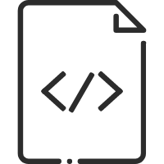



Implementation-level model checkers
MoDist [1], Samc [2] and FlyMC [3] intercept and reorder concurrent events at runtime to enforce the system into specific states.
Manually written assertions
m₁
m₂
Manually designed workloads
Execute m₂ first,
and then m₁.
Checker
server
System under test
[1] Junfeng Yang, et al. MoDist: Transparent Model Checking of Unmodified Distributed Systems. NSDI 2009.
[2] Tanakorn Leesatapornwongsa, et al. Samc: Semantic-Aware Model Checking for Fast Discovery of Deep Bugs in Cloud Systems. OSDI 2014.
[3] Jeffrey F Lukman, et al. FlyMC: Highly Scalable Testing of Complex Interleavings in Distributed Systems. EuroSys 2019.
Notes:
Implementation-level model checkers, like Modist, samc and flymc, intercept and reorder concurrent events like messages at runtime, and enforce the system into specific states. However, they rely on manually written assertions. Moreover, to perform a systematic testing, developers also need to manually design multiple workloads.
Next, I will introduce how we test distributed systems.

Slide 8

Observation and insight
TLA+ specification
System implementation
TLC model
checking
System states
System behaviors
Test oracles
Test cases
Abstract state space
Notes:
We observe that the TLA+ formal specification and the abstract state space define the system states and behaviors, so we consider that if we can use them as test oracles and test cases to test the system implementation.

Slide 9
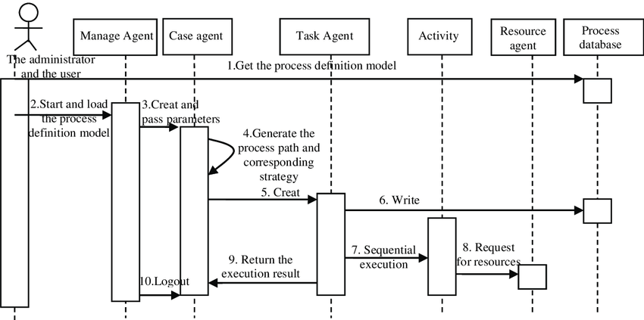
Mocket: model checking guided testing
TLA+ specification
System implementation
Map
Precise: use states and behaviors defined in the specification as testing oracles
Systematic: test the whole abstract state space
Implementation-level: find bugs in real-world distributed systems
TLC model
checking
Deploy &
execute
Guide
Abstract state space
System testing
Notes:
We propose Mocket to perform the model checking guided testing.
We first map the TLA+ specification to the system implementation. Then, we deploy and execute the mapped code. During the system execution, we use the abstract state space to guide the system testing process.
Mocket should be precise, since it uses states and behaviors defined in the specification as testing oracles.
It should also be systematic, because it tests the whole state space defined in the specification.
Finally, Mocket performs implementation-level testing. It can find bugs in real-world distributed systems.

Slide 10
Example: leader election in Raft protocol
Node 1
Node 2
Node 3
role=Follower
term=0
role=Follower
term=0
role=Follower
term=0
Timeout
role=Candidate
term=1
RequestVote(N₃)
HandleRequestVoteRequest(N₁)
RequestVote(N₂)
HandleRequestVoteRequest(N₁)
term=1
term=1
HandleRequestVoteResponse(N₂)
HandleRequestVoteResponse(N₃)
BecomeLeader
role=Leader
Notes:
We use the leader election in Raft protocol as the example to illustrate Mocket.
Consider three follower nodes with term equals 0. At first, A timeout occurs on Node 1. Node 1 changes its role to candidate and sets its term as 1.
Then, it sends a requestvote message to Node 3. Node 3 handles with the request, sets its term as 1, and sends a response back to Node 1. After that, Node 1 handles with the response. The same process also occurs on Node 2. Finally, Node 1 become the leader and changes its role to leader.

Slide 11
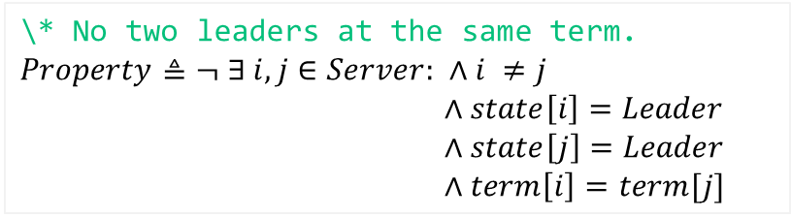
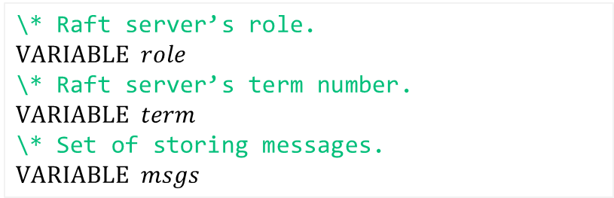
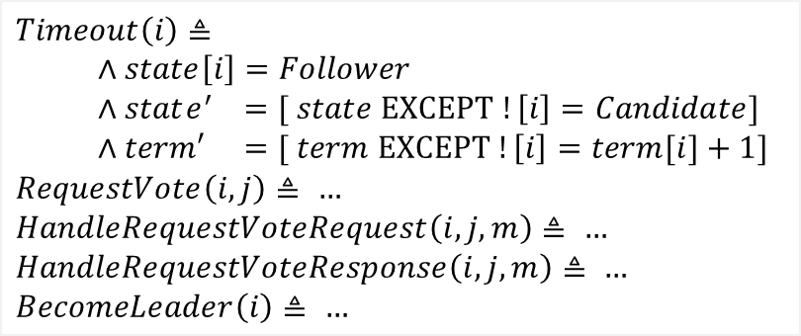
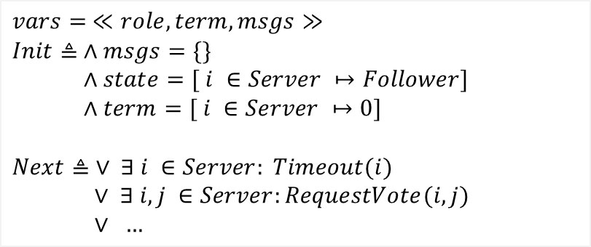
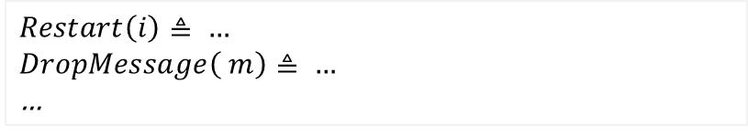
TLA+ specification
\* Raft server’s role.
$$VARIABLE role$$
\* Raft server’s term number.
$$VARIABLE term$$
\* Set of storing messages.
$$VARIABLE msgs$$
$$vars= ≪role, term, msgs≫$$
$$Init≜ ∧msgs=\{\}$$
$∧state=[ i ∈Server ↦Follower]$
$∧term=[ i ∈Server ↦0]$
$$Next≜ ∨ ∃ i ∈Server: Timeout(i)$$
$∨ ∃ i,j ∈Server:RequestVote(i,j)$
$∨ …$
Variables express system states
$$CONSTANTS Server,Follower,Candidate,Leader$$
$$Timeout\left(i\right)≜$$
$∧state\left[i\right]=Follower$
$∧state^{′} =[ state EXCEPT !\left[i\right]=Candidate]$
$∧term′ =[ term EXCEPT !\left[i\right]=term[i]+1]$
$$RequestVote\left(i, j\right)≜ …$$
$$HandleRequestVoteRequest\left(i, j, m\right)≜ …$$
$$HandleRequestVoteResponse\left(i, j, m\right)≜ …$$
$$BecomeLeader\left(i\right)≜ …$$
$$Spec≜Init∧□\left[Next\right]vars$$
\* No two leaders at the same term.
$$Property≜¬ ∃ i,j∈Server: ∧i ≠j$$
$∧state\left[i\right]=Leader$
$∧state\left[j\right]=Leader$
$∧term\left[i\right]=term[j]$
Actions express system behaviors
$$Restart\left(i\right)≜ …$$
$$DropMessage\left( m\right)≜ …$$
…
Notes:
Such a scenario can be modelled by a TLA+ specification. First, we define variables like role and term that express system states, and constants such as follower, candidate and leader. Then, we define actions that express system behaviors. RequestVote, BecomeLeader, and faults that can be tolerated by Raft, like restart and drop message. Then, we define the initial state in the specification, and the concurrency relationships between actions. After that, we define the specification should starts at the initial state and execute actions on it. At last, we define properties to check. For example, there should not be two leaders at the same term in the cluster.

Slide 12
TLC model checking
TLC performs actions at the current state to exhaust all possible states
/\ state = {N1=Follower,N2=Follower,N3=Follower}
/\ term = {N1=0,N2=0,N3=0}
/\ msgs = {}
Server = {N1, N2, N3}
Timeout(N1)
Timeout(N3)
/\ state = {N1=Candidate,N2=Follower,N3=Follower}
/\ term = {N1=0,N2=0,N3=0}
/\ msgs = {}
/\ state = {N1=Candidate,N2=Follower,N3=Follower}
/\ term = {N1=0,N2=0,N3=0}
/\ msgs = {}
Timeout(N2)
/\ state = {N1= Follower,N2=Candidate,N3=Follower}
/\ term = {N1=0,N2=0,N3=0}
/\ msgs = {}
Notes:
Then, we use TLC to perform model checking on the specification. We set 3 nodes, N1, N2 and N3 in the cluster, and starts from the initial state. TLC performs actions on the current state to exhaust all possible states. For example, timeout occurs on different nodes at the initial state and generate three different states, and TLC iteratively generate more states, and check if these states violate the property.

Slide 13
Use the state graph to guide system execution
BecomeLeader(N1)
void becomeLeader() {
state = NodeState.STATE_LEADER;
…
}
S_{i} : role={N1:Leader}
Notes:
Finally, TLC can generate a state graph, and we can use the graph to guide the system execution. For example, if the graph has an action becomeleader and generate a state, in which the variable role of N1 is Leader, we should execute the corresponding code, the method becomeleader, and change the corresponding variable state to Leader.

Slide 14
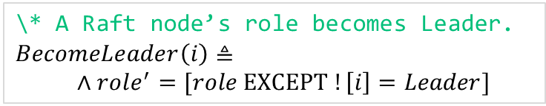
Map actions to implementation
We annotate the action names and parameters in the implementation
TLA+ action
Corresponding implementation
\* A Raft node’s role becomes Leader.
$$BecomeLeader\left(i\right)≜$$
$∧role^{′}=[role EXCEPT !\left[i\right]=Leader]$
void becomeLeader() {
state = NodeState.STATE_LEADER;
…
}
+@Action(“BecomeLeader”)
+ Action.getParams(this.NodeId);
Notes:
To realize the guidance, we must map actions to corresponding implementation code. We annotate the action name and parameters in the implementation.
For example, the action becomeleader can be mapped to a method becomeLeader, so we add an annotation with the value of the action name for the corresponding method. In addition to that, we add a statement to collect the action parameter, which is the node ID i defined in the specification.

Slide 15



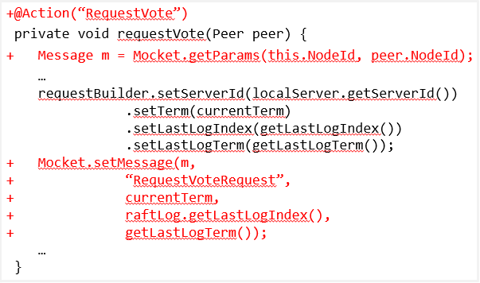
Different mapping strategies
We design multiple strategies for mapping different actions
Single-node actions
Message-related actions
External faults
User requests
+@Action(“BecomeLeader”)
+Mocket.begin(“Action”)
+Action.getParams()
+Mocket.end(“Action”)
Annotations / APIs
Overriding mapped actions
Script
Find more details in our paper!
Notes:
We design multiple strategies for mapping different actions, and you can find more details in our paper.

Slide 16
Instrument mapped actions
@Action(“BecomeLeader”)
void becomeLeader() {
+ Action.getParams(this.NodeId);
state = NodeState.STATE_LEADER;
…
}
Can I execute now?
+ Mocket.notifyAndBlock();
Yes, you can!
+ Mocket.checkState();
This is my current state. Check it please.
Mocket server
Notes:
Furthermore, we instrument each mapped action. At the beginning of the mapped action, we automatically instrument a statement notifyAndBlock. The statement sends the message to Mocket server to ask whether the code can be executed. The server checks the state graph and decide its execution timing. Once the action is enabled, the server reply and resume the blocked code. At the end of the mapped action, we automatically instrument a statement checkState. The statement collects state values and sends them to the server to check whether they are compliant to the state graph.

Slide 17
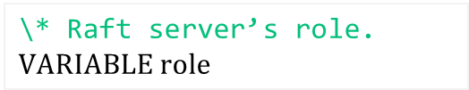
Map variables to check states
Corresponding implementation
public class RaftNode {
private NodeState state =
NodeState.STATE_FOLLOWER;
private void becomeLeader() {
state = NodeState.STATE_LEADER;
…
}
}
+ @Varibale(“role”)
TLA+ variable
Automatically add a shadow variable
\* Raft server’s role.
$$VARIABLE role$$
+ public static NodeState Mocket$state
+ = NodeState.STATE_FOLLOWER;
+ Mocket$state = NodeState.STATE_LEADER;
Check the shadow variable’s value to avoid affecting the system execution
Notes:
To check states, we need to map TLA+ variables to the implementation. For example, the TLA+ variable role can be mapped to a field state, so we add a variable annotation for the field. Mocket will automatically add a shadow variable for each annotated TLA+ variable, and change its value whenever the original variable’s value is changed. In this way, we can directly check the shadow variable’s value to avoid affecting the system execution.

Slide 18
Bug detection
Inconsistent state
Inconsistent action
Test case
System running
Test case
System running
S₀
S₀
a
a
a
a’
S₁
S’
Missing
action!
Unexpected action!
Notes:
Mocket can report inconsistency between the specification and the implementation. If Mocket finds that an action at system running generate a different state from the test case, it is an inconsistent state. If an action exists in the test case, but Mocket never encounters it during system running, it is a missing action inconsistency. On the other hand, if another different action occurs, it is an unexpected action inconsistency.

Slide 19

Is the inconsistency caused by Spec. or Impl.?
Inconsistent state
Implementation bug
Inconsistent action
Manual investigation
Specification bug
Notes:
After Mocket reports inconsistencies, we must perform a manual investigation on the inconsistency to figure out whether it is caused by the issue in specification or implementation. If it exists in implementation, it is an implementation bug. Otherwise, it is a specification bug.

Slide 20
State graph traversal
We traverse the state graph to get paths as test cases
Crash(N1)
CrashedNode: {}
CrashedNode: {N1}
Reboot(N1)
It is impossible to traverse all paths in a graph with circles!
Notes:
To find such bugs, we traverse the state graph to get paths as test cases for Mocket.
However, due to the existence of circles in the graph, it is impossible to traverse all paths. For example, for a circle with two actions of crash and reboot, we can crash a node and then reboot it infinitely.

Slide 21
Edge-coverage based graph exploration
We aim to cover as more actions (edges) as possible
Perform the depth-first search from the initial state
Prefer to visit edges that have not been visited before
1
1
2
3
2
4
2
2
2
3
4
3
4
Notes:
Thus, we choose to perform edge-coverage based graph exploration to cover as more actions as possible in a single path.
We perform the depth-first search from the initial state, and prefer to visit edges that have not been visited before.
For such a state graph, we can finally get such two paths by our strategy.

Slide 22
Edge-coverage based graph exploration
We aim to cover as more actions (edges) as possible
Perform the depth-first search from the initial state
Prefer to visit edges that have not been visited before
1
1
2
3
2
4
2
2
2
1
2
3
4
3
3
3
4
4
Notes:
Thus, we choose to perform edge-coverage based graph exploration to cover as more actions as possible in a single path.
We perform the depth-first search from the initial state, and prefer to visit edges that have not been visited before.
For such a state graph, we can finally get such two paths by our strategy.

Slide 23


Workflow
TLA+ specification
Implementation
Var₂
Class{
Field f;
Method(){
…
}
}
VARIABLE ,
ActionA $≜$
ActionB $≜$
Next $≜ ∨$
$∨$
Var₁
Map
@Variable(Var₁)
Instrument
Node 1
…
Node N
@Action(A)
Deploy
hook
hook
a₁
a_{n}
Enable a₁
Check s₁
TLC model
checking
Block a_{n}
Current test case:
s₀ → a₁ → s₁ → a₂ → s₃ → a₄ → …
Controlled
testing
Generate
To-be-tested cases
s₀ → a₃ → s₃
s₀ → a₁ → s₁ → …
…
State space graph
Test cases
Notes:
In summary, our approach works in the following 4 steps. We first map the TLA+ specification to the implementation, and perform model checking by TLC to generate state space graph. Then, we traverse the graph to generate test cases. After that, we instrument the mapped implementation and deploy it, and perform controlled testing according to test cases. During testing, we control the execution of actions and check states.

Slide 24
Evaluation: practice on Raft protocol
Existing TLA+ specification
800+ LOC
16,530 LOC
15,017 LOC
Two open-source implementations
151 LOC Annotation
152 LOC Annotation
~Two weeks
~Two weeks
Xraft
Raft-java
Notes:
To evaluate Mocket, we have performed two practices on three distributed systems.
The first practice is to apply Mocket on Raft, a consensus protocol.
Developers have already written TLA+ specification for Raft protocol, we select two open-source implementations, Xraft and Raft-java as our subjects.
Raft’s TLA+ specification is written in around 800 lines of code, and the two implementations are developed in around 16 / 15 thousands lines of code. We use 151 and 152 lines of code to annotate these two implementations, respectively, and spend 2 weeks to test each of them.

Slide 25
Evaluation: practice on ZooKeeper system
Existing system
15,895 LOC
134 LOC Annotations
~Five weeks
TLA+ specification developed by us
1,053 LOC
Notes:
The other practice is to apply Mocket on ZooKeeper, a coordination system.
ZooKeeper is a mature existing system. We developed a TLA+ specification for it. We use 1,053 lines of code to define the implementation in around 15 thousands lines of code, and use 134 lines of code for annotating it, and spend 5 weeks to perform the whole practice.

Slide 26
Detected bugs
We have detected 9 bugs including 3 unknown bugs
ID | Type | Reported Inconsistency | Elapsed Time | # Actions
Xraft Bug #1 (New) | Impl. Bug | Inconsistent state for variable votesGranted | 1 min | 6
Xraft Bug #2 (New) | Impl. Bug | Inconsistent state for variable votedFor | 7 min | 9
Xraft Bug #3 (New) | Impl. Bug | Unexpected action HandleRequestVoteResponse | 39 min | 19
Raft-java Bug #1 | Impl. Bug | Missing action HandleRequestVoteResponse | 6 min | 18
Raft-java Bug #2 | Impl. Bug | Inconsistent state for variable log | 5 hours | 31
ZooKeeper Bug #1 | Impl. Bug | Unexpected action ReceiveMessage | 13 hours | 39
ZooKeeper Bug #2 | Impl. Bug | Missing action StartElection | 29 hours | 51
Raft-spec issue #1(New) | Spec. Bug | Inconsistent state for variable messages | < 1 min | 8
Raft-spec issue #2(New) | Spec. Bug | Missing action UpdateTerm | < 1 min | 5
Notes:
In total, we have discovered 9 bugs, including 3 unknown bugs, 4 known bugs, and 2 specification bugs in Raft. The deepest bug is a known ZooKeeper bug that requires 51 actions and 29 hours to be manifested.

Slide 27
Testing efforts
We have tested more than thousands of test cases for all three systems
System | # States | # Paths | Time
Xraft | 91,532 | 39,047 | 75 hours
Raft-java | 23,911 | 9,829 | 31 hours
ZooKeeper | 105,054 | 44,361 | 124 hours
Notes:
We have tested more than thousands of test cases for all three systems. Testing ZooKeeper took the most time, 124 hours, because ZooKeeper is the most complex among the three systems.

Slide 28



Lessons learned
Testing-oriented TLA+ specification development
What properties to check?
Extract actions first!
Developing TLA+ specification only for verification
Developing TLA+ specification for testing by Mocket
Notes:
During the practices, we have also learned some lessons. For example, it is different when developing TLA+ specification for only verification and for testing by Mocket. When only for verification, we always first consider what properties to check. But when we develop the specification for testing, we first extract actions from the implementation.

Slide 29
Lessons learned
Developers may need to rerun the testing for multiple rounds to fix human mistakes
@Action(“RequestVote”)
void becomeLeader() {
state = NodeState.STATE_LEADER;
…
}
Unexpected action RequestVote!
No inconcsitencies.
@Action(“BecomeLeader”)
void becomeLeader() {
state = NodeState.STATE_LEADER;
…
}
Mocket server
Notes:
Another lesson it that developers may make mistakes when developing TLA+ specification or performing mapping, and they need to fix these mistakes and rerun the testing.
For example, when mapping an action becomeleader, we mistakenly write the action name as requestvote. During testing, Mocket server will report an unexpected action for requestvote, which is not a real bug. To fix it, we need to correct the annotation value, and rerun the whole testing.

Slide 30

Conclusion
We propose Mocket to test distributed systems
Precise: Mocket uses states and behaviors defined TLA+ specification as test oracles
Systematic: Mocket uses the state graph generated by TLC to generate test cases
We conduct two practices of applying Mocket on three distributed systems
Implementation-level: Mocket is feasible to test real-world distributed systems
https://github.com/tcse-iscas/Mocket
Notes:
To conclude this work, we propose Mocket to test distributed system.
Mocket is precise and systematic. because it uses the TLA+ specification and state graph as test oracles and test cases.
We conduct two practices of applying Mocket on three distributed systems, which prove that Mocket is feasible to test real-world distributed systems.
We have made Mocket publicly available on GitHub. Please feel free to contact us about any suggestion or question.

Slide 31
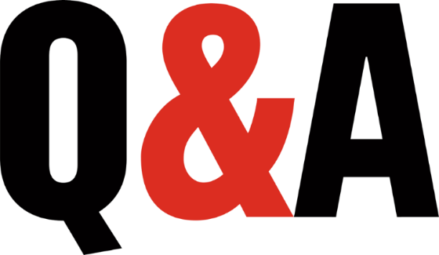
THANK YOU!
Notes:
Thank you for listening. Now I’m ready to answer questions.

