Slide 1




45th International Conference on Software Engineering
Coverage Guided Fault Injection for Cloud Systems
Yu Gao, Wensheng Dou, Dong Wang, Wenhan Feng, Jun Wei, Hua Zhong, Tao Huang
Institute of Software, Chinese Academy of Sciences
University of Chinese Academy of Sciences
Notes:
Hello, I’m Yu Gao, from Institute of Software, Chinese Academy of Sciences.
I’m pleased to introduce our work: Coverage Guided Fault Injection for Cloud Systems

Slide 2




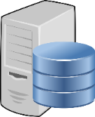

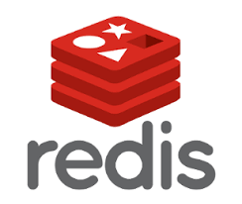
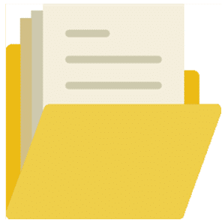




Cloud Systems
Cloud systems consist of thousands of nodes running complex protocols
Notes:
Large scale cloud systems usually consist of thousands of nodes, and involve complex protocols and implementations
Nodes in cloud systems depend on I/O operations to produce persistent states or store states into other nodes

Slide 3
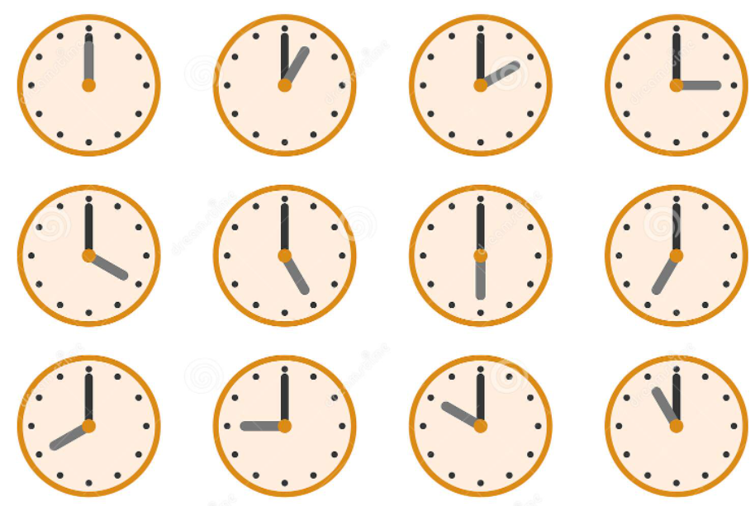

Faults in Cloud Systems
In cloud systems, any node can crash or reboot at any time
Power off
Hardware failure
Scheduled restart
Node crashes and reboots can result in specific crash states
Notes:
Node crashes and reboots are inevitable /ɪnˈevɪtəbl/ in cloud systems. Any node In cloud systems can crash or reboot at any time.
These node crashes and reboots can result in specific crash states

Slide 4












Are Cloud Systems Fault Tolerant?
Node crashes/reboots can trigger crash recovery procedures, which are designed to tolerate these faults
Node A
Node B
Node A
Node B
Node C
$O_{A3}$: W(B, msg-x)
$O_{B6}:$R(A, msg-x)
$O_{A1}$: W(B, hb)
$${\text{Recovery}}_{A}$$
$O_{B1}$: R(A, hb)
Make C take over A’s task
Remove A from its node list
$O_{B7}$: W(C, msg-y)
$O_{C4}$: R(B, msg-y)
The cloud system can correctly recover from these crash states
(b)
Notes:
When a node crashes or reboots, it will trigger corresponding recovery procedures /prəˈsiːdʒəz/, which are responsible for handling the fault and recovering the cloud system to a normal state. As shown in the figure, when node A crashes before sending a heartbeat message to node B, B will remove A from its node list. When node A crashes after submitting a task, B will make another node C take over A’s task. Both of these two crash scenarios can be tolerated by the cloud system.

Slide 5










Are Cloud Systems Fault Tolerant?
Specific node crashes/reboots can trigger crash recovery bugs hidden in incorrect crash recovery mechanisms and implementations
Node A
Node B
Node C
$O_{A3}$: W(B, msg-x)
$O_{B6}:$R(A, msg-x)
$${\text{Recovery}}_{A}$$
$O_{B7}$: W(C, msg-y)
$O_{C4}$: R(B, msg-y)
$O_{C5}$: W(Disk, buf)
Fail to recover the task
$O_{B8}$: R(C, msg-z)
$O_{C6}$: W(B, msg-z)
The cloud system cannot correctly recover from this crash state
Notes:
However, Node crashes and reboots that occur under special timing can trigger crash recovery bugs hidden in incorrect crash recovery mechanisms and implementations.
For example, the crash scenario shown in the figure can make the cloud system fail to recover the task due to a crash recovery bug.

Slide 6
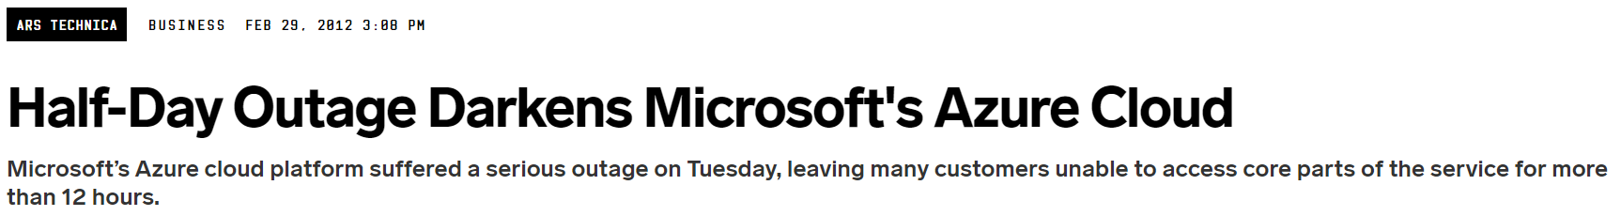
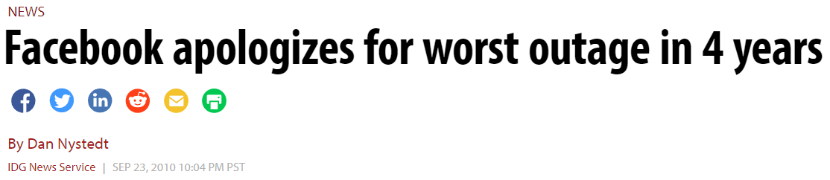
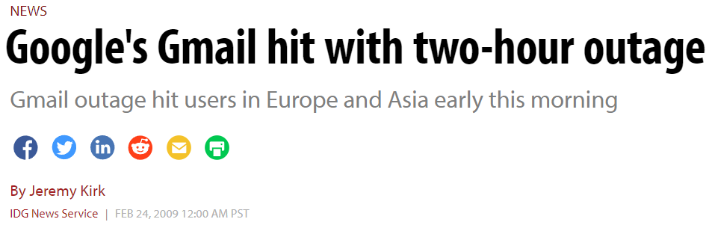
Crash Recovery Bugs can Cause Severe Consequences
Systematically test the correctness of cloud systems in dealing with node crashes and reboots?
Notes:
Crash recovery bugs can cause severe /sɪˈvɪr/ consequences, and affect the reliability and availability of cloud systems.
To test the correctness of cloud systems in how they deal with node crashes and reboots, an intuitive /ɪnˈtuːɪtɪv/ approach is to systematically exercise all possible crash scenarios, and observe whether a cloud system can correctly recover from these crash scenarios.

Slide 7








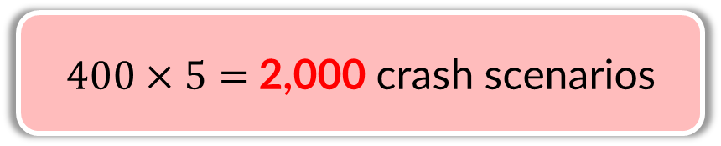








Systematically Exercising All Possible Crash Scenarios is Challenging
Cloud systems face huge crash scenario space
$$O_{1}$$
$$O_{1}$$
$$O_{1}$$
$$O_{1}$$
$$O_{1}$$
$$O_{2}$$
$$O_{2}$$
$$O_{2}$$
$$O_{2}$$
$$O_{2}$$
$400×5=$2,000 crash scenarios
…
…
…
…
…
$$O_{400}$$
$$O_{400}$$
$$O_{400}$$
$$O_{400}$$
$$O_{400}$$
Inject only one node crash on the I/O points …
Notes:
However, it’s challenging to systematically explore the crash scenario space of cloud systems. In our experiments, a HDFS system with 5 nodes can produce around 400 I/O operations for each node. When injecting only one node crash on these I/O points, we can produce 2,000 crash scenarios.

Slide 8
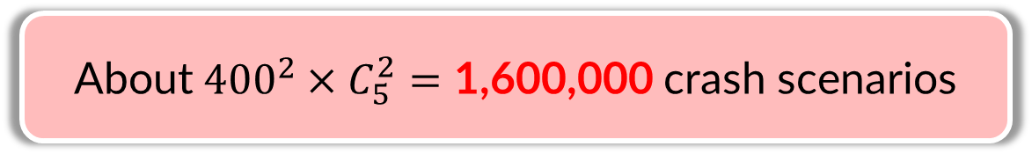
Systematically Exercising All Possible Crash Scenarios is Challenging
Cloud systems face huge crash scenario space
$$O_{1}$$
$$O_{1}$$
$$O_{1}$$
$$O_{1}$$
$$O_{1}$$
$$O_{2}$$
$$O_{2}$$
$$O_{2}$$
$$O_{2}$$
$$O_{2}$$
About${400}^{2}×C_{5}^{2}=\text{1,600,000}$crash scenarios
…
…
…
…
…
$$O_{400}$$
$$O_{400}$$
$$O_{400}$$
$$O_{400}$$
$$O_{400}$$
Inject two crashes on the I/O points from two different nodes …
Notes:
When injecting two crashes on the I/O points from two different nodes, we can produce around 1.6 million crash scenarios.

Slide 9

Systematically Exercising All Possible Crash Scenarios is Challenging
Cloud systems face huge crash scenario space
$$O_{1}$$
$$O_{1}$$
$$O_{1}$$
$$O_{1}$$
$$O_{1}$$
$$O_{2}$$
$$O_{2}$$
$$O_{2}$$
$$O_{2}$$
$$O_{2}$$
…
…
…
…
…
$$O_{400}$$
$$O_{400}$$
$$O_{400}$$
$$O_{400}$$
$$O_{400}$$
When considering more node crashes and even node reboots …
Notes:
When we further consider more node crashes and even node reboots, the number of possible crash scenarios could increase quickly. Therefore, testing cloud systems by enumerating all possible crash scenarios is time-consuming, and may be impossible.

Slide 10







Systematically Exercising All Possible Crash Scenarios is Challenging
Some crash scenarios may trigger the same recovery code and can be tolerated by the cloud system
Node A
Node B
$O_{A1}$: W(B, hb)
$O_{B1}$: R(A, hb)
$O_{A2}$: W(B, hb)
$O_{B2}$: R(A, hb)
$O_{A3}$: W(B, hb)
$O_{B3}$: R(A, hb)
Remove A from its node list
Notes:
We also observe that some crash scenarios may trigger same recovery code and can be tolerated by the cloud system. For example, the three messages shown in the figure are all heartbeat messages. Crashes before sending these heartbeat messages will result in the same recovery code, that is, B removes A from its node list. Such crash scenarios pose challenges for effectively exploring crash scenario space of cloud systems.

Slide 11
State of the Art
Random fault injection [1]: hard to hit corner cases
Exhaustive fault injection [2], distributed system model checkers [3]: not effective in exploring the huge space of crash scenarios
Fault injection strategy specified by developers [4]: rely on the experience of developers
Approaches focus on specific crash scenarios [5-7]: only test limited crash scenarios
[1] Jepsen. https://github.com/jepsen-io/Jepsen.
[2] Haryadi S. Gunawi et al., “FATE and DESTINI: A Framework for Cloud Recovery Testing”, NSD 2011.
[3] J. F. Lukman et al., “FlyMC: Highly scalable testing of complex interleavings in distributed systems”, EuroSys 2019.
[4] Pallavi Joshi et al., “PreFail: Programmable and Efficient Failure Testing Framework”, OOPSLA 2011.
[5] Ramnatthan Alagappan et al., “Correlated Crash Vulnerabilities”, OSDI 2016.
[6] Haopeng Liu et al., “FCatch : Automatically Detecting Time-of-fault Bugs in Cloud Systems”, ASPLOS 2018.
[7] Jie Lu et al., “CrashTuner: Detecting Crash-Recovery Bugs in Cloud Systems via Meta-Info Analysis”, SOSP 2019.
Notes:
A lot of works have been proposed to test the correctness of cloud systems in dealing with faults. Random fault injection frameworks inject crashes randomly, but they are difficult to hit corner-case crash recovery bugs. Exhaustive fault injection approaches and distributed system model checkers are not effective in exploring the huge space of crash scenarios. Some fault injection tools rely on developers to decide fault injection strategies, and other approaches focus on limited crash scenarios.

Slide 12
State of the Art
Random fault injection [1]: hard to hit corner cases
Exhaustive fault injection [2], distributed system model checkers [3]: not effective in exploring the huge space of crash scenarios
Fault injection strategy specified by developers [4]: rely on the experience of developers
Approaches focus on specific crash scenarios [5-7]: only test limited crash scenarios
Can we systematically and effectively explore the crash scenario space of cloud systems?
Notes:
Considering the limitations of existing approaches, we wonder can we systematically and effectively explore the crash scenario space of cloud systems?

Slide 13







Basic Idea: CrashFuzz
We use fault sequences to represent various crash scenarios
Fault sequence: all the I/O points executed in a system run and their corresponding events
Fault point info.
Node ID
Call stack
Timestamp
Event type
…
Node A:
Crash scenario:
Node B:
Node C:
$${Crash}_{B}$$
Fault sequence:
Fault-free event
$${Reboot}_{B}$$
$${FtPt}_{A}^{1}$$
$${FtPt}_{B}^{2}$$
$${FtPt}_{C}^{3}$$
Notes:
In our work, we propose a novel approach crashfuzz to achieve this goal. Our basic idea is using fault sequences to represent /ˌreprɪˈzent/ various crash scenarios. A fault sequence contains all the I/O points executed in a system run and their corresponding events, including node crash event, node reboot event and fault-free event.

Slide 14


Basic Idea: CrashFuzz
Guide a cloud system to cover new crash recovery code and increase the chance of triggering crash recovery bugs
Take a fault sequence as a special system input
Adjust fault sequences according to system feedbacks
Affect system execution
Fault sequence under test
Target system
System runtime feedbacks
Fault sequence selection
Fault sequence generation and mutation
Notes:
We take a fault sequence as a special system input, and adjust fault sequences according to system feedbacks. Based on our fault sequence generation, mutation and selection strategies, we can guide a cloud system to cover new crash recovery code and increase the chance of triggering crash recovery bugs

Slide 15
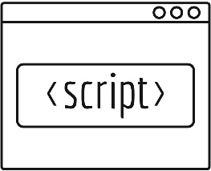


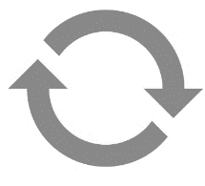
CrashFuzz Overview
Predefined checkers
ERROR entries in execution logs
Unexpected node downtime
…
Bug reports
Instrumented system
Workload
Coverage and I/O info.
Fault sequence generation and mutation
Information collection
Target system
I/O info.
Crash/reboot
Fault injection testing
Fault sequence selection
Fault sequence queue
Notes:
So here you see, we first run the target cloud system, and collect runtime information through instrumenting the target system. Based on the collected information, for example, coverage and I/O info., we generate and mutate fault sequences, and add them to a queue. Then we select a fault sequence from the queue to test based on a series of selection strategies. During fault injection testing, we will run the target system again and inject node crashes and reboots to the target system according to the fault sequence under test. During and after the fault injection testing, we use predefined checkers to detect failure /ˈfeɪljər/ symptoms and find crash recovery bugs. The failure symptoms include …, and so on. In this presentation, I will focus on the fault sequence generation, mutation and selection parts, which are the main contributions of our work.

Slide 16

























Fault Sequence Generation & Mutation
Initial run
Collect the executed I/O points
Generate the initial fault sequence that does not contain any faults
Crash an I/O point in the initial fault sequence
$${FatPt}_{A}^{1}$$
$${FtPt}_{B}^{2}$$
$${FtPt}_{B}^{3}$$
$${FtPt}_{C}^{4}$$
$${Crash}_{A}$$
$${FtPt}_{A}^{1}$$
$${FtPt}_{B}^{2}$$
$${FtPt}_{B}^{3}$$
$${FtPt}_{C}^{4}$$
Initial seq:
$${FtPt}_{A}^{1}$$
$${FtPt}_{B}^{2}$$
$${FtPt}_{B}^{3}$$
$${FtPt}_{C}^{4}$$
$${Crash}_{B}$$
Initial mutation
Target system
Initial run
Node A:
$${FtPt}_{A}^{1}$$
$${FtPt}_{B}^{2}$$
$${FtPt}_{B}^{3}$$
$${FtPt}_{C}^{4}$$
$${Crash}_{B}$$
Node B:
$${FtPt}_{A}^{1}$$
$${FtPt}_{B}^{2}$$
$${FtPt}_{B}^{3}$$
$${FtPt}_{C}^{4}$$
Node C:
$${Crash}_{C}$$
Notes:
After the initial run of the target system, we can obtain all the executed I/O points and generate the initial fault sequence that does not contain any faults. As shown in the figure, we get a initial fault sequence which contains four I/O points from three nodes. Then we crash an I/O point in the initial fault sequence to generate a group of new fault sequences. In this example, we can generate four new fault sequences.

Slide 17











Fault Sequence Generation & Mutation
Subsequent runs
Keep the fault sequence that increases the code coverage
Create a new fault sequence that reflects the actual execution behaviors based on the executed I/O points and injected faults
$${FtPt}_{A}^{1}$$
$${FtPt}_{B}^{2}$$
$${FtPt}_{B}^{3}$$
$${FtPt}_{C}^{4}$$
$${FtPt}_{A}^{1}$$
$${FtPt}_{B}^{2}$$
$${FtPt}_{B}^{3}$$
$${FtPt}_{C}^{4}$$
$${FtPt}_{C}^{5}$$
$${Crash}_{B}$$
Fault injection testing
Target system
seq’:
$${Crash}_{B}$$
seq:
Code coverage is increased!
A:
B:
C:
Notes:
For the subsequent runs, after a fault injection test, we keep the fault sequences that increase the code coverage. For such fault sequences, we first create corresponding new fault sequences based on the collected I/O points and injected faults. The created fault sequences reflect the actual execution behaviors. For example, after a fault injection test, some I/O points in the original fault sequence could disappear due to the injected faults, and some new I/O points could be executed by the recovery procedures.

Slide 18


































Fault Sequence Generation & Mutation
Subsequent runs
Crash or reboot only one non-faulty I/O point in the new fault sequence
$${FtPt}_{A}^{1}$$
$${FtPt}_{B}^{2}$$
$${FtPt}_{B}^{3}$$
$${FtPt}_{C}^{4}$$
$${FtPt}_{C}^{5}$$
$${Crash}_{B}$$
$${Crash}_{C}$$
$${FtPt}_{A}^{1}$$
$${FtPt}_{B}^{2}$$
$${FtPt}_{B}^{3}$$
$${FtPt}_{C}^{4}$$
$${FtPt}_{C}^{5}$$
$${FtPt}_{B}^{3}$$
$${FtPt}_{C}^{4}$$
$${FtPt}_{C}^{5}$$
$${FtPt}_{A}^{1}$$
$${FtPt}_{B}^{2}$$
$${Crash}_{B}$$
$${Crash}_{B}$$
seq’:
Normal mutation
$${Reboot}_{B}$$
$${FtPt}_{A}^{1}$$
$${FtPt}_{B}^{2}$$
$${FtPt}_{B}^{3}$$
$${FtPt}_{C}^{4}$$
$${FtPt}_{C}^{5}$$
A:
$${Crash}_{B}$$
$${Crash}_{C}$$
B:
$${FtPt}_{A}^{1}$$
$${FtPt}_{B}^{2}$$
$${FtPt}_{B}^{3}$$
$${FtPt}_{C}^{4}$$
$${FtPt}_{C}^{5}$$
C:
$${Crash}_{B}$$
$${Reboot}_{B}$$
Notes:
Based on the created new fault sequence, we can mutate it to generate a group of new fault sequences by adding only a node crash or reboot to the sequence.

Slide 19
Fault Sequence Generation & Mutation
Subsequent runs
To generate valid sequences that can be executed by the cloud system, the newly injected fault should satisfy some constraints
Only alive nodes can crash
Only dead nodes can be rebooted
System-specific constraints
User-specified constraints
Notes:
We make sure the newly injected fault satisfy some constraints, that is, …. Therefore, we can generate valid fault sequences that can be executed by the cloud system.

Slide 20







Fault Sequence Generation & Mutation
Subsequent runs
To generate valid sequences that can be executed by the cloud system, the newly injected fault should satisfy some constraints
$${FtPt}_{A}^{1}$$
$${FtPt}_{B}^{2}$$
$${FtPt}_{B}^{3}$$
$${FtPt}_{C}^{4}$$
$${FtPt}_{C}^{5}$$
Only alive nodes can crash
Only dead nodes can be rebooted
System-specific constraints
User-specified constraints
$${Crash}_{B}$$
$${Crash}_{B}$$
seq’:
A:
B:
C:
Do not satisfy the constraints!
Notes:
Let me show a counterexample. In this fault sequence, node B has already be crashed. Then injecting a new fault to crash node B again does not satisfy the constraints.

Slide 21








Fault Sequence Selection
Prioritize suspicious fault sequence candidates
Randomly pick a fault sequence from the candidates to test based on their priority scores
Prioritization strategies
Random selection based on priority scores
$${seq}_{1}$$
$${seq}_{1}$$
...
$${seq}_{1}$$
$${seq}_{i}$$
$${seq}_{j}$$
$${seq}_{k}$$
$${seq}_{k}$$
Faut sequence queue
Suspicious candidates
Notes:
To effectively explore fault sequences in the queue, we first apply a series of prioritization strategies to get a group of suspicious fault sequences in the queue as candidates. Then, we compute a priority score for every candidate fault sequence, and randomly pick a fault sequence from the candidates to test based on their priority scores.

Slide 22


Fault Sequence Selection
Prioritize suspicious fault sequence candidates
Prioritize the sequences that inject faults on new I/O points
A
B
C
A tested fault
“heartbeat”
Prone to cover executed code
“heartbeat”
The fault on a new I/O point
→ Prone to cover new code
“submit”
“heartbeat”
Prone to cover executed code
Notes:
First, we prioritize the fault sequences that inject faults on new I/O points. This is because the faults on tested I/O points are prone cover the executed recovery code. While the faults on new I/O points are more likely to trigger new code.

Slide 23
Fault Sequence Selection
Prioritize suspicious fault sequence candidates
Prioritize the sequences that inject faults on I/O points occurring during recovery
A
B
C
A
B
C
A
B
C
“x”
“x”
“x”
“y”
“y”
“y”
Trigger
“z”
“z”
An I/O point executed during the recovery process
Prone to complicate the recovery behaviors and trigger bugs
[1] Yu Gao et al., “An Empirical Study on Crash Recovery Bugs in Large-Scale Distributed Systems”, ESEC/FSE 2018.
Notes:
We also prioritize the sequences that inject faults on I/O points occurring during recovery. As shown in the figure, when we crash node A before sending a message x, new I/O points will be executed during the recovery process. We prioritize the faults occurring on the such I/O points. This is because such faults are prone to complicate the recovery behaviors and trigger bugs according to our previously empirical study on crash recovery bugs.

Slide 24

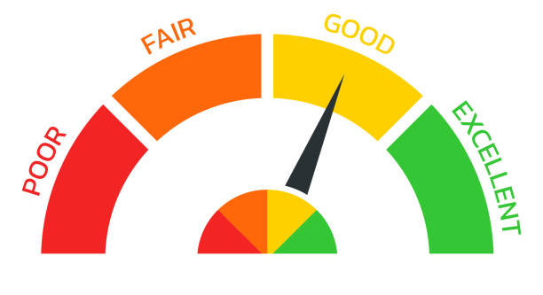


Fault Sequence Selection
Compute priority scores for the candidate fault sequences
Accelerate the testing process and test crash scenarios with multiple node crashes and reboots faster
Priority score
Execution time
…
seq:
Code coverage
# of faults
Notes:
For the selected candidate fault sequences, we compute a priority score for each of them by considering some metrics, such as …. The priority scores are used to accelerate the testing process and test crash scenarios with multiple /ˈmʌltɪpl/ node crashes and reboots faster.

Slide 25
Evaluation
Run at most 48 hours and set the maximum number of faults in a fault sequence as 10
Target 3 popular cloud systems
Target system | System type | Lines of Java code | Cluster size
ZooKeeper v3.6.3 | The distributed key-value store | 34,496 | 5 nodes
HBase v2.4.8 | The distributed NoSQL store | 805,237 | 5 nodes
HDFS v3.3.1 | The distributed file system | 471,335 | 5 nodes
Compare with 3 alternative approaches
Approach | Crash/Reboot Injection Point | Fault Sequence Generation | Fault Sequence Selection
CrashFuzz | I/O Points | Coverage Guided | Prioritization
CrashFuzz⁻ | I/O Points | Coverage Guided | FIFO
BruteForce | I/O Points | Enumeration | FIFO
Random | Random Time | Random | Random
Notes:
We evaluate our approach on three popular cloud systems, and compare it with three alternative /ɔːlˈtɜːrnətɪv/ approaches including random fault injection approach, the brute force fault injection approach and a variant of CrashFuzz. We run the target systems at most 48 hours and set the maximum number of faults in a fault sequence as 10

Slide 26
Bug Detection Results
CrashFuzz has detected 4 new bugs and 1 known bug
 | Bug ID | Failure Symptoms | # of Faults | Random | BruteForce | CrashFuzz－ | CrashFuzz
Unknown Bugs | HBASE-26883 | Data loss | 2 | ✗ | ✗ | ✗ | ✓
 | ZOOKEEPER-4503 | Data staleness | 2 | ✗ | ✗ | ✗ | ✓
 | HBASE-26897 | Cluster out of service | 2 | ✗ | ✗ | ✗ | ✓
 | HBASE-26370 | Misleading error message | 1 | ✓ | ✓ | ✓ | ✓
Known Bugs | HDFS-16508 | Operation failure | 1 | ✗ | ✓ | ✓ | ✓
Notes:
In total, CrashFuzz has detected 4 new bugs and 1 known bug. Two of them can be detected by the alternative approaches.

Slide 27
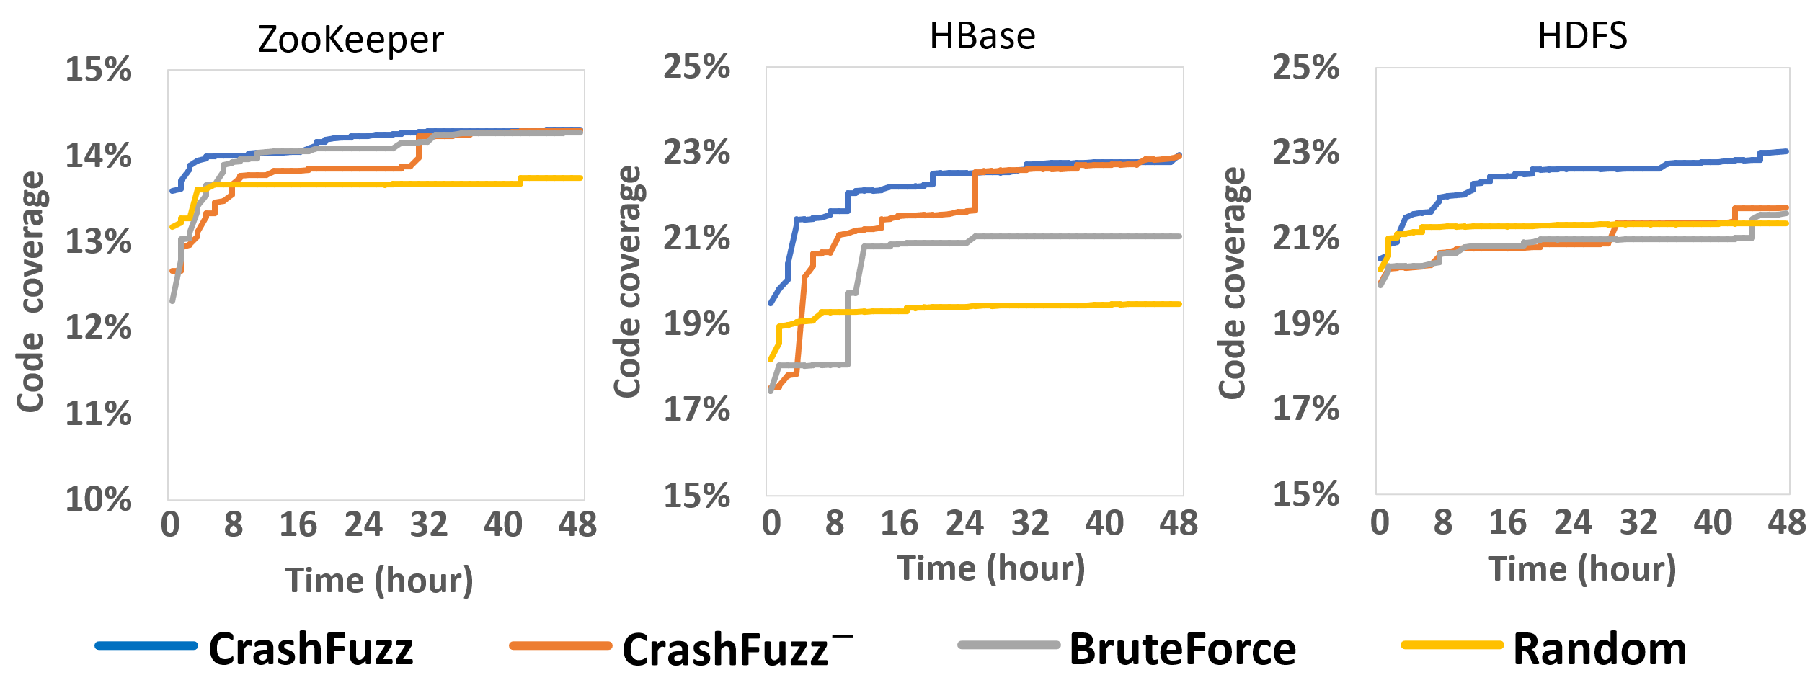
Overall Code Coverage Results
CrashFuzz can cover the most code and achieve higher code coverage faster
The increased code coverage in our experiment is more likely to be caused by the crash recovery code
Notes:
We also measure CrashFuzz’s effectiveness in testing recovery behaviors of cloud systems through the overall code coverage. As shown in the figures, CrashFuzz can cover the most code and achieve higher code coverage faster compared with alternative approaches.

Slide 28
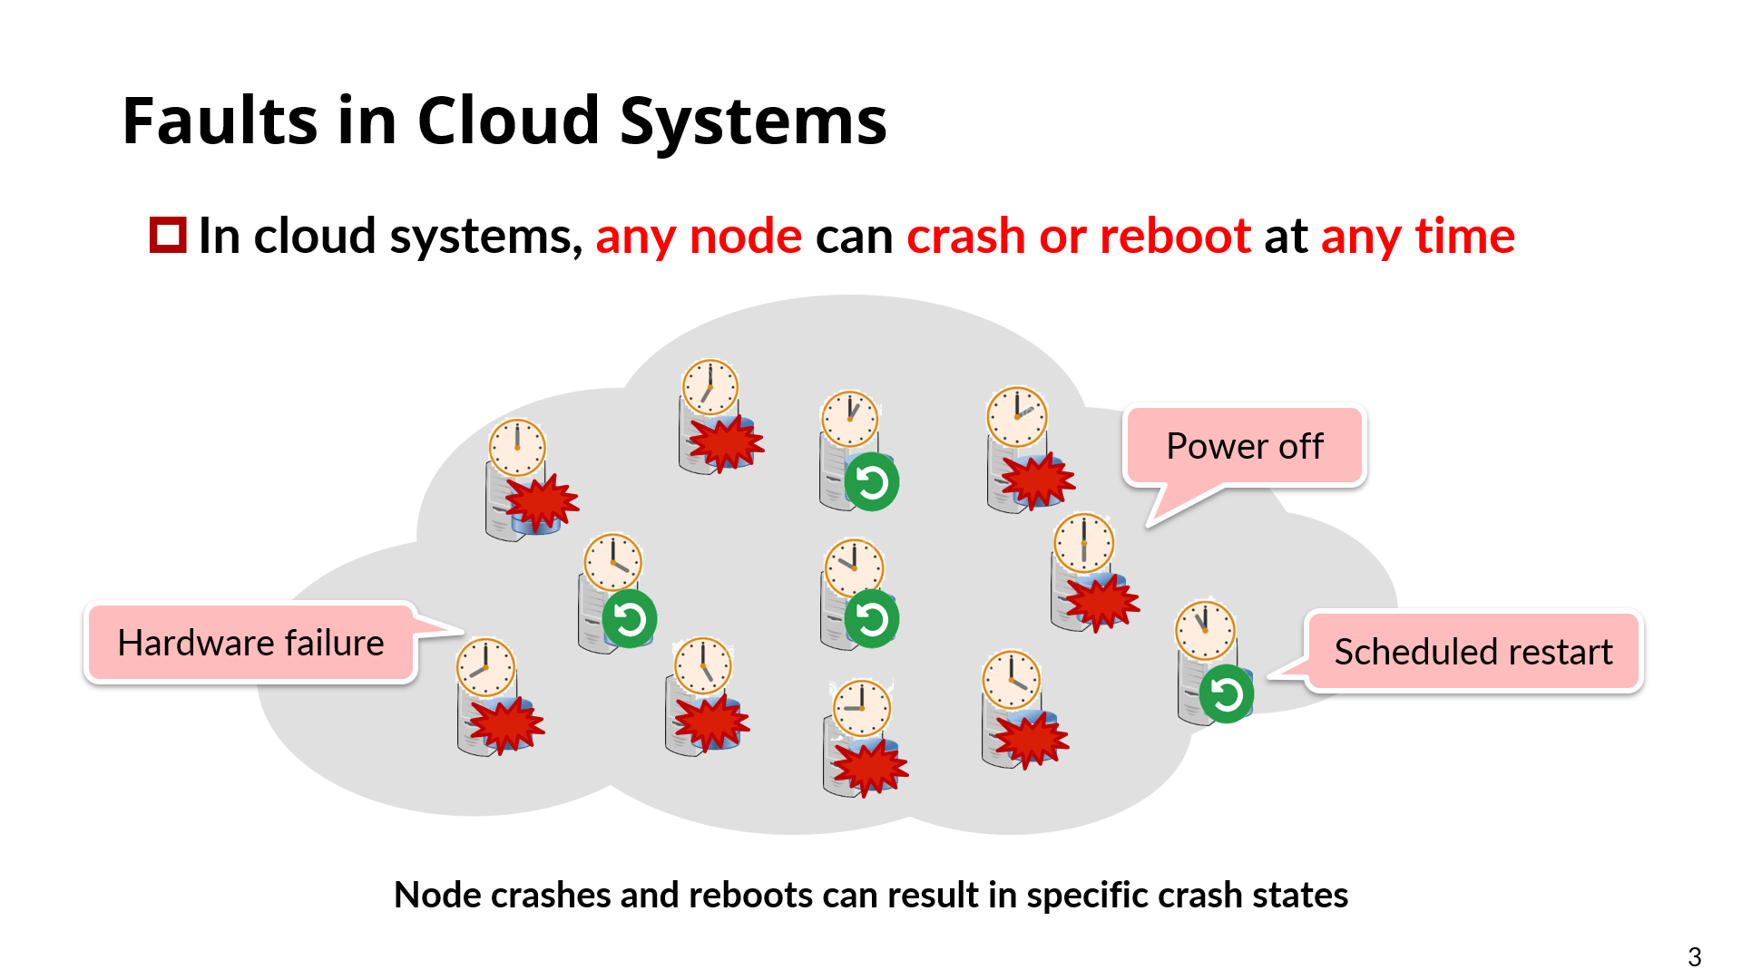
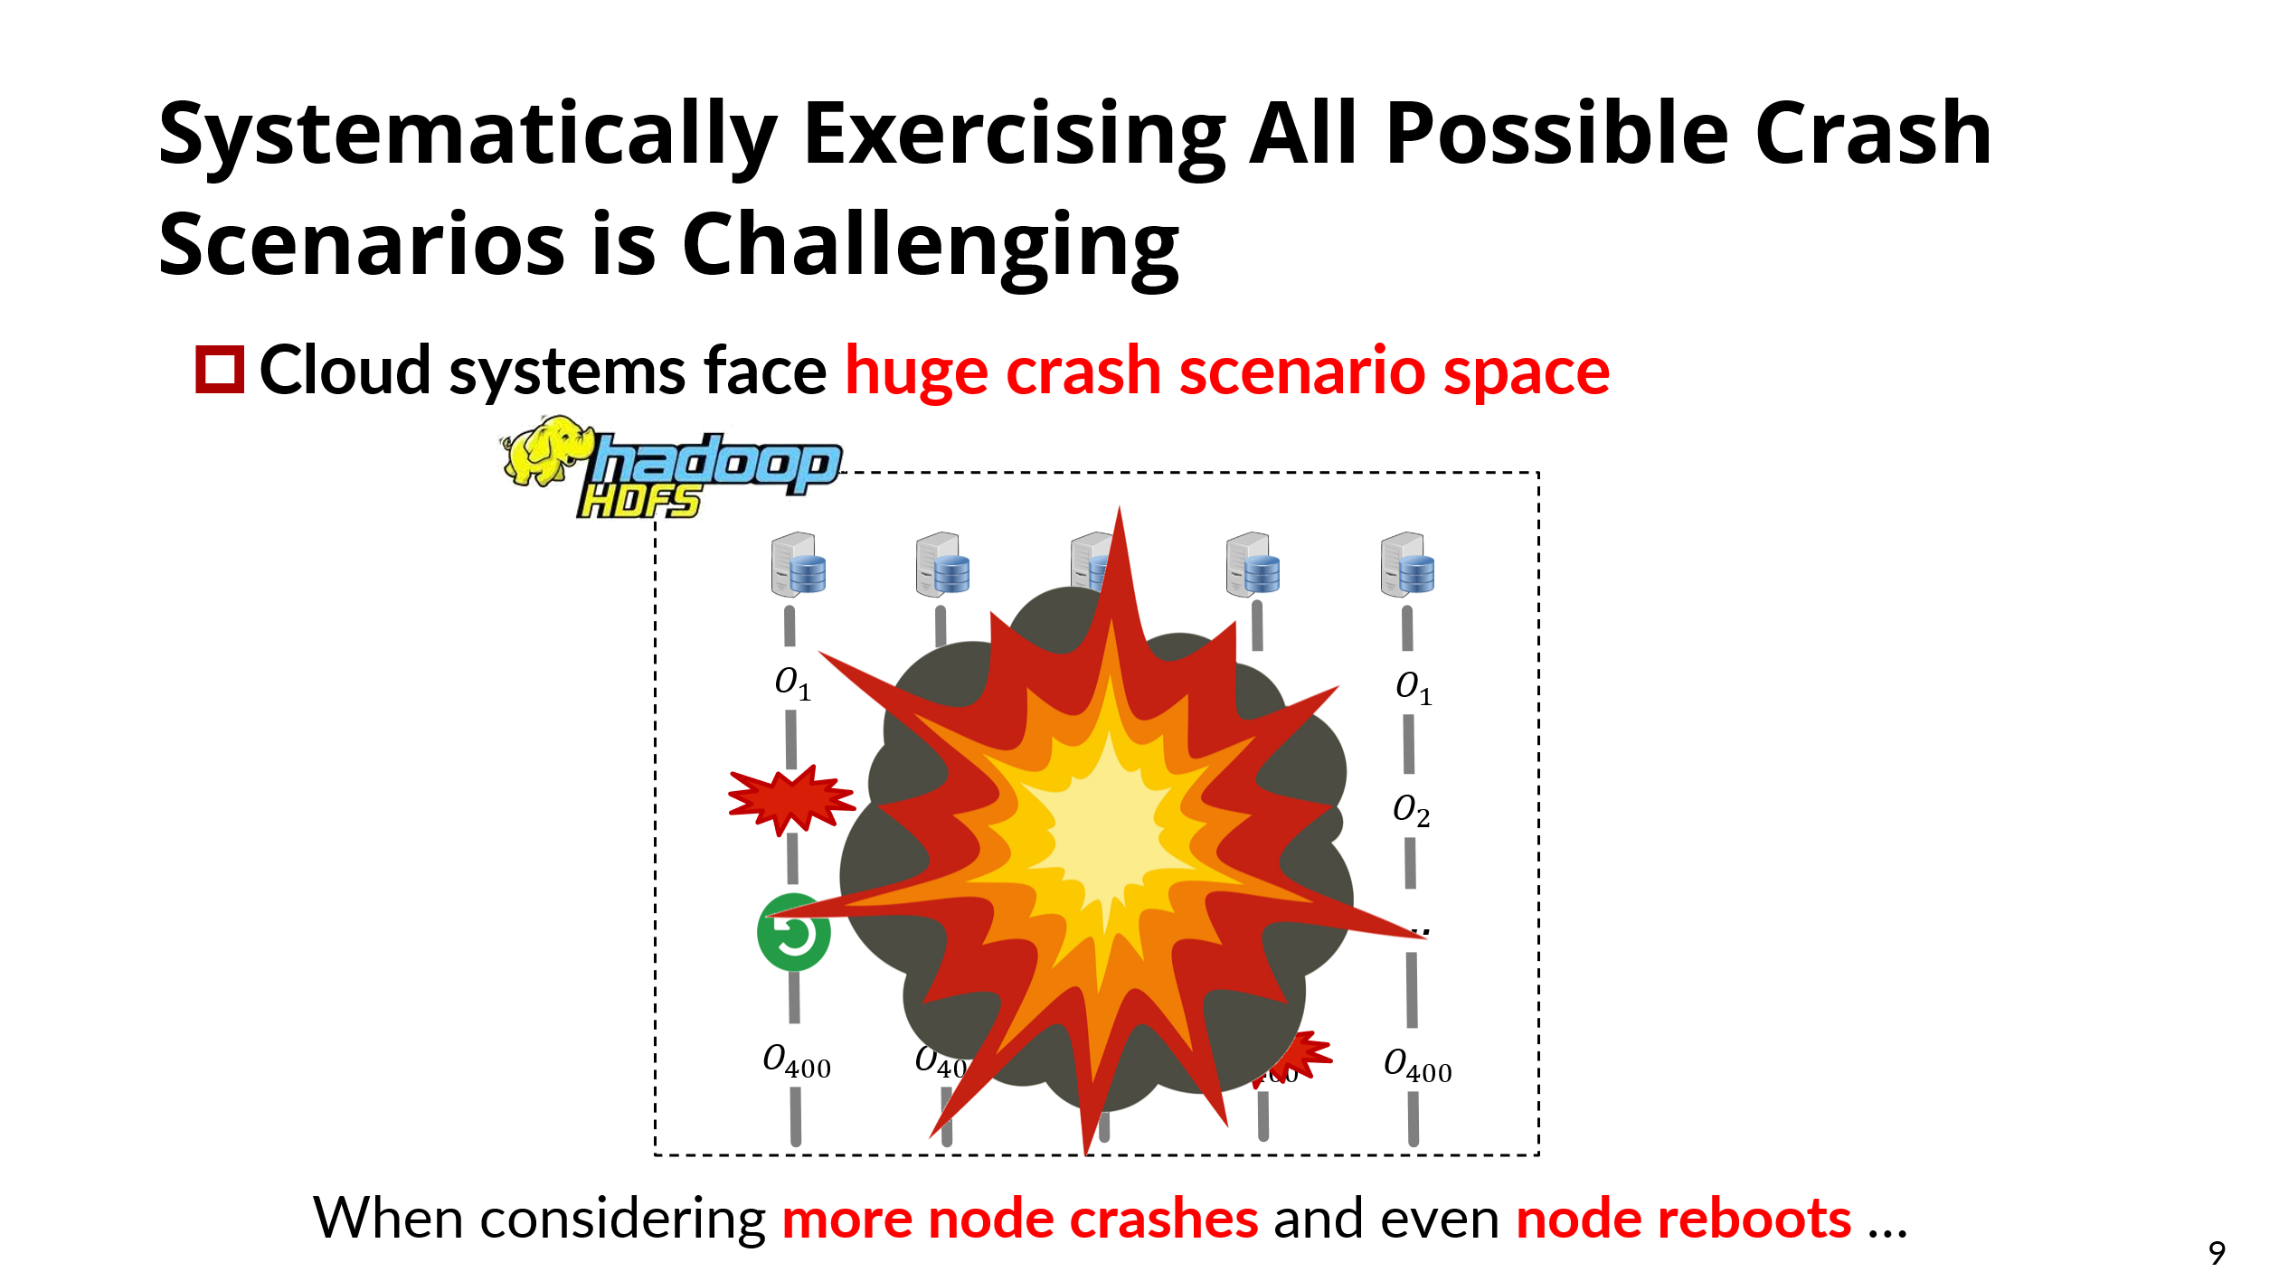
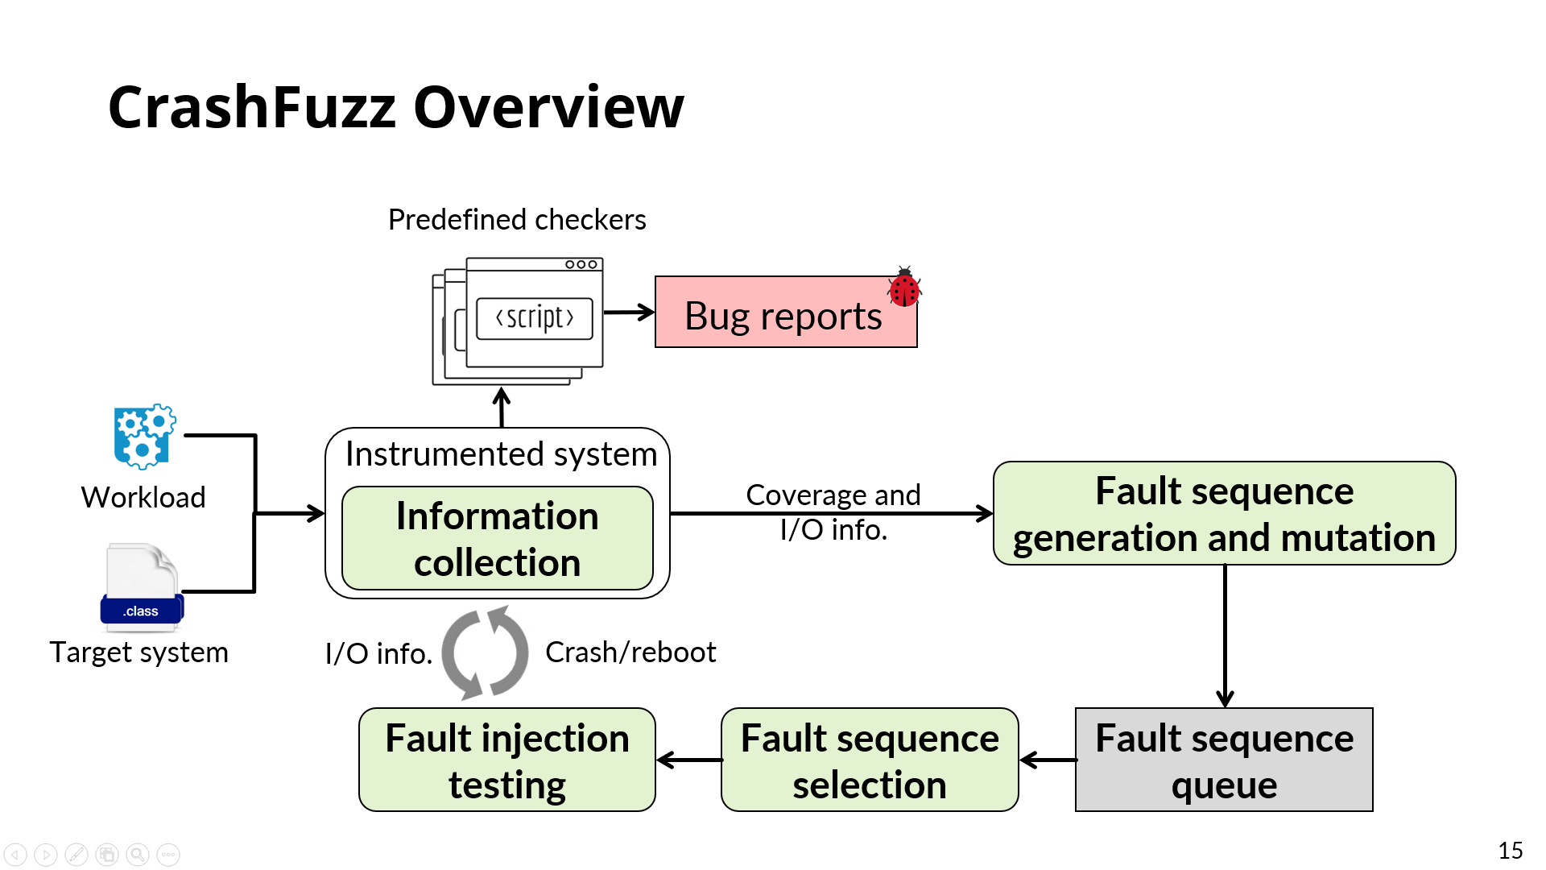
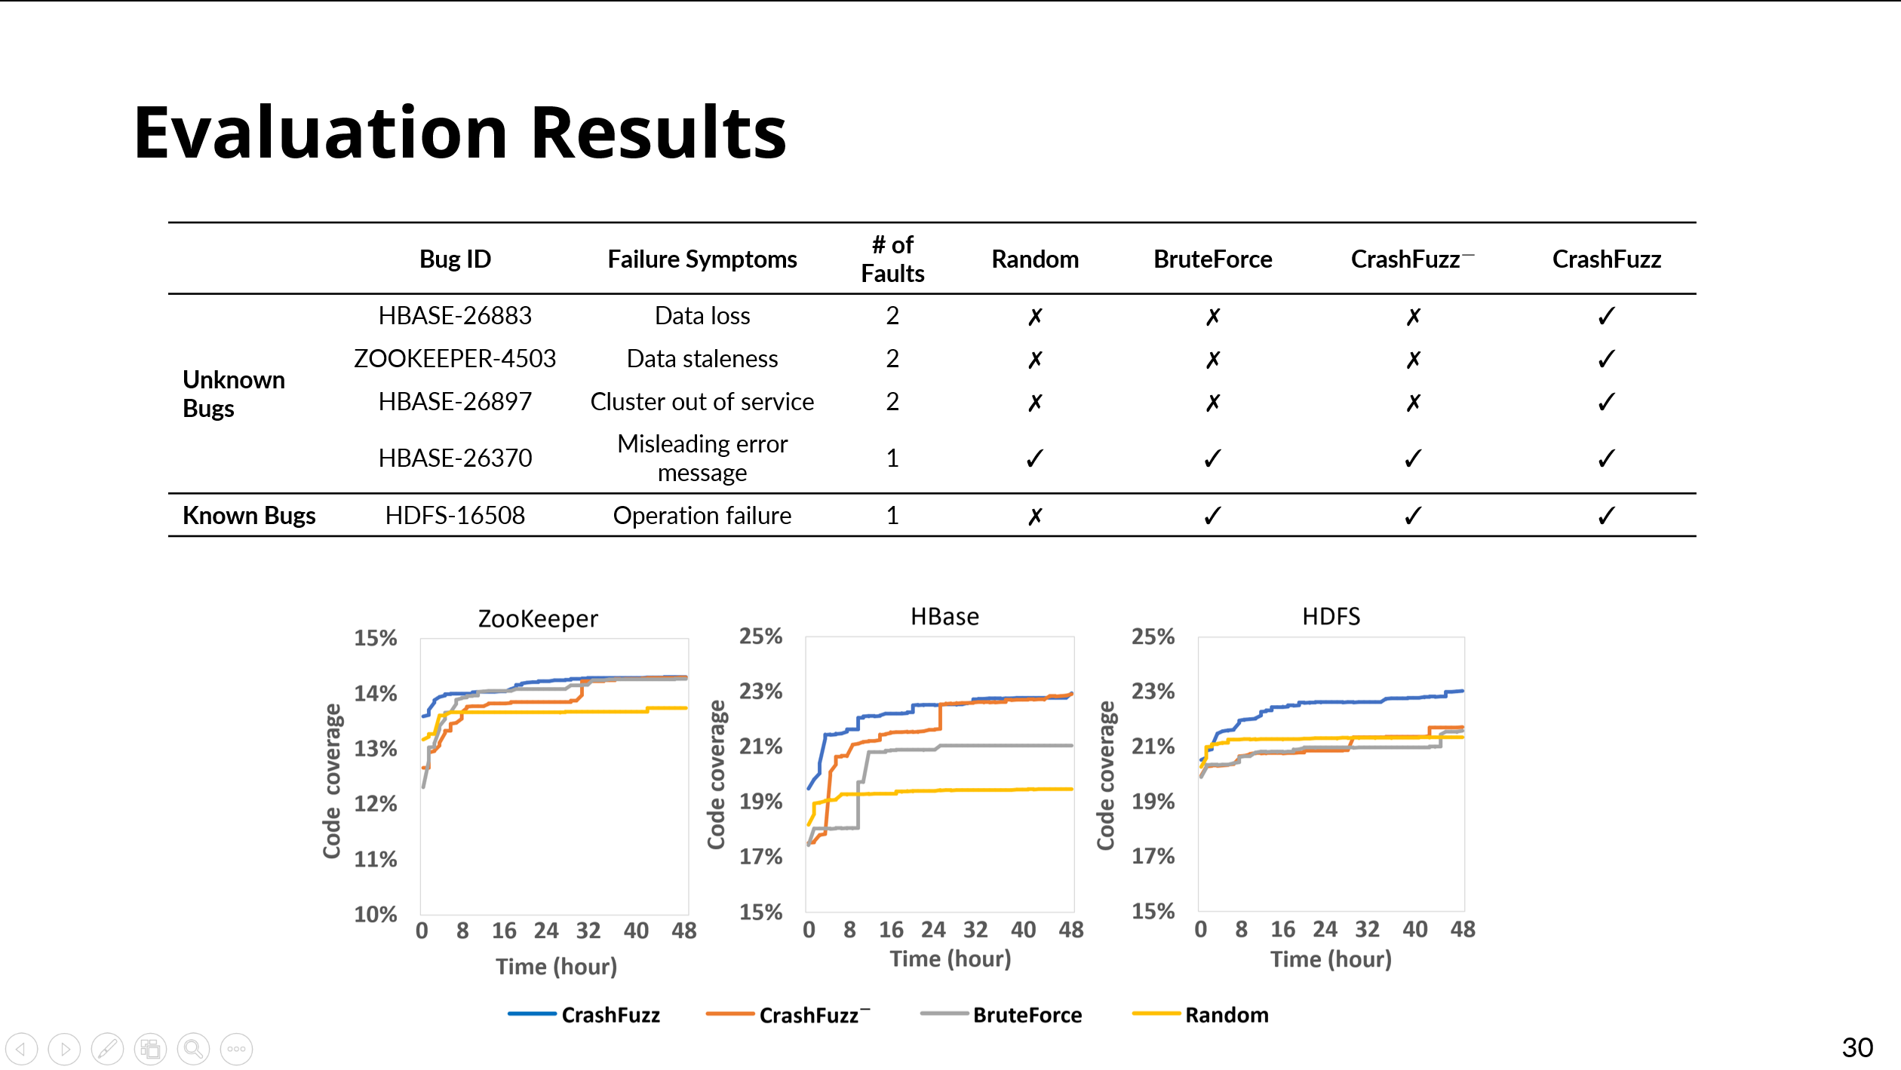

https://github.com/tcseiscas/crashfuzz
Notes:
In conclusion, Cloud systems must correctly recovery from node crashes/reboots, we propose a novel approach crashfuzz to systematically and effectively explore the huge crash scenario space of cloud systems. Our approach is avaliable on github.

