Slide 1




Testing Database Systems via Differential Query Execution
45th International Conference on Software Engineering
Jiansen Song, Wensheng Dou, Ziyu Cui, Qianwang Dai, Wei Wang,
Jun Wei, Hua Zhong, Tao Huang
Institute of Software,
Chinese Academy of Sciences
University of Chinese Academy of Sciences
Notes:
Good morning, everybody.
My name is Jiansen Song, from the University of Chinese Academy of Sciences.
Toady, I’m going to talk about our work on testing database systems via differential query execution.

Slide 2


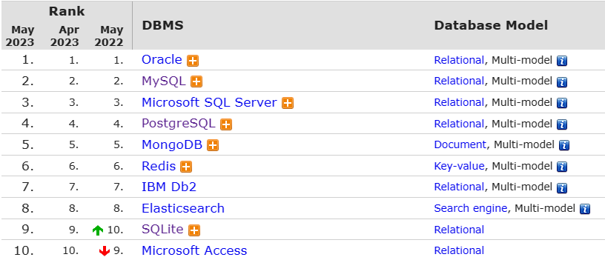

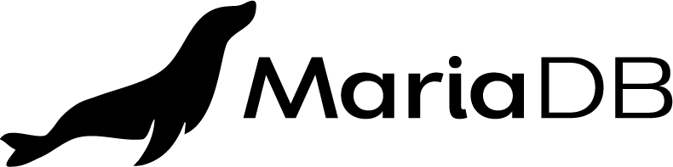


Database Management Systems
Database Management Systems (DBMSs) are widely used to store, retrieve and manipulate data
DB-Engines Ranking [1]
[1] https://db-engines.com/en/ranking
Notes:
Database Management Systems are widely used to store, retrieve and manipulate data.
According to the DB-Engines Ranking, [click] seven of the ten most popular DBMSs are relational DBMSs, like MySQL, PostgreSQL and SQLite.

Slide 3
Structured Query Language (SQL)
Relational DBMSs use SQL to retrieve and manipulate data
SELECT * FROM t1 WHERE c1 > 10
Retrieve data
UPDATE t1 SET c1 = 1 WHERE c1 = 3
Update data
DELETE FROM t1 WHERE c1 < 5
Delete data
Notes:
Relational DBMSs use SQL to retrieve and manipulate data.
For example, we can use SELECT statements to retrieve data, and UPDATE / DELETE statements to manipulate data.

Slide 4

Logic Bugs
Incorrect implementations of DBMSs can result in logic bugs
Omit a row
SELECT
Incorrect query result
Update partial table data
How to find these bugs?
UPDATE
Incorrect database state
Delete one row more
DELETE
Incorrect database state
Notes:
Incorrect implementations of DBMSs can result in logic bugs.
For SELECT statements, [click] it can return incorrect query results, for example, omit a row,
[click] For UPDATE statements, it can generate incorrect database states, for example, update partial table data.
[click] For DELETE statements, it can generate incorrect database states, for example, delete one row more.
[click] We lack an oracle to detect these bugs.

Slide 5
Existing Approaches
Detect crash bugs
SQLsmith [1] generates random statements
Squirrel [2] generates statements guided by code coverage
Detect logic bugs in SELECT statements
RAGS [3] leverages multiple DBMSs as cross-referencing oracles
PQS [4] implements a reference evaluation engine for SELECT statements
NoREC [5] and TLP [6] construct equivalent SELECT statements
These approaches cannot detect logic bugs in UPDATE / DELETE statements
[1] SQLsmith. https://github.com/anse1/sqlsmith.
[2] R. Zhong et al., “SQUIRREL: Testing database management systems with language validity and coverage feedback,” CCS 2020
[3] D. R. Slutz, “Massive stochastic testing of SQL,” VLDB 1998
[4] M. Rigger and Z. Su, “Testing database engines via pivoted query synthesis,” OSDI 2020
[5] M. Rigger and Z. Su, “Detecting optimization bugs in database engines via non-optimizing reference engine construction,” ESEC/FSE 2020
[6] M. Rigger and Z. Su, “Finding bugs in database systems via query partitioning,” OOPSLA 2020
Notes:
There are many approaches to detect bugs in DBMSs
Some approaches detect crash bugs, like SQLsmith and Squirrel
Some approaches detect logic bugs in SELECT statements, like RAGS, PQS, NoREC and TLP
[click] However, these approaches cannot detect logic bugs in UPDATE / DELETE statements

Slide 6
Observation
SQL statements utilize predicates to specify which rows to manipulate
t1
c1 | c2
1 | null
3 | 0
1 | 1
Select the third row
SELECT c1, c2 FROM t1 WHERE c2 > 0
c1 | c2
1 | 1
t1
c1 | c2
1 | null
3 | 0
1 | 1
c1 | c2
1 | null
3 | 1
1 | 1
Update the second row
UPDATE t1 SET c2 = 1 WHERE c1 > 1
t1
c1 | c2
1 | null
3 | 0
1 | 1
c1 | c2
3 | 0
1 | 1
Delete the first row
DELETE FROM t1 WHERE c2 is null
Notes:
We observe that in DBMSs, SQL statements utilize predicates to specify which rows to manipulate.
In this example, the predicate in the SELECT statement [click] specifies the third row [click] to return.
[click] For the UPDATE statement, the predicate [click] specifies the second row to update.
[click] For the DELETE statement, the predicate [click] specifies the first row to delete.

Slide 7
Observation
When having the same predicate, SELECT, UPDATE and DELETE statements should access the same rows
Select the third row
SELECT c1, c2 FROM t1 WHERE c2 > 0
c1 | c2
1 | 1
t1
c1 | c2
1 | null
3 | 0
1 | 1
c1 | c2
1 | null
3 | 0
1 | 1
UPDATE t1 SET c2 = 1 WHERE c2 > 0
Update the third row
c1 | c2
1 | null
3 | 0
Delete the third row
DELETE FROM t1 WHERE c2 > 0
Notes:
When having the same predicate, SELECT, UPDATE and DELETE statements should access the same rows
[click] In this example, these three statements should all manipulate the third row
That’s
[click] the SELECT statement returns the third row
[click] the UPDATE statement changes the third row
[click] and the DELETE statement removes the third row

Slide 8
Observation
A DBMS usually adopts different implementations for predicate evaluation in SELECT, UPDATE and DELETE statements
Evaluate the result of GREATEST function
SELECT c1 FROM t1
WHERE (GREATEST('a', c2) IN (0 < c1)) IS NOT NULL
t1
c1 | c2
a | 0
b | 1
c | 2
Check whether c1, c2 is null or not
DELETE FROM t1
WHERE (GREATEST('a', c2) IN (0 < c1)) IS NOT NULL
https://bugs.mysql.com/bug.php?id=106420
Notes:
However, a DBMS usually adopts different implementations for predicate evaluation in SELECT, UPDATE and DELETE statements.
In this example, [click] for SELECT, MySQL evaluates the result in GREATEST function.
For DELETE, MySQL only checks whether column c1, c2 is NULL or not.

Slide 9
Observation
Such inconsistent implementations may cause logic bugs
Evaluate the result of GREATEST function
SELECT c1 FROM t1
WHERE (GREATEST('a', c2) IN (0 < c1)) IS NOT NULL
t1
c1 | c2
a | 0
b | 1
c | 2
Inconsistent
Check whether c1, c2 is null or not
DELETE FROM t1
WHERE (GREATEST('a', c2) IN (0 < c1)) IS NOT NULL
https://bugs.mysql.com/bug.php?id=106420
Notes:
Such inconsistent implementations may cause logic bugs, for example, the SELECT and DELETE statements manipulate different rows

Slide 10

Approach Overview
We propose Differential Query Execution (DQE) to detect logic bugs in SELECT, UPDATE and DELETE statements
SELECT … FROM t WHERE φ
Selected rows
UPDATE t SET … WHERE φ
Updated rows
DELETE FROM t WHERE φ
Deleted rows
How to obtain the accessed rows for each statement?
Notes:
Inspired by this key observation, we propose Differential Query Execution (short for DQE), a novel and general approach to detect logic bugs in SELECT, UPDATE and DELETE statements.
The core idea is that the SELECT, UPDATE and DELETE statements with the same predicate [click] should access the same rows.
Otherwise [click], DQE reveals a logic bug in the target DBMS.
[click] The key challenge of DQE is to automatically obtain the accessed rows for a given statement.

Slide 11
Obtain the Selected Rows for a Single Table
We add a column $rowId$ to uniquely identify each row
t1
c1 | c2
1 | null
3 | 0
1 | 1
Is it the first or third row?
SELECT c1 FROM t1 WHERE c2 > 0
c1
1
t1
c1 | c2
1 | null
3 | 0
1 | 1
rowId
1
2
3
It is the third row
SELECT c1, rowId FROM t1 WHERE c2 > 0
c1 | rowId
1 | 3
Notes:
For SELECT, we need a row identifier to uniquely identify each row.
[click] In this example, we cannot figure out the SELECT returns the first or third row.
To solve this problem, we add a column $rowId$ to uniquely identify each row
[click] Given a table t1, [click] we first add a column rowId, [click] then rewrite the SELECT statement by adding rowId
In its select field. In this way, we do not change its execution semantic, and then we [click] execute the new SELECT statement to obtain the selected rows from its query result.
[click] in this example, the third row is returned.

Slide 12
Obtain the Updated Rows for a Single Table
We add a column $updated$ to mark which rows are updated
Which rows are updated?
t1
c1 | c2
1 | null
3 | 0
1 | 1
c1 | c2
1 | null
3 | 0
1 | 1
UPDATE t1 SET c2 = 1 WHERE c2 > 0
t1
c1 | c2
1 | null
3 | 0
1 | 1
rowId
1
2
3
updated
false
false
false
UPDATE t1 SET c2 = 1,
updated = true
WHERE c2 > 0
c1 | c2 | rowId | updated
1 | null | 1 | false
3 | 0 | 2 | false
1 | 1 | 3 | true
Update the third row
Notes:
For UPDATE, we need to mark which rows are updated
[click] In this example, we cannot figure out which rows are updated, since the table content is not changed after executing the UDPATE statementd
To solve this problem, we add a column $updated$ to mark which rows are updated
[click] Given a table t1, [click] we first add a column rowId, and further add a column updated [click] then rewrite the UPDATE statement by adding updated=true in its update field. In this way, we do not change its execution semantic, and then we [click] execute the new UPDATE statement to obtain the updated rows from its execution result. [click] In this example, the third row is updated.

Slide 13
Obtain the Deleted Rows for a Single Table
We use the column $rowId$ to obtain the deleted rows
t1
c1 | c2
1 | null
3 | 0
1 | 1
rowId
1
2
3
t1
c1 | c2 | rowId
1 | null | 1
3 | 0 | 2
DELETE t1 FROM t1 WHERE c2 > 0
The third row is deleted
Notes:
We use the column $rowId$ to obtain the deleted rows
Given a table t1 and a DELETE, [click] we first add a column rowId, [click] then execute the DELETE statement, and [click] finally we compare the rowId in table t1 before and after executing the delete statement, [click] in this example the third row is deleted

Slide 14

Select from Multiple Tables
Remove duplicate $rowId$s if necessary
t1
t1
c1
1
3
1
rowId
1
2
3
t1.c1 | t2.c2 | t1.rowId | t2.rowId
1 | 1 | 1 | 6
1 | 1 | 3 | 6
SELECT t1.c1, t2.c2
FROM t1, t2 WHERE t1.c1 = 1 AND t2.c2 > 0
, t1.rowId, t2.rowId
t2
c2
null
0
1
rowId
4
5
6
Remove duplicate $rowId$s
{1,3,6}
Notes:
When selecting from multiple tables, [click] we add rowId to each table, [click] then rewrite the SELECT statement, and [cilck] finally obtain the selected rows from its query result, [click] the rowId can appear more than once because of the joint operation, we remove the duplicates if necessary

Slide 15
Update on Multiple Tables
Obtain $rowId$ from each table
t1
c1
1
3
1
rowId
1
2
3
updated
false
false
false
UPDATE t1, t2 SET t1.c1 = 1, t2.c2 = 1
WHERE t1.c1 = 3 AND t2.c2 > 0
t2
c2
null
0
1
rowId
4
5
6
updated
false
false
false
Notes:
When updating on multiple tables, [click] we add rowId and updated to each table, [click] then we rewrite the UPDATE

Slide 16
Update on Multiple Tables
Obtain $rowId$ from each table
t1
c1
1
3
1
rowId
1
2
3
updated
false
false
false
t1
c1 | rowId
1 | 1
1 | 2
1 | 3
updated
false
true
false
UPDATE t1, t2 SET t1.c1 = 1, t2.c2 = 1,
t1.updated = true, t2.updated = true
WHERE t1.c1 = 3 AND t2.c2 > 0
t2
c2
null
0
1
rowId
4
5
6
updated
false
false
false
t2
c2 | rowId
null | 4
0 | 5
1 | 6
updated
false
false
true
{2,6}
Notes:
[click] we then execute the new UPDATE statement. [click] we filter rowId from each table using the condition updated=true, and combine them together

Slide 17
Compare Accessed Rows
If SELECT, UPDATE and DELETE access different rows, DQE reveals a logic bug in the target DBMS
Accessed rows
SELECT
{1,2,3}
UPDATE
{1,3}
DELETE
{1,3}
Notes:
After obtaining their accessed rows, we compare them.
If these three statements access different rows, DQE reveals a logic bug.

Slide 18
Statement Execution Strategy
If an error happens, a DBMS adopts different strategies to evaluate predicates in SELECT, UPDATE and DELETE statements
Select all rows
SELECT c2 FROM t1 WHERE not c1
Warning: Truncated incorrect DECIMAL value: 'a'
{1,2,3}
t1
c1 | rowId
a | 1
b | 2
c | 3
Update no rows
UPDATE t1 SET c2 = 0 WHERE not c1
Error: Truncated incorrect DECIMAL value: 'a'
{}
Delete no rows
DELETE FROM t1 WHERE not c1
Error: Truncated incorrect DECIMAL value: 'a'
{}
Notes:
When SELECT, UPDATE and DELETE raise errors, we compare their error message.
Since a DBMS adopts different strategies to evaluate predicates in SELECT, UPDATE and DELETE statements, we do not compare their access rows
[click] For example, In MariaDB, the same predicate in select causes a warning, and the SELECT continues to execute, finally returns all rows
[click] For the UPDATE statement, MariaDB returns errors and roll back the operation. As a result, no row is changed
[click] For the DELETE statement, MariaDB returns errors and roll back it. As a result, no row is deleted

Slide 19
Statement Execution Strategy
If an error happens, we only compare the error messages of SELECT, UPDATE and DELETE statements
SELECT c2 FROM t1 WHERE not c1
Warning: Truncated incorrect DECIMAL value: 'a'
These error messages should be the same
t1
c1 | rowId
a | 1
b | 2
c | 3
UPDATE t1 SET c2 = 0 WHERE not c1
Error: Truncated incorrect DECIMAL value: 'a'
DELETE FROM t1 WHERE not c1
Error: Truncated incorrect DECIMAL value: 'a'
https://jira.mariadb.org/browse/MDEV-27885
Notes:
[click] However, these error message should be the same

Slide 20
Statement Execution Strategy
If an error happens, we only compare the error messages of SELECT, UPDATE and DELETE statements
Incorrect error message
SELECT c2 FROM t1 WHERE c1 > 'a'
Warning: Bad Number
t1
c1 | rowId
1 | 1
2 | 2
3 | 3
UPDATE t1 SET c2 = 0 WHERE c1 > 'a'
Error: Truncated incorrect DECIMAL value: 'a'
DELETE FROM t1 WHERE c1 > 'a'
Error: Truncated incorrect DECIMAL value: 'a'
https://github.com/pingcap/tidb/issues/31719
Notes:
When they raise different errors, [click] for example, the SELECT statement raises an error with different error message, DQE reports a logic bug

Slide 21
Statement Execution Strategy
If an error happens, we only compare the error messages of SELECT, UPDATE and DELETE statements
No warnings and errors
SELECT c2 FROM t1 WHERE 0 NOT REGEXP('[')
c1
t1
c1 | rowId
1 | 1
2 | 2
3 | 3
UPDATE t1 SET c2 = 0 WHERE 0 NOT REGEXP('[')
Error: error parsing regexp: missing closing ]: `[`
DELETE FROM t1 WHERE 0 NOT REGEXP('[')
Error: error parsing regexp: missing closing ]: `[`
https://github.com/pingcap/tidb/issues/32744
Notes:
Moreover, when an error should happen, but it does not happen, DQE can also detect this kind of bugs.
For example, the SELECT statement should raise an error, but it did not.

Slide 22
UPDATE– and DELETE– Specific Errors
We do not compare UPDATE- and DELETE- specific errors with the SELECT statements
UNIQUE, PRIAMRY KEY, NOT NULL …
SELECT c1 FROM t1 WHERE c1 = 3
c1 UNIQUE
3
Ignore this error
t1
c1 UNIQUE
1
2
3
UPDATE t1 SET c1 = 1 WHERE c1 = 3
Error, Duplicate entry '1' for key 'c1'
c1 UNIQUE
1
2
DELETE FROM t1 WHERE c1 = 3
Notes:
Moreover, UPDATE and DELETE statements can raise their specific errors when violating table constraints.
For example, given a table t1 with a unique column c1 when updating to an existing values, [click] an update-specific error is raised
[click] While for SELECT and DELETE statements, they successfully manipulate the third row, and no errors happened.
In this case, we do not compare the UPDATE statement with the SELECT and DELETE statement.

Slide 23

Evaluation
RQ1: Detect new bugs
What logic bugs can DQE detect in real-world DBMSs?
RQ2: Compare with existing approaches
How many bugs detected by DQE can be found by existing approaches?
Notes:
We evaluate the effectiveness of our approach by answering the following two questions: What logic bugs can DQE detect in real-world DBMSs? and How many bugs detected by DQE can be found by existing approaches?

Slide 24
Target DBMSs
We focus on five widely-used and production-level DBMSs
DBMS | DB-Engines Ranking | GitHub Stars | Type
MySQL | 2 | 9.0K | Traditional
SQLite | 9 | 3.9K | Embedded
MariaDB | 13 | 4.8K | NewSQL
CockroachDB | 64 | 26.9K | NewSQL
TiDB | 112 | 33.9K | Traditional
Notes:
We select five widely-used and production-level DBMSs as our target.
[click] According to the DB-Engines Ranking, MySQL, SQLite and MariaDB are among the most popular DBMSs
[click] According to the GitHub Stars, CockroachDB and TiDB are the most popular relational DBMSs

Slide 25
Bug Detection Results
We have detected 50 bugs, 41 of which are confirmed as new bugs
11 bugs have been fixed
DBMS | Submitted | Confirmed | Fixed | Duplicate | Not a bug
MySQL | 7 | 1 | 1 | 0 | 6
MariaDB | 4 | 2 | 0 | 0 | 0
SQLite | 1 | 1 | 0 | 0 | 0
CockroachDB | 1 | 0 | 0 | 1 | 0
TiDB | 37 | 37 | 10 | 0 | 0
Total | 50 | 41 | 11 | 1 | 6
Notes:
In our experiment, [click] we have detected 50 bugs, [click] 41 bugs are confirmed as new bugs, [click] and 11 bugs have been fixed

Slide 26
Bug Triggering Statement
For the 41 confirmed bugs, 21 bugs are triggered by SELECT statements
20 bugs are triggered by UPDATE or DELETE statements
DBMS | SELECT | UPDATE | DELETE
MySQL | 0 | 1 | 1
MariaDB | 0 | 0 | 2
SQLite | 1 | 0 | 0
CockroachDB | 0 | 0 | 0
TiDB | 20 | 17 | 17
Total | 21 | 18 | 20
Notes:
For the 41 confirmed bugs, we analyze their bug triggering statements.
[click] 21 bugs are triggered by SELECT statements, [click] and 20 bugs are triggered by UPDATE or DELETE statements

Slide 27
Comparing with Existing Approaches
We compare DQE with PQS [1], NoREC [2] and TLP [3]
They cannot detect 20 bugs triggered by UPDATE or DELETE statements
21 bugs triggered by SELECT statements do not violate their oracles
DBMS | SELECT | UPDATE | DELETE
MySQL | 0 | 1 | 1
MariaDB | 0 | 0 | 2
SQLite | 20 | 17 | 17
CockroachDB | 0 | 0 | 0
TiDB | 1 | 0 | 0
Total | 21 | 18 | 20
[1] M. Rigger and Z. Su, “Testing database engines via pivoted query synthesis,” OSDI 2020
[2] M. Rigger and Z. Su, “Detecting optimization bugs in database engines via non-optimizing reference engine construction,” ESEC/FSE 2020
[3] M. Rigger and Z. Su, “Finding bugs in database systems via query partitioning,” OOPSLA 2020
Notes:
We further compare DQE with existing approaches, including PQS, NoREC and TLP.
For the 41 confirmed bugs, [click] They cannot detect 20 bugs triggered by UPDATE or DELETE statements [click] and the remaining 21 bugs triggered by SELECT statements do not violate their oracles

Slide 28
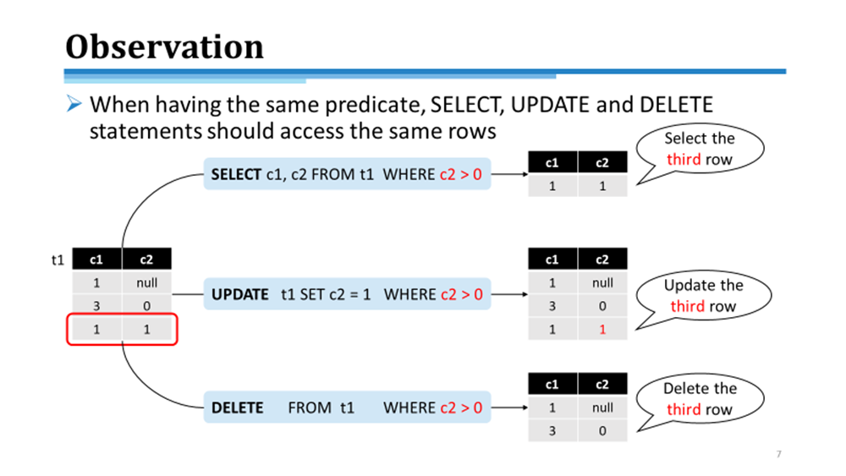
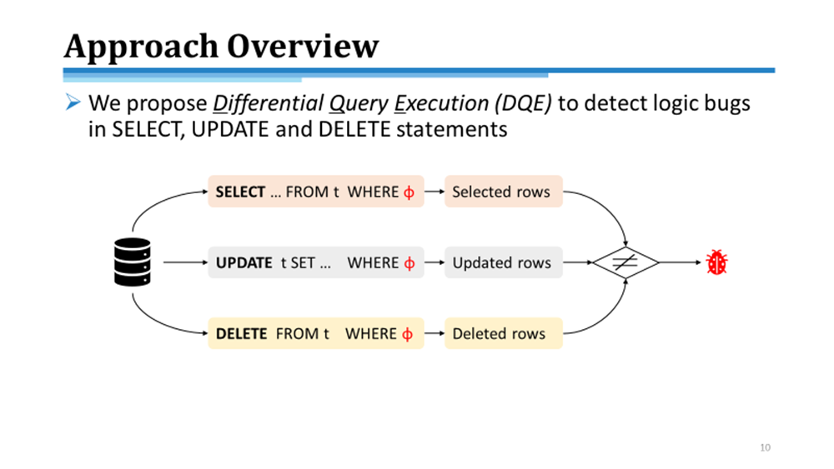
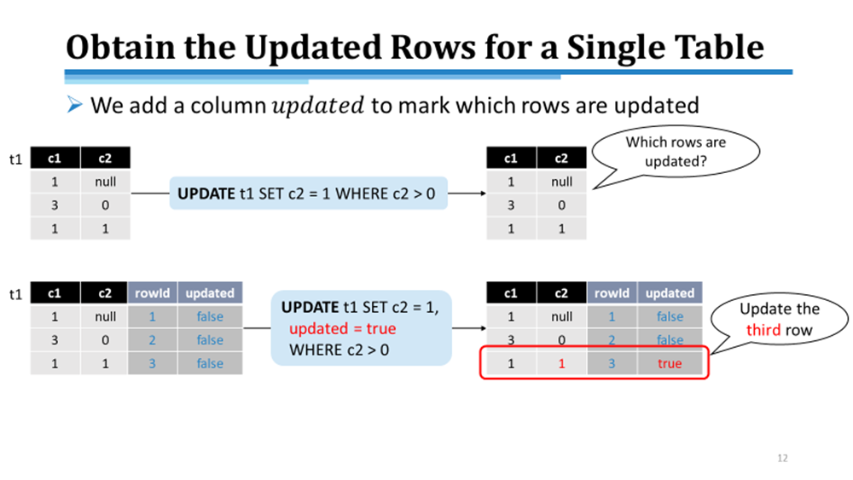
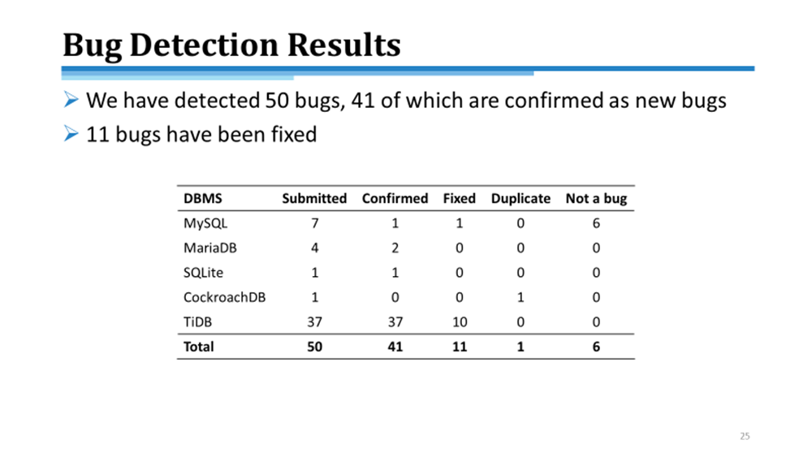

Conclusion
https://github.com/tcse-iscas/dqetool
Notes:
To summary, inspired by the key observation that SQL statements use predicate to specify which rows to manipulate, we propose DQE to detect logic bugs in SELECT, UPDATE and DELETE statements by comparing their accessed rows. To automatically obtain their accessed rows, we design two columns. We evaluate DQE on five widely-used DBMSs. The experimental result indicates that DQE is effective in detecting logic bugs. We make our tool available at GitHub. For more information, you can refer our paper Thanks for your listening.

