Slide 1


45th International Conference on Software Engineering Demonstration
Randomized Differential Testing of RDF Stores
Rui Yang, Yingying Zheng, Lei Tang, Wensheng Dou, Wei Wang, Jun Wei
Institute of Software, Chinese Academy of Sciences
University of Chinese Academy of Sciences
Notes:
Hello everyone. I’m Yang Rui, from University of Chinese Academy of Sciences.
It’s my honor to be here and talk about our work: Randomized Differential Testing of RDF Stores.

Slide 2



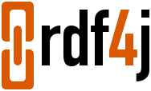
RDF Stores
RDF stores play a significant role in knowledge graphs and semantic web
Notes:
We call the graph database systems that are built on the RDF graph model as RDF stores. The representative RDF stores include MarkLogic, Apache Jena, RDF4j, and so on. They play a significant role in knowledge graphs and semantic web.

Slide 3
RDF Stores
RDF stores utilize Resource Description Framework (RDF) graph model
20
22
21
<http://age>
<http://age>
<http://age>
<http://knows>
<http://knows>
<http://John>
<http://PeterGreen>
<http://Mark>
<http://name>
<http://name>
<http://name>
John
Mark
<http://familyname>
<http://givenname>
Green
Peter
[1] I. Abdelaziz, et. al., Query optimizations over decentralized RDF graphs. ICDE 2017.
Notes:
RDF stores utilize RDF graph model to store graph data. This graph shows the personal information of three persons and their social relationship.

Slide 4
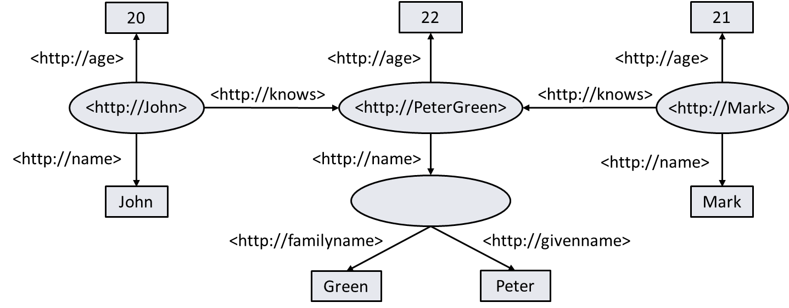
SPARQL
RDF stores utilize SPARQL as their standardized query language
SELECT ?givenName ?age
WHERE {
?person <http://name> ?name .
?person <http://age> ?age .
?name <http://givenname> ?givenName .
FILTER ( ! ( ?age = 20 ) )
}
ORDER BY ?givenName
[1] J. Perez, M. Arenas, and C. Gutierrez. Semantics and complexity of SPARQL. TODS 2009.
Notes:
RDF stores utilize SPARQL as their standardized query language. This example queries the given name and age of the person who is not 20.

Slide 5
RDF Stores Suffer from Logic Bugs
Incorrect implementations of RDF stores can introduce logic bugs, which can cause severe consequences
RDF Graph Data
<http://JohnSmith> <http://ages> 12.
SELECT *
WHERE { ?s ?p ?o .
FILTER ( 80596426678 * 1719307142 ) }
SPARQL Query
?s | ?p | ?o
?s | ?p | ?o
<http://JohnSmith> | <http://ages> | 12
[1] https://stackoverflow.com/questions/74470899/unexpected-empty-query-result-in-marklogic
Notes:
Similar to other database systems, incorrect implementations of RDF stores can introduce logic bugs that result in an incorrect query results for a given query.
This is a logic bug found in MarkLogic. We retrieve the RDF triple by a FILTER expression which should be evaluated into true. However, MarkLogic mistakenly returns an empty result because the expression is evaluated into false due to decimal overflow.

Slide 6
Existing Testing Tools
Graph database systems
Differential testing: Grand[1], GDsmith[2]
Metamorphic testing: GDBMeter[3]
Relational database management systems
Differential testing: RAGS[4], APOLLO[5]
Detect logic bugs and optimization bugs: PQS[6], TLP[7], NoREC[8], DQE[9]
Detect transaction bugs: DT²[10], Troc[11]
[1] Y. Zheng, et. al., Finding bugs in Gremlin-based graph database systems via randomized differential testing. ISSTA 2022.
[2] Z. Hua, et. al., GDsmith: Detecting bugs in Cypher graph database engines. 2023.
[3] M. Kamm, et. al., Testing graph database engines via query partitioning. ISSTA 2023.
[4] Donald S. Slutz. Massive Stochastic Testing of SQL. VLDB 1998.
[5] Jinho Jung, et. al., APOLLO: Automatic Detection and Diagnosis of Performance Regressions in Database Systems. PVLDB 2019.
[6] Manuel Rigger and Zhendong Su. Testing Database Engines via Pivoted Query Synthesis. OSDI 2020.
[7] Manuel Rigger and Zhendong Su. Finding Bugs in Database Systems via Query Partitioning. OOPSLA 2020.
[8] Manuel Rigger and Zhendong Su. Detecting Optimization Bugs in Database Engines via Non-Optimizing Reference Engine Construction. ESEC/FSE 2020.
[9] J. Song, et. al., Testing database systems via differential query execution. ICSE 2023.
[10] Z. Cui, et. al., Differentially testing database transactions for fun and profit. ASE 2022.
[11] W. Dou, et. al., Detecting isolation bugs via transaction oracle construction. ICSE 2023.
Notes:
Existing database system testing approaches detect logic bugs in relational database management systems, and Gremlin-based or Cypher-based graph database systems, which adopt the labeled property graph model.

Slide 7
Existing Testing Tools
Graph database systems
Differential testing: Grand[1], GDsmith[2]
Metamorphic testing: GDBMeter[3]
Relational database management systems
Differential testing: RAGS[4], APOLLO[5]
Detect logic bugs and optimization bugs: PQS[6], TLP[7], NoREC[8], DQE[9]
Detect transaction bugs: DT²[10], Troc[11]
None of these tools can detect logic bugs in RDF stores
[1] Y. Zheng, et. al., Finding bugs in Gremlin-based graph database systems via randomized differential testing. ISSTA 2022.
[2] Z. Hua, et. al., GDsmith: Detecting bugs in Cypher graph database engines. 2023.
[3] M. Kamm, et. al., Testing graph database engines via query partitioning. ISSTA 2023.
[4] Donald S. Slutz. Massive Stochastic Testing of SQL. VLDB 1998.
[5] Jinho Jung, et. al., APOLLO: Automatic Detection and Diagnosis of Performance Regressions in Database Systems. PVLDB 2019.
[6] Manuel Rigger and Zhendong Su. Testing Database Engines via Pivoted Query Synthesis. OSDI 2020.
[7] Manuel Rigger and Zhendong Su. Finding Bugs in Database Systems via Query Partitioning. OOPSLA 2020.
[8] Manuel Rigger and Zhendong Su. Detecting Optimization Bugs in Database Engines via Non-Optimizing Reference Engine Construction. ESEC/FSE 2020.
[9] J. Song, et. al., Testing database systems via differential query execution. ICSE 2023.
[10] Z. Cui, et. al., Differentially testing database transactions for fun and profit. ASE 2022.
[11] W. Dou, et. al., Detecting isolation bugs via transaction oracle construction. ICSE 2023.
Notes:
However, RDF stores adopt totally different graph models and query syntaxes. Existing approaches cannot be directly applied on RDF stores.

Slide 8
RD² Overview
Goal: find logic bugs in RDF stores
RDF Stores
Write to RDF Stores
Unify Result Formats
Verify Results
RDF Graph Generation
Res1
Res1’
Execute on RDF Stores
Res2
Res2’
SPARQL Query Generation
Res3
Res3’
Notes:
We propose a randomized differential testing technique RD2, to find bugs in RDF stores.
First, we generate an RDF graph and write it into multiple target RDF stores.
Then, we generate SPARQL queries.
Finally, we run a SPARQL query on multiple target RDF stores, get the query results, and reveal discrepancies.

Slide 9
RDF Graph Generation
22
object
predicate
<http://age>
Basic element
<http://PeterGreen>
subject
IRIs: <http://PeterGreen>, <http://age>,
<http://name>, <http://familyname>,
<http://givenname>, …
Blank nodes: b1, b2, …
Literals: “Green”, “Peter”, 22, …
<http://name>
<http://familyname>
<http://givenname>
Green
Peter
Notes:
An RDF graph consists of a set of RDF triples. An RDF triple consists of a subject, a predicate, and an object. We first randomly generate basic elements. Then we randomly select corresponding data for subject, predicate, and object to construct an RDF triple. Following this approach, we can generate more RDF triples.

Slide 10
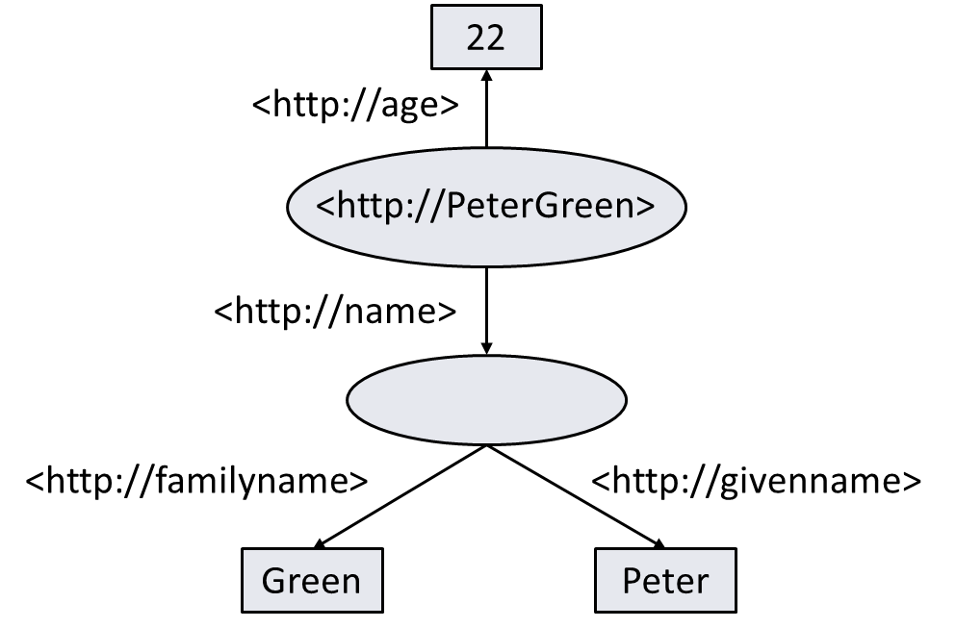
SPARQL Query Generation
Generate syntactically correct and valid SPARQL queries
Randomly build a SPARQL query’s Abstract Syntax Tree (AST)
SELECT ?givenName ?age
WHERE {
?person <http://name> ?name .
?person <http://age> ?age .
?name <http://givenname> ?givenName .
FILTER ( ! ( ?age = 20 ) )
}
ORDER BY ?givenName
Notes:
To generate syntactically correct and valid SPARQL queries, we build Abstract Syntax Trees.

Slide 11
SPARQL Query Generation
Generate syntactically correct and valid SPARQL queries
A triple pattern: variables, data generated randomly, or existing value selected from the RDF graph
FILTER expression: build an expression tree
SELECT ?givenName ?age
WHERE {
?person <http://name> ?name .
?person <http://age> ?age .
?name <http://givenname> ?givenName .
FILTER ( ! ( ?age = 20 ) )
}
ORDER BY ?givenName
Variables: ?person, ?name, ?age, ?givenName, …
Notes:
To generate the triple pattern in WHERE clause, we first randomly generate variables, and then randomly bind them to subject, predicate or object.

Slide 12
SPARQL Query Generation
Generate syntactically correct and valid SPARQL queries
A triple pattern: variables, data generated randomly, or existing value selected from the RDF graph
FILTER expression: build an expression tree
SELECT ?givenName ?age
WHERE {
?person <http://name> ?name .
?person <http://age> ?age .
?name <http://givenname> ?givenName .
FILTER ( ! ( ?age = 20 ) )
}
ORDER BY ?givenName
Variables: ?person, ?name, ?age, ?givenName, …
Increase the possibility of returning non-empty query results
Notes:
The subject, predicate and object in a triple pattern can be generated randomly, or be selected from the RDF graph. It can increase the possibility of returning non-empty query results.
We generate a FILTER expression by building an expression tree.

Slide 13
SPARQL Query Generation
Generate syntactically correct and valid SPARQL queries
SELECT clause: randomly select several existing variables
SELECT ?givenName ?age
WHERE {
?person <http://name> ?name .
?person <http://age> ?age .
?name <http://givenname> ?givenName .
FILTER ( ! ( ?age = 20 ) )
}
ORDER BY ?givenName
Notes:
The SELECT clause is generated by randomly selecting several variables existing in the WHERE clause.

Slide 14

Differentially Testing RDF Stores
Compare the query results to find discrepancies
Different RDF stores have their own storage and query result formats
Query Result
bnode9236923010660198659
SELECT ?name
WHERE {
?person <http://name> ?name .
}
_:b0
_:node1gp9su2mix1
Notes:
We adopt differential testing to find discrepancies among multiple target RDF stores.
However, different RDF stores usually have their own storage and query result formats, such as the ID of the same blank node is different in different RDF stores. So, how can we compare them?

Slide 15
Differentially Testing RDF Stores
Unify formats of blank node IDs
MarkLogic actual ID | Jena actual ID | RDF4j actual ID
bnode9236923010660198659 | _:b0 | _:node1gp9su2mix1
bnode11935990903821970957 | _:b1 | _:node1gp9su2mix2
bnode16367137124885678738 | _:b2 | _:node1gp9su2mix3
Unified ID
1
2
3
Notes:
To address it, we need to unify formats of these IDs.
We first extract actual IDs of blank nodes in each RDF store. Then we generate a unique ID for each blank node. In this way, we can convert IDs in different formats into unified IDs.

Slide 16


Usage of RD²
Run RD²
Check Reports
java -jar RD2.jar --dbname --host
--port --username –password --db-num --query-num
RD² analyzer
Discrepancy Reports
Bug Reports
Notes:
To use RD2, we first execute the command to run it and obtain discrepancy reports.
Then, we analyze discrepancies to identify bugs.

Slide 17
Evaluation
Target RDF stores
RDF Store | DB-Engines Ranking | GitHub Stars | Initial Release
MarkLogic | 1 | - | 2001
Apache Jena | 3 | 890 | 2000
RDF4j | 9 | 308 | 2000
Notes:
We evaluate RD2 on three widely-used RDF stores, MarkLogic, Apache Jena and RDF4j.

Slide 18
Bug Detection Result
RD² finds 5 bugs among the three RDF stores
RDF Stores | Detected | Confirmed | Intended
MarkLogic | 4 | 1 | 3
Apache Jena | - | - | -
RDF4j | 1 | 1 | -
Total | 5 | 2 | 3
Notes:
We find 5 logic bugs among them. 2 bugs have been confirmed, and the remaining 3 bugs are considered as intended behaviors due to different implementations.

Slide 19
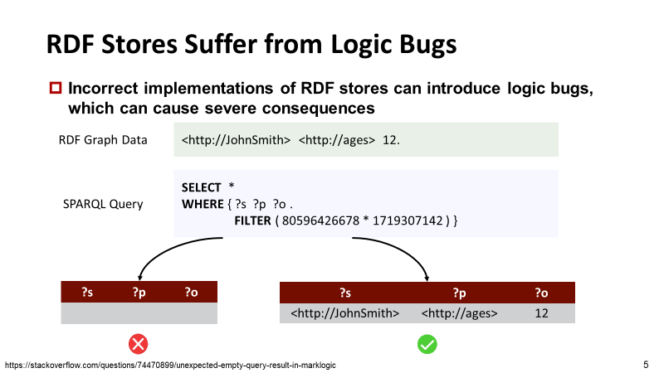
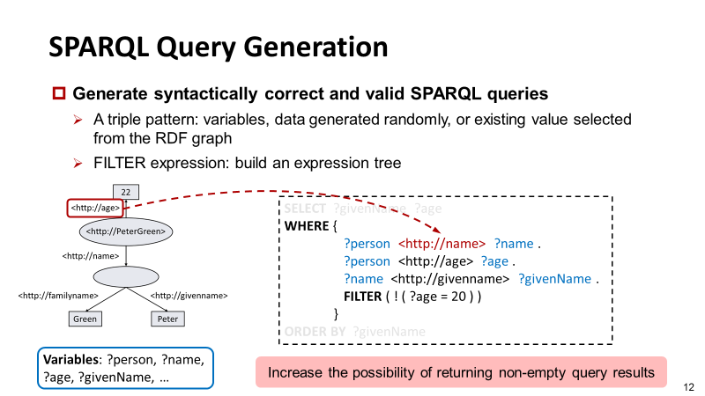
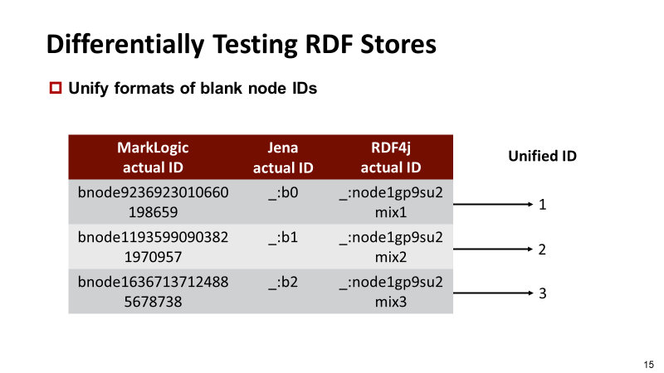
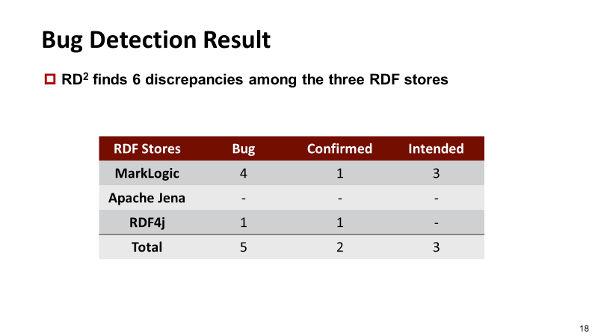

Conclusion
https://github.com/tcse-iscas/RD2.
Notes:
In conclusion, we propose a randomized differential testing approach of RDF stores to find logic bugs, and have detected 5 bugs.
That’s all. Thanks for listening.

