Slide 1





45th IEEE/ACM International Conference on Software Engineering
Detecting Isolation Bugs via Transaction Oracle Construction
Wensheng Dou, Ziyu Cui, Qianwang Dai, Jiansen Song, Dong Wang, Yu Gao, Wei Wang, Jun Wei, Lei Chen, Hanmo Wang, Hua Zhong, Tao Huang
Institute of Software, Chinese Academy of Sciences
University of Chinese Academy of Sciences
Inspur Software Group Co., Ltd.
Notes:
Hello everyone. I am Cui Ziyu from University of Chinese Academy of Sciences. It’s my honor to be here and talk about our work：Detecting Isolation Bugs via Transaction Oracle Construction.

Slide 2






Database Management System (DBMS)
DBMSs are widely used in many applications for efficiently storing and retrieving data
Notes:
Database Management Systems, such as MySQL and PostgreSQL, are widely used in many applications for efficiently storing and retrieving data. For convenience, we call Database Management Systems as DBMSs.

Slide 3




Transaction
DBMSs utilize transactions to ensure data integrity
$ 200
- 100
$ 100
Alice
$ 100
$ 10
+ 100
$ 110
Bob
BEGIN;
UPDATE account SET balance = balance – 100 WHERE name = “Alice”;
UPDATE account SET balance = balance + 100 WHERE name = “Bob”;
DBMS
COMMIT;
Notes:
DBMSs treat the integrity of data as one of the most important promises, and utilize transactions to ensure data integrity. For example, Alice wants to transfer money to Bob. (Click) The DBMS (/səbˈtrækts/) subtracts one hundred dollars from Alice’ account, (Click) then adds one hundred dollars to Bob’s account. (Click) The DBMS utilizes transaction start statement and end statement to form a transaction, and executes such a group of statements to ensure transferred data integrity.

Slide 4
Concurrent Transaction Execution
DBMSs utilize isolation to ensure the consistency of concurrent transaction execution
transaction 1
Execute
transaction 2
Execute
DBMS
DBMS
Transaction 3
Execute
…
Notes:
In DBMSs, transactions are executed concurrently. DBMSs utilize isolation to ensure consistency of concurrent transaction execution.

Slide 5
Isolation Level
Read Committed, Repeatable Read, Serializable…
Isolation levels affect the visibility of transaction statements to other concurrent transactions
/*T₁₁*/ BEGIN;
Table 1
c1 | c2
null | 0
1 | 0
null | 0
Init
/*T₁₂*/ UPDATE t SET c1=10;
c1 | c2
null | 0
1 | 0
null | 0
/*T₂₁*/ BEGIN;
Read Committed
/*T₂₃*/ SELECT * FROM t;
/*T₁₃*/ COMMIT;
Table 2
/*T₂₄*/ SELECT * FROM t;
c1 | c2
10 | 0
10 | 0
10 | 0
Read Committed
/*T₂₅*/ COMMIT;
Notes:
DBMSs provide several common isolation levels to balance consistency and DBMS performance, such as Read Committed, Repeatable Read and Serializable in MySQL. Isolation levels affect the visibility of transaction statements to other concurrent transactions. (Click) For example, at Read Committed, transaction two can see transaction one’s modification after transaction one commits.
the same query returns different results before and after another transaction that modifies the table commits.

Slide 6







Isolation Bug
Buggy transaction processing mechanisms and implementations can cause isolation bugs
Violate corresponding isolation semantics
Lead to incorrect database states and query results
Read Committed
Incorrect query result
tx1:
$$T_{11}^{}$$
$$T_{12}^{}$$
$$T_{13}^{}$$
$$T_{21}^{}$$
$$T_{22}^{}$$
$$T_{23}^{}$$
DBMS
tx2:
Concurrent transactions
Incorrect database state
Notes:
However, design flaws or buggy implementations of transaction processing mechanism implementations can cause isolation bugs, (Click) which violate corresponding isolation semantics, and lead to incorrect database states and query results.

Slide 7

Real-World Isolation Bug —— MySQL 104833
A serious bug at Read Committed in MySQL
Init
tx1
c1 | c2
null | 0
1 | 0
null | 0
BEGIN;
UPDATE t SET c1=10;
tx2
BEGIN;
UPDATE t SET c2=20 WHERE c1;
block
COMMIT;
COMMIT;
https://bugs.mysql.com/bug.php?id=104833
Notes:
Here we show a real-world isolation bug, which is detected by our tool at Read Committed. In this test case, (Click) two transactions execute concurrently on the init table. Red arrows show their execution order. (Click) Since transaction two tries to update the same row as transaction one, it is blocked. (Click) And transaction one commits.

Slide 8
Real-World Isolation Bug —— MySQL 104833
A serious bug at Read Committed in MySQL
Init
tx1
c1 | c2
null | 0
1 | 0
null | 0
BEGIN;
UPDATE t SET c1=10;
tx2
BEGIN;
UPDATE t SET c2=20 WHERE c1;
COMMIT;
COMMIT;
Expected database state
Actual database state
c1 | c2
10 | 20
10 | 20
10 | 20
c1 | c2
10 | 0
10 | 20
10 | 20
Incorrect database state
https://bugs.mysql.com/bug.php?id=104833
Notes:
Then transaction two is resumed and continues to execute the statements. After two transactions complete, (Click) we query the table and find that partial rows that satisfy the condition of transaction two’s update statement are not updated. (Click) Since transaction two updates the table after transaction one commits, we expect to obtain a database state shown in the left table. So this bug causes incorrect database state.

Slide 9
Real-World Isolation Bug —— MySQL 104833
A serious bug at Read Committed in MySQL
Init
tx1
c1 | c2
null | 0
1 | 0
null | 0
BEGIN;
UPDATE t SET c1=10;
tx2
We lack an oracle to detect isolation bugs
BEGIN;
UPDATE t SET c2=20 WHERE c1;
COMMIT;
COMMIT;
Expected database state
Actual database state
c1 | c2
10 | 20
10 | 20
10 | 20
c1 | c2
10 | 0
10 | 20
10 | 20
Incorrect database state
https://bugs.mysql.com/bug.php?id=104833
Notes:
Revealing such isolation bug is challenging. So we lack an oracle to judge whether the result of the actual transaction execution is correct.

Slide 10












Transaction Oracle Construction (Troc)
Simulate concurrent transaction execution by decoupling transactions into independent statements
tx1
tx2
Expected result
$$T_{11}^{}$$
$$T_{11}^{}$$
Infer
$$T_{12}^{}$$
$$T_{12}^{}$$
Infer
$$T_{21}^{}$$
$$T_{21}^{}$$
Infer
Simulate
$$T_{13}^{}$$
$$T_{13}^{}$$
Infer
$$T_{22}^{}$$
$$T_{22}^{}$$
Infer
$$T_{23}^{}$$
$$T_{23}^{}$$
Infer
Notes:
To address the challenge, we propose transaction oracle construction, Troc. (Click) Troc simulates concurrent transaction execution by decoupling transactions into independent statements and inferring their expected execution results.

Slide 11

Transaction Oracle Construction (Troc)
We construct a transaction oracle without reimplementing a reference DBMS
Isolation semantics
Decoupled statement
$$T_{11}^{}$$
Construct
Execute T₁₁
1
data | tx | deleted
2
data | tx | deleted
Specific view
Expected result
3
data | tx | deleted
Database change history
Notes:
Note that we construct a transaction oracle without reimplementing a reference DBMS. For a decoupled statement, (Click) we construct its specific database view under the guidance of corresponding isolation semantics and database change history. (Click) Then we execute the statement on its view to obtain its expected execution result.

Slide 12
View Construction
Database change history: how the DBMS modifies each row
rowId
data
tx
deleted
c1 | c2
null | 0
1 | 0
null | 0
1
(null, 0) | tx0 | false
c1 | c2 | rowId
null | 0 | 1
1 | 0 | 2
null | 0 | 3
2
(1, 0) | tx0 | false
3
(null, 0) | tx0 | false
Notes:
Statement database view determines what data the statement can see when it is executed. We construct statement view based on database change history. (Click) We first add a column rowId on the table. (Click) For a row in the table, we construct a list indexed by its rowId, and add a node to record the row data in current version, set tx field as the transaction creating the version and deleted field as whether the row has been deleted. (Click) Similarly, other rows are recorded in the database change history.

Slide 13
View Construction
Construct database view for UPDATE statements based on isolation semantics
S₁₁: UPDATE t SET c1 = 10 WHERE c1 IS NULL
T₁₁
1
(null, 0) | tx0 | false
2
(1, 0) | tx0 | false
3
(null, 0) | tx0 | false
c1 | c2 | rowId
null | 0 | 1
1 | 0 | 2
null | 0 | 3
Notes:
Statement’s database view is decided by two factors, that is statement type and the isolation level of its transaction. Take UPDATE statement at Read Committed as an example. The database change history contains the initial versions of table data. (Click) The statement reads all the latest versions in the database change history and constructs its view as a table.

Slide 14
View Construction
Build database change history for UPDATE statements
Attach new data versions for the modification to the view
S₁₁: UPDATE t SET c1 = 10 WHERE c1 IS NULL
T₁₁
S₁₁: UPDATE t SET c1 = 10 WHERE c1 IS NULL
T₁₁
1
(null, 0) | tx0 | false
(10, 0) | tx1 | false
2
(1, 0) | tx0 | false
3
(null, 0) | tx0 | false
(10, 0) | tx1 | false
SELECT rowId FROM stmt.view
WHERE c1 IS NULL
c1 | c2 | rowId
null | 0 | 1
1 | 0 | 2
null | 0 | 3
Execute T₁₁
c1 | c2 | rowId
10 | 0 | 1
1 | 0 | 2
10 | 0 | 3
Notes:
Then we execute the UPDATE statement on its database view. (Click) To obtain the updated rows, we construct a SELECT statement with the same condition as the UPDATE statement. (Click) Finally we update the database change history by attaching the versions of the two updated rows and setting tx field as tx1.

Slide 15
View Construction
Construct database view for SELECT statements based on isolation semantics
T₁₂
S₁₁: SELECT * FROM t WHERE c1 > 5
1
(null, 0) | tx0 | false
(10, 0) | tx1 | false
2
(1, 0) | tx0 | false
3
(null, 0) | tx0 | false
(10, 0) | tx1 | false
Expected query result
c1 | c2 | rowId
10 | 0 | 1
1 | 0 | 2
10 | 0 | 3
Execute T₁₂
c1 | c2
10 | 0
10 | 0
Notes:
For a SELECT statement that is executed in the same transaction, it should see its own transaction’s modification. (Click) It reads all latest versions in the database change history and constructs its view. (Click) We then execute the statement on its view and obtain its expected query result.

Slide 16
View Construction
Build database change history for DELETE statements based on isolation semantics
T₂₁
S₁₁: DELETE FROM t WHERE c1 = 1
1
(null, 0) | tx0 | false
2
(1, 0) | tx0 | false
(1, 0) | tx2 | true
3
(null, 0) | tx0 | false
c1 | c2 | rowId
null | 0 | 1
1 | 0 | 2
null | 0 | 3
Execute T₂₁
c1 | c2 | rowId
null | 0 | 1
null | 0 | 3
Notes:
The same process is followed for a DELETE statement in another transaction. (Click) We construct its database view and (Click) then execute it on the view. (Click) To record the deleted row, we update the database change history by setting the tx field as tx2 and the deleted field as true.

Slide 17
Statement Conflict Analysis
Fine-grained row-based lock analysis: whether a statement is blocked
S₁₁: UPDATE t SET c2 = 20 WHERE c2 <= 10
S₁₁: UPDATE t SET c2 = 20 WHERE c2 <= 10
T₁₁
T₁₁
c1 | c2 | rowId
null | 7 | 1
1 | 10 | 2
null | 12 | 3
c1 | c2 | rowId
null | 7 | 1
1 | 10 | 2
null | 12 | 3
SELECT rowId FROM stmt.view
WHERE c2 <= 10
T₂₁
S₁₁: DELETE FROM t WHERE c2 < 8 or c1 = 1
Notes:
Based on the statement’s database view, we determine whether the statement is blocked. We perform a fine-grained row-based lock analysis. (Click) For example, for a given update statement, we construct a query to obtain all rowIds that the statement accesses.

Slide 18
Statement Conflict Analysis
Fine-grained row-based lock analysis: whether a statement is blocked
S₁₁: UPDATE t SET c2 = 20 WHERE c2 <= 10
T₁₁
Conflict
c1 | c2 | rowId
null | 7 | 1
1 | 10 | 2
null | 12 | 3
c1 | c2 | rowId
null | 7 | 1
1 | 10 | 2
null | 12 | 3
rowId：{2}
T₂₁
S₁₁: DELETE FROM t WHERE c2 < 8 or c1 = 1
Notes:
We find that it accesses the first two rows. Similarly, a given DELETE statement accesses the last two rows. To determine whether two statements conflict, (Click) we perform the intersection. (Click) Since both statements access the row with rowId 2, (Click) we believe that a conflict has occurred. If the update statement executes before the delete statement, the delete statement will be blocked until transaction one completes.
DBMSs usually adopt complex and non-standard lock behaviors, for example, MySQL utilizes gap lock. It is impractical to model the detailed lock behaviors in different DBMSs. Therefore, we perform a fine-grained row-based lock analysis in a conservative way, in which we only lock necessary rows and indexes based on statements’ views.

Slide 19
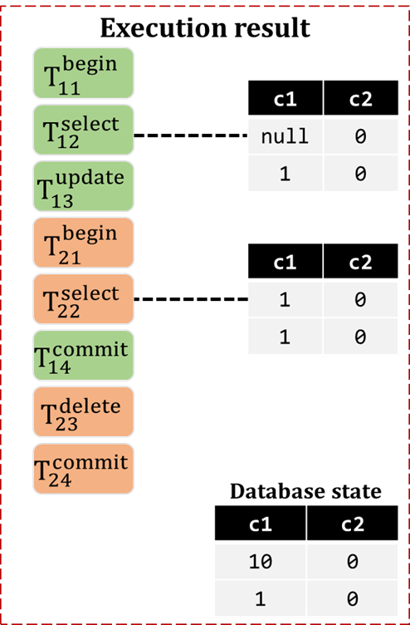
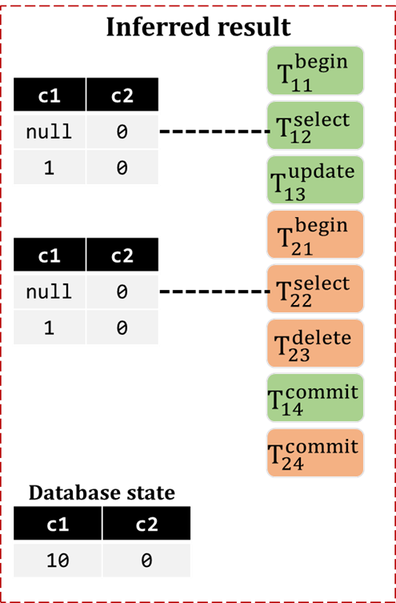
Result Comparison
Compare the statements one by one until the first difference
① incorrect
query result
② incorrect final
database state
Notes:
Finally, we compare transactions’ actual execution result with inferred execution result by analyzing their statements one by one. We can detect isolation bugs, (Click) which cause incorrect query result and (Click) incorrect final database state.

Slide 20
Evaluation
Evaluate Troc on three widely-used DBMSs
DBMS | Rank | GitHub Star | Isolation Levels
 |  |  | RU | RC | RR | SER
MySQL | 2 | 8.7k | ✓ | ✓ | ✓ | ✓
MariaDB | 13 | 4.7k | ✓ | ✓ | ✓ | ✓
TiDB | 108 | 33.3k |  | ✓ | ✓
RU: Read Uncommitted RR: Repeatable Read
RC: Read Committed SER: Serializable
Notes:
To demonstrate the effectiveness of our tool Troc, we evaluate it on three widely-used DBMSs, MySQL, MariaDB and TiDB. MySQL and MariaDB support four isolation levels, that is, Read Uncommitted, Read Committed, Repeatable Read, and Serializable. While TiDB supports Read Committed and Repeatable Read.
All these DBMSs provide good support for transactions, and are among the most widely-used DBMSs.

Slide 21
Bug Results
Troc has detected 12 unique bugs, including 7 new confirmed bugs
DBMS | Total | New | Duplicate
MySQL | 4 | 1 | 3
MariaDB | 4 | 3 | 1
TiDB | 4 | 3 | 1
Total | 12 | 7 | 5
Notes:
In total, (Click) Troc has detected 12 unique bugs, (Click) among which 7 bugs have been verified as previously-unknown bugs. Among the new confirmed bugs, one bug is fixed by DBMS developers.
In our experiment, on average, Troc takes 0.3 seconds to generate a transaction test case (including database generation), and takes 5.3 seconds for the oracle to infer the expected execution result for a single transaction test case (including transaction execution). In total, it takes 200 to 60000 test runs (about 0.5 to 200 hours) for Troc to report a bug.

Slide 22
MariaDB#26642
MariaDB returns weird query result at Repeatable Read
Init
tx1
c1 | c2
0 | 0
1 | 1
BEGIN;
SELECT * FROM t;
tx2
BEGIN;
Updated in tx2
c1 | c2
0 | 0
10 | 1
Updated in tx1
c1 | c2
10 | 0
10 | 1
UPDATE t SET c1=10 WHERE c2=1;
COMMIT;
UPDATE t SET c1=10;
SELECT * FROM t;
COMMIT;
https://jira.mariadb.org/browse/MDEV-26642
Notes:
We show a simplified test case that triggers a new isolation bug in MariaDB at Repeatable Read detected by Troc. In the test case, (Click) two transactions concurrently modify the init table. Red arrows show their execution order. After transaction one creates a snapshot at the first SELECT statement, transaction two updates column c one in the second row as 10 and commits. (Click) Transaction one then updates column c one in all rows as 10.
(Click) Transaction two firstly updates c one in the second row as 10 (Click) and commits successfully.(Click) Then (Click) transaction one queries the table by reading the snapshot established by the first SELECT statement, and(Click) obtains the correct result. (Click) Transaction one further updates c one in all rows as 10 later. Since transaction two has committed, transaction one can successfully update all rows in the table. (Click) For the third SELECT statement, transaction one returns (10, 0) and (1, 1).

Slide 23

MariaDB#26642
MariaDB returns weird query result at Repeatable Read
Init
tx1
c1 | c2
0 | 0
1 | 1
BEGIN;
SELECT * FROM t;
tx2
BEGIN;
Updated in tx1
c1 | c2
10 | 0
10 | 1
UPDATE t SET c1=10 WHERE c2=1;
COMMIT;
UPDATE t SET c1=10;
Select in tx1
SELECT * FROM t;
This is the impact of a design decision of the InnoDB REPEATABLE READ. If we changed this now after all these years, some applications could be broken.
c1 | c2
10 | 0
1 | 1
COMMIT;
Incorrect query result
https://jira.mariadb.org/browse/MDEV-26642
developers
Notes:
Then we query the table and find that transaction one retrieves only its part of updated rows. However, it should return all its updated data. (Click) So this bug causes incorrect query result. (Click) The developers explained that this bug exists in MariaDB for a long time. They mark this bug as critical, but they have not decided to fix it yet, since some applications based on MariaDB could be broken if the wrong behavior is fixed.

Slide 24
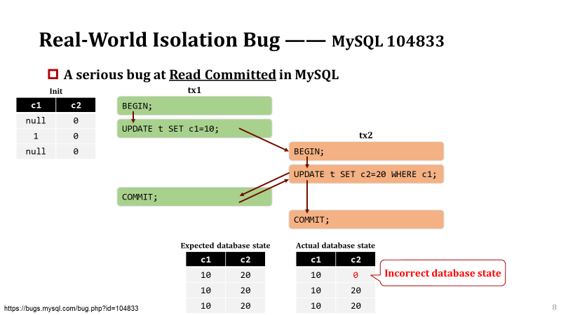
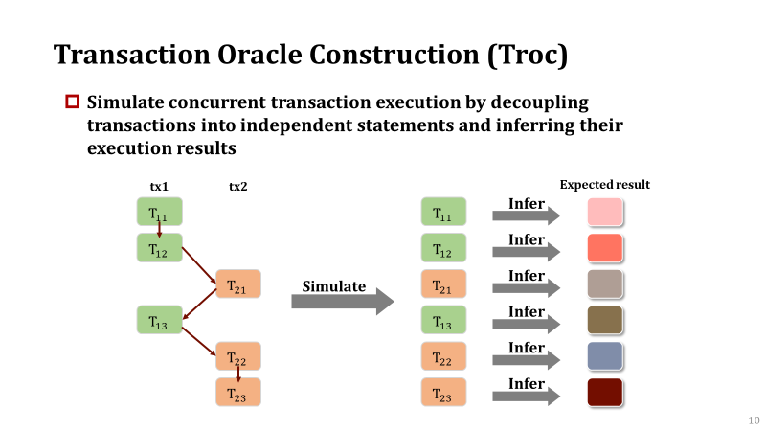
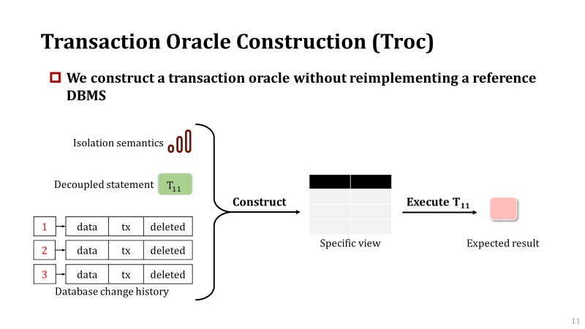
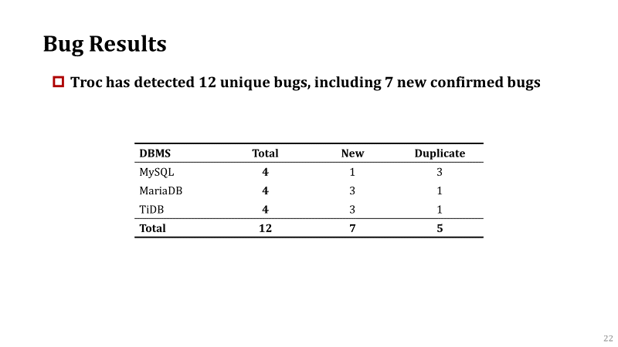

Conclusion
https://github.com/tcse-iscas/Troc
Notes:
In conclusion, we propose a general transaction testing approach, Troc, to automatically detect isolation bugs in database management systems. We construct a transaction oracle to infer the concurrent transactions’ expected execution results without reimplementing a reference DBMS. The evaluation on real-world DBMSs shows that Troc is effective in detecting isolation bugs. Our tool is available on GitHub. That’s all. Thank you.

