Slide 1
The Impact Analysis of Multiple Miners and Propagation Delay on Selfish Mining
Qing Xia, Wensheng Dou, Tong Xi, Jing Zeng,
Fengjun Zhang, Jun Wei, Geng Liang
Institute of Software, Chinese Academy of Sciences

Slide 2

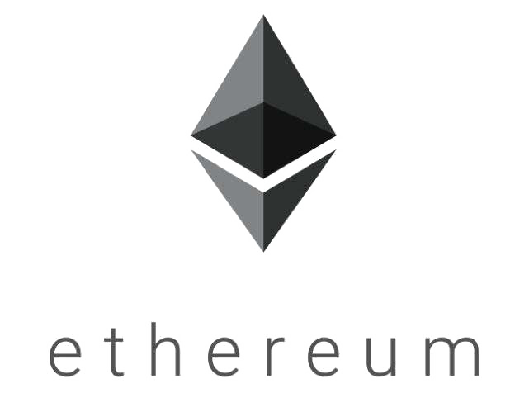


Blockchain has been widely adopted

Slide 3




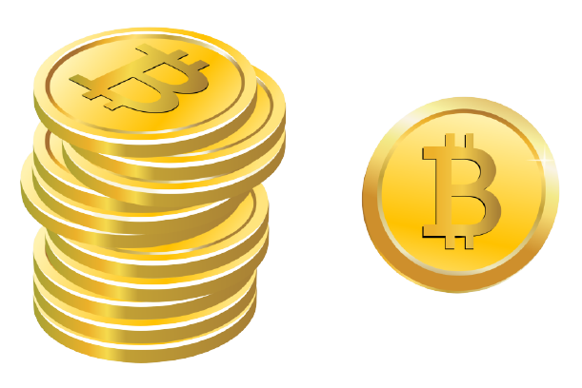

Nakamoto Consensus
One of the most widely-used consensus protocols proposed by Nakamoto Satoshi
1 second
2 seconds
Miner’s reward is proportional to its mining power

Slide 4

Selfish Mining
The game between 1 honest pool (Alice) and 1 selfish pool (Bob)
Longest chain wins!
Bob wastes its power on orphan blocks!

Slide 5
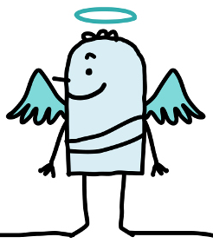
Selfish Mining
The game between 1 honest pool (Alice) and 1 selfish pool (Bob)
γ fraction of honest power
Fork happens!
Honest pool

Slide 6
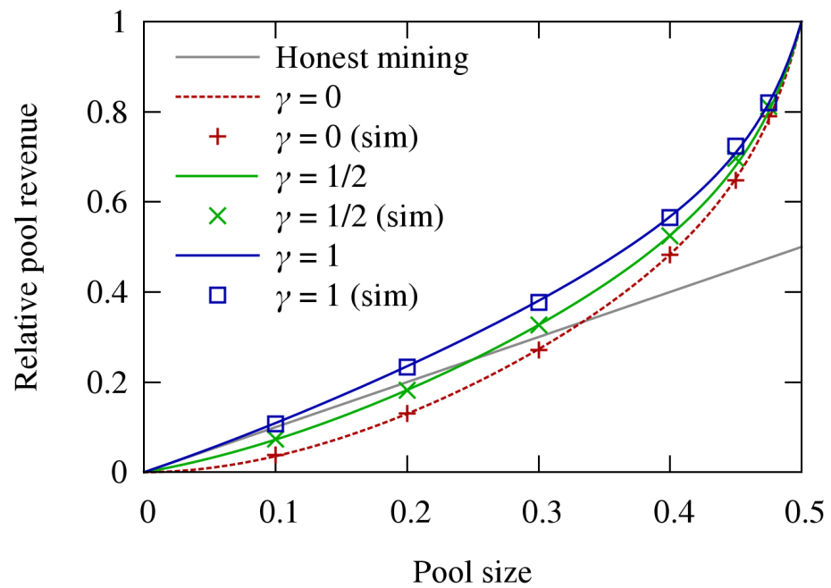
Selfish Mining
When γ = 0, Alice with ≥ 33% mining power can gain more profit
With half of the mining power, no matter what γ is, Alice can gain almost all profit
[1] I. Eyal and E. G. Sirer, Majority is not enough: Bitcoin mining is vulnerable, FC 2014.

Slide 7
Limitation 1
Previous work: Fork can only happen between the honest pool and selfish pool
Real-world scenario: Fork can happen inside the honest pool or the selfish pool
Notes:
矿池内的所有节点拥有相同的区块链视图

Slide 8
Limitation 2
Previous work: A fixed fraction of honest power always works after the selfish branch
Real-world scenario: γ is dynamically-changing and unknown due to varied delay

Slide 9
Practical Selfish Mining Strategy
Alice withholds three private blocks after receiving the stale block
Alice releases all private blocks after receiving multiple blocks

Slide 10
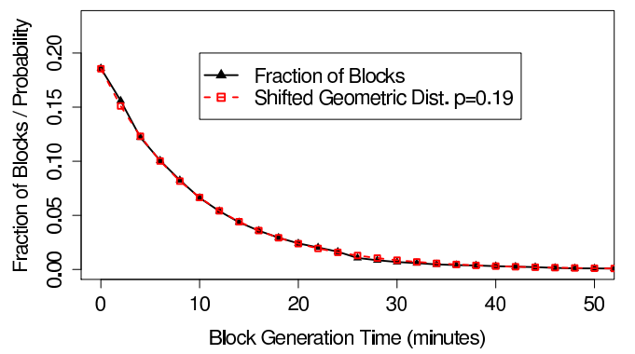
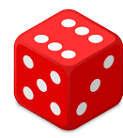

Blockchain Simulation Approach
Block generation with Proof-of-Work (PoW)
New block
Prev block hash:
0000000000005d4b…
Transactions:
tx1: 839…
tx2: a76…
tx3: db4…
Random number (Nonce):
1451738
SHA256(block)
$$t_{i}=Geometric \left(P_{i}\right)$$
00000000000000000005d4b5a3b11f699f329ede7793f54ba9ad0532177a9d28
[1] G. O. Karame, E. Androulaki, and S. Capkun, Double-spending fastpayments in bitcoin, CCS 2012.
Notes:
区块产生过程

Slide 11
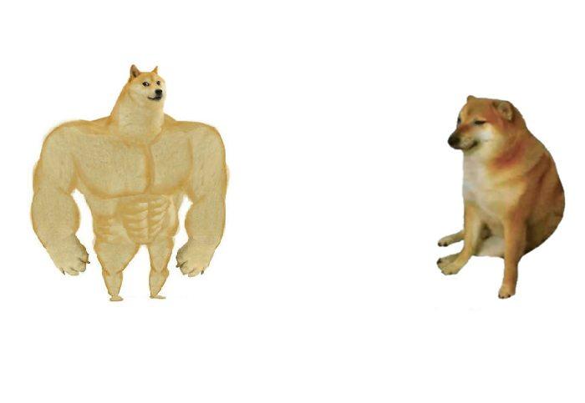



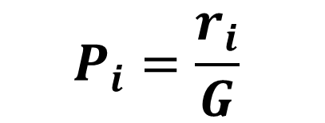
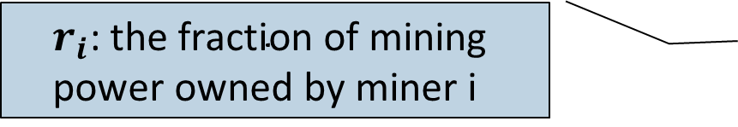
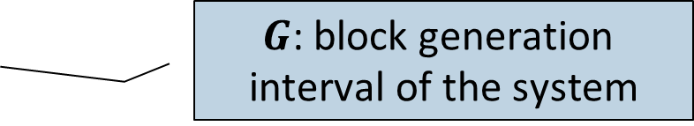
Blockchain Simulation Approach
7+2 x 29 = ?
7+2 = 9
Big miner can generate blocks faster
A lower difficulty can make block generation faster
$$r_{i}\text{: }\text{the} \text{fraction} \text{of} \text{mining} \text{power} \text{owned} \text{by} \text{miner} \text{i}$$
$$P_{i}=\frac{r_{i}}{G}$$
$$G \text{: }\text{block} \text{generation} \text{interval} \text{of} \text{the} \text{system}$$
Flexible parameters for simulation!

Slide 12
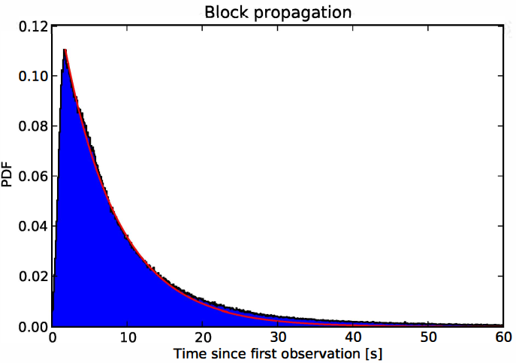
Blockchain Simulation Approach
Block propagation in the Peer-to-Peer (P2P) network
Propagation delay in Bitcoin fits the exponential curve with meantime of 12.6s [1]
The meantime becomes larger with a larger block size
$$Delay=Geometric (meantime)$$
[1] C. Decker and R. Wattenhofer, Information propagation in the bitcoin network, P2P 2013.
Notes:
Many blockchain systems adopts the same Gossip protocol as Bitcoin
We regard the delay conforms to the geometric distribution (discrete form ) with different meantime

Slide 13
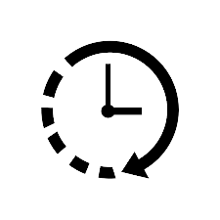
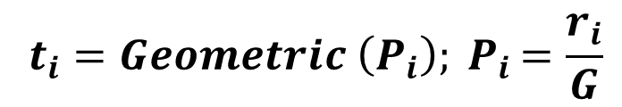
Blockchain Simulation Approach
$$t_{i}=Geometric \left(P_{i}\right){; P}_{i}=\frac{r_{i}}{G}$$
Notes:
产生区块的过程

Slide 14

Blockchain Simulation Approach
$$t_{i}=Geometric \left(P_{i}\right){; P}_{i}=\frac{r_{i}}{G}$$
$$Delay=Geometric (meantime)$$
Notes:
传播区块的过程

Slide 15
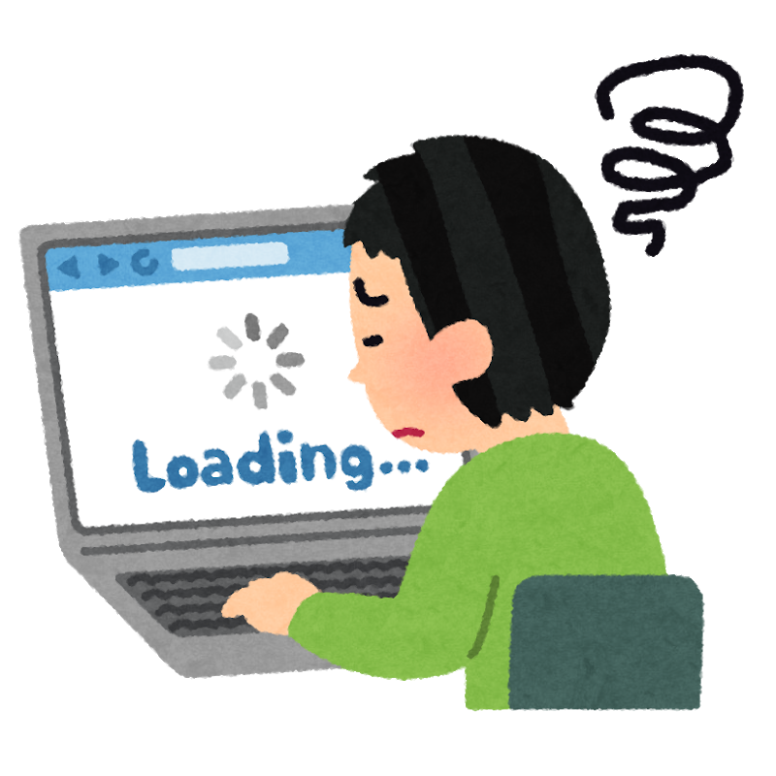

Research Questions
RQ1:How can multiple mining pools affect selfish mining?
RQ2:How can propagation delay affect selfish mining?
RQ3:How can orphan rate affect selfish mining?

Slide 16
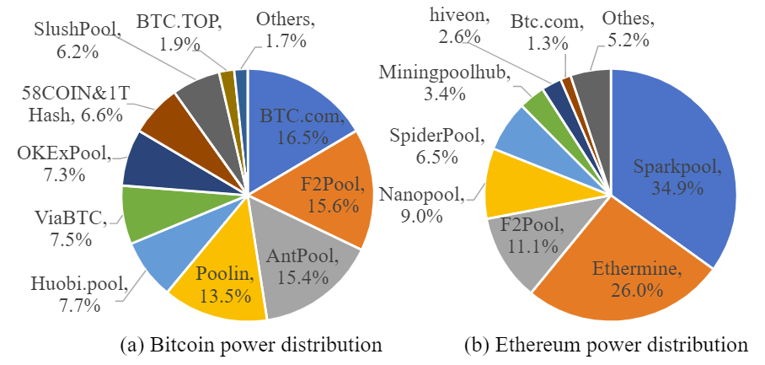
Experiment Settings
The number of multiple miners
Three cases
General case: 10 pools
More centralized case: 5 pools
More decentralized case: 20, 100 pools
Alice has 1% ~ 50% mining power, rest pools equally share the rest mining power
TOP 5 pools: 69%
TOP 10 pools: 98%
TOP 5 pools: 88%
TOP 10 pools: 96%
Notes:
Regard 5, 10, 20 miners as the centralized, general and decentralized system
Assign the first miner (Alice) 1% ~ 50% mining power, rest miners equally share the rest mining power

Slide 17
Experiment Settings
Relative propagation delay (RPD)
The ratio of propagation delay to block interval
Measures the blockchain system’s synchronization speed
 | Bitcoin | Other systems
Propagation delay | 12.6s | 15s | 6s
Block interval | 600s | 300s | 60s
Relative propagation delay (RPD) | 1/48 | 1/20 | 1/10
Increase the block size and decrease the block interval
We focus on the system with a larger relative propagation delay

Slide 18
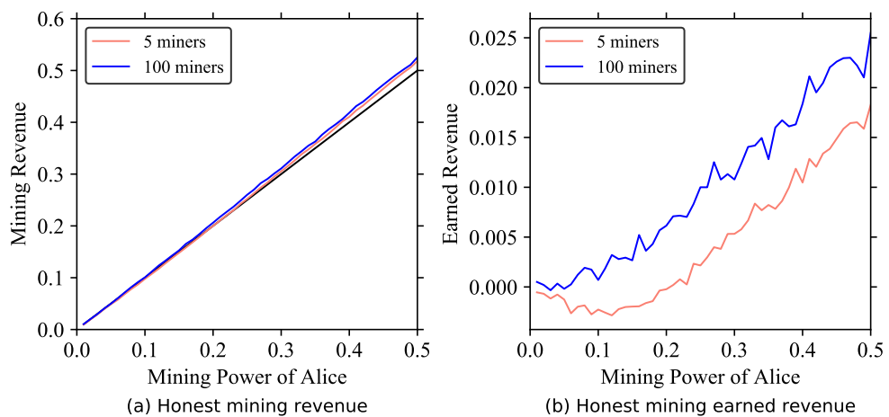

RQ1: Multiple Miners
A miner with sufficient mining power has an inherent advantage in the honest mode, especially in a more decentralized system.
Revenue increased by ~2%
Alice’s honest revenue with different honest miners

Slide 19
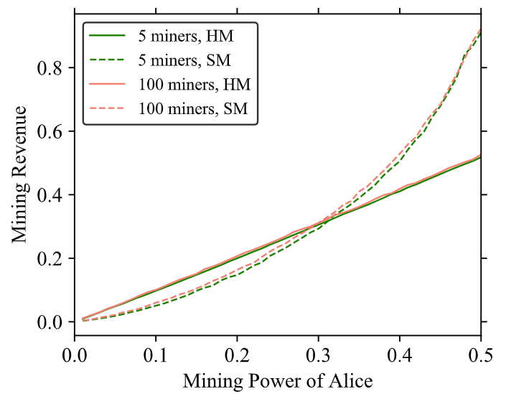
RQ1: Multiple Miners
Selfish mining performs better in the more decentralized system with more honest miners.
E.g., Alice’s profit threshold is 31% and 29% with 5 and 100 miners
Alice’s selfish revenue with different honest miners

Slide 20
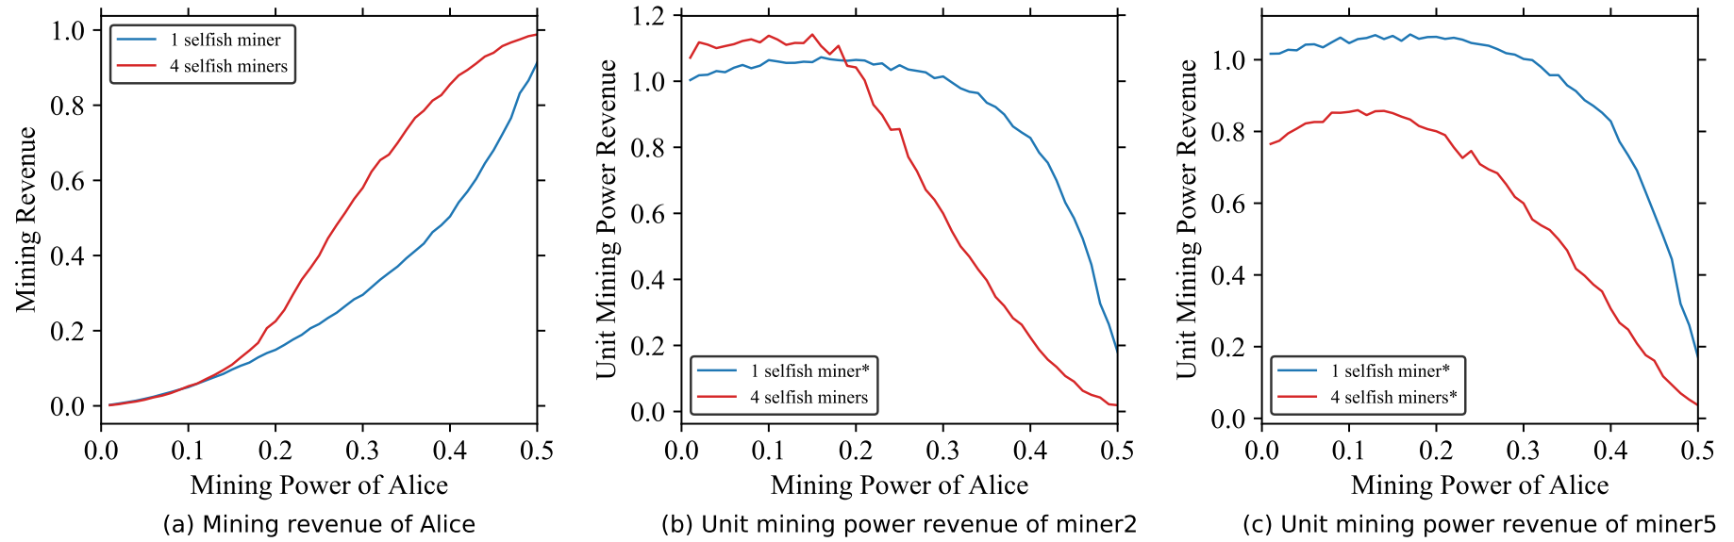
RQ1: Multiple Miners
With multiple selfish miners, the large selfish miner can benefit from selfish mining, while other smaller miners cannot.
Alice’s selfish revenue with different selfish miners

Slide 21
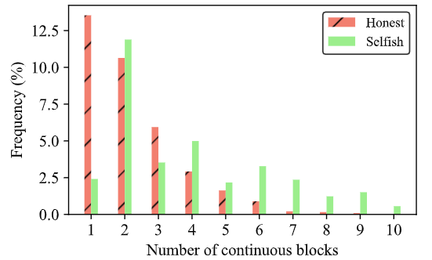
Comparison Analysis
Selfish mining results in more consecutive blocks generated by the selfish miner
selfish miner is more likely to succeed with a longer private chain

Slide 22
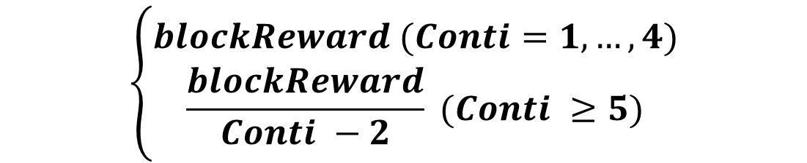
Implication
Alleviate selfish mining
Revise the reward mechanism!
$$\left\{\begin{aligned}blockReward (Conti=1,…,4) \\ \frac{blockReward}{Conti −2} (Conti ≥5)\end{aligned}\right.$$
Alice’s revenue decreases by 14% in selfish mining
Even if Alice has nearly 50% of mining power, it cannot benefit from selfish mining

Slide 23
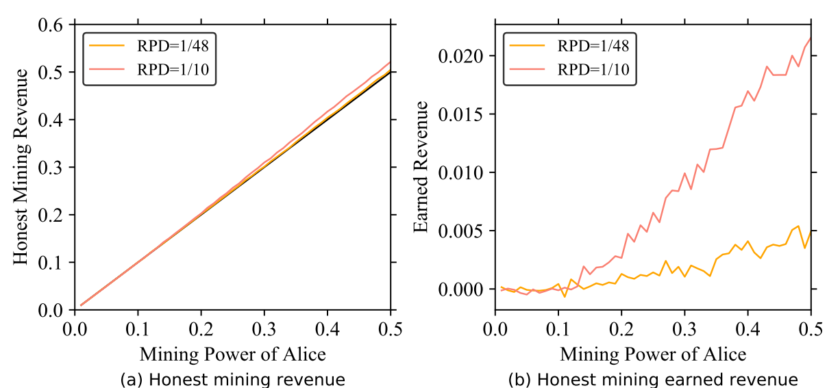
RQ2: Relative Propagation Delay (RPD)
A miner with sufficient mining power has an inherent advantage in honest mining, especially in the system with a larger delay.
Alice’s honest revenue with different RPDs

Slide 24
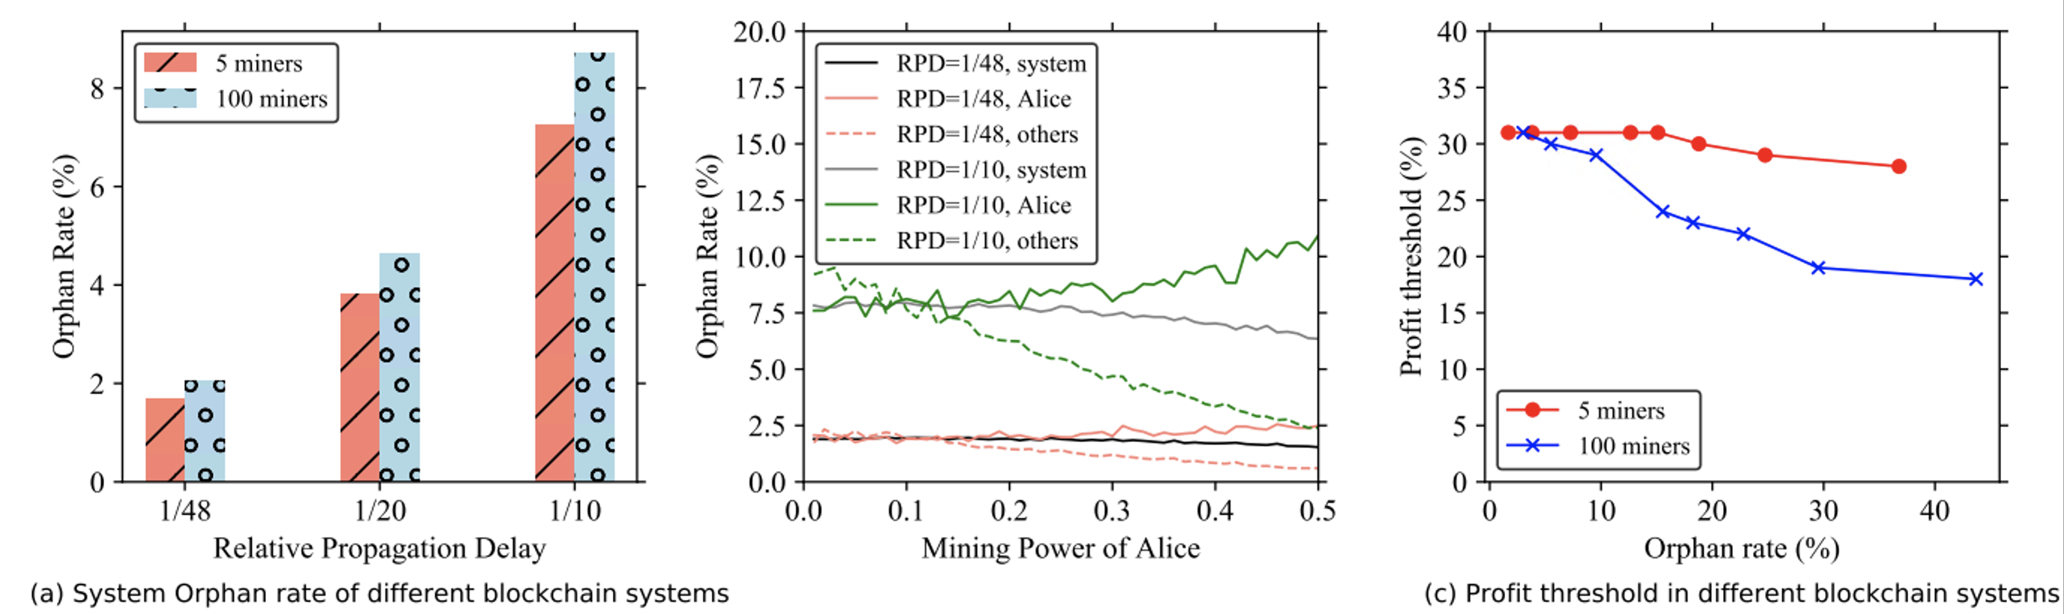
RQ3: Orphan Rate
The system has a higher orphan rate with more miners and a larger delay.
Profit threshold of selfish mining decreases when the orphan rate increases.
Profit threshold in different blockchain systems

Slide 25
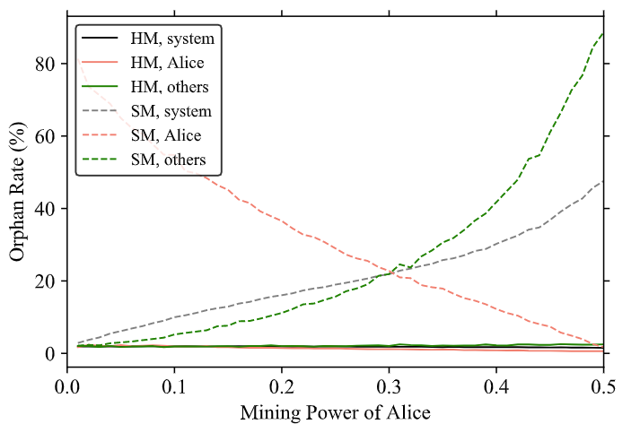
Implication
Selfish mining has a great impact on the orphan rates
Selfish miner has a high orphan rate with less mining power
As the mining power increases, the selfish orphan rate decreases, while the honest and system increases
Orphan rate in different mining modes

Slide 26
Conclusion
We propose a new selfish mining strategy to handle blockchain scenarios with multiple miners and propagation delay.
We propose a simulation approach to simulate the real-world blockchain scenarios.
We evaluate the performance of the selfish mining strategy on the simulation system and obtain many interesting findings from the empirical study.

Slide 27

THANK YOU!

