Slide 1
CACheck: Detecting and Repairing Cell Arrays in Spreadsheets
Wensheng Dou
²⁰¹⁶⁻⁰⁵⁻⁰⁸

Slide 2
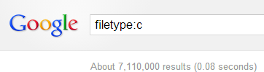
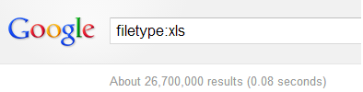

Spreadsheets are widely used
Spreadsheet is one of the most wildly-used End-user development tool nowadays
Microsoft Excel, WPS, Google Excel
Used for data storage, decision support, financial reporting, quality control...
vs.

Slide 3
Spreadsheet errors matter!
KPMG and Coopers & Lybrand have reported finding errors in more than 90% spreadsheets.
The European Spreadsheet Risks Group lists 72 publicly reported errors of up to $1billion due to inadequate spreadsheets and/or spreadsheet controls.
[1] EuSpRIG Horror Stories, http://www.eusprig.org/horror-stories.htm

Slide 4

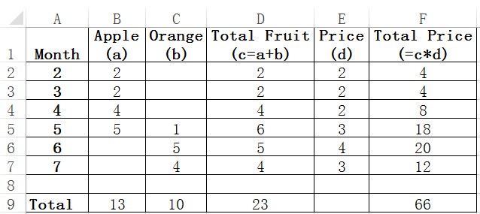
Motivating example
The spreadsheet contains incorrect formulas
Update on the incorrect formulas could cause faulty values in the spreadsheet
Should be 18
4→ 6
4→ 6
… a real example extracted from EUSES spreadsheet corpus

Slide 5
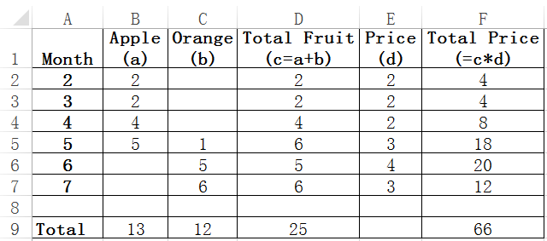
Problems
Screen shot of the spreadsheet before and after the change
No warning is issued by Excel
Q1: Which cells contain incorrect formulas?
Q2: Which cells’ values are incorrect?

Slide 6



Key challenge - No oracle!
It is hard to identify which cells contain incorrect formulas or values
Require human judgments or specifications

Slide 7
Methodology
Total Fruit = Apple + Orange
Total Price =
Total Fruit * Price
Cell array
Cells are often grouped in a row or column with the same intended computation
We call this kind of group as a cell array

Slide 8
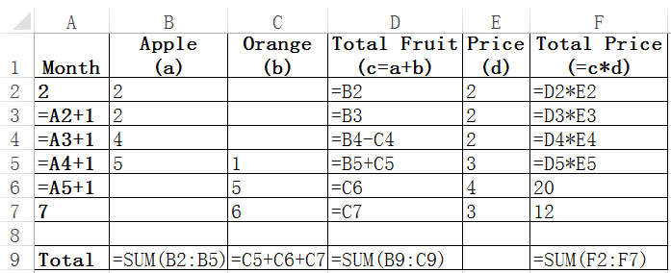
Methodology
The intended computation is ambiguous when not all the cells in a cell array follow the same formula pattern
The cell array suffers from ambiguous computation smells

Slide 9
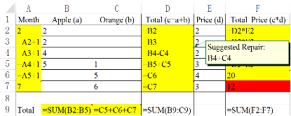
CACheck overview
Annotated
spreadsheets
Spreadsheets
Cell Array
Identification
Formula Pattern
Recovery
Cell Array
Filtering
Smells
Errors
Statically analyze ambiguous computation smells

Slide 10
CACheck overview
Annotated
spreadsheets
Spreadsheets
Cell Array
Identification
Formula Pattern
Recovery
Cell Array
Filtering
Smells
Errors
Statically analyze ambiguous computation smells

Slide 11
How to identify cell arrays?
No records about cell arrays in spreadsheets
What is the boundary of such a cell array

Slide 12
Cells reference their input cells in the similar way
Cell array
Data cells could reference any other cells.
At least there is a formula in a cell array.

Slide 13
Cells reference their input cells in the similar way
Cell array
Data cells could reference any other cells.
At least there is a formula in a cell array.

Slide 14
Cells reference their input cells in the similar way
Data cells could reference any other cells.
At least there is a formula in a cell array.

Slide 15
Possible false positives
False Positive
Our relaxed cell array detection approach could possibly introduce false positives.

Slide 16
CACheck overview
Annotated
spreadsheets
Spreadsheets
Cell Array
Identification
Formula Pattern
Recovery
Cell Array
Filtering
Smells
Errors
Statically analyze ambiguous computation smells

Slide 17

How to get the intended computation?

Slide 18
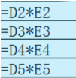
Finding candidates from existing formulas
= D_{i}*E_{i}

Slide 19

Gaining confidence
= D_{i}*E_{i}
Q: Is it likely the intended computation?
A: Yes if it computes the values of the majority of cells
5
4
20 = D6*E6

Slide 20

Conformance error detection
= D_{i}*E_{i}
Assumption:
The values of cells are more likely correct than not
6
3
12 ≠ D7*E7
Likely an error

Slide 21
What if we find multiple formula patterns?
= SUM(X2:X5), when X6, X7 = 0
= X5+X6+X7, when X2, X3, X4 = 0
Here, X = {B, C}

Slide 22
Constraints for intended formula pattern
Existing formula patterns
= SUM(X2:X5), when X6, X7 = 0
= X5+X6+X7, when X2, X3, X4 = 0
SUM, +
The values in the cell array
Likely
specifications
Likely computational components
Input cells
Likely input-output pairs
Output cells

Slide 23
Synthesizing intended formula pattern
Adapt component-based program synthesis [1][2] to find the intended formula pattern
Basic idea – Compose given computational components, and generate a program that satisfy specifications and input-output pairs. E.g., SUM and +,
For our example, we can generate SUM(X2:X5) + X6 + X7.
c1: ret = SUM(X2:X5)
c2: ret = SUM(X2:X5)+X6
c3: ret = X2+X3+X4
c4: ret = SUM(X2:X5)+X6+X7
cn: ret = ……
[1] S. Jha, S. Gulwani, S.A. Seshia, and A. Tiwari. Oracle-guided component-based program synthesis. In ACM/IEEE 32nd International Conference on Software Engineering (ICSE), pages 215–224. 2010.
[2] S. Gulwani, S. Jha, A. Tiwari, and R. Venkatesan, Synthesis of loop-free programs. In ACM SIGPLAN Conference on Programming Language Design and Implementation (PLDI), pages 62–73. 2011.

Slide 24
CACheck overview
Annotated
spreadsheets
Spreadsheets
Cell Array
Identification
Formula Pattern
Recovery
Cell Array
Filtering
Smells
Errors
Statically analyze ambiguous computation smells

Slide 25
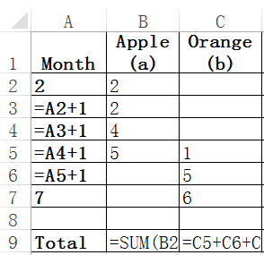
Filter out FPs
Our relaxed cell array detection approach could report many false positives.
Select a subset of all detected cell arrays, having:
More true positives
Less false positives
3 FPs

Slide 26
Filter out FPs ----- Rule 1
Cell arrays rarely overlap
Empirical study on EUSES [1] and Enron [2] shows that only 0.6% cell arrays overlap.
Only select one of them
Rule 1:
If two cell arrays overlap, only one could be true.
[1] M. Fisher and G. Rothermel, “The EUSES spreadsheet corpus: a shared resource for supporting experimentation with spreadsheet dependability mechanisms,” SIGSOFT Softw Eng Notes, vol. 30, no. 4, pp. 1–5, May 2005.
[2] F. Hermans and E. Murphy-Hill, “Enron’s Spreadsheets and Related Emails: A Dataset and Analysis.” ICSE 2015.

Slide 27
Filter out FPs ----- Rule 2
In order not to mistakenly miss true cell arrays, the set of selected cell arrays should also be maximized.
Select all of them
Rule 2:
The set of selected cell arrays are maximized.

Slide 28
Filter out FPs ----- Rule 3
Because a FP’s contained cells are put together in an unreasonable way, cells in it cannot easily be covered by the formula pattern, and causes wrong data.
No error
Rule 3:
The set of selected cell arrays have minimal errors.
2 errors
3
3

Slide 29
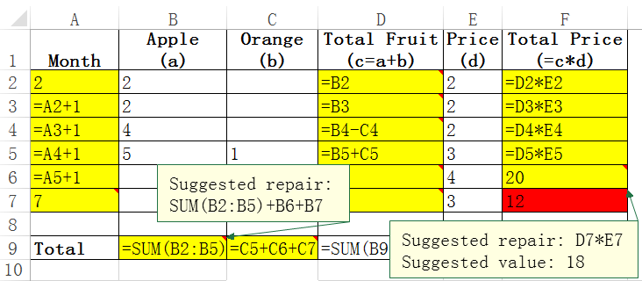
CACheck implementation
CACheck
Annotate the smells in the resulted spreadsheets

Slide 30
Evaluation
RQ1: How common are ambiguous computation smells in real-life spreadsheets?
RQ2: Can CACheck detect ambiguous computation smells precisely?
RQ3: Are ambiguous computation smells harmful?
Experimental subject: EUSES [1]
[1] M. Fisher and G. Rothermel, “The EUSES spreadsheet corpus: a shared resource for supporting experimentation with spreadsheet dependability mechanisms,” SIGSOFT Softw Eng Notes, vol. 30, no. 4, pp. 1–5, May 2005.

Slide 31
How common? (RQ1)
15.5% of cell arrays suffer from ambiguous computation smells
Category | Cell array (CA) | Smelly cell arrays (SCA) | SCA / CA
cs101 | 39 | 12 | 30.8%
database | 3,271 | 448 | 13.7%
filby | 0 | 0 | n.a.
financial | 7,008 | 1,259 | 18.0%
forms3 | 150 | 16 | 10.7%
grades | 2,955 | 666 | 22.5%
homework | 2,702 | 343 | 12.7%
inventory | 3,903 | 517 | 13.2%
jackson | 0 | 0 | n.a.
modeling | 2,018 | 182 | 9.0%
personal | 131 | 0 | 0.0%
Total | 22,177 | 3,443 | 15.5%

Slide 32
Is CACheck precise? (RQ2)
Coverage gives the percentage of cells that can be computed by the intended formula pattern
For coverage threshold of 70%, experimental precision is 86.8%
Coverage | SCA | TP | TP/SCA
100% | 1,184 | 1,092 | 92.23%
[90%, 100%) | 152 | 112 | 73.68%
[80%, 90%) | 164 | 117 | 71.34%
[70%, 80%) | 97 | 65 | 67.01%
[60%, 70%) | 406 | 74 | 18.23%
[50%, 60%) | 1,042 | 76 | 7.29%
[0%, 50%) | 398 | 50 | 12.56%
Total | 3,443 | 1,586 | 46.06%

Slide 33
Are ambiguous smells harmful? (RQ3)
CACheck detects 5,553 cells with wrong data.
1,458 cells were confirmed.
Coverage | Detected wrong cells | Confirmed wrong cells
100% | 0 | 0
[90%, 100%) | 226 | 131
[80%, 90%) | 398 | 323
[70%, 80%) | 262 | 201
[60%, 70%) | 749 | 294
[50%, 60%) | 1,496 | 218
[0%, 50%) | 2,422 | 291
Total | 5,553 | 1,458

Slide 34
Summary
Ad-hoc modification introduces computation smells
The cells in a cell array have the same computational semantics
Evaluate on EUSES
Ambiguous computation smells are common and harmful
Ambiguous computation smell detection and repairing
Evaluation

Slide 35

Thank you!

