Slide 1



46th International Conference on Software Engineering
FaultFuzz: A Coverage Guided Fault
Injection Tool for Distributed Systems
Wenhan Feng, Qiugen Pei, Yu Gao, Dong Wang, Wensheng Dou,
Jun Wei, Zheheng Liang, Zhenyue Long
Institute of Software, Chinese Academy of Sciences
China Southern Power Grid
1
Notes:
Hello everyone, I am Feng Wenhan from Chinese Academy of Sciences. I’m glad to introduce our tool FaultFuzz.

Slide 2

















Distributed Systems
Distributed systems have become the backbone of modern Internet applications
Notes:
Nowadays, distributed systems have become the backbone of modern Internet applications.

Slide 3




Faults in Distributed Systems
Faults can happen at any node and any time
Distributed systems adopt fault recovery protocols to recover from faults
c
Crash
Network disconnection
Network reconnection
Reboot
Notes:
In a distributed system, faults like crash, reboot, network disconnection and reconnection can occur at any time. Distributed systems adopt some fault recovery protocols to recover from faults and provide uninterrupted service.

Slide 4

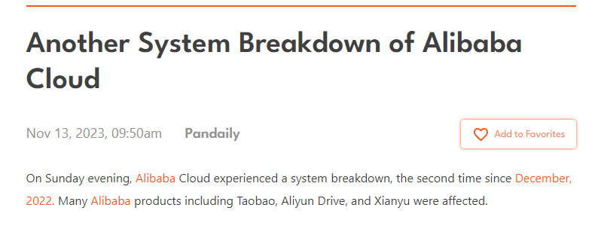


Fault Recovery Bugs
Incorrect fault recovery protocols and implementations can introduce fault recovery bugs
Notes:
However, Incorrect fault recovery protocols and implementations can introduce fault recovery bugs, which may render the entire service unavailable and lead to huge economic loss.

Slide 5
Challenges in Exposing Fault Recovery Bugs
Distributed systems face numerous fault scenarios
Where to inject faults?
When to inject faults?
What faults to inject?
Notes:
It is challenging to detect fault recovery bugs since distributed systems face numerous fault scenarios. A distributed system can contain thousands of nodes. We must decide which nodes to inject faults, when to inject faults and what faults to inject.

Slide 6



FaultFuzz
FaultFuzz: a coverage-guided fault injection tool to test distributed systems
Fault injection point: I/O point
Fault types: crash, reboot, network disconnection, network reconnection
$${IO}_{1}$$
$${IO}_{2}$$
Fault sequence under test
Target system
System runtime feedback
Fault sequence selection
Fault sequence generation and mutation
Notes:
Therefore, we propose FaultFuzz, a coverage-guided fault injection tool that can systematically and effectively test distributed systems. FaultFuzz treats I/O points as its fault injection points, affects system execution by injecting faults into I/O points. During testing, FaultFuzz can continuously collect runtime information and explore untested system behaviors by leveraging the information.

Slide 7

Information Collection
FaultFuzz collects 3 types of runtime information
I/O information
Fault information
Code coverage information
@Inject
public void send(...){...}
Information type | Description
I/O information | Node id Call stack Timestamp Destination (file path or connected node ID)
Fault information | Fault injected on this point
Coverage information | Code coverage of this test
Application-level I/O points
write(int b){
TriggerAndRecord(); ...
}
FileOutputStream.java
JRE-level I/O points
Notes:
FaultFuzz collects 3 types of runtime information. Besides fault information and code coverage information, FaultFuzz can intercept concerned I/O points to collect I/O information such as node id and call stack. For I/O points in application level, users can use @inject annotation to specify their concerned I/O points. For I/O points in JRE level, users can use our instrumented JRE to intercept I/O points.

Slide 8










Fault Sequence Generation and Mutation
FaultFuzz generates and mutates fault sequences based on the collected runtime information
Generation
Node C
$${IO}_{A}^{1}$$
$${IO}_{B}^{1}$$
$${IO}_{C}^{1}$$
$${IO}_{C}^{2}$$
Node B
FaultSeq-m1
Node A
Mutation
FaultSeq-m2
FaultSeq
FaultSeq-m3
$${IO}_{A}^{1}$$
$${IO}_{B}^{1}$$
$${IO}_{C}^{1}$$
$${IO}_{C}^{2}$$
FaultSeq-m4
Code coverage does not increase
Drop the fault sequence
Add only one feasible fault after the last fault
Notes:
After a system run, FaultFuzz generates and mutates fault sequences based on collected runtime information. If code coverage does not increase, FaultFuzz will drop the generated fault sequence. Otherwise, FaultFuzz will use the generated fault sequence to mutate new fault sequences. In particular, FaultFuzz adds only one feasible fault after the last fault in the generated fault sequence.

Slide 9


Fault Sequence Selection
FaultFuzz prioritizes fault sequences that are more likely to cover new codes and trigger new bugs
A
B
C
“heartbeat”
Similar fault scenarios
New fault scenario
“heartbeat”
“submit”
“heartbeat”
Notes:
FaultFuzz prioritizes fault sequences that are more likely to cover new codes and trigger new bugs. For instance, FaultFuzz treats regular 'heartbeat' I/O points as similar system behaviors, and avoid conducting duplicated testing on them. On the other hand, the 'submit' I/O point is regarded as a potential trigger for new fault scenarios, thereby FaultFuzz will prioritizes fault injection testing on it.

Slide 10

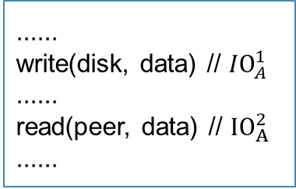




Fault Injection Testing
Given a fault sequence, FaultFuzz runs the target system to deterministically inject faults
Intercept every concerned I/O point
Send the information to the test controller
Decide to continue execution or inject a fault
......
write(disk, data) // ${IO}_{A}^{1}$
......
read(peer, data) // ${IO}_{A}^{2}$
......
Can I execute now?
Yes, you can
$${IO}_{A}^{1}$$
$${IO}_{A}^{2}$$
$${IO}_{B}^{1}$$
$${IO}_{B}^{2}$$
Controller
Notes:
Given a fault sequence, FaultFuzz runs the target system to deterministically inject faults. In particular, FaultFuzz Intercepts every concerned I/O point, sends the information to the test controller, and decides to continue execution or inject a fault.

Slide 11




FaultFuzz Architecture
Frontend
UI with Appsmith
Configuration
Auto testing
Runtime statistics
workloads
configuration
results
SpringBoot Web Server
Backend
Fault sequence pool
Fault sequence selection
Test controller
Fault sequence generation and mutation
Fault injection testing
coverage and I/O info
I/O info
SUT
Observer
Observer
Observer
Notes:
We implement FaultFuzz as a web service. FaultFuzz contains the frontend, the backend and the obervers on the system under test.

Slide 12
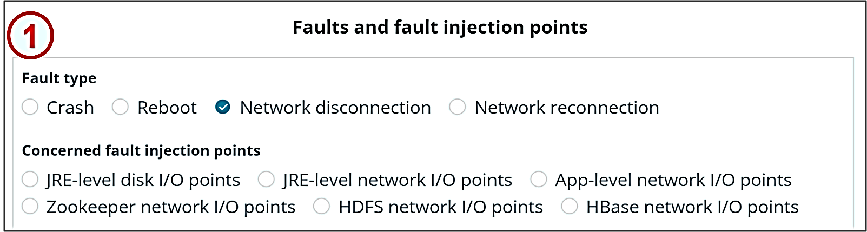


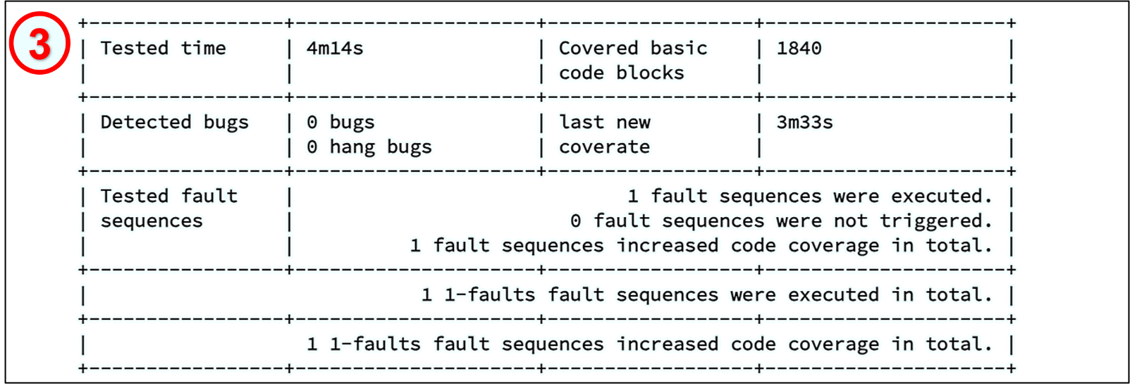


Screenshot of FaultFuzz
1
1
Specify testing configurations
2
Start testing
3
Real-time testing results
Replay a fault sequence
4
Notes:
When using FaultFuzz, users can visit the FaultFuzz website, input their testing configuration, and start the testing by clicking the corresponding button. FaultFuzz then automatically conducts the tests and provides real-time test results to users. Users can also click the replay button to replay a fault sequence and thoroughly check a fault scenario
做个视频的backup

Slide 13
Evaluation
FaultFuzz has detected 4 new bugs and 1 duplicated bug
 | Bug ID | Failure Symptoms | # of Faults
New Bugs | HBASE-26883 | Data loss | 2
 | ZOOKEEPER-4503 | Data staleness | 2
 | HBASE-26897 | Cluster out of service | 2
 | HBASE-26370 | Misleading error message | 1
Duplicated Bugs | HDFS-16508 | Operation failure | 1
Notes:
We have evaluated FaultFuzz on 3 famous distributed systems and found totally 5 bugs. 4 of these bugs are unknown before.

Slide 14
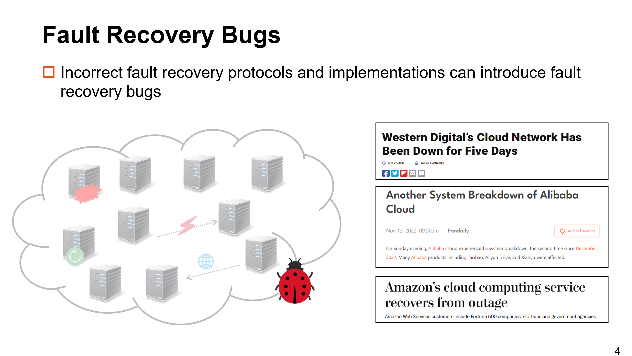
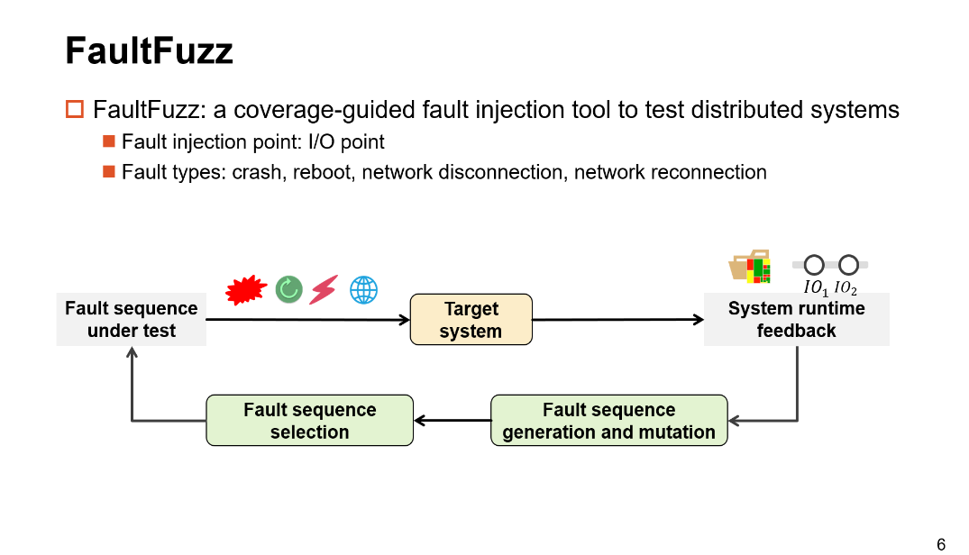
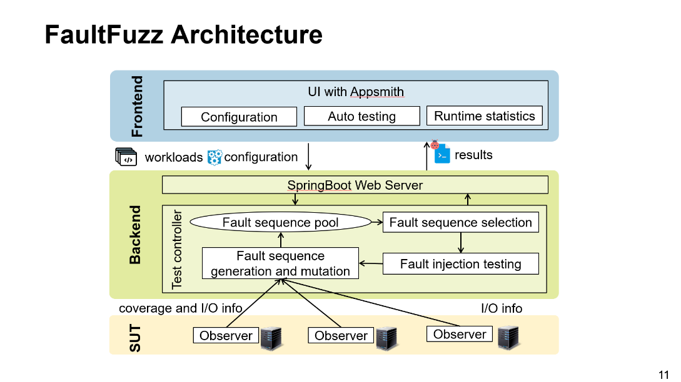
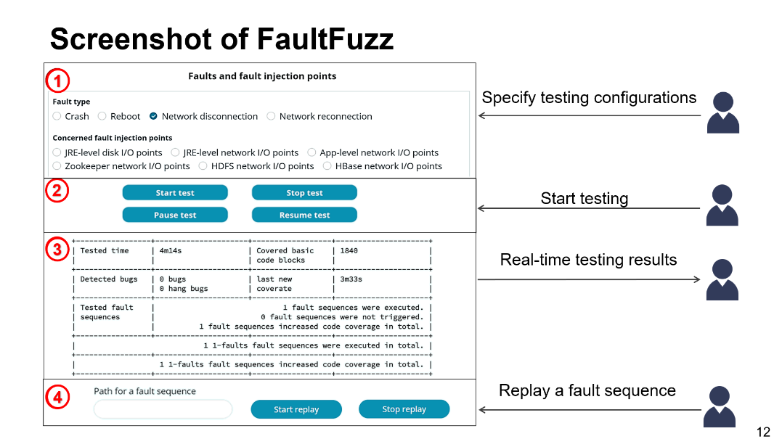

Conclusion
https://github.com/tcse-iscas/FaultFuzz
Notes:
In conclusion, we introduce FaultFuzz as a solution for detecting fault recovery bugs. FaultFuzz utilizes runtime information to perform fault injection tests in scenarios more prone to trigger bugs. We have developed FaultFuzz as a web service and provided user-friendly web interface. The source codes of our tool are available on GitHub.

