Slide 1




46th IEEE/ACM International Conference on Software Engineering
Understanding Transaction Bugs in Database Systems
Ziyu Cui, Wensheng Dou, Yu Gao, Dong Wang, Jiansen Song, Yingying Zheng, Tao Wang, Rui Yang, Kang Xu, Yixin Hu, Jun Wei, Tao Huang
Institute of Software, Chinese Academy of Sciences
University of Chinese Academy of Sciences
Sun Yat-sen University
Notes:
Hello everyone. I am Cui Ziyu from University of Chinese Academy of Sciences. It’s my honor to be here and talk about our work：Understanding Transaction Bugs in Database Systems.

Slide 2











Database Management System (DBMS)
DBMSs are widely used in many applications for efficiently storing and retrieving data
Notes:
Database Management Systems, such as MySQL and PostgreSQL, are widely used in many applications for efficiently storing and retrieving data.

Slide 3




Transaction
DBMSs utilize transactions to ensure data integrity and consistency
BEGIN;
$ 200
- 100
$ 100
UPDATE account SET balance = balance – 100 WHERE name = “Alice”;
Alice
$ 100
UPDATE account SET balance = balance + 100 WHERE name = “Bob”;
$ 10
+ 100
$ 110
COMMIT;
Bob
Notes:
DBMSs treat the integrity of data as one of the most important promises, and utilize transactions to ensure data integrity and consistency. For example, Alice wants to transfer money to Bob. (Click) The DBMS (/səbˈtrækts/) subtracts one hundred dollars from Alice’ account, (Click) then adds one hundred dollars to Bob’s account. (Click) The DBMS utilizes transaction start statement and end statement to form an explicit transaction, and executes such a group of statements to ensure transferred data integrity and consistency.

Slide 4
ACID Properties
Transactions provide guarantees for ACID properties
transaction 1
execution
transaction 2
execution
DBMS
transaction 3
execution
…
ACID
Atomicity
Consistency
Isolation
Durability
Notes:
In DBMSs, transactions are executed concurrently. (Click)Transactions provide guarantees for ACID properties, including atomicity, consistency, isolation and durability. For example, DBMSs utilize isolation to ensure consistency of concurrent transaction execution

Slide 5







Transaction Bug (TXBug)
Buggy transaction processing mechanisms and implementations can cause transaction bugs
Violate corresponding transaction semantics, e.g. ACID properties
Lead to severe consequences
DBMS
DBMS crash
tx1:
$$T_{11}^{}$$
$$T_{12}^{}$$
$$T_{13}^{}$$
$$T_{21}^{}$$
$$T_{22}^{}$$
$$T_{23}^{}$$
DBMS
tx2:
Incorrect query results
Concurrent transactions
Incorrect DBMS states
…
Notes:
However, design flaws or buggy implementations of transaction processing mechanisms can introduce transaction bugs, which violate corresponding transaction semantics, and lead to severe consequences, such as DBMS crash, incorrect DBMS states and query results.

Slide 6
A Real-World TXBug —— TiDB 21498
A TXBug at Read Committed isolation level in TiDB
Init
tx1
id | v
1 | 10
BEGIN;
SELECT * FROM t WHERE v = 10;
tx2
ALTER TABLE t DROP INDEX iv;
Updated in tx2
UPDATE t SET v = 11 WHERE id = 1;
id | v
1 | 11
SELECT * FROM t WHERE v = 10;
COMMIT;
Expected Select in tx1
Actual Select in tx1
id | v
id | v
1 | 10
Empty set
https://github.com/pingcap/tidb/issues/21498
Notes:
Here we show a real-world transaction bug triggered at Read Committed isolation level in TiDB. At read committed, transaction one can read other transactions’ committed data. In this case, transaction one first queries table and return initial table data. (Click)Then transaction two drops index 𝑖𝑣 and updates row (1,10) to (1, 11). Note that two statements in transaction two are executed as two independent autocommit transactions. So, the modifications made by transaction two have been committed to table t, (Click)and transaction one should retrieve the empty set after transaction two completes. (Click)However, the second query in txn1 returns incorrect query result.

Slide 7

Existing Works
Transaction verification approaches verify whether DBMSs with key-value data structures violate their claimed isolation levels
Elle[1], Cobra[2]
Transaction testing approaches adopt differential testing and test oracle construction to detect transaction bugs in relational DBMSs
DT²[3], Troc[4]
How effective existing approaches are in detecting real-world TXBugs?
What TXBugs cannot be detected by existing approaches?
Lack of TXBug dataset for TXBug research
[1] K. Kingsbury et al., Elle: Inferring Isolation Anomalies from Experimental Observations. (VLDB Endow 2020).
[2] C. Tan et al., Cobra: Making Transactional Key-Value Stores Verifiably Serializable. (OSDI 2020).
[3] Z. Cui et al., Differentially Testing Database Transactions for Fun and Profit. (ASE 2022).
[4] W. Dou et al., Detecting Isolation Bugs via Transaction Oracle Construction. (ICSE 2023).
Notes:
Some approaches have been proposed to detect transaction bugs in DBMSs. (Click)However, it is unclear how effective existing approaches are in detecting real-world TXBugs, and what TXBugs cannot be detected by existing approaches. We also lack a TXBug dataset for TXBug research.

Slide 8

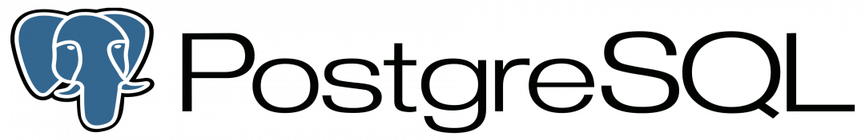
Study Methodology
Select target DBMSs - 6 widely-used DBMSs
DBMS | Release | DB-Engines Ranking | Github Stars | Database Type | Isolation Level | Concurrency Control
MySQL | 1995 | 2 | 10.2K | Traditional | RU, RC, RR, SER | Pessimistic
PostgreSQL | 1996 | 4 | 14.6K | Traditional | RC, RR, SER | Pessimistic, Optimistic
SQLite | 2000 | 10 | 5.4K | Embedded | RU, SER | Pessimistic
MariaDB | 2009 | 13 | 5.3K | Traditional | RU, RC, RR, SER | Pessimistic
CockroachDB | 2015 | 58 | 29.0K | NewSQL | SER | Optimistic
TiDB | 2017 | 72 | 36.0K | NewSQL | RC, RR | Pessimistic, Optimistic
Notes:
To understand TXBugs, we conduct a comprehensive study on TXBugs collected from six widely-used real-world relational DBMSs, including MySQL, PostgreSQL, SQLite, MariaDB, CockroachDB, and TiDB. (Click)These DBMSs rank high in the DB-Engines Ranking and are popular in Github. (Click)Our target DBMSs cover various isolation levels and concurrency control mechanisms. We collect TXBugs from these DBMSs’ issue repositories.

Slide 9
Study Methodology
Collect 140 TXBugs
Time range
Keyword
Transaction feature
2018-2022
transaction, isolation level,
commit, abort,
…
TXBug contains
at least one explicit transaction
or at least two transactions
Notes:
To collect TXBugs, we focus on the issues confirmed by DBMS developers from January 2018 to December 2022. We use keywords like “transaction”, “isolation level”, and their variations, to retrieve potentially relevant issues. We keep an issue as a TXBug if it needs at least one explicit transaction, or it needs at least two transactions to trigger. We finally collect 140 TXBugs from our studied DBMSs.

Slide 10







Study Methodology
Analyze TXBugs
Bug manifestation
Root cause
Bug impact
Detection capability of existing approaches
Issue descriptions
Embedded test cases
Developer discussions
Available fixing patches
Reproduce some TXBugs
Notes:
We analyze these TXBugs based on their issue descriptions, embedded test cases, developer discussions, and available fixing patches, and further assign them into different categories according to bug manifestations, root causes, bug impacts, and detection capability of existing approaches. We also reproduce 63 TXBugs for deeply understanding them.

Slide 11
Research Questions
RQ1 (Bug manifestation): How are TXBugs triggered?
RQ2 (Root cause): What are root causes for TXBugs?
RQ3 (Bug impact): What impacts do TXBugs have?
RQ4 (Detection capability of existing approaches): How effectively can existing approaches detect TXBugs?
Notes:
To thoroughly analyze these TXBugs, we try to answer four research questions.

Slide 12
RQ1: Bug Manifestation
TXBugs usually follow the small scope hypothesis
89.3%
86.8%
93.6%
84.7%
Implication:
Generating small transaction test cases can reduce test space and still effectively detect TXBugs within limited time and resources
Notes:
We find that TXBugs usually follow the small scope hypothesis. 89% of TXBugs do not require more than 1 initial table. 87% of initial tables do not contain more than 5 rows of data. 94% of TXBugs do not require more than 3 transactions. 85% of transactions contain no more than 4 statements. (Click)This implicates that generating small transaction test cases can reduce test space and still effectively detect TXBugs within limited time and resources

Slide 13
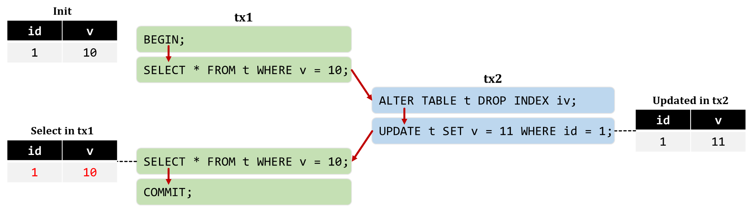
RQ1: Bug Manifestation
94.3% of TXBugs can be triggered by deterministically executing the statements in their transaction test cases in a certain order
Implication:
Deterministically triggering TXBugs can reduce the space of transaction testing
Notes:
In general, we consider that concurrent execution causes TXBugs. However, we find that 94% of TXBugs can be triggered deterministically in a certain order. Here shows such a deterministic TXBug, which can be deterministically triggered in red arrows. (Click)Deterministically triggering TXBugs can reduce the space of transaction testing

Slide 14
RQ2: Root Cause
Consistency violations of application states: TXBugs break the data integrity expected by applications
Init
CREATE TABLE t (c1 INT PRIMARY KEY) PARTITION BY RANGE (c1) (PARTITION p0 VALUES LESS THAN (10) ,PARTITION p1 VALUES LESS THAN MAXVALUE);
c1
1
Insert in tx
insert a row
INSERT INTO t VALUES (1);
c1
10
1
BEGIN;
Update in tx
+10
INSERT INTO t VALUES (10);
c1
10
11
UPDATE t SET c1=c1+10 WHERE c1 IN (1, 11);
COMMIT;
Select
c1
10
21
SELECT * FROM t ORDER BY c1;
Notes:
In TXBugs, faulty designs and implementations violate DBMSs’ transaction semantics. Here shows a TXBug that violates consistency of application states in TiDB. In this test case, table 𝑡 is required to be stored in partition. The transaction first inserts a value 10, then tries to update the value 1 to 11. After transaction completes, (Click) incorrectly updating the value 1 twice creates a corrupted application state {(10), (21)}.

Slide 15
RQ2: Root Cause
Statement correctness violations: TXBugs’ transaction statements cannot be correctly executed under the specific transaction context
CREATE TABLE t1 (c1 INT PRIMARY KEY);
CREATE TABLE t2 (c1 INT PRIMARY KEY, c2 INT NOT NULL REFERENCES t1);
Init t1
Init t2
c1
c1 | c2
BEGIN;
ALTER TABLE t2 DROP CONSTRAINT t2_c2_fkey;
Foreign key constraint
ALTER TABLE t2 ADD CONSTRAINT t2_c2_fkey FOREIGN KEY (c2) REFERENCES t1 (c1) ON DELETE CASCADE;
COMMIT;
Notes:
Here shows another TXBug that violates statement correctness in CockroachDB. In this test case, table 𝑡2 has a foreign key on column 𝑐2. In the transaction, we can successfully drop the foreign key constraint.

Slide 16
RQ2: Root Cause
Statement correctness violations: TXBugs’ transaction statements cannot be correctly executed under the specific transaction context
CREATE TABLE t1 (c1 INT PRIMARY KEY);
CREATE TABLE t2 (c1 INT PRIMARY KEY, c2 INT NOT NULL REFERENCES t1);
Init t1
Init t2
c1
c1 | c2
BEGIN;
ALTER TABLE t2 DROP CONSTRAINT t2_c2_fkey;
Foreign key constraint
ALTER TABLE t2 ADD CONSTRAINT t2_c2_fkey FOREIGN KEY (c2) REFERENCES t1 (c1) ON DELETE CASCADE;
ERROR : duplicate constraint name : " t2_c2_fkey "
COMMIT;
Notes:
But, when we add back the same foreign key constraint, (Click)CockroachDB reports an error “duplicate constraint name” .

Slide 17
RQ2: Root Cause
TXBugs violate five kinds of transaction semantics
Atomicity violation
Statement correctness violation
Read-only constraint violation
Isolation violation
Consistency violation
Implication:
Building precise transaction semantics can expose more types of TXBugs
Notes:
(Click)Existing approaches mainly focus on detecting isolation violations. (Click)Therefore, we need to build precise transaction semantics to expose more types of TXBugs.

Slide 18
RQ3: Bug Impact
76.4% of TXBugs only lead to silent failures
Silent failures
Incorrect DBMS states
Incorrect database states
Incorrect query results
Performance degradation
Missing blocking
Incorrect error reporting
Explicit failures
DBMS errors
DBMS unavailability
76.4%
18
Notes:
TXBugs can cause DBMSs to violate their transaction semantics, and lead to various severe consequences, such as DBMS errors, incorrect database states and query results. Among all studied TXBugs, 24% of TXBugs can cause explicit failures, that is DBMS errors and DBMS unavailability. However, 76% of TXBugs only lead to silent failures.

Slide 19
RQ3: Bug Impact
A transaction test case that causes a silent failure requires to be manually determined whether its execution is correct
Need to understand the execution semantics
Implication:
Revealing silent TXBugs needs to develop new test oracles
Notes:
Here shows a silent TXBug, in which the second SELECT statement in transaction one returns an incorrect query result. (Click)We can easily overlook this bug since it will not trigger explicit failures, and we cannot know whether its query result is correct without understanding the concrete semantics of the transaction test case. (Click)So, revealing silent TXBugs needs to develop new test oracles

Slide 20
RQ4: Detection Capability of Existing Approaches
54.3% of TXBugs cannot be detected by existing transaction verification[1][2] and testing[3][4] approaches
Undetectable TXBugs
Detected TXBugs
[1] K. Kingsbury et al., Elle: Inferring Isolation Anomalies from Experimental Observations. (VLDB Endow 2020).
[2] C. Tan et al., Cobra: Making Transactional Key-Value Stores Verifiably Serializable. (OSDI 2020).
[3] Z. Cui et al., Differentially Testing Database Transactions for Fun and Profit. (ASE 2022).
[4] W. Dou et al., Detecting Isolation Bugs via Transaction Oracle Construction. (ICSE 2023).
Notes:
We theoretically investigate how effectively existing transaction verification and testing approaches can detect TXBugs. In total, we find that existing approaches cannot detect 76 out of 140 TXBugs.

Slide 21
RQ4: Detection Capability of Existing Approaches
Transaction verification approaches[1][2] cannot detect 97.1% of TXBugs
key | value
1 | a
2 | b
Isolation violation
Key-value structure
Root cause
Implication:
New transaction verification approaches are required to support complex transactions’ execution history
[1] K. Kingsbury et al., Elle: Inferring Isolation Anomalies from Experimental Observations. (VLDB Endow 2020).
[2] C. Tan et al., Cobra: Making Transactional Key-Value Stores Verifiably Serializable. (OSDI 2020).
Notes:
Existing verification approaches only support key-value model, and mainly focus on detecting isolation violations, so they cannot detect 97% of TXBugs. (Click) So, new transaction verification approaches are required to support complex transactions’ execution history

Slide 22
RQ4: Detection Capability of Existing Approaches
Transaction testing approaches DT2[1], Troc[2] cannot detect 55.7% of TXBugs
Statement correctness violation
Subqueries | ✗
Pessimistic transaction mode | ✓
Optimistic transaction mode | ✗
Unsupported statements, e.g. UPSERT | ✗
…
Isolation violation
Consistency violation
DBMS features
Root cause
Implication:
TXBug detection approaches should support more SQL features and transaction semantics
More study results can be found in our paper
[1] Z. Cui et al., Differentially Testing Database Transactions for Fun and Profit. (ASE 2022).
[2] W. Dou et al., Detecting Isolation Bugs via Transaction Oracle Construction. (ICSE 2023).
Notes:
Existing transaction testing approaches use differential testing and construct transaction test oracle to detect transaction bugs. They support limited DBMS features, and can detect some violations, such as consistency violations and isolation violations. So, they cannot detect 56% of TXBugs. (Click)Thus, TXBug detection approaches should support more SQL features and transaction semantics
More study result…

Slide 23
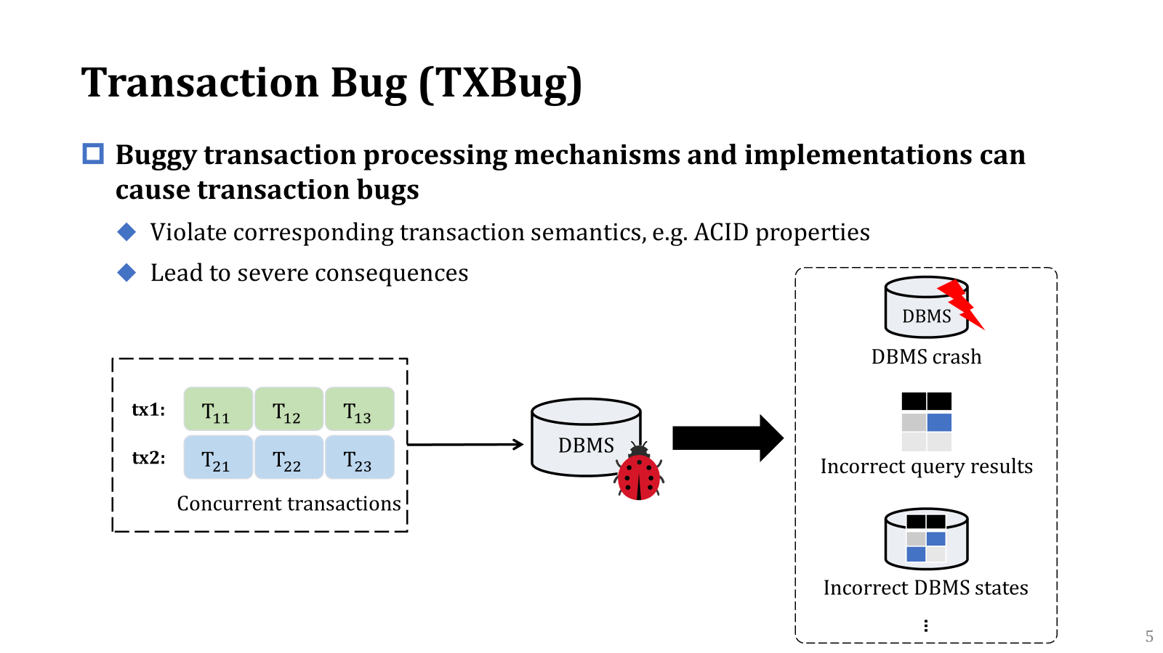
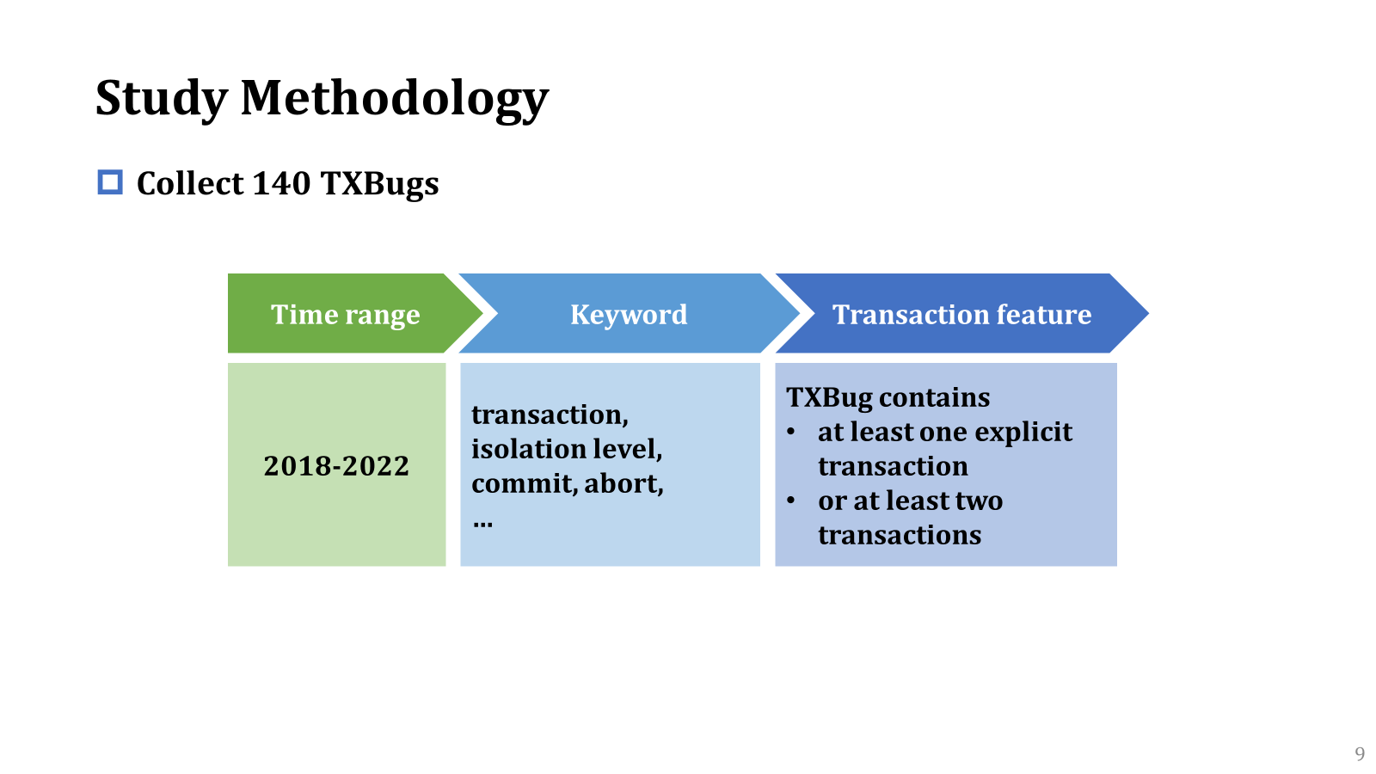
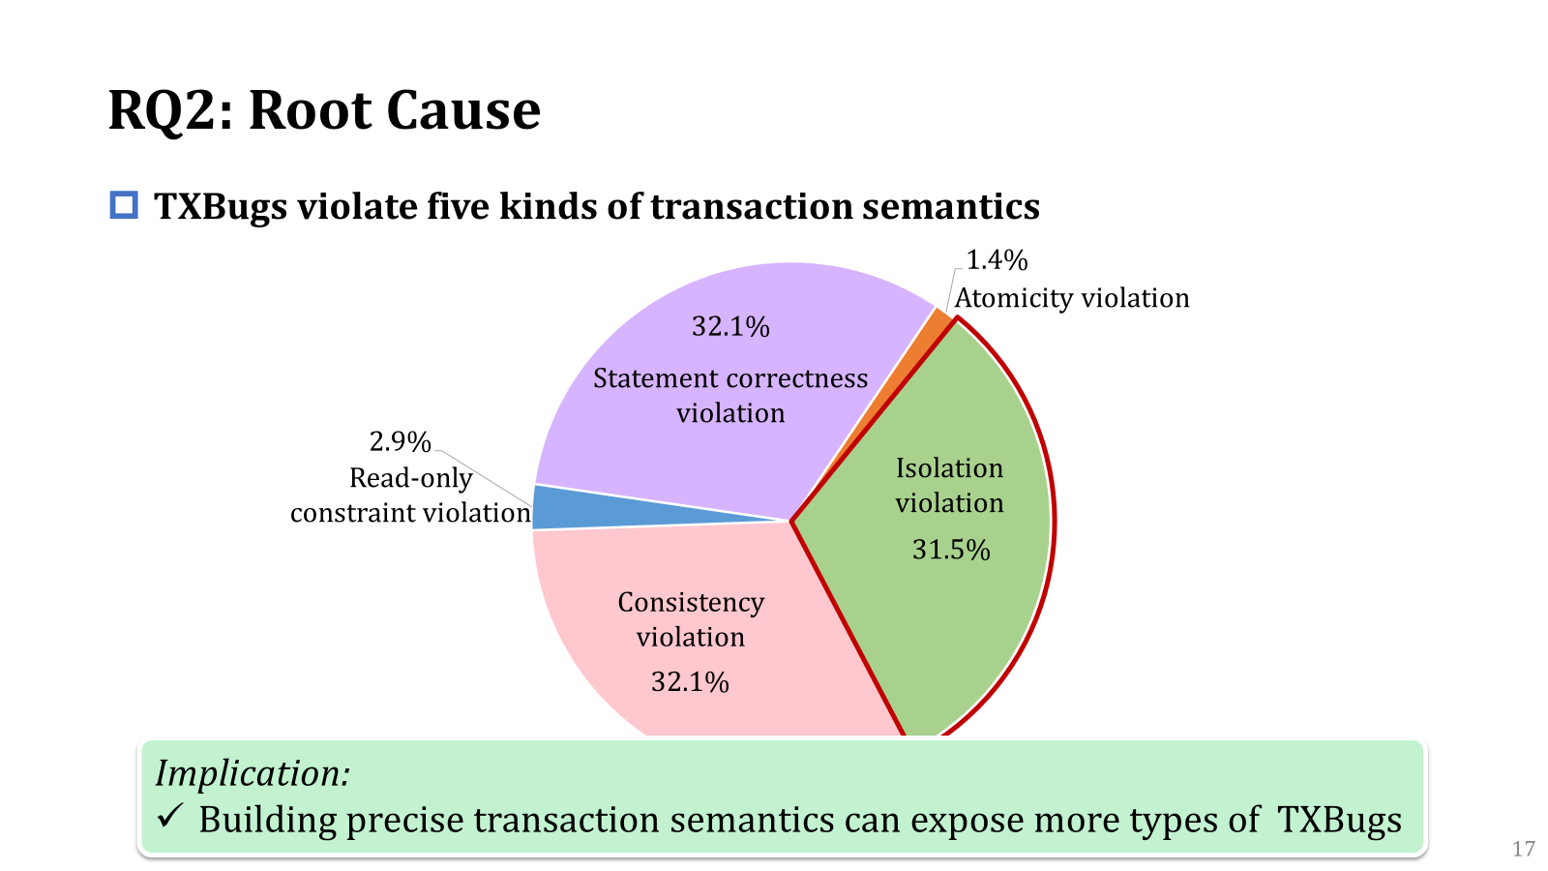
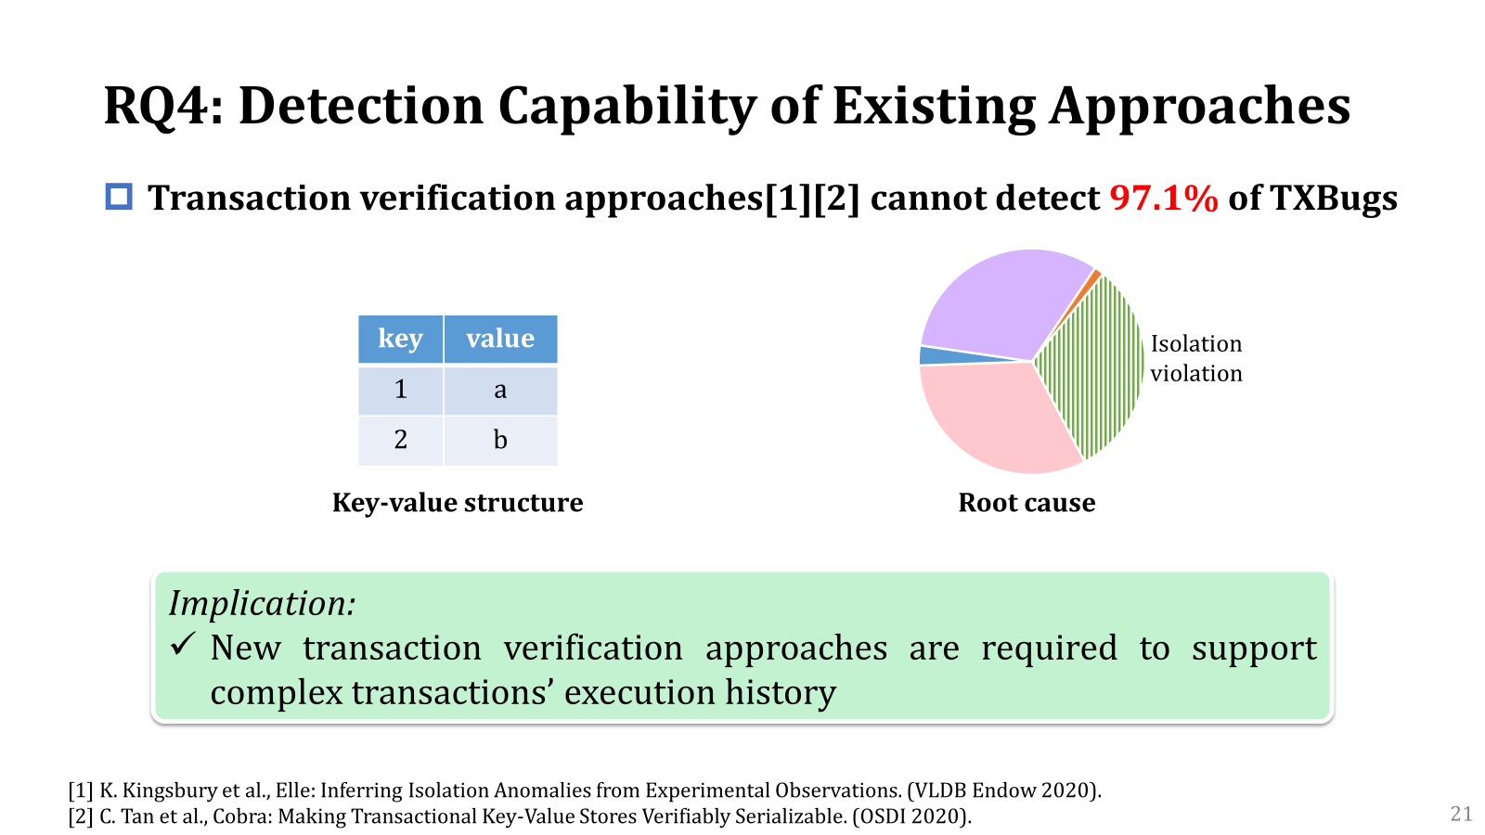

Conclusion
https://github.com/tcse-iscas/TXBug
Notes:
In conclusion, incorrect designs and implementations in DBMSs’ transaction processing mechanisms can introduce transaction bugs, which lead to severe consequences. We conduct the first in-depth study on 140 transaction bugs from six popular DBMSs. From our study, we obtain many interesting findings and lessons. We believe that our study can be beneficial for DBMS and SE researchers from many aspects, e.g., transaction testing, verification and semantics. We have made our collected TXBugs and analysis results available on GitHub. That’s all. Thank you.

