Slide 1



Detecting Cache-Related Bugs in Spark Applications
ACM SIGSOFT International Symposium on Software Testing and Analysis (ISSTA 2020)
Hui Li, Dong Wang, Tianze Huang, Yu Gao, Wensheng Dou, Lijie Xu,
Wei Wang, Jun Wei, and Hua Zhong
Institute of Software,
Chinese Academy of Sciences
University of Chinese Academy of Sciences
Beijing University of Posts and Telecommunications
Notes:
Hi, everyone. I’m Dong Wang, from University of Chinese Academy of Sciences. Today I’m here to present our work about detecting cache-related bugs in Spark applications.

Slide 2







Spark is a popular big data processing system
GraphX
MLLib
Spark SQL
Notes:
Spark is one of the most popular big data processing systems, and widely used in many big Internet companies, e.g., Facebook, Alibaba and eBay.
There are also many popular applications built on Spark, such as GraphX, MLlib and Spark SQL.

Slide 3
Spark programming model: RDD
Spark utilizes the abstraction of Resilient Distributed Dataset (RDD) to store and retrieve data.
RDD
1: val data = sc.textFile(“hdfs://…”)
2: val words = data.flatMap(x=>x.split(“ ”))
3: words.count()
4: words.take(10)
data
Notes:
Spark utilizes the abstraction of Resilient Distributed Dataset, RDD for short, to store and retrieve data.
In this word count example, the program retrieves a text file from HDFS and form an RDD data.

Slide 4
Spark programming model: Transformation
Transformations (e.g., flatMap) are used to generate new RDDs.
1: val data = sc.textFile(“hdfs://…”)
2: val words = data.flatMap(x=>x.split(“ ”))
3: words.count()
4: words.take(10)
data
flatMap
Transformation
words
Notes:
Transformation operations are used to generate new RDDs. flatMap in the example is a transformation operation. It is used to split the text into words.

Slide 5

Spark programming model: Action
For each action (e.g., count), a job is generated and executed.
1: val data = sc.textFile(“hdfs://…”)
2: val words = data.flatMap(x=>x.split(“ ”))
3: words.count()
4: words.take(10)
data
Job A₁
words
Action
$$A_{1}$$
count()
Notes:
When the program meets action operations, a job is generated and executed.
Count in this example is an action operation. As its function name shows, it can count the number of words and return the value. This action generates job A1.

Slide 6

Spark programming model: Action
For each action (e.g., count), a job is generated and executed.
All RDDs are removed from memory after executing the action.
Removed
1: val data = sc.textFile(“hdfs://…”)
2: val words = data.flatMap(x=>x.split(“ ”))
3: words.count()
4: words.take(10)
data
words
$$A_{1}$$
count()
Notes:
To save the precious memory, all RDDs are removed from memory after the action executes.

Slide 7

Spark programming model: Action
When an RDD is used by another action, it will be computed again.
1: val data = sc.textFile(“hdfs://…”)
2: val words = data.flatMap(x=>x.split(“ ”))
3: words.count()
4: words.take(10)
data
words
$$A_{1}$$
$$A_{2}$$
Action
count()
take(10)
Notes:
When an RDD is used by another action, it will be computed again.
In this example, there is another action take.

Slide 8
Spark programming model: Action
When an RDD is used by another action, it will be computed again.
Recomputed
1: val data = sc.textFile(“hdfs://…”)
2: val words = data.flatMap(x=>x.split(“ ”))
3: words.count()
4: words.take(10)
data
words
Job A₂
$$A_{1}$$
$$A_{2}$$
count()
take(10)
Notes:
Take is used to fetch out the first ten words and generates the second job A2.
A2 also uses RDD data and words, so they are recomputed again.

Slide 9
Cache mechanism in Spark
Spark provides cache APIs (persist) to persist an RDD in memory.
1: val data = sc.textFile(“hdfs://…”)
2: val words = data.flatMap(x=>x.split(“ ”))
3: words.persist()
4: words.count()
5: words.take(10)
data
Job A₁
P
words
$$A_{1}$$
count()
Notes:
Spark provides cache APIs to persist an RDD in memory.
We persist RDD words before A1.

Slide 10
Cache mechanism in Spark
Spark provides cache APIs (persist) to persist an RDD in memory.
The persisted RDD can be reused in following actions.
Not computed again
1: val data = sc.textFile(“hdfs://…”)
2: val words = data.flatMap(x=>x.split(“ ”))
3: words.persist()
4: words.count()
5: words.take(10)
data
P
words
Job A₂
$$A_{1}$$
$$A_{2}$$
count()
take(10)
Notes:
After A1, words is still in memory.
When the second action executes, A2 can directly use persisted words and avoid duplicated computation.

Slide 11
Bug Pattern 1: Missing persist
If an RDD used by multiple actions is not persisted, a missing persist bug occurs.
Missing persist bugs cause duplicated computation on RDDs, thus introducing large performance degradation.
Recomputed
1: val data = sc.textFile(“hdfs://…”)
2: val words = data.flatMap(x=>x.split(“ ”))
3: words.persist()
4: words.count()
5: words.take(10)
data
words
$$A_{1}$$
$$A_{2}$$
count()
take(10)
Duplicated computation!
Notes:
If an RDD is used by multiple actions and not properly persisted, a missing persist bug occurs.
Missing persist bugs cause duplicated computation on RDDs, thus introducing large performance degradation.

Slide 12

Bug Pattern 2: Unnecessary persist
Persisted RDDs usually occupy large memory.
If an RDD is persisted, but never used in following actions, an unnecessary persist bug occurs.
Persisted,
but not used
1: val data = sc.textFile(“hdfs://…”)
2: data.persist()
3: val words = data.flatMap(x=>x.split(“ ”))
4: words.persist()
5: words.count()
6: words.take(10)
P
data
Job A₁
P
words
Job A₂
$$A_{1}$$
$$A_{2}$$
count()
take(10)
Memory waste!
Notes:
However, persist API cannot be used casually, because persisted RDDs can usually occupy large memory.
Thus, If an RDD is persisted, but never used in following actions, an unnecessary persist bug occurs.
Like this example, both data and words are persisted in A1.
But the second job A2 directly uses words to execute.
Data is persisted but not used, so caching data is unnecessary.
Unnecessary persist bug can cause memory waste.

Slide 13



Bug Pattern 3: Missing unpersist
Persisted RDDs should be released when no actions use it any more.
1: val data = sc.textFile(“hdfs://…”)
2: val words = data.flatMap(x=>x.split(“ ”))
3: words.persist()
4: words.count()
5: words.take(10)
6: words.unpersist()
…
data
P
words
Job A₂
$$A_{1}$$
$$A_{2}$$
$$A_{3}$$
$$A_{4}$$
count()
take(10)
Notes:
Persisted RDDs should be released when no actions use it any more. Spark provides API unpersist to release persisted RDDs.
In this example, persisted RDD is used by A2.

Slide 14


Bug Pattern 3: Missing unpersist
Persisted RDDs should be released when no actions use it any more.
1: val data = sc.textFile(“hdfs://…”)
2: val words = data.flatMap(x=>x.split(“ ”))
3: words.persist()
4: words.count()
5: words.take(10)
6: words.unpersist()
…
data
P
words
$$A_{1}$$
$$A_{2}$$
$$A_{3}$$
$$A_{4}$$
count()
take(10)
Don’t use words
Notes:
But it is not used by the following actions, such as A3 and A4.

Slide 15
Bug Pattern 3: Missing unpersist
Persisted RDDs should be released when no actions use it any more.
1: val data = sc.textFile(“hdfs://…”)
2: val words = data.flatMap(x=>x.split(“ ”))
3: words.persist()
4: words.count()
5: words.take(10)
6: words.unpersist()
…
data
P
words
$$A_{1}$$
$$A_{2}$$
$$A_{3}$$
$$A_{4}$$
count()
take(10)
Don’t use words
Notes:
So it should be unpersisted before A3.

Slide 16

Bug Pattern 3: Missing unpersist
Persisted RDDs should be released when no actions use it any more.
If a persisted RDD is not used any more, but not unpersisted, a missing unpersist bug occurs.
1: val data = sc.textFile(“hdfs://…”)
2: val words = data.flatMap(x=>x.split(“ ”))
3: words.persist()
4: words.count()
5: words.take(10)
6: words.unpersist()
…
data
P
words
$$A_{1}$$
$$A_{2}$$
$$A_{3}$$
$$A_{4}$$
count()
take(10)
Don’t use words
Memory waste!
Notes:
If persisted words is not released, it is a missing unpersist bug
and causes memory waste.

Slide 17
Bug Pattern 4: Premature unpersist
If a persisted RDD is not used any more, it should be released timely.
1: val data = sc.textFile(“hdfs://…”)
2: val words = data.flatMap(x=>x.split(“ ”))
3: words.persist()
4: words.count()
5: words.take(10)
6: words.unpersist()
data
P
words
$$A_{1}$$
$$A_{2}$$
count()
take(10)
Notes:
Misusing unpersist operation at wrong positions can also introduce bugs.
A persisted RDD should be released timely when not used any more.

Slide 18
Bug Pattern 4: Premature unpersist
If a persisted RDD is not used any more, it should be released timely.
1: val data = sc.textFile(“hdfs://…”)
2: val words = data.flatMap(x=>x.split(“ ”))
3: words.persist()
4: words.count()
5: words.take(10)
6: words.unpersist()
data
P
words
After
$$A_{1}$$
$$A_{2}$$
count()
take(10)
Notes:
For example, persisted words is last used by A2, so it should be unpersisted after A2.

Slide 19
Bug Pattern 4: Premature unpersist
If a persisted RDD is not used any more, it should be released timely.
If a persisted RDD is unpersisted before the actions that will use it, a premature unpersist bug occurs.
1: val data = sc.textFile(“hdfs://…”)
2: val words = data.flatMap(x=>x.split(“ ”))
3: words.persist()
4: words.count()
5: words.unpersist()
6: words.take(10)
data
P
words
$$A_{1}$$
$$A_{2}$$
count()
take(10)
Notes:
If a persisted RDD is unpersisted before the actions that will use it, a premature unpersist bug occurs.

Slide 20
Bug Pattern 4: Premature unpersist
If a persisted RDD is not used any more, it should be released timely.
If a persisted RDD is unpersisted before the actions that will use it, a premature unpersist bug occurs.
1: val data = sc.textFile(“hdfs://…”)
2: val words = data.flatMap(x=>x.split(“ ”))
3: words.persist()
4: words.count()
5: words.unpersist()
6: words.take(10)
data
Job A₁
P
words
$$A_{1}$$
count()
Notes:
We consider a premature unpersist bug example. RDD words is persisted in A1.

Slide 21
Bug Pattern 4: Premature unpersist
If a persisted RDD is not used any more, it should be released timely.
If a persisted RDD is unpersisted before the actions that will use it, a premature unpersist bug occurs.
1: val data = sc.textFile(“hdfs://…”)
2: val words = data.flatMap(x=>x.split(“ ”))
3: words.persist()
4: words.count()
5: words.unpersist()
6: words.take(10)
data
P
words
$$A_{1}$$
count()
Notes:
After A1, words is still in memory due to the persist operation.

Slide 22
Bug Pattern 4: Premature unpersist
If a persisted RDD is not used any more, it should be released timely.
If a persisted RDD is unpersisted before the actions that will use it, a premature unpersist bug occurs.
1: val data = sc.textFile(“hdfs://…”)
2: val words = data.flatMap(x=>x.split(“ ”))
3: words.persist()
4: words.count()
5: words.unpersist()
6: words.take(10)
data
P
words
$$A_{1}$$
count()
Notes:
However, an unpersist operation remove it from memory.

Slide 23
Bug Pattern 4: Premature unpersist
If a persisted RDD is not used any more, it should be released timely.
If a persisted RDD is unpersisted before the actions that will use it, a premature unpersist bug occurs.
Recomputed
1: val data = sc.textFile(“hdfs://…”)
2: val words = data.flatMap(x=>x.split(“ ”))
3: words.persist()
4: words.count()
5: words.unpersist()
6: words.take(10)
data
P
words
Job A₂
$$A_{1}$$
$$A_{2}$$
count()
take(10)
Duplicated computation!
Notes:
Then when A2 executes, words and data are recomputed again.
So premature unpersist can cause duplicated computation and introduce performance degradation.

Slide 24
Bug Pattern 5: Lagging persist
An RDD must be persisted before the first action that uses it.
1: val data = sc.textFile(“hdfs://…”)
2: val words = data.flatMap(x=>x.split(“ ”)
3: words.persist()
4: words.count()
5: words.take(10)
data
Job A₁
P
words
Before
$$A_{1}$$
count()
Notes:
Similarly, persisting RDDs at wrong positions can also introduce bugs. To be stored in memory for the following reuse, an RDD must be persisted before the first action that uses it.
For example, A1 is the first action that uses words. So words should be persisted before A1.

Slide 25
Bug Pattern 5: Lagging persist
An RDD must be persisted before the first action that uses it.
If a should-be-persisted RDD is persisted after the first action that uses it, a lagging persist bug occurs.
1: val data = sc.textFile(“hdfs://…”)
2: val words = data.flatMap(x=>x.split(“ ”)
3: words.persist()
4: words.count()
5: words.persist()
6: words.take(10)
data
Job A₁
words
$$A_{1}$$
count()
Notes:
If a should-be-persisted RDD is persisted after the first action that uses it, a lagging persist bug occurs.
For example, if words is not persisted in A1.

Slide 26
Bug Pattern 5: Lagging persist
An RDD must be persisted before the first action that uses it.
If a should-be-persisted RDD is persisted after the first action that uses it, a lagging persist bug occurs.
1: val data = sc.textFile(“hdfs://…”)
2: val words = data.flatMap(x=>x.split(“ ”)
3: words.persist()
4: words.count()
5: words.persist()
6: words.take(10)
data
Not stored in memory
P
words
$$A_{1}$$
count()
Notes:
But persisted after A1. Words is not stored in memory when persist operation is invoked.

Slide 27
Bug Pattern 5: Lagging persist
An RDD must be persisted before the first action that uses it.
If a should-be-persisted RDD is persisted after the first action that uses it, a lagging persist bug occurs.
Recomputed
1: val data = sc.textFile(“hdfs://…”)
2: val words = data.flatMap(x=>x.split(“ ”)
3: words.persist()
4: words.count()
5: words.persist()
6: words.take(10)
data
P
words
Job A₂
$$A_{1}$$
$$A_{2}$$
count()
take(10)
Duplicated computation!
Notes:
So when A2 executes, words and data are recomputed.
Lagging persist bug can introduce duplicated computation.

Slide 28
Bug Pattern 6: Lagging unpersist
If a persisted RDD is not used any more, it should be released timely.
If a persisted RDD is not released timely, a lagging unpersist bug occurs.
1: val data = sc.textFile(“hdfs://…”)
2: val words = data.flatMap(x=>x.split(“ ”))
3: words.persist()
4: words.count()
5: words.take(10)
6: words.unpersist()
…
20: words.unpersist()
data
P
words
Job A₃
Job A₄
$$A_{1}$$
$$A_{2}$$
$$A_{3}$$
$$A_{4}$$
count()
take(10)
Don’t use words
Notes:
Unpersisting RDDs cannot be late either. We mentioned that if a persisted RDD is not used any more, it should be released timely.
If a persisted RDD is not released timely, a lagging unpersist bug occurs.
For example, Job A3 and A4 does not use RDD words. Words is still stored in memory when A3 and A4 execute.

Slide 29


Bug Pattern 6: Lagging unpersist
If a persisted RDD is not used any more, it should be released timely.
If a persisted RDD is not released timely, a lagging unpersist bug occurs.
1: val data = sc.textFile(“hdfs://…”)
2: val words = data.flatMap(x=>x.split(“ ”))
3: words.persist()
4: words.count()
5: words.take(10)
6: words.unpersist()
…
20: words.unpersist()
data
P
words
$$A_{1}$$
$$A_{2}$$
$$A_{3}$$
$$A_{4}$$
count()
take(10)
Don’t use words
Memory waste!
Notes:
After A3 and A4 finish, words is unpersisted.
Thus, the lagging unpersist operation causes memory waste when executing A3 and A4.

Slide 30
Cache-related bugs
Six bug patterns related to cache-related APIs in Spark.
Missing persist
Lagging persist
Duplicated computation
Premature unpersist
Performance slowdown
Unnecessary persist
Missing unpersist
Memory waste
Lagging unpersist
Notes:
In sunmmary, we observe 6 kinds of misuses of cache-related APIs in Spark. We call all of them as cache-related bugs.
Among them, three kinds of bugs cause duplicated computation, and the other three cause memory waste.
All of them introduce performance slowdown on Spark applications.

Slide 31
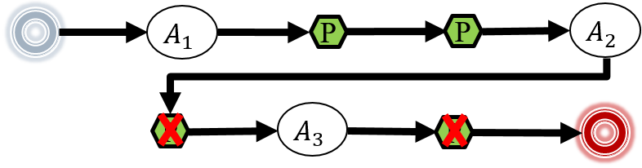

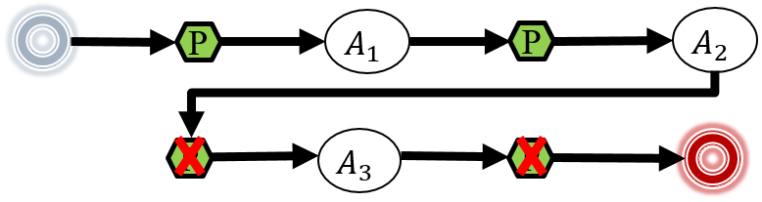
CacheCheck Overview
Original cache decisions
Inconsistency
Spark
applications
Identify persisted RDDs
Trace
Bugs
Identify persist locations
Inferred cache decisions
Identify unpersist locations
Infer correct cache decisions
Notes:
We present CacheCheck to detect cache-related bugs in Spark applications.
First of all, we run spark application and get its execution traces.
Then, we extract original cache decisions from traces.
On the other hand, we also use these traces to infer correct cache decisions by 3 steps.
First, we identify RDDs that should to be persisted.
Second, we identify persist locations of these RDDs.
Third, we identify unpersist locations of them.
Then we get correct cache decisions of all RDDs in the application.
Finally, we compare the original cache decisions and the inferred cache decisions. The inconsistency between them denotes cache-related bugs in the application.

Slide 32
Execution trace
An execution trace includes two parts
actions and RDD dependencies
persist / unpersist operations
1: val data = sc.textFile(“hdfs://…”)
2: val words = data.flatMap(x=>x.split(“ ”))
3: words.persist()
4: words.count()
5: val pairs = words.map((_,1))
6: val result = pairs.reduceByKey(_+_)
7: result.persist()
8: result.count()
9: words.unpersist()
10: result.take(10)
11: result.unpersist()
Notes:
Then, we use a extended word count example to illustrate steps of CacheCheck. First is to collect execution trace.
An execution trace includes two parts. First, actions and RDD dependencies. Second, persist and unpersist operations.

Slide 33

Execution trace
An execution trace includes two parts
actions and RDD dependencies
persist / unpersist operations
1: val data = sc.textFile(“hdfs://…”)
2: val words = data.flatMap(x=>x.split(“ ”))
3: words.persist()
4: words.count()
5: val pairs = words.map((_,1))
6: val result = pairs.reduceByKey(_+_)
7: result.persist()
8: result.count()
9: words.unpersist()
10: result.take(10)
11: result.unpersist()
data
words
Trace:
$$A_{1}$$
Start
count()
Notes:
First of all, we record the count action on RDD words as well as RDD dependencies of words.

Slide 34
Execution trace
An execution trace includes two parts
actions and RDD dependencies
persist / unpersist operations
1: val data = sc.textFile(“hdfs://…”)
2: val words = data.flatMap(x=>x.split(“ ”))
3: words.persist()
4: words.count()
5: val pairs = words.map((_,1))
6: val result = pairs.reduceByKey(_+_)
7: result.persist()
8: result.count()
9: words.unpersist()
10: result.take(10)
11: result.unpersist()
data
words
Trace:
P
$$A_{1}$$
Start
words
count()
Notes:
Words is persisted before action count. We also record it.

Slide 35


Execution trace
An execution trace includes two parts
actions and RDD dependencies
persist / unpersist operations
1: val data = sc.textFile(“hdfs://…”)
2: val words = data.flatMap(x=>x.split(“ ”))
3: words.persist()
4: words.count()
5: val pairs = words.map((_,1))
6: val result = pairs.reduceByKey(_+_)
7: result.persist()
8: result.count()
9: words.unpersist()
10: result.take(10)
11: result.unpersist()
data
words
data
pairs
words
result
Trace:
P
$$A_{1}$$
$$A_{2}$$
Start
words
count()
count()
Notes:
Similarly, we record the second action and RDD dependencies.

Slide 36
Execution trace
An execution trace includes two parts
actions and RDD dependencies
persist / unpersist operations
1: val data = sc.textFile(“hdfs://…”)
2: val words = data.flatMap(x=>x.split(“ ”))
3: words.persist()
4: words.count()
5: val pairs = words.map((_,1))
6: val result = pairs.reduceByKey(_+_)
7: result.persist()
8: result.count()
9: words.unpersist()
10: result.take(10)
11: result.unpersist()
data
words
data
pairs
words
result
Trace:
P
$$A_{1}$$
P
$$A_{2}$$
Start
words
count()
result
count()
Notes:
And another persist operation on RDD result before the second action.

Slide 37

Execution trace
An execution trace includes two parts
actions and RDD dependencies
persist / unpersist operations
1: val data = sc.textFile(“hdfs://…”)
2: val words = data.flatMap(x=>x.split(“ ”))
3: words.persist()
4: words.count()
5: val pairs = words.map((_,1))
6: val result = pairs.reduceByKey(_+_)
7: result.persist()
8: result.count()
9: words.unpersist()
10: result.take(10)
11: result.unpersist()
data
data
words
words
data
pairs
pairs
words
result
result
Trace:
P
$$A_{1}$$
P
$$A_{2}$$
$$A_{3}$$
Start
words
count()
result
count()
take(10)
Notes:
Then, follow by the third action and RDD dependencies.

Slide 38
Execution trace
An execution trace includes two parts
actions and RDD dependencies
persist / unpersist operations
1: val data = sc.textFile(“hdfs://…”)
2: val words = data.flatMap(x=>x.split(“ ”))
3: words.persist()
4: words.count()
5: val pairs = words.map((_,1))
6: val result = pairs.reduceByKey(_+_)
7: result.persist()
8: result.count()
9: words.unpersist()
10: result.take(10)
11: result.unpersist()
data
data
words
words
data
pairs
pairs
words
result
result
Trace:
P
$$A_{1}$$
P
$$A_{2}$$
P
$$A_{3}$$
Start
words
count()
result
count()
words
take(10)
Notes:
Before the third action, There is an unpersist operation on RDD words.

Slide 39
Execution trace
An execution trace includes two parts
actions and RDD dependencies
persist / unpersist operations
1: val data = sc.textFile(“hdfs://…”)
2: val words = data.flatMap(x=>x.split(“ ”))
3: words.persist()
4: words.count()
5: val pairs = words.map((_,1))
6: val result = pairs.reduceByKey(_+_)
7: result.persist()
8: result.count()
9: words.unpersist()
10: result.take(10)
11: result.unpersist()
data
data
words
words
data
pairs
pairs
words
result
result
Trace:
P
$$A_{1}$$
P
$$A_{2}$$
P
$$A_{3}$$
P
Start
words
count()
result
count()
words
take(10)
result
End
Notes:
At last, there is another unpersist on RDD result. We record it, and get the whole execution trace finally.

Slide 40



Generate complete lineage graph
data
data
words
words
data
pairs
pairs
words
result
result
P
$$A_{1}$$
P
$$A_{2}$$
P
$$A_{3}$$
P
Start
words
count()
result
count()
words
take(10)
result
End
Notes:
We will use it to identify RDDs that should to be persisted.

Slide 41
Generate whole lineage graph
Merge each action’s RDD dependencies into a whole lineage graph.
data
data
words
words
data
pairs
pairs
words
result
result
$$A_{1}$$
$$A_{2}$$
$$A_{3}$$
count()
count()
take(10)
Notes:
Before that, we need to merge all RDD dependencies into the whole lineage graph.
If the same RDD transformation occurs in different RDD dependencies, we merge it. For example, “RDD data is transformed to RDD words”, this transformation occurs in A1 and A2,
so we merge them.
So as to “pairs to result” transformation.

Slide 42



Identify should-be-persisted RDDs
To avoid duplicated computation, we should persist an RDD if it is depended by multiple actions.
If an RDD cannot be reused by following actions, it should not be persisted.
No!
P
data
P
words
$$A_{1}$$
P
No!
pairs
count()
P
result
$$A_{2}$$
$$A_{3}$$
count()
take(10)
Notes:
Then, we begin to identify should-be-persisted RDDs on the lineage graph.
The idea is simple: if an RDD is depended by multiple actions, that is to say, it is computed in multiple jobs. To avoid duplicated computation, we should persist it.
RDD words is depended by both A1 and A2, we persist it.
Although RDD data is also depended by A1 and A2, it cannot be reused by them when words is persisted, so data should not be persisted.
In a similar way, RDD result is depended by A2 and A3, so it should be persisted.
RDD pairs should not be persisted since result is persisted.

Slide 43






Identify persist locations
The RDD should be persisted right before the first action to use it.
data
First use
P
words
$$A_{1}$$
pairs
count()
P
result
$$A_{2}$$
$$A_{3}$$
count()
take(10)
$$A_{1}$$
$$A_{2}$$
$$A_{3}$$
Start
count()
count()
take(10)
End
Notes:
Next, we infer the correct cache decisions for these should-be-persisted RDDs. First we identify persist locations for every RDD.
The idea is that a should-be-persisted RDD is persisted right before the first action that uses it.
For words, A1 first use it.

Slide 44




Identify persist locations
The RDD should be persisted right before the first action to use it.
data
First use
P
words
$$A_{1}$$
pairs
count()
P
result
$$A_{2}$$
$$A_{3}$$
count()
take(10)
P
$$A_{1}$$
$$A_{2}$$
$$A_{3}$$
Start
words
count()
count()
take(10)
End
Notes:
So it should be persisted before A1.

Slide 45

Identify persist locations
The RDD should be persisted right before the first action to use it.
data
First use
P
words
$$A_{1}$$
pairs
count()
P
result
First use
$$A_{2}$$
$$A_{3}$$
count()
take(10)
P
$$A_{1}$$
P
$$A_{2}$$
$$A_{3}$$
Start
words
count()
result
count()
take(10)
End
Notes:
For result, A2 first use it. So it should be persisted before A2.

Slide 46
Identify unpersist locations
The RDD should be unpersisted right after the last action to use it.
data
Use words
P
words
$$A_{1}$$
pairs
Use words
count()
P
result
Don’t use words
$$A_{2}$$
$$A_{3}$$
count()
take(10)
P
$$A_{1}$$
P
$$A_{2}$$
$$A_{3}$$
Start
words
count()
result
count()
take(10)
End
Notes:
Then, we identify unpersist locations for should-be-persisted RDDs.
The idea is that, the persisted RDD should be unpersisted right after the last action to use it.
For words, A1 uses it.
A2 also uses it.
A3 directly uses persisted result and not use words.

Slide 47
Identify unpersist locations
The RDD should be unpersisted right after the last action to use it.
data
Use words
P
words
$$A_{1}$$
pairs
Use words
count()
P
result
Don’t use words
$$A_{2}$$
$$A_{3}$$
count()
take(10)
P
$$A_{1}$$
P
$$A_{2}$$
P
$$A_{3}$$
Start
words
count()
result
count()
words
take(10)
End
Notes:
Thus, A2 is the last action to use words. RDD words should be unpersisted right after A2.

Slide 48
Identify unpersist locations
The RDD should be unpersisted right after the last action to use it.
data
P
words
$$A_{1}$$
pairs
count()
P
result
Use result
Use result
$$A_{2}$$
$$A_{3}$$
count()
take(10)
P
$$A_{1}$$
P
$$A_{2}$$
P
$$A_{3}$$
P
Start
words
count()
result
count()
words
take(10)
result
End
Notes:
In a similar way, RDD result is used by A2 and A3. It should be unpersisted right after A3. At this point, we successfully infer the correct cache decisions.

Slide 49



Bug detection
Compare inferred cache decisions with original cache decisions
The existence of cache decisions
Inferred cache decisions
$$A_{1}$$
$$A_{2}$$
$$A_{3}$$
P
P
P
P
Start
words
count()
result
count()
words
take(10)
result
End
Original cache decisions
$$A_{1}$$
$$A_{2}$$
$$A_{3}$$
P
P
Start
count()
result
count()
take(10)
result
End
Missing persist
Notes:
Finally, we detect cache-related bugs by comparing cache decisions.
There are cache decisions we inferred before.
We compare them with the original cache decisions. If a cache decision exists in one sequence but not in the other, there is a bug.
For example, The original cache decisions do not have a persist operation on RDD words.
So it is a missing persist bug.

Slide 50



Bug detection
Compare inferred cache decisions with original cache decisions
The existence of cache decisions
The relative location of cache decisions and actions
Inferred cache decisions
$$A_{1}$$
$$A_{2}$$
$$A_{3}$$
P
P
P
P
Start
words
count()
result
count()
words
take(10)
result
End
Original cache decisions
$$A_{1}$$
$$A_{2}$$
$$A_{3}$$
P
P
P
P
Start
count()
words
result
count()
words
take(10)
result
End
Lagging persist
Notes:
On the other hand, if two kinds of cache decisions have a difference in the relative location of cache decisions and actions, there is also a bug.
For example, in the inferred cache decisions, the persist operation on words is ahead of the first action,
but they reverse in actual cache decisions: RDD words is behind action count.
So it denotes a lagging persist bug.

Slide 51
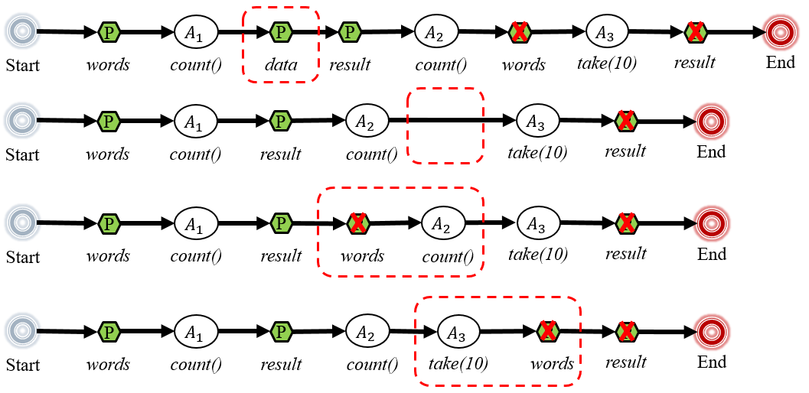
Bug detection
Compare inferred cache decisions with actual cache decisions
The existence of cache decisions
The relative location of cache decisions and actions
Inferred cache decisions
$$A_{1}$$
$$A_{2}$$
$$A_{3}$$
P
P
P
P
Start
words
count()
result
count()
words
take(10)
result
End
See more detection rules in our paper!
Notes:
The other kinds of bugs can also be detected by simply comparing the existence and locations of cache decisions.
You can find all detection rules in our paper.

Slide 52

Evaluation
RQ1: Performance impact
Can cache-related bugs seriously degrade the performance of Spark applications?
RQ2: Known bug detection
Can CacheCheck effectively detect known cache-related bugs in Spark applications?
RQ3: New bug detection
Can CacheCheck detect new cache-related bugs in real-world Spark applications?
Notes:
We raise three research questions to evaluate cache-related bugs and CacheCheck: First, can cache-related bugs seriously affect the performance of Spark applications? Second, can CacheCheck effectively detect known cache-related bugs in Spark applications? Third, can CacheCheck detect new cache-related bugs in real-world Spark applications?

Slide 53
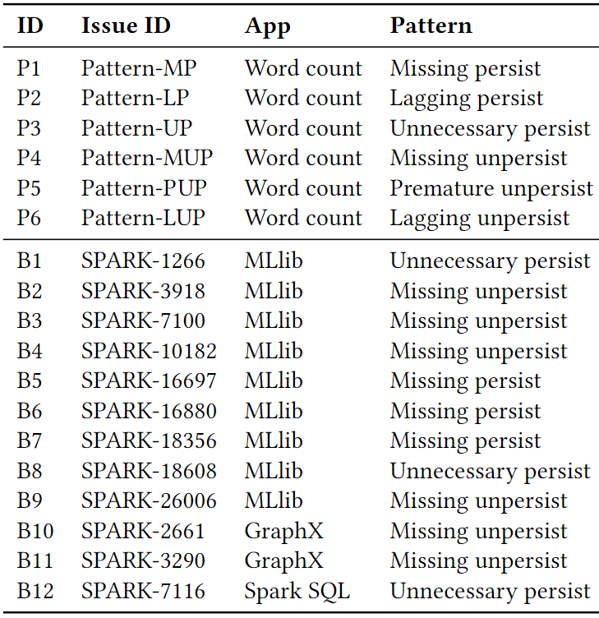
Known bug benchmark
Six word count examples for illustrating bug patterns.
Twelve real-world bugs in MLlib, GraphX and Spark SQL selected from Spark JIRA.
Notes:
To answer the first two questions, we establish a known bug benchmark. We totally collect eighteen known bugs. Six are word count examples used for illustrating six bug patterns. Twelve are real-world bugs selected from JIRA.

Slide 54
Performance impact
The 18 bugs degrade the application performance by 0.1% ~ 51.6%.
8 bugs: > 5%
Notes:
We evaluate how these bugs affect the performance of applications by comparing the execution time of buggy code and fixed code. The results show that these 18 bugs introduce the performance slowdown by 0.1 percent to 51.6 percent.
Among them, eight bugs introduce more than 5 percent slowdown.

Slide 55
Performance impact
Premature unpersist
The 18 bugs degrade the application performance by 0.1% ~ 51.6%.
Missing persist
Lagging persist
Missing persist
Bugs causing duplicated computation usually introduce larger performance slowdown.
Notes:
Besides, we find that missing persist, lagging persist and premature unpersist bugs, which can cause duplicated computation, usually introduce larger performance slowdown.

Slide 56
Performance impact
The 18 bugs degrade the application performance by 0.1% ~ 51.6%.
Missing unpersist
Unnecessary persist
Lagging unpersist
Bugs causing memory waste usually introduce slighter performance slowdown.
Notes:
In contrast, unnecessary persist, missing unpersist and lagging unpersist bugs usually introduce slighter performance slowdown, because memory waste rarely affect the execution time of applications.

Slide 57
Performance impact
The 18 bugs degrade the application performance by 0.1% ~ 51.6%.
Missing unpersist
Unnecessary persist
Some bugs that cause memory waste can also introduce large performance slowdown.
Notes:
However, bugs that cause memory waste can also cause severe impact. For example, in the missing unpersist bug, RDD is iteratively persisted in a while loop and never released, so it causes Out-of-Memory finally.

Slide 58
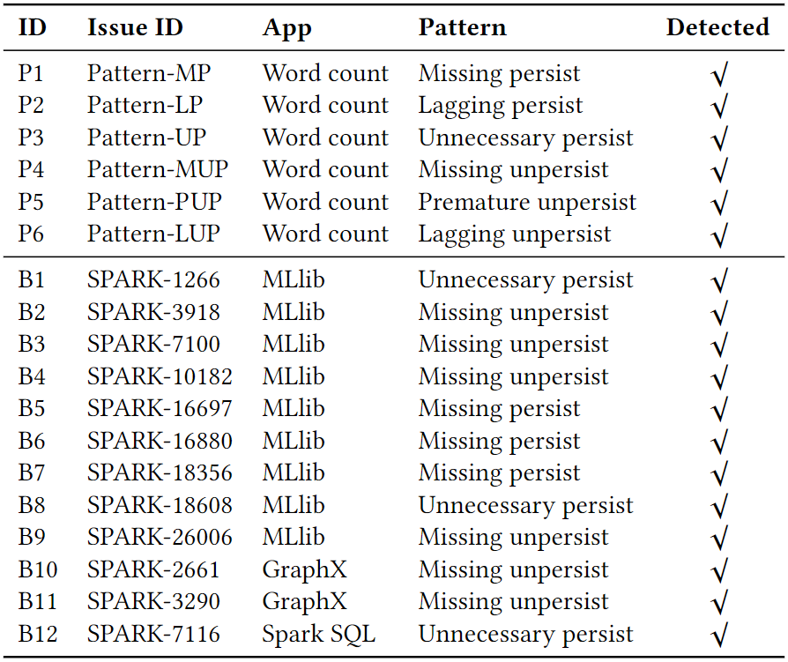
Known bug detection
All 18 known bugs are successfully detected by CacheCheck.
Notes:
We use CacheCheck to detect these 18 bugs, and all of them are successfully detected.

Slide 59
New bug detection
Six real-world Spark applications
Three Spark official applications.
Three third-party applications from GitHub.
App | Description | Star | LOC
GraphX | Graph computation | - | 32,708
MLlib | Machine learning | - | 109,786
Spark SQL | SQL | - | 395,122
MCL | Markov clustering | 32 | 1,058
Betweenness | K-betweenness centrality | 40 | 488
t-SNE | Distributed t-SNE | 129 | 798
Notes:
For new bug detection, we select six applications to detect cache-related bugs in them.
Three are Spark official applications. They are well-maintained and widely used.
The other three are third-party applications from Github.

Slide 60
New bug detection
CacheCheck detects 72 cache-related bugs in six real-world Spark applications.
53 have been confirmed
28 have been fixed
Detect bugs from six patterns
App | MP | LP | UP | MUP | LUP | PUP | Total | Confirmed | Fixed
GraphX | 1 | 0 | 6 | 1 | 0 | 0 | 8 | 7 | 0
MLlib | 24 | 1 | 10 | 2 | 12 | 2 | 51 | 43 | 27
Spark SQL | 4 | 0 | 0 | 0 | 0 | 0 | 4 | 3 | 1
MCL | 4 | 0 | 0 | 0 | 0 | 0 | 4 | 0 | 0
Betweenness | 0 | 0 | 1 | 0 | 0 | 0 | 1 | 0 | 0
t-SNE | 1 | 0 | 1 | 2 | 0 | 0 | 4 | 0 | 0
Total | 34 | 1 | 18 | 5 | 12 | 2 | 72 | 53 | 28
Notes:
Finally, we successfully detect all six kinds of bugs.
We detect 72 cache-related bugs in total, and report all of them to the community.
As the result, 53 bugs have been confirmed,
and 28 have been fixed.

Slide 61
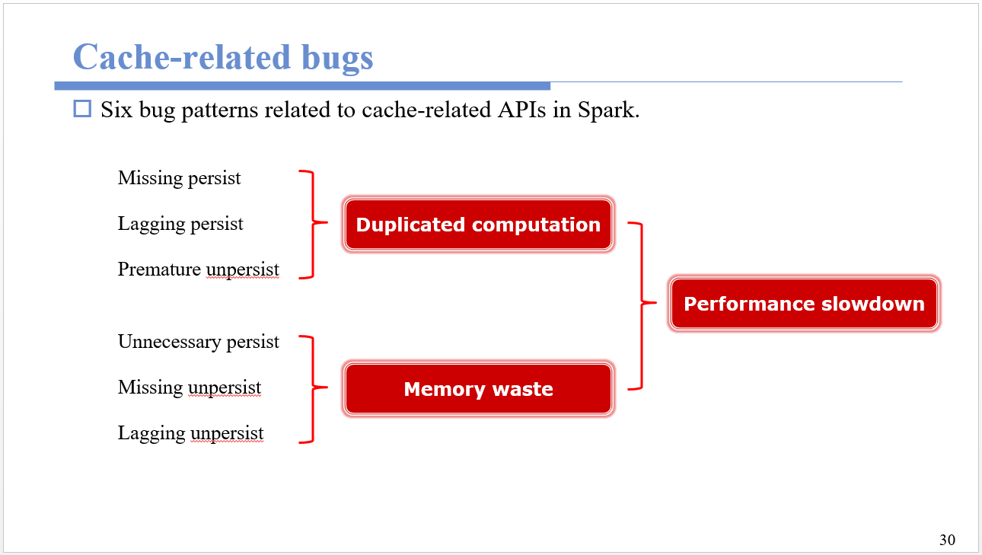
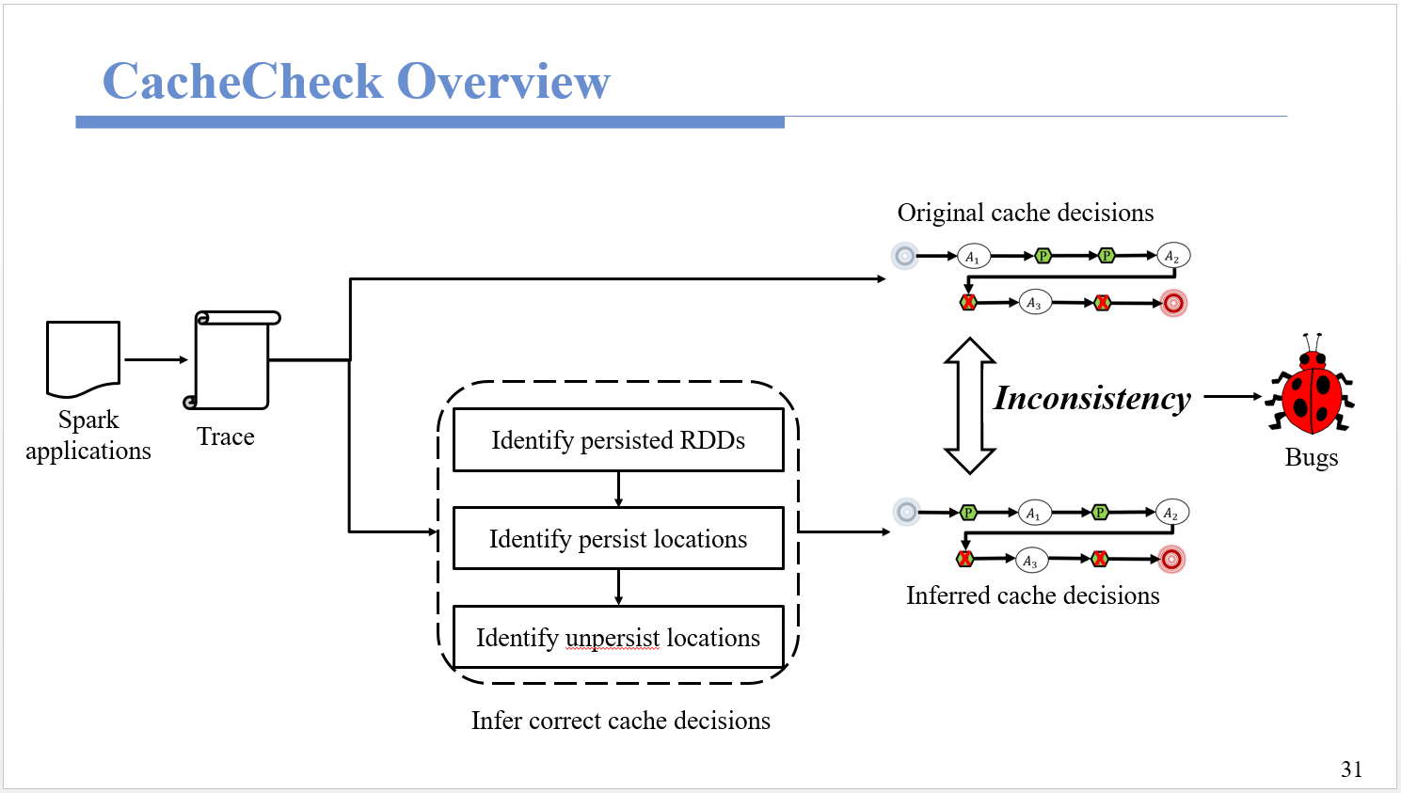
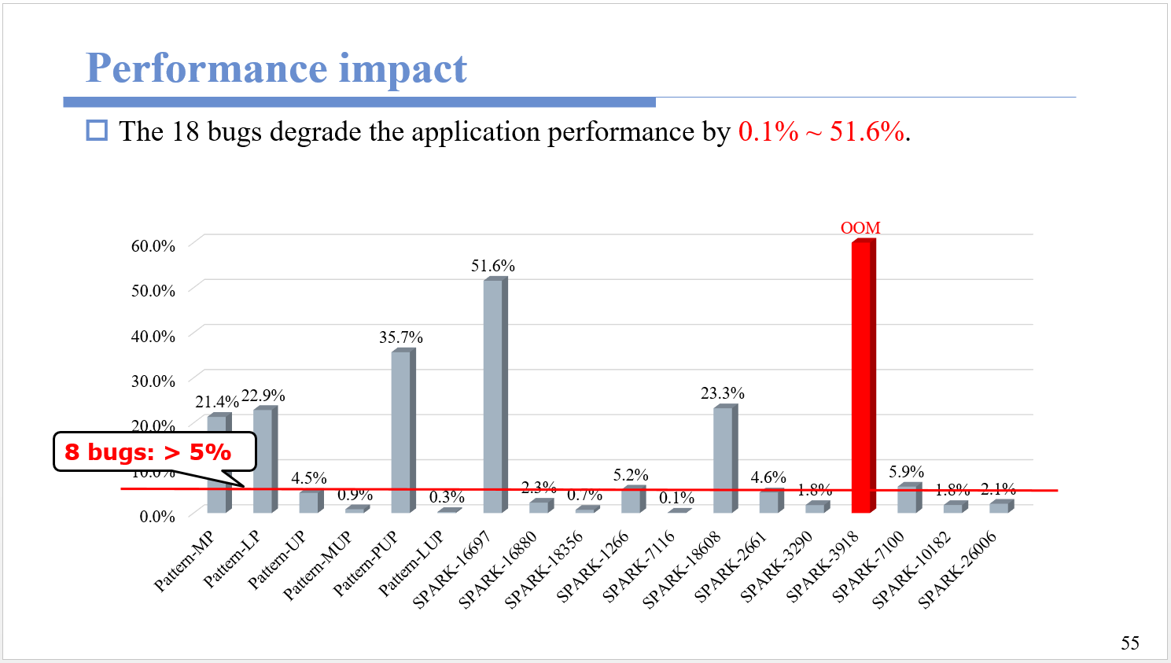
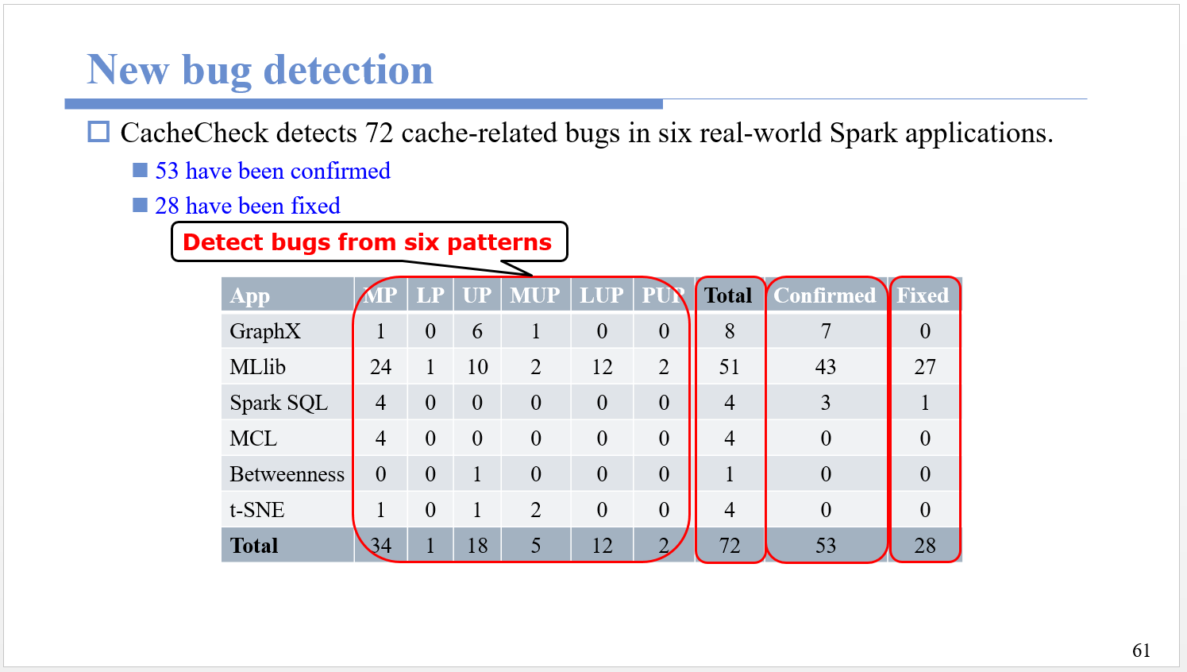
Summary
https://github.com/Icysandwich/cachecheck
Notes:
In summary, we find six kinds of cache-related bugs in Spark applications,
And present CacheCheck to detect them.
The experiments show that cache-related bugs can indeed cause performance slowdown for Spark applications.
Also, CacheCheck can effectively detect them, both for known bugs and new bugs.
CacheCheck is publicly available on GitHub. Anyone who is interested in it please feel free to contact us.

Slide 62

Thank you!
Notes:
Thanks for your attention. Any question?

