Slide 1


SpreadCluster Recovering Versioned Spreadsheets through Similarity-Based Clustering
MSR 2017 - Mining Software Repositories
Liang Xu, Wensheng Dou, Chushu Gao,
Jie Wang, Jun Wei, Hua Zhong, Tao Huang

Slide 2
Spreadsheet reuse is common
Copy
Reuse data layout
Computational logic
Modify
Service data in June
Updated version
Service data in July

Slide 3


Bug fixing in the spreadsheets
April
June
August
May
July
Version 1
Version 3
Version 5
Version 2
Version 4
We need to recheck all versions of this spreadsheet!

Slide 4
However version information is missing
April
June
August
May
July
Version 1
Version 3
Version 5
Version 2
Version 4
It is challenging for users to identify different versions of a spreadsheet manually

Slide 5
Existing techniques: filename-based approach
Identify different versions of a spreadsheet based on the filename similarity
Spreadsheet filename
May00_FOM_Req2.xls
Jun00_FOM_Req.xls
July00_FOM_Req.xls
Aug00_FOM_Req.xls
11_07act.xls
2_22act.xls
4_01act.xls
Shortened filename
FOMReq
FOMReq
FOMReq
FOMReq
act
act
act
Spreadsheet filename
May00_FOM_Req2.xls
Jun00_FOM_Req.xls
July00_FOM_Req.xls
Aug00_FOM_Req.xls
11_07act.xls
2_22act.xls
4_01act.xls
Spreadsheet filename
May00_FOM_Req2.xls
Jun00_FOM_Req.xls
July00_FOM_Req.xls
Aug00_FOM_Req.xls
11_07act.xls
2_22act.xls
4_01act.xls
Version information
W. Dou, et. al, “VEnron: A Versioned Spreadsheet Corpus and Related Evolution Analysis,” ICSE 2016

Slide 6
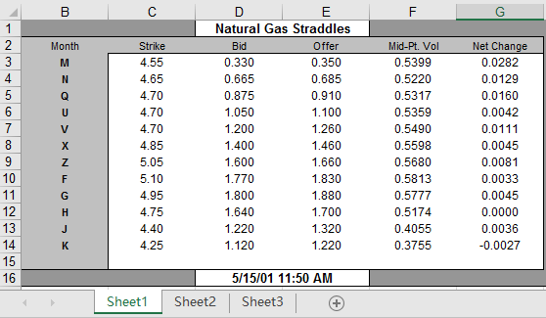
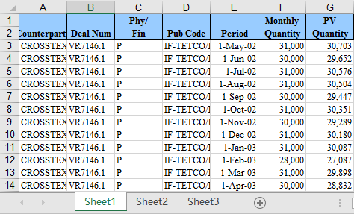
Limitations of the filename-based approach (1)
The spreadsheets with similar filenames may be completely different
Contents are completely different
The filename-based approach identifies them as different versions of a spreadsheet incorrectly
Book1.xls
Book1.xls
Filenames are the same

Slide 7
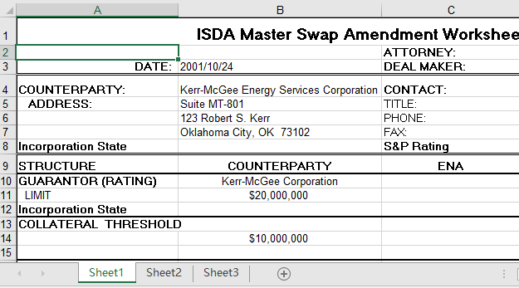
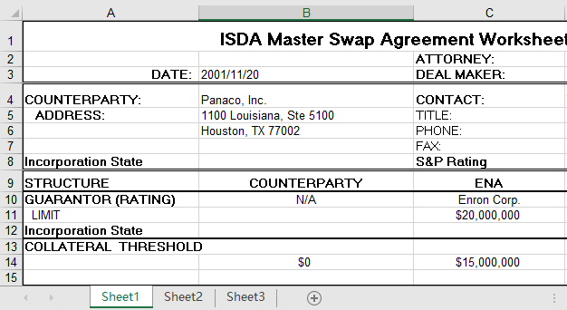
Limitations of the filename-based approach (2)
Some versions of a spreadsheet may have different filenames
Contents are similar
The filename-based approach misses some versions
Kerr-McGee Energy Services Corp.xls
Panaco Inc.xls
Filenames are completely different

Slide 8
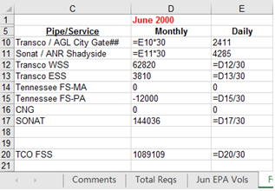
Observation
Different versions of a spreadsheet have similar contents
Similar layout
Similar worksheets
We can identify different versions based on similarity among spreadsheets

Slide 9
SpreadCluster
A similarity-based algorithm to identify different versions of a spreadsheet
Training phase
Features
Model Training
Working phase
Features
Classifier

Slide 10
Which features can be used?
Not all contents can be used as features to measure the similarity
Data is usually replaced by new data
Formulas may be modified, even deleted

Slide 11
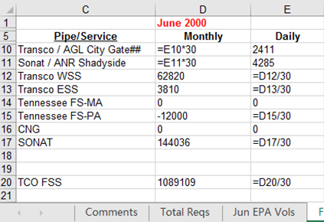
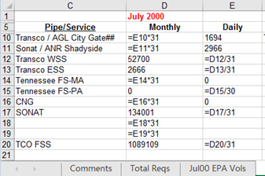
Features we selected to measure the similarity
Some contents remain stable in different versions of a spreadsheet
Table headers: Represent the semantics of processed data and formulas
Worksheet names: High-level functional descriptions of worksheets
“Comments” means this worksheet is used to record comments

Slide 12
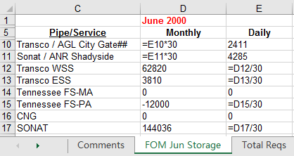
Model worksheets as vectors
All table headers in worksheets
 | GATE | Pipe/Service | Monthly | Daily | …
FOM Jun Storage | 0 | 1 | 1 | 1
 | GATE | Pipe/Service | Monthly | Daily | …
FOM Jun Storage
“Monthly” occurs one time in worksheet “FOM Jun Storage”
(0,1,1,1,…)

Slide 13
Two levels similarity measure
Spreadsheet is a finite set of worksheets
Similarity among worksheets
Cosine similarity
TF-IDF
Similarity among spreadsheets
Adapt Jaccard similarity coefficient
Cosine similarity
Comments
Jan ‘01
Feb ‘01
Mar ‘01
Comments
Feb ‘01
Jaccard
Cosine similarity
sp₁
sp₂

Slide 14
Clustering algorithm
Some versions of a spreadsheet may be dissimilar
Users tend to reuse latest version
Two adjacent versions are similar
0.20
0.9
0.80
Version 1
0.87
Version 3
Version 5
0.85
Version 2
Version 4
Single-linkage algorithm

Slide 15

Model training
Determine two thresholds by training
$θ_{ws}$: threshold to measure the similarity among worksheets
$θ_{sp}$: threshold to measure the similarity among spreadsheets
Using overall F-Measure to evaluate the clustering result
θws | θ_{SP} | overall F-Measure
0.01 | 0.01 | 0.247
0.02 | 0.01 | 0.324
⁞ | ⁞ | ⁞
0.60 | 0.33 | 0.958
⁞ | ⁞ | ⁞
We search for the combination that maximizes overall F-Measure
by enumerating all possible combinations

Slide 16
Evaluation
RQ1: Effectiveness
How effective is SpreadCluster in identifying different versions of a spreadsheet?
RQ2: Comparison
Can SpreadCluster outperform existing techniques?
RQ3: Applicability
Can SpreadCluster be applied on different domains?

Slide 17
Experimental subjects
Enron (Hermans 2015)
~15,000 spreadsheets
Extracted from an email archive in the Enron corporation
EUSES (Fisher 2005)
~4,500 spreadsheets
Obtained by searching on Google
FUSE (Barik 2015)
~250,000 spreadsheets
Extracted from ~27 billion web pages

Slide 18
Build ground truth on Enron
It is challenging to build ground truth
The creators of spreadsheets are not available
Build ground truth by combining the validated results of two existing techniques
SpreadCluster
Filename-based approach
 | Groups | Spreadsheets
Ground truth on Enron | 1,609 | 12,254
This ground truth is available online

Slide 19
RQ1:Effectiveness
Evaluate SpreadCluster on Enron
Corpus | Precision | Recall | F-Measure
Enron | 78.5% | 70.7% | 74.4%
SpreadCluster can identify different versions with high precision and recall

Slide 20
RQ2: Comparison
Compare SpreadCluster with the filename-based approach on Enron
Improve the precision by 18.7%
Improve the recall by 22.0%
 | Precision | Recall | F-Measure
SpreadCluster | 78.5% | 70.7% | 74.4%
Filename-based | 59.8% | 48.7% | 53.7%
SpreadCluster performs better than the filename-based approach

Slide 21
RQ3:Applicability
The spreadsheets in Enron are used in financial field
Apply SpreadCluster on EUSES and FUSE
No training data
Use the same thresholds as Enron
No ground truth
Only calculate the precision
 | Detected | Validated | Correct | Precision
EUSES | 213 | 213 | 170 | 79.8%
FUSE | 10,985 | 200 | 182 | 91.0%
SpreadCluster performs well in identifying different versions for a spreadsheet used in different domains

Slide 22
Conclusion
SpreadCluster can identify different versions of a spreadsheet based on similarity
SpreadCluster can achieve high precision and recall
VEnron2: A new larger versioned spreadsheet corpus
1,609 groups and 12,254 spreadsheets
Have a try!
http://www.tcse.cn/~wsdou/project/venron/

Slide 23

Thank You!

