Slide 1


31st International Symposium on Software Testing and Analysis
Finding Bugs in Gremlin-Based Graph Database Systems via Randomized Differential Testing
Yingying Zheng, Wensheng Dou, Yicheng Wang, Zheng Qin,
Lei Tang, Yu Gao, Dong Wang, Wei Wang, Jun Wei
Institute of Software, Chinese Academy of Sciences
University of Chinese Academy of Sciences

Slide 2

Graph Data
Graph data consists of vertices and edges
A vertex represents an entity
An edge describes the relationship between two entities

Slide 3
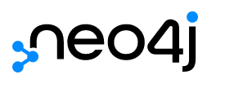




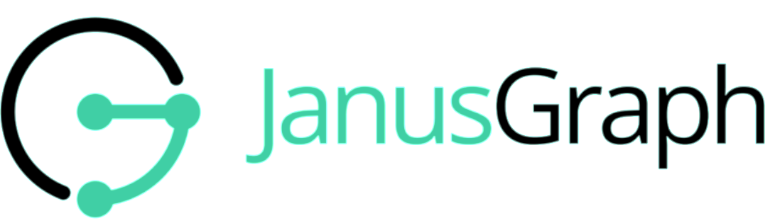
Graph Database Systems (GDBs)
GDBs support efficient storage and queries for graph data
Neo4j has been downloaded 2 million+ times^{[1]}.
[1] Neo4j. Retrieved May 23, 2022 from https://neo4j.com/product/neo4j-graph-database/.

Slide 4

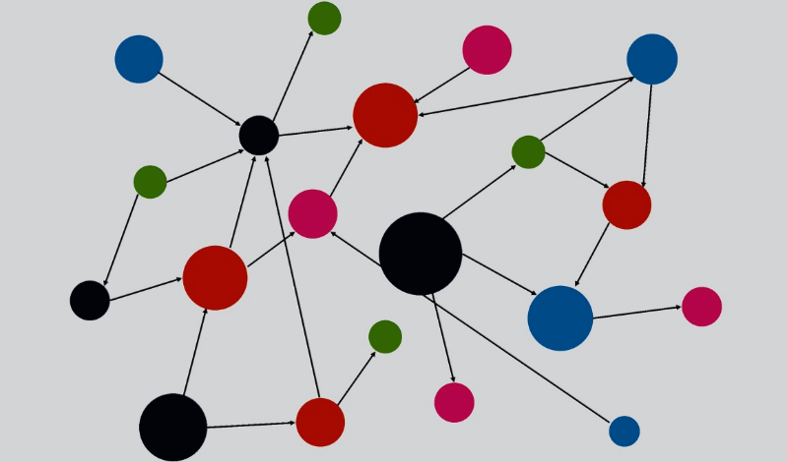
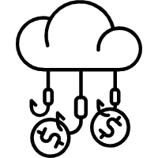


Applications of GDBs
GDBs play a significant role in numerous applications
Knowledge graphs
Social networks
Fraud detection
Medical

Slide 5



Labeled Property Graph Model
Each vertex and edge has a label name and a set of properties
since: 2020
knows
book
writes
reads
person
person
Label
name: Alice
age: 33
title: Family
wordCount: 23400
name: Nancy
age: 26
Property

Slide 6
Graph Query Language
Graph Database System | Graph Query Language
Neo4j | Cypher, Gremlin
Hugegraph | Gremlin
JanusGraph | Gremlin
TinkerGraph | Gremlin
NebulaGraph | nGQL
TigerGraph | GSQL
… | …
66% GDBs support Gremlin APIs^{[1]}
[1] DB-Engines Ranking of Graph DBMS. Retrieved May 23, 2022 from https://db-engines.com/en/ranking/graph+dbms.

Slide 7
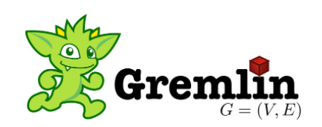
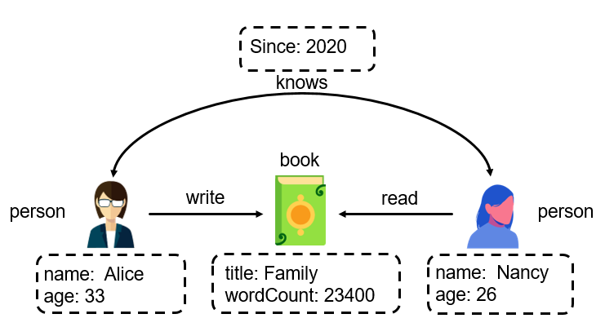

Gremlin Query Language
Gremlin links a sequence of Gremlin API calls for traversing labeled property graphs
g.V().has(‘person’, ‘age’, between(20, 35)).count()
Get all vertices
Filter vertices with the condition that person’s age is between 20 and 35
Count the number of eligible persons
How many people are between 20 and 35 years old?

Slide 8



Logic Bug in GDBs
GDBs suffer from logic bugs, in which a query returns an incorrect query result without crashing the GDBs
Expected results
Actual results
1
1
Query A
3
3
5
5
Omit a vertex
9
2
Query B
4
3
Throw an unexpected error
9
IllegalArgumentException

Slide 9





Logic Bugs Cause Severe Consequences
Error diagnosis in medical application
Logic bugs
Error detection in fraud detection application

Slide 10



A Real Logic Bug
HugeGraph forgets to deduplicate overlapping values for or() operation
How many people are 20 to 35 years old or under 29?
g.V().has(‘person’, ‘age’, or(between(20, 35), lt(29))).count()
{3} {2}
Actual results
Expected results

Slide 11
Existing Bug Detection Tools and Approaches
Relational database management systems (RDBMSs)
Differential testing: RAGS^{[1]}, APOLLO^{[2]}
Fuzzing: SQLSmith^{[3]}, AFL^{[4]}
Metamorphic testing: Non-optimizing reference engine construction^{[5]}, Query partition^{[6]}
Testing oracle: Pivoted query synthesis^{[7]}
Cannot be directly applied to GDBs!
[1] Donald S. Slutz. Massive Stochastic Testing of SQL. VLDB 1998.
[2] Jinho Jung, et. al., APOLLO: Automatic Detection and Diagnosis of Performance Regressions in Database Systems. PVLDB 2019.
[3] SQLsmith. Retrieved August 5, 2021 from https://github.com/anse1/sqlsmith.
[4] AFL. Retrieved September 13, 2021 from https://github.com/google/AFL.
[5] Manuel Rigger and Zhendong Su. Detecting Optimization Bugs in Database Engines via Non-Optimizing Reference Engine Construction. FSE 2020.
[6] Manuel Rigger and Zhendong Su. Finding Bugs in Database Systems via Query Partitioning. OOPSLA 2020.
[7] Manuel Rigger and Zhendong Su. Testing Database Engines via Pivoted Query Synthesis. OSDI 2020.

Slide 12

Goal: Finding Bugs in Gremlin-Based GDBs
We refer GDBs that adopt Gremlin to retrieve graph data as Gremlin-based GDBs

Slide 13

Grand: Randomized Differential Testing in GDBs
Construct semantically equivalent databases for multiple GDBs, and then compare the results of a Gremlin query on these databases
RS1
Gremlin Queries
RS2
RS1 = RS2 = RS3
RS3

Slide 14

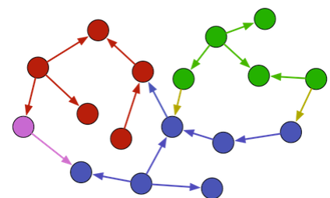


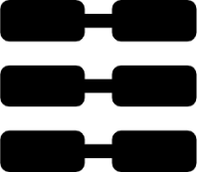
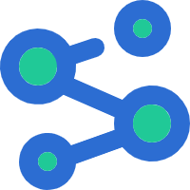
Overview of Grand
bug reports
discrepancies
analysis
g.V()
…
Mapping table
checker
GDB₁
GDB₂
…
GDB_{n}
GDB₁
GDB₂
…
GDB_{n}
Traversal model
Graph Database Generation
Gremlin Query Generation
Differential Testing
Step 1
Step 2
Step 3

Slide 15
Step 1: Graph Database Generation
bug reports
discrepancies
analysis
g.V()
…
Mapping table
checker
GDB₁
GDB₂
…
GDB_{n}
GDB₁
GDB₂
…
GDB_{n}
Traversal model
Graph Database Generation
Gremlin Query Generation
Differential Testing
Step 1
Step 2
Step 3

Slide 16
Graph Schema Generation
Randomly generate vertex types and edge types
person
book
software
Vertex Type
name: String
age: Integer
title: String
wordCount: Integer
name: String
language: String

Slide 17
Graph Schema Generation
Randomly generate vertex types and edge types
person
book
software
Vertex Type
name: String
age: Integer
title: String
wordCount: Integer
name: String
language: String
since: Integer
Edge Type
person
read
book

Slide 18
Graph Data Generation
Based on the generated graph schema, Grand randomly generates a set of vertices and edges
person
person
person
name: String
age: Integer
name: Nancy
age: 26
name: Bob
age: 16
book
book
title: String
wordCount: Integer
title: World

Slide 19
Graph Data Generation
Based on the generated graph schema, Grand generates vertices and edges
since: 2020
since: Integer
person
book
read
person
read
book
name: Nancy
age: 26
title: World

Slide 20
Step 2: Gremlin Query Generation
bug reports
discrepancies
analysis
g.V()
…
Mapping table
checker
GDB₁
GDB₂
…
GDB_{n}
GDB₁
GDB₂
…
GDB_{n}
Traversal model
Graph Database Generation
Gremlin Query Generation
Differential Testing
Step 1
Step 2
Step 3

Slide 21


Existing Query Generation Tools are Unusable
Gremlin has different syntax and query patterns from SQL
SELECT name
FROM t0
WHERE (t0.age < 30) AND
(t0.name != ‘Tom’)
g.V()
.has(‘person’, ‘age’, lt(30))
.has(‘person’, ‘name’, neq(‘Tom’))
.values(‘name’)
And
<
!=
age
30
name
Tom
Abstract Syntax Tree

Slide 22

Completely Random Gremlin Query Generation
Generate some grammatically correct but meaningless queries and ignore the semantics of Gremlin APIs
lt()
and()
g
V()
has()
out()
V()
We construct a model to guide us in generating syntactically correct and valid Gremlin queries.
or()
g
V()
V()
V()
has()
E()
where()
out()
These meaningless queries can greatly affect the effectiveness of GDB testing.
outV()
not()
Gremlin APIs

Slide 23

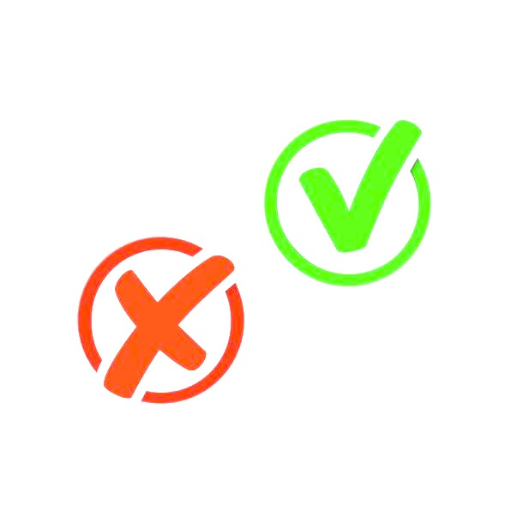
Insight
The input type of a Gremlin API in a query should match the output type of its previous Gremlin API.
person
read
book
g.V().outE()
g.E().outE()
outE()

Slide 24
Traversal Model for Gremlin
We abstract three entities, i.e., vertex, edge and value
We construct a traversal model to describe the legal operations and semantics in these entities
Edge
ep1 : 4
vp1 : 1
v1
e1
v2
vp1 : 2
Vertex
Property key : Value

Slide 25
Traversal Model - Vertex
Legal operations on a vertex
out()
has(vp1)
inV()
v2
v2
v2
vp1 : 2
vp1 : 2
vp1 : 2
e1
e1
e1
v1
v1
v1
vp1 : 1
vp1 : 1
vp1 : 1
v3
v3
v3
e2
e2
e2
vk2 : 3
vk2 : 3
vk2 : 3
Traverse v1 from vertices
Traverse v1 from edges
Filter v1 by the given conditions

Slide 26
Traversal Model - Edge
Legal operations on an edge
has(ep1, gt(3))
inE()
ep1 : 4
v2
v2
ep1 : 4
e1
e1
v1
v1
v3
v3
e2
e2
ep1 : 2
ep1 : 2
Traverse e1 from vertices
Filter e1 by the given conditions

Slide 27
Traversal Model - Value
Legal operations on values
values(ep1)
values(vp1).sum()
values(vp1)
ep1 : 4
ep1 : 4
v1
vp1 : 2
v1
vp1 : 2
vp1 : 1
e1
v2
vp1 : 1
e1
v2
Retrieve property values from vertices or edges
Aggregate property values

Slide 28
Model-based Query Statement Generation
Randomly select Gremlin APIs until the maximum query length is reached or exit condition is satisfied
Select a vertex type
Select a filter type
Select a value type
V()
2
Has(key, Predicate)
values(Vertex.propertyName)
1
4
Vertex
Vertex
g
Map
Filter
Property
entry
Graph traversal source
Vertex.propertyName
3
eq (Value)
Predicate
Select a predicate type

Slide 29
Parameters in Gremlin Query Statement
Completely random parameter generation returns lots of empty results, which can greatly affect the effectiveness of GDB testing
1
V()
2
Has(key, Predicate)
4
values(Vertex.propertyName)
Vertex
Vertex
g
Map
Filter
Property
entry
Vertex.propertyName
3
eq (Value)
No results!
How can we check results in these GDBs?

Slide 30
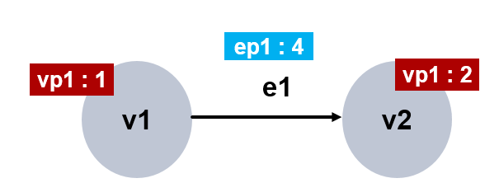
Parameter Values Generation for Gremlin APIs
Randomly select from the generated graph database
Randomly generate
1
V()
2
Has(key, Predicate)
4
values(vp1)
Vertex
Vertex
g
Map
Filter
Property
entry
Select from database
vp1
3
eq (5)
Randomly generate a value
Select from database

Slide 31
Step 3: Differential Testing in GDBs
bug reports
discrepancies
analysis
g.V()
…
Mapping table
checker
GDB₁
GDB₂
…
GDB_{n}
GDB₁
GDB₂
…
GDB_{n}
Traversal model
Graph Database Generation
Gremlin Query Generation
Differential Testing
Step 1
Step 2
Step 3

Slide 32


Differential Testing
Execute Gremlin queries on target GDBs and compare the return results
RS1
v: 1605, 1606, 1610
We convert the query results from different GDBs into a unified format.
RS2
v: 49599408, 49599320, 49599360
check
discrepancy
RS3
v: 4152, 4136, 4216
The result formats (e.g., id and property) are different.

Slide 33
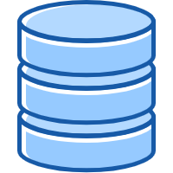
Query Result Mapping
Record the mapping relations between 𝑢𝐼𝐷 and 𝑎𝑐𝑡𝑢𝑎𝑙𝐼𝐷 in all GDBs
v2
ne1
e1
nv2
Mapping Table
v1
nv1
e2
uID
nID
uID
nID
ne2
v1
nv1
e1
ne1
v3
nv3
v2
nv2
e2
ne2
v3
nv3
actualID
uID

Slide 34
Differential Results Verification
Verify the unified query results of all target GDBs
RS1
v: 1605, 1606, 1610
v: 1, 2, 3
RS2
v: 49599408, 49599320, 49599360, 49599408, 49599320,
v: 1, 2, 3, 1, 2
Discrepancy
RS3
v: 4152, 4136, 4216
v: 1, 2, 3
uID
nID
hID
jID
1
1605
49599408
4152
2
1606
49599320
4136
3
1610
49599360
4216
4
1618
49599390
4256

Slide 35
Evaluation
Target GDBs
6 widely-used graph database systems
GDB | Rank* | GitHub Star | Initial Release
Neo4j | 1 | 9.2k | 2007
OrientDB | 5 | 4.4k | 2010
JanusGraph | 8 | 4.1k | 2017
HugeGraph | 22 | 1.7k | 2018
TinkerGraph | 23 | 1.4k | 2009
ArcadeDB | 27 | 119 | 2021
* There are total 36 GDBs in DB-Engines Ranking of Graph DBMS.

Slide 36
Evaluation
Testing methodology
Run 15 times and 1000 random queries in each time
Manually reproduce and analyze the reported discrepancies
Simplify the reported query to a simple one
Identify which GDBs are buggy
Filter out duplicated bugs
Analyzing 709 discrepancies and obtaining 21 logic bugs

Slide 37
Bug Overview
21 bugs have been found in six widely-used GDBs
GDB | Detected | Confirmed | Fixed
Neo4j | 3 | 2 | 1
OrientDB | 1 | 0 | 0
JanusGraph | 3 | 3 | 2
HugeGraph | 9 | 9 | 3
TinkerGraph | 3 | 3 | 1
ArcadeDB | 2 | 1 | 0
Total | 21 | 18 | 7

Slide 38
HugeGraph#1575
Infinity value was ignored and regarded as a String value
Insert Infinity and retrieve it
ep1 : Infinity
v1
vp1 : 2
vp1 : 1
e1
v2
IllegalArgumentException

Slide 39
HugeGraph#1735
Cannot query edges by multiple labels in Gremlin API outE()
ep1 : 4
v2
e1: el1
v1
v3
e2: el2
IllegalStatementException
ep1 : 2
g.V(1).outE(‘el1’,‘el2').hasLabel(‘el1')

Slide 40
Instruction Coverage
Achieve coverage from 32% to 61% for query engines and 16% to 42% for target GDBs

Slide 41
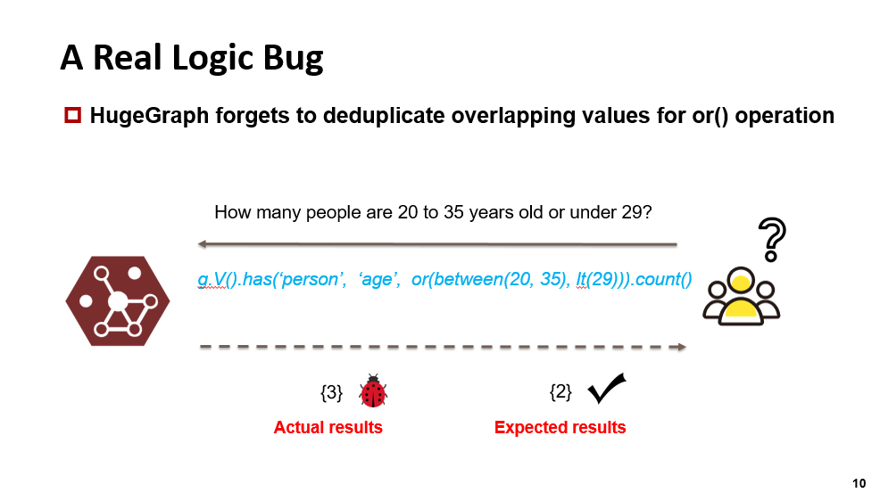
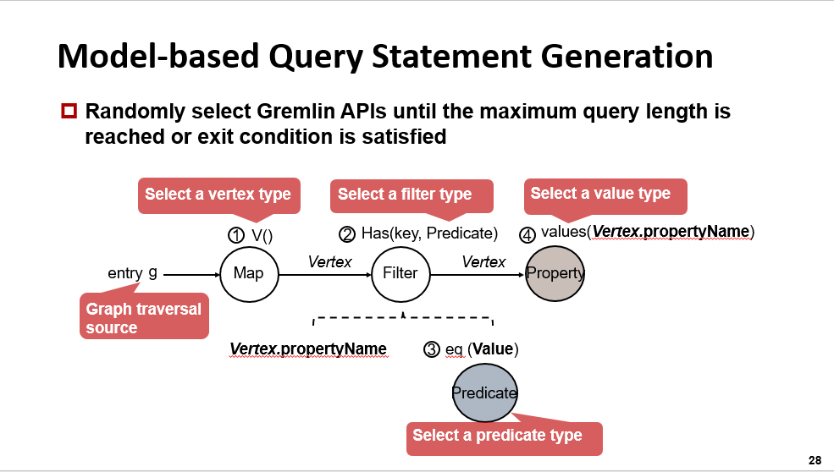
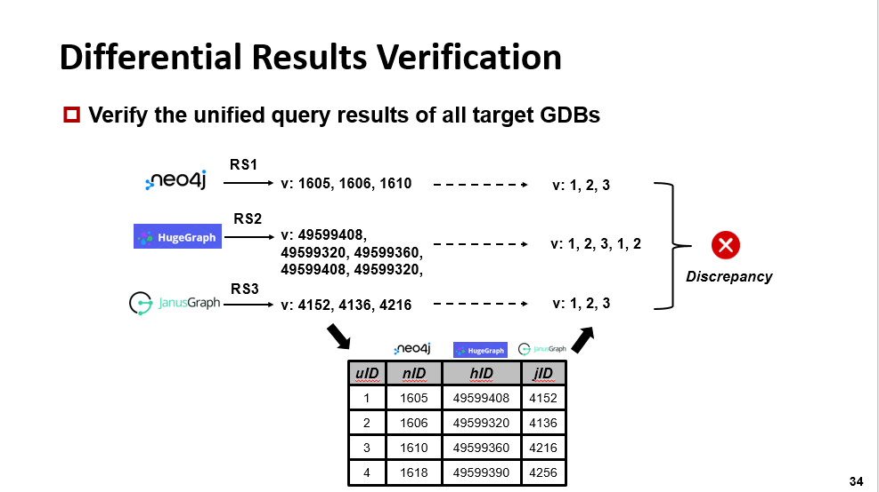
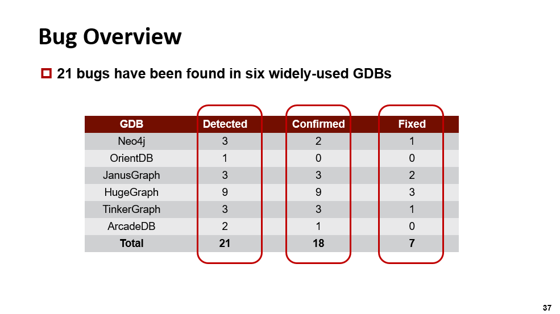

Conclusion
Goal: Find logic bugs in GDBs
Model-based query generation
Differential results verification
Evaluation: 21 bugs in six GDBs
https://github.com/tcse-iscas/Grand.

Slide 42

THANK YOU!

