Slide 1
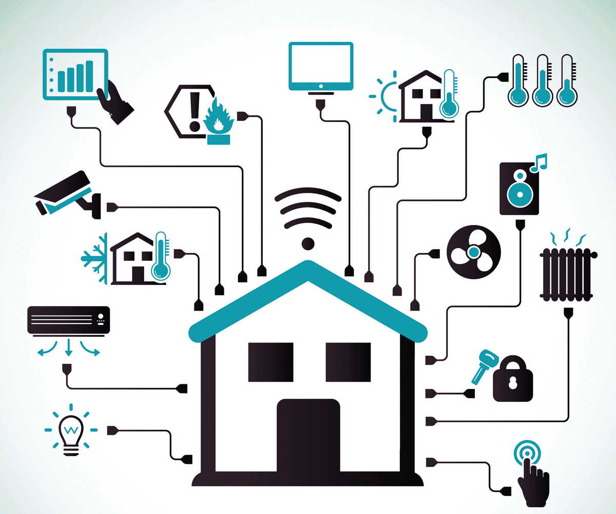


31st International Symposium on Software Testing and Analysis (ISSTA 2022)
Understanding Device Integration Bugs in Smart Home System
Tao Wang, Kangkang Zhang, Wei Chen, Wensheng Dou,
Jiaxin Zhu, Jun Wei, Tao Huang
Institute of Software,
Chinese Academy of Sciences
University of Chinese Academy of Sciences

Slide 2
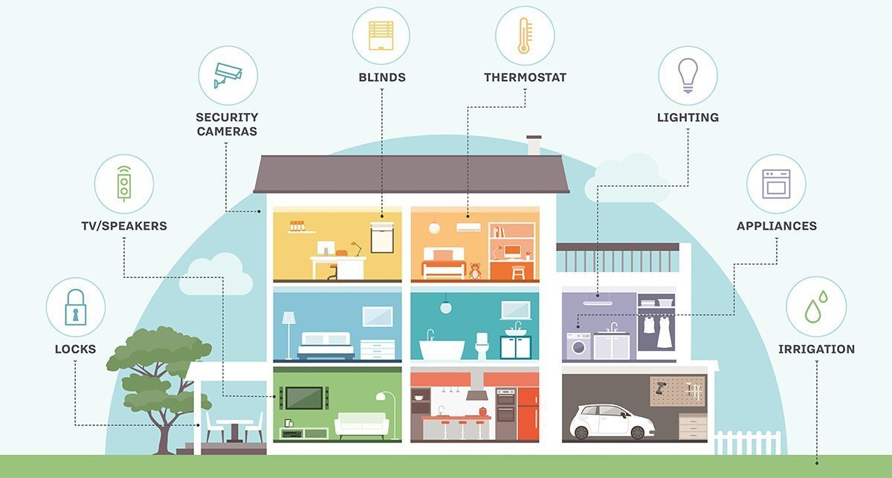
Smart Home
Internet-connected devices
Remote monitoring and management

Slide 3
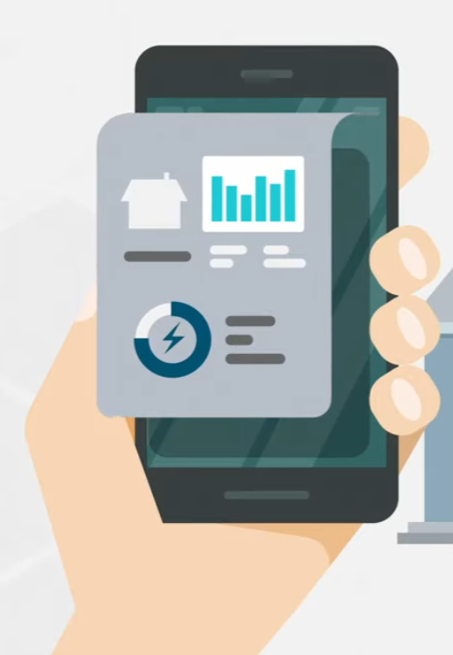



Smart Home
Internet-connected devices
Remote monitoring and management
Home Automation

Slide 4
Rapid Growth
Households with Smart Systems: Global Total [1]
(Number and Annual Spending)
Consumer
Spending ($)
Net Households with
Smart Systems (#M)
[1] https://www.digitaltvnews.net/?p=33620

Slide 5






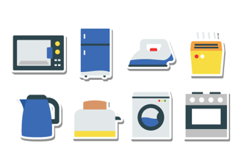

Smart Home System
Smart home systems allow users to control different kinds of devices

Slide 6




Device Integration
Device integration builds the bridge between the device and smart home system
Define an Internet of Things domain
Device layer
Control layer
Application layer
Integration
Discovery
Initialization
Release
Execution

Slide 7
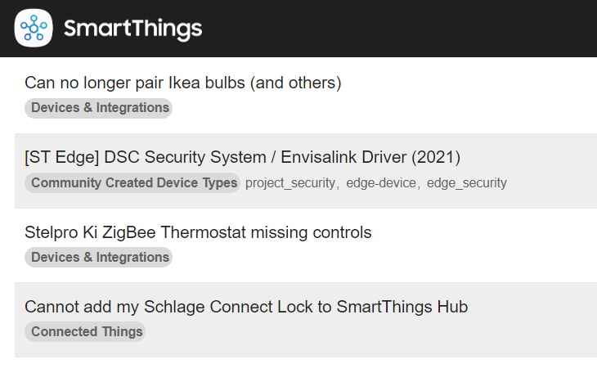
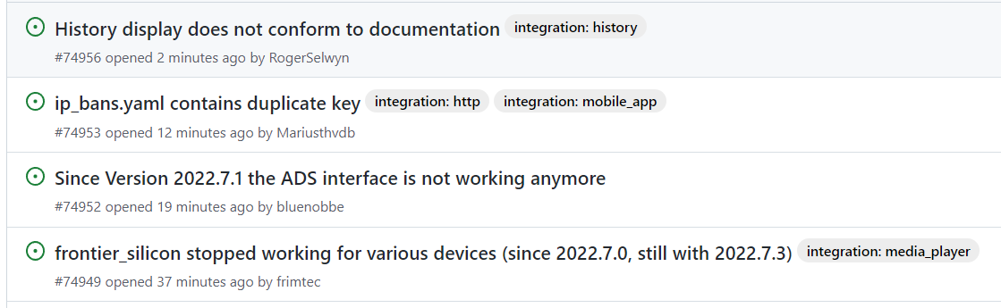
Device Integration Bug
Bugs can occur during the device integration development
We call device integration bug as iBug
Home Assistant

Slide 8
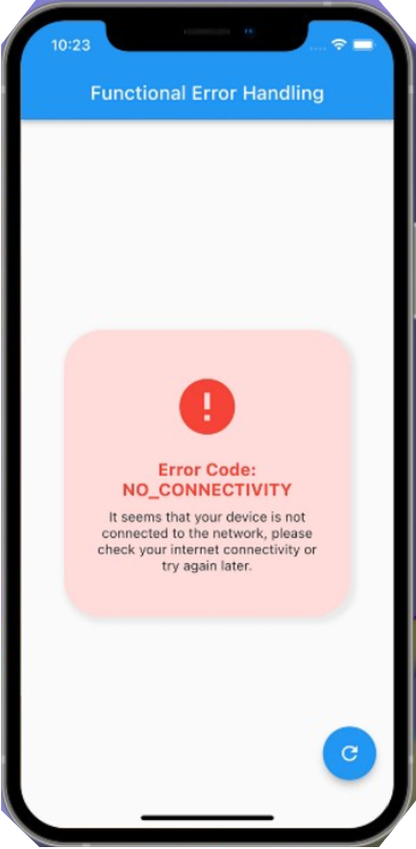



iBugs Seriously Affect Users’ Experience
…
Unavailable device
Incorrect state
Unexpected system
behavior

Slide 9

Understanding Device Integration Bugs
First empirical study on iBugs
RQ1: Root cause
- What are the root causes of iBugs?
RQ2: Fix
- How do developers fix iBugs, and are there some common fix strategies?
RQ3: Trigger condition
- What are the trigger conditions of iBugs?

Slide 10




Smart Home Systems
Home Assistant
OpenHAB
SmartThings
Open source
Allow integrate
new device
Quantity and
quality of issues
High
Low
Medium
Community activity
High
Medium
High

Slide 11
Target System
Home Assistant
1st in the number of stars of home automation system
2nd in the number of contributors to python packages [1]
Well-organized issues and PRs
Separate and maintain the device SDKs from the device integrations
[1] GitHub annual report , https://octoverse.github.com/, 2020.

Slide 12


Methodology: Bug Analysis
Issue Collection
Bug Report Collection
Bug Analysis
integration-related
Sampled batch of bug reports
2767 closed issues
5k+ integration-related
issues
RCA and labeling
Conflict solving
No
Time: 2020.5-2020.12
Tag:
Search for
merged PRs
Saturation?
Yes
2767 closed issues
A pool of 831 bug reports
330 iBugs

Slide 13
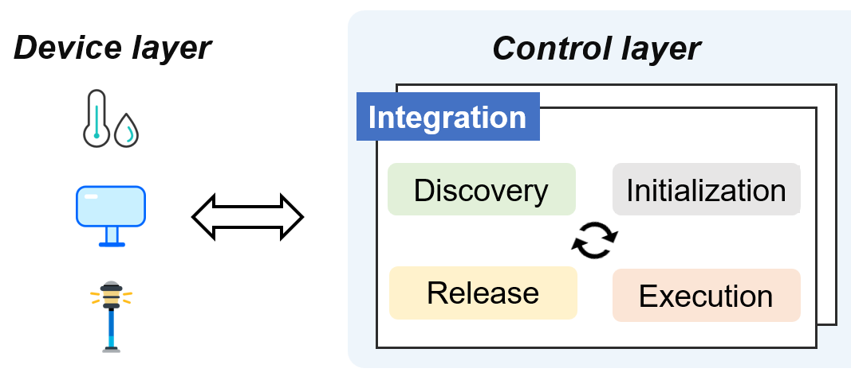
RQ1: Root Cause
Device
Others
14%
25%
Discovery
8%
16%
Initialization
30%
4%
3%
Execution
Error handling
Release

Slide 14




RQ1: Root Cause
Device (47/330)
Incompatible device (45/47)
Partially supported or not supported at all
Air-conditioning:
def heat(): ...
def cool(): ...
Finding. 13.6% (45/330) iBugs are caused by accessing incompatible devices without clear prompts.
developer
mismatch
Implication. The smart home system should give a clear prompt when a user encounters an incompatible device.
heat
cool
auto
user

Slide 15


RQ1: Root Cause
Discovery (27/330)
Configuration error (18/27)
Generate incorrect device information (9/27)
none
duplicate
ID: 003
IP: **.**.**
…
ID: MAC address
IP: **.**.**
…
Finding. The main cause of generating incorrect device information is that the accessed device does not have a unique ID.
ID: 003
IP: **.**.**
…
ID: null
IP: **.**.**
…
Implication. Developers should not use privacy information as the unique ID and should also avoid generating duplicate IDs.
Random generate ID
Use privacy information as ID

Slide 16


RQ1: Root Cause
Initialization (51/330)
Forget to keep authentication (8/51)
Error. Invalid authentication
credentials!
…
turn_off
turn_on
…
60 min
…
No response
device access
Implication. Smart home systems should inform device integration developers of the existence of an expired device authentication.

Slide 17
RQ1: Root Cause
Initialization (51/330)
Incorrect task scheduling (19/51)
avoid long operation
def setup_entry():
... // config
Time-consuming-Task()；
...
Main thread
throw
Background
thread
for long-running work
Finding. Developers can set time-consuming tasks in the main thread and it will block the system. Background threads should be delegated to execute such tasks asynchronously.

Slide 18
RQ1: Root Cause
Release (9/330)
Forget to release resources (4/9)
Incorrect release (5/9)
var auto_add, state, …
def task_1() …
def task_2() …
def release():
remove_task_1();
remove_task_2();
unintended
adding device
// Timer
def auto_add():
if auto_add == true:
add_device();
developer
Implication. The system should provide some utilities to help the resource release process or introduce an automatic garbage collection mechanism.

Slide 19
RQ1: Root Cause
Error handling (100/330)
Incorrect response handling (31/100)
Insufficient error handling (48/100)
response
{
“Id”: “00A”，
“des”: “”，
“params”: “…”
}
def handle_response():
...
var title = des.title;
title.split();
developer
NullPointerException！

Slide 20
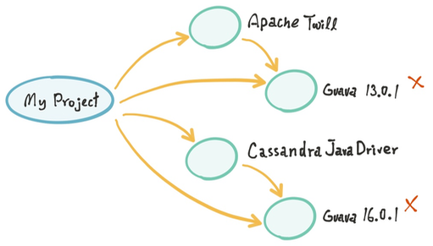
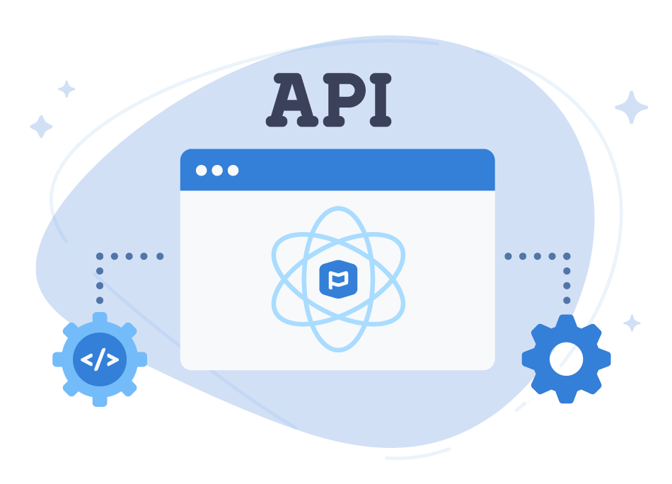
RQ1: Root Cause
Others (83/330)
API-update-caused breakage (38/83)
General code error (25/83)
Dependency conflict (3/83)

Slide 21
RQ2: Fix
Root cause
Fix strategy
Generate incorrect device information
Generate unique ID
Add watchdog or set timer to
maintain the authentication
Forget to keep authentication
Finding. Fixes of device integration bugs are highly related to their root causes. 15 out of 23 atomic categories have frequent fix patterns.
Remove heavy tasks or
turn tasks into asynchronous
Incorrect task scheduling
Inappropriate polling interval
Adjust polling interval
……

Slide 22
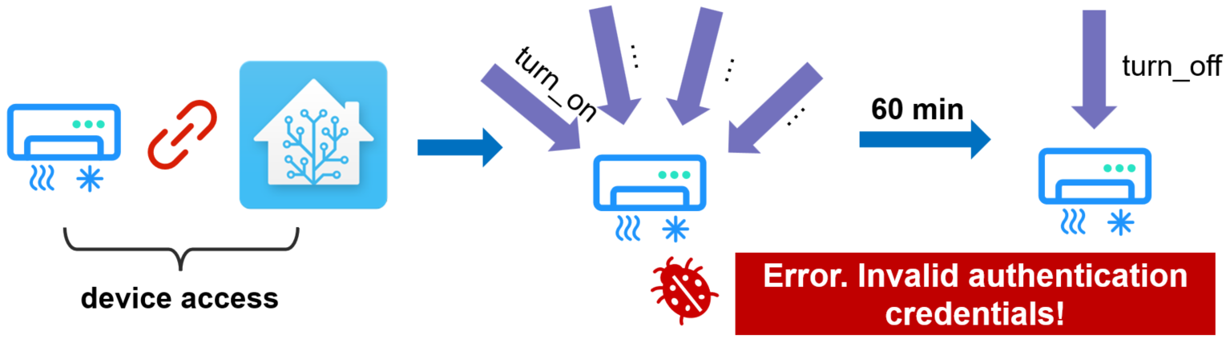
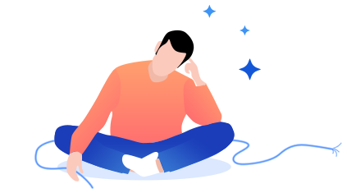
RQ2: Fix
No response
Implication. Researchers can develop automated fixing tools for iBugs based on our summarized fix patterns.
Fix strategy
+ except SessionExpiredError:
+ LOGGER.info("Tile session expired; creating a new one")
+ await client.async_init()
Forget to keep authentication

Slide 23
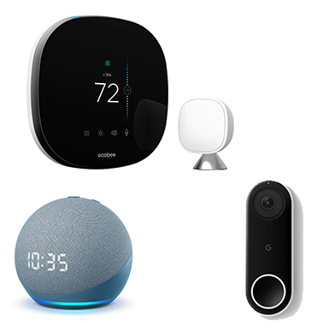


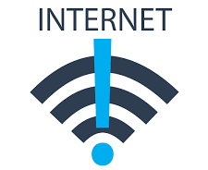
RQ3: Trigger Condition
Load integration
Reload integration
Frequent request
Invoke device service
Network interruption,
delay and recovery

Slide 24

RQ3: Trigger Condition
Perform systematically testing based on these trigger conditions
(Re-)Load deivce
Error injection
Stress testing
invoke service
+ network delay
Repeated loading and
releasing integrations
Error injection

Slide 25

Conclusion
First empirical study on device integration bugs
In-depth study on 330 iBugs in the open source smart home system
Interesting findings and lessons
iBug detection, software testing
Provide guide for developers, system designers
More details on GitHub
https://github.com/tcse-iscas/iBugs

