Slide 1


17th IEEE International Conference on Software Testing, Verification and Validation (ICST) 2024
Differential Optimization Testing of Gremlin-Based Graph Database Systems
Yingying Zheng, Wensheng Dou, Lei Tang, Ziyu Cui, Jiansen Song,
Ziyue Cheng, Wei Wang, Jun Wei, Hua Zhong, Tao Huang
Institute of Software Chinese Academy of Sciences
University of Chinese Academy of Sciences

Slide 2

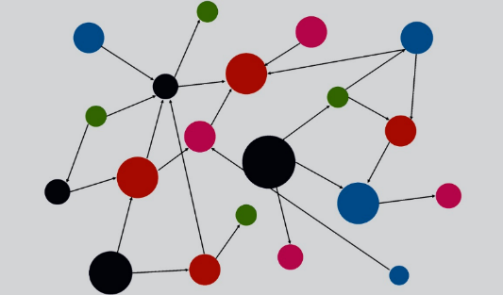




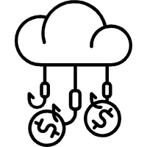

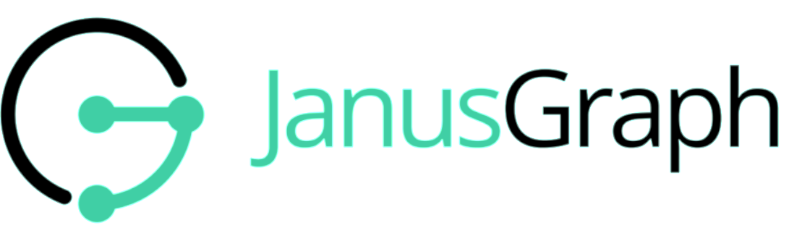


Graph Database Systems (GDBs)
GDBs support efficient storage and queries for graph data
Knowledge graphs
Social networks
Fraud detection
Medical

Slide 3
Labeled Property Graph Model
A labeled property graph consists of vertices and edges
Vertex property
v:3
name: Leonardo DiCaprio
acting
actor
e:2
v:1
directing
v:2
Vertex label
director
e:1
movie
name: James Cameron
acting
title: Titanic
e:3
v:4
name: Kate Winslet
actor

Slide 4
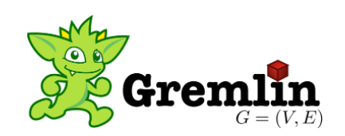
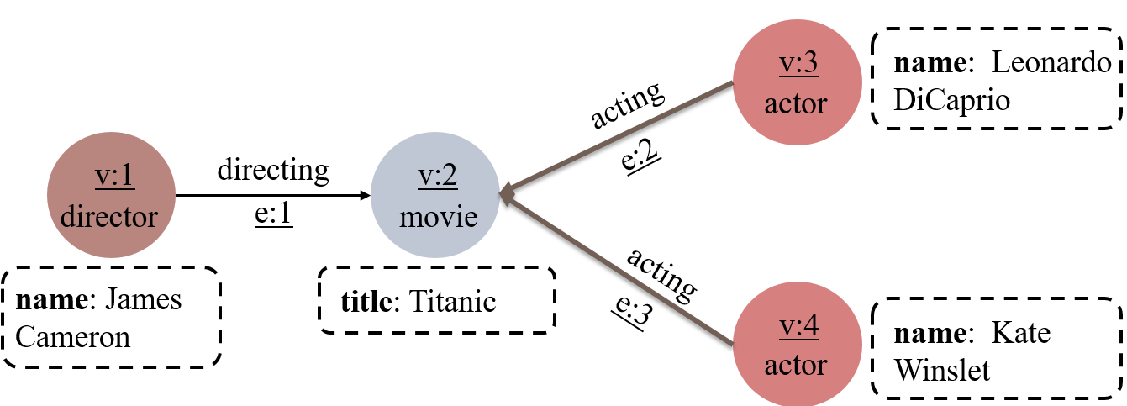
Gremlin Query Language
A Gremlin query can link a sequence of Gremlin API calls for querying labeled property graphs
Remove the incoming vertices of edges whose label is ‘acting’
Get all edges
g.E(). bothV().not(__.in(‘acting’))
Query both incoming and outgoing vertices of each edge
A labeled property graph

Slide 5
Graph Query Optimization
Common optimization strategies
Apache TinkerPop develops 15 common optimization strategies (e.g., FilterRankingStrategy) that can be adopted by each Gremlin-based GDBs
GDB-specific optimization strategies
Gremlin-based GDBs can develop their own specific optimization strategies, e.g., TinkerGraph develops TinkerGraphCountStrategy

Slide 6
Graph Query Optimization
Optimization strategies can be configured for a given Gremlin query
withStrategies(): turn on an optimization strategy
withoutStrategies(): turn off an optimization strategy
g = g.withStrategies(FilterRankingStrategy)
Q1
g.V(1,1,2).order().dedup() (order three vertices)
Q2
g.V(1,1,2).dedup().order() (order two vertices)
The complexity of optimization strategies poses a major correctness challenge for GDBs

Slide 7
Optimization Bugs
Incorrect optimizations in GDBs can introduce optimization bugs, which cause GDBs to return incorrect query results
g.withoutStrategies(LazyBarrierStrategy)
.withoutStrategies(HugeVertexStepStrategy)
.E().bothV().not(__.in('acting'))
-- v:{1,2,3,4} ❌
g.withStrategies(LazyBarrierStrategy)
.withStrategies(HugeVertexStepStrategy)
.E().bothV().not(__.in('acting'))
-- v:{1,3,4} ✔
An optimization bug HugeGraph#2163 detected by our approach in HugeGraph

Slide 8
Existing Bug Detection Techniques for GDBs
Differential testing
Grand^{[1]}, testing Gremlin-based GDBs
GDsmith^{[2]}, testing Cypher-based GDBs
RD^{2[3]}, testing SPARQL-based GDBs
Metamorphic testing
GDBMeter^{[4]}, partitioning a query into three disjoint queries in which a predicate is evaluated to true, false and null, respectively
Cannot detect optimization bugs in a GDB
[1] Yingying Zheng, et. al., Finding Bugs in Gremlin-Based Graph Database Systems via Randomized Differential Testing. ISSTA 2022.
[2] Wei Lin, et. al., GDsmith: Detecting Bugs in Graph Database Engines. ISSTA 2023.
[3] Rui Yang, et.al., Randomized Differential Testing of RDF Stores. ICSE Demo, 2023.
[4] Matteo Kamm. Testing Graph Database Engines via Query Partitioning. ISSTA 2023.

Slide 9
Existing Bug Detection Techniques for RDBMSs
Differential testing
RAGS^{[1]}, APOLLO^{[2]}, DT^{2[3]}
Metamorphic testing
NoREC^{[4]}, rewriting an optimized SQL query into a non-optimized SQL query
TLP^{[5]}, DQE^{[6]}
Others
PQS^{[7]}, SQLSmith^{[8]}, AFL^{[9]}
Cannot be directly applied to detect optimization bugs in GDBs
[1] Donald S. Slutz. Massive Stochastic Testing of SQL. VLDB 1998.
[2] Jinho Jung, et. al., APOLLO: Automatic Detection and Diagnosis of Performance Regressions in Database Systems. PVLDB 2019.
[3] Ziyu Cui, et.al., Differentially Testing Database Transactions for Fun and Profit. ASE 2022.
[4] Manuel Rigger and Zhendong Su. Detecting Optimization Bugs in Database Engines via Non-Optimizing Reference Engine Construction. FSE 2020.
[5] Manuel Rigger and Zhendong Su. Finding Bugs in Database Systems via Query Partitioning. OOPSLA 2020.
[6] Jiansen Song, et.al., Testing Database Systems via Differential Query Execution. ICSE 2023.
[7] Manuel Rigger and Zhendong Su. Testing Database Engines via Pivoted Query Synthesis. OSDI 2020.
[8] SQLsmith. Retrieved August 5, 2023 from https://github.com/anse1/sqlsmith.
[9] AFL. Retrieved September 13, 2023 from https://github.com/google/AFL.

Slide 10



Insight
For a given Gremlin query, the target GDB should return the same query results whether we open or close an optimization strategy
RS_{Q}
g.withStrategies(JanusGraphMixedIndexCountStrategy)
.V().has('person','age',lt(30)).limit(2).count().next()
4
≠
g.withoutStrategies(JanusGraphMixedIndexCountStrategy)
.V().has('person','age',lt(30)).limit(2).count().next()
RS’_{Q}
2

Slide 11

Differential Optimization Testing (DOT)
For a given Gremlin query Q, we execute Q with two different optimization configurations that should retrieve the same query result
① Generate a graph database
② Generate a Gremlin query Q
3
g.E().bothV().not(__.in('acting'))
RS_{Q}
1
2
4
optConf
1
2
3
4
5
…
n
v:{1,3,4}
④ Compare results
gdb
≠
Yes
3
4
③ Generate candidate optConfs
RS’_{Q}
⑤ Locate faulty optimizations
optConf’
1
2
3
4
5
…
n
v:{1,2,3,4}

Slide 12
Generating Graph Databases
Randomly generate vertex types and edge types, and then randomly generate vertex and edge instances
person
book
Vertex Type
since: 2020
name: String
age: Integer
title: String
wordCount: Integer
person
read
book
name: Nancy
age: 26
title: World
since: Integer
Edge Type
person
read
book
Graph data

Slide 13
Generating Gremlin Queries
Randomly generate valid Gremlin queries based on the Gremlin traversal model^{[1]}
Select a vertex type
Select a filter type
Select a filter type
1
V()
2
has(label, key, Predicate)
4
hasLable(label)
Vertex
Vertex
g
Map
Filter
entry
Filter
Graph traversal source
Label name, Vertex.propertyName
3
lt (Value)
Predicate
Select a predicate type
[1] Yingying Zheng, et. al., Finding Bugs in Gremlin-Based Graph Database Systems via Randomized Differential Testing. ISSTA. 2022.

Slide 14
Generating Optimization Configurations
Numerous optimization strategies in GDBs form a huge space for testing optimization configurations
1
2
3
4
5
…
n
1
2
3
4
5
…
n
2^{n}
…
…
1
2
3
4
5
n
We need to generate effective optimization configurations

Slide 15
Used Optimization Strategy
We refer to an optimization strategy that is opened and can be actually used for a given query Q as a used optimization strategy
g.V().out ().count().explain()
// Strategy [Category] [Traversal Steps]
…
PathRetractionStrategy [O] [GraphStep(vertex, []), VertexStep(OUT, vertex), CountGlobalStep]
CountStrategy [O] [GraphStep(vertex, []), VertexStep(OUT, vertex), CountGlobalStep]
AdjacentToIncidentStrategy [O] [GraphStep(vertex, []), VertexStep(OUT, edge), CountGlobalStep]
EarlyLimitStrategy [O] [GraphStep(vertex, []), VertexStep(OUT, edge), CountGlobalStep]
…
AdjacentToIncidentStrategy actually changes its execuftion plan, and is a used optimization strategy
We only test the used optimization strategies of a query

Slide 16
Generating Candidate Optimization Configurations
We generate candidate optimization configurations using pairwise testing of used optimization strategies
Given a Gremlin query Q:
g.E().bothV().not(__.in('acting'))
opt₁
opt₂
opt₃
opt₄
opt_{n}
…
pairwise combinations
1
3
4
1
3
4
1
3
4
1
3
4
optConf
optConf’

Slide 17

Comparing Query Results
If RS_{Q} and RS’_{Q} are not equal, we find an optimization bug
g.E().bothV().not(__.in('acting'))
RS_{Q}
optConf
…
v:{1,3,4}
1
2
3
4
5
n
≠
RS’_{Q}
optConf’
1
2
3
4
5
…
n
v:{1,2,3,4}

Slide 18
Locating Faulty Optimization Strategies
Locate optimization strategies with different states in optConf and optConf’, and enumerate all possible optimization strategies
optConf
1
2
3
4
5
…
n
v:{1,3,4}
① Obtain different states
optConf’
1
2
3
4
5
…
n
optConf₁
1
2
3
4
5
…
n
v:{1,3,4}
≠
3
4
② Change optConf with one optimization strategy
optConf₂
…
v:{1,3,4}
④ Locate the faulty optimization strategies: opt₃ and opt₄
1
2
3
4
5
n
③ Change optConf with two optimization strategies
…
v:{1,2,3,4}
optConf₃
1
2
3
4
5
n

Slide 19

Duplicate Bugs Affect Testing Efficiency
Randomly generated graph databases and Gremlin queries may trigger the same optimization strategies, thus detecting duplicate bugs
De-duplicate
We need to improve the efficiency of differential testing

Slide 20
Optimization-Guided Testing Approach
Explore new optimization strategies
Filter out Gremlin queries that trigger the same optimization strategies as some previously tested Gremlin queries
② Generate a Gremlin query
g.E().bothV().in('acting')
used opts: <opt₁, opt₃, opt₄>
No
Is <opt₁, opt₃, opt₄> new?
Yes
③ Generate candidate optConfs

Slide 21
Optimization-Guided Testing Approach
Explore new graph databases
3
② Generate a Gremlin query Q
1
2
g.E().bothV().not(__.in('acting'))
4
gdb
used opts: <opt₁, opt₃, opt₄>
① Generate a graph database
No
Is opt₁, opt₃, or opt₄ new?
Yes
③ Generate candidate optConfs

Slide 22
Evaluation
Target GDBs
Select 6 widely-used graph database systems
GDB | Rank | GitHub Star | Initial Release
Neo4j | 1 | 11.4k | 2007
OrientDB | 5 | 4.6k | 2010
JanusGraph | 7 | 4.8k | 2017
HugeGraph | 24 | 2.3k | 2018
TinkerGraph | 25 | 1.8k | 2009
ArcadeDB | 28 | 309 | 2021

Slide 23
Research Questions
RQ1: How many optimization bugs detected by DOT in real-world Gremlin-based GDBs?
RQ2: Is the optimization-guided testing approach effective?
RQ3: Can DOT detect new optimization bugs compared with existing approaches?

Slide 24
RQ1: Optimization Bug Detection
We have detected 28 optimization bugs in 6 target GDBs, and 16 have been confirmed as previously unknown bugs
GDBs | Detected | Fixed | Verified | Duplicate | False positives | Unconfirmed
Neo4j | 2 | 0 | 0 | 2 | 0 | 0
OrientDB | 2 | 0 | 1 | 0 | 1 | 0
JanusGraph | 5 | 0 | 2 | 0 | 0 | 3
HugeGraph | 15 | 3 | 7 | 0 | 1 | 4
TinkerGraph | 3 | 2 | 0 | 1 | 0 | 0
ArcadeDB | 1 | 0 | 1 | 0 | 0 | 0
Total | 28 | 5 | 11 | 3 | 2 | 7

Slide 25
RQ2: Efficiency of Optimization-Guided Approach
DOT can detect more optimization bugs using fewer test queries than DOT_{rand} without optimization-guided approach
GDBs | All (Unique) bugs |  | Test queries
 | DOT | DOT_{rand} | DOT | DOT_{rand}
Neo4j | 272（2） | 119（2） | 1,248 | 4,000
OrientDB | 398（2） | 180（2） | 1,608 | 4,317
JanusGraph | 327（5） | 173（5） | 1,444 | 2,797
HugeGraph | 215（11） | 238（8） | 598 | 1,000
TinkerGraph | 439（3） | 134（3） | 2,012 | 4,208
ArcadeDB | 191（1） | 125（1） | 1,927 | 3,140
Total | 1842 （24） | 969（21） | 8,837 | 19,462
DOT detects one bug for every 5 test queries
DOT_{rand} detects one bug for every 20 test queries

Slide 26
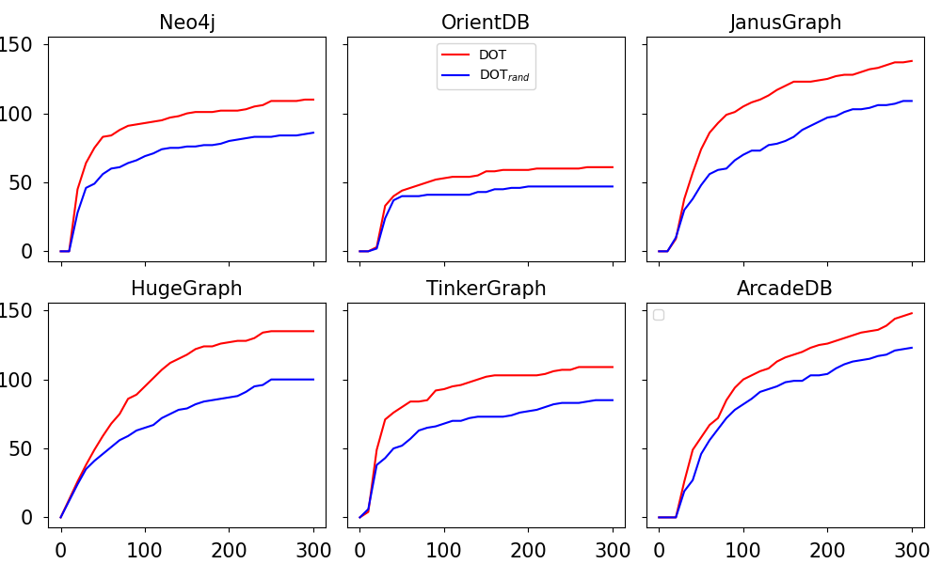
RQ2: Efficiency of Optimization-Guided Approach
DOT can explore 1.3x more unique optimization combinations than DOT_{rand}

Slide 27
RQ3: Comparison with Existing Approaches
19 out of 28 optimization bugs detected by DOT cannot be detected by existing approaches
GDBs | DOT | Grand^{[1]} | GDBMeter^{[2]}
Neo4j | 2 | 0 | 0
OrientDB | 2 | 1 | 0
JanusGraph | 5 | 1 | 0
HugeGraph | 15 | 7 | 2
TinkerGraph | 3 | 0 | 0
ArcadeDB | 1 | 0 | 0
Total | 28 | 9 | 2
[1] Yingying Zheng, et. al., Finding Bugs in Gremlin-Based Graph Database Systems via Randomized Differential Testing. ISSTA 2022.
[2] Matteo Kamm, et. al. Testing Graph Database Engines via Query Partitioning. ISSTA 2023.

Slide 28
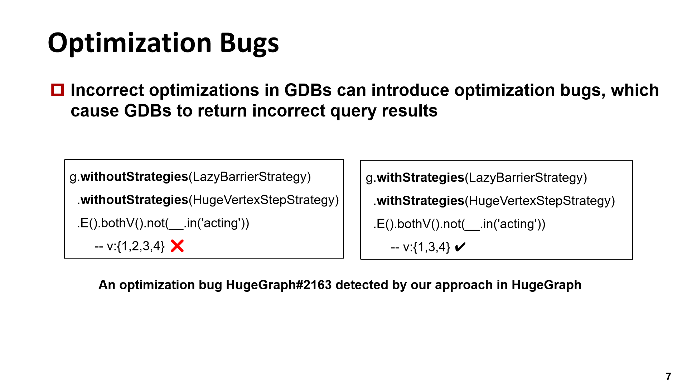
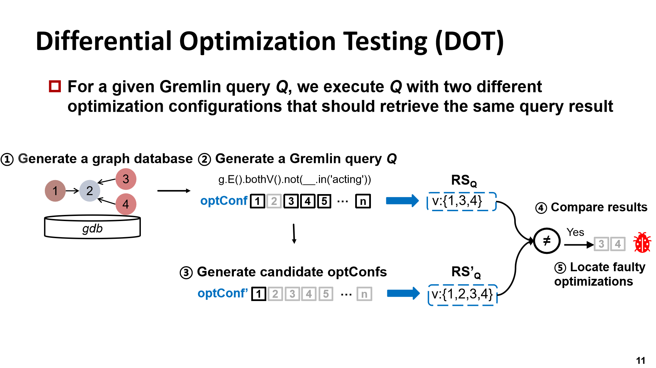
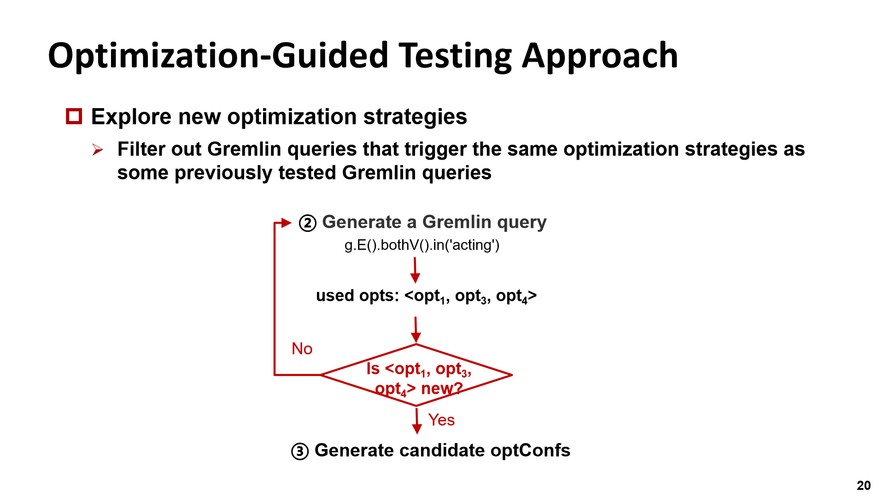
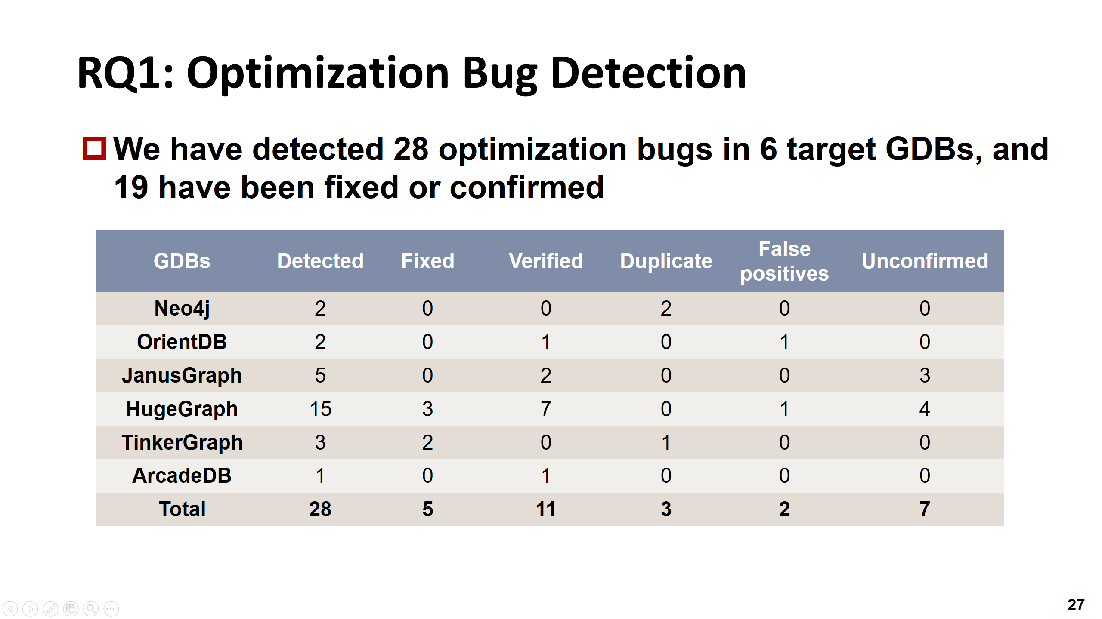
Conclusion

Slide 29

THANK YOU!

