Slide 1
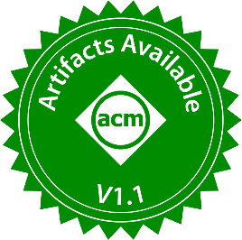


33rd International Symposium on Software Testing and Analysis (ISSTA 2024)
Testing Gremlin-Based Graph Database Systems via Query Disassembling
Yingying Zheng, Wensheng Dou, Lei Tang, Ziyu Cui, Yu Gao, Jiansen Song,
Liang Xu, Jiaxin Zhu, Wei Wang, Jun Wei, Hua Zhong, Tao Huang
Institute of Software Chinese Academy of Sciences
University of Chinese Academy of Sciences

Slide 2
Graph Data
Graph data consists of vertices and edges
Vertex properties
v₃
name: Nancy
age: 30
read
person
v₁
write
v₂
Vertex label
person
book
read
name: Alice
age: 26
title: Hello World
language: English
v₄
name: Bob
age: 21
person

Slide 3





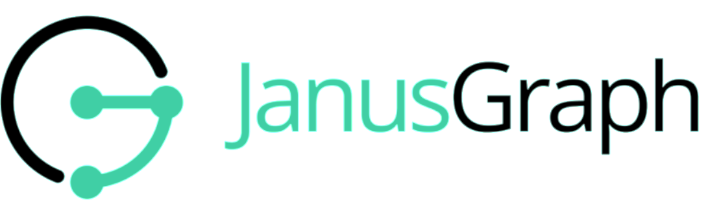
Graph Database Systems (GDBs)
GDBs support efficient storage and queries for graph data

Slide 4
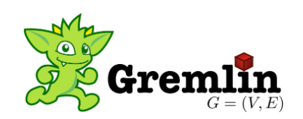


Graph Query Language
GDBs adopt graph query languages to define graph patterns, and utilize graph pattern matching to effectively retrieve graph data
About half of the GDBs in DB-Engines Ranking^{[1]} support Gremlin
[1] DB-Engines Ranking of Graph DBMS. Retrieved May 23, 2023 from https://db-engines.com/en/ranking/graph+dbms.

Slide 5
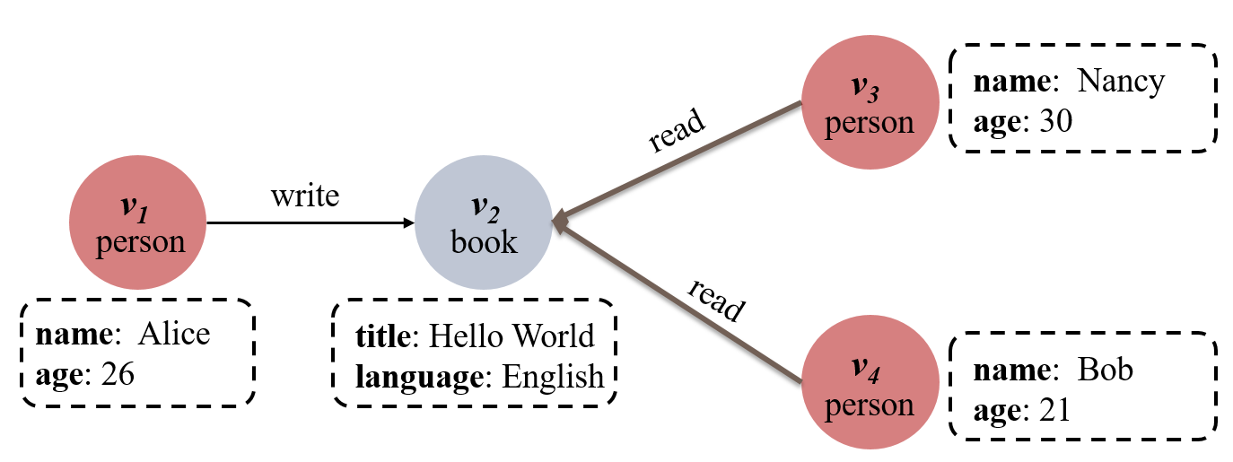
Gremlin Query Language
Gremlin allows developers to assemble a sequence of Gremlin APIs (graph traversals) to generate complex queries
v₁
v₂
v₃
v₄
Get all vertices
v₁
v₄
g.V()
.has(‘person’, ‘age’, lt(30))
.hasLabel(‘person’,’book’);
Keep persons whose age is less than 30
A property graph
Keep vertices that have a label person or book
v₁
v₄

Slide 6
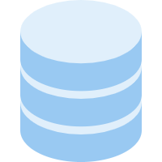
Gremlin Query Execution
GDBs adopt complex execution and optimization strategies
g.V().has(‘person’, ‘age’, lt(30)).hasLabel(‘person’,’book’);
g
V()
has(label1, key, value)
hasLabel(label1, label2)
Compiling stage
Optimization
g
V()
has(label1, key, value)
hasLabel(label1, label2)
Execution stage

Slide 7

Logic Bugs in GDBs
Incorrect implementations and optimizations of graph traversal assembly can introduce logic bugs
g.V().has(‘person’, ‘age’, lt(30)).hasLabel(‘person’,’book’);
g
V()
has(label1, key, value)
hasLabel(label1, label2)
Compiling stage
Optimization
Assembly-related logic bugs
g
V()
has(label1, key, value)
hasLabel(label1, label2)
Execution stage
v₁
v₂
v₃
v₄
-- ❌
-- ✔
v₁
v₄
A logic bug in ArcadeDB

Slide 8

Existing Bug Detection Techniques for GDBs
Differential Testing
Grand [1], Gremlin-based GDBs differential testing
GDsmith [2], Cypher-based GDBs differential testing
RD² [3], SPARQL-based GDBs differential testing
RS1
Gremlin Query
RS2
≠
RS3
Differential testing can only test common features in GDBs
[1] Yingying Zheng, et. al., Finding Bugs in Gremlin-Based Graph Database Systems via Randomized Differential Testing. ISSTA. 2022.
[2] Wei Lin, et. al., GDsmith: Detecting Bugs in Graph Database Engines. 2022.
[3] Rui Yang, et.al., Randomized Differential Testing of RDF Stores. ICSE Demo, 2023.

Slide 9
Existing Bug Detection Techniques for GDBs
Metamorphic Testing
GDBMeter [1] proposes a Predicate Partition approach
Gamera [2] designs three types of graph-aware metamorphic relations
GraphGenie [3] uses injective and surjective graph query transformation
Grev [4] rewrites a query into equivalent queries that trigger distinct query plans
DOT [5] tests GDBs using two different optimization configurations
They can detect different types of logic bugs, but cannot effectively reveal assembly-related logic bugs in GDBs
[1] Matteo Kamm, et.al., Testing Graph Database Engines via Query Partitioning. ISSTA 2023.
[2] Zeyang Zhuang, et. al., Testing Graph Database Systems via Graph-Aware Metamorphic Relations. VLDB 2024.
[3] Yuancheng Jiang, et. al., Detecting Logic Bugs in Graph Database Management Systems via Injective and Surjective Graph Query Transformation. ICSE 2024.
[4] Qiuyang Mang, et. al., Testing Graph Database Systems via Equivalent Query Rewriting. ICSE 2024.
[5] Yingying Zheng, et. al., Differential Optimization Testing of Gremlin-Based Graph Database Systems. ICST 2024.

Slide 10




Insight
For a complex Gremlin query Q, we can execute its graph traversals step by step and obtain the same query result as the original query Q
g.V()
.has(‘person’, ‘age’, lt(30))
.hasLabel(‘person’, ‘book’)
$${RS}_{Q}$$
v₁
v₂
v₃
v₄
Enable Optimization
$${RS}_{T_{1}}$$
g.V()
v₁
v₂
v₃
v₄
$${RS}_{T_{2}}$$
g.V( ).has(‘person’, ‘age’, lt(30))
v₁
v₂
v₃
v₄
v₁
v₄
Disable Optimization
$${RS}_{T_{3}}$$
g.V( ).hasLabel(‘person’, ‘book’)
v₁
v₄
v₁
v₄

Slide 11


Our Approach: Query Disassembling (QuDi)
① Randomly generate a graph database
② Randomly generate a Gremlin query Q
$${RS}_{Q}$$
v₃
g.V().has(‘person’, ‘age’, lt(30))
.hasLabel(‘person’, ‘book’)
v₁
v₂
v₃
v₄
v₁
v₂
v₄
③ Disassemble query Q
④ Compare
$${RS}_{T_{1}}$$
T₁
g.V()
v₁
v₂
v₃
v₄
≠
$${RS}_{T_{2}}$$
T₂
g.V( ).has(‘person’, ‘age’, lt(30))
v₁
v₂
v₃
v₄
v₁
v₄
$${RS}_{T_{3}}$$
T₃
g.V( ).hasLabel(‘person’, ‘book’)
v₁
v₄
v₁
v₄

Slide 12
Graph Database Generation
Randomly generate vertex types and edge types, and then randomly generate vertex and edge instances
person
book
Vertex Type
since: 2020
name: String
age: Integer
title: String
language: String
person
read
book
name: Nancy
age: 26
title: Hello world
since: Integer
Edge Type
person
read
book
Graph data

Slide 13
Gremlin Query Generation
Randomly generate valid Gremlin queries based on the Gremlin traversal model^{[1]}
Select a vertex type
Select a filter type
Select a filter type
1
V()
2
has(label, key, Predicate)
4
hasLable(label)
Vertex
Vertex
g
Map
Filter
entry
Filter
Label name, Vertex.propertyName
Predicate
Select a predicate type
3
lt (Value)
[1] Yingying Zheng, et. al., Finding Bugs in Gremlin-Based Graph Database Systems via Randomized Differential Testing. ISSTA. 2022.

Slide 14

Query Disassembling
Disassemble a Gremlin query into an atomic graph traversal sequence
g
V(). has(‘person’, ‘age’, lt(30)). hasLabel(‘person’,’book’)
Where to disassemble?
How to disassemble?

Slide 15
Atomic Graph Traversal
A group of Gremlin API calls, which return a result set with an output type of Vertex or Edge
Its sub-sequence of Gremlin API calls cannot return a result set with an output type of Vertex or Edge
g
V(). has(‘person’, ‘age’, lt(30)). hasLabel(‘person’,’book’)
lt(30) cannot return an output type of Vertex or Edge, and is only used for filtering conditions

Slide 16
Obtaining Atomic Graph Traversal
We disassemble an atomic graph traversal when it returns a result set with an output type of vertex or edge
g
V(). has(‘person’, ‘age’, lt(30)). hasLabel(‘person’,’book’)
outType: vertex
T₁
V()
outType: vertex
T₂
has(‘person’, ‘age’, lt(30))
outType: vertex
T₃
hasLabel(‘person’,’book’)

Slide 17


Execution of Atomic Graph Traversal
Retrieve the intermediate result set of its previous traversal $T_{i−1}$ as input
Construct a query to execute the current traversal $T_{i}$
$$T_{2}$$
$$T_{3}$$
has(‘person’, ‘age’, lt(30))
v₁
v₄
hasLabel(‘person’,’book’)
v₁
v₄
v₁
v₄
① Retrieve
② Construct a query
③ Execute

Slide 18
1. Parameter Passing Strategy (ParaPass)
Store the intermediate query result to an ID list $idList$
Retrieve $idList$ as a parameter of the Gremlin API V() or E()
$$T_{2}$$
$$T_{3}$$
has(‘person’, ‘age’, lt(30))
v₁
v₄
hasLabel(‘person’,’book’)
v₁
v₄
idList = {v1, v4}
g.V( ).hasLabel(‘person’, ‘book’)
v₁
v₄
Pros: it can effectively disable complex query assembly and optimizations
Cons: it is limited by the size of the parameters in API V() and E()

Slide 19


2. Temporary ID Table Strategy (TempID)
Store each ID of the intermediate query result to a vertex
$$T_{2}$$
$$T_{3}$$
has(‘person’, ‘age’, lt(30))
v₁
v₄
hasLabel(‘person’,’book’)
Retrieve vertices whose label is IDs
g.addV(‘IDs’).property(‘id’, v1);
g.addV(‘IDs’).property(‘id’, v4);
g.V().hasLabel(‘IDs’).values(‘id’).as(‘vList’)
.V().as(‘V’)
.id().as(‘V_ID’)
.where(‘vList’, P.eq(‘V_ID’)).select(‘V’)
Retrieve vertices whose id is in the vertex list {v1, v4}
$${RS}_{T_{3}}$$
Execute the third graph traversal $T_{3}$
.hasLabel(‘person’, ‘book’)
v₁
v₄
Pros: it can be commonly used in other database systems
Cons: we must spend more time to test target GDBs

Slide 20
3. Barrier Strategy (Barrier)
Append Gremlin API barrier() after atomic graph traversals
g
V()
has(‘person’, ‘age’, lt(30))
hasLabel(‘person’,’book’)
g
V()
barrier()
has(‘person’, ‘age’, lt(30))
barrier()
hasLabel(‘person’,’book’)
Turn the lazy pipeline of a Gremlin query into a bulk-synchronous pipeline
Pros: it can test bulk operations and optimizations of Gremlin
Cons: it cannot disable more complex query assembly and optimizations

Slide 21
Evaluation
Target GDBs
Select 6 widely-used graph database systems
GDB | Rank | GitHub Star | Initial Release
Neo4j | 1 | 11.4k | 2007
OrientDB | 5 | 4.6k | 2010
JanusGraph | 7 | 4.8k | 2017
HugeGraph | 24 | 2.3k | 2018
TinkerGraph | 25 | 1.8k | 2009
ArcadeDB | 28 | 309 | 2021

Slide 22
Research Questions
RQ1 (Bug detection)
How effective is QuDi in detecting logic bugs in real-world GDBs?
RQ2 (Comparison of execution strategies)
How do the proposed three execution strategies in QuDi perform in detecting logic bugs?
RQ3 (Comparison with existing approaches)
How does QuDi compare with the existing state-of-the-art approaches in bug detection capability?

Slide 23
RQ1: Bug Detection
QuDi has detected 25 logic bugs in 6 graph database systems.
GDB | Detected | New | Duplicate | False Positive | Fixed
Neo4j | 0 | 0 | 0 | 0 | 0
OrientDB | 3 | 1 | 1 | 1 | 1
JanusGraph | 3 | 2 | 0 | 0 | 0
HugeGraph | 16 | 6 | 4 | 1 | 4
TinkerGraph | 1 | 0 | 1 | 0 | 1
ArcadeDB | 2 | 1 | 1 | 0 | 2
Total | 25 | 10 | 7 | 2 | 8

Slide 24
RQ1: Bug Detection
QuDi has detected 25 logic bugs in 6 graph database systems.
GDB | Detected | New | Duplicate | False Positive | Fixed
Neo4j | 0 | 0 | 0 | 0 | 0
OrientDB | 3 | 1 | 1 | 1 | 1
JanusGraph | 3 | 2 | 0 | 0 | 0
HugeGraph | 16 | 6 | 4 | 1 | 4
TinkerGraph | 1 | 0 | 1 | 0 | 1
ArcadeDB | 2 | 1 | 1 | 0 | 2
Total | 25 | 10 | 7 | 2 | 8

Slide 25
RQ1: Bug Detection
QuDi can detect bugs caused by incorrect implementations and optimizations of atomic graph traversal assembly
GDB | Confirmed | Atomic graph traversal assembly | Single atomic graph traversal
Neo4j | 0 | 0 | 0
OrientDB | 2 | 0 | 2
JanusGraph | 2 | 0 | 2
HugeGraph | 10 | 8 | 2
TinkerGraph | 1 | 1 | 0
ArcadeDB | 2 | 2 | 0
Total | 17 | 11 | 6

Slide 26
RQ1: Bug Detection
QuDi can detect bugs caused by incorrect implementations of single atomic graph traversals
GDB | Confirmed | Atomic graph traversal assembly | Single atomic graph traversal
Neo4j | 0 | 0 | 0
OrientDB | 2 | 0 | 2
JanusGraph | 2 | 0 | 2
HugeGraph | 10 | 8 | 2
TinkerGraph | 1 | 1 | 0
ArcadeDB | 2 | 2 | 0
Total | 17 | 11 | 6

Slide 27
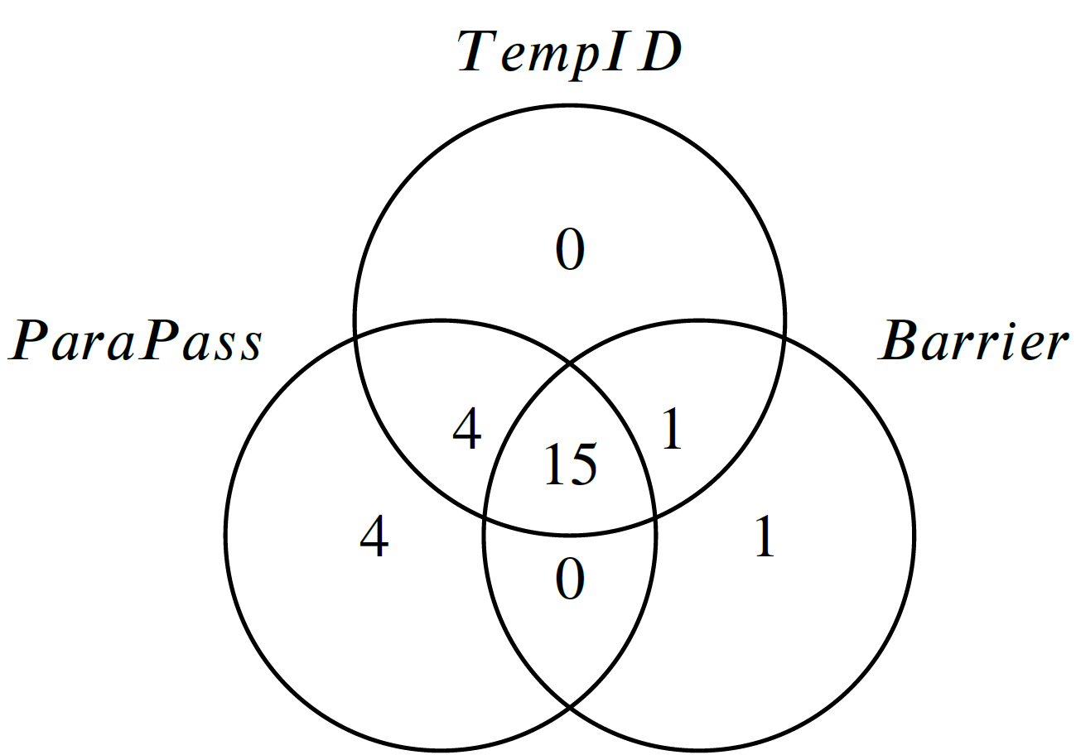
RQ2: Comparison of Execution Strategies
These three execution strategies can complement each other
ParaPass (23) and TempID (20) can find more bugs than Barrier (17)
ParaPass and Barrier can find four and one new bugs that other two execution strategies cannot detect, respectively
ParaPass: Parameter passing strategy
TempID: Temporary ID table strategy
Barrier: Barrier strategy

Slide 28
RQ3: Comparison with Existing Approaches
QuDi can find new bugs that Grand and GDBMeter cannot detect
Grand (i.e., differential testing) cannot detect 6 logic bugs，and reports 2 false positives
GDB | QuDi | Grand | GDBMeter
Neo4j | 0 | 0 | 0
OrientDB | 3 | 3 | 0
JanusGraph | 3 | 2 | 0
HugeGraph | 16 | 11 | 6
TinkerGraph | 1 | 1 | 0
ArcadeDB | 2 | 2 | 0
Total | 25 | 19 | 6

Slide 29
RQ3: Comparison with Existing Approaches
QuDi can find new bugs that Grand and GDBMeter cannot detect
GDBMeter (i.e., query partitioning) cannot detect 19 logic bugs
GDB | QuDi | Grand | GDBMeter
Neo4j | 0 | 0 | 0
OrientDB | 3 | 3 | 0
JanusGraph | 3 | 2 | 0
HugeGraph | 16 | 11 | 6
TinkerGraph | 1 | 1 | 0
ArcadeDB | 2 | 2 | 0
Total | 25 | 19 | 6

Slide 30
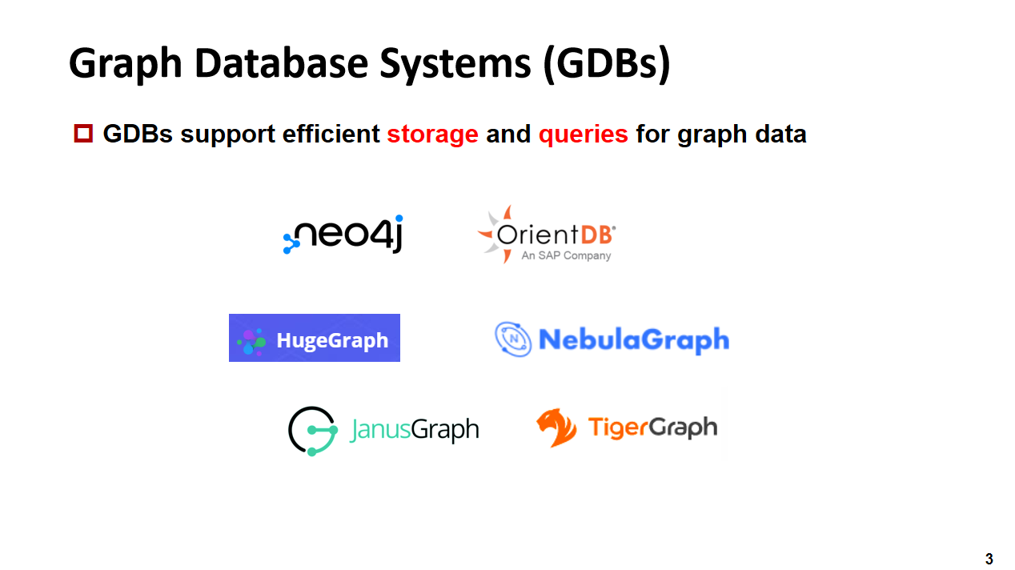
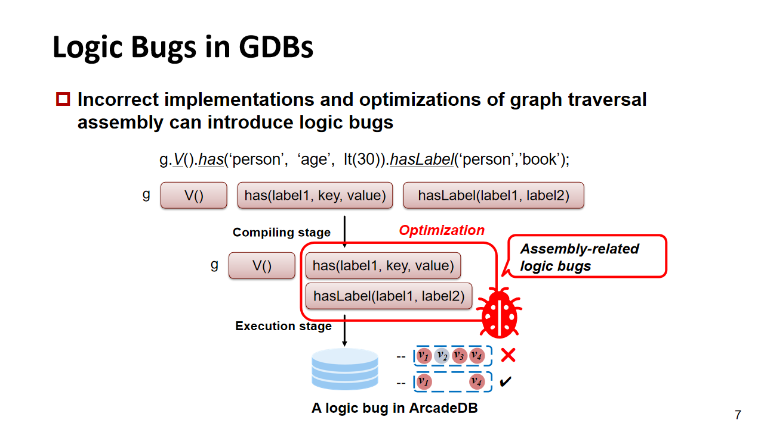
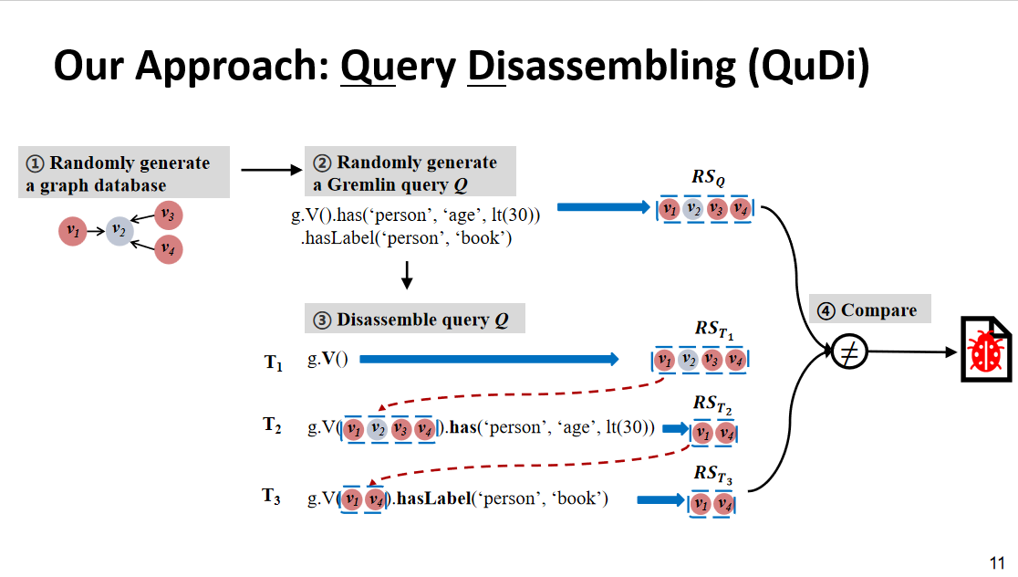
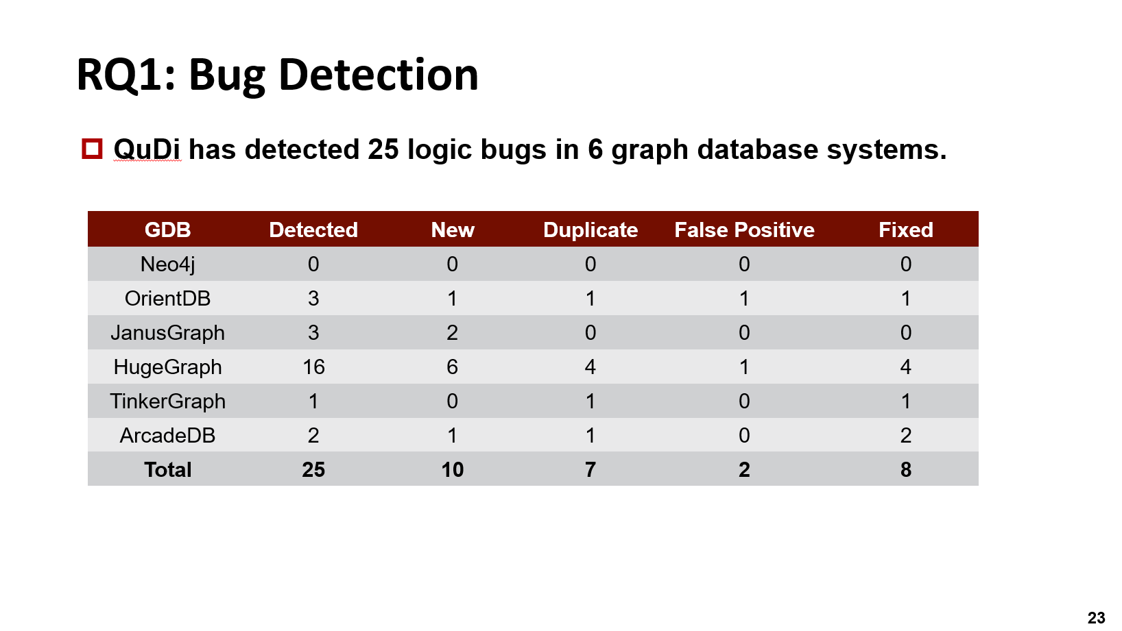

Conclusion
https://doi.org/10.5281/zenodo.12771889

