Slide 1


41th International Conference on Data Engineering (ICDE 2025)
Proving Cypher Query Equivalence
Lei Tang, Wensheng Dou, Yingying Zheng, Lijie Xu,
Wei Wang, Jun Wei, Tao Huang
Institute of Software Chinese Academy of Sciences
University of Chinese Academy of Sciences

Slide 2









Graph Database Systems (GDBs)
GDBs support efficient storage and queries for graph data

Slide 3
Property Graph Model
Many GDBs use property graph model to store graph data, which consists of labeled nodes and relationships with properties
Property
n₃
name: Jack
r₂
Read
Person
n₁
r₁
Write
n₂
Label
Person
Book
r₃
Read
name: J. L. Rowling
title: Harry Potter
n₄
Person
name: Alice

Slide 4

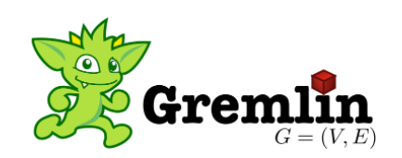
Graph Query Language
Graph query languages are designed for efficiently querying and updating property graphs
GDB | DB-Engines ranking [1]
Neo4j | 1
Microsoft Azure Cosmos DB | 2
Aerospike | 3
ArangoDB | 4
Virtuoso | 5
OrientDB | 6
GraphDB | 7
Memgraph | 8
Amazon Neptune | 9
JanusGraph | 10
Cypher
GQL
[1] DB-Engines Ranking of Graph DBMS. Retrieved May 23, 2023 from https://db-engines.com/en/ranking/graph+dbms.

Slide 5
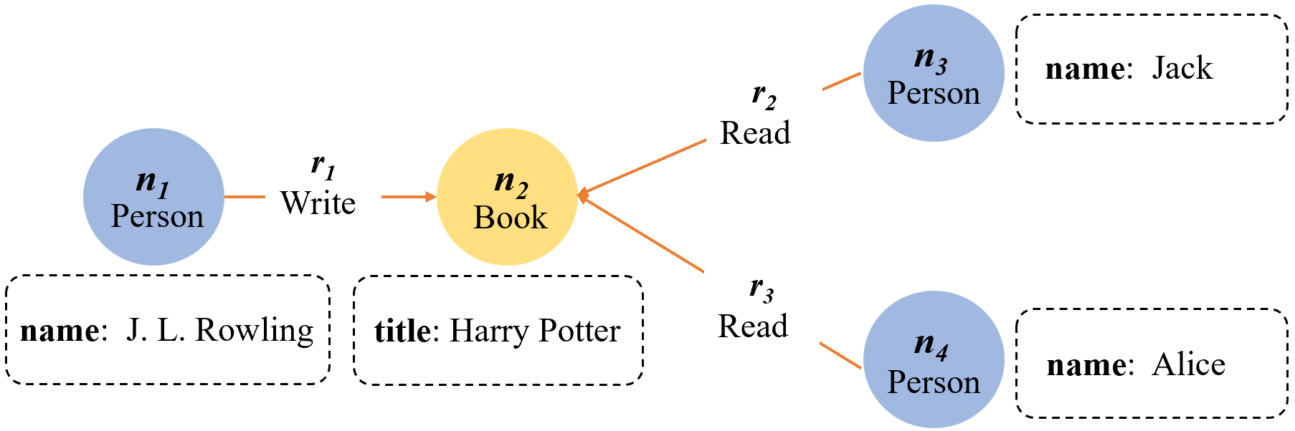
Cypher Query Language
Cypher is a declarative graph query language
Graph pattern
MATCH (writer :Person) -[ :Write]-> (book :Book) <-[ :Read]- (reader)
Predicate
book.name | reader.name
Harry Potter | Jack
Harry Potter | Alice
WHERE book.name = 'Harry Potter'
Query result
RETURN book.name, reader.name

Slide 6
Query Equivalence
Queries always return the same results on any database instance
Equal
MATCH (p :Person)
WHERE p.name = 'Alice'
RETURN p.age
MATCH (p :Person {name: 'Alice' })
RETURN p.age
The two queries filter nodes in different locations
Query equivalence can be used for query deduplication, query optimization, etc.

Slide 7
Existing SQL Query Equivalence Provers
Syntax-based approaches
UDP [1] and SPES [2] normalize SQL queries into canonical forms, and check if they are isomorphic
SELECT SUM (c1) FROM t1, t2
SUM
Equal
SUM
SELECT SUM (c1) FROM t2, t1
SELECT
Equal
SELECT
t1
t2
t2
t1
Equal
Equal
[1] S. Chu, et al., Axiomatic foundations and algorithms for deciding semantic equivalences of SQL queries. VLDB 2018.
[2] Q. Zhou, et al., Spes: A symbolic approach to proving query equivalence under bag semantics. ICDE 2022.

Slide 8
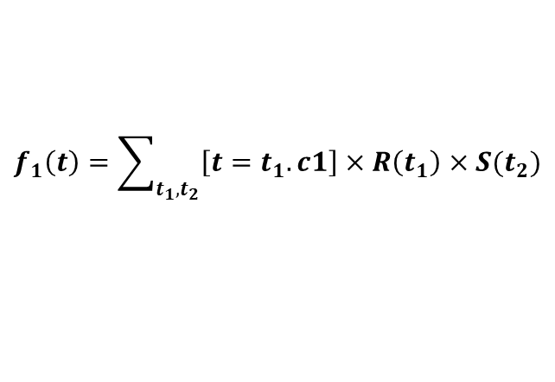
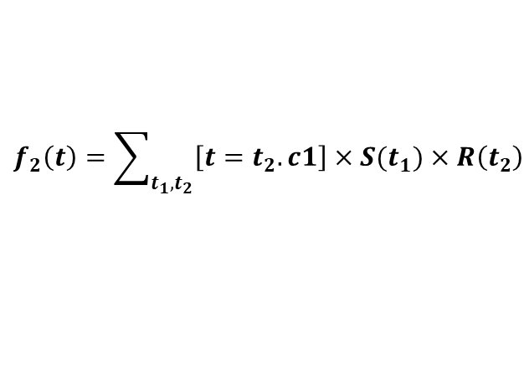

Existing SQL Query Equivalence Provers
Semantics-based approaches
SQLSolver [1] and QED [2] model SQL queries as algebraic expressions, and use SMT solvers to prove their equivalence
Solved by SMT solvers
SELECT R.c1
FROM R, S
$$f_{1}\left(t\right)=\sum_{t_{1},t_{2}}{\left[t=t_{1}. c1\right]×R\left(t_{1}\right)×S(t_{2})}$$
$$f_{1}(t)=f_{2}(t) ?$$
SELECT R.c1
FROM S, R
$$f_{2}\left(t\right)=\sum_{t_{1},t_{2}}{\left[t=t_{2}.c1\right]×S(t_{1})×R\left(t_{2}\right)}$$
These provers are designed to model SQL queries
[1] H. Ding, et al., Proving query equivalence using linear integer arithmetic. SIGMOD 2023.
[2] S. Wang, et al., Qed: A powerful query equivalence decider for SQL. VLDB 2024.

Slide 9
Existing Approaches cannot Model Property Graphs
Nodes and relationships in property graphs cannot be modeled as tabular data
Name | Age | Job
Jack | 20 | Student
Alice | 26 | Teacher
Rowling | 50 | Writer
Relational model
Property graph model

Slide 10
Existing Approaches cannot Model Cypher Queries
Cypher significantly differs from SQL in both syntaxes and semantics
SQL query
Cypher query
SELECT p FROM ( SELECT Person.age AS p
FROM Person JOIN Book ON Person.id =
Book.id WHERE Person.name = 'Alice' ) AS sub
MATCH (p :Person) -[]-> (b)
WHERE p.name = 'Alice'
RETURN p.age
Name | Age | Job
Jack | 20 | Student
Alice | 26 | Teacher
Rowling | 50 | Writer
Relational calculus
Graph pattern matching

Slide 11
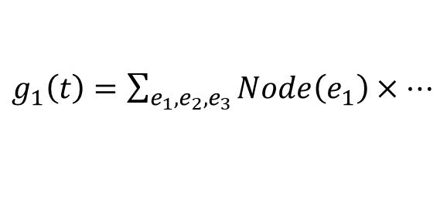
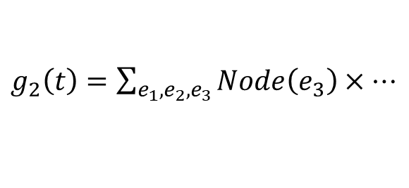

Our Approach: GraphQE
GraphQE models Cypher queries as graph-oriented algebraic expressions, i.e., G-expressions
GraphQE solves the equivalence of G-expressions using SMT solvers
MATCH () --> (n) RETURN n
$g_{1}\left(t\right)=\sum_{e_{1},e_{2},e_{3}}{Node\left(e_{1}\right)×…}$
$$∃t. g_{1}\left(t\right)≠g_{2}\left(t\right)?$$
MATCH (n) <-- () RETURN n
$g_{2}\left(t\right)=\sum_{e_{1},e_{2},e_{3}}{Node\left(e_{3}\right)×…}$
Two Cypher queries
G-expressions
SMT solvers

Slide 12

Multiplicity
$g\left(t\right)$ returns a tuple $t$’s multiplicity in the query result
MATCH (b :Book) <-[ :Read]- (p :Person)
RETURN b.name
Result
b.name
Harry Potter
Harry Potter
$$g\left(Harry Potter\right)=2$$

Slide 13
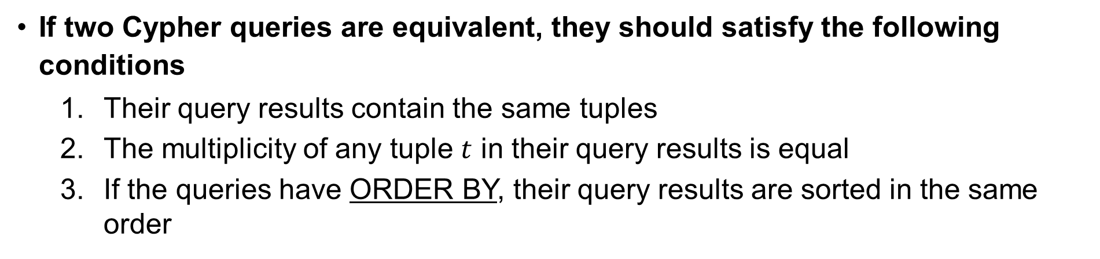
Cypher Query Equivalence
If two Cypher queries are equivalent, they should satisfy the following conditions
Their query results contain the same tuples
The multiplicity of any tuple $t$ in their query results is equal
If the queries have ORDER BY, their query results are sorted in the same order
MATCH (reader :Person) -[ :Read]-> (book :Book)
WHERE book.name = 'Harry Potter'
RETURN reader.name, book.name
MATCH (reader :Person) -[ :Read]-> (book :Book {name: 'Harry Potter'})
RETURN reader.name, book.name
These two queries return the same query results for any property graph

Slide 14














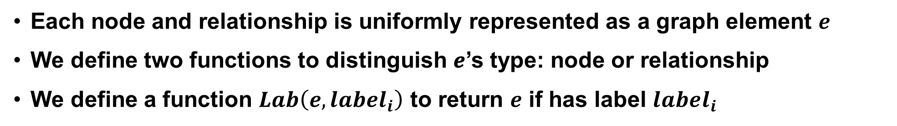
Model Property Graph
Each node and relationship is uniformly represented as a graph element $e$
We define two functions to distinguish 𝒆’s type: node or relationship
We define a function $Lab\left(e, label_{i}\right)$ to return $e$ if has label $label_{i}$
$$1 if e is a node$$
$$1$$
$$if e has label_{i}$$
$$Node\left(e\right)=$$
$$Lab\left(e, label_{i}\right)=$$
$$0 otherwise$$
$$0$$
$$otherwise$$
$$1 if e is a relationship$$
e₁
e₂
Read
e₃
$$Rel\left(e\right)=$$
Person
Book
$$0 otherwise$$
$$Node\left(e_{1}\right)=1$$
$$Rel\left(e_{2}\right)=1$$
$$Lab\left(e_{3}, Book\right)=1$$

Slide 15








Model Property Graph
We define two functions ($out\left(e\right)$ and $in(e)$) to model the source and target nodes of a relationship $e$
$$out(e)$$
$$e^{′}s outgoing node$$
$$in(e)$$
$$e^{′}s incoming node$$
e₁
e₂
Read
e₃
Person
Book
$$out\left(e_{2}\right)=e_{1}$$
$$Rel\left(e_{2}\right)=1$$
$$in(e_{2})=e_{3}$$

Slide 16




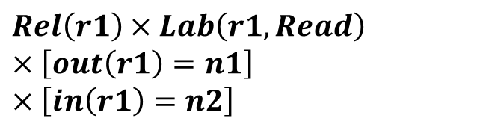
Model Cypher Query
We model a Cypher graph pattern by modeling its node and relationship patterns
Relationship pattern
Node pattern
Node pattern
(n1 :Person) -[ r1 :Read ]-> (n2 :Book)
$$Node\left(n1\right)×Lab\left(n1, Person\right)$$
$$Rel\left(r1\right)×Lab\left(r1, Read\right)$$
$$×\left[out\left(r1\right)=n1\right]$$
$$×\left[in\left(r1\right)=n2\right]$$
$Node\left(n2\right)×$ $Lab\left(n2, Book\right)$
$$×$$
$$×$$

Slide 17
Model Cypher Query
Summation operator ($Σ$) is used for calculating the number of times a graph pattern matches
MATCH (n1 :Person) -[ r1 :Read ]-> (n2 :Book)
$$\sum_{n1,r1,n2}{\begin{aligned}Node\left(n1\right)×Lab\left(n1, Person\right)×Node\left(n2\right)× Lab\left(n2, Book\right) \\ ×Rel\left(r1\right)×Lab\left(r1, Read\right)×\left[out\left(r1\right)=n1\right]×\left[in\left(r1\right)=n2\right]\end{aligned}}$$
Enumerate all property graph elements n1, r1, and n2, and calculate the number of times the graph pattern matches

Slide 18


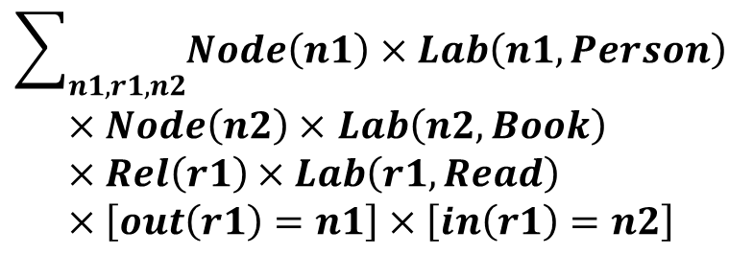

Model Cypher Predicates
The operator $[σ]$ transforms Boolean expressions $σ$ into 1 for true and 0 for false
1
If $n2$.name equals 'Harry Potter'
$$[n2.name=′Harry Potter′]$$
0
otherwise
MATCH (n1 :Person) -[ r1 : Read ]-> (n2 :Book)
$$\sum_{n1,r1,n2}{Node\left(n1\right)×Lab\left(n1, Person\right)}$$
$×Node\left(n2\right)×$ $Lab\left(n2, Book\right)$
$$×Rel\left(r1\right)×Lab\left(r1, Read\right)$$
$$×\left[out\left(r1\right)=n1\right]×\left[in\left(r1\right)=n2\right]$$
WHERE n2.name = 'Harry Potter'
$$×[n2.name=′Harry Potter′]$$

Slide 19

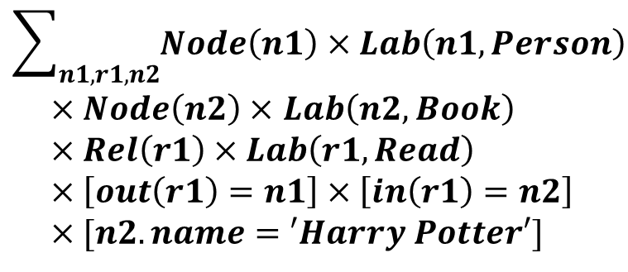
Model Cypher Results
We use ${t.c}_{i}$ to denote the $i$-th column of any tuple $t$ in the query result
MATCH (n1 :Person) -[ r1 : Read ]-> (n2 :Book)
$$\sum_{n1,r1,n2}{Node\left(n1\right)×Lab\left(n1, Person\right)}$$
$×Node\left(n2\right)×$ $Lab\left(n2, Book\right)$
$$×Rel\left(r1\right)×Lab\left(r1, Read\right)$$
$$×\left[out\left(r1\right)=n1\right]×\left[in\left(r1\right)=n2\right]$$
$$×[n2.name=′Harry Potter′]$$
WHERE n2.name = 'Harry Potter'
RETURN n1.name, n2.name
$$×\left[t.c1=n1.name\right]×[t.c2=n2.name]$$
c1 | c2
Alice | Harry Potter
Jack | Harry Potter
First column
Second column
Query result

Slide 20
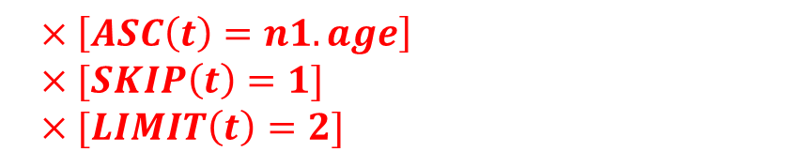
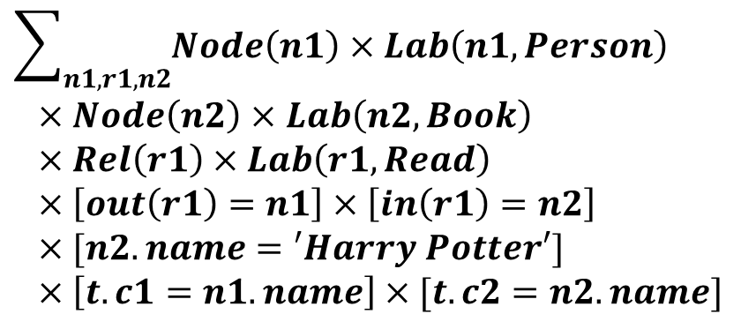
Model Cypher Sorting and Truncation
We cannot directly model ORDER BY, LIMIT and SKIP
We treat ORDER BY, LIMIT and SKIP as black-box functions without modeling their concrete semantics
MATCH (n1 :Person) -[ r1 :Read ]-> (n2 :Book)
$$\sum_{n1,r1,n2}{Node\left(n1\right)×Lab\left(n1, Person\right)}$$
$×Node\left(n2\right)×$ $Lab\left(n2, Book\right)$
$$×Rel\left(r1\right)×Lab\left(r1, Read\right)$$
$$×\left[out\left(r1\right)=n1\right]×\left[in\left(r1\right)=n2\right]$$
$$×[n2.name=′Harry Potter′]$$
$$×\left[t.c1=n1.name\right]×[t.c2=n2.name]$$
WHERE n2.name = 'Harry Potter'
RETURN n1.name, n2.name
ORDER BY n1.age ASC
SKIP 1
LIMIT 2
$$×\left[ASC\left(t\right)=n1.age\right]$$
$$×[SKIP\left(t\right)=1]$$
$$×[LIMIT\left(t\right)=2]$$

Slide 21
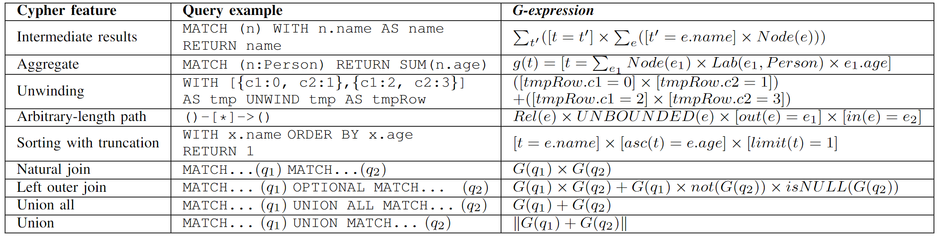
Model More Cypher Features
GraphQE supports most common Cypher features and some complex features
More details can be found in our paper

Slide 22

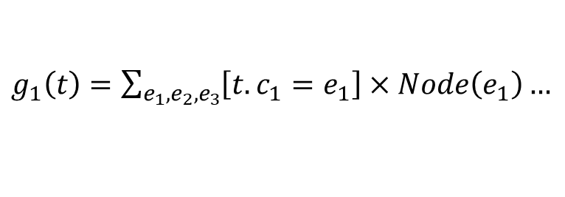
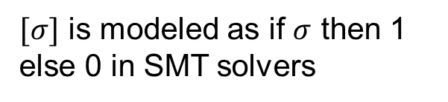
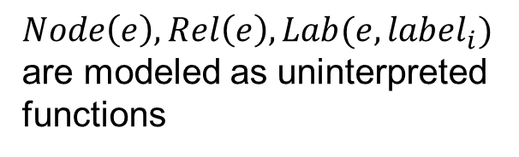
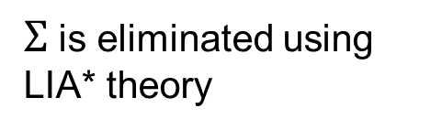
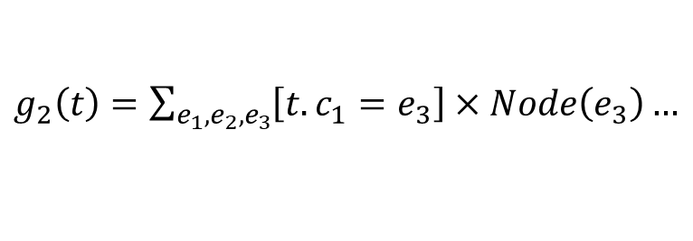
Prove G-expression Equivalence
GraphQE uses SMT solvers to prove the equivalence of G-expressions
$Σ$ is eliminated using LIA* theory
$g_{1}\left(t\right)=\sum_{e_{1},e_{2},e_{3}}{\left[t.c_{1}=e_{1}\right]×Node\left(e_{1}\right)…}$
$Node\left(e\right), Rel\left(e\right), Lab(e,label_{i})$ are modeled as uninterpreted functions
${∃t. g}_{1}\left(t\right)≠g_{2}(t)$?
$g_{2}\left(t\right)=\sum_{e_{1},e_{2},e_{3}}{\left[t.c_{1}=e_{3}\right]×Node\left(e_{3}\right)…}$
G-expressions
SMT solvers
$[σ]$ is modeled as if $σ$ then 1 else 0 in SMT solvers
[1] H. Ding, et al., Proving query equivalence using linear integer arithmetic. SIGMOD 2023.

Slide 23
Evaluation
RQ1 (Effectiveness)
How effective is GraphQE in proving Cypher query equivalence?
RQ2 (Performance)
How fast is GraphQE in proving Cypher query equivalence?

Slide 24
Dataset Construction
Translate SQL equivalent query dataset Calcite [1]
We use the translation principles of Cytosm [1], which is an automated SQL-Cypher translator
We obtain 80 pairs of equivalent Cypher queries
SQL query pairs cannot be translated into Cypher
Untranslated cases (152 pairs)
SQL query pairs are translated into the same Cypher query
[1] “Calcite test suite,” 2021. Available: https://github.com/georgia-tech-db/Qizhou2020spes/blob/main/testData
[2] B. A. Steer, et al,. Cytosm: Declarative property graph queries without datamigration. GRADES, 2017.

Slide 25
Dataset Construction
Rewrite real-world Cypher queries using equivalent transformation rules
Rename variables
Reverse path direction
Splitte graph pattern
Query source | Description | Cypher queries | Equivalent Cypher query pairs
LDBC [1] | GDB benchmark | 7 | 13
Cypher-for-Gremlin [2] | Cypher query plugin | 14 | 23
Graphdb-benchmarks [3] | GDB benchmark | 15 | 32
Our dataset contains 148 (80+68) pairs of equivalent Cypher queries
[1] O. Erling, et al,. The LDBC social network benchmark:Interactive workload. SIGMOD, 2015.
[2] M. Brandizi, et al,. Getting the best of linkeddata and property graphs: Rdf2neo and the KnetMiner use case. SWAT4LS, 2018.
[3] https://github.com/opencypher/cypher-for-gremlin, 2024.

Slide 26
RQ1: Effectiveness
GraphQE has proven 138 out of 148 (93%) pairs of equivalent Cypher queries
Project | Query pairs | Proven
Calcite-Cypher | 80 | 73
LDBC | 13 | 13
Cypher-for-Gremlin | 23 | 23
Graphdb-benchmarks | 32 | 29
Total | 148 | 138

Slide 27
RQ1: Effectiveness
GraphQE has proven 138 out of 148 (93%) pairs of equivalent Cypher queries
查询来源 | 等价查询对总数 | 成功证明数
Calcite-Cypher | 80 | 73
LDBC | 13 | 13
Cypher-for-Gremlin | 23 | 23
Graphdb-benchmarks | 32 | 29
Total | 148 | 138

Slide 28
RQ1: Effectiveness
GraphQE has proven 138 out of 148 (93%) pairs of equivalent Cypher queries
Project | Query pairs | Proven
Calcite-Cypher | 80 | 73
LDBC | 13 | 13
Cypher-for-Gremlin | 23 | 23
Graphdb-benchmarks | 32 | 29
Total | 148 | 138

Slide 29
Unproven Cases
Unsupported built-in functions
MATCH (n) WHERE n.license =~ "^[a-z][a-z][a-z]$" RETURN n
MATCH (n) WHERE n.license =~ "^[a-z]{3}$" RETURN n
Different regular expressions match the same string values
Ignore concrete semantics for ORDER BY
MATCH (n) WITH n.num ORDER BY n.num ASC RETURN n.num LIMIT 1
MATCH (n) RETURN MIN(n.num)
The MIN aggregation is equivalent to sorting the result in ascending order and taking the first tuple

Slide 30
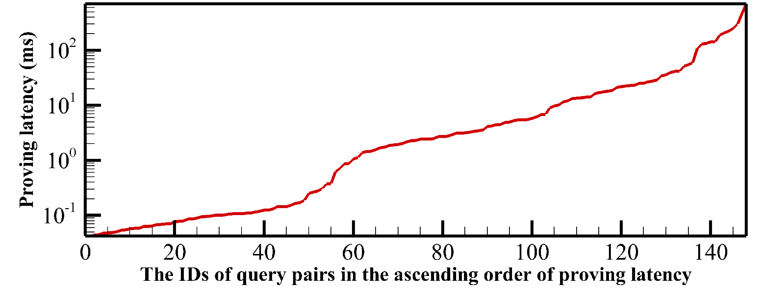
RQ2: Performance
The average Cypher equivalence proving latency is 38 ms

Slide 31
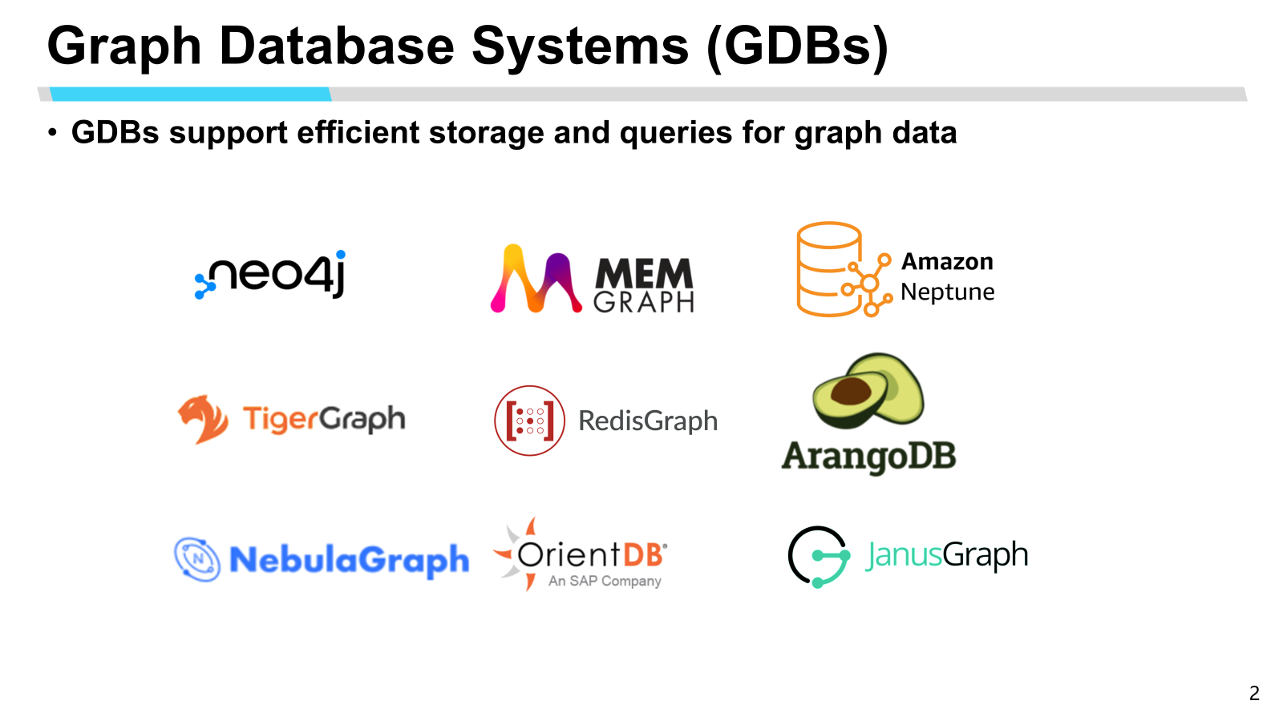
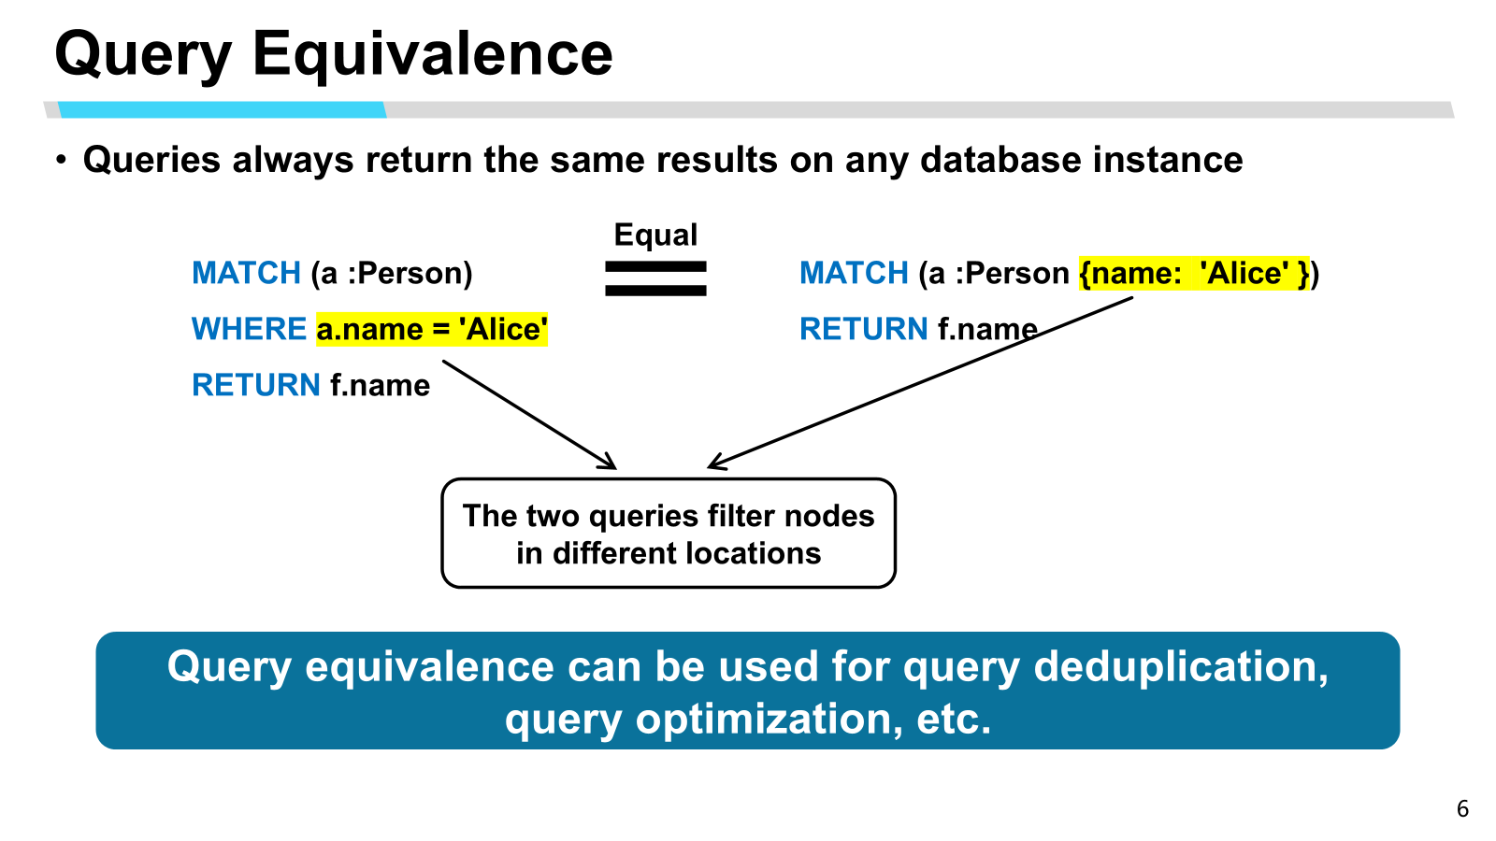
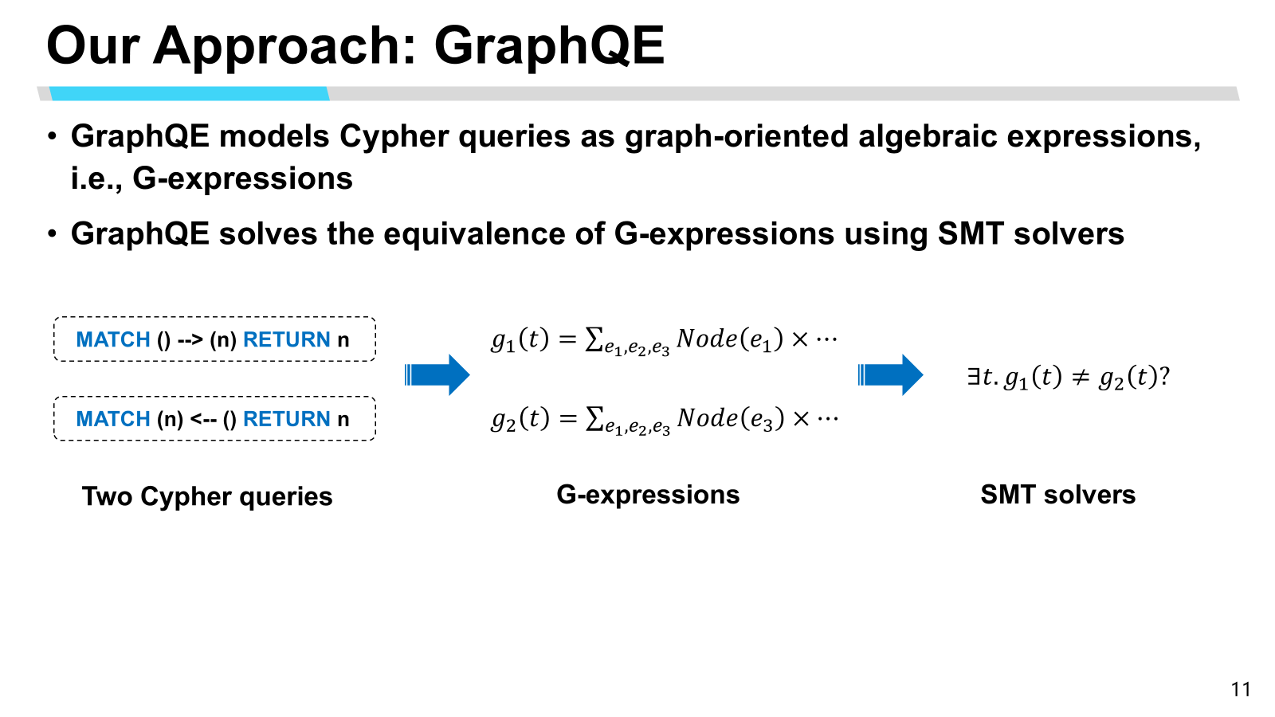
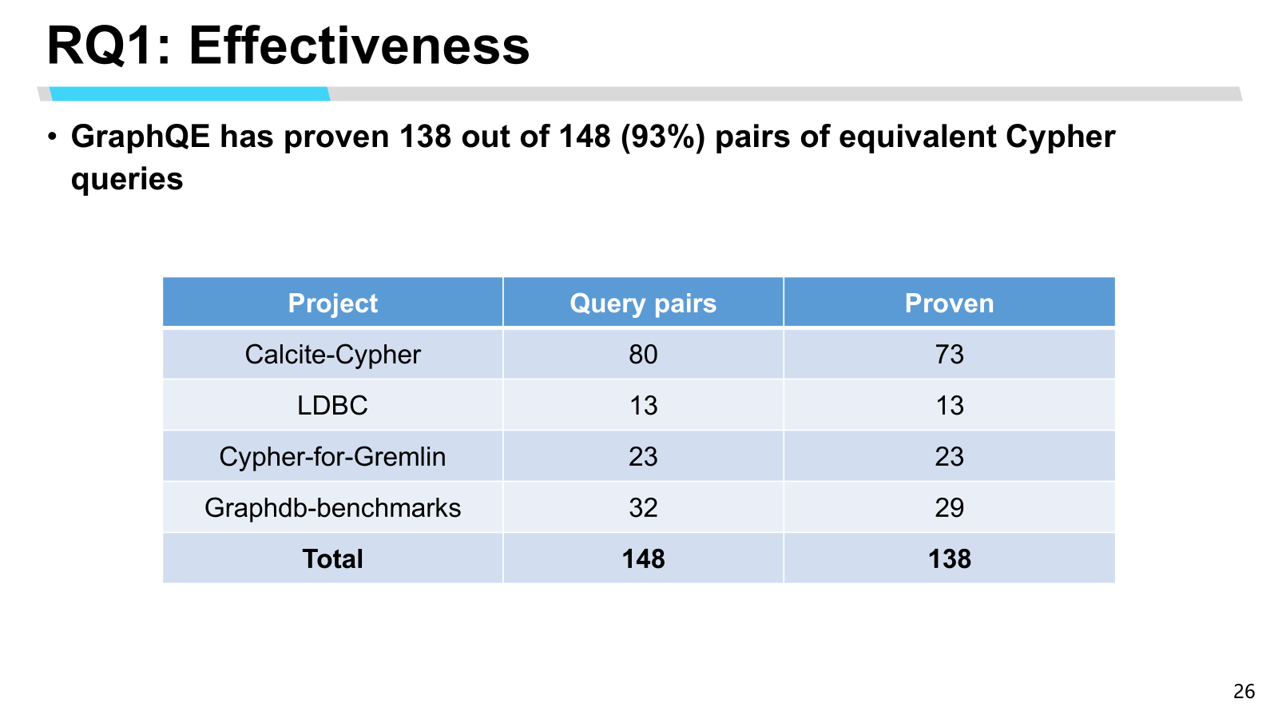

Conclusion
https://github.com/choeoe/GraphQe

