Slide 1


47th IEEE/ACM International Conference on Software Engineering
Evaluating Garbage Collection Performance Across Managed Language Runtimes
Yicheng Wang, Wensheng Dou, Yu Liang, Yi Wang,
Wei Wang, Jun Wei, Tao Huang
Institute of Software
Chinese Academy of Sciences
University of Chinese
Academy of Sciences

Slide 2
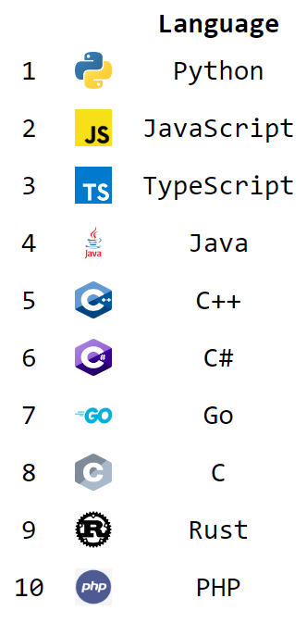
2
Managed Language Runtimes
Manage memory leveraging garbage collection (GC)
C++:
Object* newObj = new Object();
Object[]* newArray = new Object[5];
delete newObj;
delete[] newArray;
7 of top 10 languages rely on garbage collection ^{[1]}
Java:
Object newObj = new Object();
Object[] newArray = new Object[5];
[1] https://tjpalmer.github.io/languish/

Slide 3
2
GC Implementations
Identify live objects, reclaim dead objects
Heap
Memory
Parallel GC
CMS GC
G1 GC
GC
Application
Thread
Parallel GC
Thread
Concurrent GC
Thread
More than 50 languages have their own GC implementations ^{[1]}
[1] Jones, Hosking, et al. The garbage collection handbook: the art of automatic memory management.

Slide 4
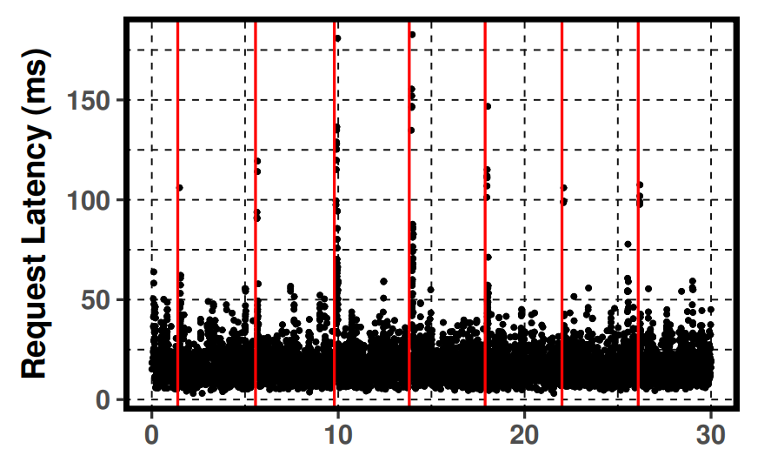
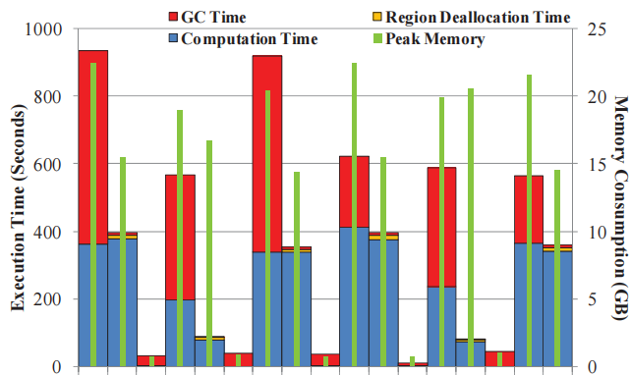
2
GC Performance Overhead
GC pauses and concurrent GC activities degrade application performance
GC pauses cause long tail latency^{[1]}
GC activities decrease application throughput^{[2]}
[1] Wu, Mingyu, et al. Platinum: A CPU-Efficient Concurrent Garbage Collector for Tail-Reduction of Interactive Services. ATC 2020.
[2] Nguyen, Khanh, et al. Yak: A High-Performance Big-Data-Friendly Garbage Collector. OSDI 2016.

Slide 5

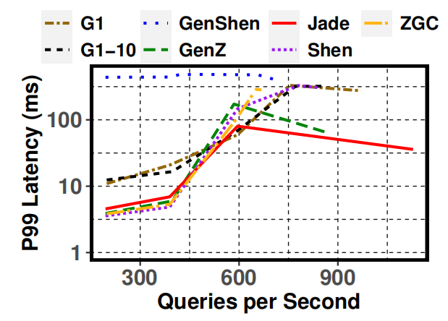


2
Evaluate GC in Individual Runtimes
Construct benchmarks with typical applications
Compare GC implementations in individual language runtimes^{[1,2,3]}
[1] Zhao, Wenyu, et al. Low-latency, high-throughput garbage collection.PLDI 2022.
[2] Liang Mao, et al. Jade: A High-throughput Concurrent Copying Garbage Collector. EuroSys 2024.
[3] Wang, Chenxi, et al. MemLiner: Lining up Tracing and Application for a Far-Memory-Friendly Runtime. OSDI 2022.

Slide 6








2
Evaluate GCs across Different Runtimes
Benchmarks in specific language cannot be executed in other runtimes
Written in Java
Written in Go
Standard Go
Tiny Go

Slide 7

2
Evaluate GCs across Different Runtimes
Implement GCs in the same runtime
GC have high migration costs^{[1]}
Written in Java
Implement Go GC
in Java runtime
Written in Go
Standard Go
Tiny Go
[1] Zhao, Wenyu, et al. Deconstructing the garbage-first collector. VEE 2020.

Slide 8



2
Evaluate GCs across Different Runtimes
Implement the same functions in different languages^{[1,2]}
Java Heap
java.util.HashMap:
8 fields, 64 bytes
$$o_{1}$$
$$o_{2}$$
$$o_{3}$$
$$o_{4}$$
$$o_{5}$$
$$o_{6}$$
.NET Heap
Inconsistent
GC Workload
HashMap
Function
Collections.Dictionary:
4 fields, 32bytes
$$o_{1}$$
$$o_{2}$$
$$o_{3}$$
$$o_{4}$$
Go Heap
map:
9 fields, 48 bytes
$$o_{1}$$
$$o_{2}$$
$$o_{3}$$
$$o_{4}$$
$$o_{3}$$
$$o_{5}$$
[1] Lion, David, et al. Investigating Managed Language Runtime Performance. ATC 2020.
[2] Nanz, Sebastian, and Carlo A. Furia. A comparative study of programming languages in rosetta code. ICSE 2015.

Slide 9

2
Goal & Challenge
Scientiﬁcally compare GCs across different runtimes
How to create a consistent real-world GC workload in different runtimes?
Java Heap
$$o_{1}$$
$$o_{2}$$
$$o_{3}$$
$$o_{4}$$
$$o_{5}$$
$$o_{6}$$
.NET Heap
Consistent
GC Workload
$$o_{1}$$
$$o_{2}$$
$$o_{3}$$
$$o_{4}$$
$$o_{5}$$
$$o_{6}$$
Real-world
GC Workload
Go Heap
$$o_{1}$$
$$o_{2}$$
$$o_{3}$$
$$o_{4}$$
$$o_{5}$$
$$o_{6}$$

Slide 10





2
GC Evaluation Across Runtimes (GEAR)
Collect memory operation trace of a real-world application
Real-world
Applications
Object Class
Information
Trace
Collection
Instrumented
Java Runtime
Object Operation Trace

Slide 11




2
GC Evaluation Across Runtimes (GEAR)
Transform memory trace into a
runtime-agnostic MOP program
Real-world
Applications
Object Class
Information
Trace
Collection
Trace
to MOP
MOP
Instrumented
Java Runtime
Memory Opertaion Primitives (MOP)
Object Operation Trace

Slide 12




2
GC Evaluation Across Runtimes (GEAR)
Convert a MOP program to
runtime-specific programs
JAVA
Real-world
Applications
Object Class
Information
Consistent GC workload
Trace
Collection
Trace
to MOP
MOP
MOP
to Programs
C#
Go
Instrumented
Java Runtime
Memory Opertaion Primitives (MOP)
Object Operation Trace

Slide 13









2
Influencing Factors of GC
Typical GC workflow analysis
Heap Memory
$$o_{1}$$
$$o_{2}$$
$$o_{3}$$
$$o_{4}$$
$$o_{5}$$
$$o_{6}$$
$$o_{7}$$
$$o_{8}$$
$$o_{9}$$

Slide 14







2
Influencing Factors of GC
Typical GC workflow analysis
Traverse the reference graph to mark live objects
Heap Memory
GC Roots
$$o_{1}$$
$$o_{2}$$
$$r_{1}$$
$$r_{2}$$
$$o_{3}$$
$$o_{4}$$
$$o_{5}$$
$$o_{6}$$
$$r_{3}$$
...
...
$$o_{7}$$
$$o_{8}$$
$$o_{9}$$

Slide 15
2
Influencing Factors of GC
Typical GC workflow analysis
Traverse the reference graph to mark live objects
Reclaim dead objects and relocate the survived objects
Heap Memory
$$o_{1}$$
$$o_{2}$$
$$o_{3}$$
$$o_{6}$$
$$o_{7}$$

Slide 16




2
Influencing Factors of GC
Influential memory information
Mark phase: object number, object reference relationship
Reclaim phase: object size
Heap Memory
GC Roots
$$o_{6}$$
$$o_{1}$$
$$o_{2}$$
$$r_{1}$$
$${ f}_{1} int$$
$$r_{2}$$
$$o_{3}$$
$$o_{4}$$
$$o_{5}$$
$$o_{6}$$
$${ f}_{2} obj$$
$$r_{3}$$
$${ f}_{3} long$$
...
...
$$o_{7}$$
$$o_{8}$$
$$o_{9}$$

Slide 17
2
Memory Opertaion Primitives (MOP)
Portray the memory operation that influence GC
Object structure → Object size
Object creation → Object number
Object reference update → Reference relationships
Exclude computational operations
Arithmetic operations (+, -, ×, ÷)
Comparison opeartions (>, ==, <)

Slide 18





2
Memory Opertaion Primitives (MOP)
Object structure
Use primitive types to build complex classes
Exclude runtime-specific built-in types (such as String, HashMap)
$$o_{6}$$
class manager {
Object super;
int f1;
Object f2;
long f3;
}
$${ f}_{1} int$$
$$o_{6}$$
$${ f}_{2} obj$$
$${ f}_{3} long$$

Slide 19

2
Memory Opertaion Primitives (MOP)
Object creation
Creation of specific type object that will be allocated in heap memory
Exclude runtime-specific object creation (clone, unsafeAllocate)
Heap Memory
$$o_{1}$$
$$o_{2}$$
NewInstance(manager);
$$o_{3}$$
$$o_{4}$$
$$o_{5}$$
$$o_{6}$$
$$o_{7}$$
$$o_{8}$$
$$o_{9}$$

Slide 20

2
Memory Opertaion Primitives (MOP)
Reference update
Change of object fields or array members
Exclude runtime-specific object reference updates (arrayCopy, putObject)
Heap Memory
Obj5.f1 = null;
$$o_{1}$$
$$o_{2}$$
Obj2.f2 = Obj6;
$$o_{3}$$
$$o_{4}$$
$$o_{5}$$
$$o_{6}$$
$$o_{7}$$
$$o_{8}$$
$$o_{9}$$

Slide 21

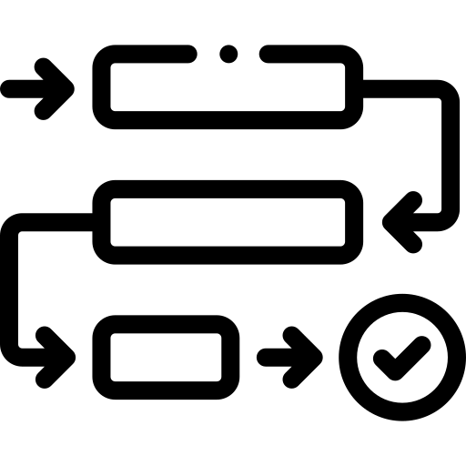

2
Memory Opertaion Primitives (MOP)
Code structures
Method definition
Loop structure
Thread creation
public void method() {
xxx;
}
Loop(i, 0, 10, 1){
xxx;
}
spawn method(stu);

Slide 22


2
MOP Programs to Runtime-Specific Programs
Conversion relations between MOP & target languages
Statement | MOP | Java | Go | C#
Primitive Types | int | int | int32 | int
 | float | float | float32 | float
 | double | double | int64 | double
Array Creation | NewArray(Type, len) | new Type[] | make([]Type) | new Type[]
Thread creation | spawn f() | new Thread(()->f()) | go func() | new Thread(()=>f())
... | ... | ... | ... | ...

Slide 23


2
MOP Programs to Runtime-Specific Programs
Convert MOP programs to target languages
for (int j = 0; j < Length; j += 1){
tem[j] = new Obj();
Obj_init(tem[j]);
}
for j := 0; j < Length; j += 1 {
tem[j] = &OBJ{}
Obj_init(tem[j])
}
Loop(j, 0, Length, 1){
tem[j] = NewInstance(Obj);
Obj_init(tem[j]);
}
for (int j = 0; j < Length; j += 1){
tem[j] = new Obj();
Obj_init(tem[j]);
}

Slide 24




2
MOP Programs Construction
Manual construction has limitations
How to create MOP programs based on real-world memory usages?
simulated GC workloads
MOP
Typical memory usage pattern
Manual construction

Slide 25


2
MOP Programs Construction
Manual construction has limitations
How to create MOP programs based on real-world memory usages?
simulated GC workloads
Real-world GC workloads
MOP
Typical memory usage pattern
Manual construction
Memory trace
Real-world
application

Slide 26



2
Memory Trace Collection
Instrument the source code of popular Java runtime
Collect the memory trace of real-world application during its execution
Include class information and memory operation information related to MOP statements
Real-world
applications
Instrumented
Java runtime
Memory trace

Slide 27
2
Memory Trace Collection
Class information
Instument the class loading process
Collect the information during the initialization of the classes
public class manager {
Object field；
public static void main() {
manager test = new manager();
test.field = null;
test.fruit();
}
}
class java_lang_Object {
}
class manager {
java_lang_Object super;
java_lang_Object field;
}
Java application
Collected trace

Slide 28
2
Memory Trace Collection
Object allocation
Instrument the new bytecode process logic and JNI methods related to object creation (clone, unsafe)
public class manager {
Object field；
public static void main() {
manager test = new manager();
test.field = null;
test.fruit();
}
}
Add PR ID:0x04, C:[String, T:main, M:manager.main ([String)V
New ID:0x56, C:manager, T:main, M:manager.main ([String;)V
Add PR ID:0x56, C:manager, T:main, M:manager.<init> ()V
Return ID:NULL, C:NULL, T:main, M:manager.<init> ()V
Add LR ID:0x56, C:manager, T:main, M:manager.main ([String;)V
Put ID:0x56, C1:manager, ID2:null, C2:null, f:field, T:main,
M:manager.main ([String;)V
Add PR ID:0x56, C:manager, T:main, M:manager.fruit ()V
...
Return ID:NULL, C:NULL, T:main, M:manager.fruit ()V
Java application
Collected trace

Slide 29
2
Memory Trace Collection
Reference update
Instrument the putfield/aastore bytecode process logic and JNI methods related to reference change(arrayCopy)
public class manager {
Object field；
public static void main() {
manager test = new manager();
test.field = null;
test.fruit();
}
}
Add PR ID:0x04, C:[String, T:main, M:manager.main ([String)V
New ID:0x56, C:manager, T:main, M:manager.main ([String;)V
Add PR ID:0x56, C:manager, T:main, M:manager.<init> ()V
Return ID:NULL, C:NULL, T:main, M:manager.<init> ()V
Add LR ID:0x56, C:manager, T:main, M:manager.main ([String;)V
Put ID:0x56, C1:manager, ID2:null, C2:null, f:field, T:main,
M:manager.main ([String;)V
Add PR ID:0x56, C:manager, T:main, M:manager.fruit ()V
...
Return ID:NULL, C:NULL, T:main, M:manager.fruit ()V
Java application
Collected trace

Slide 30
2
Memory Trace Collection
Method & thread
Instrument the method stack frame & current thread handler
public class manager {
Object field；
public static void main() {
manager test = new manager();
test.field = null;
test.fruit();
}
}
Add PR ID:0x04, C:[String, T:main, M:manager.main ([String)V
New ID:0x56, C:manager, T:main, M:manager.main ([String;)V
Add PR ID:0x56, C:manager, T:main, M:manager.<init> ()V
Return ID:NULL, C:NULL, T:main, M:manager.<init> ()V
Add LR ID:0x56, C:manager, T:main, M:manager.main ([String;)V
Put ID:0x56, C1:manager, ID2:null, C2:null, f:field, T:main,
M:manager.main ([String;)V
Add PR ID:0x56, C:manager, T:main, M:manager.fruit ()V
...
Return ID:NULL, C:NULL, T:main, M:manager.fruit ()V
Java application
Collected trace

Slide 31
2
Memory Trace to MOP Program
Trace filtering
Discard the operations of JVM-related threads
Extract the operations between the call and return of the Main function
Add Root ID:0x01, Set:VMGlobal, C:Class
Add Root ID:0x80, Set:ClassLoader, C:[Object
New ID:0x03, C:String, T:Monitor
Add LR H:0x03, C:String, T:Monitor
...
Add PR ID:0x04, C:[String, T:main, M:manager.main ([String)V
New ID:0x56, C:manager, T:main, M:manager.main ([String;)V
Add PR ID:0x56, C:manager, T:main, M:manager.<init> ()V
Return ID:NULL, C:NULL, T:main, M:manager.<init> ()V
...
Return ID:NULL, C:NULL, T:main, M:manager.fruit ()V
Return ID:NULL, C:NULL, T:main, M:manager.main ([String;)V
...
Add PR ID:0x78, C:Thread, M:Thread.exit ()V
Add PR ID:NULL, C:NULL, M:Thread.current ()Thread;
JVM initial
Main function
JVM exit
Collected trace

Slide 32
2
Memory Trace to MOP Program
Initial transformation
Build the method definitions
Add PR ID:0x04, C:[String, T:main, M:manager.main ([String)V
New ID:0x56, C:manager, T:main, M:manager.main ([String;)V
Add PR ID:0x56, C:manager, T:main, M:manager.<init> ()V
Return ID:NULL, C:NULL, T:main, M:manager.<init> ()V
Add LR ID:0x56, C:manager, T:main, M:manager.main ([String;)V
Put ID:0x56, C1:manager, ID2:null, C2:null, f:field, T:main,
M:manager.main ([String;)V
Return ID:NULL, C:NULL, T:main, M:manager.main ([String;)V
void manager_main_v0(String[] string_array_1) {
manager manager_0 = NewInstance(manager);
manager_init_v0(manager_0);
}
ID | Variables
0x04 | string_array_1
Initially transformed
MOP program
Local variable table

Slide 33
2
Memory Trace to MOP Program
Initial transformation
Transform the operations in trace to MOP statements one-to-one.
Add PR ID:0x04, C:[String, T:main, M:manager.main ([String)V
New ID:0x56, C:manager, T:main, M:manager.main ([String;)V
Add PR ID:0x56, C:manager, T:main, M:manager.<init> ()V
Return ID:NULL, C:NULL, T:main, M:manager.<init> ()V
Add LR ID:0x56, C:manager, T:main, M:manager.main ([String;)V
Put ID:0x56, C1:manager, ID2:null, C2:null, f:field, T:main,
M:manager.main ([String;)V
Return ID:NULL, C:NULL, T:main, M:manager.main ([String;)V
void manager_main_v0(String[] string_array_1) {
manager manager_0 = NewInstance(manager);
manager_init_v0(manager_0);
}
ID | Variables
0x04 | string_array_1
0x56 | manager_0
Initially transformed
MOP program
Local variable table

Slide 34
2
Memory Trace to MOP Program
Initial transformation
Table of local variables helps determine the source of objects
Add PR ID:0x04, C:[String, T:main, M:manager.main ([String)V
New ID:0x56, C:manager, T:main, M:manager.main ([String;)V
Add PR ID:0x56, C:manager, T:main, M:manager.<init> ()V
Return ID:NULL, C:NULL, T:main, M:manager.<init> ()V
Add LR ID:0x56, C:manager, T:main, M:manager.main ([String;)V
Put ID:0x56, C1:manager, ID2:null, C2:null, f:field, T:main,
M:manager.main ([String;)V
Return ID:NULL, C:NULL, T:main, M:manager.main ([String;)V
void manager_main_v0(String[] string_array_1) {
manager manager_0 = NewInstance(manager);
manager_init_v0(manager_0);
}
ID | Variables
0x04 | string_array_1
0x56 | manager_0
Initially transformed
MOP program
Local variable table

Slide 35
2
MOP Program Simpliﬁcation
Merge method deﬁnitions with the same process ﬂow
void manager_fruit__v1(manager manager_0) {
ArrayList arraylist_0 = NewInstance(ArrayList);
ArrayList_init_v0(arraylist_0);
Loop(i, 0, 2, 1){
String string_0 = NewInstance(String);
root[i] = string_0;
ArrayList_add_v0(arraylist_0, i, string_0);
}
}
void manager_fruit__v0(manager manager_0) {
ArrayList arraylist_0 = NewInstance(ArrayList);
ArrayList_init_v0(arraylist_0);
Loop(i, 0, 2, 1){
String string_0 = NewInstance(String);
root[i] = string_0;
ArrayList_add_v0(arraylist_0, i, string_0);
}
}
Merge
void manager_fruit__v2(manager manager_0) {
ArrayList arraylist_0 = NewInstance(ArrayList);
ArrayList_init_v0(arraylist_0);
Loop(i, 0, 2, 1){
String string_0 = NewInstance(String);
root[i] = string_0;
ArrayList_add_v0(arraylist_0, i, string_0);
}
}
Simplified MOP program
Initially transformed
MOP program

Slide 36
2
MOP Program Simpliﬁcation
Merge consecutive codes with identical statements
void manager_fruit__v0(manager manager_0) {
ArrayList arraylist_0 = NewInstance(ArrayList);
ArrayList_init_v0(arraylist_0);
String string_0 = NewInstance(String);
root[0] = string_0;
ArrayList_add_v0(arraylist_0, 0, string_0);
String string_1 = NewInstance(String);
root[1] = string_1;
ArrayList_add_v0(arraylist_0, 1, string_1);
String string_2 = NewInstance(String);
root[2] = string_2;
ArrayList_add_v0(arraylist_0, 2, string_2);
}
void manager_fruit__v0(manager manager_0) {
ArrayList arraylist_0 = NewInstance(ArrayList);
ArrayList_init_v0(arraylist_0);
Loop(i, 0, 2, 1){
String string_0 = NewInstance(String);
root[i] = string_0;
ArrayList_add_v0(arraylist_0, i, string_0);
}
}
Construct
Loop
Initially transformed
MOP program
Simplified MOP program

Slide 37
2
Evaluation
Research questions
RQ1: Can GEAR create consistent GC workloads across different runtimes?
RQ2: Can GEAR create real-world GC workloads for different runtimes?
Target runtimes
Java, Go, C#
Experimental applications
3 manually crafted memory usages (WebServer, DataBase, BigData)
20 real-world applications sampled from GitHub, Guava and Rosetta

Slide 38
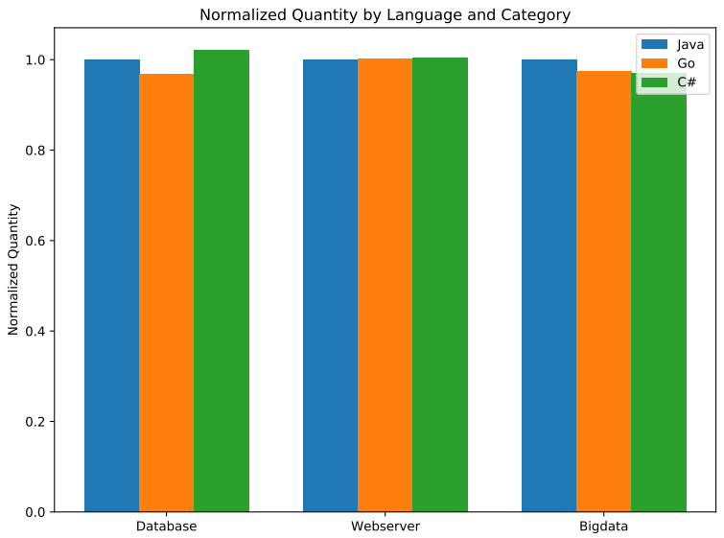
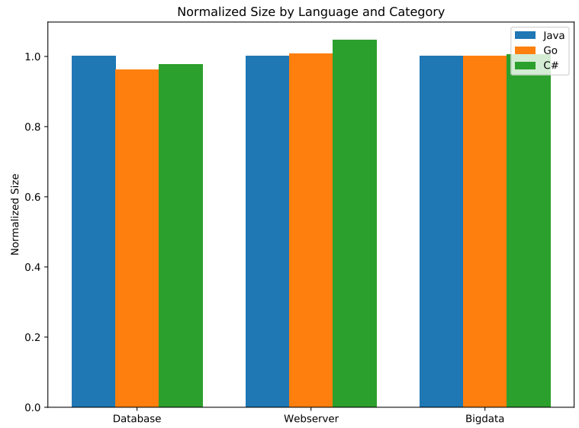
2
Evaluation
RQ1: Consistent GC workload creation across runtimes
The maximum difference in object numbers and sizes is less than 5%
Object Numbers
Object Sizes

Slide 39
2
Evaluation
RQ2: Real-world GC workload generation
Source | Application | Trace | To MOP | Gen Exec | Diff
GitHub | jvm-gc | 34s / 1.2GB | 152s / 629KB | 1.3× | 1.7%
 | gcbench | 35s / 1.0GB | 242s / 462KB | 1.4× | 3.7%
Guava
 | Segment | 71s / 2.3GB | 527s / 1354KB | 1.4× | 4.6%
 | Monitor | 25s / 0.9GB | 105s / 703KB | 1.2× | 3.7%
Rosetta | Bell Numbers | 36s / 1.5GB | 315s / 4307KB | 1.2× | 2.5%
 | Numeric Error | 21s / 0.9GB | 95s / 229KB | 1.2× | 4.8%

Slide 40
2
Evaluation
RQ2: Real-world GC workload generation
Source | Application | Trace | To MOP | Gen Exec | Diff
GitHub | jvm-gc | 34s / 1.2GB | 152s / 629KB | 1.3× | 1.7%
 | gcbench | 35s / 1.0GB | 242s / 462KB | 1.4× | 3.7%
Guava
 | Segment | 71s / 2.3GB | 527s / 1354KB | 1.4× | 4.6%
 | Monitor | 25s / 0.9GB | 105s / 703KB | 1.2× | 3.7%
Rosetta | Bell Numbers | 36s / 1.5GB | 315s / 4307KB | 1.2× | 2.5%
 | Numeric Error | 21s / 0.9GB | 95s / 229KB | 1.2× | 4.8%

Slide 41
2
Evaluation
RQ2: Real-world GC workload generation
Source | Application | Trace | To MOP | Gen Exec | Diff
GitHub | jvm-gc | 34s / 1.2GB | 152s / 629KB | 1.3× | 1.7%
 | gcbench | 35s / 1.0GB | 242s / 462KB | 1.4× | 3.7%
Guava
 | Segment | 71s / 2.3GB | 527s / 1354KB | 1.4× | 4.6%
 | Monitor | 25s / 0.9GB | 105s / 703KB | 1.2× | 3.7%
Rosetta | Bell Numbers | 36s / 1.5GB | 315s / 4307KB | 1.2× | 2.5%
 | Numeric Error | 21s / 0.9GB | 95s / 229KB | 1.2× | 4.8%

Slide 42
2
Evaluation
RQ2: Real-world GC workload generation
The maximum object statistics difference between original Java programs and generated programs is 4.8%
Source | Application | Trace | To MOP | Gen Exec | Diff
GitHub | jvm-gc | 34s / 1.2GB | 152s / 629KB | 1.3× | 1.7%
 | gcbench | 35s / 1.0GB | 242s / 462KB | 1.4× | 3.7%
Guava
 | Segment | 71s / 2.3GB | 527s / 1354KB | 1.4× | 4.6%
 | Monitor | 25s / 0.9GB | 105s / 703KB | 1.2× | 3.7%
Rosetta | Bell Numbers | 36s / 1.5GB | 315s / 4307KB | 1.2× | 2.5%
 | Numeric Error | 21s / 0.9GB | 95s / 229KB | 1.2× | 4.8%

Slide 43
2
Cross-Runtime GC Performance Study
Target GC implementations
Target applications
3 memory usage patterns
9 real-world applications
4 data structures (Stack, Queue, Tree, Array)
GC Algorithms | Compact | Generational | Concurrency
Java ZGC | Moving | No | Mostly
Go GC | Non-Moving | Implicit | Partially
C# Server GC | Moving | Yes | None

Slide 44
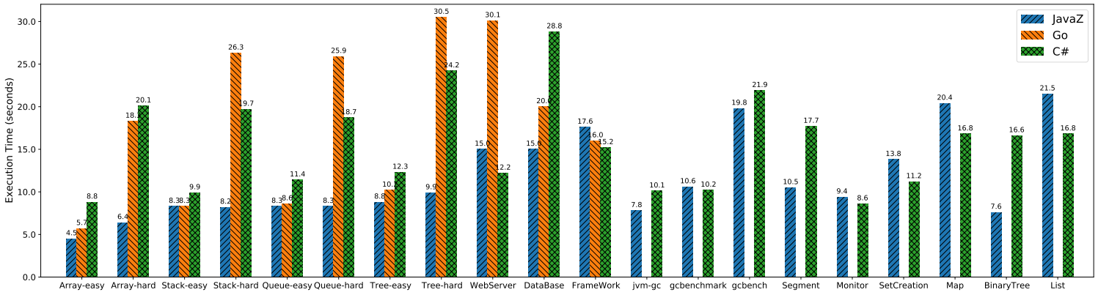
2
Cross-Runtime GC Performance Study
Average execution time of applications
The performance of GC implementations varies in different applications

Slide 45
2
Findings
Reference relationships
Java ZGC and Go GC perform significantly worse under the single-linked object reference graph (Stack structure)
C# GC is less affected by object reference relationships
Go GC time
C# Server GC time

Slide 46
2
Findings
Heap adjustment stragegy
Go GC performs relatively worse under adequate memory budget
Go GC heuristic heap adjustment is too strict on memory usage
Average memory usage under
application WebServer
Execution time under
application WebServer

Slide 47
2
Findings
Parallelism
Java ZGC suffers slowdowns when parallelism doubles in some cases
Go GC scales better when increasing application parallelism
Speedup of application Tree
Speedup of application Queue
More details and findings can be found in our paper

Slide 48
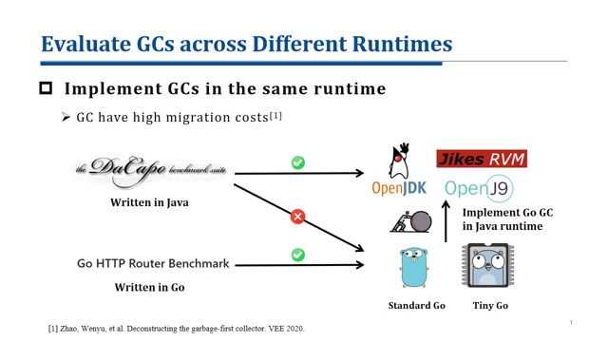
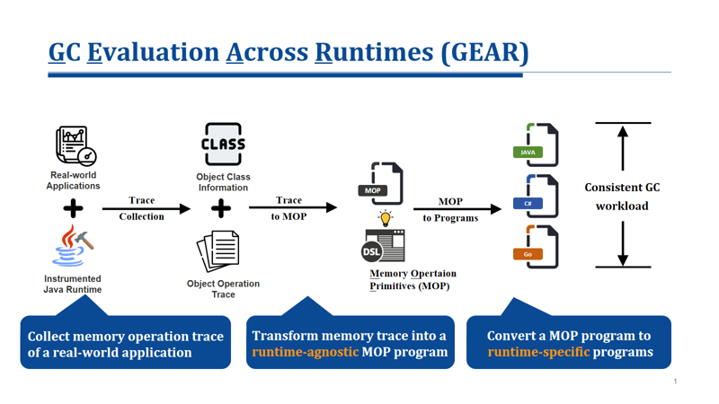
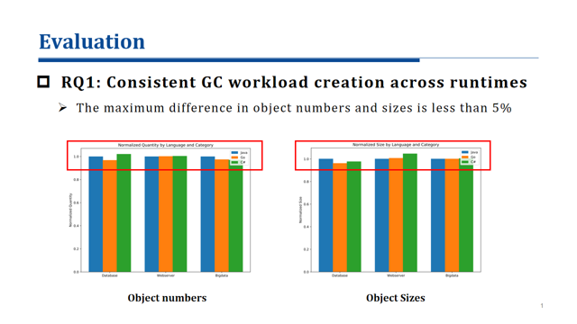
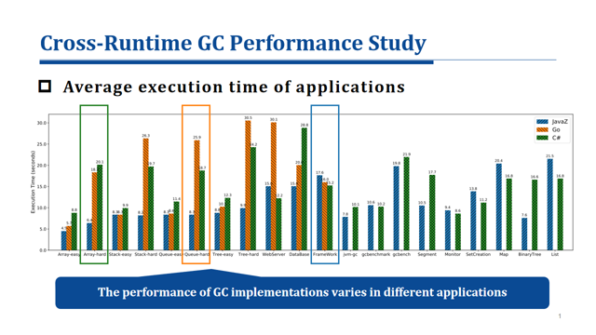
2
Conclusions

