Slide 1


34th ACM SIGSOFT International Symposium on Software Testing and Analysis (ISSTA 2025)
Model Checking Guided Incremental Testing for Distributed Systems
Yu Gao, Dong Wang, Wensheng Dou, Wenhan Feng, Yu Liang, Yuan Feng, Jun Wei
Institute of Software, Chinese Academy of Sciences
University of Chinese Academy of Sciences

Slide 2

















Cloud Systems
Large-scale distributed systems have become the cornerstone of many important applications

Slide 3
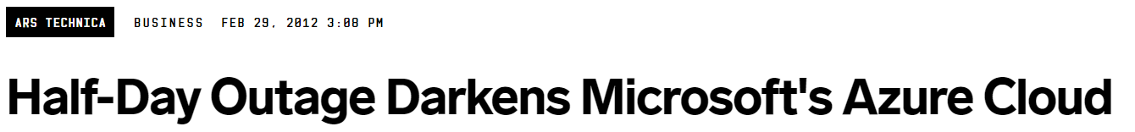

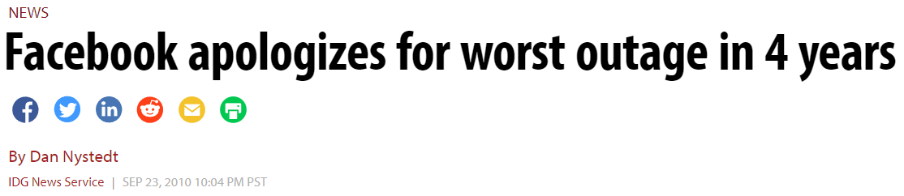

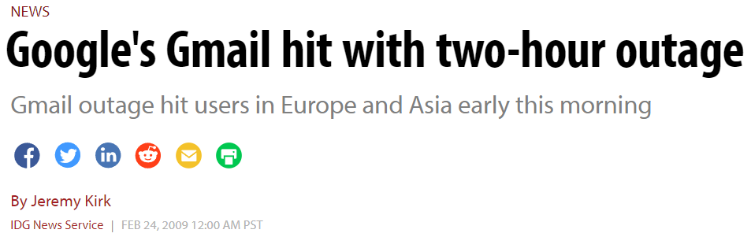

Distributed System Bugs
Various non-deterministic events make distributed systems complex and prone to bugs
……
……

Slide 4



How to Test Distributed Systems Systematically?
Model Checking Guided Testing (MCGT)
Automatically generate test cases by traversing the verified abstract state space derived from a distributed system’s formal specification
The verified abstract state space
Impl.
Formal spec.
Test cases
Model checking
Expected system behaviors
at the design level
Inconsistencies
Actual system behaviors

Slide 5


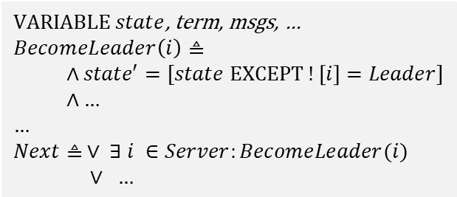
Model Checking Guided Testing (MCGT)
Mocket [1] is the state-of-the-art MCGT approach for distributed systems
TLA+ spec.
Abstract state graph
$VARIABLE state$, term, msgs, …
$$BecomeLeader\left(i\right)≜$$
$∧state′=[state EXCEPT !\left[i\right]=Leader]$
$∧$ …
…
$$Next≜ ∨ ∃ i ∈Server:BecomeLeader(i)$$
$∨ …$
Model checking
Incorrect state
Unexpected action
Missing action
Mapping
Test cases
Inconsistencies
+ @Varibale(“state”)
private NodeState state;
+ @Action(“BecomeLeader”)
private void becomeLeader() {
+ Mocket.notifyAndBlock();
state = NodeState.STATE_LEADER;
…
+ Mocket.checkState();
}
Can I execute?
Yes!
Report current state
[1] Wang et al. Model Checking Guided Testing for Distributed Systems. EuroSys 2023.
System impl.
Test controller

Slide 6




MCGT is Inefficient During System Evolution
Mocket needs to re-run the entire testing process for the evolved system to verify its correctness
+ new features
Generate abstract state graph
Generate test cases
Involve a lot of test cases irrelevant to the changes
Verify the system
Modify spec. or impl.
Execute all test cases (in weeks)
Refine spec.
Detect bugs
Distributed systems can evolve …
MCGT is inefficient for testing system changes!

Slide 7
Our Goal
1. Avoid generating change-irrelevant test cases
+ new features
Refine spec.
2. Precisely verify the changes to TLA+ spec. and system impl.
Change affected transitions are limited

Slide 8

iMocket: Precisely Evaluate System Changes
Spec.
StateGraph
Impl.
Extract spec. and impl. changes
Identify affected states and transitions
Generate incremental test cases
Evolve
Spec.’
These test cases can be completed in seconds to days
Impl.’
StateGraph'

Slide 9
Extract System Changes
We summarize the change types from both the specification and implementation that can affect the state graph
TLA+ spec.
Add a variable
Delete a variable
Add a basic block
Delete a basic block
System impl.
Modify the code within a mapped action
Allow an action sequence
Forbid an action sequence

Slide 10

Extract Specification Changes
TLA+ is a formal specification language based on temporal logic
Variables express system states
VARIABLE msg,cache,stage
Request(data) $≜$
$∧$ stage = “standby”
$∧$ stage’= “request”
$∧$ msg’ = msg \union {data}
$∧$ UNCHANGED <<cache>>
MaxRespond $≜$ …
Process $≜$ …
Next $≜$ $∨$ \E d \in Data: Request(d)
$∨$ MaxRespond
$∨$ Process
Init $≜$ …
Spec $≜$ $Init∧□\left[Next\right]vars$
Actions express system behaviors
Spec ::= Init /\ [][(\/ Action)+]_{vars}
Init ::= BasicBlock
Action ::= Block+ | BasicBlock /\Block*
Block ::= (\/ BasicBlock)+
BasicBlock ::= (/\ Statement)+
Statement ::= Judgment | Assignment | UNCHANGED
The abstract TLA+ syntax

Slide 11
Extract Specification Changes
TLA+ is a formal specification language based on temporal logic
VARIABLE msg,cache,stage
Request(data) $≜$
$∧$ stage = “standby”
$∧$ stage’= “request”
$∧$ msg’ = msg \union {data}
$∧$ UNCHANGED <<cache>>
MaxRespond $≜$ …
Process $≜$ …
Next $≜$ $∨$ \E d \in Data: Request(d)
$∨$ MaxRespond
$∨$ Process
Init $≜$ …
Spec $≜$ $Init∧□\left[Next\right]vars$
msg={}
cache={}
stage=“standby”
s_{init}
Request(0)
…
s₁
MaxRespond
…
s₂
MaxRespond
Process
…
s₃
…
s₄
The state graph

Slide 12


Extract Specification Changes
Developers can modify TLA+ variables and actions
VARIABLE msg,cache,stage,count
Request(data) $≜$
$∧$ …
$∧$ UNCHANGED <<cache,count>>
MaxRespond $≜$ …
Process $≜$ …
MinRespond $≜$ \E m \in msg:
$∧$ stage = “request”
$∧$ stage’= “respond”
$∧$ cache’= cache \union {m}
$∧$ m = getMin(cache’)
$∧$ msg’ = (msg \ {m}) \union {Min}
Next $≜$ $∨$ …
$∨$ MinRespond
…
Add a TLA+ avariable
count=0
…
s_{init}
Modify a basic block
MinRespond
msg={Min}
count=1
…
…
s₁
s₆
MaxRespond
…
s₂
Process
MinRespond
…
s₃
…
s₄
MaxRespond
Add a basic block
count=1
…
s₇
TLA+ spec. changes
New state graph

Slide 13
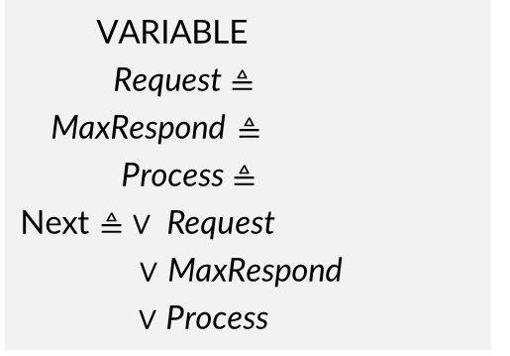
Extract Specification Changes
We perform static analysis on both the original and modified TLA+ specifications and construct them as abstract syntax trees (ASTs)
/\msg = {}
/\cache = {}
/\stage = “standby”
Init
msg
cache
VARIABLE
Request $≜$
MaxRespond $≜$
Process $≜$
Next $≜ ∨ \text{Request}$
$∨$ MaxRespond
$∨$ Process
Action
Request
MaxRespond
Process
Block
\E m \in msg:
/\ …
Basic Block
/\ m = getMax(cache’)
/\ msg’= (msg \ {m}) \union {Max}
/\ m /= getMax(cache’)
/\ msg’= (msg \ {m}) \union {NotMax}

Slide 14
Extract Specification Changes
We compare the specifications and their corresponding ASTs before and after the changes to identify spec. changes
Before change
After change
Init
…
Init
…
Action
…
…
…
Action
…
…
…
MinRespond
Block
…
Block
…
…
Basic Block
/\ m = getMax(cache’)
/\ msg’= (msg \ {m}) \union {Max}
…
Basic Block
/\ m = getMax(cache’)
/\ msg’= (msg \ {m}) \union {Max}
…
/\ m = getMin(cache’)
/\ msg’= (msg \ {m}) \union {Min}
An added basic block!

Slide 15
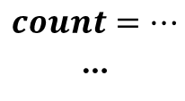


Extract Implementation Changes
MCGT aims to verify the code within mapped actions
1. @Variable(“count”)
2. int sentCount = 0;
3. @Action(“Process”)
4. public void process(Response resp) {
5. …
6. }
7. public void unmapped_function(){…}
…
The corresponding state graph
$$count=…$$
…
Process
OtherBehavior
$$…$$
$$…$$
Impl.

Slide 16
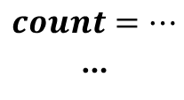
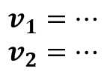
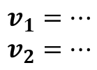
Extract Implementation Changes
When the code within a mapped action is modified, we should retest the corresponding state transitions
1. @Variable(“count”)
2. int sentCount = 0;
3. @Action(“Process”)
4. public void process(Response resp) {
5. sentCount += 1;
6. }
7. public void unmapped_function(){…}
…
The corresponding state graph
$$count=…$$
…
Process
OtherBehavior
Modify the code within a mapped action
$$v_{1}=…$$
$$v_{2}=…$$
$$v_{1}=…$$
$$v_{2}=…$$
Impl. changes

Slide 17
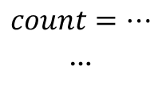
Extract Implementation Changes
When the code outside the mapped actions is modified, we cannot test such changes
1. @Variable(“count”)
2. int sentCount = 0;
3. @Action(“Process”)
4. public void process(Response resp) {
5. …
6. }
7. public void unmapped_function(){…}
…
The corresponding state graph
$$count=…$$
…
Process
OtherBehavior
$$v_{1}=…$$
$$v_{2}=…$$
$$v_{1}=…$$
$$v_{2}=…$$
Impl. changes
We cannot obtain the corresponding testing oracles!
Modify the code outside the mapped actions

Slide 18

Extract Implementation Changes
When the code outside the mapped actions is modified, we cannot test such changes
1. @Variable(“count”)
2. int sentCount = 0;
3. @Action(“Process”)
4. public void process(Response resp) {
5. …
6. }
7. public void unmapped_function(){…}
…
The corresponding state graph
Var₁
count
VARIABLE
Process $≜$
Unmapped $≜$
Next $≜ ∨$ Process
$∨$ Unmapped
$$count=…$$
…
Process
OtherBehavior
$$v_{1}=…$$
$$v_{2}=…$$
$$v_{1}=…$$
$$v_{2}=…$$
@Action(“Unmapped”)
Unmapped
Impl. changes
Modify the code outside the mapped actions

Slide 19
Extract Implementation Changes
We organize the two code versions into abstract syntax trees and perform static analysis to identify code changes within mapped actions.
class RaftConsensusServiceImpl
@Action(HandleRequestVoteRequest)
handleRequestVoteRequest(…);
class RaftNode
stepdown(newTerm);
votedFor = newVotedFor;
…
@Variable(votedFor)
int votedFor;
stepdown(int term)
The logic related to the variable votedFor has been modified in the action HandleRequestVoteRequest!

Slide 20

Extract Implementation Changes
Automatically identifying changes in action concurrency within distributed system code is challenging
@Action(“Request”)
public Response send(Node n, Data d) {…}
@Action(“Process”)
public void process(Response resp) {…}
main(){
-- Lock l;
while(…) {
new Thread(){
-- getLock(l);
Response resp = send(node, data);
process(resp);
-- releaseLock(l);
};}}
Complex code structure
Large codebase
Intricate interactions across nodes
Complexity of concurrency
Tool limitations
…

Slide 21
Extract Implementation Changes
Testers are required to explicitly detail their modifications to action concurrency
@Action(“Request”)
public Response send(Node n, Data d) {…}
@Action(“Process”)
public void process(Response resp) {…}
main(){
-- Lock l;
while(…) {
new Thread(){
-- getLock(l);
Response resp = send(node, data);
process(resp);
-- releaseLock(l);
};}}
The allowed action sequence:
Request → Request

Slide 22
Identifying Affected States and Transitions
Change type: Add a basic block
…
…
s_{init}
…
MinRespond
…
MinRespond
s₁
…
…
…
s₆
…
s₂
…
…
/\ m = getMin(cache’)
/\ msg’= (msg \ {m}) \union {Min}
MinRespond
Process
…
s₃
…
s₄
Add a basic block in TLA+ spec.
Add some nodes and edges in the state graph

Slide 23
Identifying Affected States and Transitions
Change type: Add a basic block
…
…
s_{init}
…
MinRespond
…
MinRespond
s₁
…
…
…
Affected state transitions:
Incorrect state?
Missing action?
s₆
…
s₂
…
…
/\ m = getMin(cache’)
/\ msg’= (msg \ {m}) \union {Min}
MinRespond
Process
…
s₃
…
s₄
Add a basic block in TLA+ spec.
Add some nodes and edges in the state graph

Slide 24
Identifying Affected States and Transitions
Change type: Delete a basic block
…
…
s_{init}
…
MinRespond
…
MinRespond
s₁
…
…
…
s₆
…
s₂
…
…
/\ m = getMin(cache’)
/\ msg’= (msg \ {m}) \union {Min}
MinRespond
Process
…
s₃
…
s₄
Delete a basic block in TLA+ spec.
Delete some nodes and edges in the state graph

Slide 25
Identifying Affected States and Transitions
Change type: Delete a basic block
…
…
s_{init}
…
MinRespond
…
MinRespond
s₁
…
…
…
s₆
…
s₂
…
…
/\ m = getMin(cache’)
/\ msg’= (msg \ {m}) \union {Min}
MinRespond
Process
…
Affected state transitions:
Unexpected action?
s₃
…
s₄
Delete a basic block in TLA+ spec.
Delete some nodes and edges in the state graph

Slide 26
Identifying Affected States and Transitions
Change type: Allow an action sequence
…
s_{init}
Request(1)
Request(0)
The allowed action sequence:
…
s₁
Request → Request
MaxRespond
Request(1)
Modify code to align with the spec.
…
…
s₂
s₃
The spec. was not modified, so the state graph remains unchanged

Slide 27
Identifying Affected States and Transitions
Change type: Allow an action sequence
…
s_{init}
Request(1)
Request(0)
The allowed action sequence:
…
s₁
Request → Request
MaxRespond
Request(1)
Modify code to align with the spec.
…
…
s₂
s₃
Affected state transitions:
Incorrect state?
Missing action?
The spec. was not modified, so the state graph remains unchanged

Slide 28
Identifying Affected States and Transitions
Different change types have varying impacts on the state graph, necessitating different testing patterns
ID | Change Type | State Graph Change | Testing Pattern
P1 | Add a basic block | Add some nodes and edges | Test edges corresponding to the action associated with the added basic block, as well as all direct successor edges of the matched edges
P2 | Delete a basic block | Remove some nodes and edges | Test all successor edges of nodes that originally contained the deleted edges among their outgoing edges
P3 | Add a variable | Change all nodes; change some edges due to modified basic blocks | Apply P1 for added basic blocks; apply P2 for deleted basic blocks
P4 | Delete a variable
P5 | Modify code within actions | - | Test edges that match the modified action code logic
P6 | Allow an action sequence | - | Test edges that match the first action and their direct successor edges that match the second action
P7 | Forbid an action sequence | - | Test all direct successor edges of the edges that match the first action

Slide 29
Identifying Affected States and Transitions
Different change types have varying impacts on the state graph, necessitating different testing patterns
ID | Change Type | State Graph Change | Testing Pattern
P1 | Add a basic block | Add some nodes and edges | Test edges corresponding to the action associated with the added basic block, as well as all direct successor edges of the matched edges
P2 | Delete a basic block | Remove some nodes and edges | Test all successor edges of nodes that originally contained the deleted edges among their outgoing edges
P3 | Add a variable | Change all nodes; change some edges due to modified basic blocks | Apply P1 for added basic blocks; apply P2 for deleted basic blocks
P4 | Delete a variable
P5 | Modify code within actions | - | Test edges that match the modified action code logic
P6 | Allow an action sequence | - | Test edges that match the first action and their direct successor edges that match the second action
P7 | Forbid an action sequence | - | Test all direct successor edges of the edges that match the first action

Slide 30
Identifying Affected States and Transitions
Different change types have varying impacts on the state graph, necessitating different testing patterns
ID | Change Type | State Graph Change | Testing Pattern
P1 | Add a basic block | Add some nodes and edges | Test edges corresponding to the action associated with the added basic block, as well as all direct successor edges of the matched edges
P2 | Delete a basic block | Remove some nodes and edges | Test all successor edges of nodes that originally contained the deleted edges among their outgoing edges
P3 | Add a variable | Change all nodes; change some edges due to modified basic blocks | Apply P1 for added basic blocks; apply P2 for deleted basic blocks
P4 | Delete a variable
P5 | Modify code within actions | - | Test edges that match the modified action code logic
P6 | Allow an action sequence | - | Test edges that match the first action and their direct successor edges that match the second action
P7 | Forbid an action sequence | - | Test all direct successor edges of the edges that match the first action

Slide 31
Generating Incremental Test Cases
We adopt a growth-based test case generation algorithm
Affected state transitions
Test case 2
Test case 1

Slide 32

Evaluation
We evaluate iMocket on 12 representative change scenarios from three real-world distributed systems
Scenario ID | Description | Change in LOC
 |  | Total | Spec | Impl
Raft-java#1 | Add the feature of manually installing snapshots | 70 | 14 | 56
Raft-java#2 | Refine the specification detail of Pre-Vote mechanism | 21 | 21 | -
Raft-java#3 | Fix the implementation bug of wrongly handling with vote response | 35 | - | 35
Raft-java#4 | Fix the implementation bug of wrongly reading the snapshot index | 212 | - | 212
ZooKeeper#1 | Fix the implementation bug of incorrect election conditions | 122 | - | 122
ZooKeeper#2 | Fix the implementation bug of incorrect epoch setting | 148 | - | 148
ZooKeeper#3 | Fix three implementation bugs related to transaction errors | 267 | - | 267
Xraft#1 | Fix the implementation bug of incorrect implementation of votesGranted | 1453 | - | 1453
Xraft#2 | Fix the implementation bug of incorrect persist of votedFor | 2 | - | 2
Xraft#3 | Fix the implementation bug of wrongly handling with NoOp logs | 2 | - | 2
Raft-spec#1 | Fix the specification bug of wrongly executing the function UpdateTerm asan action | 43 | 43 | -
Raft-spec#2 | Fix the specification bug of wrongly handling with AppendEntries messages | 43 | 43 | -
Xraft
Raft-java

Slide 33
Evaluation
We evaluate iMocket on 12 representative change scenarios from three real-world distributed systems
Scenario ID | Description | Change in LOC
 |  | Total | Spec | Impl
Raft-java#1 | Add the feature of manually installing snapshots | 70 | 14 | 56
Raft-java#2 | Refine the specification detail of Pre-Vote mechanism | 21 | 21 | -
Raft-java#3 | Fix the implementation bug of wrongly handling with vote response | 35 | - | 35
Raft-java#4 | Fix the implementation bug of wrongly reading the snapshot index | 212 | - | 212
ZooKeeper#1 | Fix the implementation bug of incorrect election conditions | 122 | - | 122
ZooKeeper#2 | Fix the implementation bug of incorrect epoch setting | 148 | - | 148
ZooKeeper#3 | Fix three implementation bugs related to transaction errors | 267 | - | 267
Xraft#1 | Fix the implementation bug of incorrect implementation of votesGranted | 1453 | - | 1453
Xraft#2 | Fix the implementation bug of incorrect persist of votedFor | 2 | - | 2
Xraft#3 | Fix the implementation bug of wrongly handling with NoOp logs | 2 | - | 2
Raft-spec#1 | Fix the specification bug of wrongly executing the function UpdateTerm asan action | 43 | 43 | -
Raft-spec#2 | Fix the specification bug of wrongly handling with AppendEntries messages | 43 | 43 | -
Xraft
Raft-java

Slide 34
Reduction Effectiveness
Scenario ID | #Test cases |  |  | Test time
 | Full Traversal | iMocket | Reduction | Full Traversal | iMocket | Reduction
Raft-java#1 | 145,222 | 359 | 99.75% | 8 days | 29 min | 99.14%
Raft-java#2 | 215,336 | 120,357 | 44.11% | 12 days | 7 days | 47.64%
Raft-java#3 | 85,976 | 42,331 | 50.76% | 5 days | 2 days | 50.29%
Raft-java#4 | 85,976 | 956 | 98.89% | 5 days | 79 min | 98.90%
ZooKeeper#1 | 342,770 | 179,331 | 47.68% | >3 weeks | 15 days | >51.77%
ZooKeeper#2 | 519,609 | 3,580 | 99.31% | >3 weeks | 10 hours | >99.91%
ZooKeeper#3 | 7,212,493 | 785 | 99.99% | >3 weeks | 2 hours | >99.99%
Xraft#1 | 296,154 | 19,259 | 93.50& | >3 weeks | 37 hours | >99.08%
Xraft#2 | 296,154 | 24,306 | 91.79% | >3 weeks | 2 days | >93.42%
Xraft#3 | 296,154 | 1,534 | 99.48% | >3 weeks | 3 hours | >99.71%
Raft-spec#1 | 85,976 | 64,732 | 24.71% | 5 days | 3 days | 22.54%
Raft-spec#2 | 85,976 | 44,711 | 48.00% | 5 days | 2 days | 44.30%

Slide 35
Safety and Precision
Test cases generated by iMocket can collectively cover the code relevant to system changes
Scenario ID | Can cover related code? | Can trigger fixed bugs? | Triggered ratio
Raft-java#1 | √ | - | -
Raft-java#2 | √ | - | -
Raft-java#3 | √ | √ | 98.47%
Raft-java#4 | √ | √ | 97.89%
ZooKeeper#1 | √ | √ | 95.11%
ZooKeeper#2 | √ | √ | 83.03%
ZooKeeper#3 | √ | √ | 68.91%
Xraft#1 | √ | √ | 100%
Xraft#2 | √ | √ | 95.39%
Xraft#3 | √ | √ | 90.74%

Slide 36
Safety and Precision
Test cases generated by iMocket can successfully trigger bugs in all the implementation bug-fixing scenarios
Scenario ID | Can cover related code? | Can trigger fixed bugs? | Triggered ratio
Raft-java#1 | √ | - | -
Raft-java#2 | √ | - | -
Raft-java#3 | √ | √ | 98.47%
Raft-java#4 | √ | √ | 97.89%
ZooKeeper#1 | √ | √ | 95.11%
ZooKeeper#2 | √ | √ | 83.03%
ZooKeeper#3 | √ | √ | 68.91%
Xraft#1 | √ | √ | 100%
Xraft#2 | √ | √ | 95.39%
Xraft#3 | √ | √ | 90.74%

Slide 37
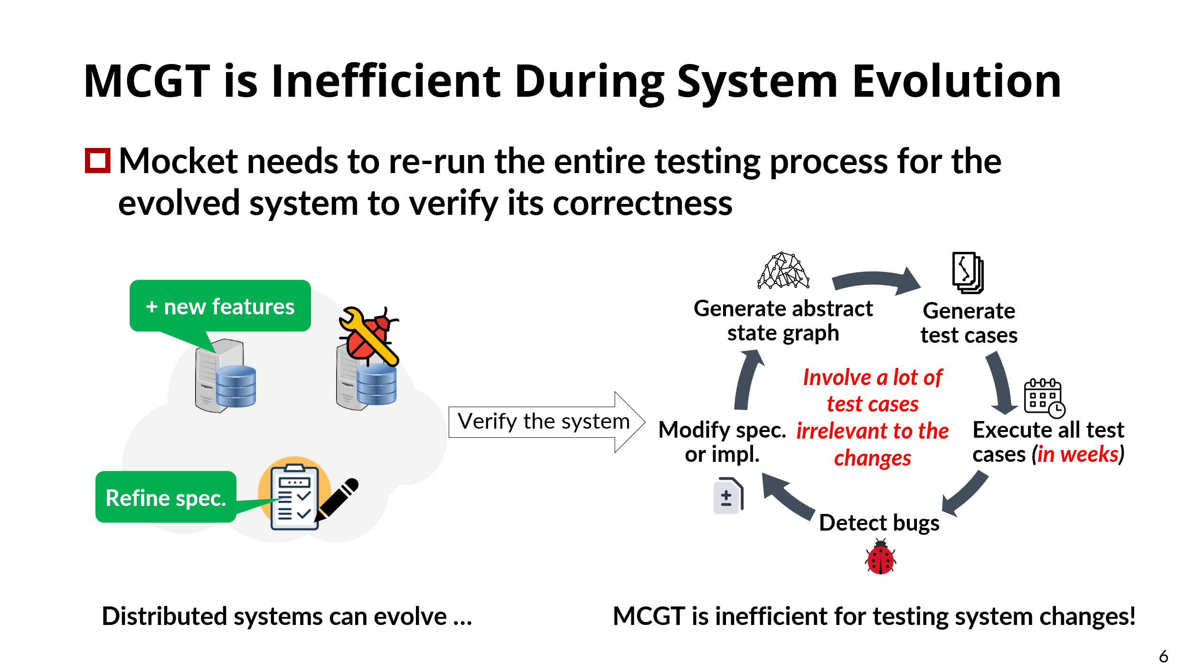
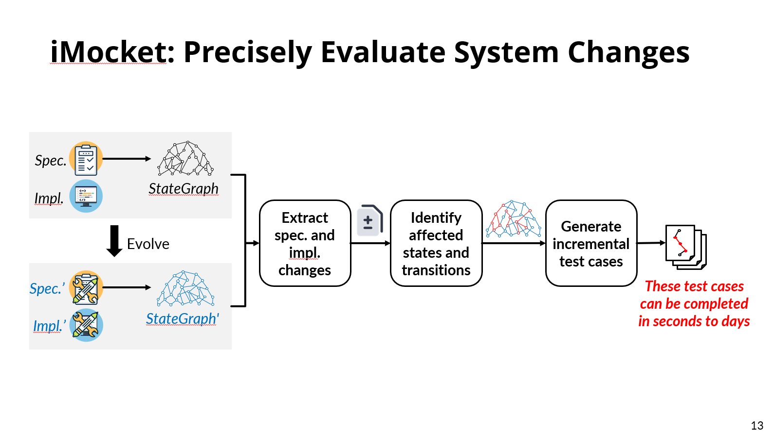
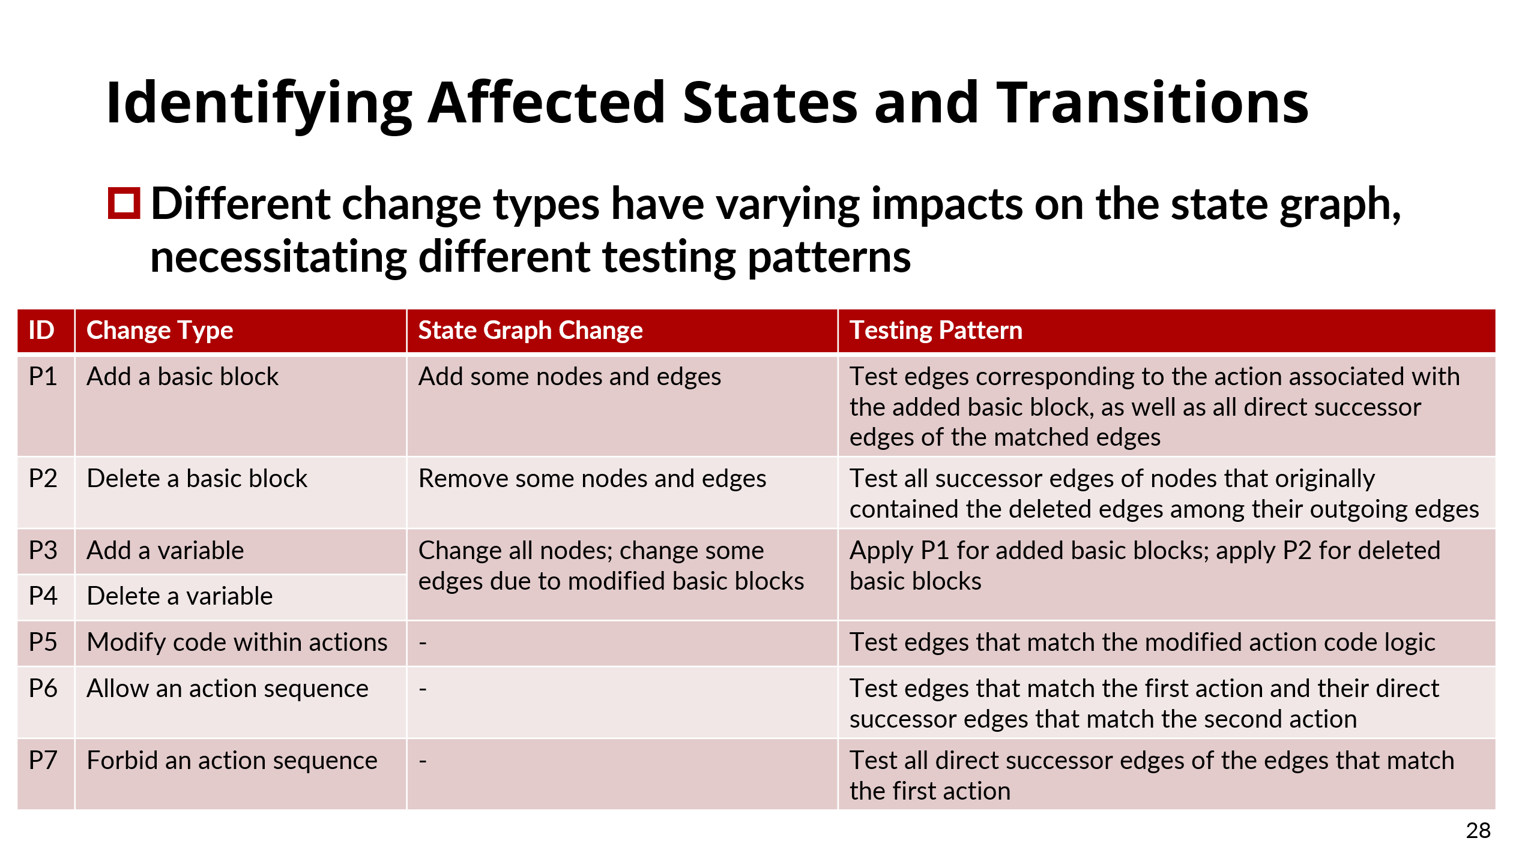
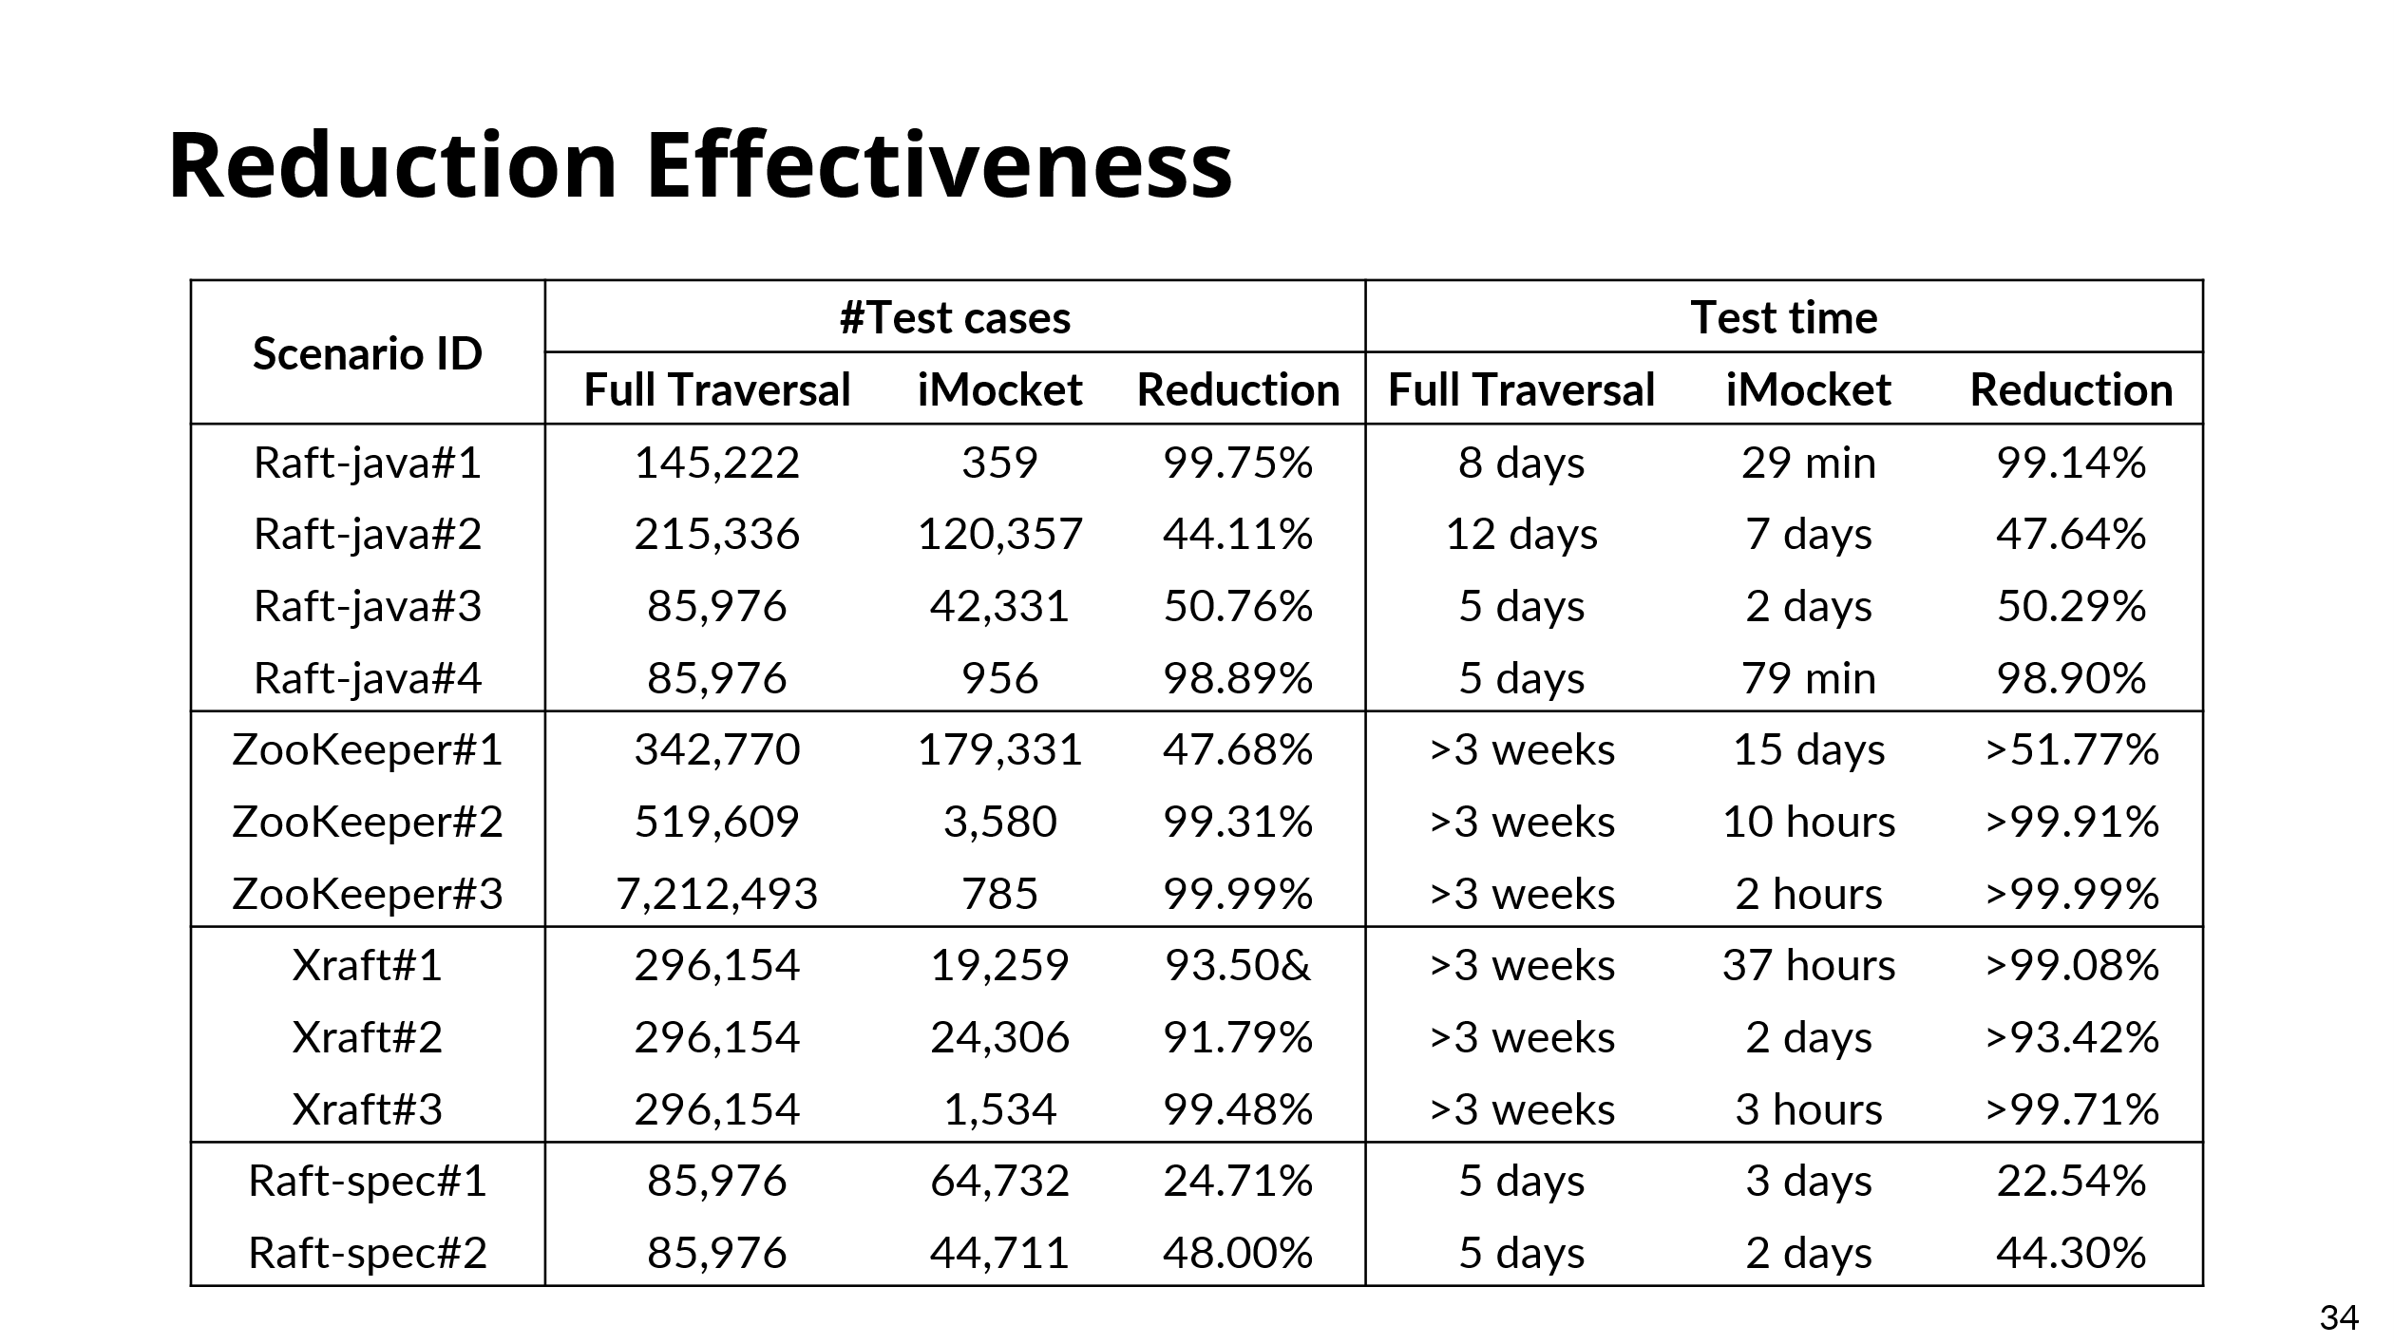

https://github.com/tcse-iscas/iMocket

Slide 38

THANK YOU!

