Slide 1


34th ACM SIGSOFT International Symposium on Software Testing and Analysis (ISSTA 2025)
Detecting Isolation Anomalies in Relational DBMSs
Rui Yang, Ziyu Cui, Wensheng Dou, Yu Gao, Jiansen Song,
Xudong Xie, Jun Wei
Institute of Software, Chinese Academy of Sciences
University of Chinese Academy of Sciences

Slide 2












Relational Database Management Systems (DBMSs)
Relational DBMSs have been widely used in many applications as their data storage infrastructure

Slide 3


Transaction
Relational DBMSs utilize transactions to ensure data consistency and integrity
BEGIN;
UPDATE account SET balance=balance – 100 WHERE name = “Alice”;
Alice
$ 100
UPDATE account SET balance=balance + 100 WHERE name = “Bob”;
Bob
COMMIT;

Slide 4

Isolation Level
Relational DBMSs usually provide several isolation levels to strike a balance between consistency and performance [1-4]
Read Uncommitted
Read Committed
Repeatable Read
Serializable
[1] The ANSI isolation levels. http://www.adp-gmbh.ch/ora/misc/isolation_level.html.
[2] Hal Berenson, et. al., A Critique of ANSI SQL Isolation Levels. SIGMOD 1995.
[3] Atul Adya. Weak Consistency: A Generalized Theory and Optimistic Implementations for Distributed Transactions. Massachusetts Institute of Technology 1999.
[4] Atul Adya, et. al., Generalized Isolation Level Definitions. ICDE 2000.

Slide 5









Isolation Anomaly
Incorrect implementations of transaction mechanisms can undermine the isolation levels, leading to isolation anomalies
Isolation anomalies can lead to incorrect query results, incorrect database states and constraint violation
Incorrect query result
Read Committed
$T_{1}$:
$$s_{11}^{}$$
$$s_{12}^{}$$
$$s_{13}^{}$$
DBMS
Incorrect database state
$T_{2}$:
$$s_{21}^{}$$
$$s_{22}^{}$$
$$s_{23}^{}$$
Concurrent transactions
Constraint violation

Slide 6




Isolation Anomaly
An isolation anomaly (write skew) in MySQL under Repeatable Read
Table t
$$T_{1}$$
$$T_{2}$$
key | value
x | 10
y | 20
$s_{11}$: BEGIN;
$s_{12}$: SELECT value FROM t WHERE key = ‘x’;
-- { (10) }
$s_{13}$: UPDATE t SET value = 10 WHERE key = ‘y’; $s_{14}$: COMMIT;
$s_{21}$: BEGIN;
$s_{22}$: SELECT value FROM t WHERE key = ‘y’;
-- { (20) }
$s_{23}$: UPDATE t SET value = 20 WHERE key = ‘x’;
$s_{24}$: COMMIT;
Final database state
key | value
x | 20
y | 10
Assign x to y
Assign y to x
Unexpected
x = y

Slide 7




Existing Isolation Checkers
Elle [1], Cobra [2], Emme [3], PolySI [4], Viper [5], Leopard [6]
Obtain the execution history of concurrent transactions
Analyze the execution history to infer dependencies among transactions
Detect isolation anomalies based on isolation anomaly patterns
$$T_{1}$$
$T_{1}$: read(x, 10), write(y, 10)
$T_{2}$: read(y, 20), write(x, 20)
obtain
detect
rw
rw
$$T_{2}$$
key-value operations
transactions’ history
isolation anomalies
[1] Kyle Kingsbury and Peter Alvaro. Elle: Inferring Isolation Anomalies from Experimental Observations. VLDB 2020.
[2] Cheng Tan, Changgeng Zhao ,Shuai Mu, and Michael Walfish. Cobra: Making Transactional Key-Value Stores Verifiably Serializable. OSDI 2020.
[3] Jack Clark, Alastair F Donaldson, John Wickerson, and Manuel Rigger. Validating Database System Isolation Level Implementations with Version Certificate Recovery. EuroSys 2024.
[4] Kaile Huang, Si Liu, Zhenge Chen, Hengfeng Wei, David A. Basin, Haixiang Li, and Anqun Pan. Efficient Black-box Checking of Snapshot Isolation in Databases. VLDB 2023.
[5] Jian Zhang, Ye Ji, Shuai Mu, and Cheng Tan. Viper: A Fast Snapshot Isolation Checker. EuroSys 2023.
[6] Keqiang Li, Siyang Weng, Peiyuan Liu, Lyu Ni, Chengcheng Yang, Rong Zhang, Xuan Zhou, Jianghang Lou, Gui Huang, Weining Qian, et al. Leopard: A Black-Box Approach for Efficiently Verifying Various Isolation Levels. ICDE 2023.

Slide 8

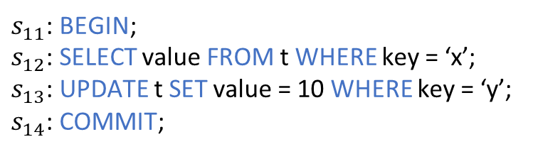




Dependencies in Key-Value Data Models
Existing isolation checkers infer dependencies based on the keys accessed by transaction operations
$$T_{1}$$
$s_{11}$: BEGIN;
$s_{12}$: SELECT value FROM t WHERE key = ‘x’;
$s_{13}$: UPDATE t SET value = 10 WHERE key = ‘y’;
$s_{14}$: COMMIT;
Read value of x
$$rw(x)$$
$$rw(y)$$
$s_{21}$: BEGIN;
$s_{22}$: SELECT value FROM t WHERE key = ‘y’;
$s_{23}$: UPDATE t SET value = 20 WHERE key = ‘x’;
$s_{24}$: COMMIT;
Write value of x
$$T_{2}$$
Only support simple key-value data models and read(key) and write(key, value) operations

Slide 9
Features of Relational DBMSs
Relational data models
No keys
Compound keys
Foreign keys
Table t1
Table t2
Table t3
c1 | c2
1 | 10
2 | 10
2 | 20
c1 PK | c2 PK | c3 UNIQUE
4 | 40 | 10
Foreign key
c1 PK | c2
10 | 50
20 | 60
Table with
no keys
Table with
compound key
Table with
foreign key

Slide 10
Features of Relational DBMSs
Flexible SQL operations
Subqueries
Complex predicates
DELETE and REPLACE statements
SELECT c1 FROM (SELECT c1, c2 FROM t1 WHERE c1+c2 > 10);
Subquery
UPDATE t1 SET c2 = c2–100 WHERE c1+c2 > 10;
Complex predicate
DELETE FROM t1 WHERE c1 < 10;
DELETE statement
REPLACE INTO t1 VALUES (2, 20);
REPALCE statement

Slide 11



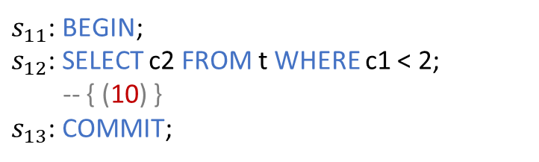
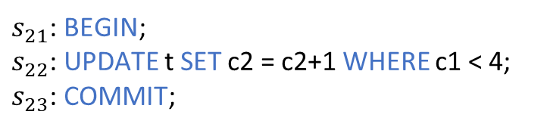

Key Challenge
Cannot infer which rows the transaction reads or writes
Table t
c1 | c2
1 | 10
2 | 10
2 | 20
4 | 40
$$T_{1}$$
$s_{11}$: BEGIN;
$s_{12}$: SELECT c2 FROM t WHERE c1 < 2;
-- { (10) }
$s_{13}$: COMMIT;
Which rows does $s_{12}$ read?
Final database state
c1 | c2
1 | 11
2 | 11
2 | 21
4 | 40
$s_{21}$: BEGIN;
$s_{22}$: UPDATE t SET c2 = c2+1 WHERE c1 < 4;
$s_{23}$: COMMIT;
Which rows does $s_{22}$ write?
$$T_{2}$$

Slide 12
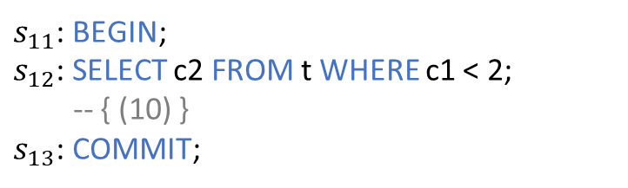
Key Idea
Uniquely identify each row by an auxiliary column rowId
Table t
c1 | c2
1 | 10
2 | 10
2 | 20
4 | 40
$$T_{1}$$
$s_{11}$: BEGIN;
$s_{12}$: SELECT c2 FROM t WHERE c1 < 2;
-- { (10) }
$s_{13}$: COMMIT;
Which rows does $s_{12}$ read?

Slide 13
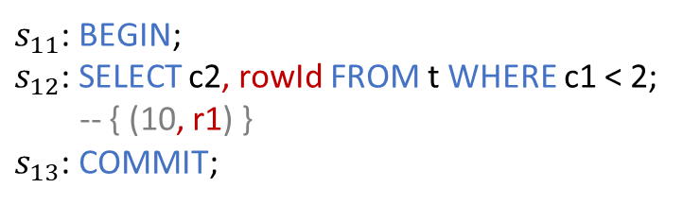
Key Idea
Uniquely identify each row by an auxiliary column rowId
Table t
c1 | c2 | rowId
1 | 10 | r1
2 | 10 | r2
2 | 20 | r3
4 | 40 | r4
$$T_{1}$$
$s_{11}$: BEGIN;
$s_{12}$: SELECT c2, rowId FROM t WHERE c1 < 2;
-- { (10, r1) }
$s_{13}$: COMMIT;
Which rows does $s_{12}$ read?
Read r1

Slide 14
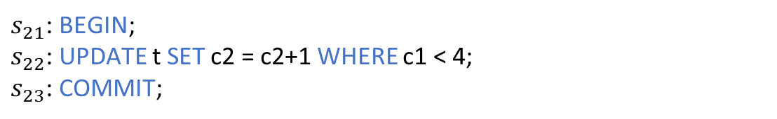


Key Idea
Maintain a list of transactions that create or modify a row by an auxiliary column wList
Table t
c1 | c2 | rowId
1 | 10 | r1
2 | 10 | r2
2 | 20 | r3
4 | 40 | r4
Which rows does $s_{22}$ write?
$$T_{2}$$
$s_{21}$: BEGIN;
$s_{22}$: UPDATE t SET c2 = c2+1 WHERE c1 < 4;
$s_{23}$: COMMIT;

Slide 15
Key Idea
Maintain a list of transactions that create or modify a row by an auxiliary column wList
Table t
Append only
c1 | c2 | rowId | wList
1 | 10 | r1 | T0
2 | 10 | r2 | T0
2 | 20 | r3 | T0
4 | 40 | r4 | T0
Which rows does $s_{22}$ write?
$$T_{2}$$
$s_{21}$: BEGIN;
$s_{22}$: UPDATE t SET c2 = c2+1 WHERE c1 < 4;
$s_{23}$: COMMIT;

Slide 16
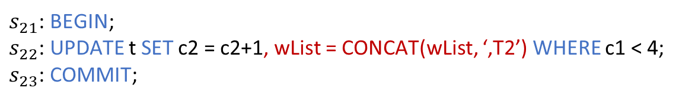
Key Idea
Maintain a list of transactions that create or modify a row by an auxiliary column wList
Table t
Append only
c1 | c2 | rowId | wList
1 | 10 | r1 | T0
2 | 10 | r2 | T0
2 | 20 | r3 | T0
4 | 40 | r4 | T0
Which rows does $s_{22}$ write?
$$T_{2}$$
$s_{21}$: BEGIN;
$s_{22}$: UPDATE t SET c2 = c2+1, wList = CONCAT(wList, ‘,T2’) WHERE c1 < 4;
$s_{23}$: COMMIT;
Table t
c1 | c2 | rowId | wList
1 | 11 | r1 | T0,T2
2 | 11 | r2 | T0,T2
2 | 21 | r3 | T0,T2
4 | 40 | r4 | T0
Write r1, r2 and r3

Slide 17

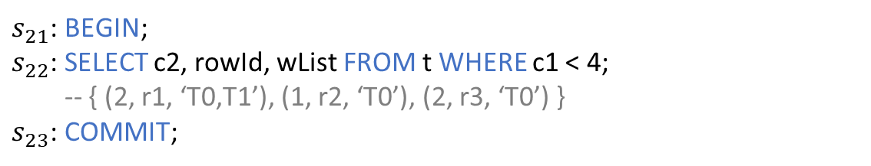

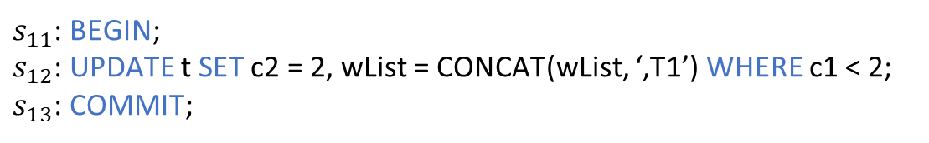
Write-Read Dependency (wr)
Transaction $T_{1}$ writes row $r$, and transaction $T_{2}$ reads row $r$ written by $T_{1}$, then $T_{2}$ wr depends on $T_{1}$
Table t
c1 | c2 | rowId | wList
1 | 1 | r1 | T0
2 | 1 | r2 | T0
2 | 2 | r3 | T0
4 | 4 | r4 | T0
$$T_{1}$$
$s_{11}$: BEGIN;
$s_{12}$: UPDATE t SET c2 = 2, wList = CONCAT(wList, ‘,T1’) WHERE c1 < 2;
$s_{13}$: COMMIT;
Final database state
$s_{21}$: BEGIN;
$s_{22}$: SELECT c2, rowId, wList FROM t WHERE c1 < 4;
-- { (2, r1, ‘T0,T1’), (1, r2, ‘T0’), (2, r3, ‘T0’) }
$s_{23}$: COMMIT;
c1 | c2 | rowId | wList
1 | 2 | r1 | T0,T1
2 | 1 | r2 | T0
2 | 2 | r3 | T0
4 | 4 | r4 | T0
$$T_{2}$$

Slide 18
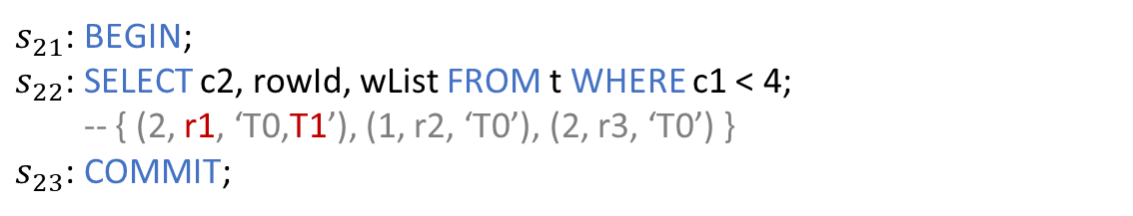

Write-Read Dependency (wr)
Transaction $T_{1}$ writes row $r$, and transaction $T_{2}$ reads row $r$ written by $T_{1}$, then $T_{2}$ wr depends on $T_{1}$
Table t
c1 | c2 | rowId | wList
1 | 1 | r1 | T0
2 | 1 | r2 | T0
2 | 2 | r3 | T0
4 | 4 | r4 | T0
$$T_{1}$$
$s_{11}$: BEGIN;
$s_{12}$: UPDATE t SET c2 = 2, wList = CONCAT(wList, ‘,T1’) WHERE c1 < 2;
$s_{13}$: COMMIT;
$$wr(r1)$$
Final database state
$s_{21}$: BEGIN;
$s_{22}$: SELECT c2, rowId, wList FROM t WHERE c1 < 4;
-- { (2, r1, ‘T0,T1’), (1, r2, ‘T0’), (2, r3, ‘T0’) }
$s_{23}$: COMMIT;
c1 | c2 | rowId | wList
1 | 2 | r1 | T0,T1
2 | 1 | r2 | T0
2 | 2 | r3 | T0
4 | 4 | r4 | T0
$$T_{2}$$

Slide 19

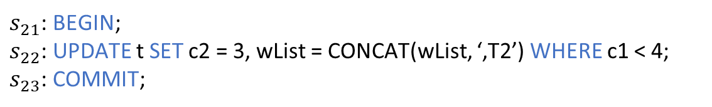
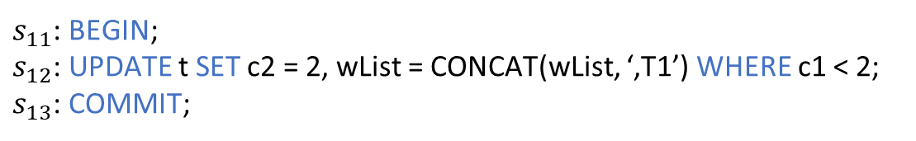
Write-Write Dependency (ww)
Transaction $T_{1}$ writes row $r$, and transaction $T_{2}$ writes the next version of row $r$, then $T_{2}$ ww depends on $T_{1}$
Table t
c1 | c2 | rowId | wList
1 | 1 | r1 | T0
2 | 1 | r2 | T0
2 | 2 | r3 | T0
4 | 4 | r4 | T0
$$T_{1}$$
$s_{11}$: BEGIN;
$s_{12}$: UPDATE t SET c2 = 2, wList = CONCAT(wList, ‘,T1’) WHERE c1 < 2;
$s_{13}$: COMMIT;
Final database state
$s_{21}$: BEGIN;
$s_{22}$: UPDATE t SET c2 = 3, wList = CONCAT(wList, ‘,T2’) WHERE c1 < 4;
$s_{23}$: COMMIT;
c1 | c2 | rowId | wList
1 | 3 | r1 | T0,T1,T2
2 | 3 | r2 | T0,T2
2 | 3 | r3 | T0,T2
4 | 4 | r4 | T0
$$T_{2}$$

Slide 20

Write-Write Dependency (ww)
Transaction $T_{1}$ writes row $r$, and transaction $T_{2}$ writes the next version of row $r$, then $T_{2}$ ww depends on $T_{1}$
Table t
c1 | c2 | rowId | wList
1 | 1 | r1 | T0
2 | 1 | r2 | T0
2 | 2 | r3 | T0
4 | 4 | r4 | T0
$$T_{1}$$
$s_{11}$: BEGIN;
$s_{12}$: UPDATE t SET c2 = 2, wList = CONCAT(wList, ‘,T1’) WHERE c1 < 2;
$s_{13}$: COMMIT;
$$ww(r1)$$
Final database state
$s_{21}$: BEGIN;
$s_{22}$: UPDATE t SET c2 = 3, wList = CONCAT(wList, ‘,T2’) WHERE c1 < 4;
$s_{23}$: COMMIT;
c1 | c2 | rowId | wList
1 | 3 | r1 | T0,T1,T2
2 | 3 | r2 | T0,T2
2 | 3 | r3 | T0,T2
4 | 4 | r4 | T0
$$T_{2}$$

Slide 21


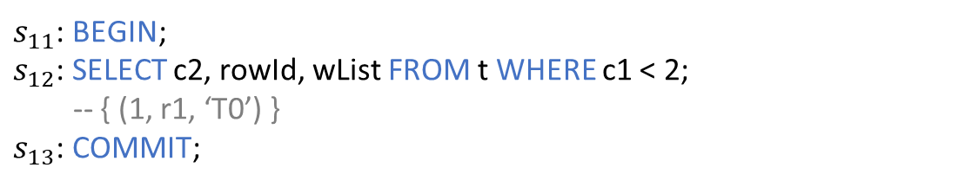
Read-Write Dependency (rw)
Transaction $T_{1}$ reads row $r$, and transaction $T_{2}$ writes the next version of row $r$, then $T_{2}$ rw depends on $T_{1}$
Table t
c1 | c2 | rowId | wList
1 | 1 | r1 | T0
2 | 1 | r2 | T0
2 | 2 | r3 | T0
4 | 4 | r4 | T0
$$T_{1}$$
$s_{11}$: BEGIN;
$s_{12}$: SELECT c2, rowId, wList FROM t WHERE c1 < 2;
-- { (1, r1, ‘T0’) }
$s_{13}$: COMMIT;
Final database state
c1 | c2 | rowId | wList
1 | 2 | r1 | T0,T2
2 | 1 | r2 | T0
2 | 2 | r3 | T0
4 | 4 | r4 | T0
$s_{21}$: BEGIN;
$s_{22}$: UPDATE t SET c2 = 2, wList = CONCAT(wList, ‘,T2’) WHERE c1 < 2;
$s_{23}$: COMMIT;
$$T_{2}$$

Slide 22
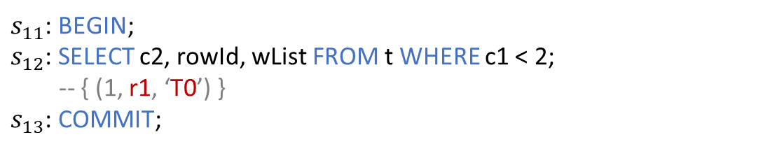

Read-Write Dependency (rw)
Transaction $T_{1}$ reads row $r$, and transaction $T_{2}$ writes the next version of row $r$, then $T_{2}$ rw depends on $T_{1}$
Table t
c1 | c2 | rowId | wList
1 | 1 | r1 | T0
2 | 1 | r2 | T0
2 | 2 | r3 | T0
4 | 4 | r4 | T0
$$T_{1}$$
$s_{11}$: BEGIN;
$s_{12}$: SELECT c2, rowId, wList FROM t WHERE c1 < 2;
-- { (1, r1, ‘T0’) }
$s_{13}$: COMMIT;
Final database state
$$rw(r1)$$
c1 | c2 | rowId | wList
1 | 2 | r1 | T0,T2
2 | 1 | r2 | T0
2 | 2 | r3 | T0
4 | 4 | r4 | T0
$s_{21}$: BEGIN;
$s_{22}$: UPDATE t SET c2 = 2, wList = CONCAT(wList, ‘,T2’) WHERE c1 < 2;
$s_{23}$: COMMIT;
$$T_{2}$$

Slide 23
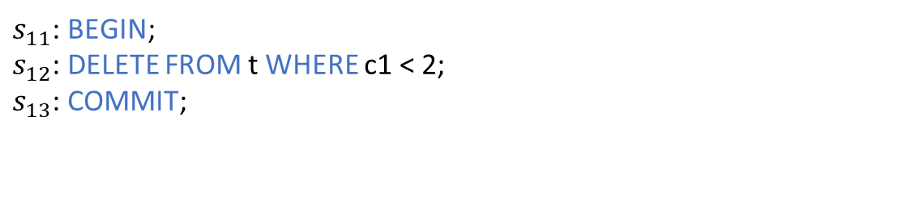

How to Handle DELETE Statements?
Cannot update and retrieve wLists for its modified rows after its execution, since the rows have been deleted
Final database state
$$T_{1}$$
c1 | c2 | rowId | wList
1 | 3 | r1 | T0,T2
2 | 3 | r2 | T0,T2
2 | 3 | r3 | T0,T2
4 | 4 | r4 | T0
$s_{11}$: BEGIN;
$s_{12}$: DELETE FROM t WHERE c1 < 2;
$s_{13}$: COMMIT;

Slide 24
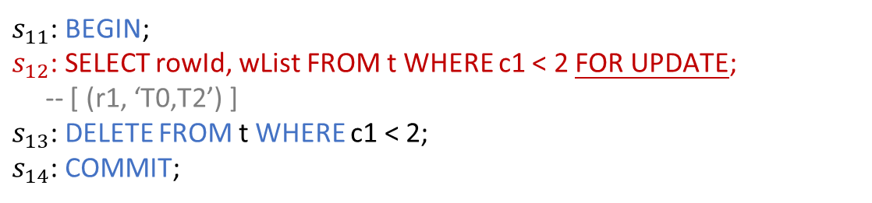
Obtain Dependencies of DELETE Statements
Retrieve rowIds and wLists of the rows to be deleted by adding a SELECT FOR UPDATE statement before each DELETE statement
$$T_{1}$$
The same lock mechanism
Final database state
c1 | c2 | rowId | wList
1 | 3 | r1 | T0,T2
2 | 3 | r2 | T0,T2
2 | 3 | r3 | T0,T2
4 | 4 | r4 | T0
$s_{11}$: BEGIN;
$s_{12}$: SELECT rowId, wList FROM t WHERE c1 < 2 FOR UPDATE;
-- [ (r1, ‘T0,T2’) ]
$s_{13}$: DELETE FROM t WHERE c1 < 2;
$s_{14}$: COMMIT;

Slide 25
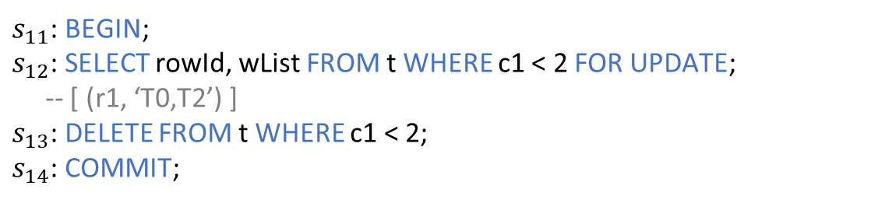
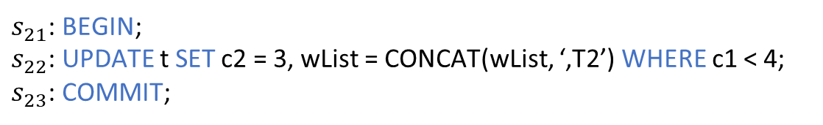

Write-Write Dependency (ww)
Transaction $T_{2}$ writes row $r$, and then transaction $T_{1}$ deletes row $r$, then $T_{1}$ ww depends on $T_{2}$
Final database state
$$T_{1}$$
c1 | c2 | rowId | wList
1 | 3 | r1 | T0,T2
2 | 3 | r2 | T0,T2
2 | 3 | r3 | T0,T2
4 | 4 | r4 | T0
$s_{11}$: BEGIN;
$s_{12}$: SELECT rowId, wList FROM t WHERE c1 < 2 FOR UPDATE;
-- [ (r1, ‘T0,T2’) ]
$s_{13}$: DELETE FROM t WHERE c1 < 2;
$s_{14}$: COMMIT;
$s_{21}$: BEGIN;
$s_{22}$: UPDATE t SET c2 = 3, wList = CONCAT(wList, ‘,T2’) WHERE c1 < 4;
$s_{23}$: COMMIT;
$$T_{2}$$

Slide 26

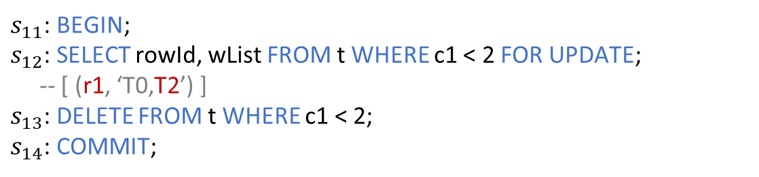
Write-Write Dependency (ww)
Transaction $T_{2}$ writes row $r$, and then transaction $T_{1}$ deletes row $r$, then $T_{1}$ ww depends on $T_{2}$
Final database state
$$T_{1}$$
c1 | c2 | rowId | wList
1 | 3 | r1 | T0,T2
2 | 3 | r2 | T0,T2
2 | 3 | r3 | T0,T2
4 | 4 | r4 | T0
$s_{11}$: BEGIN;
$s_{12}$: SELECT rowId, wList FROM t WHERE c1 < 2 FOR UPDATE;
-- [ (r1, ‘T0,T2’) ]
$s_{13}$: DELETE FROM t WHERE c1 < 2;
$s_{14}$: COMMIT;
$$ww(r1)$$
$s_{21}$: BEGIN;
$s_{22}$: UPDATE t SET c2 = 3, wList = CONCAT(wList, ‘,T2’) WHERE c1 < 4;
$s_{23}$: COMMIT;
$$T_{2}$$

Slide 27

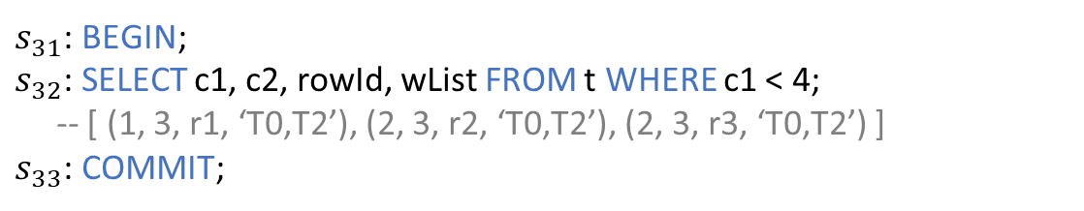

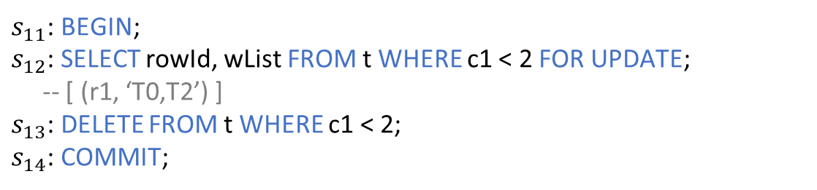
Read-Write Dependency (rw)
Transaction $T_{2}$ reads row $r$, and then transaction $T_{1}$ deletes row $r$, then $T_{1}$ rw depends on $T_{2}$
Final database state
$$T_{1}$$
c1 | c2 | rowId | wList
1 | 3 | r1 | T0,T2
2 | 3 | r2 | T0,T2
2 | 3 | r3 | T0,T2
4 | 4 | r4 | T0
$s_{11}$: BEGIN;
$s_{12}$: SELECT rowId, wList FROM t WHERE c1 < 2 FOR UPDATE;
-- [ (r1, ‘T0,T2’) ]
$s_{13}$: DELETE FROM t WHERE c1 < 2;
$s_{14}$: COMMIT;
$s_{31}$: BEGIN;
$s_{32}$: SELECT c1, c2, rowId, wList FROM t WHERE c1 < 4;
-- [ (1, 3, r1, ‘T0,T2’), (2, 3, r2, ‘T0,T2’), (2, 3, r3, ‘T0,T2’) ]
$s_{33}$: COMMIT;
$$T_{3}$$

Slide 28

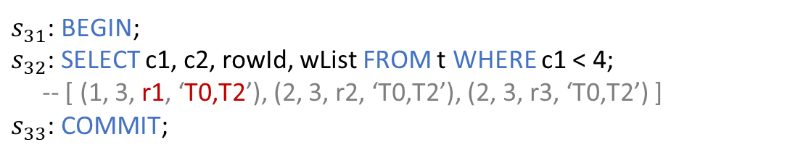
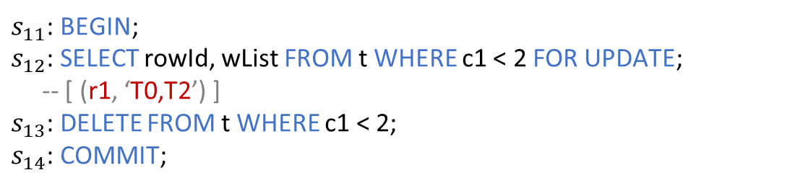
Read-Write Dependency (rw)
Transaction $T_{2}$ reads row $r$, and then transaction $T_{1}$ deletes row $r$, then $T_{1}$ rw depends on $T_{2}$
Final database state
$$T_{1}$$
c1 | c2 | rowId | wList
1 | 3 | r1 | T0,T2
2 | 3 | r2 | T0,T2
2 | 3 | r3 | T0,T2
4 | 4 | r4 | T0
$s_{11}$: BEGIN;
$s_{12}$: SELECT rowId, wList FROM t WHERE c1 < 2 FOR UPDATE;
-- [ (r1, ‘T0,T2’) ]
$s_{13}$: DELETE FROM t WHERE c1 < 2;
$s_{14}$: COMMIT;
$$rw(r1)$$
$s_{31}$: BEGIN;
$s_{32}$: SELECT c1, c2, rowId, wList FROM t WHERE c1 < 4;
-- [ (1, 3, r1, ‘T0,T2’), (2, 3, r2, ‘T0,T2’), (2, 3, r3, ‘T0,T2’) ]
$s_{33}$: COMMIT;
$$T_{3}$$

Slide 29


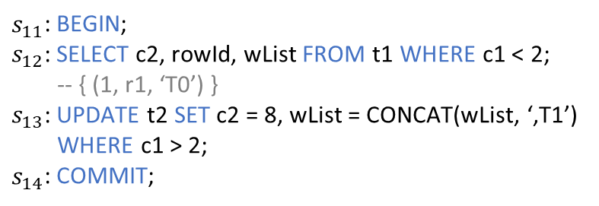

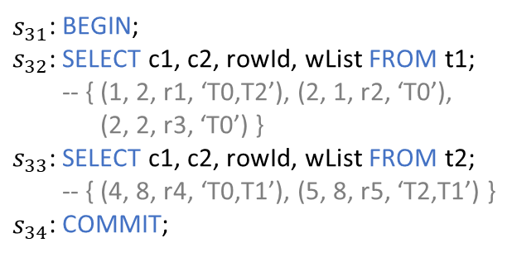


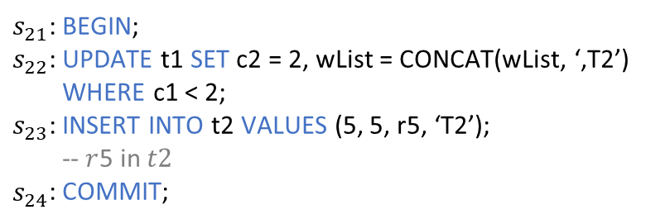


Isolation Anomaly Detection
Construct dependency graph among transactions
Table t1
$$T_{1}$$
$$T_{3}$$
c1 | c2 | rowId | wList
1 | 1 | r1 | T0
2 | 1 | r2 | T0
2 | 2 | r3 | T0
$s_{11}$: BEGIN;
$s_{12}$: SELECT c2, rowId, wList FROM t1 WHERE c1 < 2;
-- { (1, r1, ‘T0’) }
$s_{13}$: UPDATE t2 SET c2 = 8, wList = CONCAT(wList, ‘,T1’)
WHERE c1 > 2;
$s_{14}$: COMMIT;
$s_{31}$: BEGIN;
$s_{32}$: SELECT c1, c2, rowId, wList FROM t1;
-- { (1, 2, r1, ‘T0,T2’), (2, 1, r2, ‘T0’),
(2, 2, r3, ‘T0’) }
$s_{33}$: SELECT c1, c2, rowId, wList FROM t2;
-- { (4, 8, r4, ‘T0,T1’), (5, 8, r5, ‘T2,T1’) }
$s_{34}$: COMMIT;
$$wr(r4, r5)$$
$$rw(r1)$$
$$ww(r5)$$
$$wr(r1)$$
Table t2
$s_{21}$: BEGIN;
$s_{22}$: UPDATE t1 SET c2 = 2, wList = CONCAT(wList, ‘,T2’)
WHERE c1 < 2;
$s_{23}$: INSERT INTO t2 VALUES (5, 5, r5, ‘T2’);
-- $r$5 in $t2$
$s_{24}$: COMMIT;
c1 | c2 | rowId | wList
4 | 4 | r4 | T0
$$T_{2}$$

Slide 30
















Isolation Anomaly Detection
Four cycle-related isolation anomaly patterns for the relational data models based on the isolation anomaly definition of Adya et al. [1-2]
G0: Write cycles
G1b: Intermediate reads
$$T_{1}$$
$$T_{1}$$
$$ww$$
$$ww$$
①
$$wr$$
②
$$rw$$
$$T_{2}$$
$$T_{2}$$
G1c: Circular information flow
G2-item: Anti-dependency cycles
$$T_{1}$$
$$T_{1}$$
$ww$/$wr$
$ww$/$wr$
$$rw$$
$ww$/$wr$/$rw$
$$T_{2}$$
$$T_{2}$$
lost update, write skew, read skew, read-write skew, …
[1] Atul Adya. Weak Consistency: A Generalized Theory and Optimistic Implementations for Distributed Transactions. Massachusetts Institute of Technology 1999.
[2] Atul Adya, et. al., Generalized Isolation Level Definitions. ICDE 2000.

Slide 31



Isolation Anomaly Detection
A cycle-independent isolation anomaly pattern for the relational data models based on the isolation anomaly definition of Adya et al. [1-2]
G1a: Aborted reads w1[$x_{i}$] ... r2[$x_{i}$] ... ($a_{1}$ and $c_{2}$ in any order)
Rollback
Commit
$$wr$$
$$T_{1}$$
$$T_{2}$$
[1] Atul Adya. Weak Consistency: A Generalized Theory and Optimistic Implementations for Distributed Transactions. Massachusetts Institute of Technology 1999.
[2] Atul Adya, et. al., Generalized Isolation Level Definitions. ICDE 2000.

Slide 32






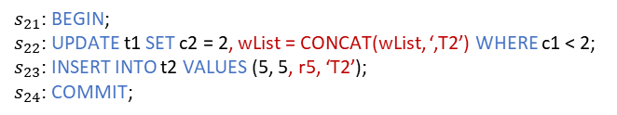

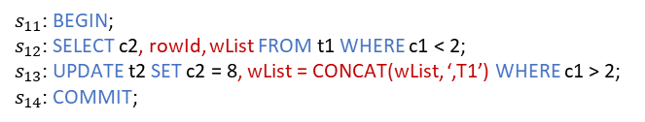

IsoRel
A black-box isolation checker for relational DBMSs
1
2
5
Database
Generation
Auxiliary Column Generation
Execute
Relational DBMS
c1 | c2
1 | 1
2 | 1
2 | 2
c1 | c2 | rowId | wList
1 | 1 | r1 | T0
2 | 1 | r2 | T0
2 | 2 | r3 | T0
History
$$rw(r1)$$
3
4
6
Transaction Generation
SQL Statement Instrumentation
Dependency Graph Construction
$$T_{1}$$
$$T_{2}$$
$$ww(r5)$$
$s_{11}$: BEGIN;
$s_{12}$: SELECT c2, rowId, wList FROM t1 WHERE c1 < 2;
$s_{13}$: UPDATE t2 SET c2 = 8, wList = CONCAT(wList, ‘,T1’) WHERE c1 > 2;
$s_{14}$: COMMIT;
$$T_{1}$$
7
Isolation Anomaly Detection
$s_{21}$: BEGIN;
$s_{22}$: UPDATE t1 SET c2 = 2, wList = CONCAT(wList, ‘,T2’) WHERE c1 < 2;
$s_{23}$: INSERT INTO t2 VALUES (5, 5, r5, ‘T2’);
$s_{24}$: COMMIT;
$$T_{2}$$

Slide 33
Initial Database Generation
Randomly generate data types, column constraints, and data
Table t1
Table t2
Table t3
c1 INT NOT NULL | c2 TEXT
1 | ‘a’
2 | null
2 | ‘12’
c1 INT PK | c2 DOUBLE PK | c3 INT UNIQUE
4 | 4.0 | 10
Foreign key
c1 INT PK | c2 DOUBLE
10 | 50.1
20 | 60.2

Slide 34
Transaction Generation
Generate transaction start statement BEGIN
Randomly generate a set of SQL statements involving complex SQL operations
Randomly generate transaction end statement COMMIT/ROLLBACK
BEGIN;
SELECT c1 FROM t1 WHERE c1+c2 > 10;
UPDATE t1 SET c2 = c2–100 WHERE c1 < 10;
INSERT INTO t1 VALUES (3, 11, 11);
COMMIT;

Slide 35
SQL Statement Instrumentation
Record and obtain the data rows accessed by each SQL statement atomically
SQL Type | SQL Example | Instrumented SQL Statement
SELECT | SELECT c1, c2 FROM t WHERE c2>1 | SELECT c1, c2, rowId, wList FROM t WHERE c2>1
INSERT | INSERT INTO t(c1, c2) VALUES (1, 1) | INSERT INTO t(c1, c2, rowId, wList) VALUES (1, 1, rowId, ‘TxId’)
UPDATE | UPDATE t SET c1=1 WHERE c2>1 | UPDATE t SET c1=1, wList=CONCAT(wList, ‘,TxId’) WHERE c2>1
DELETE | DELETE FROM t WHERE c2>1 | SELECT rowId, wList FROM t WHERE c2>1 FOR UPDATE DELETE FROM t WHERE c2>1
REPLACE with Key | REPLACE INTO t(c1, c2) VALUES (1, 1) /**c1 is the primary key of table t**/ | SELECT rowId, wList FROM t WHERE c1=1 FOR UPDATE REPLACE INTO t(c1, c2, rowId, wList) VALUES (1, 1, rowId, ‘TxId’)
REPLACE without Key | REPLACE INTO t(c1, c2) VALUES (1, 1) /**There is no primary key in table t**/ | REPLACE INTO t(c1, c2, rowId, wList) VALUES (1, 1, rowId, ‘TxId’)
The SQL statement instrumentation is isolation-agnostic,
without affecting the concurrent transaction execution

Slide 36
Evaluation
RQ1 (effectiveness): How effective is IsoRel in detecting isolation anomalies in relational DBMSs?
RQ2 (root cause): What are the root causes of the isolation anomalies detected by IsoRel?
RQ3 (comparison): How does IsoRel compare against existing isolation checkers?

Slide 37
Evaluation
Evaluate IsoRel on five widely-used relational DBMSs
Relational DBMS | DB-Engines Rank | GitHub Stars | Isolation Level |  |  |  | Concurrency Control
 |  |  | RU | RC | RR | SER
MySQL | 2 | 9.9K | ✓ | ✓ | ✓ | ✓ | Pessimistic
PostgreSQL | 4 | 13.9K |  | ✓ | ✓ | ✓ | Pessimistic Optimistic
MariaDB | 13 | 5.1K | ✓ | ✓ | ✓ | ✓ | Pessimistic
CockroachDB | 67 | 29.8K |  |  |  | ✓ | Optimistic
TiDB | 87 | 35.6K |  | ✓ | ✓ |  | Pessimistic Optimistic
RU: Read Uncommitted RR: Repeatable Read
RC: Read Committed SER: Serializable

Slide 38
RQ1: Isolation Anomaly Detection Results
IsoRel successfully reproduces 6 known isolation anomalies
ID | Relational DBMS | Release Version | Isolation Level | Isolation Anomaly
1 | MySQL | v8.0.34 | RR | write skew
2 | MySQL | v8.0.34 | RR | read-write skew
3 | MySQL | v8.0.34 | RR | lost update
4 | PostgreSQL | v12.3 | RR | write skew
5 | MariaDB-Galera | v10.7.3 | RR | lost update
6 | TiDB | v2.1.7 | RR | write skew

Slide 39
RQ1: Isolation Anomaly Detection Results
IsoRel has revealed 48 unique isolation anomalies
Relational DBMS | #Txn | Isolation Level |  |  |  | #Isolation Anomaly |  | Lost Update | Read-Write Skew | Write Skew
 |  | RU | RC | RR | SER | Total | Unique
MySQL | 5774 | 0 | 0 | 57 | 0 | 57 | 14 | 4 | 4 | 6
PostgreSQL | 2536 | - | 0 | 8 | 0 | 8 | 6 | 0 | 0 | 6
MariaDB | 4515 | 0 | 0 | 92 | 0 | 92 | 14 | 4 | 4 | 6
CockroachDB | 4090 | - | - | - | 0 | 0 | 0 | 0 | 0 | 0
TiDB | 5802 | - | 0 | 168 | - | 168 | 14 | 4 | 4 | 6
Total | 22717 | 0 | 0 | 325 | 0 | 325 | 48 | 12 | 12 | 24

Slide 40







RQ2: Analyzing Isolation Anomalies
No lock conflicts due to the timing of COMMIT (36/48)
$$T_{1}$$
Table t1
c1 | c2
1 | 1
2 | 1
$s_{11}$: BEGIN;
$s_{12}$: SELECT c2 FROM t1 WHERE c1 < 2;
-- { (1) }
$$r1$$
$$r2$$
Table t2
c1 | c2
4 | 4
$$r3$$
$s_{21}$: BEGIN;
$$T_{2}$$

Slide 41

RQ2: Analyzing Isolation Anomalies
No lock conflicts due to the timing of COMMIT (36/48)
$$T_{1}$$
Table t1
c1 | c2
1 | 2
2 | 1
$s_{11}$: BEGIN;
$s_{12}$: SELECT c2 FROM t1 WHERE c1 < 2;
-- { (1) }
$$r1$$
$$r2$$
Table t2
c1 | c2
4 | 4
$$r3$$
$s_{21}$: BEGIN;
$s_{22}$: UPDATE t1 SET c2 = 2 WHERE c1 < 2;
$$T_{2}$$

Slide 42

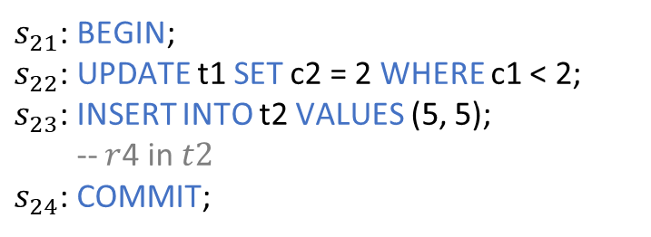
RQ2: Analyzing Isolation Anomalies
No lock conflicts due to the timing of COMMIT (36/48)
$$T_{1}$$
Table t1
c1 | c2
1 | 2
2 | 1
$s_{11}$: BEGIN;
$s_{12}$: SELECT c2 FROM t1 WHERE c1 < 2;
-- { (1) }
$$r1$$
$$r2$$
Table t2
c1 | c2
4 | 4
5 | 5
$$r3$$
$s_{21}$: BEGIN;
$s_{22}$: UPDATE t1 SET c2 = 2 WHERE c1 < 2;
$s_{23}$: INSERT INTO t2 VALUES (5, 5);
-- $r$4 in $t2$
$s_{24}$: COMMIT;
$$r4$$
$$T_{2}$$

Slide 43

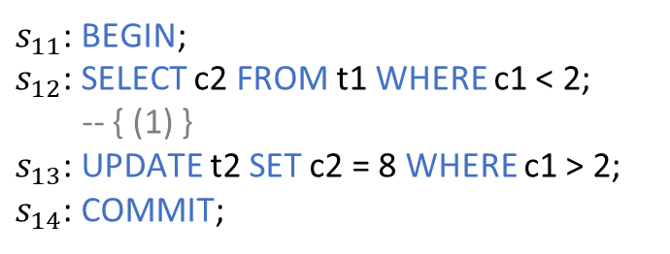


RQ2: Analyzing Isolation Anomalies
No lock conflicts due to the timing of COMMIT (36/48)
$$T_{1}$$
Table t1
c1 | c2
1 | 2
2 | 1
$s_{11}$: BEGIN;
$s_{12}$: SELECT c2 FROM t1 WHERE c1 < 2;
-- { (1) }
$s_{13}$: UPDATE t2 SET c2 = 8 WHERE c1 > 2;
$s_{14}$: COMMIT;
$$r1$$
$$r2$$
Table t2
$$rw(r1)$$
$$ww(r4)$$
Read-write skew
(G2-item)
c1 | c2
4 | 8
5 | 8
$$r3$$
$s_{21}$: BEGIN;
$s_{22}$: UPDATE t1 SET c2 = 2 WHERE c1 < 2;
$s_{23}$: INSERT INTO t2 VALUES (5, 5);
-- $r$4 in $t2$
$s_{24}$: COMMIT;
$$r4$$
$$T_{2}$$

Slide 44


RQ2: Analyzing Isolation Anomalies
No lock conflicts due to accessing different rows (12/48)
$$T_{1}$$
Table t1
c1 | c2
1 | 1
2 | 2
$s_{11}$: BEGIN;
$s_{12}$: SELECT c1, c2 FROM t1 WHERE c1 < 2;
-- [ (1, 1) ]
$$r1$$
$$r2$$
Table t2
c1 | c2
3 | 3
4 | 4
$$r3$$
$s_{21}$: BEGIN;
$s_{22}$: SELECT c1, c2 FROM t2 WHERE c1 < 4;
-- [ (3, 3) ]
$$r4$$
$$T_{2}$$

Slide 45

RQ2: Analyzing Isolation Anomalies
No lock conflicts due to accessing different rows (12/48)
$$T_{1}$$
Table t1
c1 | c2
1 | 1
2 | 2
$s_{11}$: BEGIN;
$s_{12}$: SELECT c1, c2 FROM t1 WHERE c1 < 2;
-- [ (1, 1) ]
$s_{13}$: UPDATE t2 SET c1 = 5 WHERE c1 < 4;
$$r1$$
$$r2$$
Table t2
c1 | c2
5 | 3
4 | 4
$$r3$$
$s_{21}$: BEGIN;
$s_{22}$: SELECT c1, c2 FROM t2 WHERE c1 < 4;
-- [ (3, 3) ]
$$r4$$
$$T_{2}$$

Slide 46
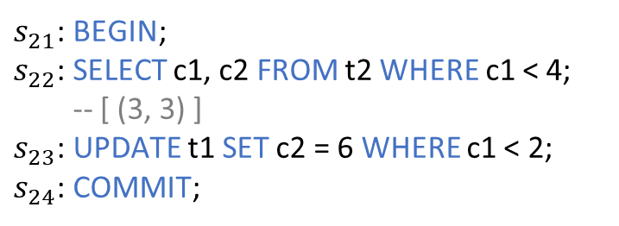

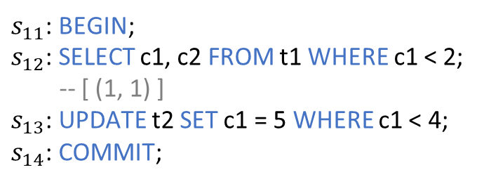
RQ2: Analyzing Isolation Anomalies
No lock conflicts due to accessing different rows (12/48)
$$T_{1}$$
Table t1
c1 | c2
1 | 6
2 | 2
$s_{11}$: BEGIN;
$s_{12}$: SELECT c1, c2 FROM t1 WHERE c1 < 2;
-- [ (1, 1) ]
$s_{13}$: UPDATE t2 SET c1 = 5 WHERE c1 < 4;
$s_{14}$: COMMIT;
$$r1$$
$$r2$$
Table t2
$$rw(r1)$$
$$rw(r3)$$
Write skew
(G2-item)
c1 | c2
5 | 3
4 | 4
$$r3$$
$s_{21}$: BEGIN;
$s_{22}$: SELECT c1, c2 FROM t2 WHERE c1 < 4;
-- [ (3, 3) ]
$s_{23}$: UPDATE t1 SET c2 = 6 WHERE c1 < 2;
$s_{24}$: COMMIT;
$$r4$$
$$T_{2}$$

Slide 47
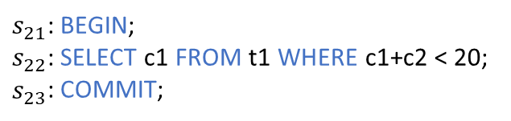
RQ3: Comparison with Existing Isolation Checkers
Analyze whether Elle [1], Cobra [2] and PolySI [3] can conceptually detect the 48 isolation anomalies revealed by IsoRel
Involve relational data models different from key-value data models
Involve complex SQL operations different from read(key) and write(key, value) operations
Table t1
Table t2
Table t3
c1 | c2
1 | 10
2 | 10
2 | 20
c1 PK | c2 PK | c3 UNIQUE
4 | 40 | 10
Foreign key
c1 PK | c2
10 | 50
20 | 60
$s_{21}$: BEGIN;
$s_{22}$: SELECT c1 FROM t1 WHERE c1+c2 < 20;
$s_{23}$: COMMIT;
Relational data models
Complex SQL operations
[1] Kyle Kingsbury and Peter Alvaro. Elle: Inferring Isolation Anomalies from Experimental Observations. VLDB 2020.
[2] Cheng Tan, Changgeng Zhao ,Shuai Mu, and Michael Walfish. Cobra: Making Transactional Key-Value Stores Verifiably Serializable. OSDI 2020.
[3] Kaile Huang, Si Liu, Zhenge Chen, Hengfeng Wei, David A. Basin, Haixiang Li, and Anqun Pan. Efficient Black-box Checking of Snapshot Isolation in Databases. VLDB 2023.

Slide 48
RQ3: Comparison with Existing Isolation Checkers
Only 2 key-value anomalies can be detected by existing isolation checkers
4 anomalies involve relational data models different from key-value data models
42 anomalies involve complex SQL operations different from read(key) and write(key, value) operations
Relational data models
Can be detected by existing isolation checkers
Detection Capabilities of Existing Isolation Checkers
 | IsoRel | Elle [1] | Cobra [2] | PolySI [3]
Isolation Anomaly | 48 | 2 | 0 | 2
Complex SQL operations
[1] Kyle Kingsbury and Peter Alvaro. Elle: Inferring Isolation Anomalies from Experimental Observations. VLDB 2020.
[2] Cheng Tan, Changgeng Zhao ,Shuai Mu, and Michael Walfish. Cobra: Making Transactional Key-Value Stores Verifiably Serializable. OSDI 2020.
[3] Kaile Huang, Si Liu, Zhenge Chen, Hengfeng Wei, David A. Basin, Haixiang Li, and Anqun Pan. Efficient Black-box Checking of Snapshot Isolation in Databases. VLDB 2023.

Slide 49
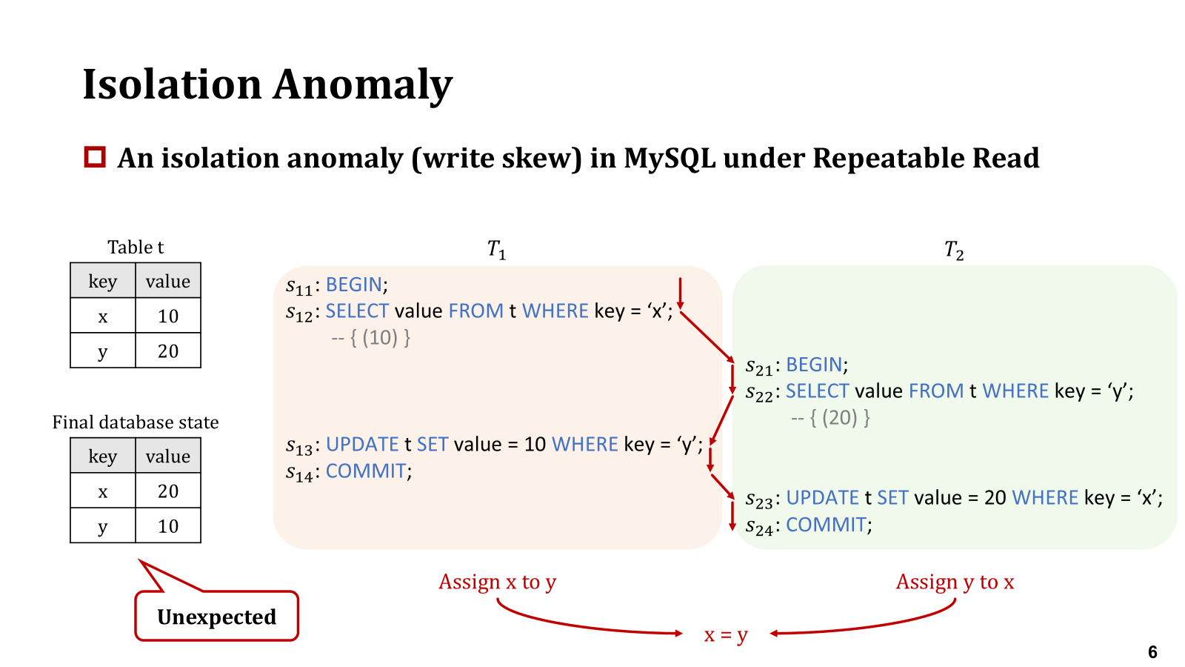
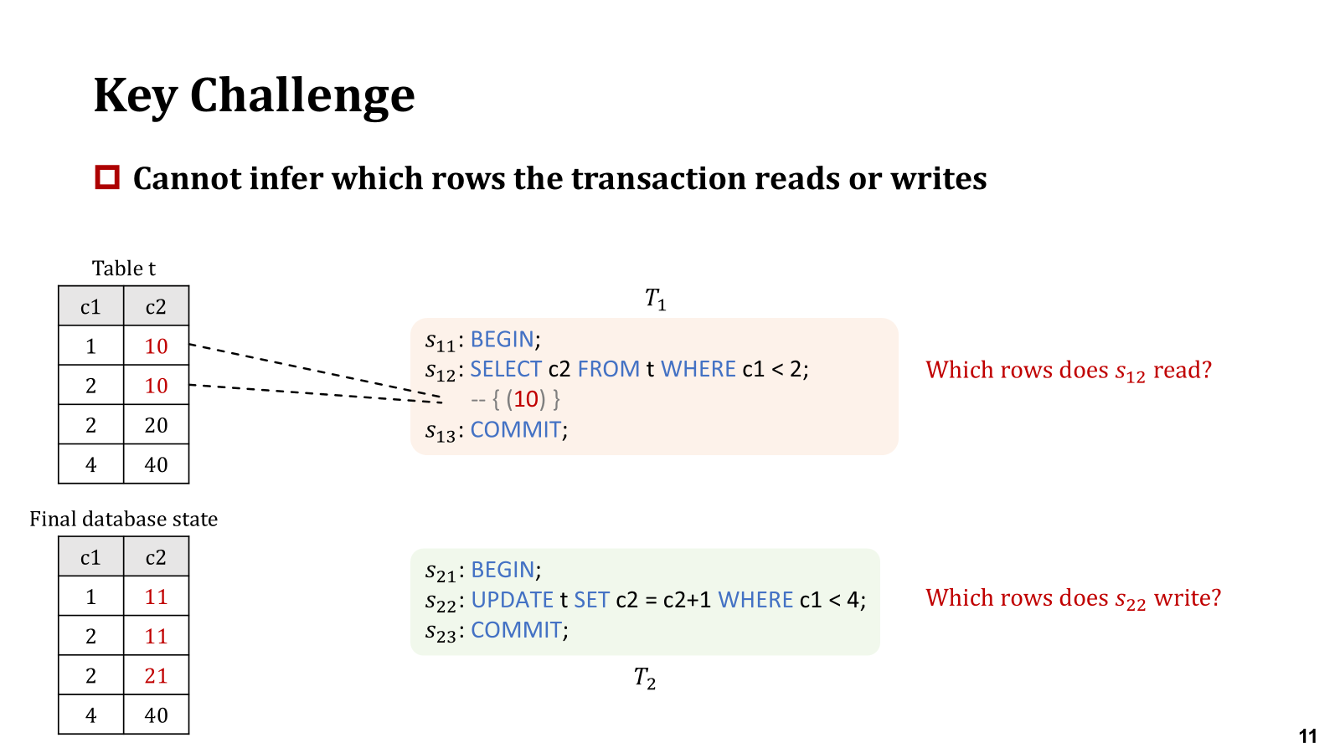
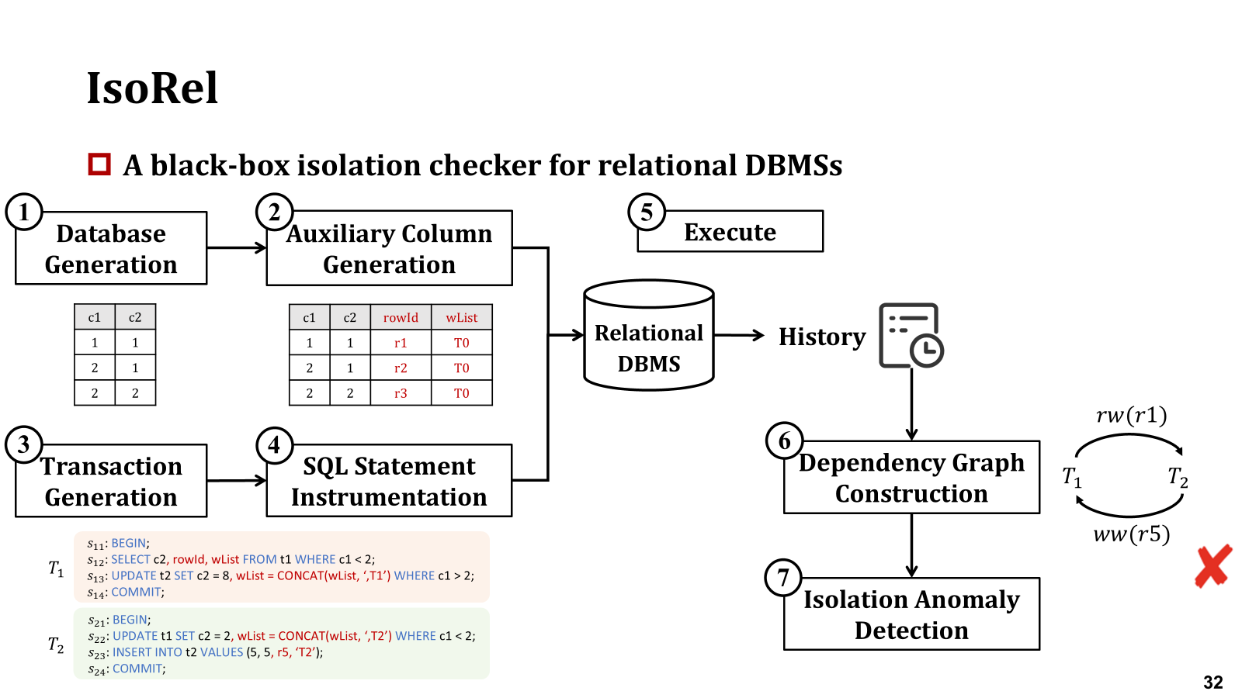
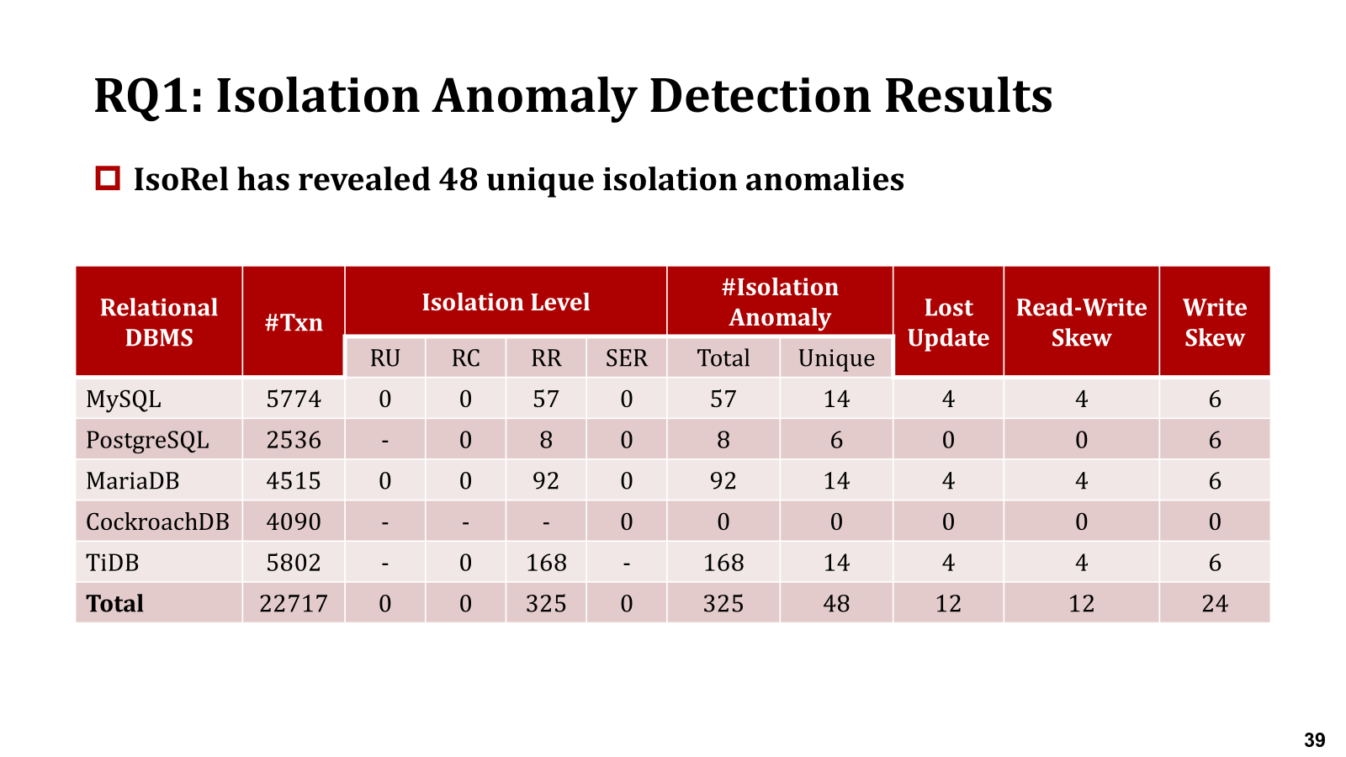
Conclusion
https://figshare.com/s/c79c57db38052eab488b

Slide 50

THANK YOU!

