Slide 1



Detecting Schema-Related Logic Bugs in Relational DBMSs via Equivalent Database Construction
Research 16: Query Processing and Optimization II
51st International Conference on Very Large Databases
Jiansen Song, Wensheng Dou, Yingying Zheng, Yu Gao, Ziyu Cui, Wei Wang, Jun Wei
Institute of Software
Chinese Academy of Sciences
University of Chinese Academy of Sciences

Slide 2
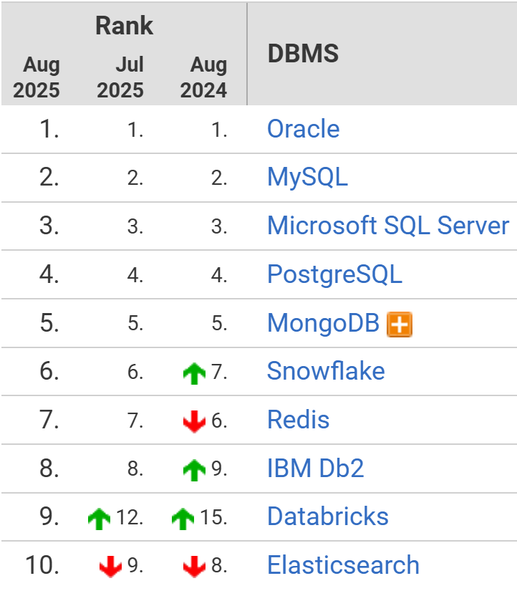
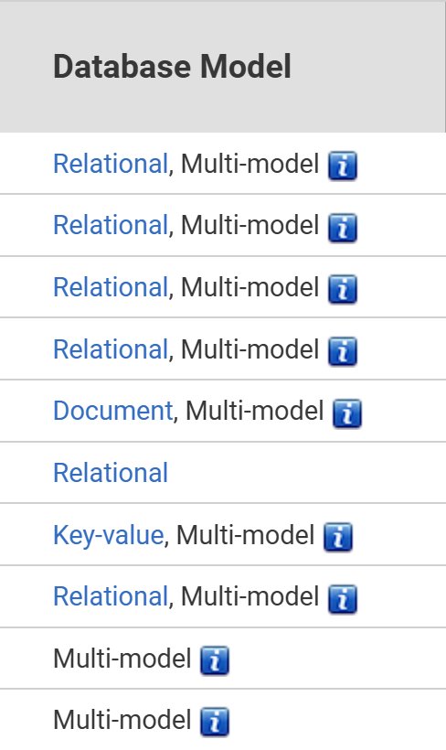





Database Management System (DBMS)
DBMSs are widely used to store and retrieve data
DB-Engines Ranking
https://db-engines.com/en/ranking

Slide 3
Database Schema
DBMSs use database schemas to describe data storage in databases
Database schemas include tables, columns, constraints, and relationships
t1
t2
c1: INT PRIMARY KEY
c2: TEXT
c3: TEXT NOT NULL
c4: CHAR(10)
c5: INT PRIMARY KEY
c6: DATE
c7: TEXT
c8: INT
Foreign Key

Slide 4
Data Definition Language (DDL)
DBMSs provide flexible DDL statements to create, modify, and delete database schemas
CREATE TABLE t1 (c1 INT);
CREATE TABLE t1 (c1 INT, c2 INT);
CREATE INDEX i1 ON t1(c1);
CREATE INDEX i2 ON t1(c1, c2);
ALTER TABLE t1 ADD COLUMN c2 INT;
ALTER TABLE t1 DROP COLUMN c1;
ALTER TABLE t1 MODIFY c1 VARCHAR(100);
ALTER TABLE t1 CHANGE c1 c2 INT;

Slide 5
Schema-Related Information
DBMSs manage various schema-related information internally to store database schema and optimize DBMS execution
INFORMATION_SCHEMA is an ANSI-standard way to store database schema
User-visible
User-invisible
pg_attribute
pg_constraint
pg_index
…
File organization
Pages & blocks
Statistical & Performance metadata
…
INFORMATION_SCHEMA
Other schema-related information

Slide 6


Schema-Related Logic Bug (schemaBug)
Incorrect implementations related to schema-related information maintenance and utilization can introduce schema-related logic bugs
t1
t2
c1: INT UNIQUE
c2: INT PRIMARY KEY
CREATE TABLE t0 (c2 INT PRIMARY KEY);
CREATE TABLE t1 (c1 INT UNIQUE,
FOREIGN KEY (c1) REFERENCES t0(c2));
ALTER TABLE t0 RENAME AS t2;
t1
t0
c1: INT UNIQUE
c2: INT PRIMARY KEY

Slide 7
Schema-Related Logic Bug (schemaBug)
schemaBugs may cause incorrect execution results for subsequent SQL statements, e.g., incorrect database states or incorrect query results
t1
c1 INT
0
CREATE TABLE t0 (c1 INT, c2 BLOB)
ROW_FORMAT=REDUNDANT;
ALTER TABLE t0 DROP c2;
INSERT INTO t0 (c1) VALUES (0);
t1
c1 INT
https://jira.mariadb.org/browse/MDEV-35122

Slide 8




Existing Approaches
Existing approaches focus on detecting bugs in SELECT statements
NoREC [1] transforms WHERE clauses into SELECT expressions
Radar [2] examines the correctness of metadata-related query optimizations
DQP [3] enforces different query plans for the same query
$$db$$
SELECT
NoREC, DQP
Same
$$db$$
SELECT’
They cannot be effectively applied to detect schemaBugs
[1] M. Rigger and Z. Su, Detecting optimization bugs in database engines via non-optimizing reference engine construction, ESEC/FSE 2020
[2] Song et al., Detecting Metadata-Related Logic Bugs in Database Systems via Raw Database Construction, VLDB 2025
[3] Ba et al., Keep It Simple: Testing Databases via Differential Query Plans, SIGMOD 2024

Slide 9

















Observation
Different DDL sequences can create equivalent databases, which share the same user-visible database schema
$$s_{0}$$
$$ε$$
CREATE TABLE t1 (c1 INT, c2 INT);
ALTER TABLE t1 ADD INDEX i0(c1);
$$db_{1}$$
$$Table(c1)$$
$$Table(c1,c2)$$
=
$$s_{2}$$
$$t1(c1)$$
$$s_{1}$$
$$t1(c1,c2)$$
$$INDEX(c1)$$
CREATE TABLE t1 (c1 INT);
ALTER TABLE t1 ADD INDEX i0(c1);
ALTER TABLE t1 ADD COLUMN c2 INT;
$$db_{2}$$
$$s_{3}$$
$$t1(c1,INDEX(c1))$$
$$INDEX(c1)$$
$$Add(c2)$$
$$s_{4}$$
$$t1(c1, c2, INDEX\left(c1\right))$$

Slide 10


Observation
DBMSs should return the same execution results for the same SQL statements executed on the equivalent databases
$$db_{1}$$
t1
c1 INT
INSERT INTO t1 VALUE (0);
0
Same database schema
Same
Same
$$db_{2}$$
t1
c1 INT
INSERT INTO t1 VALUE (0);
0

Slide 11







Approach
We propose DDLCheck to detect schema-related logic bugs in DBMSs
DML &
SELECT
CREATE
CREATE
ALTER
ALTER
$$db_{1}$$
Query
Result
Database
State
Generating
DDL Sequence
Same
$$≠$$
DML &
SELECT
Bug
CREATE
ALTER
$$db_{2}$$
● Generating
SQL Statement
Query
Result
Database
State
 Synthesizing
DDL Sequence
❍ Executing and comparing
execution results

Slide 12


Generating DDL Sequence
Starting from an empty database schema, we generate a DDL sequence that consists of various DDL statement types
Empty database schema
CREATE TABLE t1 (c1 INT);
CREATE TABLE t2 (c1 INT, c2 INT);
$$t1(c1 INT); t2(c1 INT, c2 INT)$$
CREATE INDEX i1 ON t1(c1);
ALTER TABLE t2 DROP COLUMN c2;
$$t1(c1 INT, INDEX(c1)); t2(c1 INT)$$

Slide 13

Synthesizing DDL Sequence
We synthesize CREATE statements to create the same database schema
CREATE TABLE t1 (c1 INT,
c2 INT NOT NULL);
ALTER TABLE t1 ADD
PRIMARY KEY (c1);
t1
$$db_{1}$$
c1: INT PRIMARY KEY
c2: INT NOT NULL
CREATE TABLE t1 (
c1 INT PRIMARY KEY,
c2 INT NOT NULL);
Generated DDL sequence
Database schema
Synthesized DDL sequence

Slide 14







Comparing Execution Results
Compare the execution results against databases $db_{1}$ and $db_{2}$
$$db_{1}$$
DML
$$db_{1}$$
SELECT
Database
State
Query
Result
Same
Same
$$≠$$
$$≠$$
Bug
Bug
$$db_{2}$$
DML
$$db_{2}$$
SELECT
Database
State
Query
Result

Slide 15

Testing Similar DDL Sequences Reduces Efficiency
Different DDL sequences can create the same or similar schema-related information, reducing the testing efficiency of DDLCheck
CREATE TABLE t0 (c1 INT);
RENAME TABLE t0 TO t1;
CREATE TABLE t2 (c1 INT);
RENAME TABLE t2 TO t3;
t0
t1
t2
t3
c1: INT
c1: INT
c1: INT
c1: INT

Slide 16

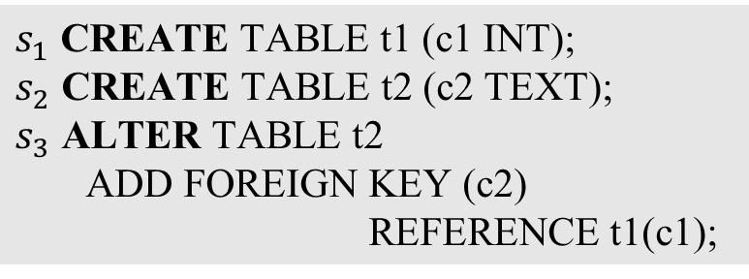







Sequence-Oriented Testing Optimization
DDLCheck focuses on testing unique table structure changes
A database schema transition graph is maintained to record the table structure change history conducted by the DDL sequence
$$n_{1,0}$$
$$n_{2,0}$$
$$s_{1}$$
$$s_{2}$$
$s_{1}$ CREATE TABLE t1 (c1 INT);
$s_{2}$ CREATE TABLE t2 (c2 TEXT);
$s_{3}$ ALTER TABLE t2
ADD FOREIGN KEY (c2)
REFERENCE t1(c1);
$n_{1,1}$
t1
$n_{2,1}$
t2
c1 INT
c2 TEXT
$$s_{3}$$
$n_{2,2}$
t2
c2 TEXT
FK(c2,t1.c1)

Slide 17


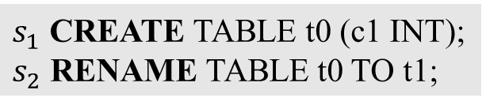









Sequence-Oriented Testing Optimization
Given two database transition graphs, we compare the stored table structured in each node and the statement type of each edge
$s_{1}$ CREATE TABLE t0 (c1 INT);
$s_{2}$ RENAME TABLE t0 TO t1;
$s_{3}$ CREATE TABLE t2 (c1 INT);
$s_{4}$ RENAME TABLE t2 TO t3;
$$n_{1,0}$$
$$n_{1,0}$$
$$s_{1}$$
CREATE
$$s_{3}$$
$n_{2,1}$
t0
$n_{2,1}$
t2
c1 INT
c1 INT
$$s_{2}$$
RENAME
$$s_{4}$$
$n_{2,2}$
t1
$n_{2,2}$
t3
c1 INT
c1 INT

Slide 18

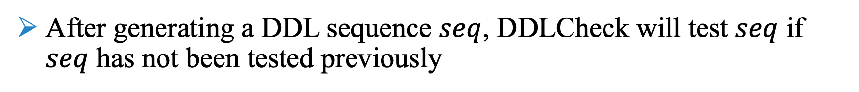
Workflow
After generating a DDL sequence $seq$, DDLCheck will test $seq$ if $seq$ has not been tested previously
Tested DSTGs
Generate another sequence
No
CREATE
ALTER
ALTER
isNew?
Yes
A new one,
We test it
Sequence
Database Schema
Transition Graph (DSTG)

Slide 19
Evaluation
RQ1: Bug detection capability
What schemaBugs can DDLCheck detect in real-world relational DBMSs?
RQ2: Effectiveness of DDL-sequence-oriented testing optimization
How effective is the DDL-sequence-oriented testing optimization in DDLCheck?
RQ3: Comparing with existing approaches
How many bugs detected by DDLCheck can be found by existing approaches?

Slide 20
Target DBMSs
We select six widely-used and production-level relational DBMSs
DBMS | DB-Engines Ranking | GitHub Stars | Type
MySQL | 2 | 10.8K | Traditional
PostgreSQL | 4 | 16.1K | Traditional
SQLite | 10 | 7.1K | Embedded
MariaDB | 15 | 5.6K | Traditional
CockroachDB | 64 | 30.1K | NewSQL
TiDB | 77 | 37.2K | NewSQL

Slide 21
Bug Detection Capability
34 bugs are submitted
29 bugs are confirmed as new bugs
9 bugs have been fixed
DBMS | Submitted | Confirmed | Fixed | schema𝐵𝑢𝑔 | Crash
MySQL | 14 | 14 | 2 | 13 | 1
MariaDB | 11 | 7 | 3 | 5 | 0
CockroachDB | 2 | 1 | 0 | 1 | 2
TiDB | 7 | 7 | 4 | 2 | 5
Total | 34 | 29 | 9 | 21 | 8

Slide 22
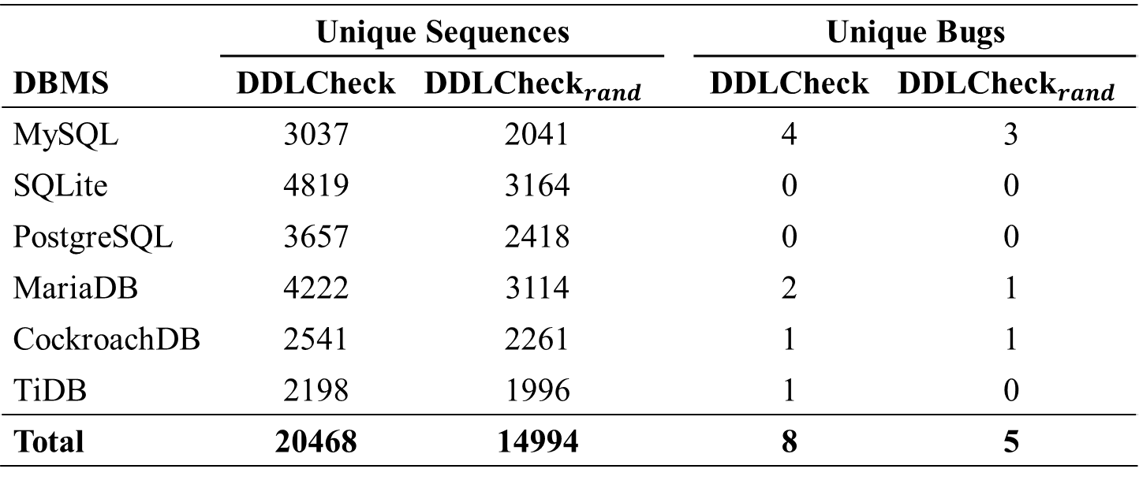
Effectiveness of Testing Optimization
Compare DDLCheck and DDLCheck_{𝑟𝑎𝑛𝑑} that tests all the generated DDL sequences
 | Unique Sequences |  |  | Unique Bugs
DBMS | DDLCheck | $${\text{DDLCheck}}_{rand}$$ |  | DDLCheck | $${\text{DDLCheck}}_{rand}$$
MySQL | 3037 | 2041 |  | 4 | 3
SQLite | 4819 | 3164 |  | 0 | 0
PostgreSQL | 3657 | 2418 |  | 0 | 0
MariaDB | 4222 | 3114 |  | 2 | 1
CockroachDB | 2541 | 2261 |  | 1 | 1
TiDB | 2198 | 1996 |  | 1 | 0
Total | 20468 | 14994 |  | 8 | 5
DDLCheck can test more unique sequences and detect more unique bugs

Slide 23
Comparing with Existing Approaches
Investigate whether the 21 confirmed schemaBugs can be detected by existing approaches
DBMS | DDLCheck | NoREC | Radar | DQP
MySQL | 13 | 0 | 10 | 8
MariaDB | 5 | 0 | 1 | 0
CockroachDB | 1 | 0 | 1 | 0
TiDB | 2 | 0 | 1 | 1
Total | 21 | 0 | 13 | 9
Existing approaches can detect at most 13 out of the 21 confirmed schemaBugs
[1] M. Rigger and Z. Su, Detecting optimization bugs in database engines via non-optimizing reference engine construction, ESEC/FSE 2020
[2] Song et al., Detecting Metadata-Related Logic Bugs in Database Systems via Raw Database Construction, VLDB 2025
[3] Ba et al., Keep It Simple: Testing Databases via Differential Query Plans, SIGMOD 2024

Slide 24
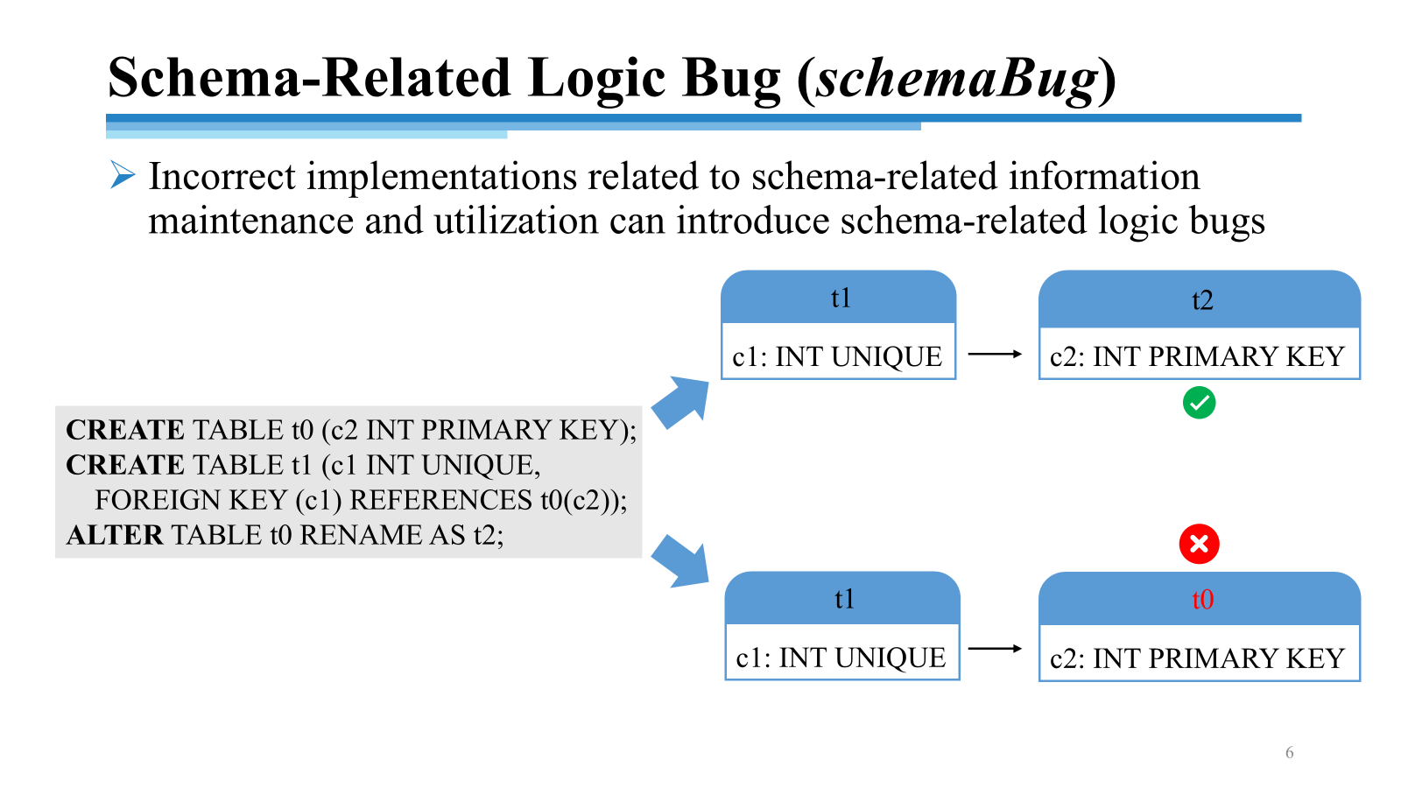
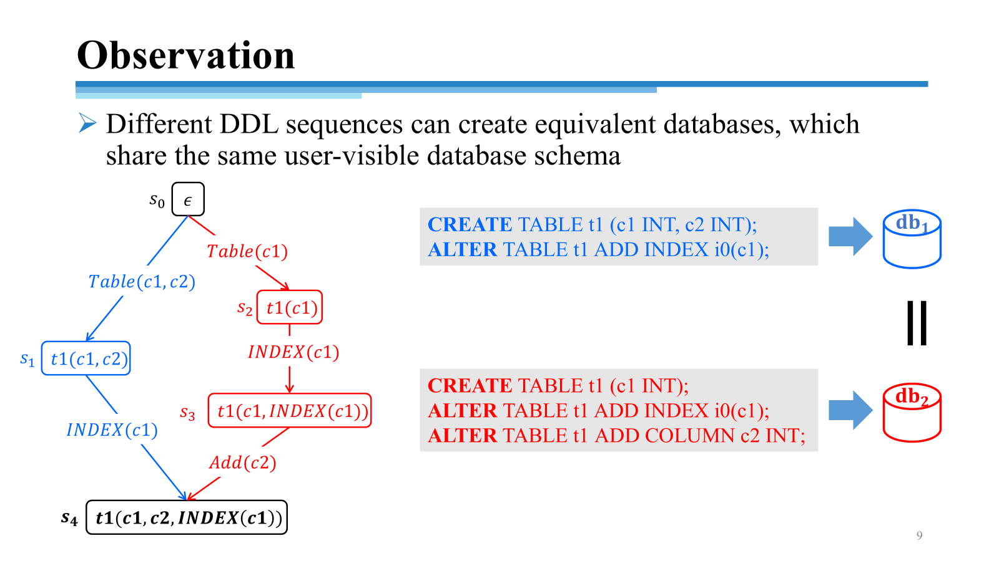
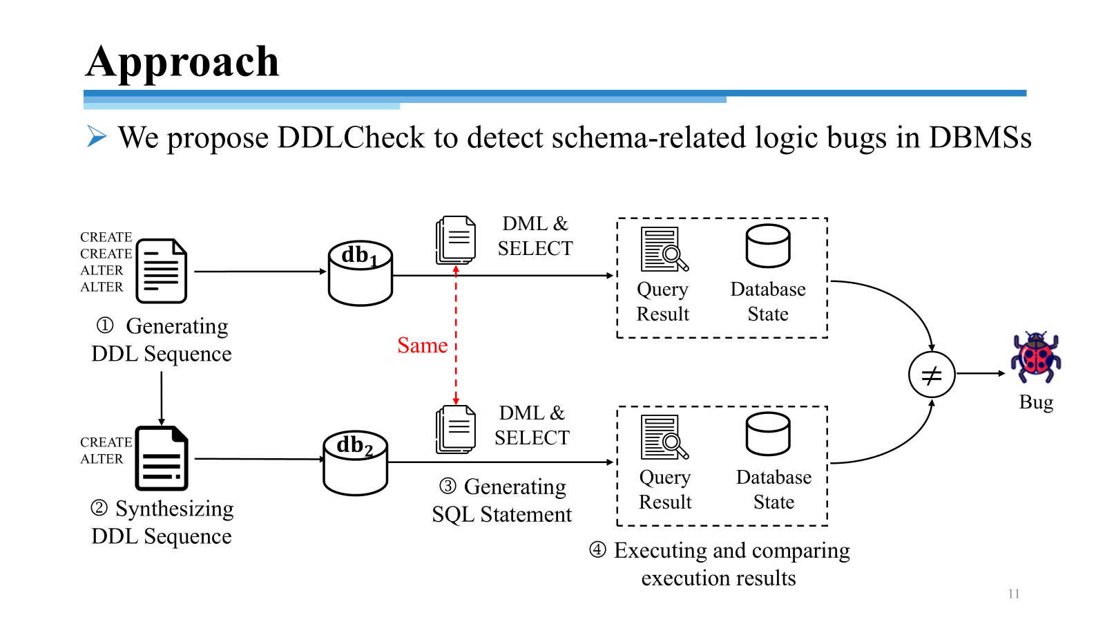
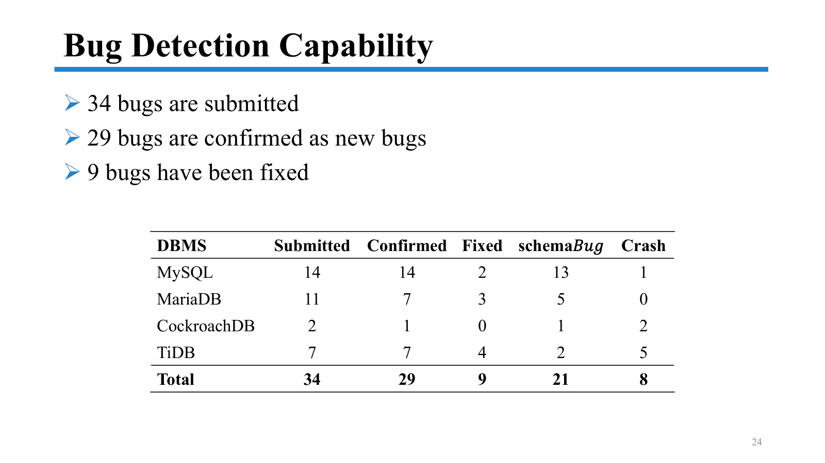
Conclusion
https://figshare.com/s/e222bd56c4925375ac34

