Slide 1



Research 52 – Transaction Management
51st International Conference on Very Large Data Bases
Simple Testing Can Expose Most Critical Transaction Bugs: Understanding and Detecting Write-Specific Serializability Violations in Database Systems
Ziyu Cui, Wensheng Dou, Yu Gao, Rui Yang, Yingying Zheng, Jiansen Song,
Yuan Feng, and Jun Wei
Institute of Software, Chinese Academy of Sciences
University of Chinese Academy of Sciences
Wuhan Dameng Database

Slide 2












Database Management System (DBMS)
DBMSs are widely used in many applications for efficiently storing and retrieving data

Slide 3




Transaction
DBMSs utilize transactions to ensure data integrity and consistency
BEGIN;
$ 200
- 100
$ 100
UPDATE account SET balance = balance – 100 WHERE name = “Alice”;
Alice
$ 100
UPDATE account SET balance = balance + 100 WHERE name = “Bob”;
$ 10
+ 100
$ 110
COMMIT;
Bob

Slide 4







Transaction Bug (txBug)
Incorrect implementations of transaction processing mechanisms in DBMSs can introduce transaction bugs
Lead to severe consequences
DBMS
DBMS crash
tx1:
$$s_{11}^{}$$
$$s_{12}^{}$$
$$s_{13}^{}$$
$$s_{21}^{}$$
$$s_{22}^{}$$
$$s_{23}^{}$$
DBMS
tx2:
Incorrect query results
Concurrent transactions
Critical txBugs
Incorrect database states
…

Slide 5


A Real-World Critical txBug —— TiDB 42121
A critical txBug at Repeatable Read isolation level under the pessimistic transaction mode in TiDB
Init
tx1
c1 PK
1.0
BEGIN;
tx2
BEGIN;
INSERT INTO t VALUES (2.0);
REPLACE INTO t VALUES (1.0);
SELECT c1 FROM t;
Wrongly execute without blocking
DELETE FROM t WHERE c1 < 5.0;
COMMIT;
COMMIT;
Actual database state
Expected database state
c1 PK
2.0
c1 PK
https://github.com/pingcap/tidb/issues/42121

Slide 6
Dirty Write is Prohibited for All Isolation Levels
A transaction cannot overwrite a data item that has previously been written by another in-flight transaction [1-2]
Isolation Level | Dirty Write | Dirty Read | Non-repeatable Read | Phantom Read
Read Uncommitted
Read Committed
Repeatable Read
Serializable
[1] The ANSI isolation levels. http://www.adp-gmbh.ch/ora/misc/isolation_level.html.
[2] Hal Berenson, et. al., A Critique of ANSI SQL Isolation Levels. SIGMOD 1995.

Slide 7

Dirty Write is Prohibited for All Isolation Levels
Concurrent transactions that encounter write conflicts will be blocked, then the actual schedule will be serialized
tx1
BEGIN;
BEGIN;
tx1
UPDATE t SET c1=10;
tx2
UPDATE t SET c1=10;
BEGIN;
COMMIT;
UPDATE t SET c1=20;
block
BEGIN;
tx2
UPDATE t SET c1=30;
UPDATE t SET c1=20;
COMMIT;
UPDATE t SET c1=30;
COMMIT;
COMMIT;
Concurrent schedule
Serial schedule

Slide 8
Dirty Write is Prohibited for All Isolation Levels
The execution of a committed transaction should be equivalent to executing each SQL statement as an autocommit statement
tx1
BEGIN;
UPDATE t SET c1=10;
tx2
UPDATE t SET c1=10;
BEGIN;
UPDATE t SET c1=20;
block
UPDATE t SET c1=30;
UPDATE t SET c1=20;
COMMIT;
UPDATE t SET c1=30;
COMMIT;
Serial schedule without transaction control statements
Concurrent schedule

Slide 9



























Write-Specific Serializability (WSS)
WSS: A schedule of concurrent transactions should produce the same final database state as that produced by a corresponding serial schedule of the same transactions
$$s_{11}^{}$$
$$s_{12}^{}$$
$$s_{21}^{}$$
$$s_{31}^{}$$
$$s_{22}^{}$$
$$s_{13}^{}$$
$$s_{32}^{}$$
$$s_{33}^{}$$
$$s_{23}^{}$$
$$s_{11}^{}$$
$$s_{12}^{}$$
$$s_{13}^{}$$
tx1:
Concurrent schedule
$$s_{21}^{}$$
$$s_{22}^{}$$
$$s_{23}^{}$$
Database state
=
tx2:
$$s_{31}^{}$$
$$s_{32}^{}$$
$$s_{33}^{}$$
tx3:
$$s_{11}^{}$$
$$s_{12}^{}$$
$$s_{13}^{}$$
$$s_{31}^{}$$
$$s_{32}^{}$$
$$s_{33}^{}$$
$$s_{21}^{}$$
$$s_{22}^{}$$
$$s_{23}^{}$$
Serial schedule under WSS

Slide 10

Research Questions
RQ1: How effectively can WSS expose critical txBugs?
RQ2: To expose WSS violations, what serial patterns can be used to infer the serial schedules under WSS?

Slide 11


Empirical Study on Critical Transaction Bugs
Collect 35 critical transaction bugs from a transaction bug dataset [1]
DBMS | DB-Engines Ranking | Github Stars | Isolation Level | Concurrency Control | Database Type | Critical txBugs
MySQL | 2 | 10.2K | RU, RC, RR, SER | Pessimistic | Traditional | 2
PostgreSQL | 4 | 14.6K | RC, RR, SER | Pessimistic, Optimistic | Traditional | 1
SQLite | 10 | 5.4K | RU, SER | Pessimistic | Embedded | 2
MariaDB | 13 | 5.3K | RU, RC, RR, SER | Pessimistic | Traditional | 5
CockroachDB | 58 | 29.0K | SER | Optimistic | NewSQL | 2
TiDB | 72 | 36.0K | RC, RR | Pessimistic, Optimistic | NewSQL | 23
Total | - | - | - | - | - | 35
[1] Z. Cui et al., Understanding Transaction Bugs in Database Management Systems. (ICSE 2024).

Slide 12
Empirical Study on Critical Transaction Bugs
32 WSS violations
91.4% of critical txBugs’ transaction test cases violate WSS
txBugs that do not violate WSS
WSS violations

Slide 13































































Empirical Study on WSS Violations
For a concurrent schedule of transactions, we can obtain multiple serial schedules, which can produce different final database states
Concurrent schedule
$$s_{11}^{}$$
$$s_{12}^{}$$
$$s_{21}^{}$$
$$s_{31}^{}$$
$$s_{22}^{}$$
$$s_{13}^{}$$
$$s_{32}^{}$$
$$s_{33}^{}$$
$$s_{23}^{}$$
Final database state
$$s_{11}^{}$$
$$s_{12}^{}$$
$$s_{13}^{}$$
$$s_{21}^{}$$
$$s_{22}^{}$$
$$s_{23}^{}$$
$$s_{31}^{}$$
$$s_{32}^{}$$
$$s_{33}^{}$$
$$s_{11}^{}$$
$$s_{12}^{}$$
$$s_{13}^{}$$
$$s_{31}^{}$$
$$s_{32}^{}$$
$$s_{33}^{}$$
$$s_{21}^{}$$
$$s_{22}^{}$$
$$s_{23}^{}$$
$$s_{21}^{}$$
$$s_{22}^{}$$
$$s_{23}^{}$$
$$s_{31}^{}$$
$$s_{32}^{}$$
$$s_{33}^{}$$
$$s_{11}^{}$$
$$s_{12}^{}$$
$$s_{13}^{}$$
Serial schedule
$$s_{31}^{}$$
$$s_{32}^{}$$
$$s_{33}^{}$$
$$s_{21}^{}$$
$$s_{22}^{}$$
$$s_{23}^{}$$
$$s_{11}^{}$$
$$s_{12}^{}$$
$$s_{13}^{}$$
$$s_{31}^{}$$
$$s_{32}^{}$$
$$s_{33}^{}$$
$$s_{11}^{}$$
$$s_{12}^{}$$
$$s_{13}^{}$$
$$s_{21}^{}$$
$$s_{22}^{}$$
$$s_{23}^{}$$
$$s_{21}^{}$$
$$s_{22}^{}$$
$$s_{23}^{}$$
$$s_{11}^{}$$
$$s_{12}^{}$$
$$s_{13}^{}$$
$$s_{31}^{}$$
$$s_{32}^{}$$
$$s_{33}^{}$$

Slide 14
Empirical Study on WSS Violations
All WSS violations can be detected by using First Commit/Rollback First Scheduled (FCRFS) serial pattern to infer serial schedules
If transaction tx1 is committed or aborted before another transaction tx2, tx1 should be scheduled before tx2 in the serial schedule
tx1.begin
tx1.commit
Session 1
tx2.begin
tx2.commit
Concurrent schedule
Session 2
tx3.begin
tx3.commit
Session 3
tx2.begin
tx2.commit
tx3.begin
tx3.commit
Serial schedule under WSS
tx1.begin
tx1.commit
Correctness analysis of WSS by FCRFS serial pattern can be found in our paper.

Slide 15
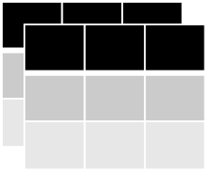

































WriteCheck
A simple and general transaction testing approach to detect WSS violations
subOrder
tx1
$$s_{11}$$
$$s_{12}$$
③
Generate
submitted
order
$$s_{11}$$
$$s_{31}$$
$$s_{21}$$
$$s_{22}$$
$$s_{32}$$
$$s_{12}$$
$$s_{33}$$
tx2
$$s_{21}$$
$$s_{22}$$
Concurrent result
④
Execute subOrder on db
$$s_{11}$$
tx3
$$s_{31}$$
$$s_{32}$$
$$s_{33}$$
Report error
$$s_{12}$$
Succeed
actualSchedule
Generate
transactions
$$s_{11}$$
$$s_{31}$$
$$s_{21}$$
$$s_{32}$$
$$s_{12}$$
$$s_{33}$$
$$s_{22}$$
…
②
db state
{1, 2}
⑤
Infer serial schedule
based on actualSchedule
≠
db
Serial result
⑦ Compare
$$s_{11}$$
Succeed
Generate
database
serialSchedule
⑥
Apply
serialSchedule
on db
①
$$s_{11}$$
$$s_{12}$$
$$s_{31}$$
$$s_{32}$$
$$s_{33}$$
$$s_{21}$$
$$s_{22}$$
$$s_{12}$$
Succeed
…
Start
db state
{0, 1}

Slide 16
Database and Transaction Generation
Randomly generate data type, data, and constraint for database
Randomly generate transactions
+----------------------+-------------------+------------------+
| id (INT PRIMARY KEY) | name (VARCHAR) | balance (DOUBLE) |
+----------------------+-------------------+------------------+
| 1 | Alice | 0 |
| 2 | Bob | 300 |
+----------------------+-------------------+------------------+
BEGIN;
SELECT * FROM account;
UPDATE account SET balance=balance–100 WHERE name = “Alice”;
INSERT INTO account VALUES (3, “Mary”, 100);
COMMIT;

Slide 17
Obtain Actual Schedule
Design a transaction execution protocol to obtain a transaction test case’s actual schedule
s₁₁ BEGIN
s₁₁ BEGIN
s₂₁ BEGIN
s₂₂ UPDATE
s₃₁ BEGIN
s₁₂ DELETE
DBMS
s₂₃ COMMIT
s₃₂ INSERT
s₁₃ COMMIT
s₃₃ COMMIT
Submitted order
Actual schedule

Slide 18
Obtain Actual Schedule
Design a transaction execution protocol to obtain a transaction test case’s actual schedule
s₁₁ BEGIN
s₁₁ BEGIN
s₂₁ BEGIN
s₂₁ BEGIN
s₂₂ UPDATE
s₂₂ UPDATE
s₃₁ BEGIN
s₃₁ BEGIN
s₁₂ DELETE
s₂₃ COMMIT
block
DBMS
s₂₃ COMMIT
s₁₂ DELETE
s₃₂ INSERT
s₃₂ INSERT
s₁₃ COMMIT
s₁₃ COMMIT
s₃₃ COMMIT
s₃₃ COMMIT
Submitted order
Actual schedule

Slide 19
Infer Serial Schedule
Use FCRFS serial pattern to infer serial schedules under WSS
s₁₁ BEGIN
s₂₁ BEGIN
s₂₁ BEGIN
s₂₂ UPDATE
s₂₂ UPDATE
s₂₃ COMMIT
s₃₁ BEGIN
s₁₁ BEGIN
Infer
s₂₃ COMMIT
s₁₂ DELETE
s₁₂ DELETE
s₁₃ COMMIT
s₃₂ INSERT
s₃₁ BEGIN
s₁₃ COMMIT
s₃₂ INSERT
s₃₃ COMMIT
s₃₃ COMMIT
Actual schedule
Serial schedule under WSS

Slide 20
Compare Execution Results
Compare whether the write operation succeeds or not and the final database state
Concurrent result
Serial result
s₁₁ BEGIN
s₂₁ BEGIN
s₂₁ BEGIN
s₂₂ UPDATE
s₂₂ UPDATE
Inconsistent error reporting
s₂₃ COMMIT
s₃₁ BEGIN
s₁₁ BEGIN
s₂₃ COMMIT
s₁₂ DELETE
Succeed
Error
s₁₂ DELETE
s₁₃ COMMIT
s₃₂ INSERT
s₃₁ BEGIN
s₁₃ COMMIT
s₃₂ INSERT
s₃₃ COMMIT
s₃₃ COMMIT
Final database state
Inconsistent database state
Final database state

Slide 21
Evaluation
Evaluate WriteCheck on six widely-used DBMSs
DBMS | Rank | GitHub Star | Isolation Levels
 |  |  | RU | RC | RR | SER
MySQL | 2 | 11.4k | ✓ | ✓ | ✓ | ✓
PostgreSQL | 4 | 17.6k |  | ✓ | ✓ | ✓
SQLite | 10 | 7.8k | ✓ |  |  | ✓
MariaDB | 13 | 6.1k | ✓ | ✓ | ✓ | ✓
CockroachDB | 68 | 30.9k |  |  |  | ✓
TiDB | 73 | 38.5k |  | ✓ | ✓
RU: Read Uncommitted RR: Repeatable Read
RC: Read Committed SER: Serializable

Slide 22
Overall WSS Violations
WriteCheck has detected 22 unique WSS violations
13 critical transaction bugs
9 WSS violations stem from improper or inconsistent designs in the target DBMSs, which are permissible
DBMS | Total | txBug |  | False Positive
 |  | New (Fixed) | Duplicate
MySQL | 3 | 1 (0) | 0 | 2
PostgreSQL | 3 | 0 (0) | 0 | 3
SQLite | 0 | 0 | 0 | 0
MariaDB | 5 | 3 (1) | 0 | 2
CockroachDB | 0 | 0 | 0 | 0
TiDB | 11 | 7 (1) | 2 | 2
Total | 22 | 11 (2) | 2 | 9

Slide 23
Example of False Positives
Semi-consistent read in MySQL can introduce false positives at Read Uncommitted and Read Committed isolation levels
Concurrent schedule
Serial schedule under WSS
Init
tx1: BEGIN;
tx1: BEGIN;
c1 | c2
1
5
Apply on
Init
Apply on
tx1: UPDATE t SET c1=5, c2=‘tx1’
WHERE c1=1;
tx1: UPDATE t SET c1=5, c2=‘tx1’
WHERE c1=1;
c1 | c2
1
5
tx2: BEGIN;
tx1: COMMIT;
Apply on
tx2: UPDATE t SET c1=1, c2=‘tx2’
WHERE c1=5;
tx2: BEGIN;
Table after executing tx1
tx1: COMMIT;
tx2: UPDATE t SET c1=1, c2=‘tx2’
WHERE c1=5;
Apply on
c1 | c2
5 | ‘tx1’
5
tx2: COMMIT;
tx2: COMMIT;
Concurrent database state
Serial database state
c1 | c2
5 | ‘tx1’
1 | ‘tx2’
c1 | c2
1 | ‘tx2’
1 | ‘tx2’

Slide 24
Comparison with Existing Approaches
Detection capability comparison on reported critical txBugs
Collect all the critical txBugs reported by the existing approaches
Investigate whether these 29 critical txBugs can be exposed by an approach when the corresponding transaction test cases are provided
DBMSs | Reported Critical txBugs |  |  | WriteCheck | DT² | Troc | TxCheck
 | Total | WriteCheck | Existing Approaches | Total | Total | Total | Total
MySQL | 3 | 1 | 2 | 3 | 2 | 3 | 1
PostgreSQL | 0 | 0 | 0 | 0 | 0 | 0 | 0
SQLite | 0 | 0 | 0 | 0 | 0 | 0 | 0
MariaDB | 8 | 3 | 5 | 8 | 7 | 3 | 2
CockroachDB | 0 | 0 | 0 | 0 | 0 | 0 | 0
TiDB | 18 | 9 | 9 | 18 | 14 | 8 | 13
Total | 29 | 13 | 16 | 29 | 23 | 14 | 16
Benefited from the simplicity of WriteCheck, WriteCheck can detect more critical txBugs than existing approaches.

Slide 25
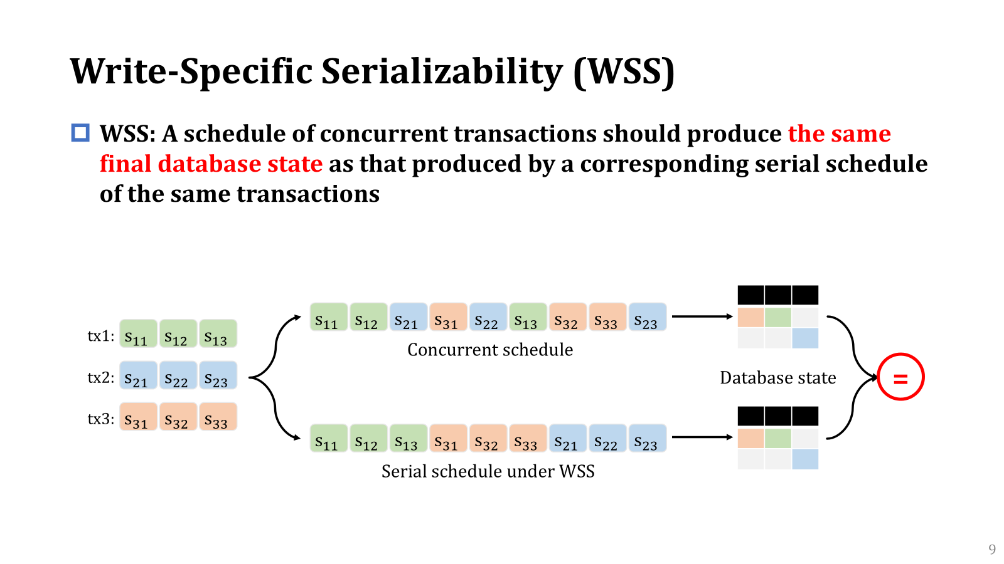
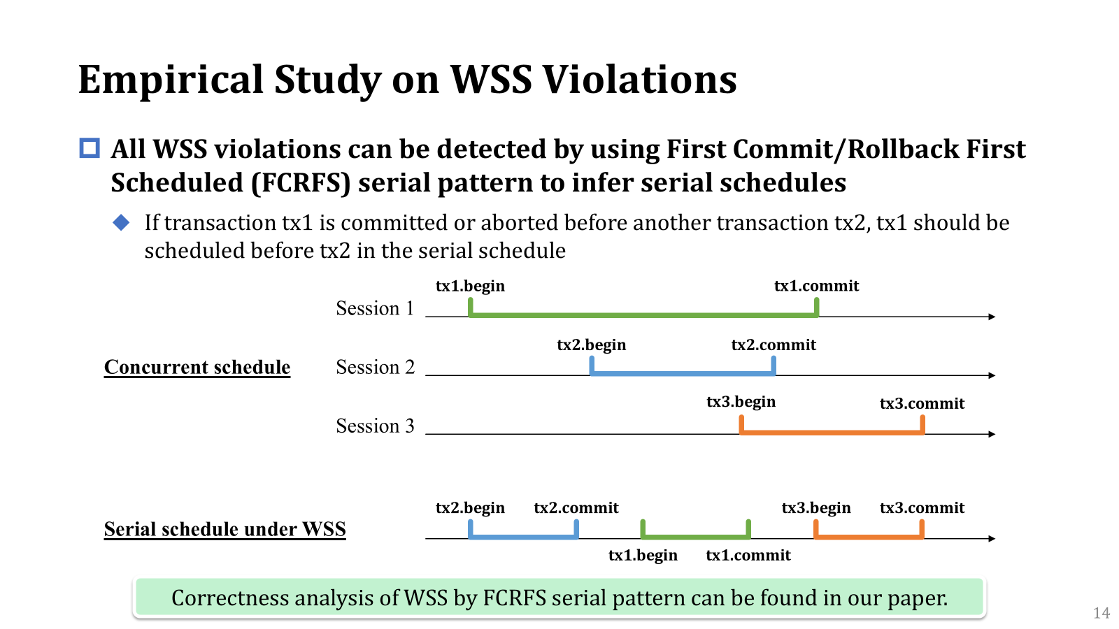
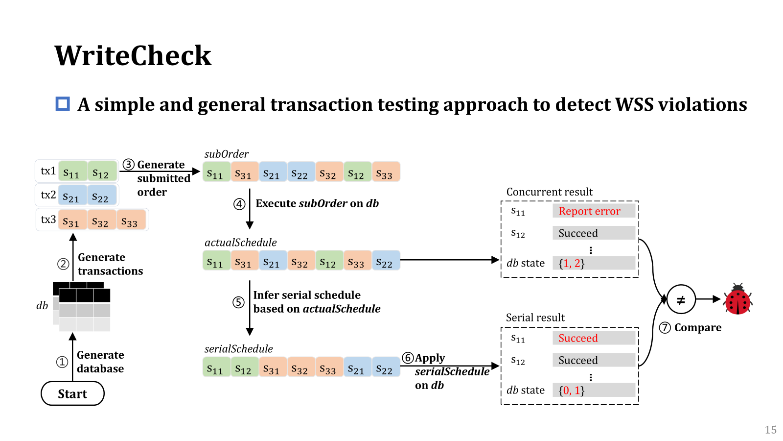
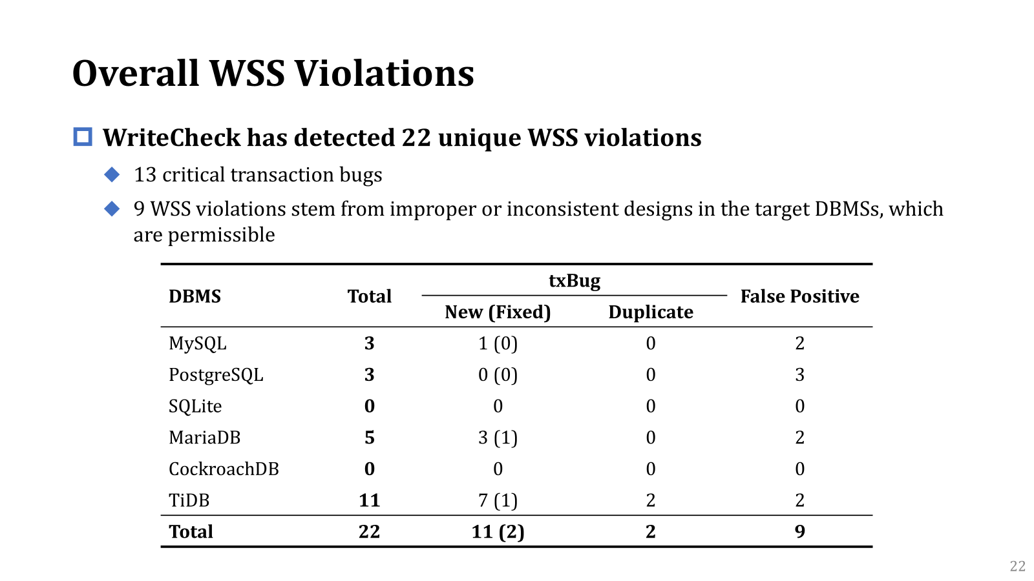

Conclusion
https://github.com/tcse-iscas/WriteCheck

