Slide 1

Fast Reproducing Web Application Errors
Jie Wang, Wensheng Dou, Chushu Gao, Jun Wei
Institute of Software
Chinese Academy of Sciences
2015-11-5

Slide 2
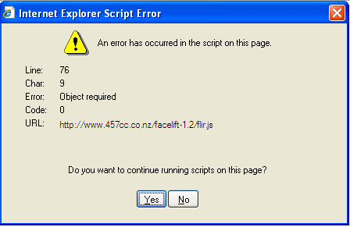
Errors in web applications
Web application “crash”
document.getElementById(tableName).rows;
Notes:
Web applications have been growing fast，yet come along with a variety of bugs, almost all of us has encountered this annoying dialog. This is a kind of web application crash, This example shows an “Object required” error, this may be caused by accessing to an object that is null

Slide 3
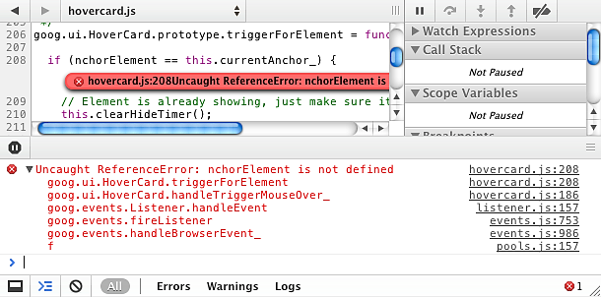
Errors in web applications
Exceptions thrown by development tools
Notes:
From developer side. The developer tools will show the exactly exception and call stack. In this example, the exception is thrown because the corresponding variable is not defined.

Slide 4
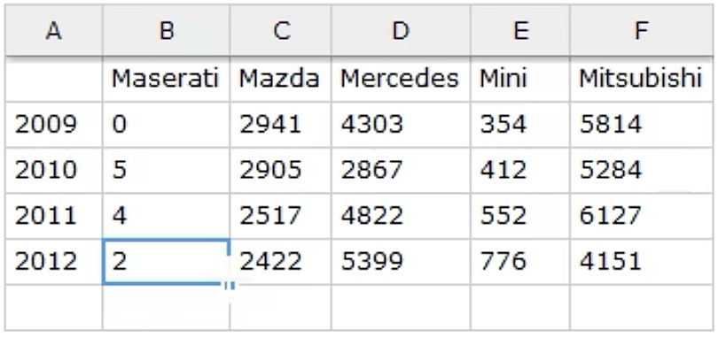
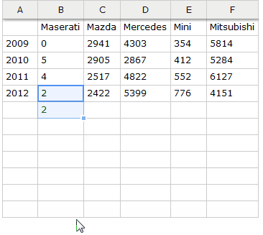
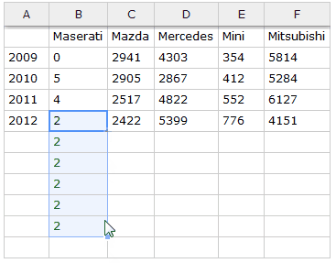
Errors in web applications
Functionality errors
Expected dragging down
Buggy dragging down
From github.com/hadsontable Issues#1910
Notes:
**first page add a mouse picture
There are also ... And the error may be triggered by a special sequence of events.
Below is an excel like web application.
->Left fig is the expected dragging behavior, Dragging down the mouse should autofill the cells with the value of the started cell.
->However, a functionality bug occurs as shown in the right figure. This is because the event handler is not properly handled.

Slide 5



Web debugging tools
Debugging and testing JavaScript programs
Record replay
Mugshot[1], Jalangi[2]
~~~~
Trace
~~~~
Record
Replay
[1] Mugshot : Deterministic Capture and Replay for JavaScript Applications (OSDI 2010)
[2] Jalangi: a selective record-replay and dynamic analysis framework for JavaScript (Esec/Fse13)
Notes:
There are many tools for debugging and tesing js progams. Such as record replay tools…, They record the user interaction events or program execution traces, Thus they can use this information to produce the errors repeatedly.

Slide 6
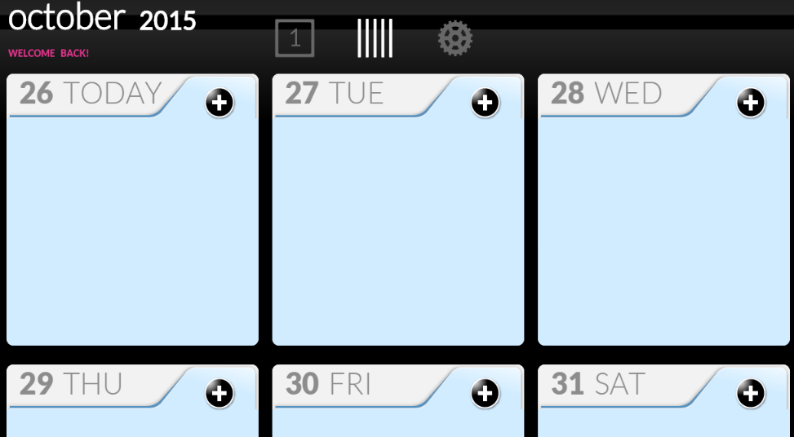
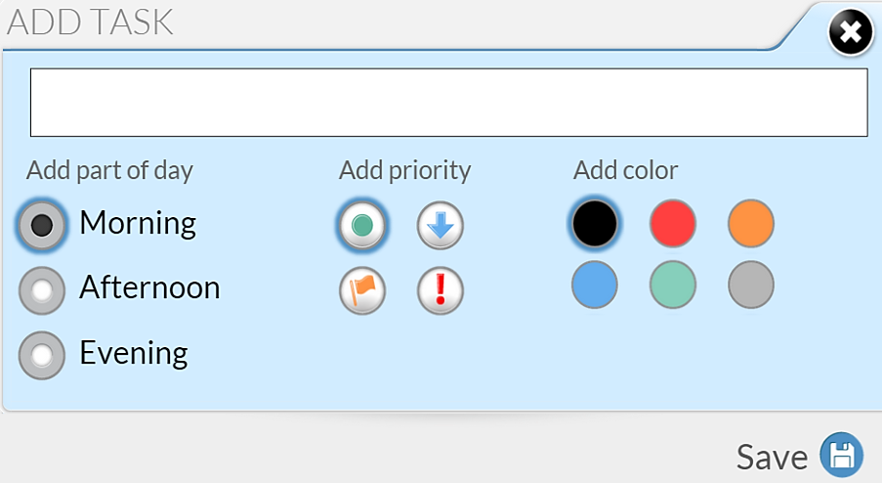
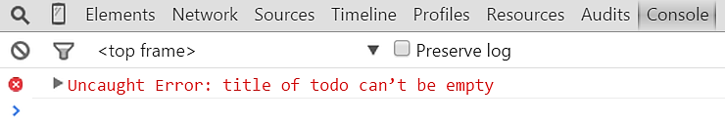
Motivation
A real-world bug example
2. input a white space
1. click
3. click
Notes:
->We present an example to show our motivation. This is a web application named TODOList to scheduling tasks.

Slide 7
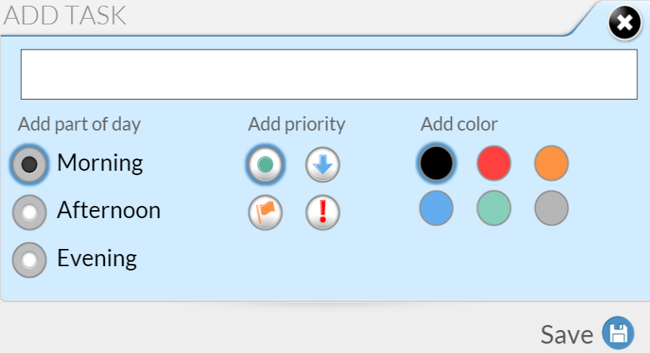
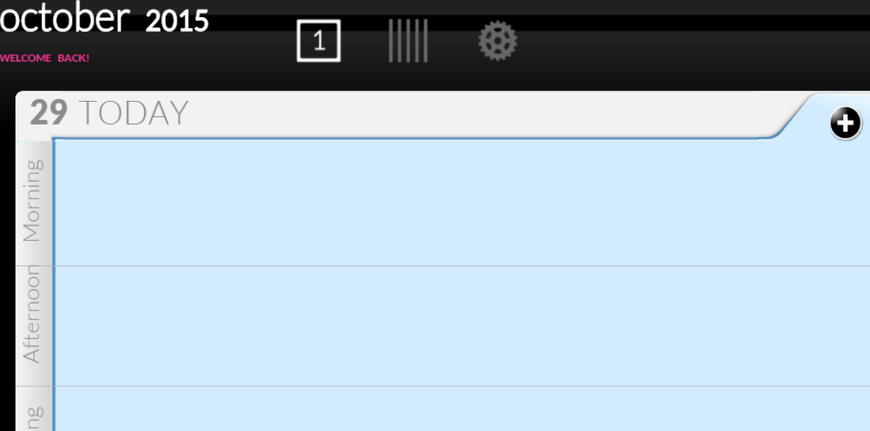
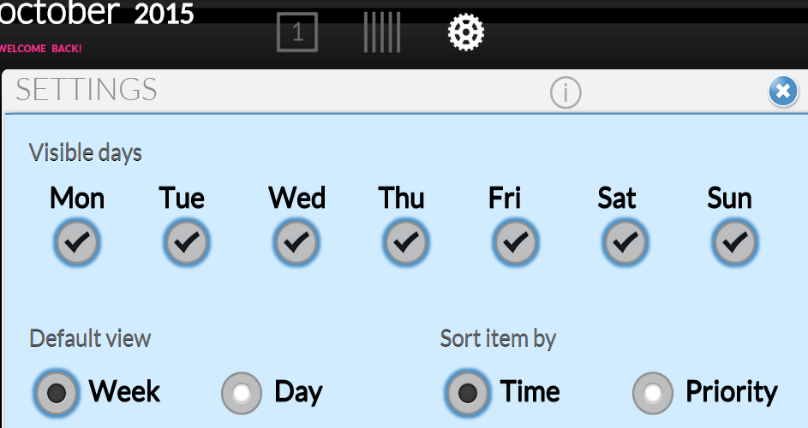
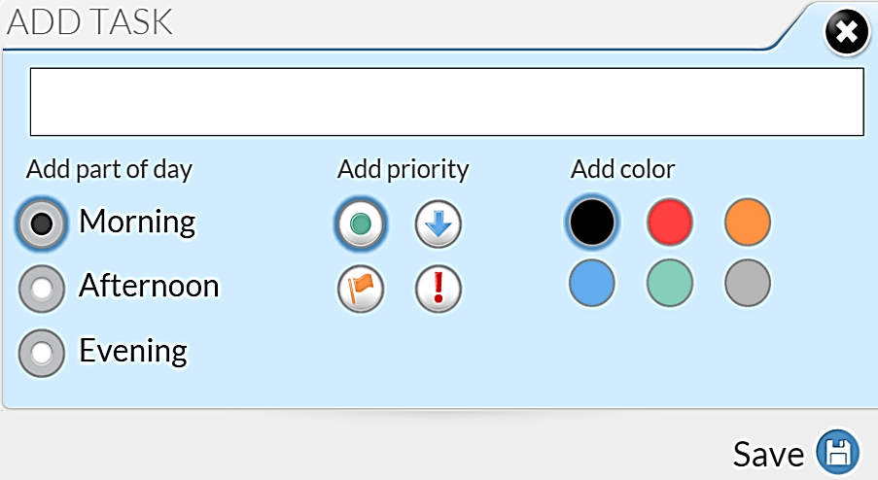
Motivation
However, the error can be triggered by a long execution
…
input a white space
Error-related events are interleaved with irrelevant ones
Notes:
….finally we click the save button and triggered the previous error.->although this trace is very long, we only need these 3 events, to reproduce the error, the other hundreds of events are irrelevant and replaying these irrelevant events is meaningless and time consuming. However these 3 events are interleaving with irrelevant ones. so how can we remove the irrelevant events? -> This is a right our work.

Slide 8
Goal
Reproducibility
High reduction rate
~~~~~~~~~~~~~~~~~~~~~~~~~~~~~~~~~~~~~~~~~~~~~
Record
Reduce
Replay
~~~~~~~~~
Notes:
**添加长trace变短case的阶段

Slide 9

Basic idea
Dynamic slicing
e₁: click …
e₂: mousemove …
e₃: mouseover …
e₄: mouseover …
e₅: keydown …
e₆: keypress …
e₇: keyup …
.
.
.
e_{n}: click…
Error-related events
e₁: click …
e₂: mousemove …
e₄: mouseover …
e₆: keypress …
e_{n}: click…
Slicing criteria:
error-related assertions;
Notes:
Our main approach applies dynamic slicing, identifying dependencies among events is of most importance, for a given long event trace and the last event is the error event, this error event is often used as slicing criteria, it can be ….;we trace from this event backward, and identify how the event is related, then all the error related event should be in the result set. Thus we can get a very short event slice.

Slide 10
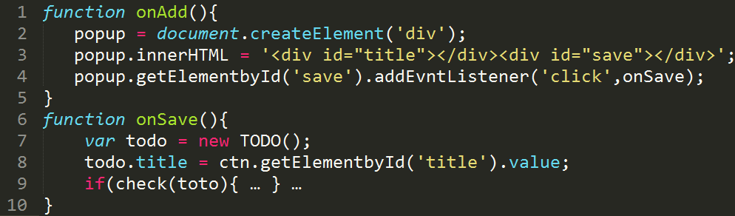
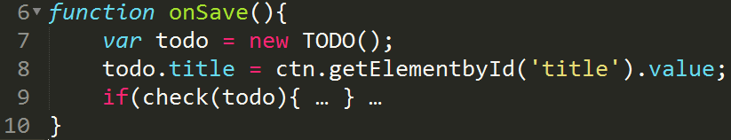

Challenges
Source code of TODOList
e1. Clicking add button
e2. Clicking save button
div
div
div
id:title
click:onSave
id:save
Notes:
however, there are some challenges for our work. I will show an example to explain them. E1 refers to clicking the add button, function onAdd will be executed. e2 refers to clicking the save button, and onSave will be executed . Line2 will create an DOM node popup. Then Line3 will add 2 child nodes to the it, line4 will register a click event handler to node save. Then when clicking the save button, line7 will create a new object todo, in line 8, the right hand of the assignment will read the value attribute of node title. Line 9 will check if the todo object is valid, an exception will be thrown if not.

Slide 11
Challenge 1
Missing dependencies without knowing the DOM semantics
e1. Clicking add button
e2. Clicking save button
div
div
div
id:title
click:onSave
id:save
Notes:
Two types of semantics***->The 1st challenge is that we need to understand the DOM syntax. DOM api can be function calls like line 2. and also can be assignment like line3. the function calls are implemented in native code, without knowing the DOM syntax, the data dependencies will be missed.

Slide 12
Challenge 2
Missing dependencies without fine-grained DOM dependency model. E.g. line 8 depends on line 3
e1. Clicking add button
Modifying the subtree
e2. Clicking save button
div
div
div
id:title
Reading node title
id:save
Notes:
->The 2nd challenge is that we do not have a fine-grained DOM dependency model. E.g. line 8 doesn’t depend on line 3 because line 8 doesn’t use any variables set or modified by line 3, however, when we considering the DOM structure, line 3 is modifying subtree of popup, which will affect the reading title operation in line 8.

Slide 13
Challenge 3
Dynamic feature and event-driven feature
onAdd happends before onSave
e1. Clicking add button
e2. Clicking save button
popup
div
title
save
click:onSave
The click event handler onSave is registered during onAdd
Notes:
->the 3rd challenge comes from the dynamic feature of web application, e.g. The click event handler onSave is registered during execution of onAdd, thus the onAdd event should happends before onSave

Slide 14

Overview-Slicing based analysis
~~~~~~~~~~~~~~~~~~~~~~~~~~~~~~~~~~~~~~~~~~~~~~~~
JavaScript analysis
Building Event Dependency Graph
DOM analysis
JS+DOM analysis
Original
event trace
Event slicing
Error-related event trace
~~~~~~~~~~~~
Replay
Notes:
We present an approach to resolve these challenges. Given an …trace, We present some analyses to collect data dependencies, and then use these collected information to build the dependency relationship among events. And finally we can perform event slicing to get the error related event trace. And we can use this short trace to reproduce the error for developers.
We will explain these components respectively.

Slide 15
JavaScript dependency analysis
Def-Use relation:
The use of a variable depends on its last definition
Source code
n:= 2;
x:= ( x mod n ) + 1;
…
…
foo (x)
Error-related variable
Notes:
The js dependency analysis identifies how the data is related. It utilize the Def-use relation. the following example shows how this can be done. Given a source code, we record the execution trace, all the records are in single assigned mode, e.g. line 2 will be split into 2 records. Once we got these records, we will use the def-use relation to associate the use a variable to its last definition, suppose line5 triggers an error and x is the error related variable, thus trace from record 6, it depends on record 3, similarly we find the remaining data dependencies.

Slide 16
JavaScript dependency analysis
Example TODOList
e1. Clicking add button
Missing DOM dependencies
e2. Clicking save button
However, the DOM dependencies are missing!
Line 8 doesn’t use any variables modified by line 3
Notes:
Line2…
Line3 and line4…
Similarly line8…
However…,

Slide 17
DOM dependency analysis
Example TODOList
e1. Clicking add button
DOM dependencies
e2. Clicking save button
div
title
save
Observation: Accessing DOM node depends on the last modifications to its related nodes
Notes:
It seems that line8 doesn’t use any variables defined by line3, however …
Line3 …
Line8…

Slide 18
Accessing DOM node depends on the last modifications to its related nodes
Case 1. Accessing a node
Modifications to itself
Modifications to its ancestor nodes
ancestor
1. Add node div
div
input
2. Add node input
3. read node input
itself
Notes:
Specifically, we give three cases to build fine-grained DOM dependency.
The 1st ..
…
According this rule, we will search all the modifications on its ancestor nodes that affect this operation 3.
Modify subtree of div will affect op3…

Slide 19
Accessing DOM node depends on the last modifications to its tree structure
Case 2. Accessing an attribute
Modification to that attribute
Dependencies on its belonging node (obtained by case 1)
ancestor
1. Add node div
div
title
save
3. Read attribute value of node title
2. Modify attribute value of node title
value:” ”
attribute
Notes:
Similarly according to rule1, op3 depends on op1,
And according to current rule, modify attiring bute value of node will affect op3

Slide 20
Accessing DOM node depends on the last modifications to its related nodes
Case 3. Accessing the subtree
Modifications to all the nodes of the subtree
Dependencies to its belonging node (obtained by case 1)
ancestor
1. Add node div
div
3. Read subtree of node div
input
2. Modify node input
save
Nodes of the subtree
Notes:
每种情况举个DOM 树的例子，不需要代码

Slide 21
Event Dependency Graph (EDG)
Use JS dependency analysis and DOM dependency analysis to collect data dependencies
e1
Definition: e_{i} depends on e_{j} if e_{j} uses variables defined or modified by e_{i}
1
2
3
e2
4
5
6
7
8
variable
JS dependency
DOM dependency
Event dependency
Notes:
By JS analysis or DOM analysis or combination .., we then identify the dependency relationship among events. The figure below shows the data is depended for the TODOList example , the green array represent dependency collected by JS dependency, the red…, we define that …., in this example, e2 uses variables modified by e1, thus E2 depends on e1. By this way, we can build a event dependency graph.

Slide 22
Event Dependency Graph (EDG)
Calculate key events through EDG.
E.g. eventSlice(e6) = {e2,e3,e4,e5,e6}
e1
e2
e3
e4
e5
e6
Notes:
Once we have build the event dependency graph, we can calculate the key events. let’s see an example. E6 is the erroneous event, We will color the events that e6 can reach. We see e6 depends on e5 and e4, and iteratively e5 depends on e2 and e3, finally we got the event slice e2,e3,e4,e5,e6

Slide 23
Evaluation
RQ1: Can the reduced event trace reproduce the error faithfully? (reproducibility)
RQ2: Can our approach remove the irrelevant errors effectively? (efficiency)

Slide 24
Evaluation
Various web applications
Subjects: open-source projects from Github
We selected 10 bugs.
Reproducible
Apps | Description | JS size | Popularity
Chart.js | basic charts | 105K | 14803
Handsontable | Excel-like data grid editor | 4.7M | 4989
TodoList | Offline calendar | 312K | 19
JPushMenu | A menu library | 1.5M | 134
FullPage | To create full screen scrolling websites | 882K | 9518
Editor.md | A markdown editor | 257K | 530
My-mind | Online mindmapping software | 223K | 1449
Notes:
We have selected 7 open-source web application from github.
We totally collect 10 bugs using the following ciriteria, …
The table show the application, most of them are very popular. the size of the Javascript source code can be rather large, e.g. the source code size of hadnsontable is 4.7 M

Slide 25



RQ1:Reproducibility
All the errors can be reproduced ( JS+DOM )
BugId | JS | JS+ DOM
1
2
3
4
5
6
7
8
9
10
Notes:
firstly evaluates the reproducibility. we find that all the errors are reproduced through our combined js and DOM analysis. Merely JS analysis may fail to reproduce an error, since it can’t understand the DOM syntax.

Slide 26
RQ2: Efficiency
Average reduction rate : 96%
BugId | All | Coarse DOM | JS+DOM | Expected | Rate(%)
1 | 1139 | 342 | 74 | 6 | 94%
2 | 1168 | 757 | 139 | 6 | 88.6%
3 | 403 | 344 | 29 | 5 | 94%
4 | 694 | 388 | 28 | 3 | 96.4%
5 | 606 | 67 | 34 | 6 | 95%
6 | 342 | 6 | 2 | 2 | 100%
7 | 1410 | 53 | 24 | 3 | 98.5%
8 | 398 | 39 | 30 | 3 | 93.2%
9 | 1023 | 97 | 9 | 2 | 99.3%
10 | 1454 | 40 | 8 | 6 | 99.9%
Notes:
+coarse DOM.
Then we use the reduction rate to evaluate the efficiency, the average reduction rate is 96%

Slide 27
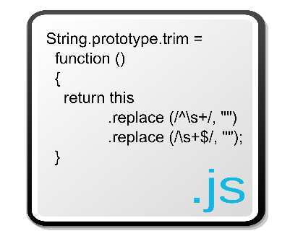
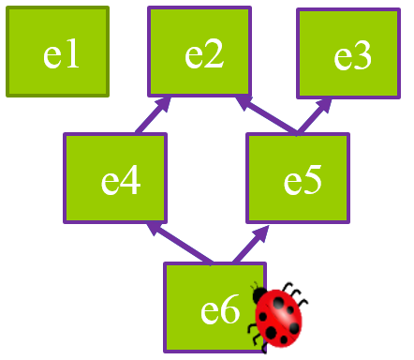
Conclusion
~~~~~~~~~~~~~~~~~~~~~~~~~~~~~~~~~~~~~~~~~~~~~~~~
~~~~~~~~~~~~~~~~~~~~~~~~~~~~~~~~~~~~~~~~~~~~
Javascript analysis
JS+DOM
DOM analysis
…
Replay
~~~~~~~~~~~~
Notes:
Finally we conclude our work.
Present a novel approach to fast reproducing web base errors
Given …, we Abstract JS and DOM instructions and present several analyses to build well-grained dependencies.
Our approach output a very short trace with high reducing rate and yet reproducible.

Slide 28
Questions?
Thank you!

