Slide 1



Detecting Faulty Empty Cells in Spreadsheets
SANER 2018 - Software Analysis, Evolution and Reengineering
Liang Xu, Shuo Wang, Wensheng Dou, Bo Yang, Chushu Gao,
Jun Wei, Tao Huang
University of Chinese Academy of Sciences
State Key Laboratory of Computer Science, Institute of Software, Chinese Academy of Sciences
North China University of Technology
Notes:
Good afternoon, everyone.
I am Liang Xu. I come from University of Chinese Academy of Sciences.
It ‘s my honor to be here and talk about our work: Detecting Faulty Empty Cells in Spreadsheets

Slide 2
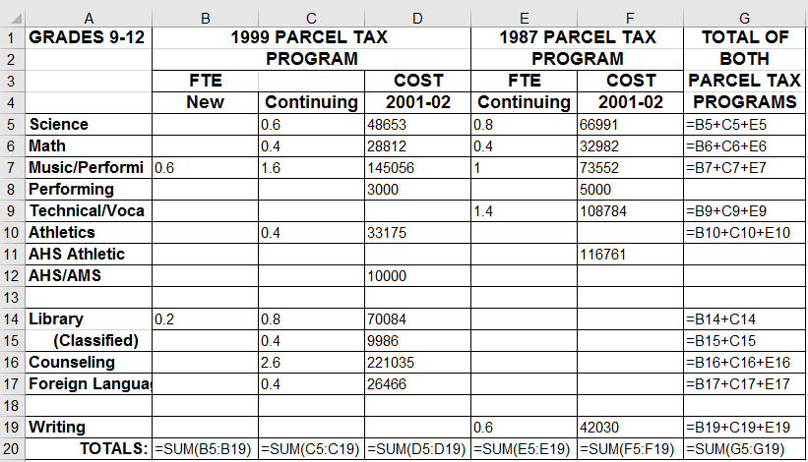
Empty cells are usually used for different purposes
A real-world spreadsheet extracted from EUSES [1]
Table layout
Default value“0”
Benign
Separate different parts
[1] M. Fisher and G. Rothermel, “The EUSES Spreadsheet Corpus: A Shared Resource for Supporting Experimentation with Spreadsheet Dependability Mechanisms,” ACM SIGSOFT Softw. Eng. Notes, pp. 1–5, 2005.
Notes:
Empty cells are very common in the spreadsheets.
Here is a real world spreadsheet extracted from EUSES.
We can see that the empty cells are usually used for different purposes.
First, Empty cells are used to form table layouts.
Second, Empty cells are used as default value zero.
Third, Empty cells are used to separate different parts of data.
Overall, those empty cells are used correctly.

Slide 3
Some empty cells are faulty
The contexts show that they should contain formulas
Total
Faulty empty cells
Bi+Ci+Ei
B
C
E
G
Notes:
However, some empty cells are faulty. And The contexts show that they should contain formulas.
According to the keyword “Total” contained in the header of column G and its formulas, we can infer that Column G is calculated by adding the data in columns B, C, and E.
Thus, the formulas in these three empty cells are missing.
Maybe, User deleted the formulas unintentionally, because their input cells do contain any data.
We call the empty cells that should contain formulas as faulty empty cells.

Slide 4

Faulty empty cells are harmful
An error: should be 0.5
0.5
G11
Notes:
Faulty empty cells are harmful.
First, faulty empty cells increase maintenance cost.
Due to lack of formula, When one of input cells is updated, user have to calculated the result according to formula and then fill the result manually.
Second, faulty empty cells may cause errors.
If user forget to modify a faulty empty cell when its input cells are updated, An error is introduced. Furthermore, Manual calculation and input are very error prone
Thus, it is necessary to detect faulty empty cells.

Slide 5

Existing techniques
SmellSheet Detective[1]
An empty cell is faulty when all its four neighbor cells are non empty
Faulty empty cell
[1] J. Cunha, et al., “SmellSheet Detective: A Tool for Detecting Bad Smells in Spreadsheets,” VL/HCC, 2012, pp. 243–244.
Notes:
SmellSheet Detective report an empty cell as faulty empty cell when all its four neighbor cells in the same column or row are not empty.
For example, empty cell G8. its four neighbor cells in the column are not empty. Thus G8 is reported as faulty empty cell.

Slide 6
Motivation
SmellSheet Detective suffers from false positives and false negatives
False negative
False positive
G11
Separate different parts
G18
Notes:
However, SmellSheet suffers from false positives and false negatives.
For example, Empty cell G8 is used to separate different parts of data. While, smellsheet reports it as faulty empty cell because its four neighbor cells are not empty.
Empty cell G11 is faulty. While, smellsheet Detective can not detect it because two neighbor cells is empty.
Thus, we need a more effective detection tool to detect faulty empty cell.

Slide 7
Key observation
The cells in a row or column are usually grouped together, and have the same computational semantics, called cell array [1]
The empty cells in a cell array are faulty
[1] W. Dou, C. Xu, S. C. Cheung, and J. Wei, “CACheck: Detecting and Repairing Cell Arrays in Spreadsheets,” Trans. Softw. Eng., vol. 43, pp. 226–251, 2017.
Notes:
The cell with same formulas together in a row or column are usually grouped, called cell array .
There are two cell arrays in this table, marked by different colors.
We observe that the empty cells adjacent to cell arrays are more likely to be faulty.

Slide 8
Challenges
How to identify cell arrays that contain empty cells?
Which faulty empty cells had caused errors?
Reduce quality
Should be 0.5
Notes:
Based on this key observation, Two research problems must to be solved,
The first one is How to identify the cell arrays that contain empty cells? Empty cells are used as borders of cell arrays
The second one is Do the faulty cells cause errors? If yes, which faulty empty cells caused errors?

Slide 9
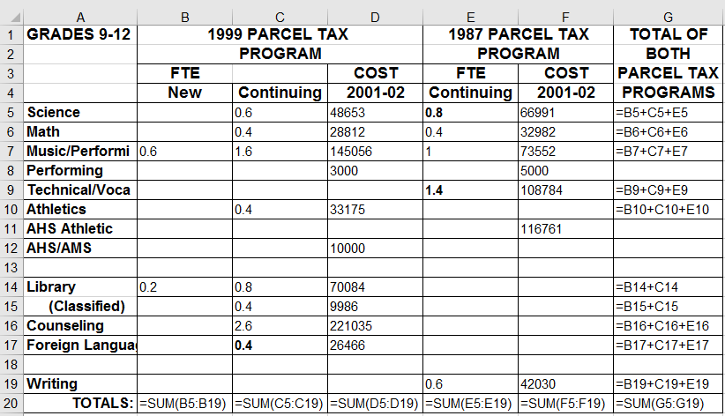
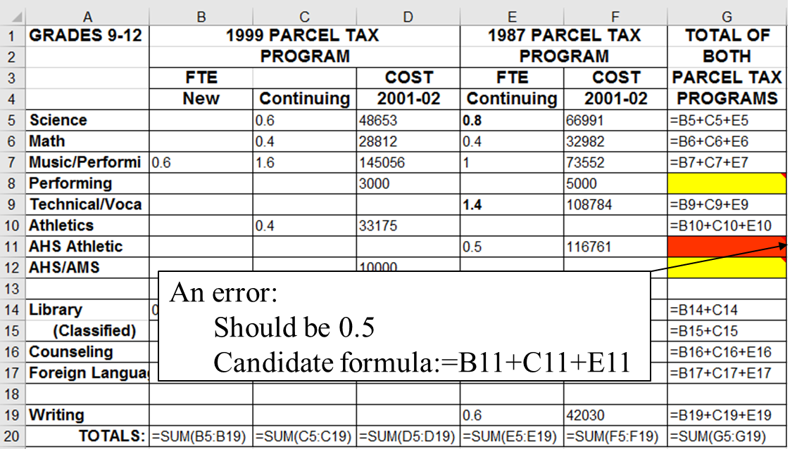
EmptyCheck overview
EmptyCheck can detect faulty empty cells by extracting cell arrays that contain empty cells
EmptyCheck can detect errors by recovering the missed formulas
Spreadsheets
Annotated spreadsheets
Cell Array
Extraction
Error
Detection
Notes:
Based on this key observation, we proposed a cluster-based approach, EmptyCheck, to detect faulty empty cells in spreadsheets.

Slide 10
Extract cell arrays (1)
Extract data areas
Notes:
We first extract the data area of tables.
We found that the rows that only contain strings are usually the borders of data areas.
For example, the first four rows and first one column are identified as borders.
Thus, we can identify the data area.

Slide 11
Extract cell arrays (2)
Extract cell arrays from each column and row in a data area
Notes:
Then we extract all cell arrays from the data areas.
Taking the column G in the data area as an example to show how we extract the cell arrays.
We extract cell array from up to down.
First, We select the first cell as the seed of a cell array. Then we extends it.
If next cell contains the same formulas, we add them to this cell array.
If next cell is data or empty cells, we add them to this cell array directly.
If next cell contain different formula, if they reference their input cells in the similar way, we add them to this cell array.
We can see that these formulas all reference the cells in the same row. Thus, we add them to this cell array.
We repeat these steps until we found a cell contains a formula that reference its input cell in a different way.
We can see the formula in G20 reference the cells in the same column. Finally, we identify a cell array.
Similarly, we can identify the cell arrays in each row.

Slide 12
Identify faulty empty cells
Suppress false positives
Cells in a cell array usually have the same type of headers
String
Same
Faulty empty cells
Diff
String
String
Empty
False positives
Empty
Notes:
The empty cells in the cell arrays are likely to be faulty empty cells.
We observe that the cells in a cell array usually have the same type headers.
We can see that the type of the non-empty cells’ headers are string, while, that of empty cell G13 and G18 is empty. So they are detected as false positives and remove from the cell array,
The empty cells G8 G11 and G12 have the string headers, Thus, they are reported as faulty empty cells.

Slide 13
Detect errors (1)
Extract formula pattern for each cell array
Select the formula pattern that can cover most cells
Candidate 1
=Bi+Ci+Ei
Candidate 2
=Bi+Ci
Notes:
To detect the errors caused by faulty empty cells, we first recover the formula pattern for each cell array.
According to the formulas in G, we can get two candidate patterns.
The first pattern can cover ten cells while, the other only can cover four cells.
Thus, the first one is selected as formula pattern.

Slide 14
Detect errors (2)
According to the formula pattern, if a faulty empty cell’s value should be non-zero, it caused an error
=Bi+Ci+Ei
G11 contains an error:
Should be 0.5
=B8+C8+E8=0
=B11+C11+E11= 0.5
=B12+C12+E12=0
Notes:
According to the recovered formula pattern ,we fill in each faulty empty cell with the formula.
The faulty empty cells that got non-zero output are reported as errors.

Slide 15
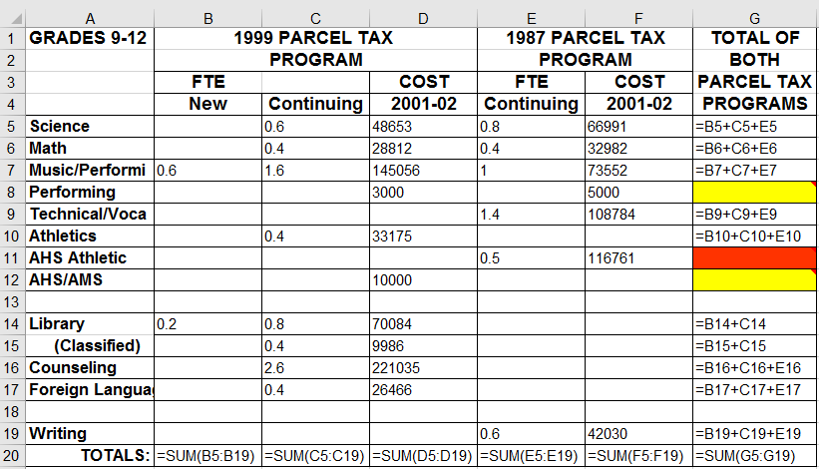
Implementation
We implement EmptyCheck as an Excel plugin
An error:
Should be 0.5
Candidate formula:=B11+C11+E11
Notes:
EmptyCheck uses a widely used method, colors and tips, to visualize the detected faulty empty cells in spreadsheets:
the faulty empty cells that have caused errors are marked by red color and others are marked by yellow color
The tips give the recommended formulas that should be filled
when user clicks the faulty empty cell G11, its tip gives more detail information

Slide 16
Evaluation
RQ1: How common are faulty empty cells in spreadsheets?
RQ2: Can EmptyCheck detect faulty empty cells precisely?
RQ3: How is EmptyCheck compared with other techniques?
e.g., SmellSheet Detective[1]
[1] J. Cunha, et al., “SmellSheet Detective: A Tool for Detecting Bad Smells in Spreadsheets,” VL/HCC, 2012, pp. 243–244.

Slide 17
Evaluation
Subject
EUSES[1]
Represent the spreadsheets used in real life[2]
1,617 spreadsheets with formulas
Methodology
Build ground truth
Evaluate EmptyCheck and other techniques
[1] M. Fisher and G. Rothermel, “The EUSES Spreadsheet Corpus: A Shared Resource for Supporting Experimentation with Spreadsheet Dependability Mechanisms,” ACM SIGSOFT Softw. Eng. Notes, pp. 1–5, 2005.
[2] B. Jansen, “Enron versus EUSES: A Comparison of Two Spreadsheet Corpora,” in Proceedings of Workshop on Software Engineering Methods in Spreadsheets (SEMS), 2015, pp. 41–47.
Notes:
We select Euses as our subject to evalaue EmptyCheck. Because it is widely used and its spreadsheets can Represent the spreadsheets used in real life.
We first build the needed ground truth, then we Run EmptyCheck and other techniques.

Slide 18
Build ground truth (1)
Statistics of 100 sampled spreadsheets with formulas
Categories | Spreadsheet | Worksheet | Formula | Empty Cell
cs101 | 2 | 2 | 52 | 20
database | 10 | 31 | 1,282 | 1,131
financial | 14 | 19 | 1,332 | 1,948
forms3 | 2 | 2 | 95 | 50
grades | 23 | 37 | 5,074 | 6,000
homework | 24 | 31 | 3,001 | 2,647
inventory | 17 | 58 | 2,612 | 4,093
modeling | 8 | 10 | 2,851 | 3,190
Total | 100 | 190 | 16,299 | 19,079
Notes:
There are more than 1,617 spreadsheets with formulas, It is
It is time-consuming and impractical to build a ground truth for our experiments using all these 1,617 spreadsheets. Therefore, we randomly sample 100 spreadsheets from them .
This table shows the detail information about our experimental subject
There are 190 worksheets, containing 16,299 formulas and 19,079 empty cells

Slide 19
Build ground truth (2)
For each empty cell
Check it manually
Should it contain formula?
Yes
No
Should it contain non-zero value?
Yes
No
Benign empty cell
Faulty
empty cell
Faulty empty cell that had caused error
Notes:
To building the ground truth,
We carefully checked each empty cell in the 100 selected spreadsheets, and try to answer the following questions for each empty cell:
1) Should it contain a formula?
2) If yes, it is marked as faulty empty cell, otherwise,
3) Should it contain non-zero value?
4) If yes, this faulty empty cell causes an error.

Slide 20
Build ground truth (3)
Statistics of faulty empty cells in the ground truth
Categories | Faulty Empty Cells
 | Total | Error | % E/T
cs101 | 3 | 3 | 100.00%
database | 29 | 11 | 37.93%
financial | 24 | 24 | 100.00%
forms3 | 0 | 0 | 0.00%
grades | 69 | 59 | 85.51%
homework | 68 | 50 | 73.53%
inventory | 91 | 56 | 61.54%
modeling | 202 | 147 | 72.77%
Total | 486 | 350 | 72.02%
Most faulty empty cells are harmful in spreadsheets
Notes:
From these 100 selected spreadsheets,
we find 486 faulty empty cells .
Furthermore, we found that 350 faulty empty cells have caused errors
We can see that 72.02% faulty empty cells have caused errors .
Thus, faulty empty cells are harmful in spreadsheets

Slide 21
RQ1: How common are faulty empty cells?
36% spreadsheets and 24% worksheets contain at least one faulty empty cell
Categories | Spreadsheet | Worksheet
cs101 | 1 | 1
database | 5 | 5
financial | 3 | 3
forms3 | 0 | 0
grades | 4 | 6
homework | 7 | 7
inventory | 10 | 16
modeling | 6 | 8
Total | 36 (36%) | 46 (24.21%)
The faulty empty cells are common in spreadsheets

Slide 22
RQ2: Can EmptyCheck detect faulty empty cells precisely?
Detection results reported by EmptyCheck
Categories | Faulty Empty Cells
 | Detected | True | Precision | Recall
cs101 | 3 | 3 | 100.00% | 100.00%
database | 33 | 27 | 81.82% | 93.10%
financial | 48 | 23 | 47.92% | 95.83%
forms3 | 0 | 0 | 0.00% | 0.00%
grades | 94 | 65 | 69.15% | 94.20%
homework | 85 | 68 | 80.00% | 100.00%
inventory | 119 | 56 | 47.06% | 61.54%
modeling | 182 | 181 | 99.45% | 89.60%
Total | 564 | 423 | 75.00% | 87.04%
EmptyCheck achieves high precision and high recall
Notes:
We ran EmptyCheck on the 100 sampled spreadsheets.
This table shows the detection results reported by EmptyCheck.
We can see that EmptyCheck detected 564 faulty empty cells and 423 faulty empty cells are confirmed as true positives.
Thus, the precision of EmptyCheck is 75.00% and the recall is 87.04%

Slide 23
RQ3: How is EmptyCheck compared with existing techniques?
Detection results reported by SmellSheet Detective[1]
Categories | Faulty Empty Cells
 | Detected | True | Precision | Recall
cs101 | 0 | 0 | 0.00% | 0.00%
database | 22 | 0 | 0.00% | 0.00%
financial | 21 | 0 | 0.00% | 0.00%
forms3 | 0 | 0 | 0.00% | 0.00%
grades | 85 | 0 | 0.00% | 0.00%
homework | 98 | 0 | 0.00% | 0.00%
inventory | 10 | 0 | 0.00% | 0.00%
modeling | 98 | 18 | 18.37% | 8.96%
Total | 334 | 18 | 5.39% | 3.70%
EmptyCheck performs much better than existing techniques
[1] J. Cunha, et al., “SmellSheet Detective: A Tool for Detecting Bad Smells in Spreadsheets,” VL/HCC, 2012, pp. 243–244.
Notes:
We compare EmptyCheck with Smellsheet on the same spreadsheets.
This is the detection result of Smellsheet.
We can see that SmellSheet Detective detected 334 faulty empty cells. However, only 18 of them are confirmed to be true positives.
The precision and recall are very low.
Thus, EmptyCheck perform much better than existing techniques in detecting faulty empty cells

Slide 24
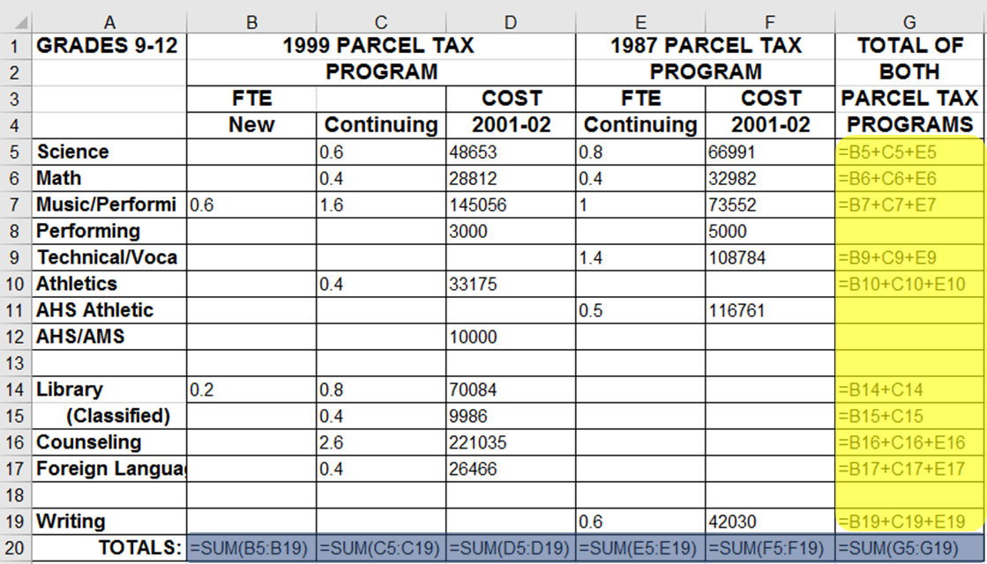
Future Work
More kinds of contexts can be used
E.g., the semantics of headers and structural information
The cells in the last row should contain formulas

Slide 25
Summary
We propose a new spreadsheet smell, faulty empty cell, which is harmful to spreadsheets.
We propose EmptyCheck, which can automatically detect faulty empty cells and recommend the needed formulas.
The evaluation on the EUSES corpus shows that EmptyCheck can detect faulty empty cell precisely.
Notes:
Let me summarize my talk.
We proposed a new spreadsheet smell, faulty empty cell. It is harmful to spreadsheets.
We proposed EmptyCheck, which can detect faulty empty cells and recommend the needed formulas
We evaluated EmptyCheck on the EUSES, and the result shows that EmptyCheck can detect faulty empty cell precisely

Slide 26

Thank you!
Notes:
Thanks for your attention. I am ready to take the questions.

