Slide 1


THE DATABASE OF
THE HOTEL BOOKING SYSTEM
Presentation by Shamil Shaimuratov and Yestleu Ismailkhan
Group SUBD 2216-13–Ch

Slide 2
OBJECTIVES
1
2
Database modeling
SQL Implementation
3
4
Interface Design
Functionality

Slide 3
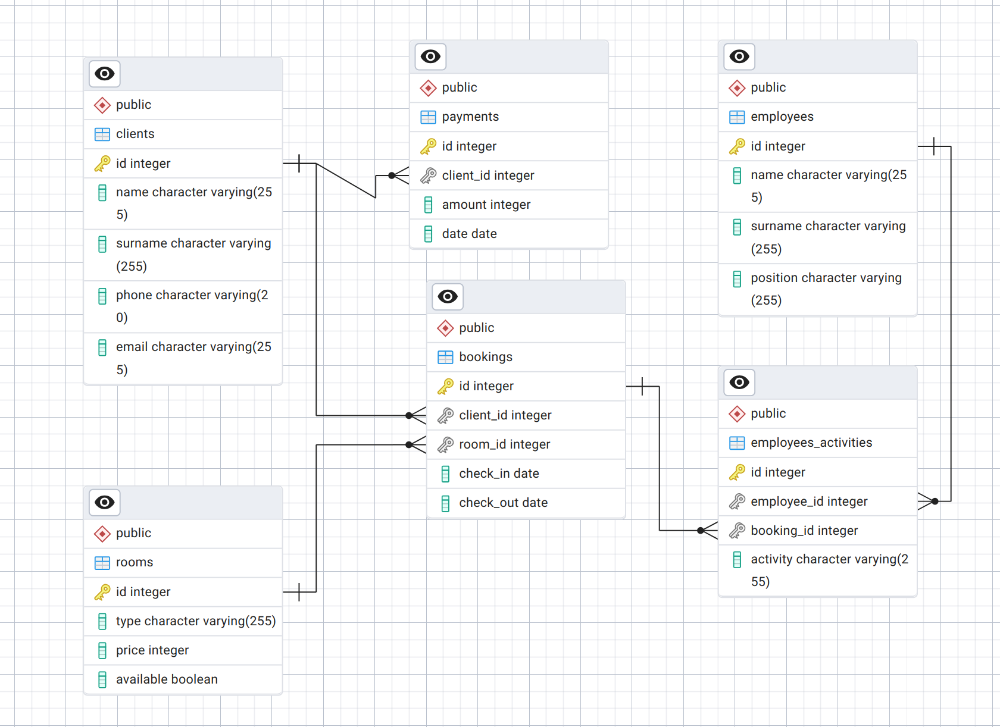
DATABASE MODELING
Entity-Relationship diagram (ERD)

Slide 4
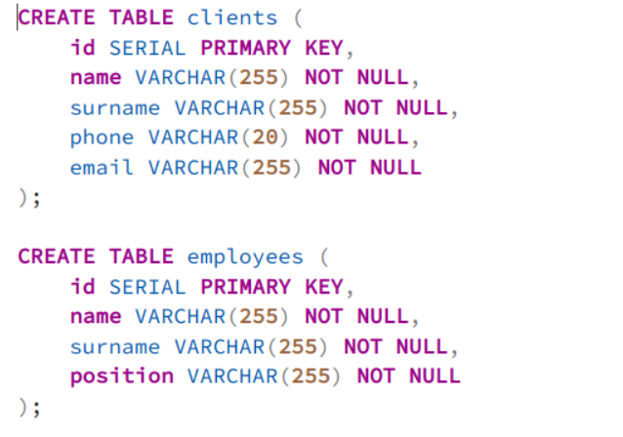
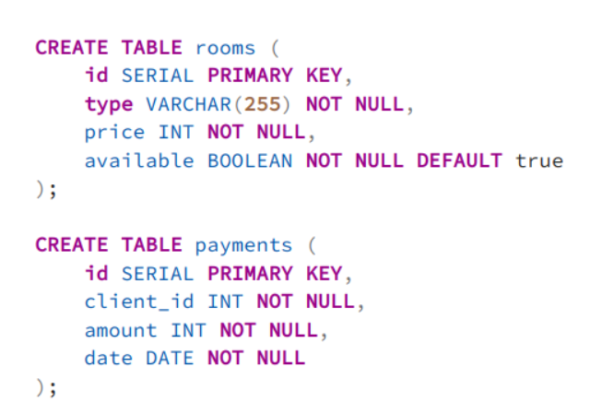
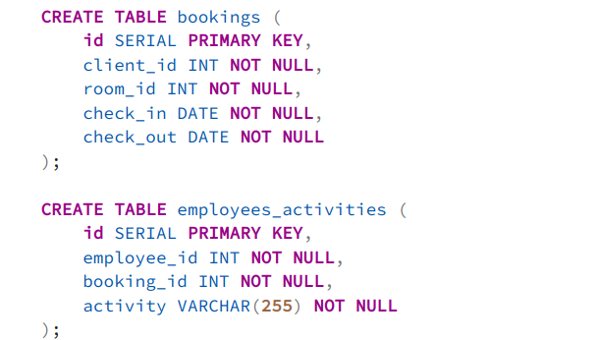
DATABASE MODELING \ SQL IMPLEMENTATION
Development of an ERD-based database model in PostgreSQL that includes customers, employees, hotel rooms, reservations and payments

Slide 5
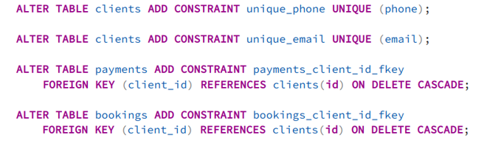
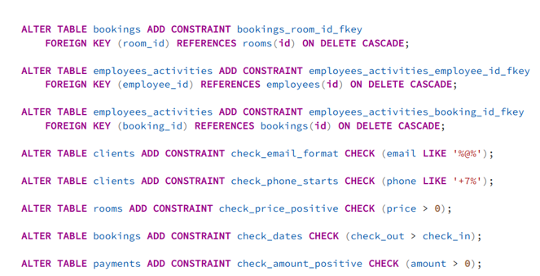
SQL IMPLEMENTATION
Implementation of Constraints using SQL queries that ensure data integrity and error protection

Slide 6
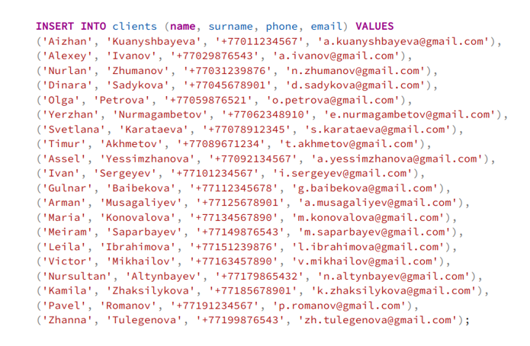
SQL IMPLEMENTATION
Filling each table with 20 rows using SQL queries. Example of the clients table

Slide 7
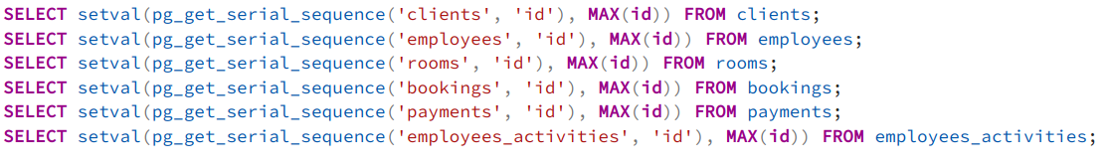
SQL IMPLEMENTATION
Using the setvar function to synchronize the auto-increment sequence with the maximum ID value in the table, preventing conflicts when adding data

Slide 8
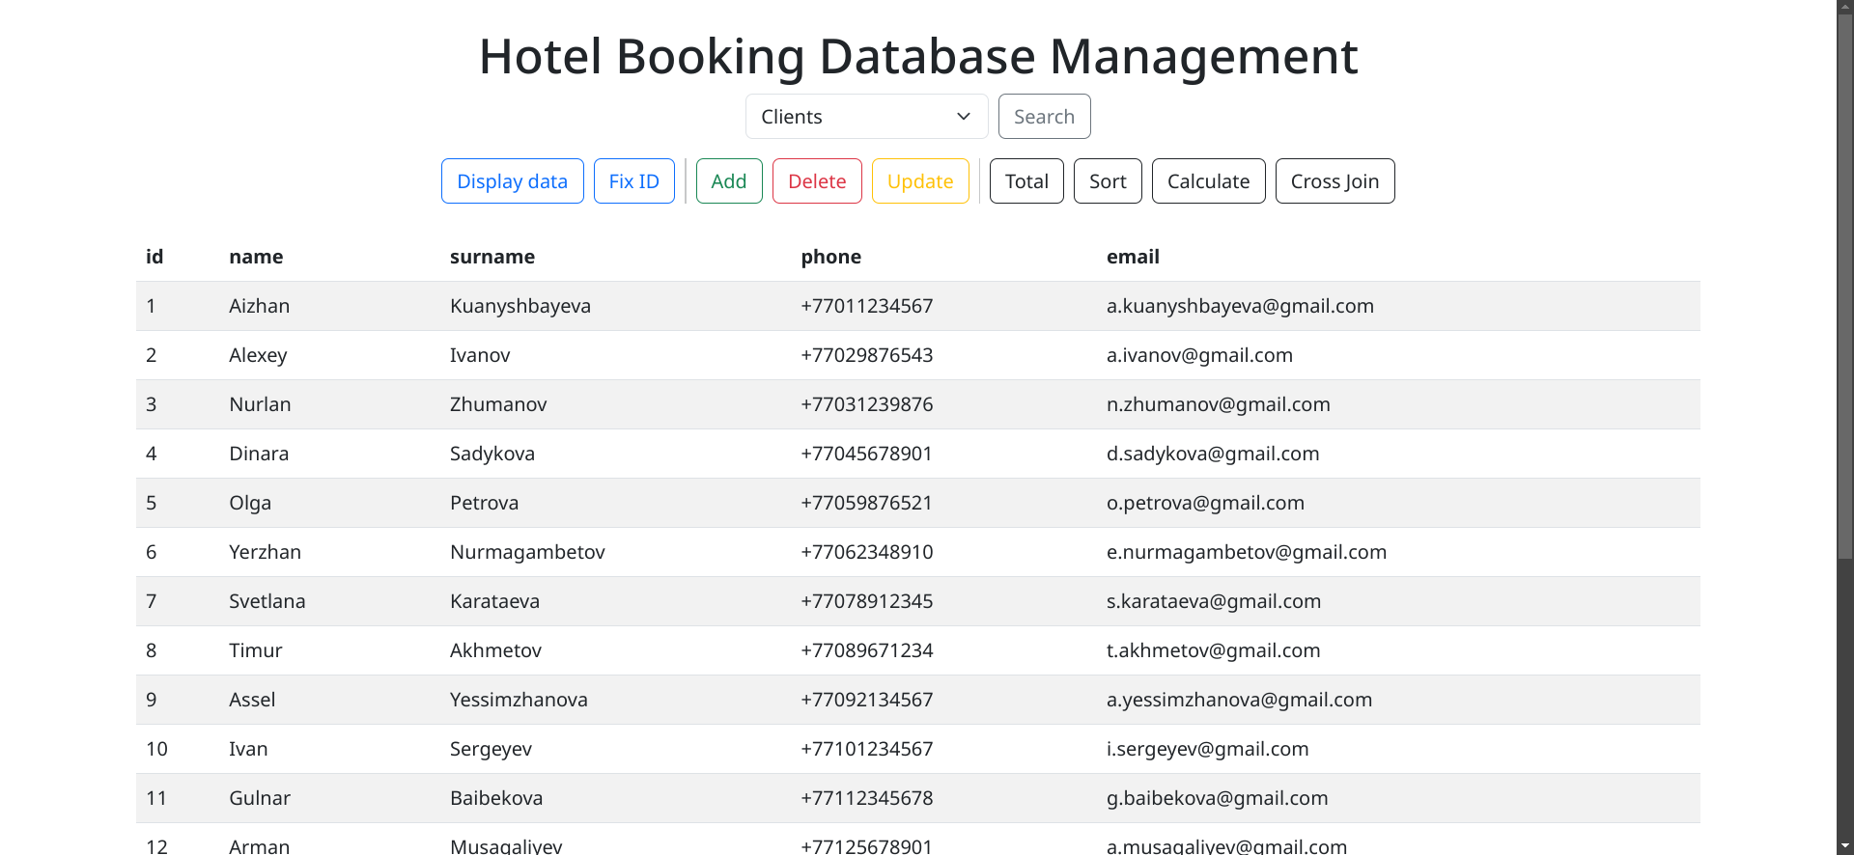
INTERFACE DESIGN
Creating an intuitive and user-friendly interface for the database management using HTML, Bootstrap, PHP, and JavaScript

Slide 9
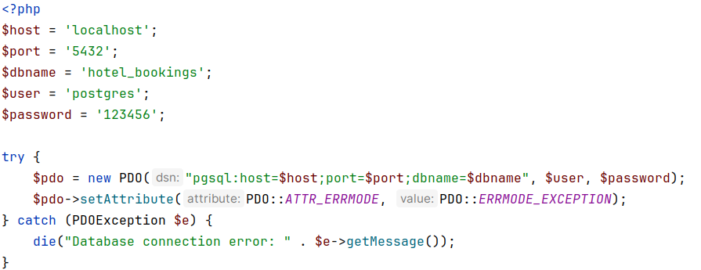
INTERFACE DESIGN
The php-pgsql driver(PHP Data Object module) was used to connect the database to the GUI

Slide 10
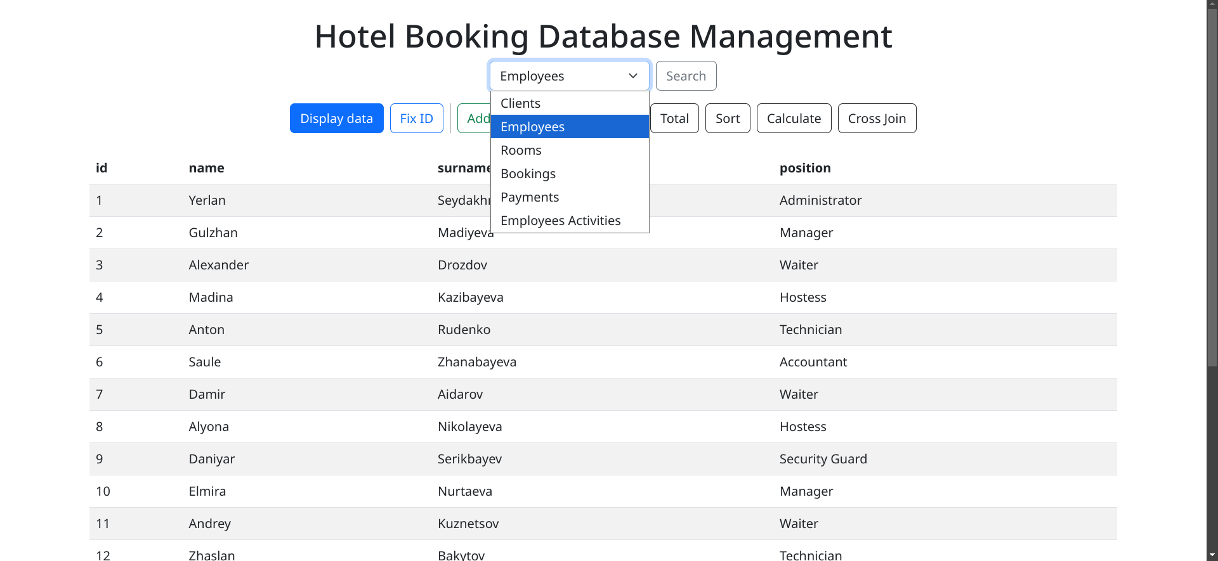
FUNCTIONALITY (DISPLAY DATA)
The first function that awaits us is the display of data from the selected table

Slide 11
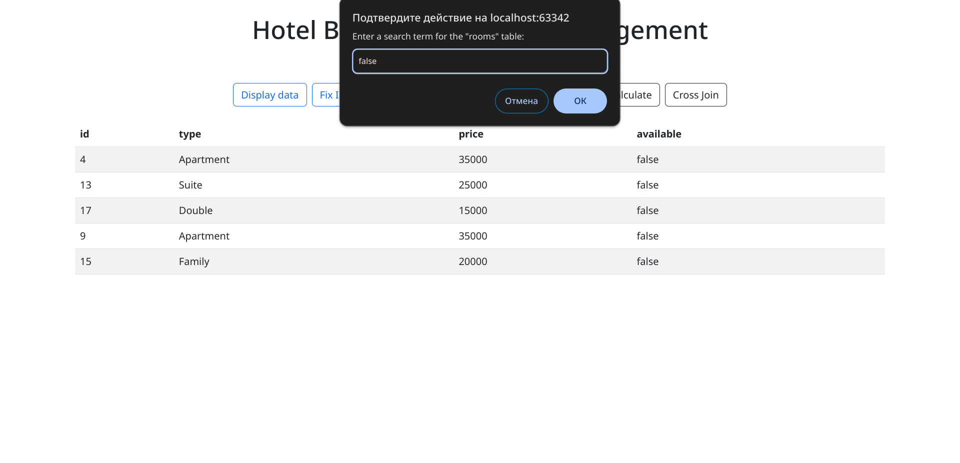
FUNCTIONALITY (SEARCH)
The following function allows us to find data in the table by any of the values

Slide 12
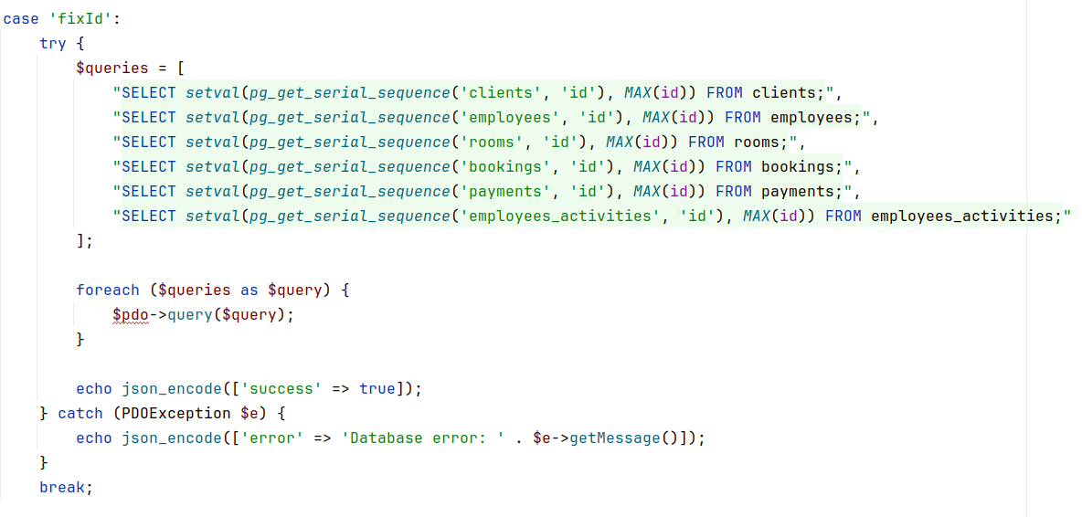
FUNCTIONALITY (FIX ID)
This function restores the order for the ID using SQL queries with setvar function

Slide 13
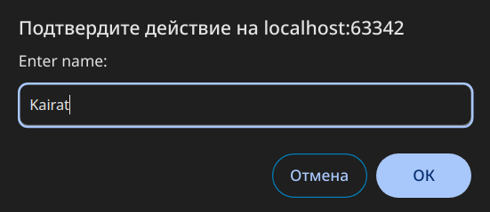
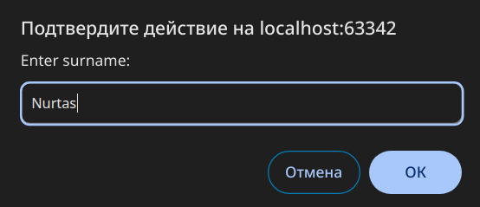
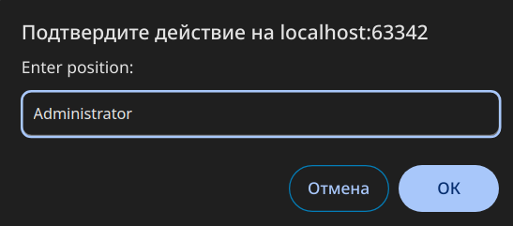
FUNCTIONALITY (ADD)
The function of adding a new record

Slide 14
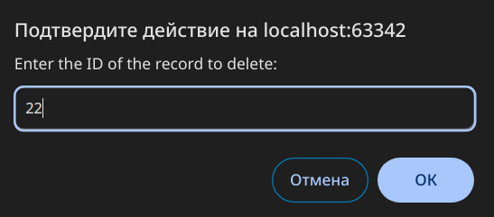
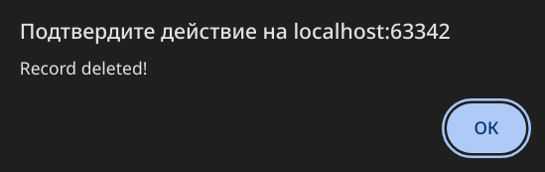
FUNCTIONALITY (DELETE)
Function for deleting a row by ID

Slide 15
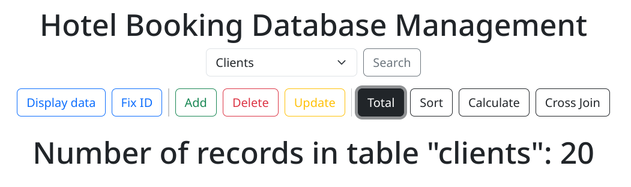
FUNCTIONALITY (TOTAL)
A function for quickly counting the number of rows in a table

Slide 16
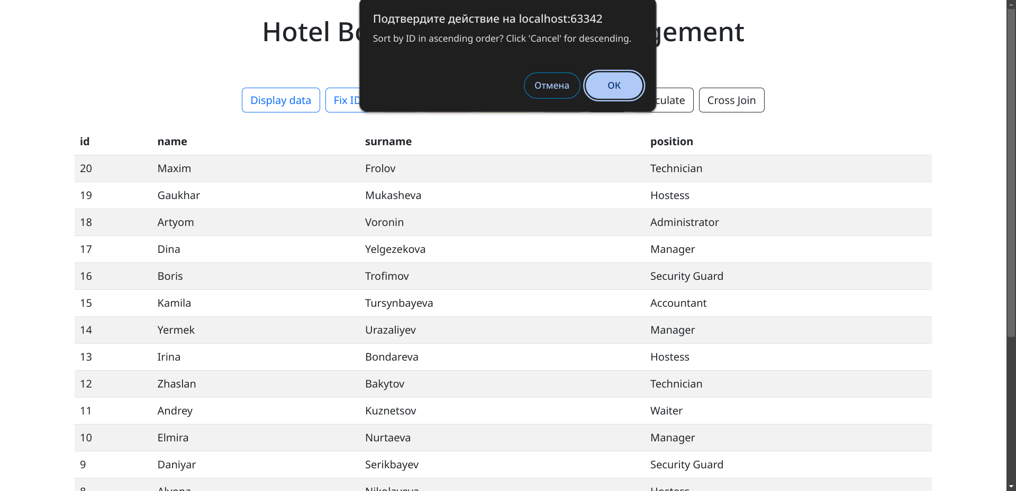
FUNCTIONALITY (SORT)
Function for sorting by ID (ASC / DESC)

Slide 17
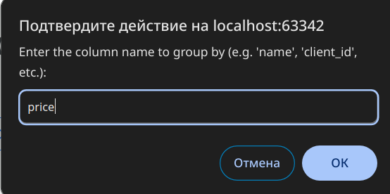
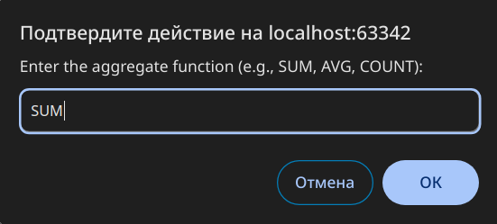
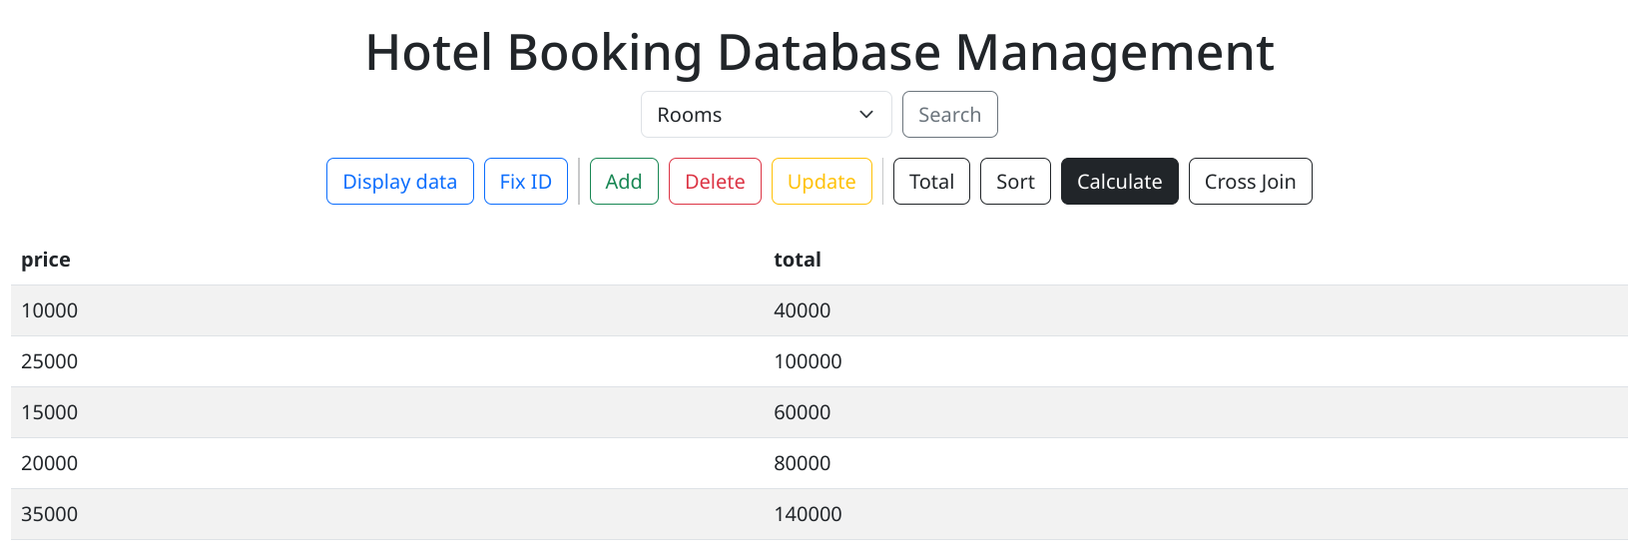
FUNCTIONALITY (CALCULATE)
Function for calculations(AVG, SUM, COUNT)

Slide 18
FUNCTIONALITY (CALCULATE)
Function for calculations(AVG, SUM, COUNT)

Slide 19
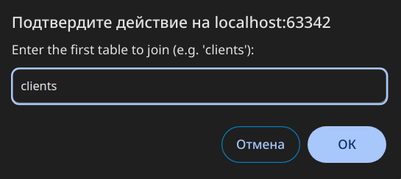
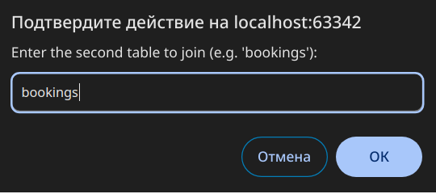
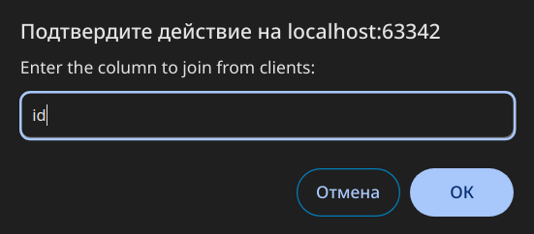
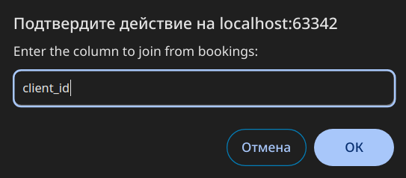
FUNCTIONALITY (CROSS JOIN)
The function for is a combination of data from several tables without an explicit connection

Slide 20
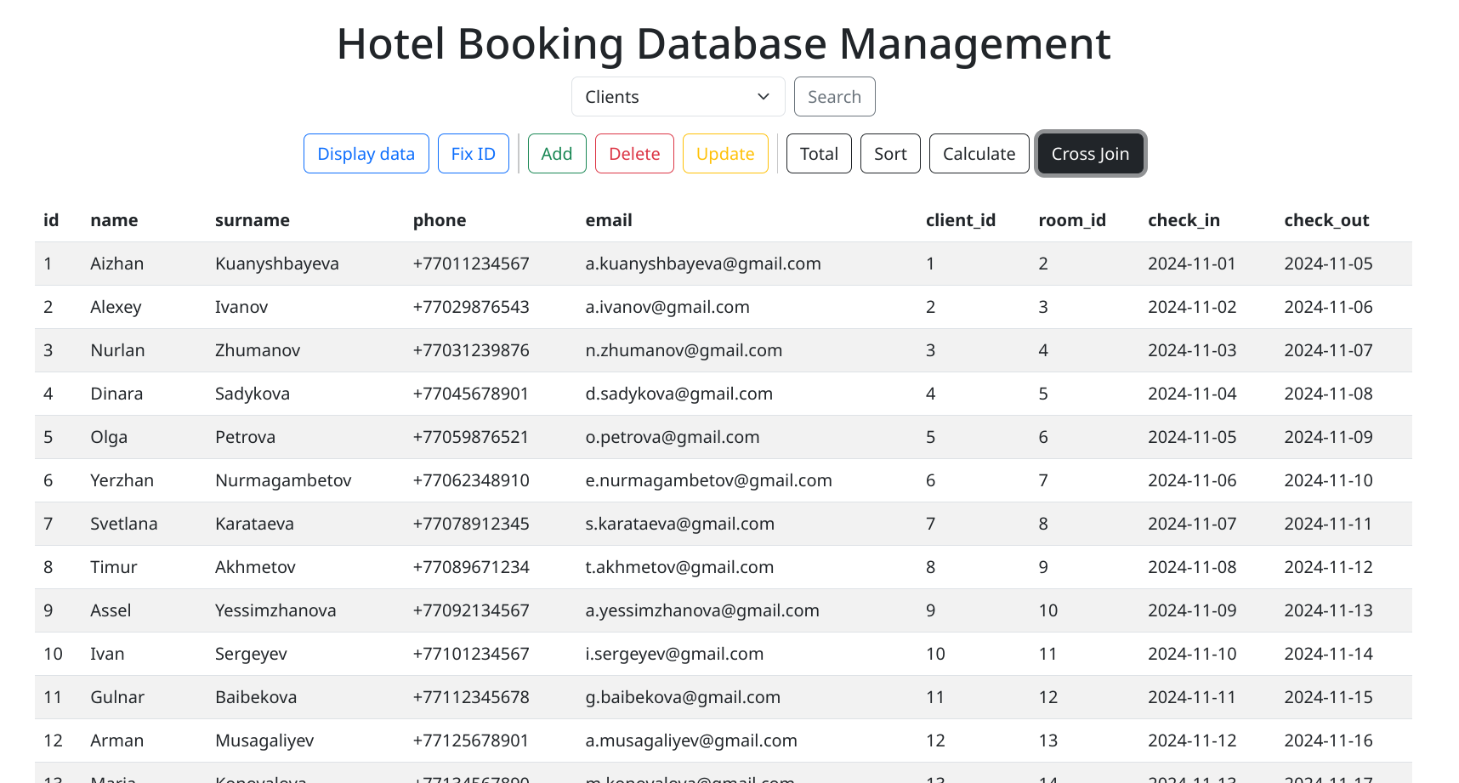
FUNCTIONALITY (CROSS JOIN)
Result of Cross Join

