Slide 1

Team7 - Predicting Arrest Outcomes for Urban Crime Events
1. Problem & Business Context
2. Data & EDA Highlights
3. Modeling Approach
4. Results & Deployment Demo
5. Recommendations & Impact
* Chicago Crimes (2015-2025) + NIBRS External Generalization

Slide 2
01
Problem Statement & Business Context
Predict whether a reported crime incident is likely to lead to an arrest using only information available at reporting time.
Goal
Why this matters
Prediction target
Arrest = 1 / 0
Decision point
At incident reporting time
Core inputs
time, location, offense category, crime-against type......
Prioritize analyst attention for high-probability cases
Learn patterns that can transfer across jurisdictions
Build a proof-of-concept decision-support workflow
Business framing
This is an analyst support tool, not an autonomous policing system.
The model provides a triage score to support review, prioritization and monitoring.

Slide 3
02
Dataset Overview & Split Strategy
Chicago Crimes Dataset
NIBRS Dataset
Source:
Chicago Police Department CLEAR system
Coverage used in project materials:
Jan 1, 2015 - Dec 31, 2025
After EDA cleaning:
2,713,480 rows and 25 columns
Source:
FBI NIBRS incident-level data
Used as an external generalization benchmark
Aligned to the same 43 engineered features
Train:
Chicago 2015-2024
2,477,280 incidents | 43 features
Local Holdout:
Chicago 2025 236,200 incidents
External Holdout:
NIBRS 2024 1,161,668 incidents
Feature Engineering:
Missing value treatment
Cyclical time encoding
Strict one-hot alignment

Slide 4
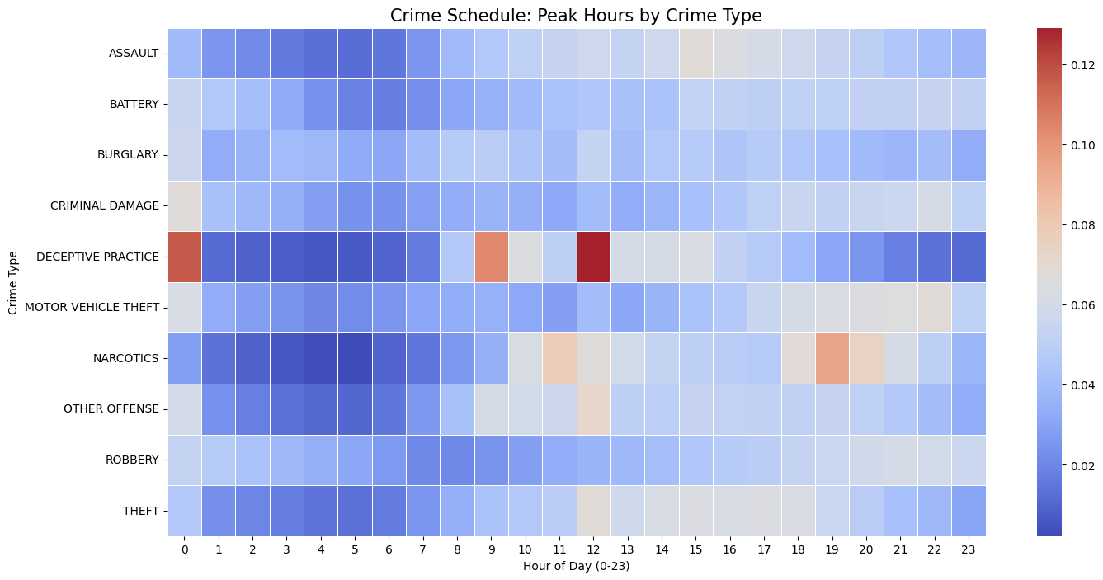
02
EDA Highlight 1: Temporal Crime Patterns
What We Observed:
EDA revealed clear daily and seasonal timelines in the data
Fraudulent crimes following a 9-to-5 schedule during "business hours"
Violent crimes surging between 8 PM and 2 AM during "night time"
Model Implication:
To capture these non-linear cyclic variations, we performed sine-cosine cyclic encoding on the time features (hours, months).

Slide 5
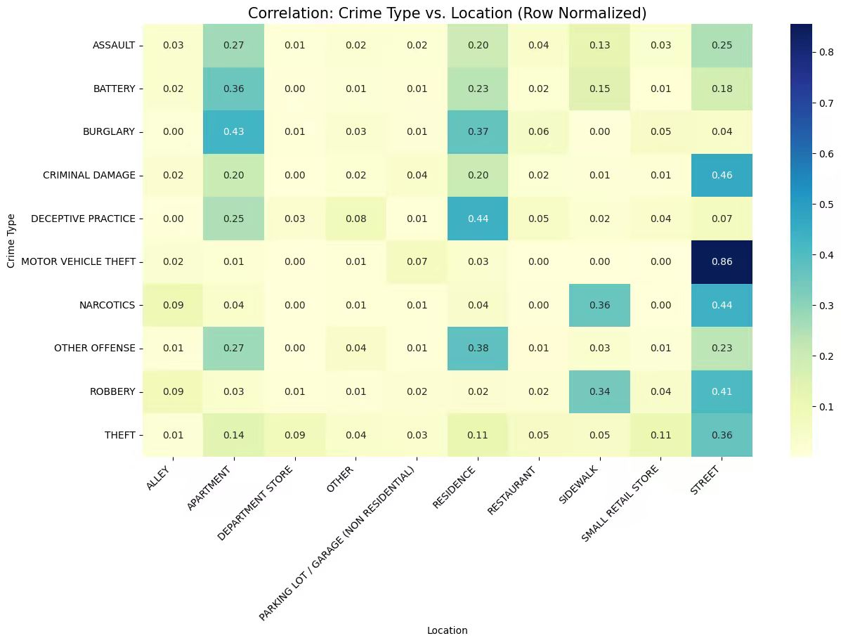
02
EDA Highlight 2: Spatial Hotspots & Crime Context
What We Observed:
High concentration of crime in specific neighborhoods
Commercial theft is almost entirely concentrated in street
Violent crimes (battery/assault) primarily occur in private residences such as apartments
Model Implication:
Based on this finding, we focused on one-hot encoding of standardized location types

Slide 6
03
Model Development Methodology
Logistic Regression
MLP
Interpretable baseline
L2 regularization
class_weight = balanced
Weighted loss for class imbalance
Captures higher-order feature interactions
5 epochs in notebook experiment
Random Forest
LightGBM
Bagging-based ensemble
Strong recall and AUC
Robust under domain shift
Gradient boosting ensemble
Efficient nonlinear learning
Strong city-specific performance
Evaluation Metrics:
Accuracy, Precision, Recall, F1-score, AUC-ROC
Validation Design:
Out-of-time test on Chicago 2025
Cross-domain test on NIBRS 2024
Why Multiple Models:
The task mixes sparse categorical features, cyclical time features and external transfer risk, so we compare interpretability, local fit and robustness together.

Slide 7
04
Results, Robustness & Key Findings
Chicago 2025 temporal holdout
NIBRS 2024 external holdout
Best F1: MLP = 0.520
Best AUC: Random Forest = 0.837
Best Accuracy: LightGBM = 0.826
Best F1: Random Forest = 0.593
Best AUC: Random Forest = 0.810
Best Precision: LR = 0.688
Model | Precision | Recall | F1 | AUC
Logistic Regression | 0.413 | 0.585 | 0.484 | 0.796
MLP | 0.464 | 0.591 | 0.520 | 0.832
Random Forest | 0.351 | 0.743 | 0.477 | 0.837
LightGBM | 0.465 | 0.581 | 0.517 | 0.811
Model | Precision | Recall | F1 | AUC
Logistic Regression | 0.688 | 0.439 | 0.536 | 0.762
MLP | 0.622 | 0.480 | 0.541 | 0.794
Random Forest | 0.557 | 0.633 | 0.593 | 0.810
LightGBM | 0.630 | 0.450 | 0.525 | 0.765
Large disjoint holdouts (n=235,060 and n=1,161,668) make the observed ranking differences operationally meaningful. Formal significance testing is a natural next step.

Slide 8
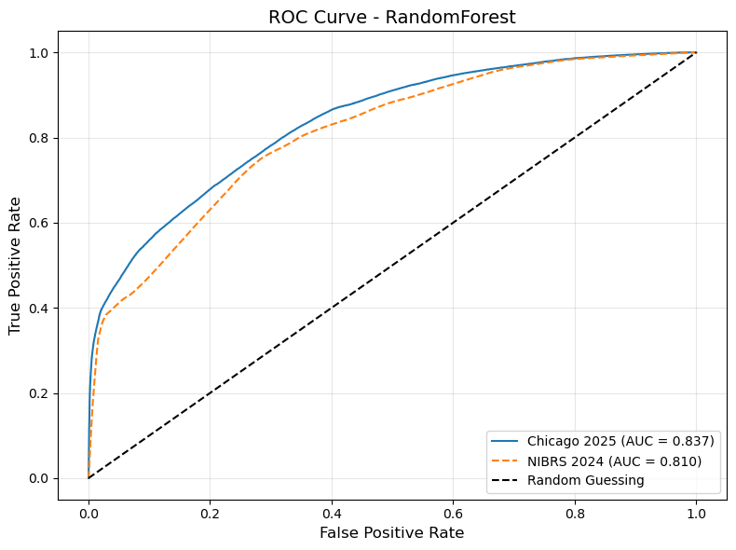
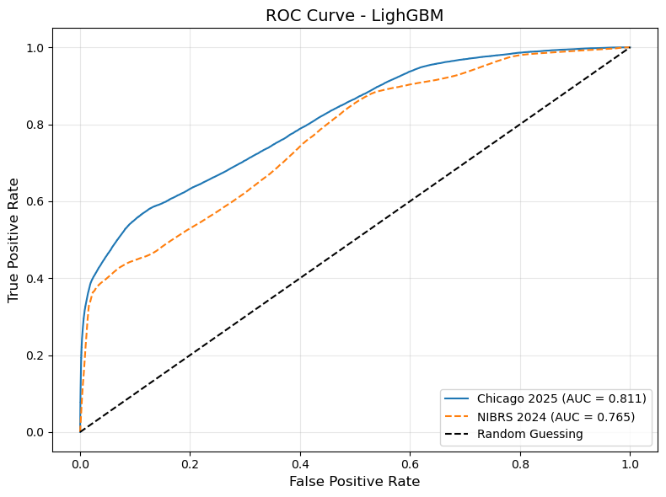
04
Model Explainability & Practical Insight
Consistent Top Signals
Crime-against category, drug/narcotic offenses, department or discount-store locations, residence/home context, and cyclical time features appear repeatedly across models.
Business Interpretation
Arrest probability is not driven by one factor. It emerges from the joint context of offense type, place and time, which supports the choice of nonlinear models for deployment.

Slide 9
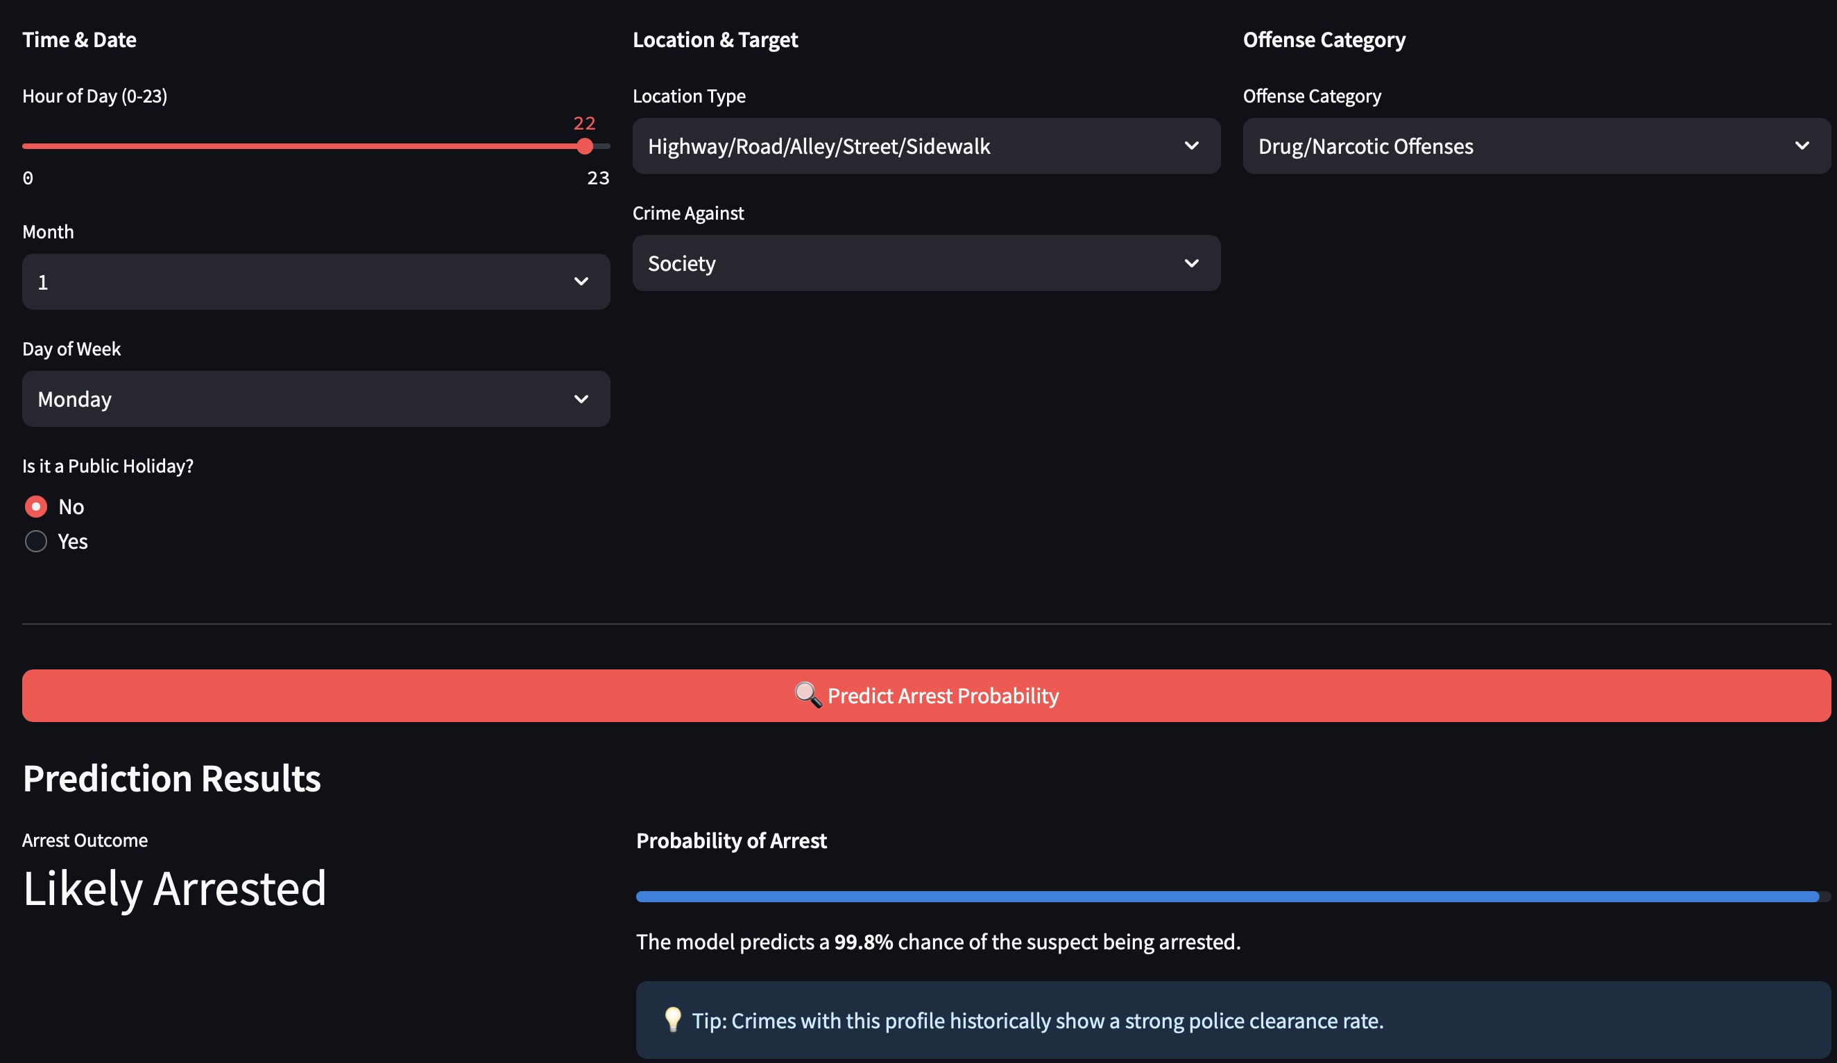
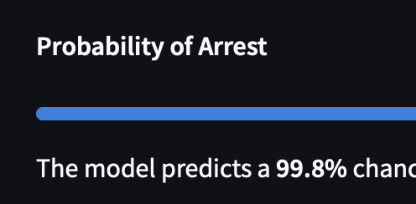

04
Live Demo: Deployed Model Walkthrough
Case 1: A Model with a High Arrest Rate — “The Sure Catch”
The model can identify cases where the police are “proactively pursuing” suspects or where arrests are likely.
Input Settings:
Time: 10:00 PM
Location: Highway/Road/Alley/Street/Sidewalk
Crime Against: Society
Offense Category: Drug/Narcotic Offenses or Weapon Law Violations
Step 1: Activate the backend API by visiting https://prediction-api-vlwb.onrender.com
Step 2: Visit https://prediction-dashboard-5y9c.onrender.com/

Slide 10
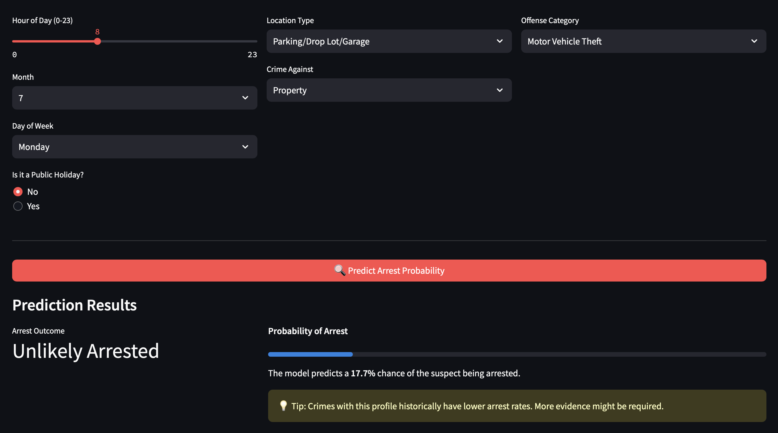
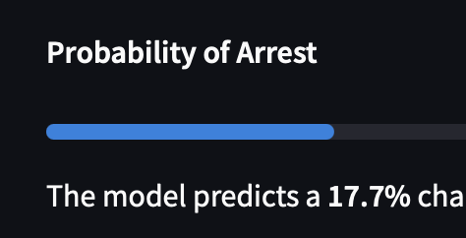
04
Live Demo: Deployed Model Walkthrough
Case 2: A Model with a Low Arrest Rate — “Property Losses Discovered After the Fact” (The Cold Case)
The model has not overfitted and addresses the real-world challenge of extremely low clearance rates for property crimes.
Input Settings:
Time: 8:00 AM (Typically discovered when the victim wakes up in the morning to get ready for work)
Location: Parking lot, drop-off area, garage, or residence/home
Crime Against: Property
Offense Category: Motor Vehicle Theft or Burglary/Breaking & Entering

Slide 11
05
Business Recommendations & Expected Impact
Expected Impact
Recommendation 1
Deploy first as an analyst-facing triage tool
Recommendation 2
Monitor drift separately for Chicago and non-Chicago data
Recommendation 3
Add fairness checks and threshold calibration before wider operational use
Short Term
• Faster case triage
• Better visibility into arrest-likely patterns
Medium Term
• Reusable feature pipeline for public-safety analytics
• Shared benchmark for cross-jurisdiction comparison
Limitation
• Model uses incident attributes only; it does not observe patrol decisions or resource availability
Closing Message
The main contribution is not only higher predictive performance, but a workflow tested on both future-time and external-jurisdiction data.

