Slide 1

Problem definition
Given a graph G and one query node q $∈$ G, find hierarchical communities $G_{q}$.
Connectivity: $G_{q}$is connected and $G_{q}∈$ G.
Structure cohesiveness: k-core, k-truss, etc.
Profile(not only keyword) cohesiveness: hierarchy-based attributes, shared approximate hierarchical attributes。

Slide 2
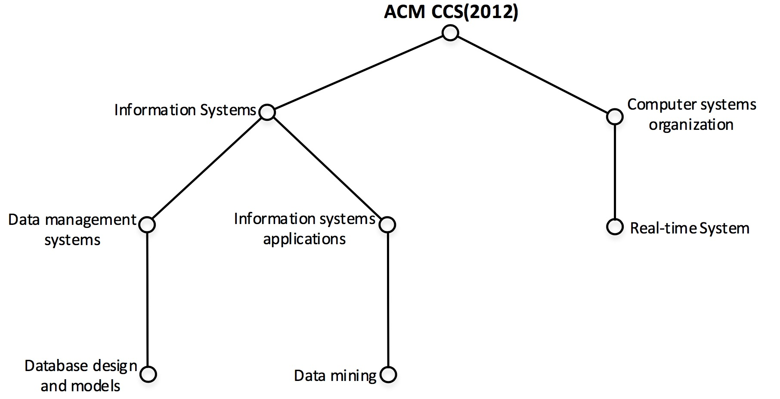
Profile cohesiveness
Composite Attributes- a hierarchical structure
Categorize attributes: Computing Classification System (ACM CCS)
Contain other metadata: time, frequency, etc.

Slide 3
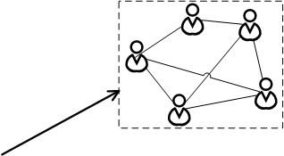
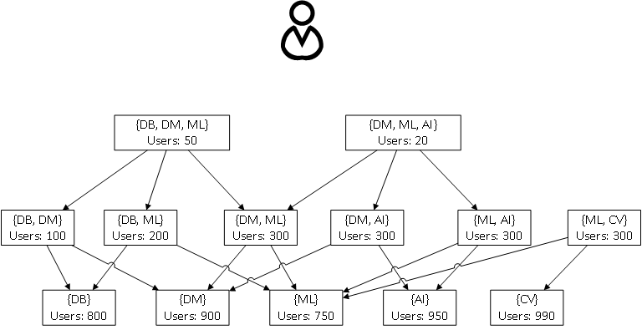
OLAP
Aggregated attributes of communities
Size, keyword dimension, number of shared keywords, and other metadata of keywords
Allows users to view each individual communities
Keep all the communities in memory and compress them

Slide 4
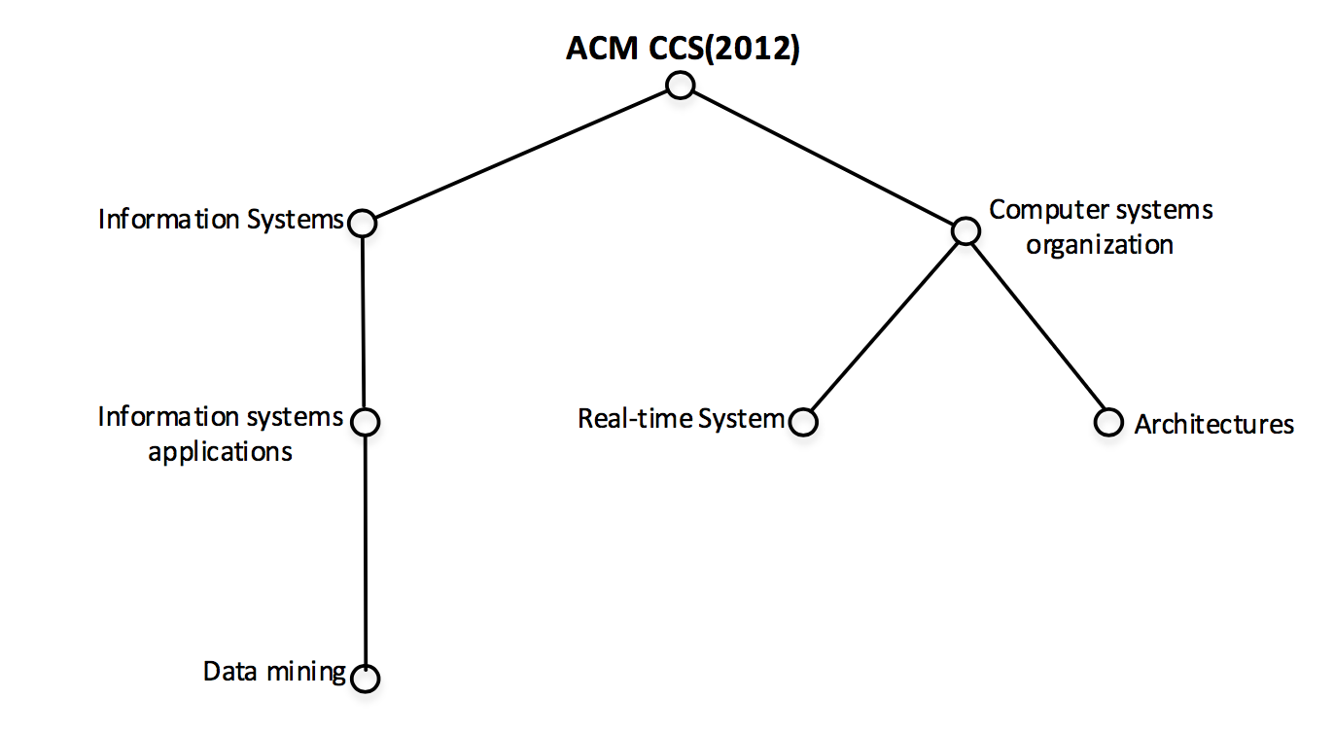
technical challenge
How to organize the data structure?
How to define the shared approximate hierarchical attributes?
How to compare the similarity of two hierarchical attributes of vertices?

