Slide 1

Problem definition
Given a profiled graph G, a profile tree T, and one query node $q$ $∈$ G, find communities, each of which is a $G_{q}$ satisfying the following properties:
Connectivity: $G_{q}$is connected and $G_{q}∈$ G.
Structure cohesiveness: k-core
Profiled cohesiveness: all the vertices in Gq share the maximal subtree of q;

Slide 2
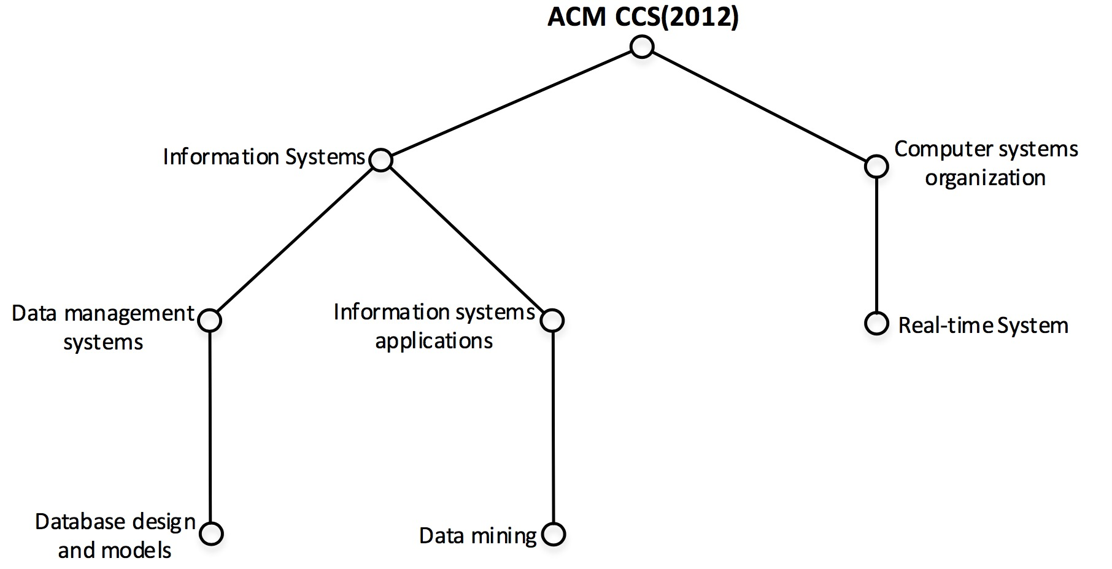
Profile cohesiveness
Composite Attributes- a hierarchical structure
Categorize attributes: Computing Classification System (ACM CCS)
Contain other metadata: time, frequency, etc.
Strategy
We can encode the position of attributes in the classification
system.
Then we compare and compute targeted ACs by using it.

Slide 3
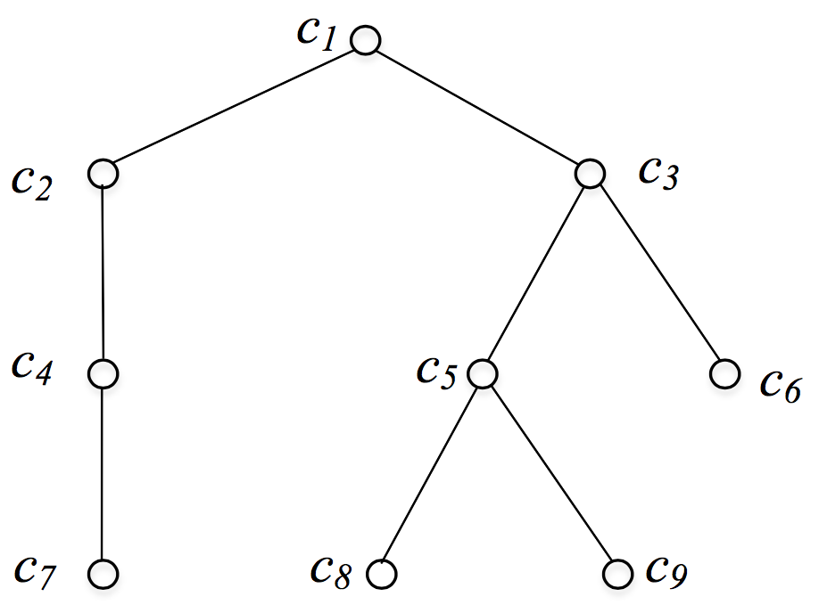
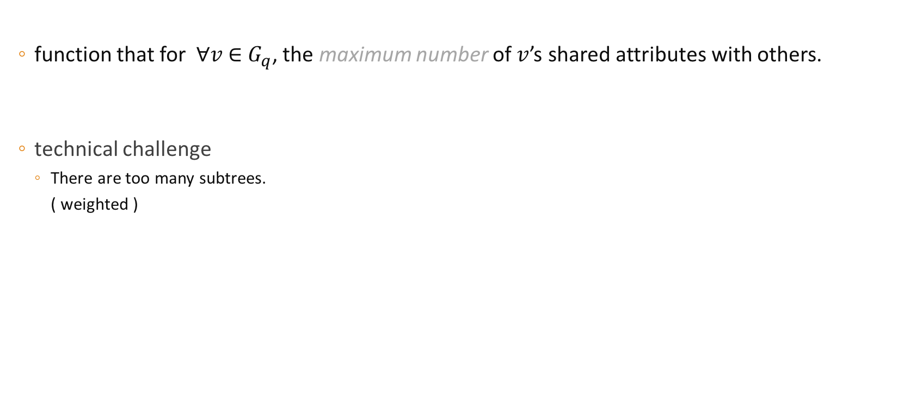

Sim$(G_{q})$
function that for $∀v$ $∈$ $G_{q}$, the maximum number of $v$’s shared attributes with others.
technical challenge
There are too many subtrees.
( weighted )

