Slide 1
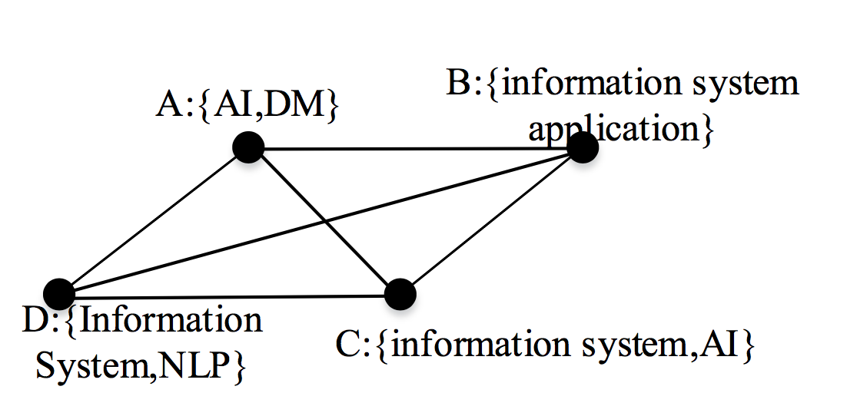
Motivation
If we want to search the communities of A. We get the community contains AC whose common keyword is AI.
Is that good?

Slide 2
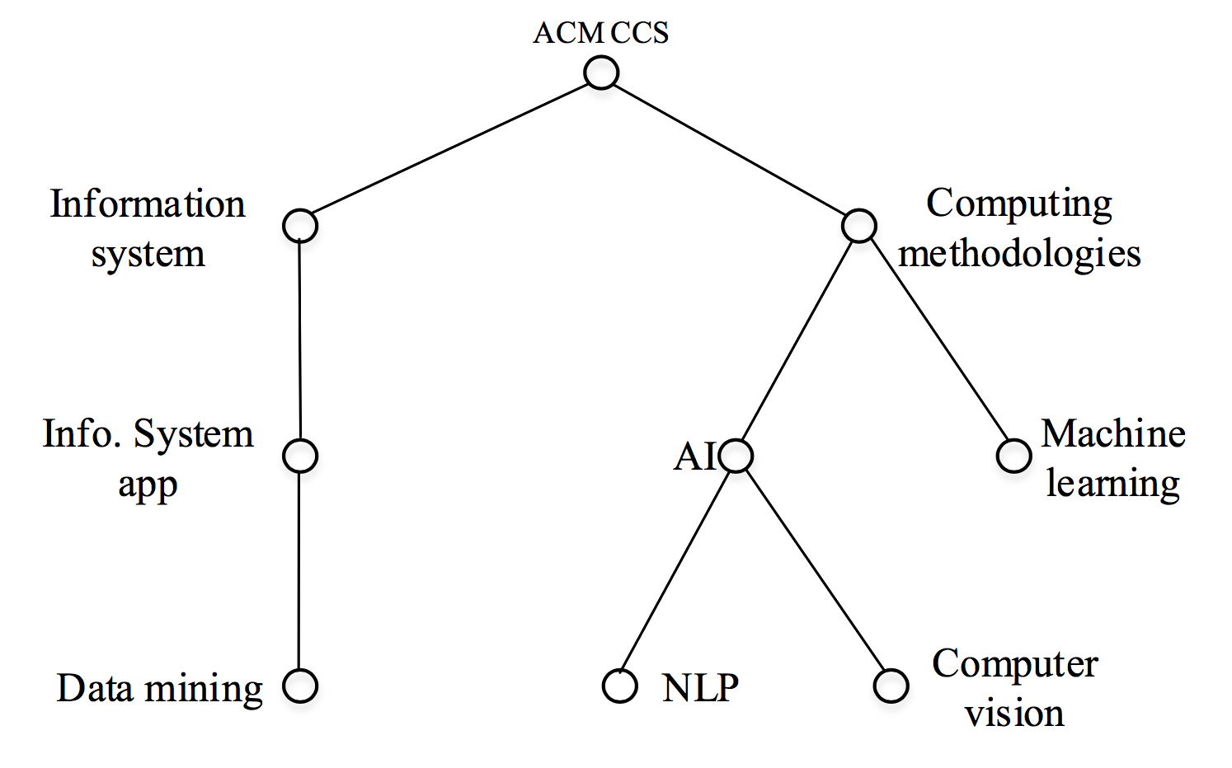
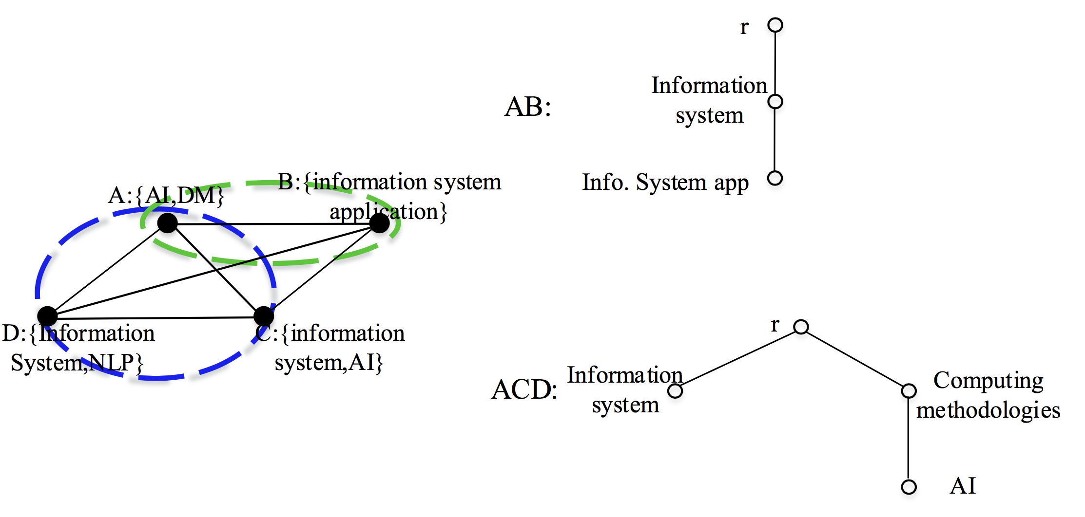
Hierarchical profile

Slide 3
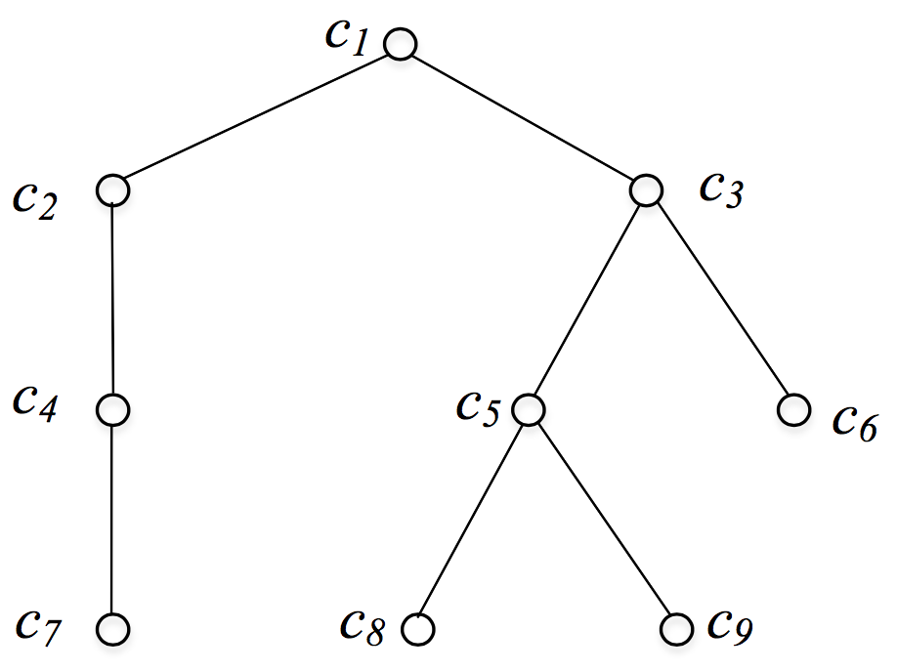

P-tree
A profile tree (P-tree) $T=(V,E)$ is a hierarchy-based set of attributes. $V$ is the set of tree nodes. $l:V→A$ is a function one-on-one mapping tree nodes to a set of attributes $A$={$a_{1},$ $a_{2}$, ……, $a_{n}$}, i.e., $∀x∈V, l\left(x\right)=$ $a_{x}.$ $E=\{(x,y)|x,y∈V\}$ is the set of edges representing relationship between attributes, such that $∀(x,y)∈E$, $l\left(y\right)$ is the semantic sub-attributes of $l\left(x\right).$ One distinguished node $r∈V$ denotes the root of $T,$and for $∀y∈V,y≠r$, $∃!x∈V, s.t.(x,y)∈E$.

Slide 4
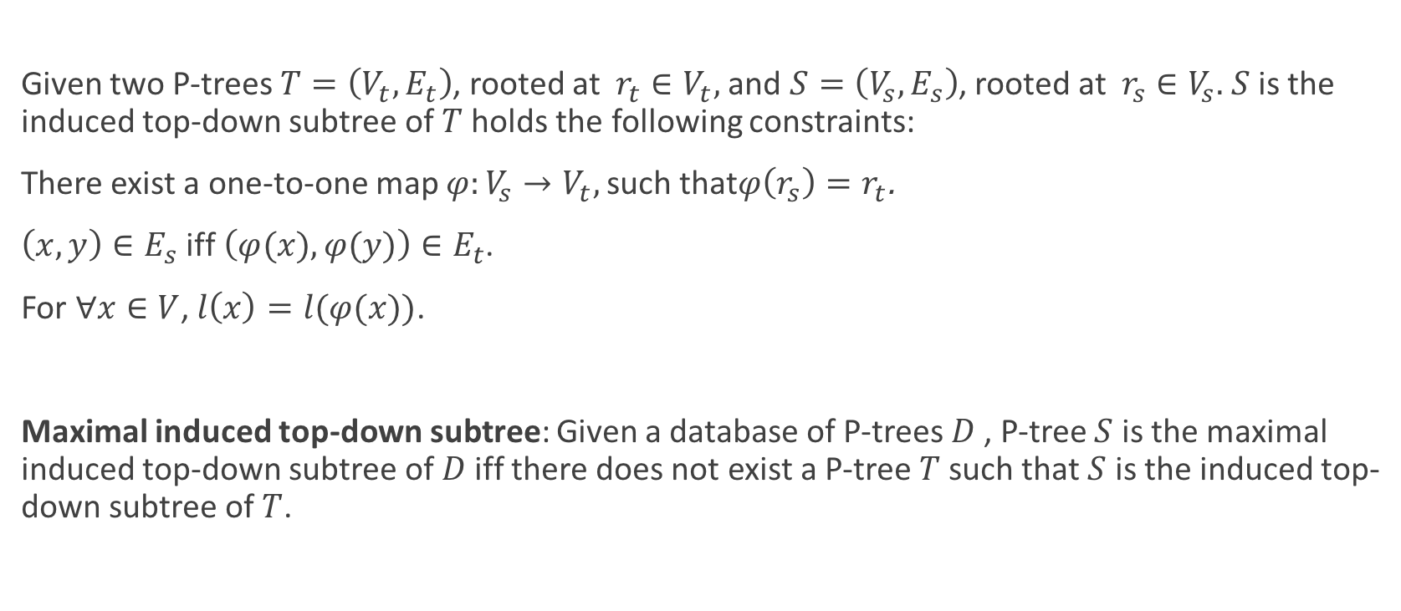
Induced top-down subtree
Given two P-trees $T=\left(V_{t},E_{t}\right)$, rooted at $r_{t}∈V_{t},$and $S=\left(V_{s},E_{s}\right)$, rooted at $r_{s}∈V_{s}.$ $S$ is the induced top-down subtree of $T$ holds the following constraints:
There exist a one-to-one map $φ:V_{s}→V_{t},$such that$φ\left(r_{s}\right)=r_{t}$.
$\left(x,y\right)∈E_{s}$ iff $\left(φ(x),φ(y)\right)∈E_{t}$.
For $∀x∈V$, $l\left(x\right)=l(φ(x))$.
Maximal induced top-down subtree: Given a database of P-trees $D$ , P-tree $S$ is the maximal induced top-down subtree of $D$iff there does not exist a P-tree $T$ such that $S$ is the induced top-down subtree of $T$.

Slide 5
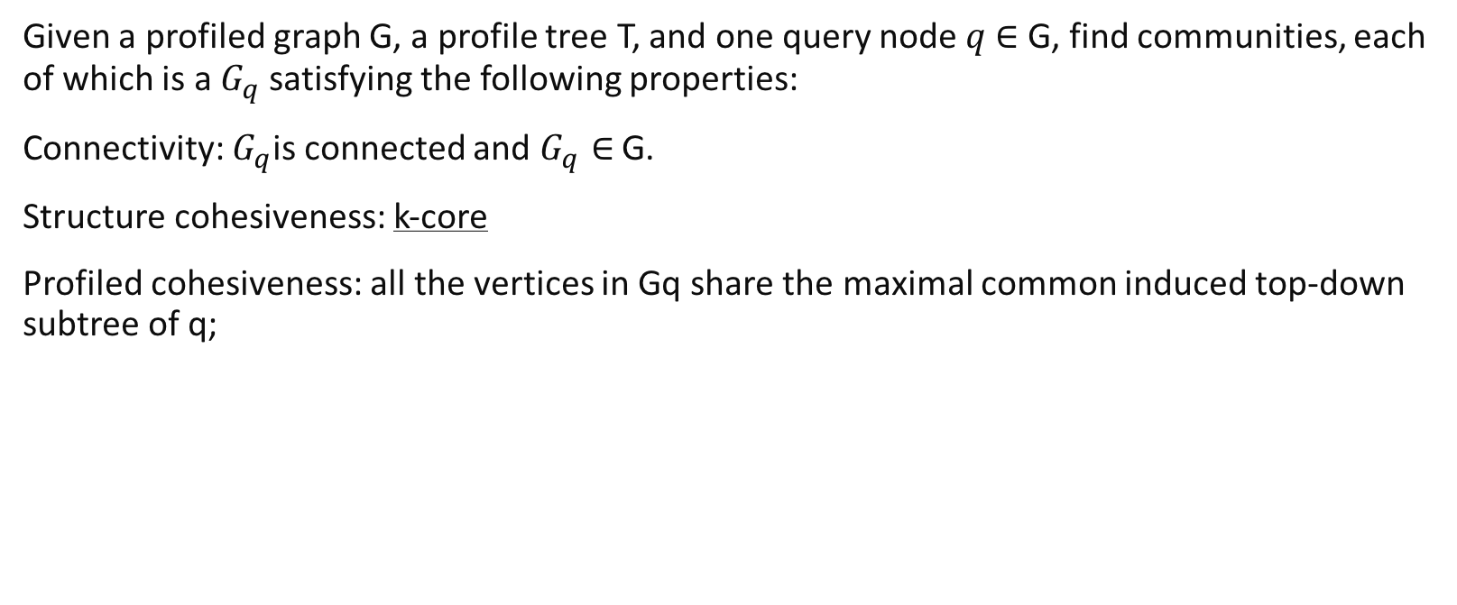
Problem definition
Given a profiled graph G, a profile tree T, and one query node $q$ $∈$ G, find communities, each of which is a $G_{q}$ satisfying the following properties:
Connectivity: $G_{q}$is connected and $G_{q}∈$ G.
Structure cohesiveness: k-core
Profiled cohesiveness: all the vertices in Gq share the maximal common induced top-down subtree of q;

Slide 6
Example of problem

Slide 7
NP-HARD

Slide 8
Baseline solution
Inc
Dec

