Slide 1
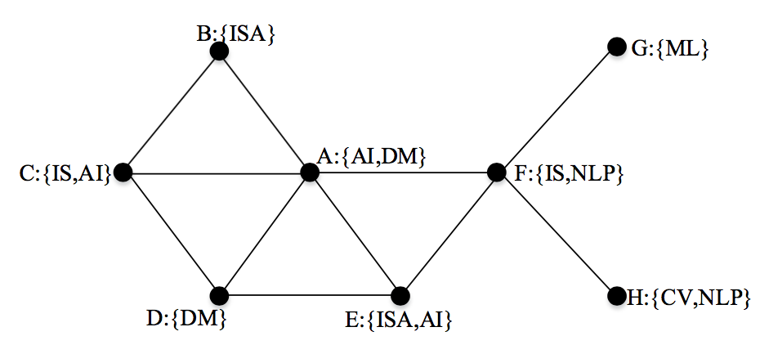
Motivation
IS: information system
ISA: information system application
DM: data mining
CM: computing methodologies
AI: artificial intelligence
NLP: natural language processing
CV: computer vision
If we want to search the communities of A. It seems that no community containing A holds both keyword and connectivity cohesiveness although A shares the common keyword “AI” and “DM” with C and D respectively.

Slide 2
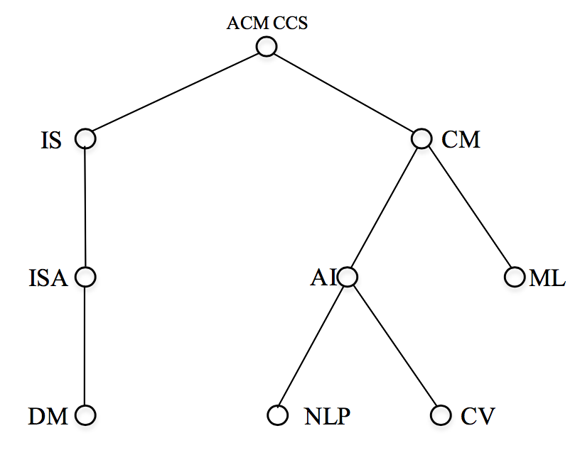
Hierarchical profile
Thus we want to consider the meaning and relationship of the keywords.
We use tree structure called hierarchical profile to describe the attributes.
IS: information system
ISA: information system application
DM: data mining
CM: computing methodologies
AI: artificial intelligence
NLP: natural language processing
CV: computer vision

Slide 3
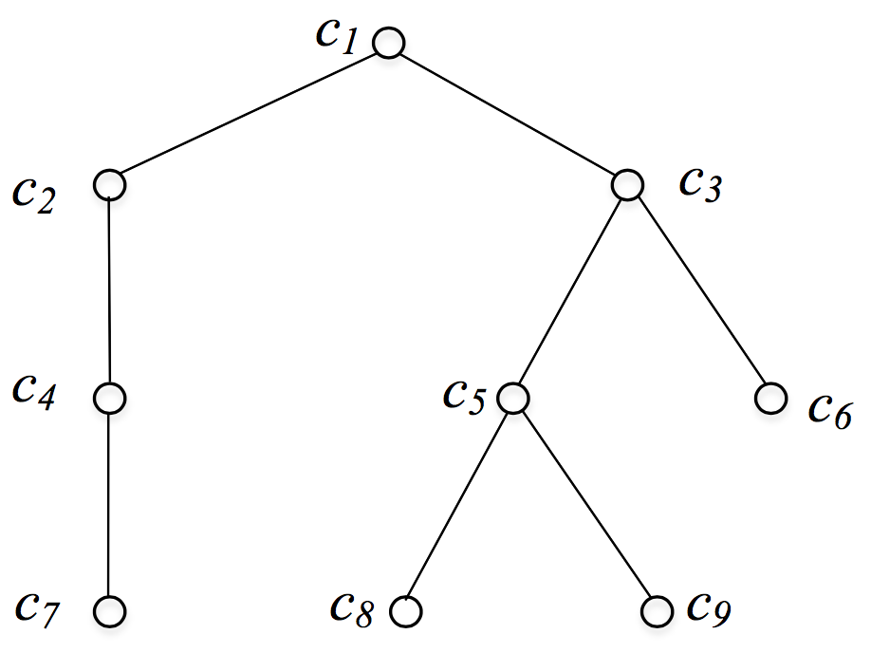

P-tree
A profile tree (P-tree) $T=(V,E)$ is a hierarchy-based set of attributes. $V$ is the set of tree nodes. $l:V→A$ is a function one-on-one mapping tree nodes to a set of attributes $A$={$a_{1},$ $a_{2}$, ……, $a_{n}$}, i.e., $∀x∈V, l\left(x\right)=$ $a_{x}.$ $E=\{(x,y)|x,y∈V\}$ is the set of edges representing relationship between attributes, such that $∀(x,y)∈E$, $l\left(y\right)$ is the semantic sub-attributes of $l\left(x\right).$ One distinguished node $r∈V$ denotes the root of $T,$and for $∀y∈V,y≠r$, $∃!x∈V, s.t.(x,y)∈E$.

Slide 4
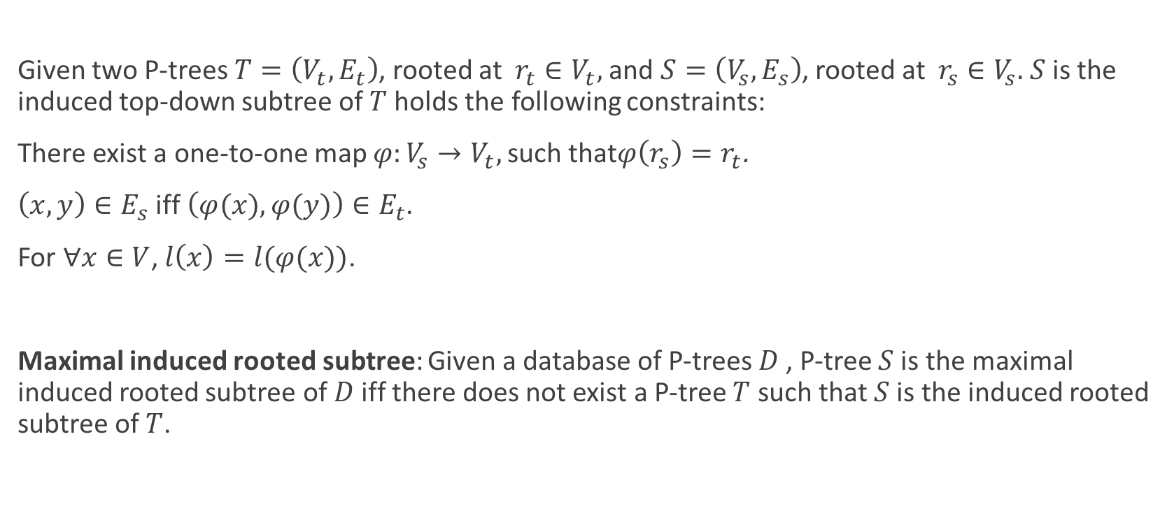
Induced rooted subtree
Given two P-trees $T=\left(V_{t},E_{t}\right)$, rooted at $r_{t}∈V_{t},$and $S=\left(V_{s},E_{s}\right)$, rooted at $r_{s}∈V_{s}.$ $S$ is the induced top-down subtree of $T$ holds the following constraints:
There exist a one-to-one map $φ:V_{s}→V_{t},$such that$φ\left(r_{s}\right)=r_{t}$.
$\left(x,y\right)∈E_{s}$ iff $\left(φ(x),φ(y)\right)∈E_{t}$.
For $∀x∈V$, $l\left(x\right)=l(φ(x))$.
Maximal induced rooted subtree: Given a database of P-trees $D$ , P-tree $S$ is the maximal induced rooted subtree of $D$iff there does not exist a P-tree $T$ such that $S$ is the induced rooted subtree of $T$.

Slide 5
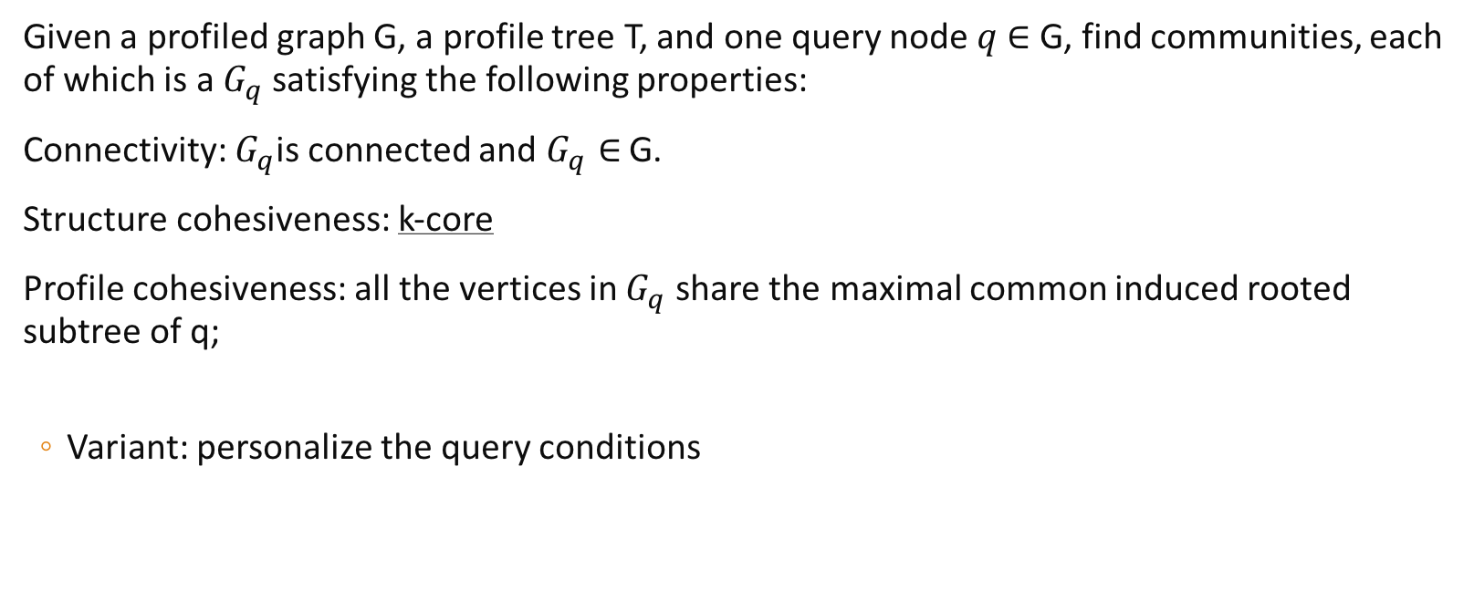
Problem definition
Given a profiled graph G, a profile tree T, and one query node $q$ $∈$ G, find communities, each of which is a $G_{q}$ satisfying the following properties:
Connectivity: $G_{q}$is connected and $G_{q}∈$ G.
Structure cohesiveness: k-core
Profile cohesiveness: all the vertices in $G_{q}$ share the maximal common induced rooted subtree of q;
Variant: personalize the query conditions

Slide 6
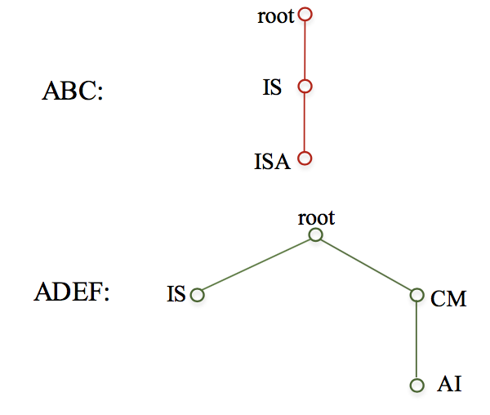
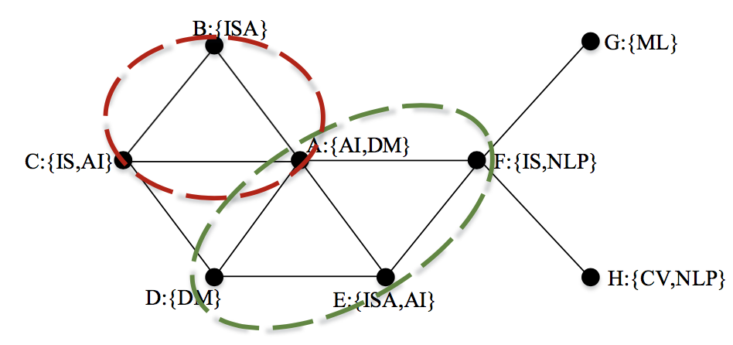
Example of problem
Two communities are searched in which vertices share the maximal hierarchical profile with A.

Slide 7
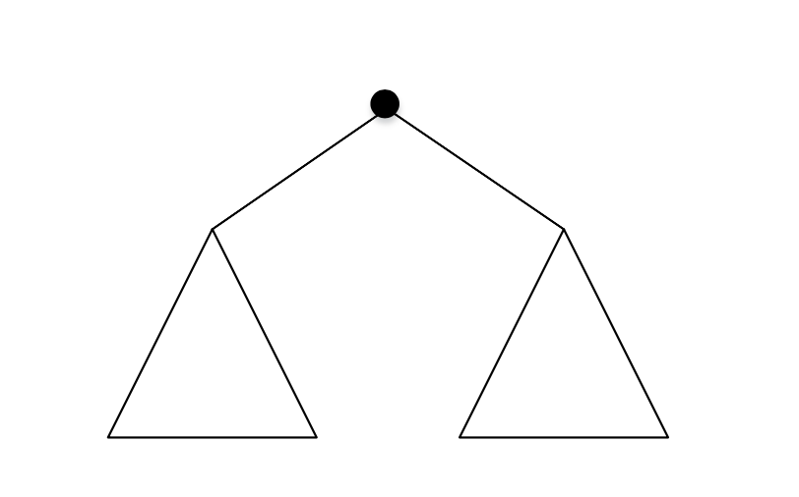
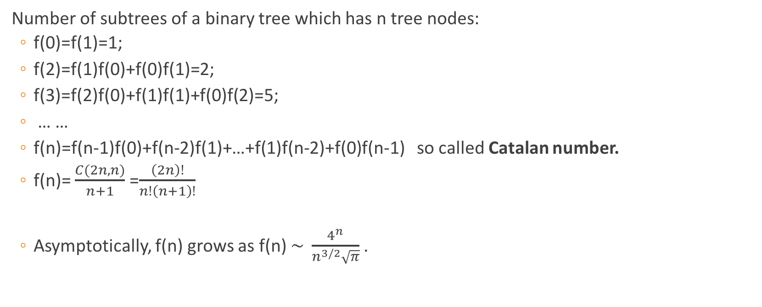
Special case: binary tree
Number of subtrees of a binary tree which has n tree nodes:
f(0)=f(1)=1;
f(2)=f(1)f(0)+f(0)f(1)=2;
f(3)=f(2)f(0)+f(1)f(1)+f(0)f(2)=5;
… …
f(n)=f(n-1)f(0)+f(n-2)f(1)+…+f(1)f(n-2)+f(0)f(n-1) so called Catalan number.
f(n)= $\frac{C(2n,n)}{n+1}$ =$\frac{\left(2n\right)!}{n!\left(n+1\right)!}$
Asymptotically, f(n) grows as f(n) $\sim \frac{4^{n}}{n^{3/2}\sqrt{π}}$.

Slide 8
NP-HARD
Maximal frequent subtree pattern mining is np-hard[1].
There are two main steps in tree pattern mining: enumeration and counting.
Enumeration is NP-hard and counting is #p-complete[2]. Thus the problem of maximal frequent subtree pattern mining is NP-hard.
[1] Yang G. The complexity of mining maximal frequent itemsets and maximal frequent patterns[C]//Proceedings of the tenth ACM SIGKDD international conference on Knowledge discovery and data mining. ACM, 2004: 344-353.
[2] Valiant L G. The complexity of computing the permanent[J]. Theoretical computer science, 1979, 8(2): 189-201.

Slide 9

Baseline solution
Basic idea:
Search K-$\hat{core}$ containing query vertex $A$.
Mining Maximal common profile.
Output targeted communities containing A.

Slide 10
Mining maximal common profile
Recently, the proposed approaches for mining maximal frequent tree pattern rely on a sequential encoding of the database trees.
encode trees to sequences:
post-order encoding: TRIPS[1]
pre-order encoding: TIDES[1], CMTreeMiner[2]
Patterns generation + pruning strategies
Patterns checking
[1] Tatikonda S, Parthasarathy S, Kurc T. TRIPS and TIDES: new algorithms for tree mining[C]//Proceedings of the 15th ACM international conference on Information and knowledge management. ACM, 2006: 455-464.
[2] Chi Y, Xia Y, Yang Y, et al. Mining closed and maximal frequent subtrees from databases of labeled rooted trees[J]. IEEE Transactions on Knowledge and Data Engineering, 2005, 17(2): 190-202.

Slide 11
Advanced solution
Index + query

