Slide 1
Algo+index
6.12

Slide 2
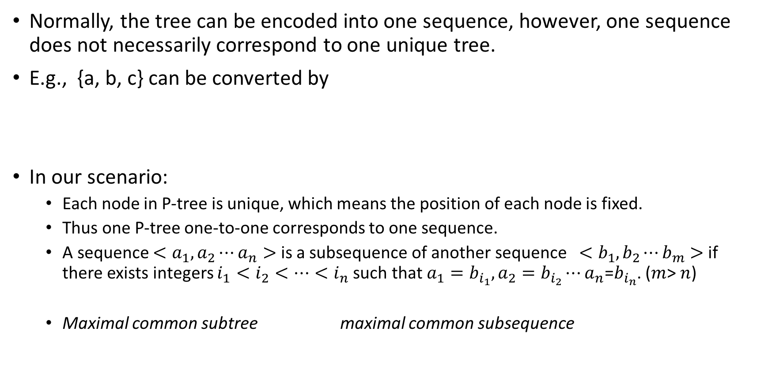
transformation
Normally, the tree can be encoded into one sequence, however, one sequence does not necessarily correspond to one unique tree.
E.g., {a, b, c} can be converted by
In our scenario:
Each node in P-tree is unique, which means the position of each node is fixed.
Thus one P-tree one-to-one corresponds to one sequence.
A sequence $<a_{1}, a_{2}⋯a_{n}>$ is a subsequence of another sequence $<b_{1},b_{2}⋯b_{m}>$ if there exists integers $i_{1}<i_{2}<⋯<i_{n}$ such that $a_{1}=b_{i_{1}},a_{2}=b_{i_{2}}⋯a_{n}$=$b_{i_{n}}$. ($m$> $n$)
Maximal common subtree maximal common subsequence
a
a
b
c
b
c
[1]Agrawal R, Srikant R. Mining sequential patterns[C]//Data Engineering, 1995. Proceedings of the Eleventh International Conference on. IEEE, 1995: 3-14.

Slide 3
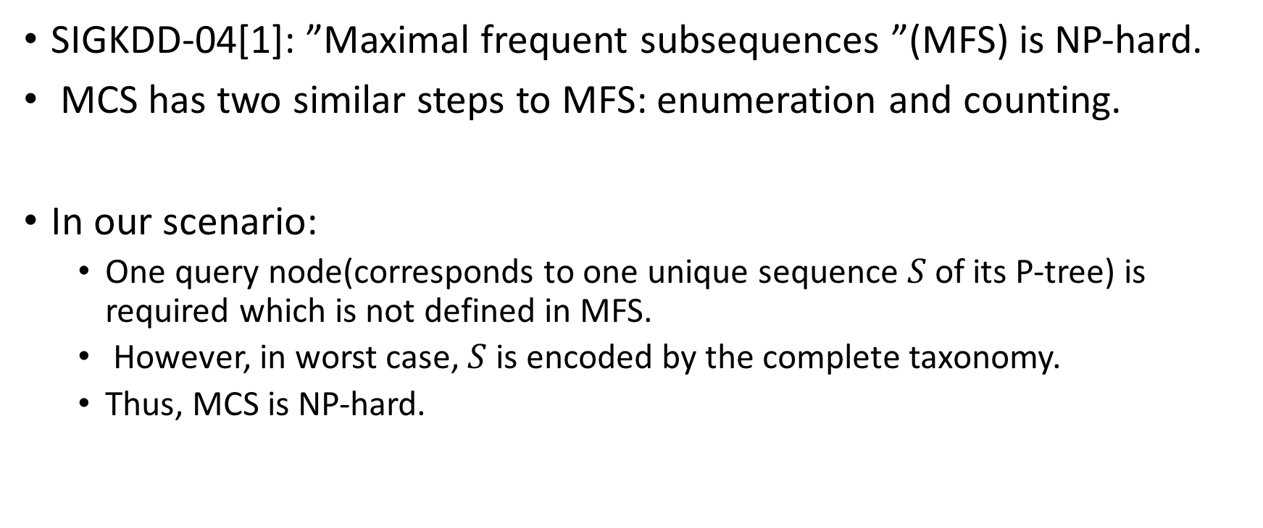
Maximal common subsequence(MCS)
SIGKDD-04[1]: ”Maximal frequent subsequences ”(MFS) is NP-hard.
MCS has two similar steps to MFS: enumeration and counting.
In our scenario:
One query node(corresponds to one unique sequence $S$of its P-tree) is required which is not defined in MFS.
However, in worst case, $S$ is encoded by the complete taxonomy.
Thus, MCS is NP-hard.
[1] Yang G. The complexity of mining maximal frequent itemsets and maximal frequent patterns[C]//Proceedings of the tenth ACM SIGKDD international conference on Knowledge discovery and data mining. ACM, 2004: 344-353.

Slide 4
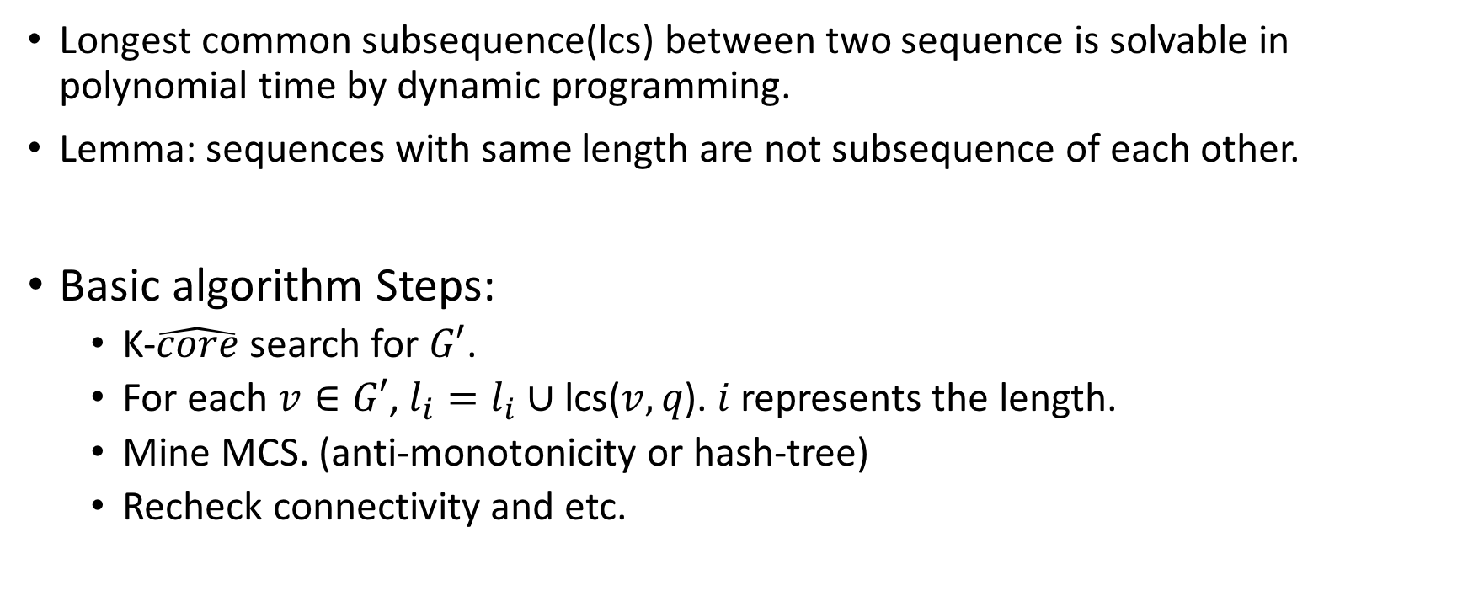
basic algorithm Ⅱ
Longest common subsequence(lcs) between two sequence is solvable in polynomial time by dynamic programming.
Lemma: sequences with same length are not subsequence of each other.
Basic algorithm Steps:
K-$\hat{core}$ search for $G′$.
For each $v∈G′$, $l_{i}=l_{i}∪\text{lcs}\text{(}v,q\text{).} i$ represents the length.
Mine MCS. (anti-monotonicity or hash-tree)
Recheck connectivity and etc.

Slide 5
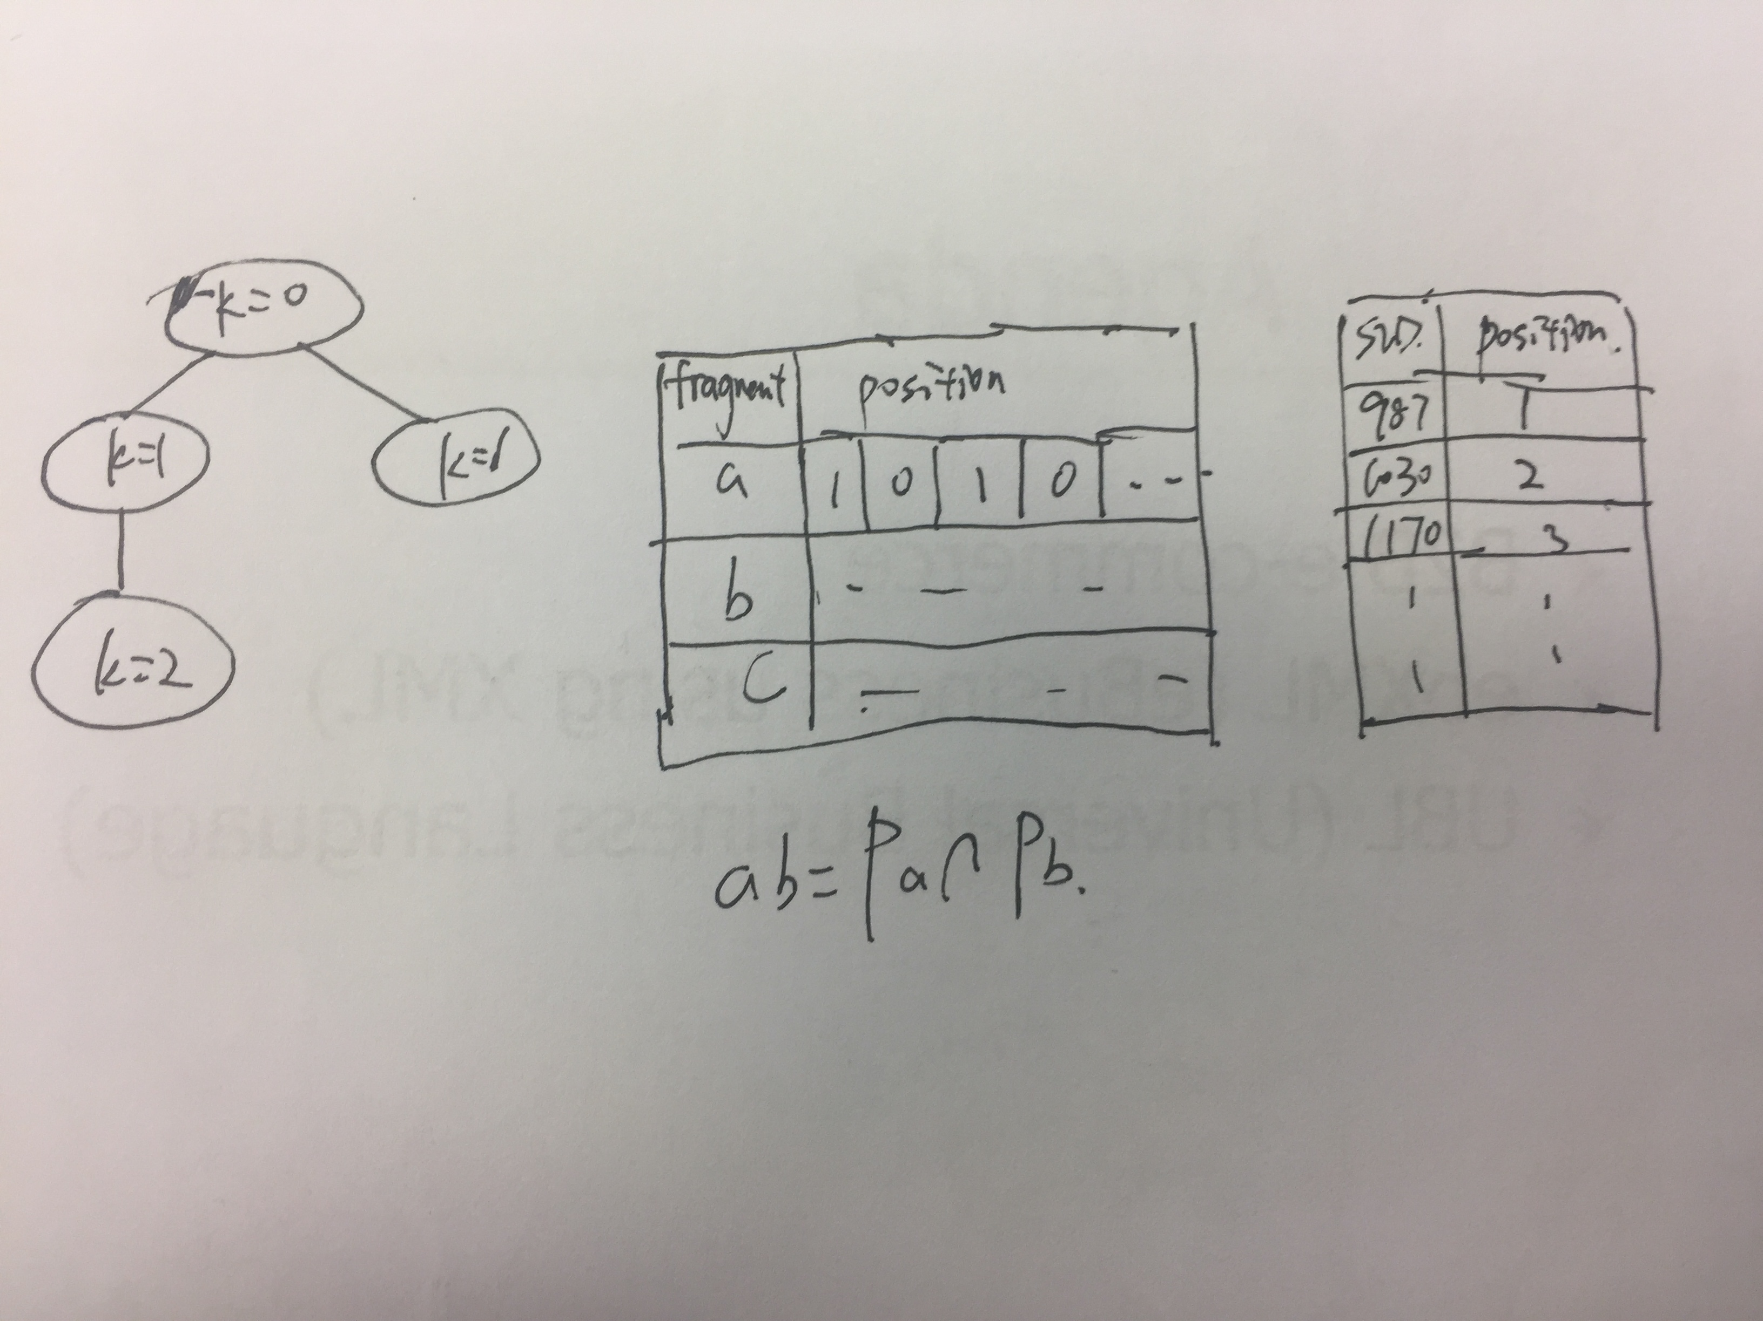
Naïve Index

Slide 6
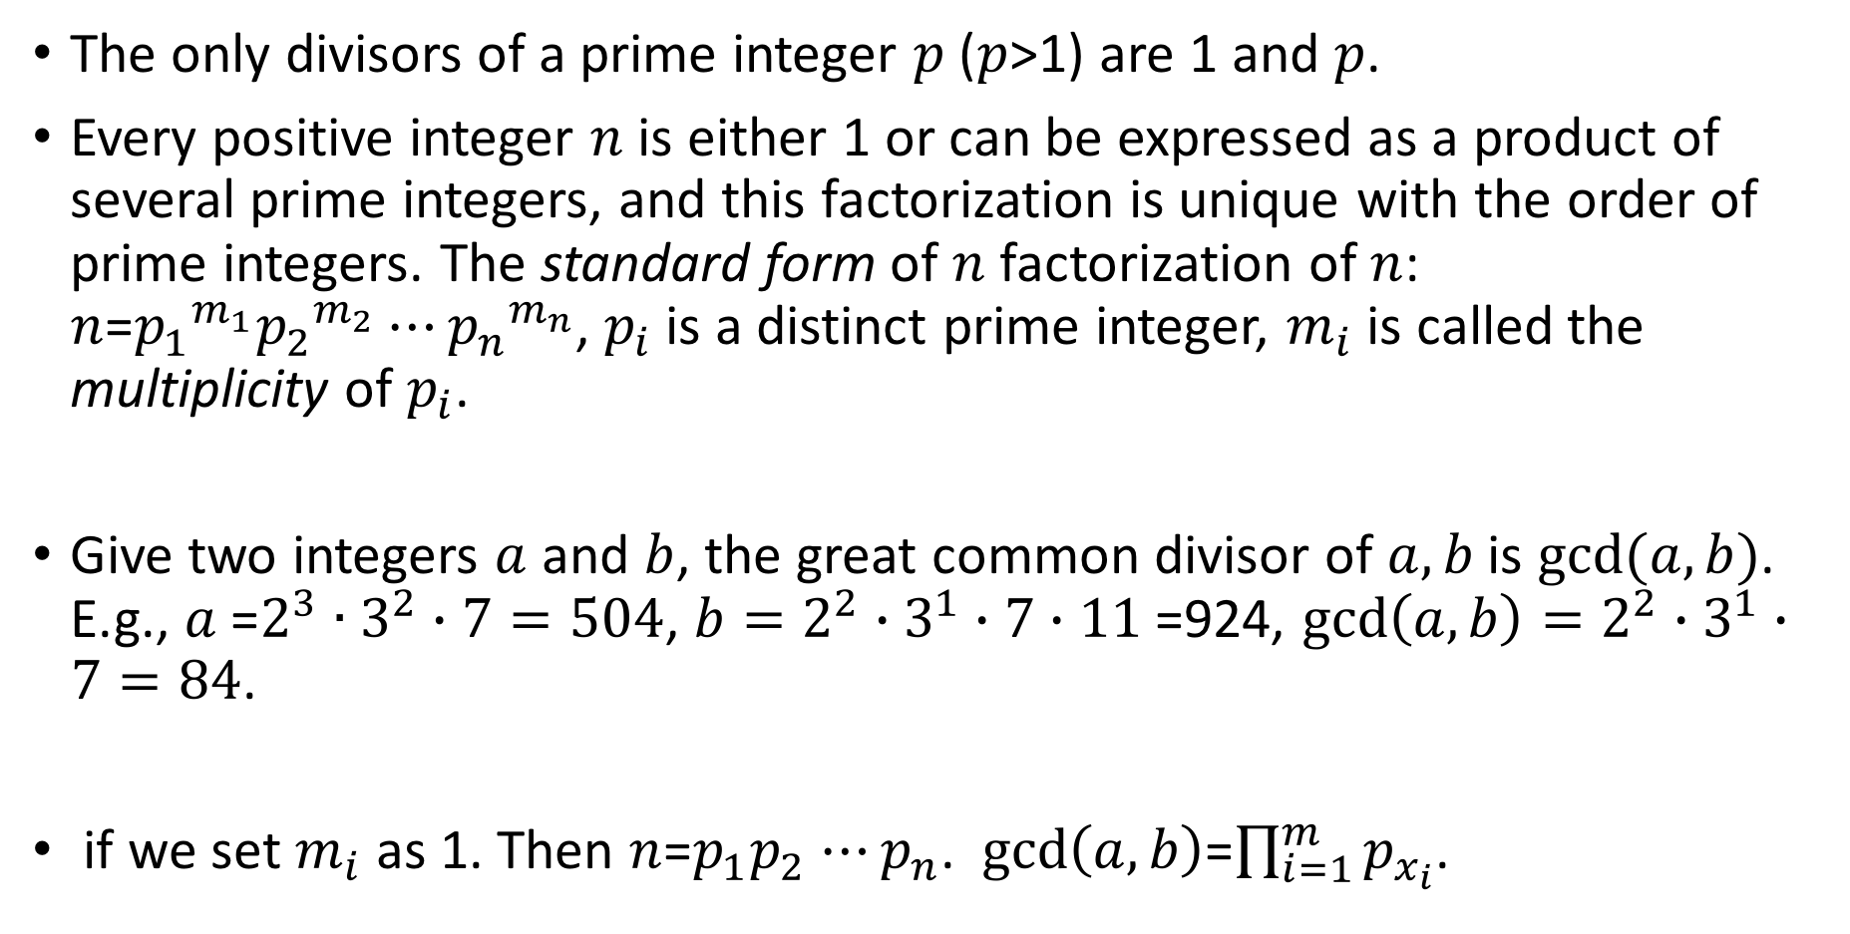
compressed index-mathematic preliminary
The only divisors of a prime integer $p$ ($p$>1) are 1 and $p$.
Every positive integer $n$ is either 1 or can be expressed as a product of several prime integers, and this factorization is unique with the order of prime integers. The standard form of $n$ factorization of $n$: $n$=${p_{1}}^{m_{1}}{p_{2}}^{m_{2}}⋯{p_{n}}^{m_{n}}$, $p_{i}$ is a distinct prime integer, $m_{i}$ is called the multiplicity of $p_{i}$.
Give two integers $a$ and $b$, the great common divisor of $a,b$ is $gcd(a,b)$. E.g., $a$=$2^{3}∙3^{2}∙7=504$, ${b=2}^{2}∙3^{1}∙7$ $∙11$ =924, $gcd\left(a,b\right)=2^{2}∙3^{1}∙7=84$.
if we set $m_{i}$ as 1. Then $n$=$p_{1}p_{2}$ $⋯p_{n}$. $gcd\left(a,b\right)$=$\prod_{i=1}^{m}{p_{x_{i}}}$.

Slide 7
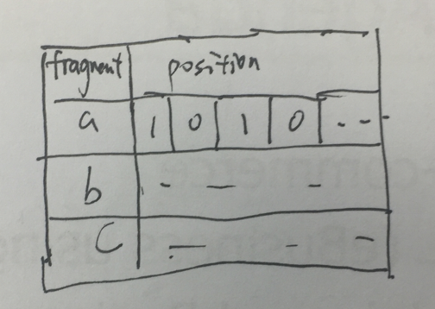
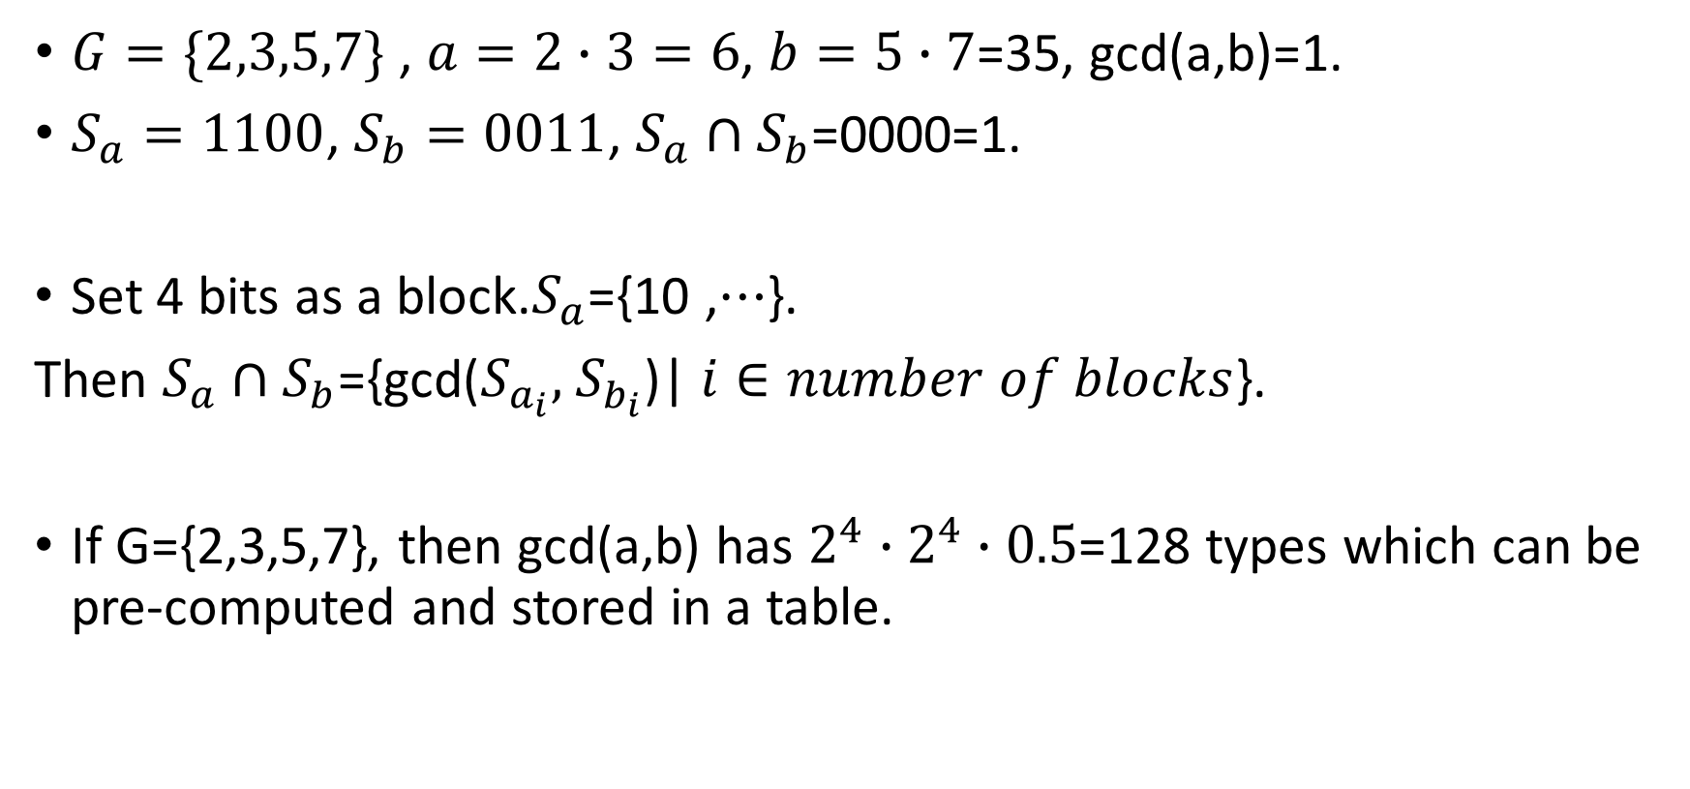
compressed index-mathematic preliminary
$G=\{2,3,5,7\}$ , $a=2∙3=6$, $b=5∙7$=35, gcd(a,b)=1.
$S_{a}=1100$, $S_{b}=0011$, $S_{a}∩S_{b}$=0000=1.
Set 4 bits as a block.$S_{a}$={10 ,$⋯$}.
Then $S_{a}∩S_{b}$={gcd($S_{a_{i}},$ $S_{b_{i}}$)| $i∈number of blocks$}.
If G={2,3,5,7}, then gcd(a,b) has $2^{4}∙2^{4}∙0.5$=128 types which can be pre-computed and stored in a table.

Slide 8
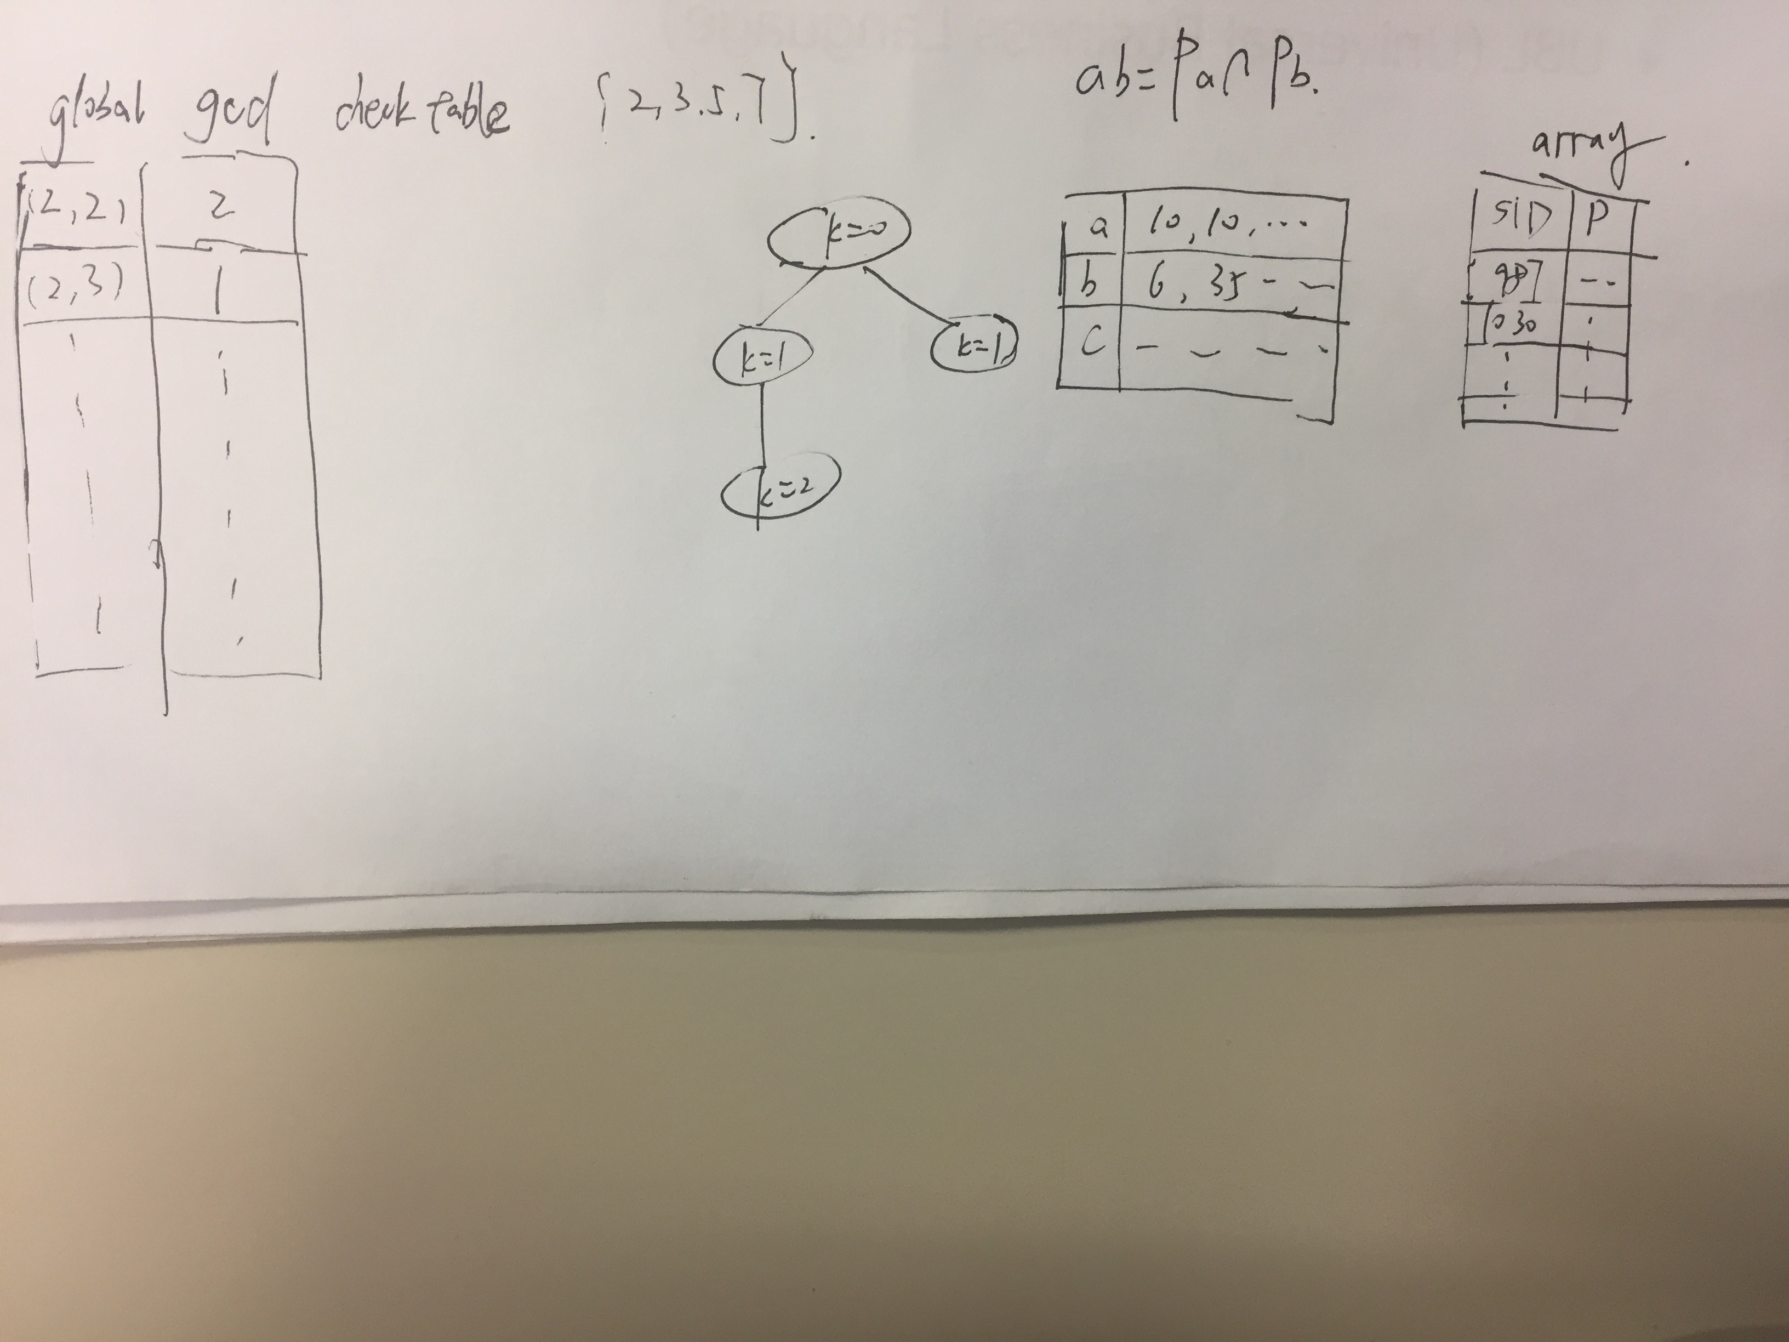
Compressed index

