Slide 1
Effective community search over large profiled graph

Slide 2
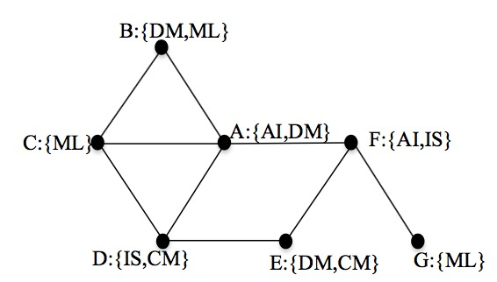
Weakness of ACQ
AI: artificial intelligence
IS: information system
DM: data mining
CM: computing methodologies
ML: machine learning
Let q = A, k = 2, S={AI, DM}. Then, there is no community sharing at least one keyword.

Slide 3
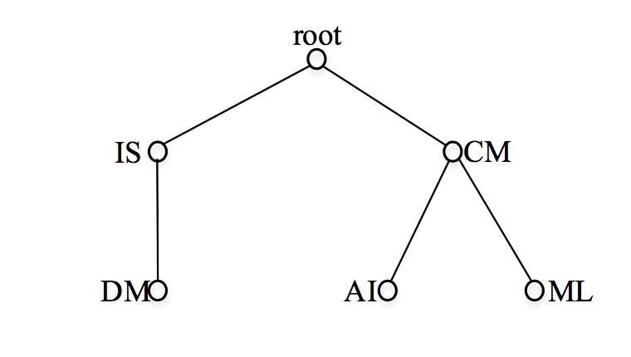
Hierarchical profile
We want to consider the meaning and relationship of the keywords.
We use tree structure called hierarchical profile to describe the attributes.
AI: artificial intelligence
IS: information system
DM: data mining
CM: computing methodologies
ML: machine learning
Notes:
According to the computing classification system devised by ACM. DM is a sub-discipline of IS ,and AI and ML are two sub-disciplines of CM.

Slide 4
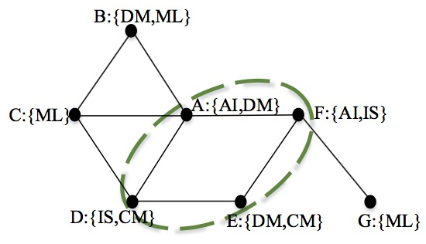
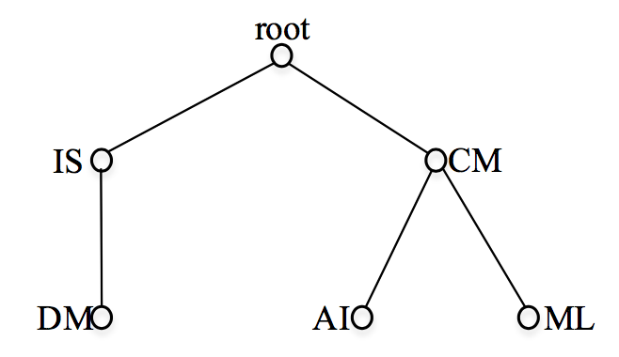
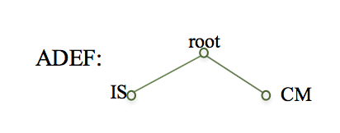
Motivation
Let q = A, k = 2.
Notes:
if we import this hierarchical profile model.

Slide 5
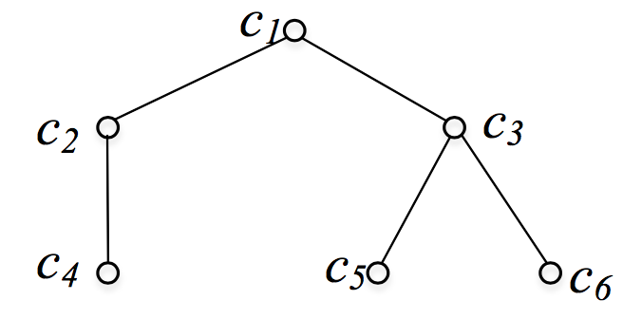

Profile-tree (P-tree)
A profile tree (P-tree) $T=(V,E)$ is a hierarchy-based set of attributes. $V$ is the set of tree nodes. $l:V→A$ is a function one-on-one mapping tree nodes to a set of attributes $A$={$a_{1},$ $a_{2}$, ……, $a_{n}$}, i.e., $∀x∈V, l\left(x\right)=$ $a_{x}.$ $E=\{(x,y)|x,y∈V\}$ is the set of edges representing relationship between attributes, such that $∀(x,y)∈E$, $l\left(y\right)$ is the semantic sub-attributes of $l\left(x\right).$ One distinguished node $r∈V$ denotes the root of $T,$and for $∀y∈V,y≠r$, $∃!x∈V, s.t.(x,y)∈E$.

Slide 6
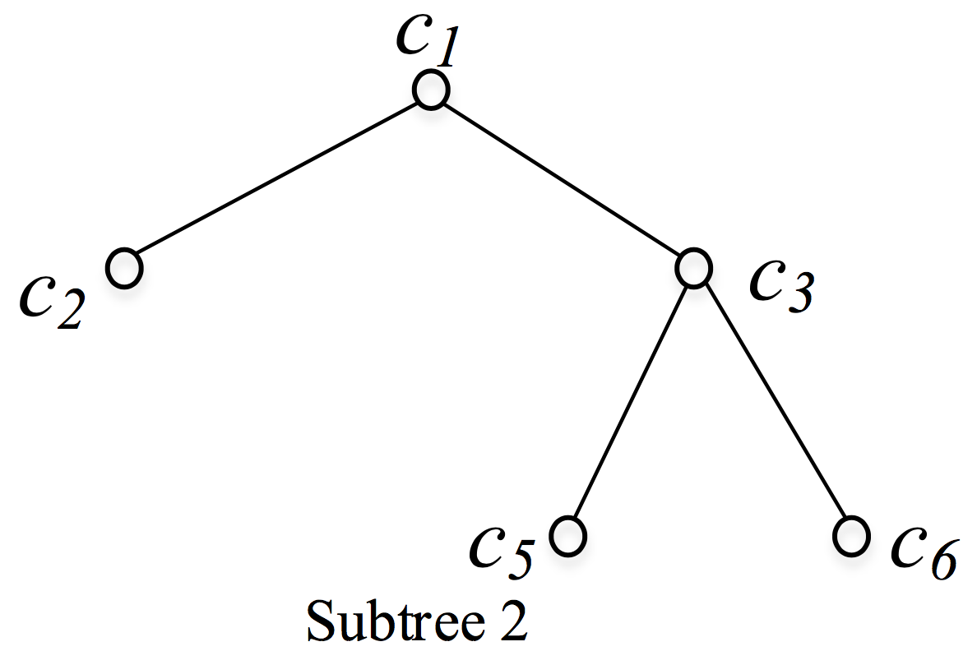
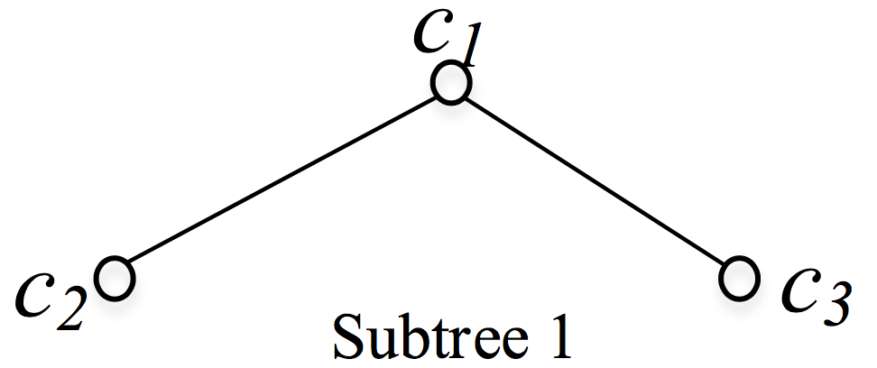
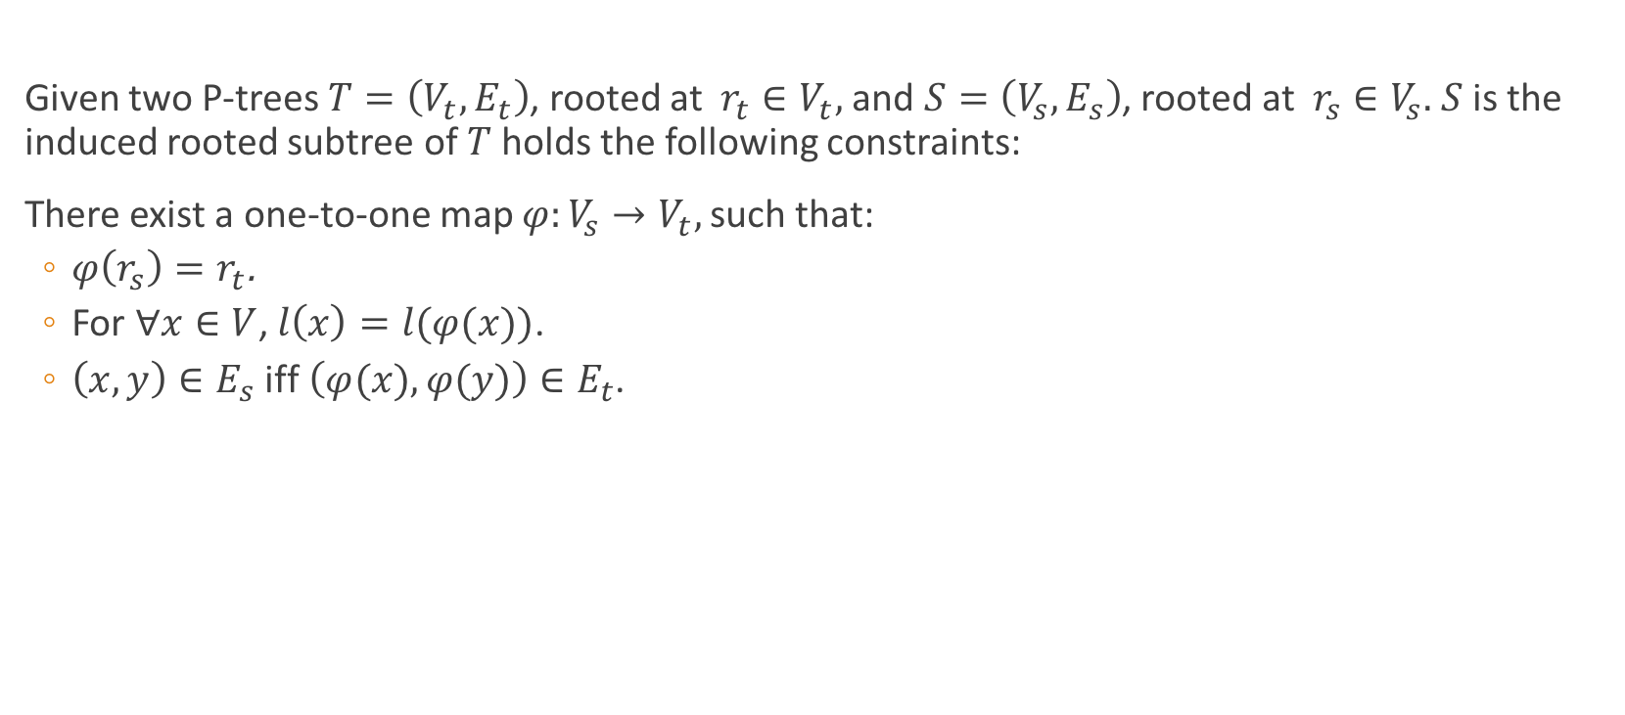
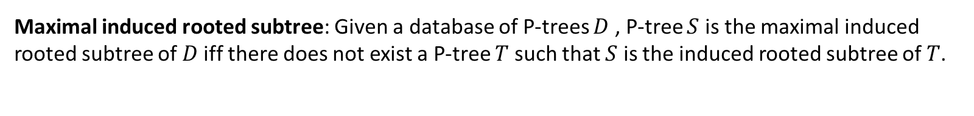
Induced rooted subtree
Given two P-trees $T=\left(V_{t},E_{t}\right)$, rooted at $r_{t}∈V_{t},$and $S=\left(V_{s},E_{s}\right)$, rooted at $r_{s}∈V_{s}.$ $S$ is the induced rooted subtree of $T$ holds the following constraints:
There exist a one-to-one map $φ:V_{s}→V_{t},$such that:
$φ\left(r_{s}\right)=r_{t}$.
For $∀x∈V$, $l\left(x\right)=l(φ(x))$.
$\left(x,y\right)∈E_{s}$ iff $\left(φ(x),φ(y)\right)∈E_{t}$.
Maximal induced rooted subtree: Given a database of P-trees $D$ , P-tree $S$ is the maximal induced rooted subtree of $D$iff there does not exist a P-tree $T$ such that $S$ is the induced rooted subtree of $T$.
Notes:
based on the definition of P tree, now we look at the definition of induced rooted subtree.

Slide 7

Problem definition
Given a profiled graph G, a profile tree T, and one query node $q$ $∈$ G, find communities, each of which is a subgraph $G_{q}$ satisfying the following properties:
Connectivity: $G_{q}$is connected and $G_{q}⊆$ G;
Structure cohesiveness: k-core;
Semantic cohesiveness: all the vertices in $G_{q}$ share the maximal common induced rooted subtree of q;

Slide 8
main features
Profiled attribute
Meanings and relationships of keywords can be considered in the profile.
Ease of interpretation
The theme of an AC can be explained by the maximal common profiles.
Comprehensiveness
Vertices with similar but not necessarily the same keywords can be searched.
Communities returned depends on maximal common profiles but not the maximum number of shared keywords.

Slide 9
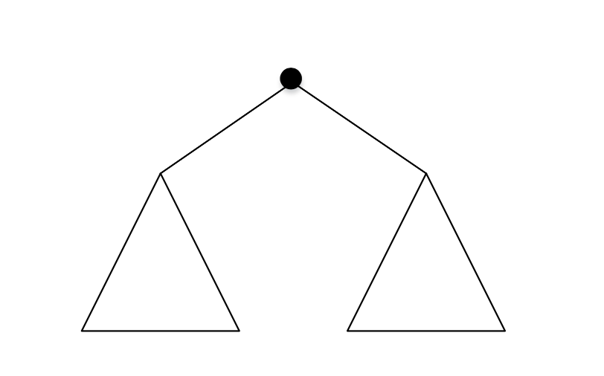
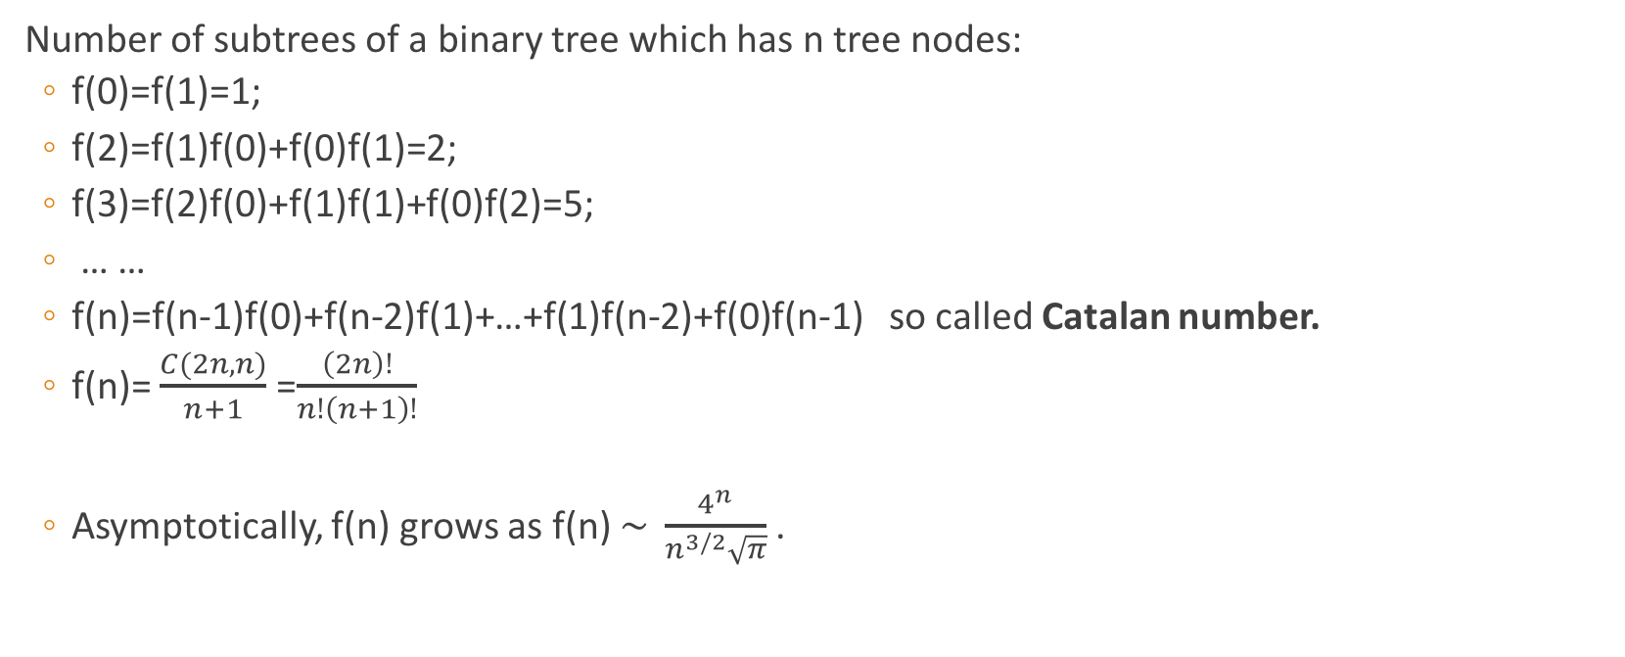
Special case: binary tree
Number of subtrees of a binary tree which has n tree nodes:
f(0)=f(1)=1;
f(2)=f(1)f(0)+f(0)f(1)=2;
f(3)=f(2)f(0)+f(1)f(1)+f(0)f(2)=5;
… …
f(n)=f(n-1)f(0)+f(n-2)f(1)+…+f(1)f(n-2)+f(0)f(n-1) so called Catalan number.
f(n)= $\frac{C(2n,n)}{n+1}$ =$\frac{\left(2n\right)!}{n!\left(n+1\right)!}$
Asymptotically, f(n) grows as f(n) $\sim \frac{4^{n}}{n^{3/2}\sqrt{π}}$.
Notes:
Note that mining maximal common induced subtree is not easy.
4 to the power of n
[æsɪmp'tɒtɪkə]
so it's expensive to enumerate all the subtrees.

Slide 10
NP-HARD
Maximal frequent subtree pattern mining is np-hard[1].
There are two main steps in tree pattern mining: enumeration and counting.
Enumeration is NP-hard and counting is #p-complete[2]. Thus the problem of maximal frequent subtree pattern mining is NP-hard.
[1] Yang G. The complexity of mining maximal frequent itemsets and maximal frequent patterns[C]//Proceedings of the tenth ACM SIGKDD international conference on Knowledge discovery and data mining. ACM, 2004: 344-353.
[2] Valiant L G. The complexity of computing the permanent[J]. Theoretical computer science, 1979, 8(2): 189-201.

Slide 11

Baseline & advanced solution
Basic idea:
Search K-$\hat{core}$ containing query vertex $A$.
Mining Maximal common profile.
Output targeted communities containing A.
Advanced solution: Index + query

Slide 12
Algorithm:Mining maximal common profile
Recently, the proposed approaches for mining maximal frequent tree pattern rely on a sequential encoding of the database trees.
encode trees to sequences:
post-order encoding: TRIPS[1]
pre-order encoding: TIDES[1], CMTreeMiner[2]
Patterns generation + pruning strategies
Incremental generation manner
Decremental generation manner
Patterns checking
[1] Tatikonda S, Parthasarathy S, Kurc T. TRIPS and TIDES: new algorithms for tree mining[C]//Proceedings of the 15th ACM international conference on Information and knowledge management. ACM, 2006: 455-464.
[2] Chi Y, Xia Y, Yang Y, et al. Mining closed and maximal frequent subtrees from databases of labeled rooted trees[J]. IEEE Transactions on Knowledge and Data Engineering, 2005, 17(2): 190-202.

Slide 13



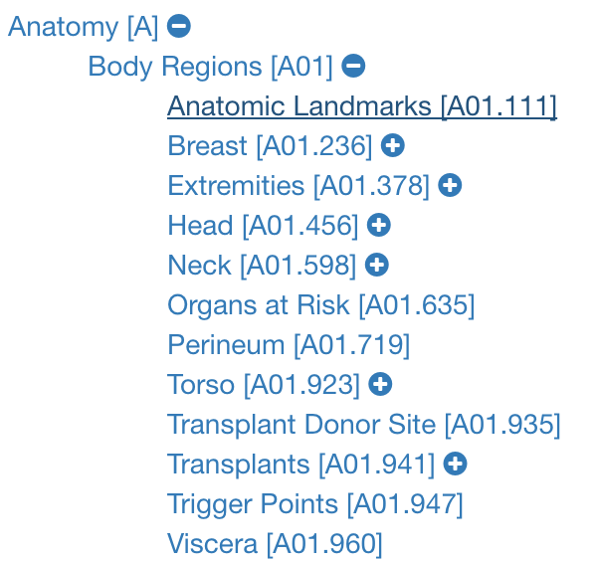
Real datasets
PubMed:
a free database of references on life sciences and biomedical topics.
Node: authors
Edges: co-author relationship
Size: more than 27 million records
profile: Medical Subject Headings(Mesh) is created to index journal articles and books in the life sciences. It originally has 57840 different entries.
Notes:
bibliography [ˌbɪbliˈɑ:grəfi] sub-attributes
anatomy [əˈnætəmi]
if we look further i.to anatomy
In a word, Mesh is a very detailed classification system.

Slide 14

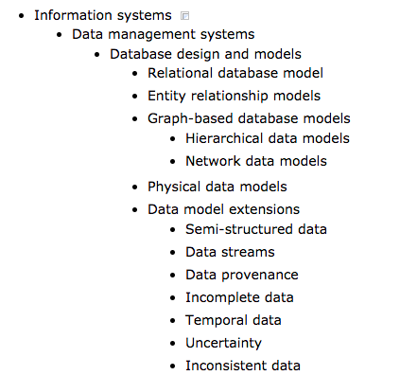
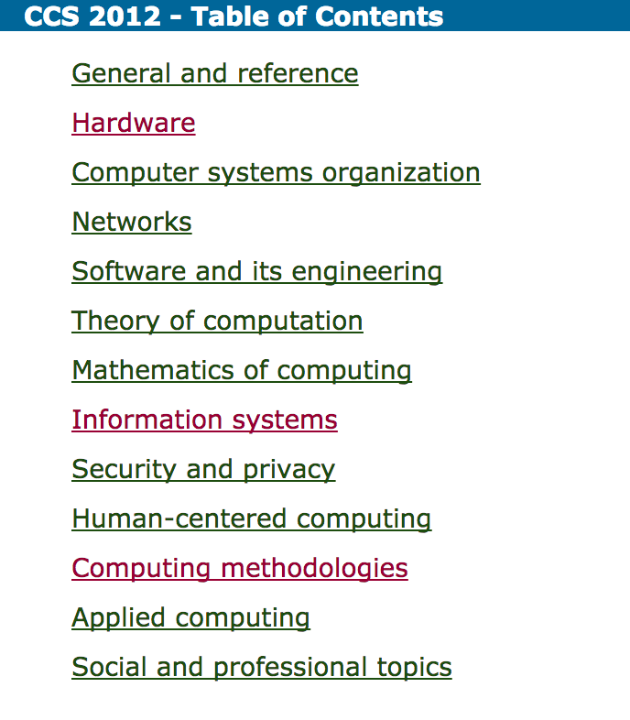
Real datasets
DBLP:
a computer science bibliography website.
Node: authors
Edge: co-author relationship
Size: more than 3.7 million publications and 1.8 million authors.
Profile: Computing Classification System(ACM CCS) a subject classification system for computing devised by the ACM.
Notes:
bibliography [ˌbɪbliˈɑ:grəfi]

