Slide 1
Barriers to the implementation of k-anonymity and related microdata anonymization techniques in a realworld application
Andreas Wiegand
Ludwig Schallner
Frei verwendbar

Slide 2
Index
1. Introduction
2. k-anonymity
3. Extendet scenarios
4. Datatypes
5. Summary

Slide 3
Introduction
Identity disclosure
Individual is linked to a particular record
Attribute disclosure
new information revealed about some individual
Tables give useful information to researchers, but
Record owners interest is to be anonym.
We have to anonymize the data before releasing

Slide 4
K-ANONYMITY
Is achieved if:
At least k matching record with the same quasi-identifiers
Identifiers
Attributes which identifies individuals explicitly
Quasi-identifiers
Identifies an record owner only by combination of other Qis
Sensitive Data
Data to which record owner doesn't want to get linked

Slide 5
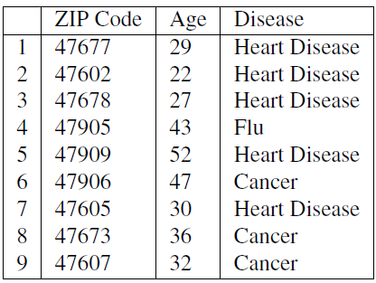
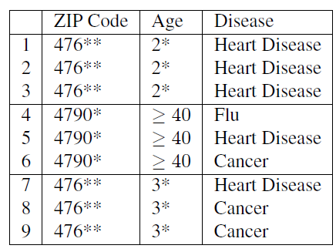
Example of K-Anonymity
Table 1: original data
Table 2: 3-Anoymized

Slide 6
The Adversary’s Knowledge is Unknown
Adversary has access to table
And knows that the table is generalized + knows the domain of the attributes
Instance-level background knowledge
Adversary knows that his target does not suffer from a disease
May conclude what the target really suffers from
Demographic background knowledge
Adversary knows e.g P(t[condition] = cancer| t[Age]>=40)
May use it to interference about records

Slide 7
Attacks on K-ANONYMITY
Homogeneity Attack
Background Knowledge Attack/attribute linkage
Unsorted Matching Attacks
Complementary Release Attack

Slide 8
Homogeneity Attack
This attack is based on the homogeneity of data
Age and Zip-Code of the target
Leads to concluding of disease of the record owner

Slide 9
Background Knowledge Attack
This attack is based on background knowlegde
Alice knows additionally that e.g. Carl(36, 47605) has a low risk of heart disease → conclude he has cancer

Slide 10
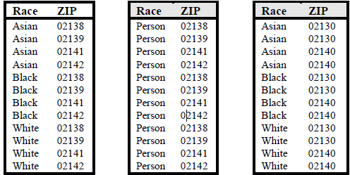
Unsorted Matching Attacks
Based on order of tuples in the released data
Often used in real world
release of sensitive data
Generation of ZIP
Generation of race

Slide 11
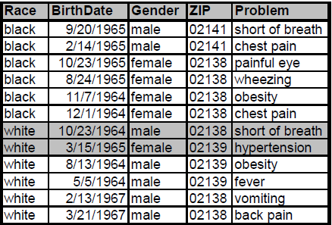
Complementary Release Attack
Prior examples, all attributes were quasi-identifier
Not typical in the real world → subsequent releases are common
Are unique → subsequent release

Slide 12
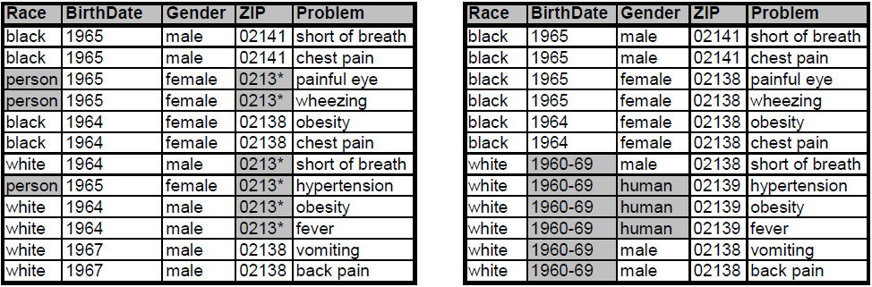
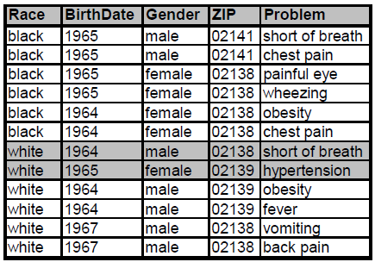
Complementary Release Attack
Linking both tables on {Problem}
Released table 1
Released table 2
Are unique Fix: table 2 is based on table 1
Linked table of table 1 and 2

Slide 13
5. Complexity of Optimal K-Anonymity
NP-hard
Finally, we presented two e±cient greedy approxima-tion algorithms for the problem. Can an approximationalgorithm be found whose performance ratio is indepen-dent of k? We suspect that ­(log k) might be a lowerbound on the possible approximability of the problem(within polynomial time), given that such a lower boundexists for k-set cover.

Slide 14
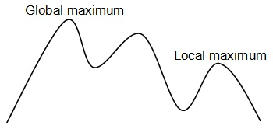
Optimal K-Anonymity
Goal of k-anonmity algorithm is to find a optimal solution
Minimal Information loss
NP – Hard
Heuristic /Approximations/ Loss Metrics
Notes:
Some, but not all, algorithms find an optimal solution.Here, optimal describes the solution which results inminimal information loss according to a given metric.Solving this problem has been proven to be NP-hardThe main reasons for this are that an optimal solution guaranteesminimal information loss, which is important for the usefulness of the result
So before we can look at the metrics we need to unterstand the working of these algorthims.

Slide 15
K-Anonymity Generalization and Supression
Suppression refers to removing a certain attribute value
and replacing occurrences of the value with a special value
"?," indicating that any value can be placed instead.
Suppression can drastically reduce the quality of the data
Work wise with suppression get help to get k-anonymity but keep in mind that we want to use data -> information loss
Some algorthim work with maxsup
The idea of generalizing an attribute is a simple concept. A value is replaced by a less specific, more general value that is faithful to the original.
Generalization incluce suppression
There is no compination between optimal k-anonymity and dataquality
Notes:
The authors of [20] introduced the notion of monotonic
generalization hierarchies. In a monotonic generalization hierarchy,
the groups at level l +1 are built by merging groups
from level l. This allows pruning of large parts of the search
space, because all states which are successors of an anonymous
state are also anonymous. Furthermore, all predecessors of a
non-anonymous state are also non-anonymous. This is because
generalization is monotonic for the complete dataset if it is
monotonic for each quasi-identifier. An example is shown
in Figure 3, where the fact that (2, 1, 1) is non-anonymous
implies that all of its predecessors are also non-anonymous
(dark gray). Furthermore, all successors of the
Supression problem: Suppression can drastically reduce the quality of the data
if not properly used

Slide 16
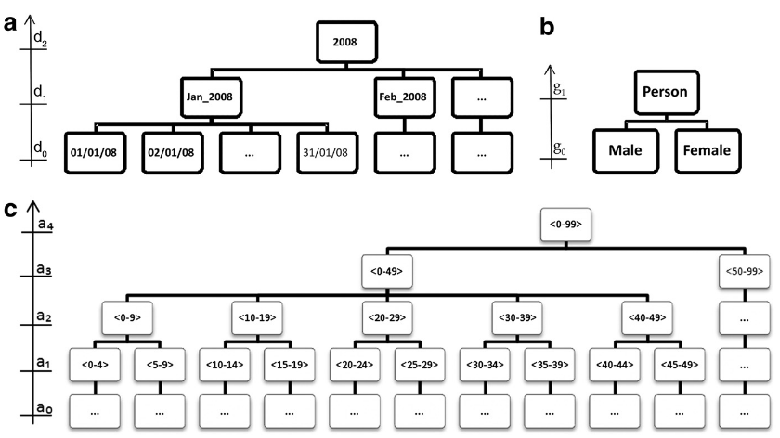
K-Anonymity Generalication latis

Slide 17
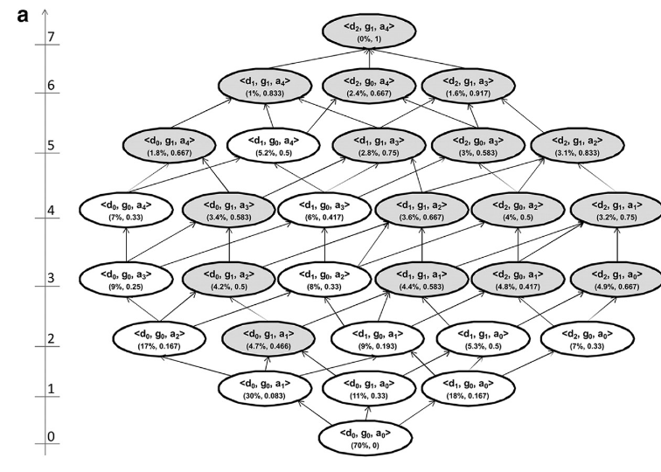
Notes:
The three information loss metrics that we have presented above (Prec, DM*, and non-uniform entropy) are monotonic
within any given generalization strategy. This means that as we move up the lattice along any generalization strategy the
information loss value will either remain the same or increase. This property is important because it means that if we have two
k-anonymous nodes in the same generalization strategy, then the one lower in the strategy will always have a lower information loss.

Slide 18
K-anonymity Information Loss Metric
Out of the highlighted nodes in the lattice, Samarati24
proposes that the node with the lowest lattice height should
be selected as the optimal solution.
An information loss metric that takes into account the height of the generalization hierarchy is Precision or Prec. The Prec was introduced by Sweeney46,47 as an information loss metric that is suitable for hierarchical data.
Another commonly used information loss metric is the
Discernability Metric or DM.
Notes:
In our example of Figure 2, this would be node d0, g1, a1. The assumption being
made is that this solution balances the extent generalization with the extent of suppression.
The lattice height is not considered a good information loss
metric because it does not account for the generalization
hierarchy depths of the quasi-identifiers. For example, if we
generalize “Male” to “Person” then this is given equal weight
to generalizing age in years to age in five year intervals. In the
former case there is no information left in the gender variable,
whereas the five year age interval still conveys a considerable
amount of information and there are three more possible
generalizations left in the age hierarchy
the number of generalization steps applied to the total number
of possible generalization steps (total height of the generalization
hierarchy) gives the amount of information loss for that
particular variable. For example, in Figure 1 if age is generalized
from age in years to age in five year intervals, then the
value is ¼. Overall Prec information loss is the average of the
Prec values across all quasi-identifiers in the dataset. As a
consequence, the more a variable is generalized, the higher the
information loss.
The discernability
metric assigns a penalty to every record that is proportional
to the number of records that are indistinguishable from it.
Following the same reasoning, DM assigns a penalty equal
to the whole dataset for every suppressed record (since
suppressed records are indistinguishable from all other
records). The formula for DM metric appears in online

Slide 19
5. Complexity of Optimal K-Anonymity
NP-hard
Finally, we presented two e±cient greedy approxima-tion algorithms for the problem. Can an approximationalgorithm be found whose performance ratio is indepen-dent of k? We suspect that ­(log k) might be a lowerbound on the possible approximability of the problem(within polynomial time), given that such a lower boundexists for k-set cover.

Slide 20
K-anonymity Information Loss Metric
Pr0blems with the Metrics:
The concept behind DM has been criticized because DM
does not measure how much the generalized records approximatethe original records.
Notes:
For example, suppose we want to achieve 2-anonymity, and we have a single
quasi-identifier, age, and six records with the following age values: 9, 11, 13, 40, 42, and 45. The minimal DM* value is
when all of the records are grouped into three pairs: 9,11, 13,40, and 42,45. The criticism is that the second pair
has a very wide range and that a more sensible grouping mwould have only two equivalence classes: 9,11,13 and

Slide 21
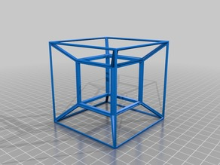
6. Datatype - High-Dimensional Transaction Data
Transaction data is high-dimensional
Each dimension could be a potential QID attribute
Curse of high-dimensionality
Bound background knowledge of the attacker
Notes:
Transaction data is usually high-dimensional. For example, Amazon.com has several
million catalog items. Each dimension could be a potential QID attribute used
for record or attribute linkages; therefore, employing traditional privacy models, such
as k-anonymity, would require including all dimensions into a single QID.
Due to the
curse of high-dimensionality [Aggarwal 2005], it is very likely that lots of data has to
be suppressed or generalized to the top-most values in order to satisfy k-anonymity,
even if k is small. Obviously, such anonymous data is useless for data analysis.
In any real-life privacy attack, it is unlikely that the attacker would know all
quasi-identifying attributes of a target victim due to the effort it would take to gather
every piece of background knowledge. Thus, it is reasonable to bound the attacker’s
background knowledge in the privacy model.

Slide 22
6. Datatyp - Moving Object Data
Location-based services (LBS)
Location can be a quasi – Idendifier
CliqueCloar
In the context of LBSs and mobile users, location k-anonymity demands that location information contained in a message sent from a mobile user to a LBS should be indistinguishable from at least k−1 other messages from different mobile nodes
Attacks Restricted Space Identification and Observation Identification.
Spatial cloaking and temporal cloaking
Notes:
The cloaking algorithm is run by
the location protection broker on a trusted server,
which anonymizes messages from the mobile nodes
by cloaking the location information contained in
the messages to reduce or avoid privacy threats before
forwarding them to the LBS provider(s).
Restricted Space Identiﬁcation. If A knows that space L exclusively belongs to subject S then A learns that S is in L and S has sent M. For example, when the owner of a suburban house sends a message from his garage or driveway, the coordinates can be correlatedwith a databaseof geocodedpostal addresses (e.g., [30]) to identify the residence. An address lookup in phone or property listings then reveals the owner and likely originator of the messag
Observation Identiﬁcation. If A has observed the current location L of subject S and ﬁnds a message M from L then A learns that S has sent M. For example, the subject has revealed its identity and location in a previous message and then wants to send an anonymous message. The later message can be linked to the previous one through the location information.
First, a given degree of location anonymity
can be maintained, regardless of population density, by decreasing
the location accuracy through enlarging the revealed
spatial area, such that there are other k−1 mobile nodes present
in the same spatial area. This approach is called spatial cloaking.
Second, one can achieve the location anonymity by delaying
the message until k mobile nodes have visited the same
area located by the message sender. This approach is called
temporal cloaking.

Slide 23
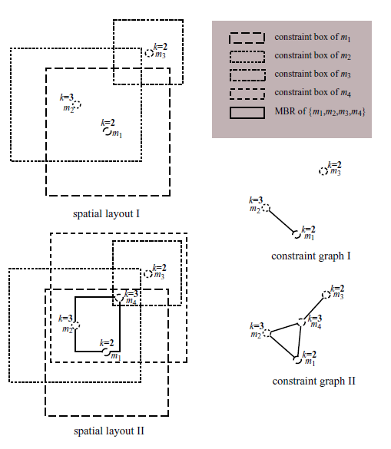
6. Datatyp - Moving Object Data

Slide 24
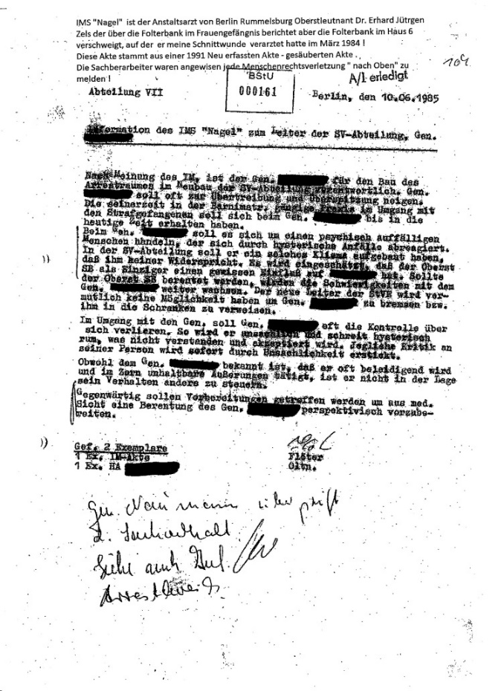

6. Datatyp - Unstructured Data
Unstructural data can also have sensitive data and QID
Text and Pictures
Sanitization
de-identiﬁcation
Notes:
Sanitization of a document involves removing sensitive information from the document, in order to reduce thdocument’s classification level, possibly yielding an unclassified document.
In hospitals, medical records are sanitized to remove sensitive patent information (patient identity information, diagnoses of deadly diseases, etc.). Document sanitization is also
critical to companies who need to prevent malafide or inadvertentdisclosure of proprietary information while sharing data with outsourced operations.
We wish to retain same facial information about the photographed people, for example a fashion shop interested in knowing how many of it’s visitors are male or female. I Sometimes, the photograph may be used psychologically and should therefore look more visually appealing (For a photo of a war victim, a blurred face would be much more eﬀective in raising awareness then a black rectangle). I Because we can achieve results as good as blackout but better looking

Slide 25
Datatyp - Unstructured Data cont‘d
k-Same. Face identification results when a face image is properly associated with explicit identifiers, such as name and address, of the person who is the subject of the face image.
In the next section, face recognition software is examined in detail. The goal of this work is to alter face images in such a way that automated face recognition cannot be reliably performed on the resulting images. Before claims of thwarting face recognition software can be made, more discussion is needed on altering face images. This is termed de-identification of face images, as described in Definition 2.7.

Slide 26
Datatyp - Unstructured Data cont‘d
Erase
However, the problem formulation considered in the above setup and ERASE are different. While the goal in the K-anonymization is to anonymize a given database, in ERASE, the aim to sanitize a single document. (K-safety)
E denote the set of entities
We associate each entity e 2 E with a set of terms C(e) which collectively represent the entire knowledge the adversary has about the entity
Each disease is an entity, and its context includes the symptoms and the drugs used to cure the disease.P of protected
Problem NP-Hard
Notes:
Traditionally, documents are sanitized manually by qualified reviewers.
However, manual sanitization does not scale as the volume
of data increases.

Slide 27
7. Summary
K-anonymity, l-Diversity, t-clossness don‘t provide a full privacy protection
Every privacy Modell tries to overcome the downsites of his parent
All kind of data can leak privacy information

