Slide 1
Barriers to the implementation of k-anonymity and related microdata anonymization techniques in a realworld application
Andreas Wiegand
Ludwig Schallner

Slide 2
Inhaltsverzeichnis
1. Introduction
2. k-anonymity
3. Extendet scenarios
3. p-sensitive k-anonymity
3. l-diversity
4. t-closeness

Slide 3
Introduction
Identity disclosure
Individual is linked to a particular record
Attribute disclosure
new information revealed about some individual
Tables give useful information to researchers, but
Record owners interest is to be anonym.
We have to anonymize the data before releasing

Slide 4
K-ANONYMITY
Is achieved if:
At least k matching record with the same quasi-identifiers
Identifiers
Attributes which identifies individuals explicitly
Quasi-identifiers
Identifies an record owner only buy combination of other Qis
Sensitive Data
Data to which record owner doesn't want to get linked

Slide 5
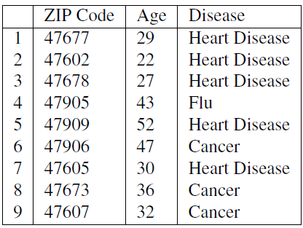
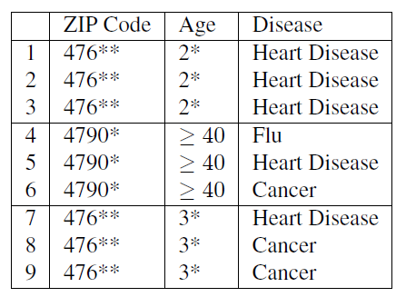
Example of K-Anonymity
Table 1: original data
Table 2: 3-Anoymized

Slide 6
The Adversary’s Knowledge is Unknown
Adversary has access to table
And knows that the table is generalized + knows the domain of the attributes
Instance-level background knowledge
Adversary knows that his target does not suffer from a disease
May conclude what the target really suffers from
Demographic background knowledge
Adversary knows e.g P(t[condition] = cancer| t[Age]>=40)
May use it to interference about records

Slide 7
Attacks on K-ANONYMITY
Homogeneity Attack
Background Knowledge Attack/attribute linkage
Unsorted Matching Attacks
Complementary Release Attack

Slide 8
Homogeneity Attack
This attack is based on the homogeneity of data
Age and Zip-Code of the Target
Leads to concluding of disease of the record owner

Slide 9
Background Knowledge Attack
This attack is based on background knowlegde
Alice knows additionaly that e.g Carl(37, 4768) is asian (low risk of heart disease)
Conclude he has cancer

Slide 10
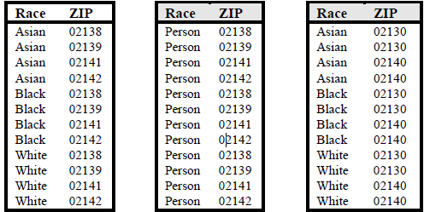
Unsorted Matching Attacks
Based on order of tuples in the released data
Often used in real world
release of sensitive data
Solution: random sorting
Generation of ZIP
Generation of race

Slide 11
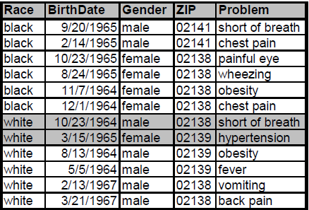
Complementary Release Attack
Prior examples, all attributes were quasi-identifier
Not typical in the real world → subsequent releases are common
Are unique → subsequent release

Slide 12
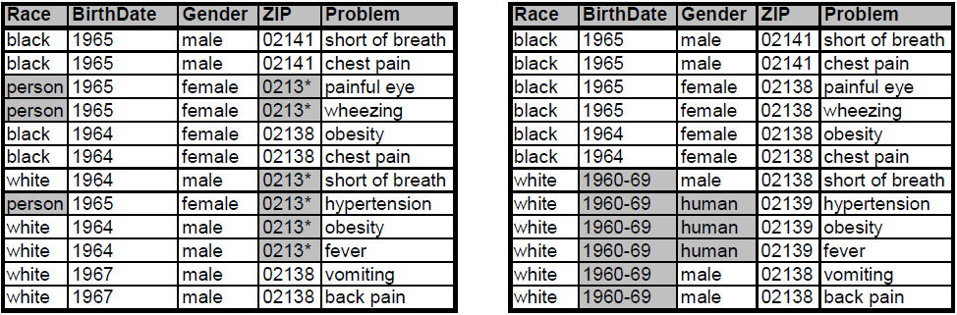
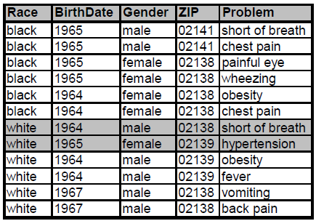
Complementary Release Attack
Linked both tables on {Problem} possible
Released table 1
Released table 2
Are unique Fix: table 2 is based on table 1
Linked table of table 1 and 2

Slide 13
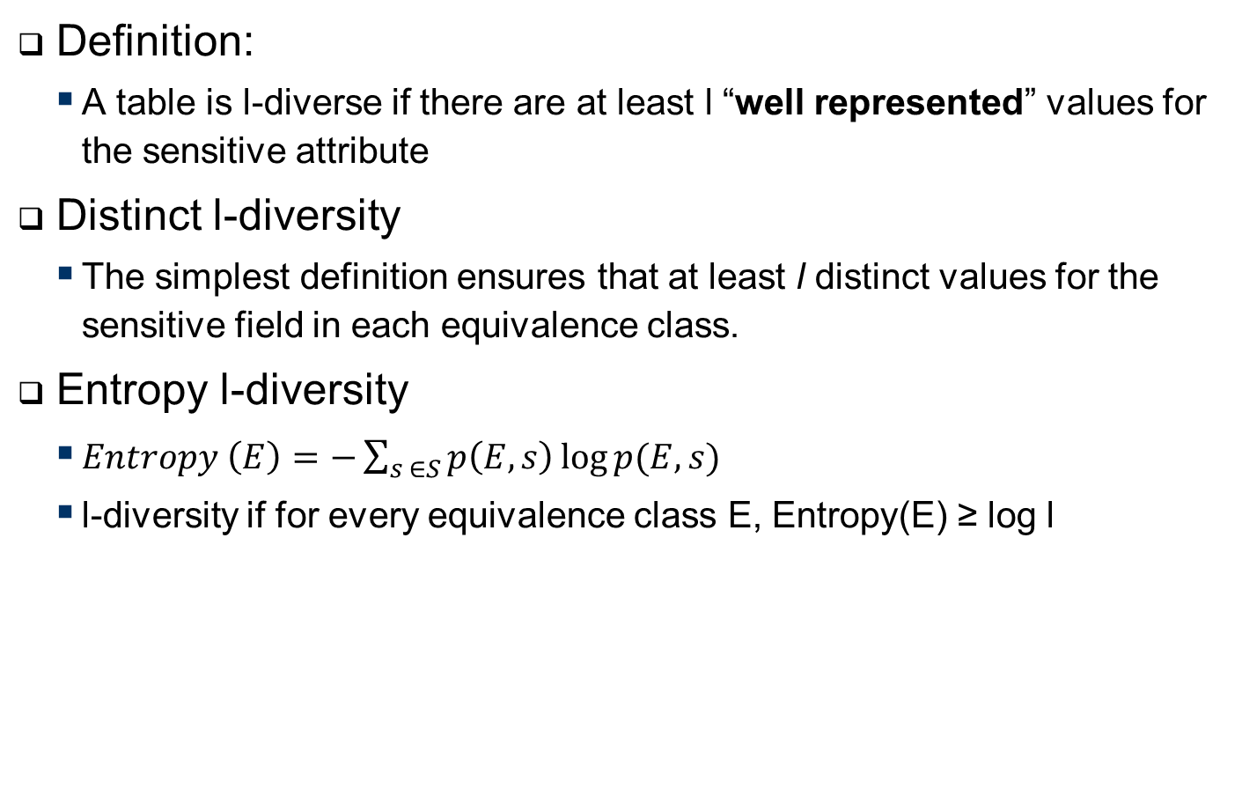
L-Diversity
Definition:
A table is l-diverse if there are at least l “well represented” values for the sensitive attribute
Distinct l-diversity
The simplest definition ensures that at least l distinct values for the sensitive field in each equivalence class.
Entropy l-diversity
$Entropy \left(E\right)=−\sum_{s ∈S}{p\left(E,s\right)\log{p(E,s)}}$
l-diversity if for every equivalence class E, Entropy(E) ≥ log l
Notes:
Entropy l diversity
Sometimes this may too restrictive,
as the entropy of the entire table may be low if a few
values are very common. This leads to the following
less conservative notion of -diversity.

Slide 14
L-Diversity
Recursive (c, l)-diversity.
Makes sure that most frequent values not too often and
Most less frequent not too rarely
Compromise between the prior ones
Let n be the number of values in a equivalent class
r_{i} , l <= I <= n FASDF
Then E is said to have recursive ((c, l)-diversity if r1 < c(rl +rl+1 +...+rm))

Slide 15
EXTENDED SCENARIOS - Multiple Release Publishing
Different data recipients got different claims to the data
T(Job, Sex, Age, Race, Disease, Salary)
Pharma company intresed in diesease with attribute job,sex, age
Another is intereset in JOB, AGE, RACE
Relse one table with {JOB, Sex, Age, Race}
- A drawback is that information is released unnecessarily, in that neither of the two purposes needs all four attributes
You make one for both of them. Problem

Slide 16
EXTENDED SCENARIOS – Multiple Release Publishing
Size | Hobby | lecture
160 cm | football | biology
160 cm | football | biology
180 cm | videogames | sport
180 cm | dancing | phyisic
190 cm | basketball | math
190 cm | collecting stamps | math
Hobby | residence | Disease
football | Bamberg | Diabetes
football | Bamberg | Diabetes
videogames | Erlangen | Cancer
dancing | Forchheim | Diabetes
basketball | Erlangen | Cancer
collecting stamps | Bamberg | Cancer
Size | Hobby | residence | Disease | lecture
160 cm | football | Bamberg | Diabetes | biology
160 cm | football | Bamberg | Diabetes | biology
180 cm | videogames | Erlangen | Cancer | sport
180 cm | dancing | Forchheim | Diabetes | phyisic
190 cm | basketball | Erlangen | Cancer | math
190 cm | collecting stamps | Bamberg | Cancer | math

Slide 17
EXTENDED SCENARIOS – Sequential Release Publishing
In some other scenarios, the data is released continuously
and sequentially as new information becomes available.
Consider the problem ofsequential anonymization [Wang and Fung 2006]: a data publisher has previouslyreleased T1, . . . , Tp−1 and now wants to publish the next release Tp, where all Tiare projections of the same underlying table, and each individual release, not thejoin, serves a data mining purpose. The data publisher wants to prevent record and attribute linkages through the join of T1, . . . , Tp.

Slide 18
EXTENDED SCENARIOS – Sequential Release Publishing
Example
Hobby | Sex | Disease
painting | Female | Diabetes
painting | Female | Cancer
basketball | Male | HIV
basketball | Male | Diabetes
Hobby | Sex | Disease
painting | Female | Diabetes
painting | Female | Cancer
Painting | Female | HIV
Basketball | Male | HIV
Basketball | Male | Diabetes
Hobby | Sex
painting | Female | Diabetes
painting | Female | HIV
Basketball | Male | HIV
Basketball | Male | Diabetes

Slide 19
6.3. Continuous Data Publishing -
In the model of continuous data publishing, the data publisher has previously published
T1, . . . , Tp−1 and now wants to publish Tp, where Ti is an updated release ofTi−1 with record insertions and/or deletions. The problem assumes that all recordsfor the same individual remain the same in all releases. Even though each releaseT1, . . . , Tp is individually anonymous, the privacy requirement could be compromisedby comparing different releases and eliminating some possible sensitive values for avictim.

Slide 20
Continuous Data Publishing -
Example
Example 6.3. Let Table VIII(a) be the first release T1. Let Table VIII(b) be thesecond release T2 after inserting a new record. Both T1 and T2 satisfy 2-diversity independently.Suppose the attacker knows that a female lawyer, Alice, has a record in T2but not in T1, based on the timestamp that Alice was admitted to a hospital. From T2,the attacker can infer that Alice must have contracted either Flu, Fever, or HIV. Bycomparing T2 with T1, the attacker can identify that the first two records in T2 mustbe old records from T1 and, thus, infer that Alice must have contracted HIV.

Slide 21
6.4. Collaborative Data Publishing -
So far, we have considered only a single data publisher. In real-life data publishing,a single organization often does not hold the complete data. Organizations need toshare data for mutual benefits or for publishing to a third party. For example, twocredit card companies want to integrate their customer data for developing a frauddetectionsystem or for publishing to a bank. However, the credit card companies donot want to indiscriminately disclose their data to each other or to the bank for reasonssuch as privacy protection and business competitiveness. Figure 4 depicts thisscenario, called collaborative data publishing, where several data publishers own differentsets of attributes on the same set of records and want to publish the integrateddata on all attributes. Say, publisher 1 owns {RecID, Job, Sex, Age}, and publisher 2owns {RecID, Salary, Disease}, where RecID, such as the SSN, is the record identifiershared by all data publishers. They want to publish an integrated k-anonymous tableon all attributes. Also, no data publisher should learn more specific information, owned
by the other data publishers, than the information that appears in the final integrated
table.

Slide 22
High-Dimensional Transaction Data
Aol example Transaction data is usually high-dimensional. For example, Amazon.com has several million catalog items. Each dimension could be a potential QID attribute used for record or attribute linkages; therefore, employing traditional privacy models, such as k-anonymity, would require including all dimensions into a single QID. Due to the curse of high-dimensionality [Aggarwal 2005], it is very likely that lots of data has to be suppressed or generalized to the top-most values in order to satisfy k-anonymity, even if k is small. Obviously, such anonymous data is useless for data analysis.

Slide 23
High-Dimensional Transaction Data
Each dimension could be a potential QID attribute
Curse of high-dimensionality
Bound backgroundknowledge of the attacker

Slide 24
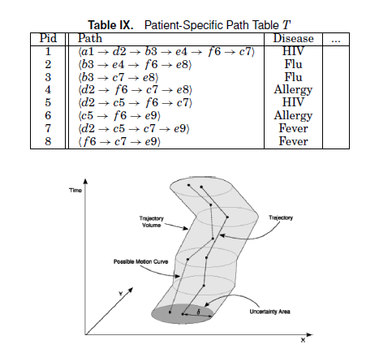
Moving Object Data
- Location-based services (LBS)
There are a few recent works on anonymizing moving objects. Abul et al. [2008] extended
the traditional k-anonymity model to anonymize a set of moving objects. The
intuition is to have at least k moving objects appearing within the radius δ of the path
of every moving object in the same period of time, as depicted in Figure 5.

Slide 25
Textual Data
Most previous work focused on anonymizing the structural or semistructural data.What about the unstructural data, such as text documents? Saygin et al. [2006] describesimplicit and explicit privacy threats in text document repositories. Sanitizationof text documents involves removing sensitive information or removing potential linkinginformation that can associate an individual person to the sensitive information ina document. This research direction is in its infancy.Kokkinakis and Thurin [2007] implemented a system for automatically anonymizinghospital discharge letters by identifying and deliberately removing all phrases fromclinical text that satisfy some predefined types of sensitive entities. The identificationphase is achieved by collaborating with an underlying generic named entity recognitionsystem.

Slide 26
p-sensitive k-anonymity
identity disclosure and attribute disclosure.
dentity disclosure and attribute disclosure.
Identity disclosure refers to identification of an entity
(person, institution) and attribute disclosure occurs when
the intruder finds out something new about the target
entity [11]. Identity disclosure does not automatically
imply attribute

Slide 27
P-sensitive k -anonymity
The for each tuple of k-anonymity there are at least p different sensitive data
Problem:p-Sensitive k-anonymity has the limitation of implicitly assuming that each confidential attribute takes values uniformly over its domain, that is, that the frequencies of the various values of a confidential attribute are similar. When this is not the case, achievingp-sensitive k-anonymity may cause a huge data utility loss. This is illustrated in the following example.

Slide 28
l-diversity
Definition 3 (l-Diversity): A data set is said to satisfy
l-diversity if, for each group of records sharing a
combination of key attributes, there are at least l “wellrepresented” values for each confidential attribute.
According to [9] the term “well-represented” can be
defined in several ways:

Slide 29
Different l-diversity
1) Distinct l-diversity. There must be at least l distinct values for the confidential attribute in each group of records sharing a combination of key attributes. This is equivalent to l-sensitive k-
2) Entropy l-diversity..
3) Recursive (c, l)-diversity

Slide 30
Pr0blems with l-diversity
l-Diversity may be difficult and unnecessary to
achieve. The argument is the same given against
p-sensitive k-anonymity in Example 2 above.
l-Diversity is insufficient to prevent attribute disclosure.
At least the following two attacks are conceivable:
Skewness attack:
Similarity attack: sematical same cofidentail attributes

Slide 31
t-close´ness
Definition: Definition 4 (t-Closeness): A data set is said to
satisfy t-closeness if, for each group of records sharing
a combination of key attributes, the distance between
the distribution of the confidential attribute in the group
and the distribution of the attribute in the whole data
set is no more than a threshold t.

Slide 32
t-close´ness
Problems:
Whereas the paper [7] elaborates on several ways
o check t-closeness (using several distances between
distributions), no computational procedure
to enforce this property is given.

Slide 33
Differential privacy

