Slide 1
Barriers to the implementation of k-anonymity and related microdata anonymization techniques in a realworld application
Andreas Wiegand
Ludwig Schallner

Slide 2
Index
1. Introduction
2. k-anonymity
3. l-diversity
4. t-closeness
5. Extendet scenarios
6. Datatypes
7. Summary

Slide 3
Introduction
Identity disclosure
Individual is linked to a particular record
Attribute disclosure
new information revealed about some individual
Tables give useful information to researchers, but
Record owners interest is to be anonym.
We have to anonymize the data before releasing

Slide 4
K-ANONYMITY
Is achieved if:
At least k matching record with the same quasi-identifiers
Identifiers
Attributes which identifies individuals explicitly
Quasi-identifiers
Identifies an record owner only by combination of other Qis
Sensitive Data
Data to which record owner doesn't want to get linked

Slide 5
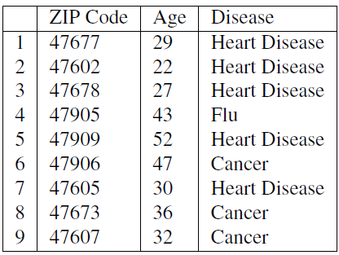
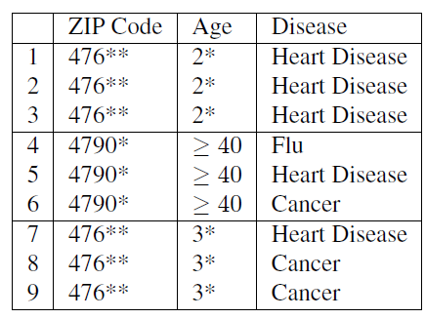
Example of K-Anonymity
Table 1: original data
Table 2: 3-Anoymized

Slide 6
The Adversary’s Knowledge is Unknown
Adversary has access to table
And knows that the table is generalized + knows the domain of the attributes
Instance-level background knowledge
Adversary knows that his target does not suffer from a disease
May conclude what the target really suffers from
Demographic background knowledge
Adversary knows e.g P(t[condition] = cancer| t[Age]>=40)
May use it to interference about records

Slide 7
Attacks on K-ANONYMITY
Homogeneity Attack
Background Knowledge Attack/attribute linkage
Unsorted Matching Attacks
Complementary Release Attack

Slide 8
Homogeneity Attack
This attack is based on the homogeneity of data
Age and Zip-Code of the target
Leads to concluding of disease of the record owner

Slide 9
Background Knowledge Attack
This attack is based on background knowlegde
Alice knows additionally that e.g. Carl(36, 47605) has a low risk of heart disease → conclude he has cancer

Slide 10
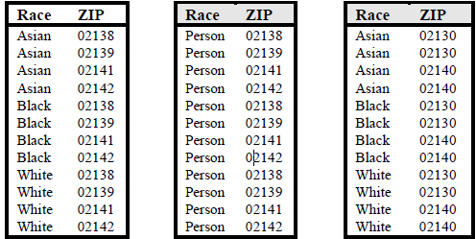
Unsorted Matching Attacks
Based on order of tuples in the released data
Often used in real world
release of sensitive data
Generation of ZIP
Generation of race

Slide 11
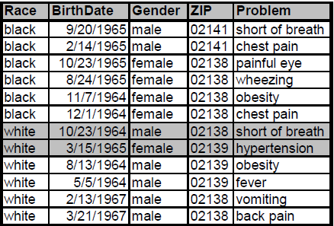
Complementary Release Attack
Prior examples, all attributes were quasi-identifier
Not typical in the real world → subsequent releases are common
Are unique → subsequent release

Slide 12
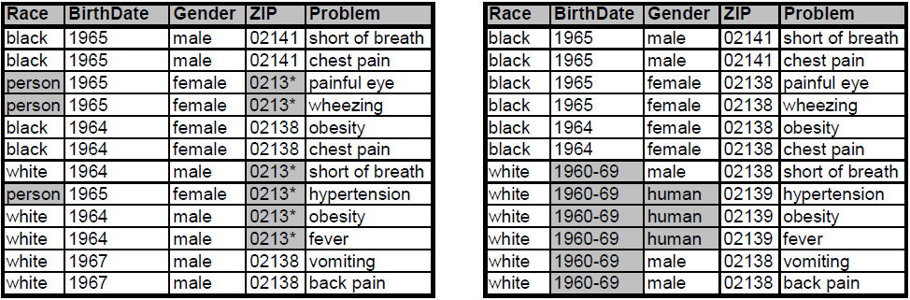
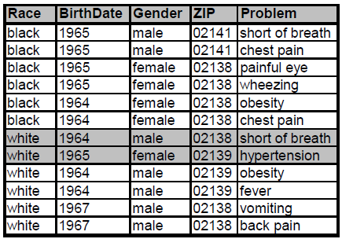
Complementary Release Attack
Linking both tables on {Problem}
Released table 1
Released table 2
Are unique Fix: table 2 is based on table 1
Linked table of table 1 and 2

Slide 13
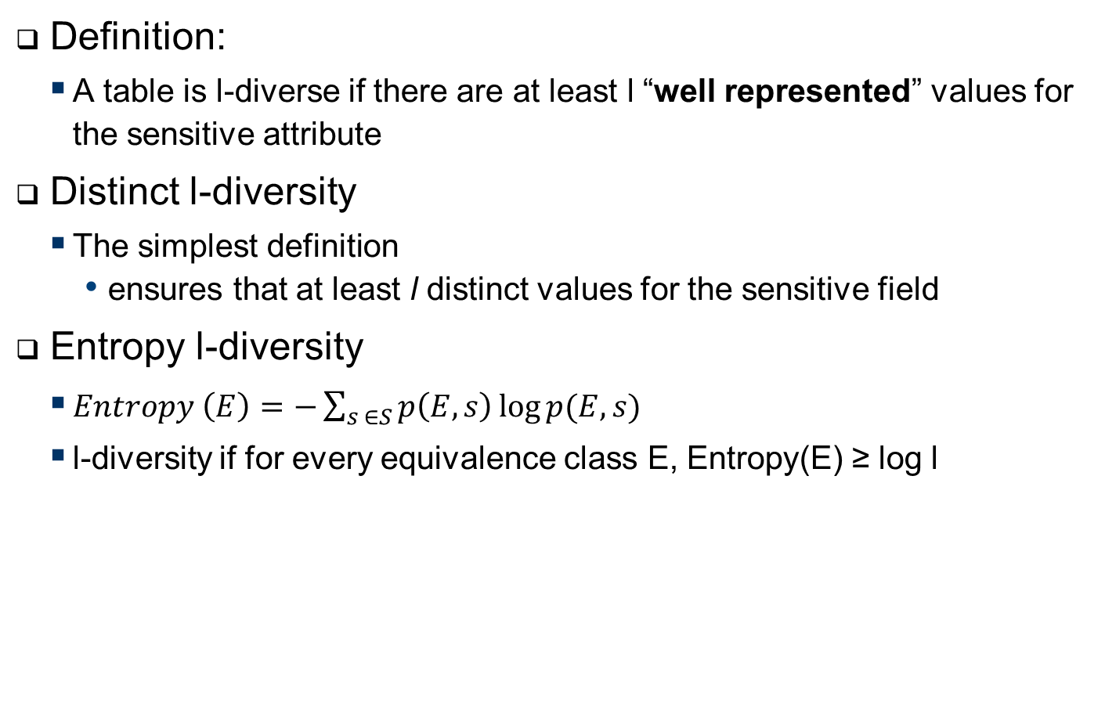
L-Diversity
Definition:
A table is l-diverse if there are at least l “well represented” values for the sensitive attribute
Distinct l-diversity
The simplest definition
ensures that at least l distinct values for the sensitive field
Entropy l-diversity
$Entropy \left(E\right)=−\sum_{s ∈S}{p\left(E,s\right)\log{p(E,s)}}$
l-diversity if for every equivalence class E, Entropy(E) ≥ log l
Notes:
Entropy l diversity
Sometimes this may too restrictive,
as the entropy of the entire table may be low if a few
values are very common. This leads to the following
less conservative notion of -diversity.

Slide 14
L-Diversity
Recursive (c, l)-diversity.
Makes sure that most frequent values not too often and
Most less frequent not too rarely
Compromise between the prior ones
Let m be the number of values in a equivalent class
And r_{i} , l <= i <= m
Then E is said to have recursive ((c, l)-diversity if r₁ < c(r_{l} +r_{l+1}+...+r_{m})

Slide 15
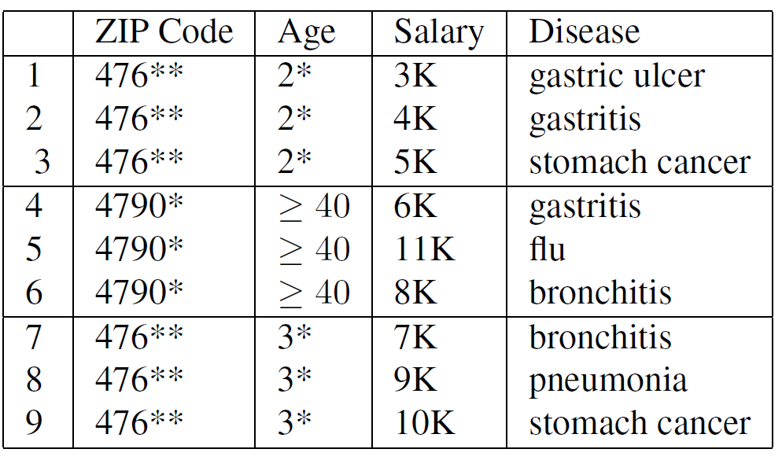
L-diversity Weakness
Similarity attack:
Attackers knows that victims data is e.g. one of the first three records
Can conclude its salary is relatively low
Conclusion
L-Diversity does not take semantic closeness into account

Slide 16
4. t-Closeness
Definition: (The t-closeness Principle:) An equivalence class is said to have t-closeness if the distance between the distribution of a sensitive attribute in this class and the distribution of the attribute in the whole table is no more than a threshold t. A table is said to have t-closeness if all equivalence classes have t-closeness.
Source: t-Closeness: Privacy Beyond k-Anonymity and l–Diversity, Ninghui Li, Tiancheng Li
Distance measure between the distribution with Earth mover's distance (EMD)
30.01.2018
Notes:
t-closeness formalizes the idea of global background knowledge by requiring that the distribution of a sensitive attribute in any equivalence class is close to the distribution of the attribute in the overall table (i.e., the distance between the two distributions should be no more than a threshold t). This effectively limits the amount of individual-specific information an observer can learn.

Slide 17
4. t-Closeness cont´d
Lacks of flexibility
EMD function is not suitable for preventing attribute linkage on numerical sensitive attributes
Enforcing t-closeness would greatly degrade the data utility because it requires the distribution of sensitive values to be the same in all QID groups.
30.01.2018
Notes:
First, it lacks the flexibility of specifying different
protection levels for different sensitive values.
Second, the EMD function is not suitable for preventing attribute linkage on numerical sensitive attributes
Third, enforcing t-closeness would greatly degrade the data utility because it requires the distribution of sensitive values to be the same in all qid groups. This would significantly damage the correlation between QID and sensitive attributes.

Slide 18
5. Extended Scenarios - Multiple Release Publishing
Different data recipients got different claims to the data
T(Job, Sex, Age, Race, Disease, Salary)
Another is intereset in {JOB, AGE, RACE}
Realse one table with {JOB, Sex, Age, Race}
A drawback is that information is released unnecessarily, in that neither of the two purposes needs all four attributes
They take the QID and merge their releases together
Notes:
Complementary Release Attack:

Slide 19
5. Extended Scenarios – Multiple Release Publishing
T1:
T2:
Age | Job | Class
30 | Lawyer | C1
30 | Lawyer | C1
40 | Carpenter | C2
40 | Electrician | C3
50 | Engineer | C4
50 | Clerk | C4
Job | Birthplace | Disease
Lawyer | US | Cancer
Lawyer | US | Cancer
Carpenter | France | HIV
Engineer | France | HIV
Clerk | US | HIV
Join of T1 and T2:
Age | Job | Birthplace | Disease | Class
30 | Lawyer | US | Cancer | C1
30 | Lawyer | US | Cancer | C1
40 | Carpenter | France | HIV | C2
50 | Engineer | France | HIV | C4
50 | Clerk | US | HIV | C4
Notes:
Let us Suppose that the data publisher
releases one projection view T1 to one data recipient and releases another projection
view T2 to another data recipient. Both views are from the same underlying patient
table. Further suppose that the data publisher does not want {Age, Birthplace} to be
linked to Diseaset. When T1 and T2 are examined separately, the Age = 40 group
and the Birthplace = France group have size 2. However, by joining T1 and T2 using
T1.Job = T2.Job, an attacker can uniquely identify the record owner in the {40,France}
group, thus linking {Age, Birthplace} to Disease without difficulty. Moreover, the join
reveals the inference {30,US} → Cancer with 100% confidence for the record owners
in the {30,US} group. Such an inference cannot be made when T1 and T2 are examined

Slide 20
5. Extended Scenarios - Sequential Release Publishing
the data is released continuously and sequentially as new information becomes available.
released T1, . . . , Tp−1 and now wants to publish the next release Tp
T1,…..,Tp-1 can´t be changed afterwards
Differents to multiple Release Publishing T1, . . . , Tp−1 have been published and, therefore, cannot be modified.
Any attempt at prevention of privacy violation has to rely on anonymizing the next

Slide 21
5. Extended Scenarios - Sequential Release Publishing
T1:
T2:
Age | Job | Class
30 | Lawyer | C1
30 | Lawyer | C1
40 | Carpenter | C2
40 | Electrician | C3
50 | Engineer | C4
50 | Clerk | c4
Job | Birthplace | Disease
Lawyer | US | Cancer
Lawyer | US | Cancer
Carpenter | France | HIV
Electrician | UK | Cancer
Engineer | France | HIV
Clerk | US | HIV
Join of T1 and T2:
Age | Job | Birthplace | Disease | Class
30 | Lawyer | US | Cancer | C1
30 | Lawyer | US | Cancer | C1
40 | Carpenter | France | HIV | C2
40 | Electrician | UK | Cancer | C3
50 | Engineer | France | HIV | C4
50 | Clerk | US | HIV | C4
30 | Lawyer | US | Cancer | C1
30 | Lawyer | US | Cancer | c1

Slide 22
5. Extended Scenarios - Continuous Data Publishing
the data publisher has previously published T1, . . . , Tp−1
Tp, where Ti is an updated release ofTi−1 with record insertions and/or deletions
The problem assumes that all records for the same individual remain the same in all releases. Even though each release T1, . . . , Tp is individually anonymous, the privacy requirement could be compromised by comparing different releases and eliminating some possible sensitive values for a victim
Notes:
In the model of continuous data publishing, the data publisher has previously published T1, . . . , Tp−1 and now wants to publish Tp, where Ti is an updated release ofTi−1 with record insertions and/or deletions

Slide 23
5. Extended Scenarios - Continuous Data Publishing
T1:
Job | Sex | Disease
Programmer | Female | Cancer
Pogrammer | Female | Diabetes
Artist | Male | Fever
Artist | Male | Cancer
T2:
T3:
Job | Sex | Disease
Programmer | Female | Cancer
Programmer | Female | Diabetes
Programmer | Female | HIV
Artist | Male | Fever
Artist | Male | Cancer
Job | Sex | Disease
Programmer | Female | Cancer
Programmer | Female | Fever
Artist | Male | Fever
Artist | Male | Cancer
Notes:
Let Table VIII(a) be the first release T1. Let Table VIII(b) be the
second release T2 after inserting a new record. Both T1 and T2 satisfy 2-diversity independently.
Suppose the attacker knows that a female lawyer, Alice, has a record in T2
but not in T1, based on the timestamp that Alice was admitted to a hospital. From T2,
the attacker can infer that Alice must have contracted either Flu, Fever, or HIV. By
comparing T2 with T1, the attacker can identify that the first two records in T2 must
be old records from T1 and, thus, infer that Alice must have contracted HIV.

Slide 24
5. EXTENDED SCENARIOS - Collaborative Data Publishing
More than one data publisher
Different data publisher owns different attributes
Goal: k-anonymous table on all attributes
2 approaches - integrate then generalize(ITG)/ generalize then integrate(GTI)
ITG disadvantage data publisher know all private information
GIT disadvantage QID is not known

Slide 25
Finding the optimal solution

Slide 26
5. Complexity of Optimal K-Anonymity
NP-hard
Finally, we presented two e±cient greedy approxima-tion algorithms for the problem. Can an approximationalgorithm be found whose performance ratio is indepen-dent of k? We suspect that ­(log k) might be a lowerbound on the possible approximability of the problem(within polynomial time), given that such a lower boundexists for k-set cover.

Slide 27
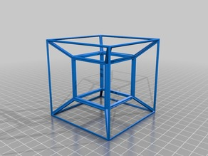
6. Datatype - High-Dimensional Transaction Data
Transaction data is high-dimensional
Each dimension could be a potential QID attribute
Curse of high-dimensionality
Bound background knowledge of the attacker
Notes:
Transaction data is usually high-dimensional. For example, Amazon.com has several
million catalog items. Each dimension could be a potential QID attribute used
for record or attribute linkages; therefore, employing traditional privacy models, such
as k-anonymity, would require including all dimensions into a single QID.
Due to the
curse of high-dimensionality [Aggarwal 2005], it is very likely that lots of data has to
be suppressed or generalized to the top-most values in order to satisfy k-anonymity,
even if k is small. Obviously, such anonymous data is useless for data analysis.
In any real-life privacy attack, it is unlikely that the attacker would know all
quasi-identifying attributes of a target victim due to the effort it would take to gather
every piece of background knowledge. Thus, it is reasonable to bound the attacker’s
background knowledge in the privacy model.

Slide 28
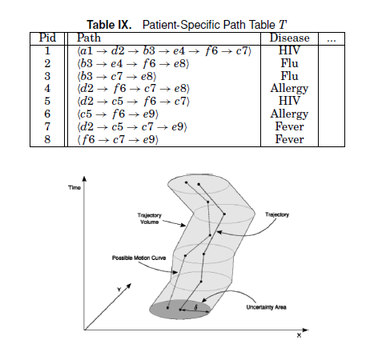
6. Datatyp - Moving Object Data
- Location-based services (LBS)
- Background knowledge Attack
- Solution: k- Anonymity for timestamp and location with radius Delta
Source: Privacy-Preserving Data Publishing: A Survey of
Recent Developments

Slide 29
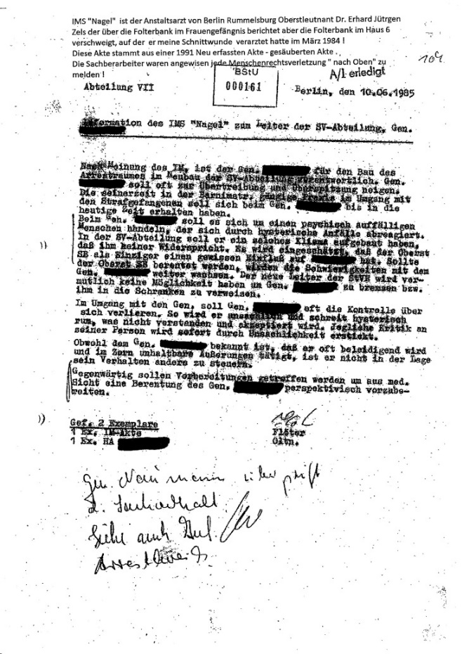

6. Datatyp - Unstructured Data
Unstructural data can also have sensitive data and QID
Text and Pictures
Sanitization
de-identiﬁcation
Notes:
Sanitization of a document involves removing sensitive information from the document, in order to reduce thdocument’s classification level, possibly yielding an unclassified document.
In hospitals, medical records are sanitized to remove sensitive patent information (patient identity information, diagnoses of deadly diseases, etc.). Document sanitization is also
critical to companies who need to prevent malafide or inadvertentdisclosure of proprietary information while sharing data with outsourced operations.
We wish to retain same facial information about the photographed people, for example a fashion shop interested in knowing how many of it’s visitors are male or female. I Sometimes, the photograph may be used psychologically and should therefore look more visually appealing (For a photo of a war victim, a blurred face would be much more eﬀective in raising awareness then a black rectangle). I Because we can achieve results as good as blackout but better looking

Slide 30
Datatyp - Unstructured Data cont‘d
Erase
However, the problem formulation considered in the above setup and ERASE are different. While the goal in the K-anonymization is to anonymize a given database, in ERASE, the aim to sanitize a single document. (K-safety)
E denote the set of entities
We associate each entity e 2 E with a set of terms C(e) which collectively represent the entire knowledge the adversary has about the entity
Each disease is an entity, and its context includes the symptoms and the drugs used to cure the disease.P of protected
Problem NP-Hard
Notes:
Traditionally, documents are sanitized manually by qualified reviewers.
However, manual sanitization does not scale as the volume
of data increases.

Slide 31
Datatyp - Unstructured Data cont‘d
k-Same. Face identification results when a face image is properly associated with explicit identifiers, such as name and address, of the person who is the subject of the face image.
In the next section, face recognition software is examined in detail. The goal of this work is to alter face images in such a way that automated face recognition cannot be reliably performed on the resulting images. Before claims of thwarting face recognition software can be made, more discussion is needed on altering face images. This is termed de-identification of face images, as described in Definition 2.7.

Slide 32
7. Summary
K-anonymity, l-Diversity, t-clossness don‘t provide a full privacy protection
Every privacy Modell tries to overcome the downsites of his parent
All kind of data can leak privacy information

