Slide 1
Barriers to the implementation of k-anonymity and related microdata anonymization techniques in a realworld application
Andreas Wiegand
Ludwig Schallner
Frei verwendbar

Slide 2
Index
1. Basics
2. k-anonymity
3. OLA
4. 2. Algorithmus
5. Datatyp - Moving Object Data
6. Datatype - High-Dimensional Transaction Data
7. Summary

Slide 3
Basics
Identity disclosure
Individual is linked to a particular record
Attribute disclosure
new information revealed about some individual
Tables give useful information to researchers, but
Record owners interest is to be anonym.
We have to anonymize the data before releasing

Slide 4
K-ANONYMITY
Is achieved if:
At least k matching record with the same quasi-identifiers
Identifiers
Attributes which identifies individuals explicitly
Quasi-identifiers
Identifies an record owner only by combination of other Qis
Sensitive Data
Data to which record owner doesn't want to get linked

Slide 5
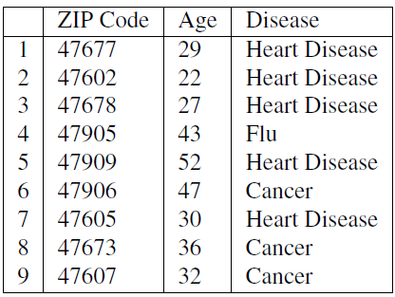
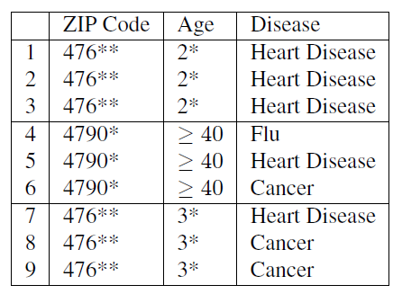
Example of K-Anonymity
Table 1: original data
Table 2: 3-Anoymized

Slide 6
The Adversary’s Knowledge is Unknown
Adversary has access to table
And knows that the table is generalized + knows the domain of the attributes
Instance-level background knowledge
Adversary knows that his target does not suffer from a disease
May conclude what the target really suffers from
Demographic background knowledge
Adversary knows e.g P(t[condition] = cancer| t[Age]>=40)
May use it to interference about records

Slide 7
Homogeneity Attack
This attack is based on the homogeneity of data
Age and Zip-Code of the target
Leads to concluding of disease of the record owner

Slide 8
Background Knowledge Attack
This attack is based on background knowlegde
Alice knows additionally that e.g. Carl(36, 47605) has a low risk of heart disease → conclude he has cancer

Slide 9
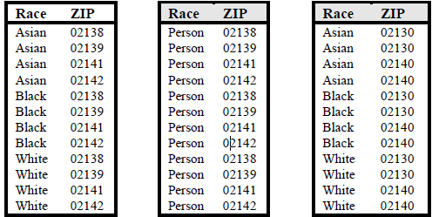
Unsorted Matching Attacks
Based on order of tuples in the released data
Often used in real world
release of sensitive data
Generation of ZIP
Generation of race

Slide 10
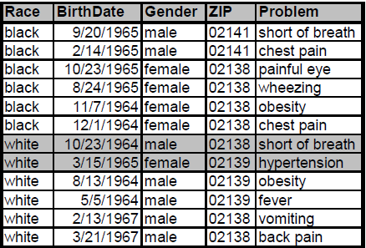
Complementary Release Attack
Prior examples, all attributes were quasi-identifier
Not typical in the real world → subsequent releases are common
Are unique → subsequent release

Slide 11
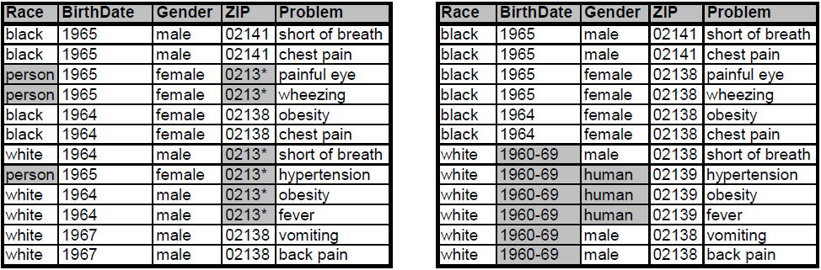
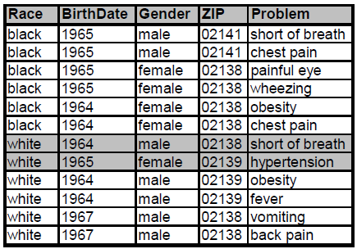
Complementary Release Attack
Linking both tables on {Problem}
Released table 1
Released table 2
Are unique Fix: table 2 is based on table 1
Linked table of table 1 and 2

Slide 12
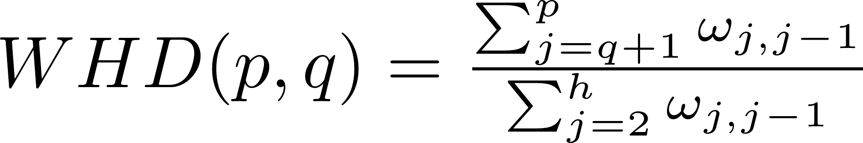
Quality of k-anonymization
Calculate information loss/distortion:
Modification rate:
The fraction of cells being modified
Does not consider hierarchical structures
Weighted hierarchical Distance
Uniformed Weight: wj,j-1 = 1 (where 2<= j<=h)
Or height weight

Slide 13
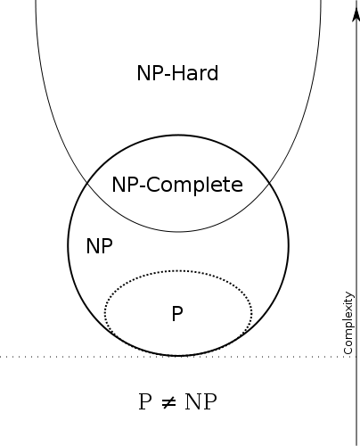
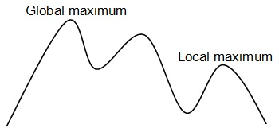
Optimal K-Anonymity
Goal of k-anonmity algorithm is to find a optimal solution
Minimal Information loss
Datamining
Heuristic /Approximations/ Loss Metrics
NP-Hard
Notes:
The goal of an optimal K-anonymity Alogrithm is to balance the we known k-anonymity definition with the amount of information loss we get by anonmitaz the dataset.
Information loss is important because the data is used for applikations like datamining or machinelearning apllications . An tehrefor we don’t want to get rid of to much information because it’s the essence of usefull dataming . Example
To measue the amount of information loss the algorthims use Loss Metrics. In practice there are a lot proposed and used in practice but non of them are the real deal. So no one of them are scintifical acceptebal because they are all just heuristics approximations. We will later see example to understand the problem clearer. -> another barrier
To Solving this problem has been proven to be NP-hard. So these means we ar at least in NP-Complett problems but possible harder. Maybe we wont find an answer if this solution got an optimal k-anonymity version. –> anther barrier

Slide 14
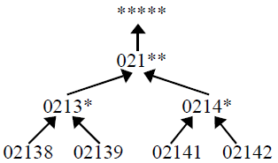
K-Anonymity Generalization and Supression
Generalizing: a value is replaced by a less specific, more general value
Generalization include Suppression
Suppression refers to removing a certain attribute value
Some Algorithm work with MaxSup
There is no compination between optimal k-anonymity and dataquality
Problem: Suppression can drastically
reduce data quality
Source: ACHIEVING k-ANONYMITY PRIVACY PROTECTION
USING GENERALIZATION AND SUPPRESSION: Sweeney 2002
Notes:
The idea of generalizing an attribute is a simple concept. A value is replaced by a less specific, more general value that is faithful to the original. Like in the example below the zipcode 02138 can be transform to 0213* by deleting the rightmost
Char.
Supression means get rid of a value at all
MaxSup means that in the hole k-anonymized dataset only some procentig of attributes are allowed to supressed
Supression problem: Suppression can drastically reduce the quality of the data if not properly used: example

Slide 15
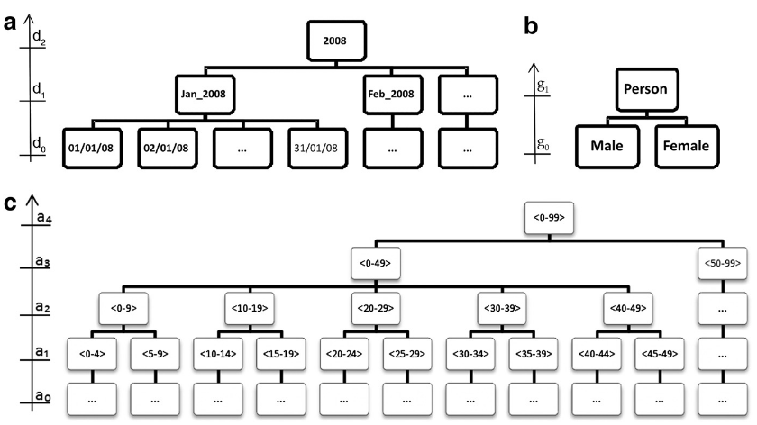
K-Anonymity - Generalizations lattice
Source: A Globally Optimal k-Anonymity Method for the De-Identification of Health Data:16:670–682. DOI 10.1197/jamia.M3144.
<d1,g0,a4>
Notes:
Here a some generalization examples we will need to unterstand the following algrothm.

Slide 16
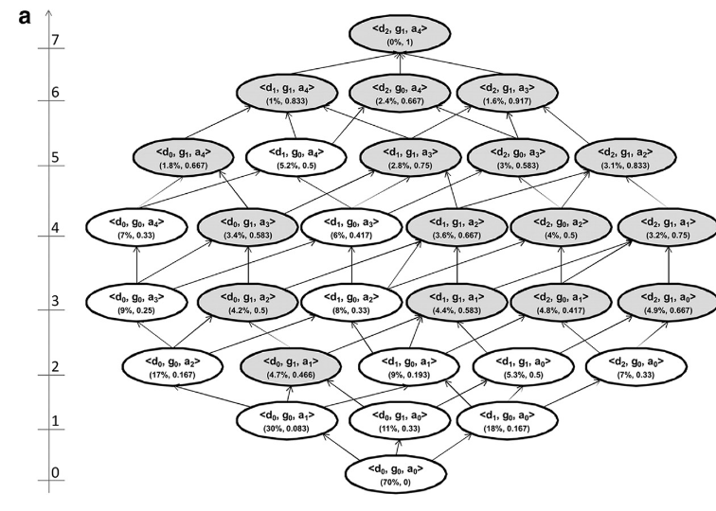
K-Anonymity - Generalizations lattice con‘t
Notes:
The three information loss metrics that we have presented above (Prec, DM*, and non-uniform entropy) are monotonic
within any given generalization strategy. This means that as we move up the lattice along any generalization strategy the
information loss value will either remain the same or increase. This property is important because it means that if we have two
k-anonymous nodes in the same generalization strategy, then the one lower in the strategy will always have a lower information loss.
The generalization hierarchies for the three quasi-identifiers in
Figure 1 can be represented as a lattice, as in panel (a) of Figure
2. The height of each row of nodes is shown on the left hand
side, ranging from zero to 7 in this case. The arrows illustrate
the possible generalization paths that can be taken through the
lattice. A series of connected paths from the bottom node to the
top node is a generalization strategy. Panel (b) of Figure 2 shows two
generalization strategies which pass through the node d0, g1,
a2. Each node in the lattice represents a possible instance of the
dataset. One of these nodes is the globally optimal solution and
the objective of a k-anonymity algorithm is to find it efficiently.
All equivalence classes in the dataset that are smaller than k are
suppressed.26 In Figure 2, 70% of the records were suppressed in
the dataset represented by node d0, g0, a0 because these
records were in small equivalence classes. As more generalization
is applied, the extent of suppression goes down. For example,
node d0, g0, a1, with age generalized to 5-year intervals, has
only 30% of the records suppressed.

Slide 17
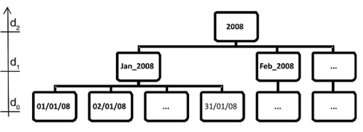
K-Anonymity - Information Loss Metric
Lowest lattice height
example
Prec: takes lattice height into account
example
Discernability Metric or DM.
Notes:
Out of the highlighted nodes in the lattice, Samarati24 proposes that the node with the lowest lattice height should be selected as the optimal solution. In our example of Figure
2, this would be node d0, g1, a1. The assumption being made is that this solution balances the extent of generalization with the extent of suppression
The lattice height is not considered a good information loss metric because it does not account for the generalization hierarchy depths of the quasi-identifiers. For example, if we generalize “Male” to “Person” then this is given equal weight
to generalizing age in years to age in five year intervals. In the former case there is no information left in the gender variable, whereas the five year age interval still conveys a considerable amount of information and there are three more possible generalizations left in the age hierarchy
An information loss metric that takes into account the height of the generalization hierarchy is Precision or Prec.
The Prec was introduced by Sweeney as an information loss metric that is suitable for hierarchical data. For every variable, the ratio ofthe number of generalization steps applied to the total number
of possible generalization steps (total height of the generalization hierarchy) gives the amount of information loss for that particular variable.
For example, in Figure 1 if age is generalized from age in years to age in five year intervals, then the value is ¼. Overall Prec information loss is the average of the Prec values across all quasi-identifiers in the dataset. As a
consequence, the more a variable is generalized, the higher the information loss. Moreover, variables with more generalization steps (i.e., more levels in their generalization hierarchy) tend to have less information loss than ones with shorter hierarchies. Using Prec as the information loss metric, the noded2, g0, a1 would be the optimal node rather than node d0, g1, a1 in
Figure 2: the former has a Prec of 0.417 and the latter a Prec of 0.466.
Another commonly used information loss metric is the Discernability Metric or DM.2The discernability
metric assigns a penalty to every record that is proportional to the number of records that are indistinguishable from it.
Following the same reasoning, DM assigns a penalty equal to the whole dataset for every suppressed record (since suppressed records are indistinguishable from all other records).
The DM* information loss also solves a weakness with the Prec metric in that Prec does not take into account the size
of the equivalence classes. If we generalize gender to “Person” in Table a of Figure 3 to obtain Table c in Figure
3, then the Prec for Table (c) would be 0.33 and DM* would be 16. However, Table b in Figure 3 has a Prec of 0.0833 and a DM* of 28. As can be seen in this case, the
higher Prec value had a lower DM* value. The reason is that there are more equivalence classes in (b) than in (c),
and one of the equivalence classes is larger; the Prec metric does not consider the structure of the data itself.
the number of generalization steps applied to the total number
of possible generalization steps (total height of the generalization
hierarchy) gives the amount of information loss for that
particular variable. For example, in Figure 1 if age is generalized
from age in years to age in five year intervals, then the
value is ¼. Overall Prec information loss is the average of the
Prec values across all quasi-identifiers in the dataset. As a
consequence, the more a variable is generalized, the higher the
information loss.
The discernability
metric assigns a penalty to every record that is proportional
to the number of records that are indistinguishable from it.
Following the same reasoning, DM assigns a penalty equal
to the whole dataset for every suppressed record (since
suppressed records are indistinguishable from all other
records). The formula for DM metric appears in online

Slide 18
The OLA Algorithm
For each generalization strategy, conduct a binary search to find all the k-anonymous nodes.
For each generalization strategy with k-anonymous nodes, only the k-anonymous node with the lowest height within the strategy is retained. For example, in Figure 2 both nodes d0, g1, a1 and d0, g1, a2 are k-anonymous, but they are both part of the same generalization strategy and d0, g1, a1 is below d0, g1, a2 in the lattice. This means that d0, g1, a1 will have less information loss on all the three metrics we considered. The node d0, g1, a1 is called a k-minimal node.
Now that we have the k-minimal nodes, these are compared n terms of their information loss and the node with the smallest information loss is selected as the globally optimal solution. Because of the monotonicity property, the k-minimal node with the smallest information loss must also have the smallest information loss among all k-anonymous nodes in the lattice.

Slide 19
6. Datatyp - Moving Object Data
The cloaking algorithm
Location-based services (LBS)
Restricted Space Identiﬁcation and Observation Identiﬁcation
location k-anonymity demands that location information contained in a message sent from a mobile user to a LBS should be indistinguishable from at least k−1 other messages from different mobile nodes
Location can be a Quasi – Identifier
Spatial cloaking and Temporal cloaking
Usability and anonymity
m1
m1
Notes:
SO no we are looking to another realworld example of k-anonmization and its problems: The cloaking algorithm
The cloaking algorithm is run by the location protection broker on a trusted server, which anonymizes messages from the mobile nodes by cloaking the location information contained in
the messages to reduce or avoid privacy threats before forwarding them to the LBS provider(s).
Restricted Space Identiﬁcation. If A knows that space L exclusively belongs to subject S then A learns that S is in L and S has sent M. For example, when the owner of a suburban house sends a message from his garage or driveway, the coordinates can be correlated with a databaseof geocodedpostal addresses (e.g., [30]) to identify the residence. An address lookup in phone or property listings then reveals the owner and likely originator of the messag
Observation Identiﬁcation. If A has observed the current location L of subject S and ﬁnds a message M from L then A learns that S has sent M. For example, the subject has revealed its identity and location in a previous message and then wants to send an anonymous message. The later message can be linked to the previous one through the location information.
First, a given degree of location anonymity can be maintained, regardless of population density, by decreasing
the location accuracy through enlarging the revealed spatial area, such that there are other k−1 mobile nodes present
in the same spatial area. This approach is called spatial cloaking.
Second, one can achieve the location anonymity by delaying
the message until k mobile nodes have visited the same area located by the message sender. This approach is called temporal cloaking.

Slide 20
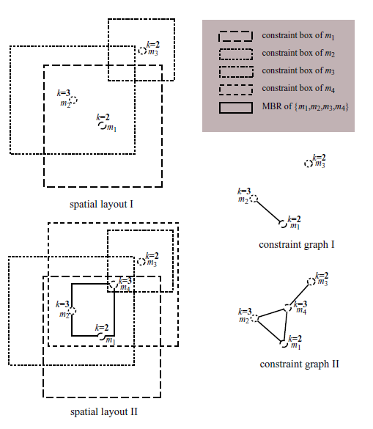
6. Datatyp - Moving Object Data
ms ∈ S : uid, rno, {t, x, y}, k, {dt, dx, dy}, C
success rate
Relative anonymity level
Relative spatial resolution
Relative temporal resolution
Message processing time
Anonymity can cost Utility
A Customizable k-Anonymity Model for Protecting Location Privacy – Bugra a. Ling
Notes:
A main technical challenge for developing an efficient cloaking
algorithm is to find a set of messages and to assign the
smallest possible spatio-temporal cloaking box to these messages,
such that the k-anonymity requirements are satisfied for
all messages in the set.
Messages that can not be anonymized until their deadline
are dropped. The deadline of a message is the high point along
the temporal dimension in its spatio-temporal constraint box.
Messages are uniquely identifiable by the sender’s identifier, message reference number pairs, (uid, rno), within the set S.
Messages from the same mobile node have same sender identifiers but different reference numbers. In a received message,
x, y, and t together form the three dimensional spatio-temporal point of the message, denoted as P(ms). The coordinate (x, y)
refers to the spatial position of the mobile node in the two dimensional space (i.e., x-axis and y-axis), and the timestamp t
refers to the time point at which the mobile node was present at that position (temporal dimension: t-axis of the message).
The dt value of the message represents the temporal tolerance specified by the user. Similarly, dx and dy specify the tolerances with
3 respect to the spatial dimensions. The values of these three parameters are dependent on the requirements of the external
LBS and users’ preferences with regard to quality of service. For instance, larger spatial tolerances may result in less accurate
results to location-dependent service requests and larger temporal tolerances may result in higher latencies of the messages.

Slide 21
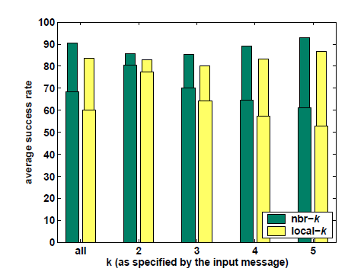
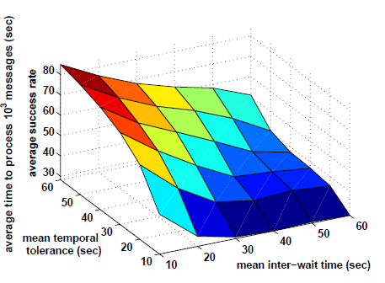
6. Datatyp - Moving Object Data
A Customizable k-Anonymity Model for Protecting Location Privacy – Bugra a. Ling
Notes:
They simulated simple traffic on an computer. They loaded a map of a region Georgia of 160 km2. And they got around 100000 cars the produced messages during the simulation. Each Each message specifies an anonymity level (k value) from the list {5, 4, 3, 2}.

Slide 22
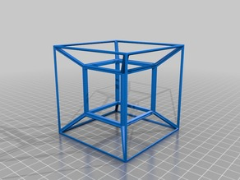
6. Datatype - High-Dimensional Transaction Data
Transaction data is high-dimensional
Each dimension could be a potential QID attribute
Curse of high-dimensionality
Bound background knowledge of the attacker
Notes:
Transaction data is usually high-dimensional. For example, Amazon.com has several
million catalog items. Each dimension could be a potential QID attribute used
for record or attribute linkages; therefore, employing traditional privacy models, such
as k-anonymity, would require including all dimensions into a single QID.
Due to the curse of high-dimensionality it is very likely that lots of data has to
be suppressed or generalized to the top-most values in order to satisfy k-anonymity,
even if k is small. Obviously, such anonymous data is useless for data analysis.
In such cases, many attributes (eg. salary) con-
tinue to be sensitive, but also cannot be ruled out as
quasi-identiers. Such situations are quite likely in real
life, since an adversary may also have personal knowl-
edge of the target of interest. It is in fact quite likely
that an adversary who is acquainted with a target of
interest knows much more than is available from public
information.
In any real-life privacy attack, it is unlikely that the attacker would know all
quasi-identifying attributes of a target victim due to the effort it would take to gather
every piece of background knowledge. Thus, it is reasonable to bound the attacker’s
background knowledge in the privacy model.

Slide 23
7. Summary
There is no compination between optimal k-anonymity and dataquality
Attacks against anonymity
Usability and anonymity
Identifie Quasi identifiers
NP – Hard
Only heuristics no rules like mutual Information

Slide 24
Source
k-ANONYMITY: A MODEL FOR PROTECTING PRIVACY - LATANYA SWEENEY
ACHIEVING k-ANONYMITY PRIVACY PROTECTIONUSING GENERALIZATION AND SUPPRESSION- LATANYA SWEENEY
Efficient Multidimensional Suppression for K-Anonymity – Kisilevich
A Globally Optimal k-Anonymity Method for the De-Identification of Health Data - EL EMAM
On the Complexity of Optimal Kanonymity - Adam Meyerson/ Ryan Williams
On k-Anonymity and the Curse of Dimensionality - Charu C. Aggarwal

