Slide 1
Barriers to the implementation of k-anonymity and related microdata anonymization techniques in a realworld application
Andreas Wiegand
Ludwig Schallner
Frei verwendbar

Slide 2
Index
1. Introduction
2. k-anonymity
3. l-diversity
4. t-closeness
5. Extendet scenarios
6. Datatypes
7. Summary

Slide 3
Introduction
Identity disclosure
Individual is linked to a particular record
Attribute disclosure
new information revealed about some individual
Tables give useful information to researchers, but
Record owners interest is to be anonym.
We have to anonymize the data before releasing

Slide 4
K-ANONYMITY
Is achieved if:
At least k matching record with the same quasi-identifiers
Identifiers
Attributes which identifies individuals explicitly
Quasi-identifiers
Identifies an record owner only by combination of other Qis
Sensitive Data
Data to which record owner doesn't want to get linked

Slide 5
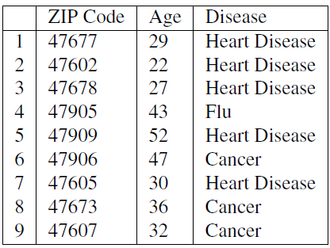
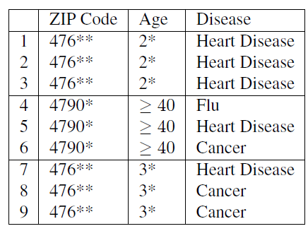
Example of K-Anonymity
Table 1: original data
Table 2: 3-Anoymized

Slide 6
The Adversary’s Knowledge is Unknown
Adversary has access to table
And knows that the table is generalized + knows the domain of the attributes
Instance-level background knowledge
Adversary knows that his target does not suffer from a disease
May conclude what the target really suffers from
Demographic background knowledge
Adversary knows e.g P(t[condition] = cancer| t[Age]>=40)
May use it to interference about records

Slide 7
Attacks on K-ANONYMITY
Homogeneity Attack
Background Knowledge Attack/attribute linkage
Unsorted Matching Attacks
Complementary Release Attack

Slide 8
Homogeneity Attack
This attack is based on the homogeneity of data
Age and Zip-Code of the target
Leads to concluding of disease of the record owner

Slide 9
Background Knowledge Attack
This attack is based on background knowlegde
Alice knows additionally that e.g. Carl(36, 47605) has a low risk of heart disease → conclude he has cancer

Slide 10
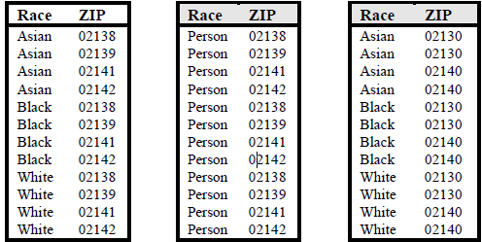
Unsorted Matching Attacks
Based on order of tuples in the released data
Often used in real world
release of sensitive data
Generation of ZIP
Generation of race

Slide 11
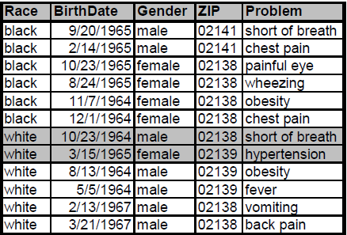
Complementary Release Attack
Prior examples, all attributes were quasi-identifier
Not typical in the real world → subsequent releases are common
Are unique → subsequent release

Slide 12
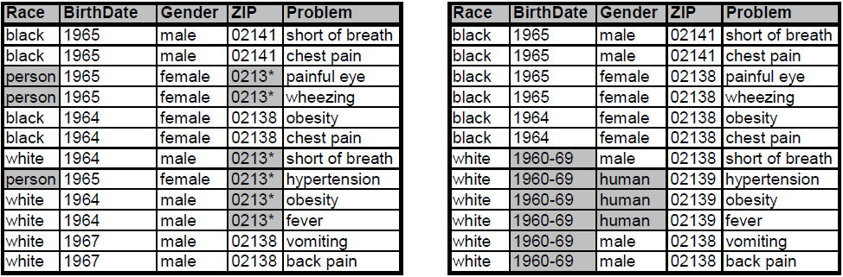
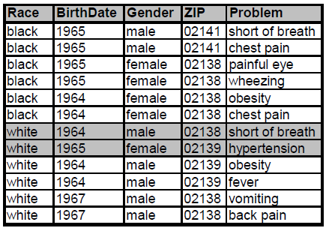
Complementary Release Attack
Linking both tables on {Problem}
Released table 1
Released table 2
Are unique Fix: table 2 is based on table 1
Linked table of table 1 and 2

Slide 13
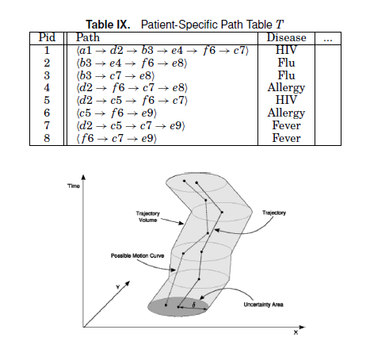
6. Datatyp - Moving Object Data
- Location-based services (LBS)
- Background knowledge Attack
- Solution: k- Anonymity for timestamp and location with radius Delta
Source: Privacy-Preserving Data Publishing: A Survey of
Recent Developments

Slide 14
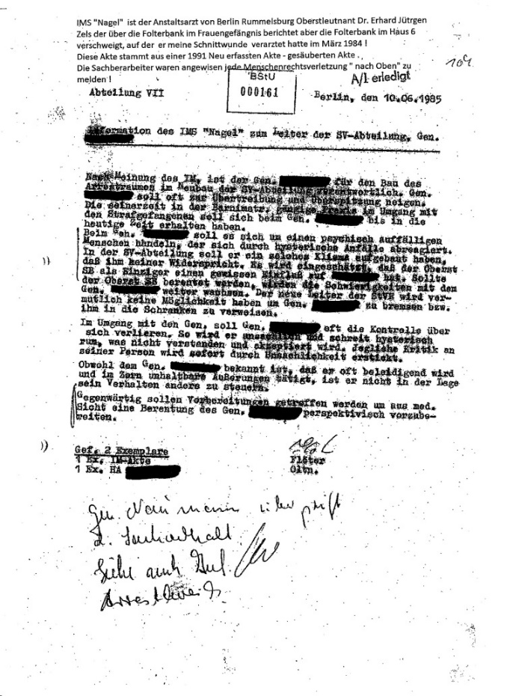

6. Datatyp - Unstructured Data
Unstructural data can also have sensitive data and QID
Text and Pictures
Sanitization
de-identiﬁcation
Notes:
Sanitization of a document involves removing sensitive information from the document, in order to reduce thdocument’s classification level, possibly yielding an unclassified document.
In hospitals, medical records are sanitized to remove sensitive patent information (patient identity information, diagnoses of deadly diseases, etc.). Document sanitization is also
critical to companies who need to prevent malafide or inadvertentdisclosure of proprietary information while sharing data with outsourced operations.
We wish to retain same facial information about the photographed people, for example a fashion shop interested in knowing how many of it’s visitors are male or female. I Sometimes, the photograph may be used psychologically and should therefore look more visually appealing (For a photo of a war victim, a blurred face would be much more eﬀective in raising awareness then a black rectangle). I Because we can achieve results as good as blackout but better looking

Slide 15
Datatyp - Unstructured Data cont‘d
k-Same. Face identification results when a face image is properly associated with explicit identifiers, such as name and address, of the person who is the subject of the face image.
In the next section, face recognition software is examined in detail. The goal of this work is to alter face images in such a way that automated face recognition cannot be reliably performed on the resulting images. Before claims of thwarting face recognition software can be made, more discussion is needed on altering face images. This is termed de-identification of face images, as described in Definition 2.7.

Slide 16
Datatyp - Unstructured Data cont‘d
Erase
However, the problem formulation considered in the above setup and ERASE are different. While the goal in the K-anonymization is to anonymize a given database, in ERASE, the aim to sanitize a single document. (K-safety)
E denote the set of entities
We associate each entity e 2 E with a set of terms C(e) which collectively represent the entire knowledge the adversary has about the entity
Each disease is an entity, and its context includes the symptoms and the drugs used to cure the disease.P of protected
Problem NP-Hard
Notes:
Traditionally, documents are sanitized manually by qualified reviewers.
However, manual sanitization does not scale as the volume
of data increases.

Slide 17
5. Complexity of Optimal K-Anonymity
NP-hard
Finally, we presented two e±cient greedy approxima-tion algorithms for the problem. Can an approximationalgorithm be found whose performance ratio is indepen-dent of k? We suspect that ­(log k) might be a lowerbound on the possible approximability of the problem(within polynomial time), given that such a lower boundexists for k-set cover.

Slide 18
K-Anonymity Goal
Some, but not all, algorithms find an optimal solution.
Here, optimal describes the solution which results in
minimal information loss according to a given metric.
Solving this problem has been proven to be NP-hard
The main reasons for this are that an optimal solution guaranteesminimal information loss, which is important for the usefulness of the result.

Slide 19
K-Anonymity Generalization and Supression
Suppression is preferable to generalization because the former affects single records whereas generalization affects all the records in the dataset.24Therefore, when searchingfor an optimal solution, a solution that imposes moresuppression would be selected instead of one that imposesmore generalization
However, because of the negative impact of missingness on the ability to perform meaningful data analysis, 43 the end-users will want to impose limits on the amount of suppression that is allowed. We will refer to this limit as MaxSup. It is assumed that the data analyst will specify MaxSup such that complete bcase analysis can be performed or imputation techniques can be used to compensate for the missing data
Suppression refers to removing a certain attribute value
and replacing occurrences of the value with a special value
"?," indicating that any value can be placed instead.
Suppression can drastically reduce the quality of the data
if not properly used
Notes:
The authors of [20] introduced the notion of monotonic
generalization hierarchies. In a monotonic generalization hierarchy,
the groups at level l +1 are built by merging groups
from level l. This allows pruning of large parts of the search
space, because all states which are successors of an anonymous
state are also anonymous. Furthermore, all predecessors of a
non-anonymous state are also non-anonymous. This is because
generalization is monotonic for the complete dataset if it is
monotonic for each quasi-identifier. An example is shown
in Figure 3, where the fact that (2, 1, 1) is non-anonymous
implies that all of its predecessors are also non-anonymous
(dark gray). Furthermore, all successors of the
Supression problem: Suppression can drastically reduce the quality of the data
if not properly used

Slide 20
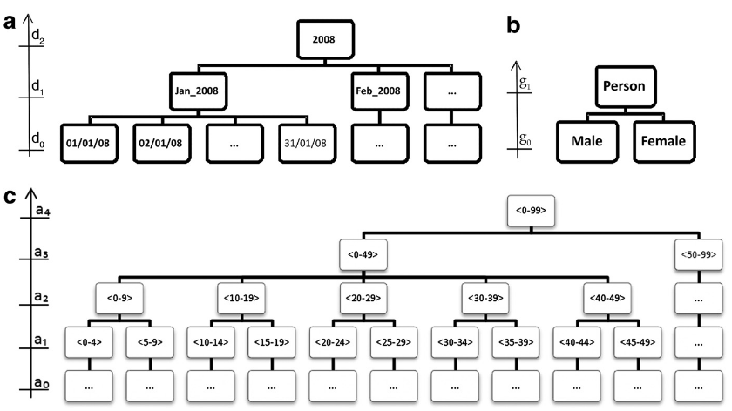
K-Anonymity Generalication latis

Slide 21
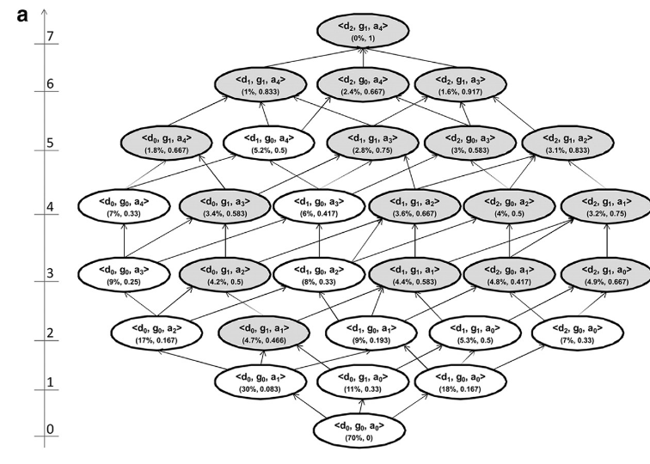
Notes:
The three information loss metrics that we have presented above (Prec, DM*, and non-uniform entropy) are monotonic
within any given generalization strategy. This means that as we move up the lattice along any generalization strategy the
information loss value will either remain the same or increase. This property is important because it means that if we have two
k-anonymous nodes in the same generalization strategy, then the one lower in the strategy will always have a lower information loss.

Slide 22
K-anonymity Information Loss Metric
Out of the highlighted nodes in the lattice, Samarati24
proposes that the node with the lowest lattice height should
be selected as the optimal solution.
An information loss metric that takes into account the height of the generalization hierarchy is Precision or Prec. The Prec was introduced by Sweeney46,47 as an information loss metric that is suitable for hierarchical data.
Another commonly used information loss metric is the
Discernability Metric or DM.
Notes:
In our example of Figure 2, this would be node d0, g1, a1. The assumption being
made is that this solution balances the extent generalization with the extent of suppression.
The lattice height is not considered a good information loss
metric because it does not account for the generalization
hierarchy depths of the quasi-identifiers. For example, if we
generalize “Male” to “Person” then this is given equal weight
to generalizing age in years to age in five year intervals. In the
former case there is no information left in the gender variable,
whereas the five year age interval still conveys a considerable
amount of information and there are three more possible
generalizations left in the age hierarchy
the number of generalization steps applied to the total number
of possible generalization steps (total height of the generalization
hierarchy) gives the amount of information loss for that
particular variable. For example, in Figure 1 if age is generalized
from age in years to age in five year intervals, then the
value is ¼. Overall Prec information loss is the average of the
Prec values across all quasi-identifiers in the dataset. As a
consequence, the more a variable is generalized, the higher the
information loss.
The discernability
metric assigns a penalty to every record that is proportional
to the number of records that are indistinguishable from it.
Following the same reasoning, DM assigns a penalty equal
to the whole dataset for every suppressed record (since
suppressed records are indistinguishable from all other
records). The formula for DM metric appears in online

Slide 23
K-anonymity Information Loss Metric
Pr0blems with the Metrics:
The concept behind DM has been criticized because DM
does not measure how much the generalized records approximatethe original records.
Notes:
For example, suppose we want to achieve 2-anonymity, and we have a single
quasi-identifier, age, and six records with the following age values: 9, 11, 13, 40, 42, and 45. The minimal DM* value is
when all of the records are grouped into three pairs: 9,11, 13,40, and 42,45. The criticism is that the second pair
has a very wide range and that a more sensible grouping mwould have only two equivalence classes: 9,11,13 and

Slide 24
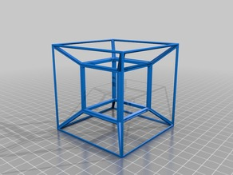
6. Datatype - High-Dimensional Transaction Data
Transaction data is high-dimensional
Each dimension could be a potential QID attribute
Curse of high-dimensionality
Bound background knowledge of the attacker
Notes:
Transaction data is usually high-dimensional. For example, Amazon.com has several
million catalog items. Each dimension could be a potential QID attribute used
for record or attribute linkages; therefore, employing traditional privacy models, such
as k-anonymity, would require including all dimensions into a single QID.
Due to the
curse of high-dimensionality [Aggarwal 2005], it is very likely that lots of data has to
be suppressed or generalized to the top-most values in order to satisfy k-anonymity,
even if k is small. Obviously, such anonymous data is useless for data analysis.
In any real-life privacy attack, it is unlikely that the attacker would know all
quasi-identifying attributes of a target victim due to the effort it would take to gather
every piece of background knowledge. Thus, it is reasonable to bound the attacker’s
background knowledge in the privacy model.

Slide 25
5. Complexity of Optimal K-Anonymity
NP-hard
Finally, we presented two e±cient greedy approxima-tion algorithms for the problem. Can an approximationalgorithm be found whose performance ratio is indepen-dent of k? We suspect that ­(log k) might be a lowerbound on the possible approximability of the problem(within polynomial time), given that such a lower boundexists for k-set cover.

Slide 26
7. Summary
K-anonymity, l-Diversity, t-clossness don‘t provide a full privacy protection
Every privacy Modell tries to overcome the downsites of his parent
All kind of data can leak privacy information

