Slide 1
Barriers to the implementation of k-anonymity and related microdata anonymization techniques in a realworld application
Andreas Wiegand
Ludwig Schallner

Slide 2
Summary
1. Introduction
2. k-anonymity
3. Extendet scenarios
3. p-sensitive k-anonymity
3. l-diversity
4. t-closeness

Slide 3
Introduction
Identity disclosure
Individual is linked to a particular record
Attribute disclosure
new information revealed about some individual
Tables give useful information to researchers, but
Record owners interest is to be anonym.
We have to anonymize the data before releasing

Slide 4
K-ANONYMITY
Is achieved if:
At least k matching record with the same quasi-identifiers
Identifiers
Attributes which identifies individuals explicitly
Quasi-identifiers
Identifies an record owner only by combination of other Qis
Sensitive Data
Data to which record owner doesn't want to get linked

Slide 5
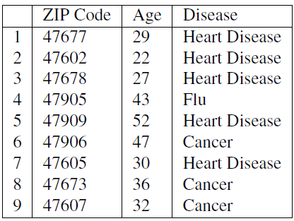
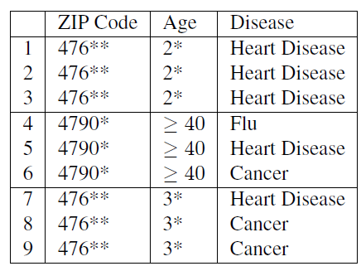
Example of K-Anonymity
Table 1: original data
Table 2: 3-Anoymized

Slide 6
The Adversary’s Knowledge is Unknown
Adversary has access to table
And knows that the table is generalized + knows the domain of the attributes
Instance-level background knowledge
Adversary knows that his target does not suffer from a disease
May conclude what the target really suffers from
Demographic background knowledge
Adversary knows e.g P(t[condition] = cancer| t[Age]>=40)
May use it to interference about records

Slide 7
Attacks on K-ANONYMITY
Homogeneity Attack
Background Knowledge Attack/attribute linkage
Unsorted Matching Attacks
Complementary Release Attack

Slide 8
Homogeneity Attack
This attack is based on the homogeneity of data
Age and Zip-Code of the target
Leads to concluding of disease of the record owner

Slide 9
Background Knowledge Attack
This attack is based on background knowlegde
Alice knows additionally that e.g. Carl(36, 47605) has a low risk of heart disease → conclude he has cancer

Slide 10
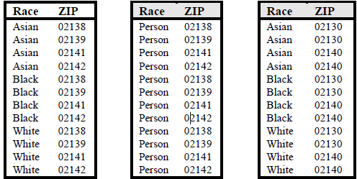
Unsorted Matching Attacks
Based on order of tuples in the released data
Often used in real world
release of sensitive data
Generation of ZIP
Generation of race

Slide 11
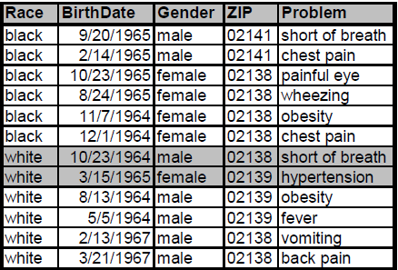
Complementary Release Attack
Prior examples, all attributes were quasi-identifier
Not typical in the real world → subsequent releases are common
Are unique → subsequent release

Slide 12
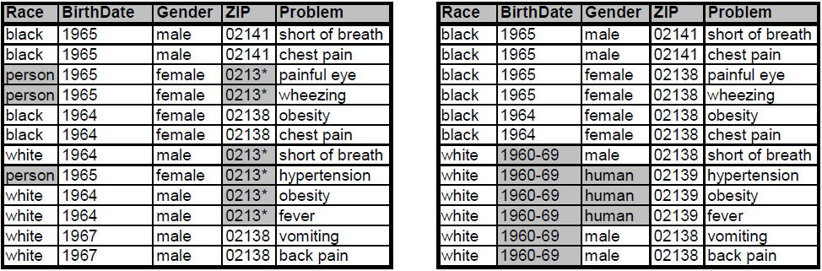
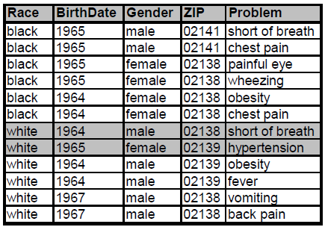
Complementary Release Attack
Linking both tables on {Problem}
Released table 1
Released table 2
Are unique Fix: table 2 is based on table 1
Linked table of table 1 and 2

Slide 13
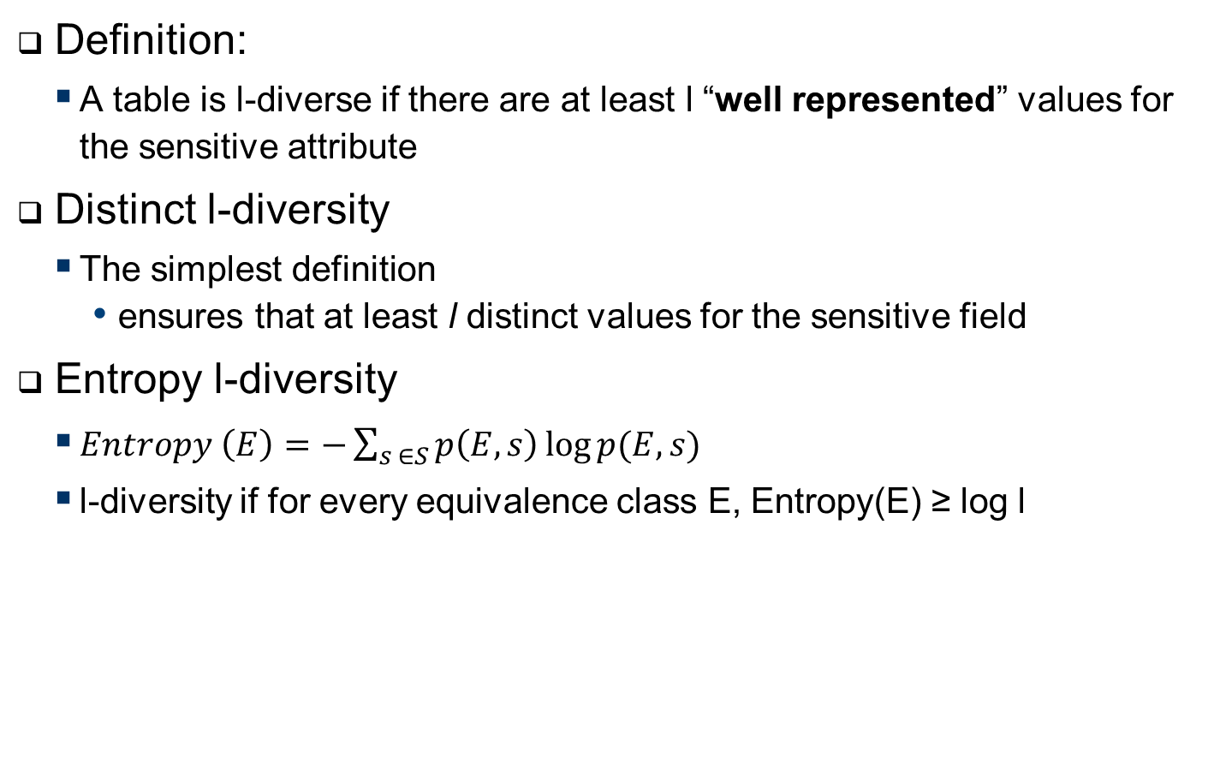
L-Diversity
Definition:
A table is l-diverse if there are at least l “well represented” values for the sensitive attribute
Distinct l-diversity
The simplest definition
ensures that at least l distinct values for the sensitive field
Entropy l-diversity
$Entropy \left(E\right)=−\sum_{s ∈S}{p\left(E,s\right)\log{p(E,s)}}$
l-diversity if for every equivalence class E, Entropy(E) ≥ log l
Notes:
Entropy l diversity
Sometimes this may too restrictive,
as the entropy of the entire table may be low if a few
values are very common. This leads to the following
less conservative notion of -diversity.

Slide 14
L-Diversity
Recursive (c, l)-diversity.
Makes sure that most frequent values not too often and
Most less frequent not too rarely
Compromise between the prior ones
Let m be the number of values in a equivalent class
And r_{i} , l <= i <= m
Then E is said to have recursive ((c, l)-diversity if r₁ < c(r_{l} +r_{l+1}+...+r_{m})

Slide 15
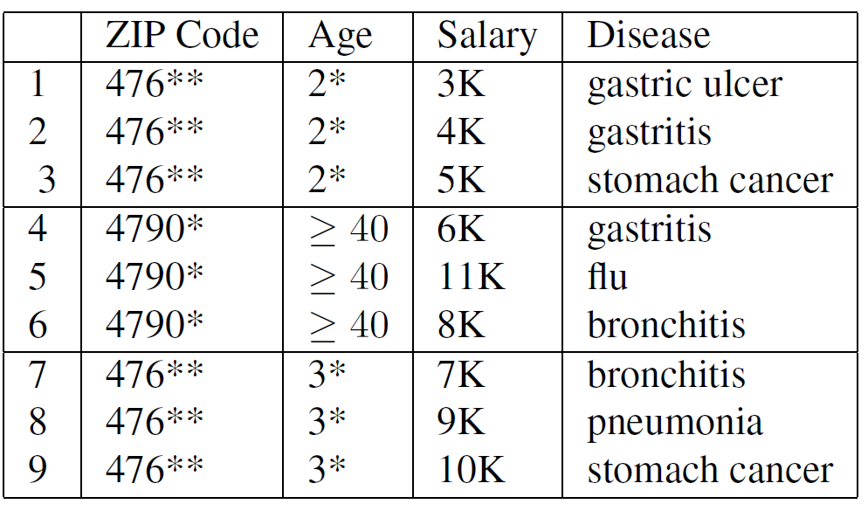
L-diversity Weakness
Similarity attack:
Attackers knows that victims data is e.g. one of the first three records
Can conclude its salary is relatively low
Conclusion
L-Diversity does not take semantic closeness into account

