Slide 1

Vehicular Communication Simulations with NS-3
Konstantinos Katsaros

Slide 2
Expected outcomes from training
Learn how to write a scenario for vehicular communication evaluation
Learn how to configure your scenario for different environments
Learn about selected topics in more detail
Answer your questions

Slide 3
Agenda
Basic components of vehicular scenario
Setting up
Mobility
Network devices
Addressing / Routing
Applications
Getting Results
Integrated Simulators (NS-3 + …)
Q & A

Slide 4
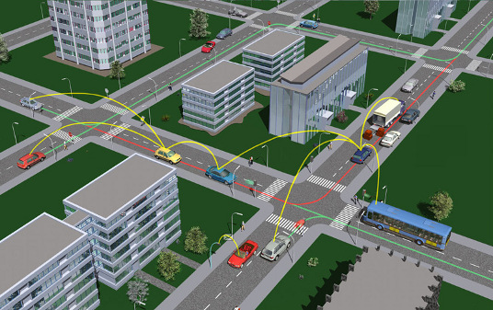
Vehicular Communications Overview
Figure 1: Vehicular Communications

Slide 5
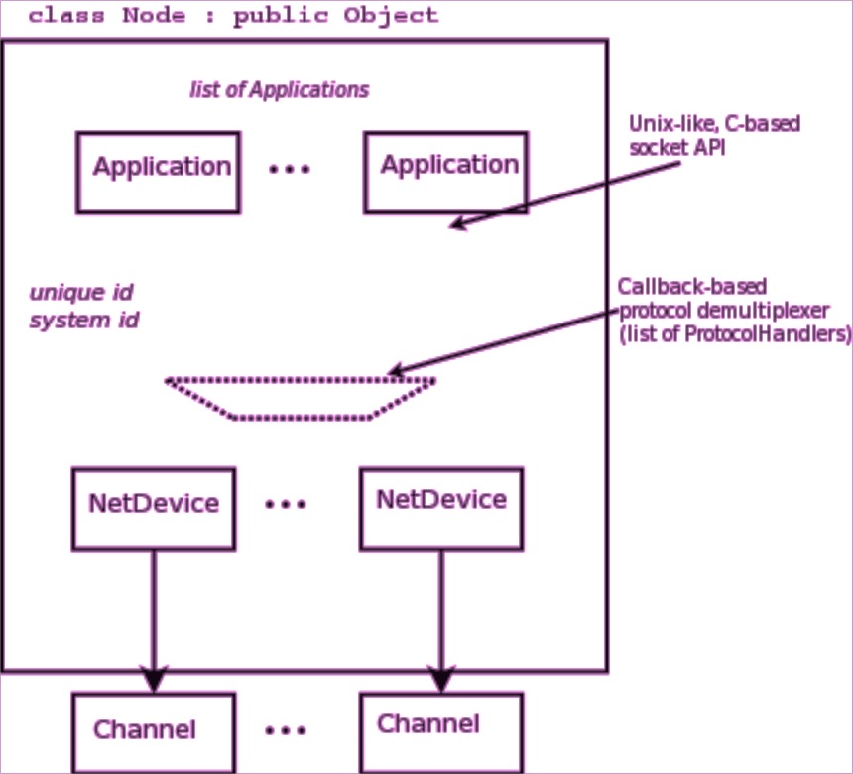
Basic Vehicular Scenario Components
Nodes & Mobility
Vehicles (moving), Road Side Units / Traffic Lights (static), Other (static, moving)
Network Devices
WiFi (ad-hoc, infrastructure), WAVE, LTE, Wired P2P, Other
Network / Routing
IPv4/6, Broadcast, MANET/VANET routing protocols, clustering
Applications
ITS-specific (BSM), Generic On/Off, Ping etc
Figure 2: High-level node architecture

Slide 6
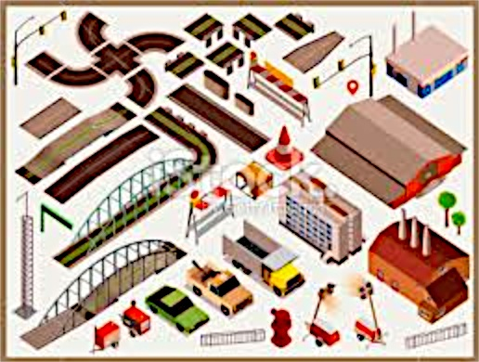
Nodes & mobility
Where to place the nodes? How do they move?

Slide 7
Nodes & Mobility
ALL nodes have to be created before simulation starts
Position Allocators setup initial position of nodes
List, Grid, Random position…
Mobility models specify how nodes will move
Constant position, constant velocity/acceleration, waypoint…
Trace-file based from mobility tools such as SUMO, BonnMotion (using NS2 format)
Routes Mobility using Google API (*)
(*) To be presented in WNS3 - 2015

Slide 8
Position Allocation Example
RSUs/ TL
List MobilityHelper mobility; // place two nodes at specific positions (100,0) and (0,100) Ptr<ListPositionAllocator> positionAlloc = CreateObject<ListPositionAllocator> (); positionAlloc->Add (Vector (100, 0, 0)); positionAlloc->Add (Vector (0, 100, 0)); mobility.SetPositionAllocator(positionAlloc);
Grid Position
MobilityHelper mobility;
// setup the grid itself: nodes are laid out started from (-100,-100) with 20 per row, the x
// interval between each object is 5 meters and the y interval between each object is 20 meters
mobility.SetPositionAllocator ("ns3::GridPositionAllocator",
"MinX", DoubleValue (-100.0),
"MinY", DoubleValue (-100.0),
"DeltaX", DoubleValue (5.0),
"DeltaY", DoubleValue (20.0),
"GridWidth", UintegerValue (20),
"LayoutType", StringValue ("RowFirst"));
Random Rectangle Position
// place nodes uniformly on a straight line from (0, 1000)
MobilityHelper mobility;
Ptr<RandomRectanglePositionAllocator> positionAloc = CreateObject<RandomRectanglePositionAllocator>();
positionAloc->SetAttribute("X", StringValue("ns3::UniformRandomVariable[Min=0.0|Max=100.0]"));
positionAloc->SetAttribute("Y", StringValue("ns3::ConstantRandomVariable[Constant=50.0]"));
mobility.SetPositionAllocator(positionAloc);
Parking lot
Highway road

Slide 9
Mobility Model Example
Constant Position
MobilityHelper mobility;
mobility.SetMobilityModel ("ns3::ConstantPositionMobilityModel");
mobility.Install (nodes);
Constant Speed
MobilityHelper mobility;
mobility.SetMobilityModel ("ns3::ConstantVelocityMobilityModel");
mobility.Install (nodes);
Ptr<UniformRandomVariable> rvar = CreateObject<UniformRandomVariable>();
for (NodeContainer::Iterator i = nodes.Begin (); i != nodes.End (); ++i){
Ptr<Node> node = (*i);
double speed = rvar->GetValue(15, 25);
node->GetObject<ConstantVelocityMobilityModel>()->SetVelocity(Vector(speed,0,0));
}
Trace-file based
std::string traceFile = “mobility_trace.txt”;
// Create Ns2MobilityHelper with the specified trace log file as parameter
Ns2MobilityHelper ns2 = Ns2MobilityHelper (traceFile);
ns2.Install (); // configure movements for each node, while reading trace file
Notes:
Explain key differences of these models and under what situations would I use each one.

Slide 10
Interesting ns-3 extensions
ns-3-highway-mobility (https://code.google.com/p/ns-3-highway-mobility/)
Implement IDM and MOBIL change lane, highway class, traffic-lights.
Based on ns-3.8
No longer maintained
Virtual Traffic Lights (PROMELA) (https://dsn.tm.kit.edu/misc_3434.php)
Manhattan IDM mobility model
NLOS propagation loss models
(Virtual) Traffic Light applications

Slide 11
Hands-on Example (1)
Example training-mobility-example.cc
Scenarios selection
1. Parking Lot (Static Grid)
2. Highway (Constant speed)
3. Urban (Manhattan Grid trace file)

Slide 12
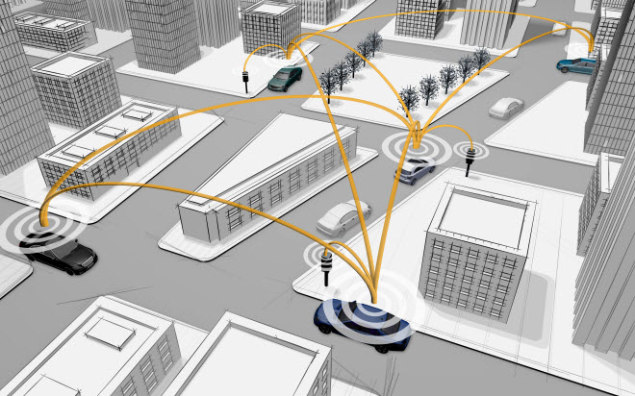
Network Devices
How nodes communicate? Wireless communication examples.

Slide 13
Network Devices - WiFi
WiFi module features
DCF implementation (Basic + RTS/CTS)
802.11 a/b/g/n (2.4 & 5 GHz) PHY
MSDU/MPDU aggregation
QoS support (EDCA only)
Infrastructure and ad-hoc modes
Rate adaptation algorithms
More on ns-3 documentation http://www.nsnam.org/docs/models/html/wifi.html

Slide 14
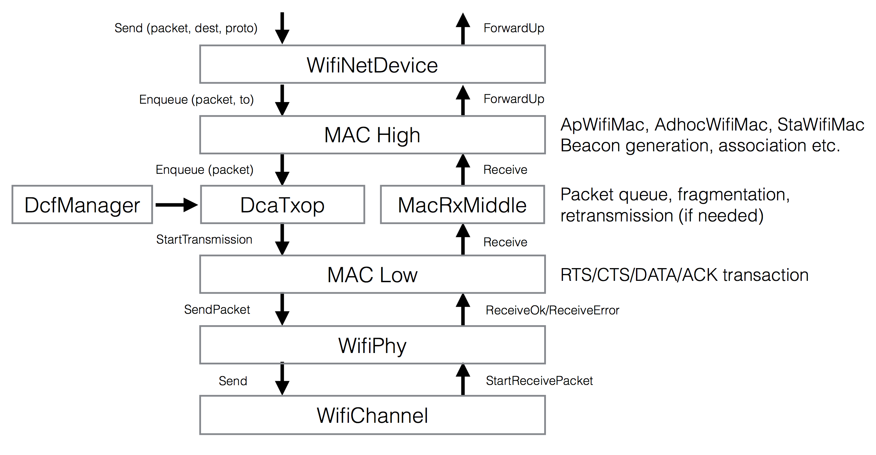
WiFi Module Architecture

Slide 15
MAC High
Presently, three MAC high models
AdhocWifiMac: simplest one
ApWifiMac: beacon, associations by STAs
StaWifiMac: association based on beacons
All inherit from RegularWifiMac, which handles QoS and non-QoS support

Slide 16
MAC Low
MacLow
RTS/CTS/DATA/ACK transactions
DcfManager
implements the DCF
DcaTxop and EdcaTxopN:
One for NonQoS, the other for QoS
Packet queue
Fragmentation/Retransmissions

Slide 17
Rate Control Algorithms
The following rate control algorithms can be used by the MAC low layer:
Algorithms found in real devices:
ArfWifiManager (default for WifiHelper), OnoeWifiManager, ConstantRateWifiManager, MinstrelWifiManager
Algorithms in literature:
IdealWifiManager, AarfWifiManager, AmrrWifiManager, CaraWifiManager, RraaWifiManager, AarfcdWifiManager, ParfWifiManager, AparfWifiManager
Example use of constant rate
std::string phyMode ("OfdmRate54Mbps");
wifi.SetRemoteStationManager ("ns3::ConstantRateWifiManager",
"DataMode",StringValue (phyMode),
"ControlMode",StringValue (phyMode));
Other rate managers may not require manual setting as they automatically select the “best” rate

Slide 18
WiFi PHY
Work at packet (frame) level
Different models available
YansWifiPhy – default & most widely used
PhySimWifi (*) – symbol-level, too slow for practical use
SpectrumWifiPhy (unfinished model, work stalled)
Models power spectral density of each transmission
Supports inter-technology interference
Some details are not implemented (e.g. preamble/capture effect)
(*) https://dsn.tm.kit.edu/english/ns3-physim.php

Slide 19
Propagation Models
Propagation Loss
ITUR1411, LogDistance, ThreeLogDistance, Range, TwoRayGround, Friis
Nakagami, Jakes
Obstacle model (*)
Propagation Delay
Constant Speed
Random
Be careful when using YansWifiChannelHelper::Default() the LogDistance propagation model is added. Calling AddPropagationLoss() again will add a second propagation loss model.
(*) To be presented in WNS3 2015

Slide 20
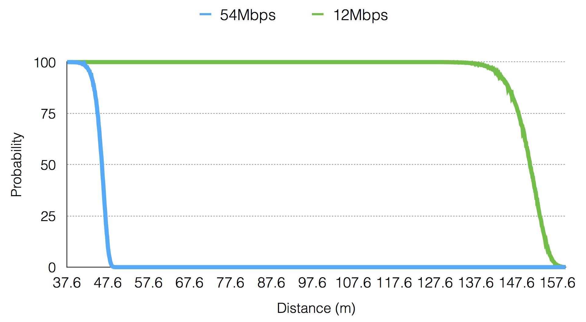
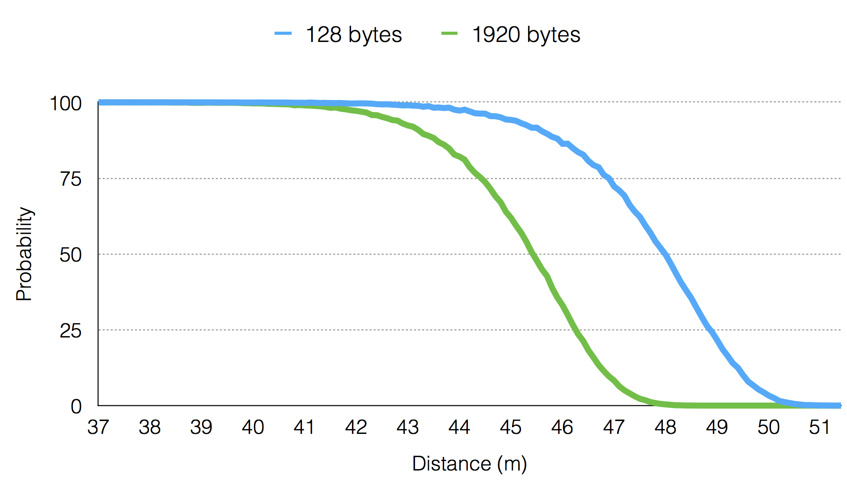
Communication Range
Depends on many factors
Propagation loss model and PHY configuration
Frame size (big vs small)
Transmission mode (6Mbps vs 54 Mbps)

Slide 21
Hands-on Example (2)
Example training-wifi-example.cc
Scenarios
Adhoc, Infrastructure
IEEE 802.11a/b/g
QoS/Non-QoS

Slide 22
Network Devices - WAVE
WAVE features:
MAC layer (IEEE 802.11p) – “Outside the context of a BSS (OCB)”
Multi-channel operation (IEEE 1609.4)
Management information through vendor specific action (VSA) frame.
More on ns-3 documentation http://www.nsnam.org/docs/models/html/wave.html
Notes:
This MAC does not require any association between devices (similar to an adhoc WiFi MAC)

Slide 23
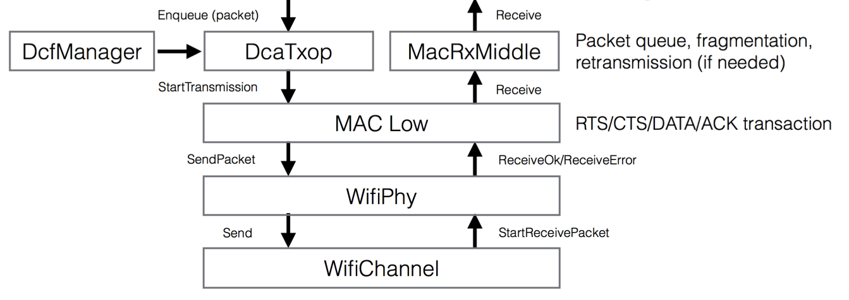
WAVE Module Architecture
Send, SendWsmp, SendVsa
ForwardUp,
ForwardVsa
WaveNetDevice
WAVE
module
IEEE 1609.4
SchChannelScheduler, ChannelManager, VSARepeater, ChannelCoortinator
OcbWifiMac
WIFI
module

Slide 24
WAVE Module Design (1)
WaveNetDevice
has multiple internal MAC entities, each one used to support each channel.
allows for multiple PHY entities, permitting single/multiple-PHY.
OcbWifiMac
similar to AdhocWifiMac
SendX
sends a WSMP packets, specifying Tx parameters, e.g. channel number.
Send/SetReceiveCallback
allows the sending all IP-based packets.

Slide 25
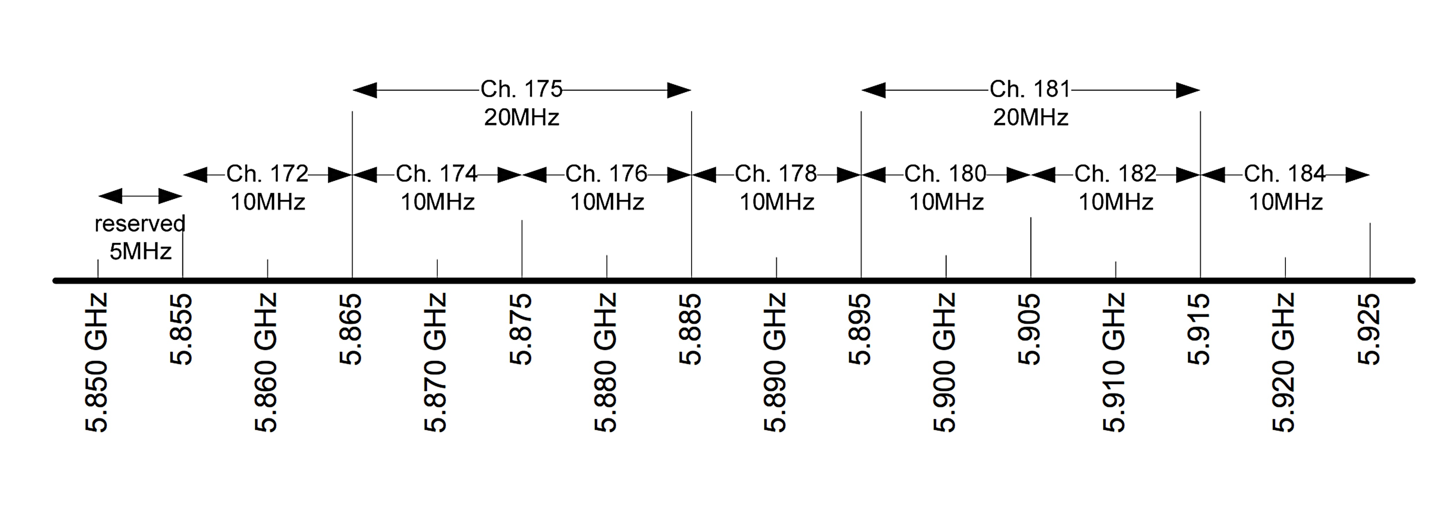
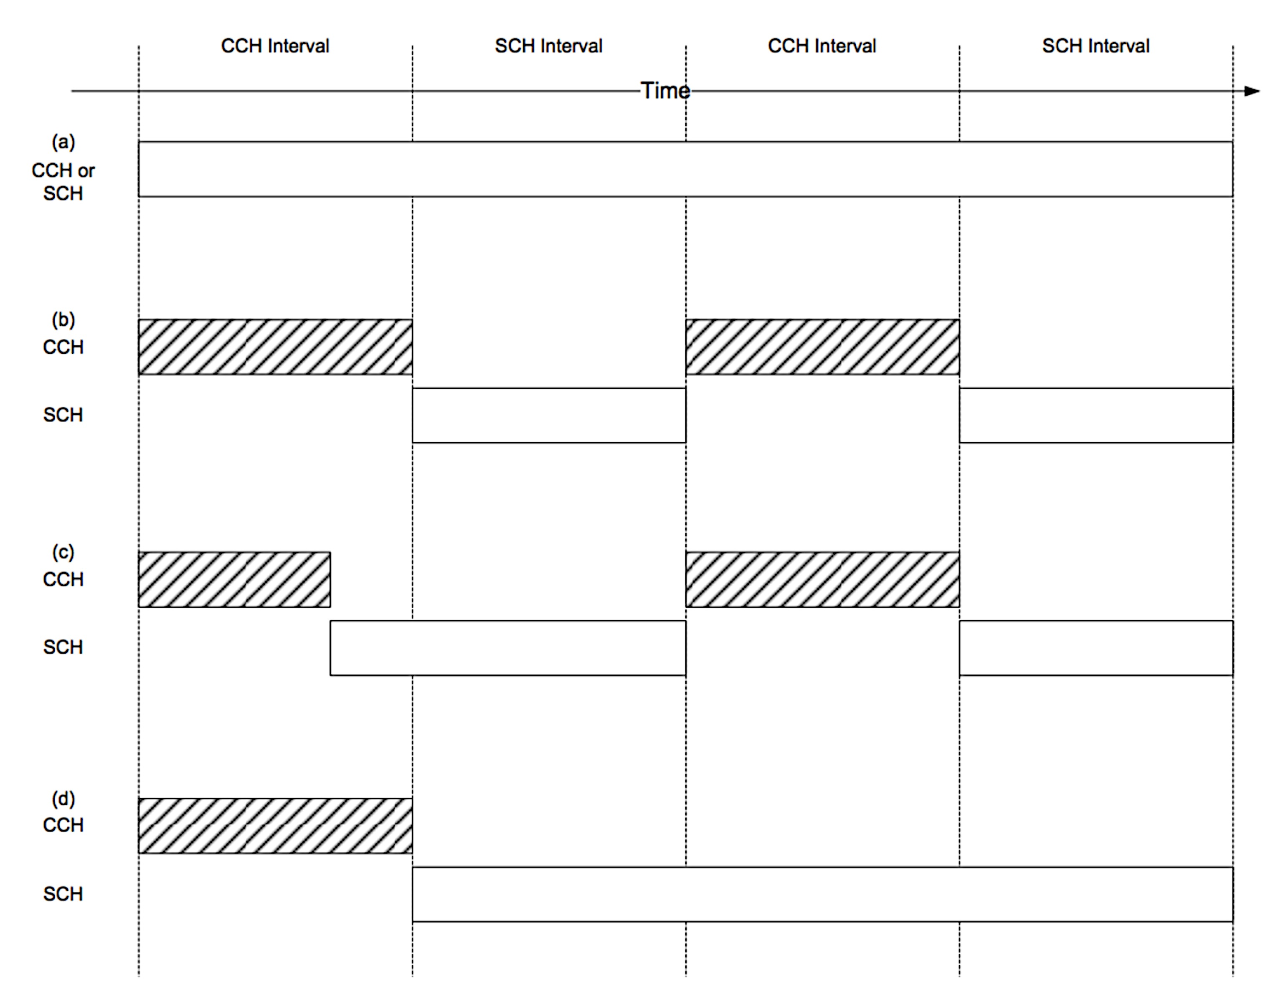
Multi-channel Operations (IEEE 1609.4 - 2013)
Channel 178 is the control channel (CCH).
Channels 172, 174, 176, 180, 182, and 184 are service channels (SCH).
Channels 174 and 176 and channels 180 and 182 could be combined to produce two twenty megahertz channels, channels 175 and 181, respectively.
Continuous
(b) Alternating
(c) Immediate
(d) Extended

Slide 26
WAVE Module Design (2)
ChannelScheduler
provides API to switch channels. Current implementation: DefaultChannelScheduler multi-channel, single PHY. StartSch/StopSch assigns channel access for sending packets.
used to assign access for ContinuousAccess, ExtendedAccess, AlternationgAccess
ChannelCoordinator
used to generate channel coordination events. Current default channel intervals are: 50ms CCH, 50ms SCH, 4ms Guard.
Register/DeleteTxProfile
should be registered to specify tx parameters before transmission.

Slide 27
Channel Access Assignment
Continuous (Default)
for (uint32_t i = 0; i != devices.GetN (); ++i){
Ptr<WaveNetDevice> device = DynamicCast<WaveNetDevice>(devices.Get(i));
// Alternating access without immediate channel switch
const SchInfo schInfo = SchInfo (SCH1, true, EXTENDED_CONTINUOUS);
Simulator::Schedule (Seconds (0.0), &WaveNetDevice::StartSch, device, schInfo);
}
Alternating
Configure channel intervals. Default 50/50ms.
Config::SetDefault ("ns3::ChannelCoordinator::CchInterval", TimeValue (MilliSeconds(80)));
Config::SetDefault ("ns3::ChannelCoordinator::SchInterval", TimeValue (MilliSeconds(20)));
for (uint32_t i = 0; i != devices.GetN (); ++i){
Ptr<WaveNetDevice> device = DynamicCast<WaveNetDevice>(devices.Get(i));
// Alternating access without immediate channel switch
const SchInfo schInfo = SchInfo (SCH1, false, EXTENDED_ALTERNATING);
Simulator::Schedule (Seconds (0.0), &WaveNetDevice::StartSch, device, schInfo);
}
Extended
for (uint32_t i = 0; i != devices.GetN (); ++i){
Ptr<WaveNetDevice> device = DynamicCast<WaveNetDevice>(devices.Get(i));
// Extended access for 8 SYNC intervals without immediate channel switch
const SchInfo schInfo = = SchInfo (SCH1, false, 8);
Simulator::Schedule (Seconds (0.0), &WaveNetDevice::StartSch, device, schInfo);
}
Tx Profile
the IP-based packets will be transmitted in SCH1 with 6Mbps and 4 txPowerLevel with adaptable mode.
const TxProfile txProfile = TxProfile (SCH1, true, 4, WifiMode("OfdmRate6MbpsBW10MHz"));
Simulator::Schedule (Seconds (2.0), &WaveNetDevice::RegisterTxProfile, sender, txProfile);
Notes:
I recently learned that US Stds expect there to be NO time coordination, and that (dedicated, continuous) channel access is completely random.

Slide 28
Hands-on Example (3)
Examples wave-simple-802.11p.cc & wave-simple-device.cc
IEEE 802.11p example
WAVE example for sending WSMP, simple IP, and VSA packets

Slide 29
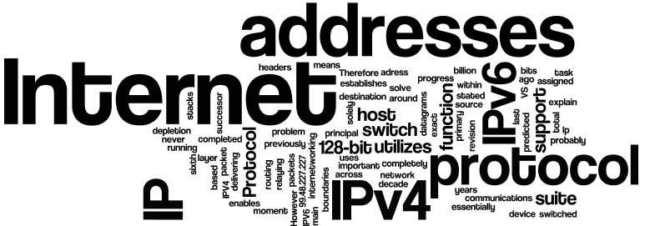
Internetworking
How everything is linked? Addressing, routing protocols etc.

Slide 30
Network (IP / Routing)
IPv4 and IPv6 addressing available, but restrictions in routing implementations
Ad-hoc routing protocols (IPv4 only)
AODV, OLSR, DSR, DSDV
GPSR, CLWPR (*)
Epidemic (**)
Cluster (**)
Different setup (see manet/vanet-routing-compare.cc)
Some are sensitive to start time.
Also possible:
Use linux-kernel implementation with DCE, e.g. NEMO, MIP.
Calculate routes offline and use static routes.
(*) Presented in WNS3 2012
(**) To be presented in WNS3 2015

Slide 31
Applications
ITS specific
BSMApplication: Broadcast Basic Safety Messages periodically.
Dummy packets 200bytes @ 10Hz only if node is moving
WaveBsmStats used to manage statistics
Generic (sample)
OnOffApplication: Generate traffic with constant bit rate during the ON period.
Control data rate, packet size, On/Off times
Ping: send ICMP ECHO requests and wait for reply
Control packet size, interval

Slide 32
Setting Up Applications
Timing is very important in wireless simulations
Setting multiple applications to start at the same time is not a good idea in general (ApplicationContainer::Start () sets all in container)
Nodes are likely to initiate route building process at the exact same time
collision is almost guaranteed

Slide 33
Maximum “Application” Rate
The maximum achievable “application” data rate is not the same as the “Wi-Fi” rate due to:
Timing (IFS)
RTS/CTS/ACK
Multihop (shared medium)
Avoid setting application rate == Wi-Fi rate

Slide 34
QoS support
Use of QosTag to mark packets with higher priority for use by QoS-aware MAC
void
TagMarker(Ptr<const Packet> packet)
{
QosTag qosTag;
qosTag.SetUserPriority(UP_VO);
packet->AddPacketTag (qosTag);
}
Config::ConnectWithoutContext ("/NodeList/*/ApplicationList/*/$ns3::OnOffApplication/Tx", MakeCallback (&TagMarker));

Slide 35
Getting Results
FlowMonitor
Only unicast IP flows (over TCP/UDP).
Known issues with DSR
ASCII Trace Analyzing
Slow process, generates large files
Data Collection Framework
Exploit trace sources to capture events (e.g. packet Tx/Rx) and analyze them during simulation.
Probe: mechanism to instrument and control output in the form of trace sources.
Collector: consumes data generated from probes.
Aggregator: end point of data collection.
Plot with GnuPlot, save to data bases/files.

Slide 36
Hands-on Example (4)
Example vanet-routing-compare.cc
Scenarios:
1. Random Waypoint Mobility, 40 nodes, IEEE 802.11p continuous access
2. Trace source mobility (Zurich), 99 vehicles
BSM application and IP traffic with selection of routing protocols (AODV default)

Slide 37
Hands-on Example (5)
Example training-wave-example.cc
Scenarios
1. Continuous: continuous access for default CCH channel.
2. Alternating: alternating access for default 50ms CCHI on CCH channel and default 50ms SCHI on SCH channel.
3. Alternating-80-20: alternating access for 80ms CCHI on CCH channel and 20ms SCHI on SCH channel.
4. Alternating-20-80: alternating access for 20ms CCHI on CCH chanel and 80ms SCHI on SCH channel.

Slide 38
Integrated simulators
Online coupling of NS-3 and mobility simulators
iTETRIS (http://www.ict-itetris.eu/)
Coupled with ns-3.18
Provides complete ETSI ITS stack
VNS (http://www.dcc.fc.up.pt/~rjf/vns/index.html)
Based on ns-3.16 (loosely coupled)
VSimRTI (https://www.dcaiti.tu-berlin.de/research/simulation/)
Coupled with ns-3.15
ONVIS (http://ovnis.gforge.uni.lu/)
Based on ns-3.10

Slide 39
References & Acknowledgments
Daniel Lertpratchya, “Wi-Fi Module in NS-3”, NS-3 training, 2014
NS-3 documentation https://www.nsnam.org/docs/models/html/index.html
Thanks to Junling Bu and Scott Carpenter for example codes

Slide 40
Q&A

